Slide 1
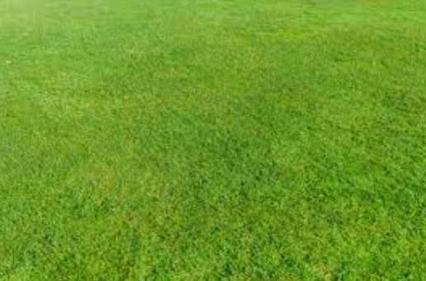
The Lord is My Shepherd
Psalm 23

Slide 2

Visualizing
A study skill that creates a mental picture from descriptive details in the scriptures. We can imagine being present at events described in the scriptures.
Mourning into Dancing
Thou hast turned for me my mourning into dancing: thou hast put off my sackcloth, and girded me with gladness; (Psalm 30:11)
What we can learn from the images

Slide 3
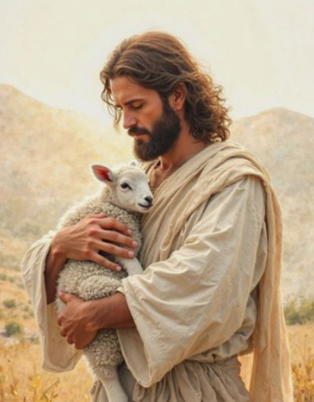
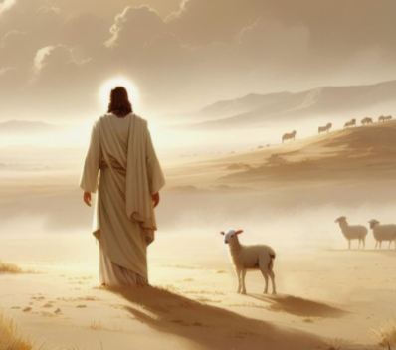

The Lord is My Shepherd
Take a minute to try to imagine or visualize a shepherd taking care of or protecting their sheep.
John 10:11-15
Ezekiel 34:11-16
The Lord cares about my needs
Psalm 23:1

Slide 4
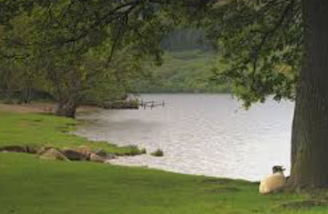
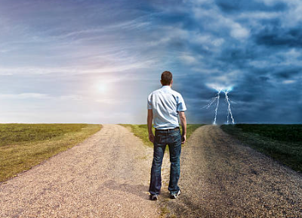
Psalm 23:2-3
He maketh me to lie down in green pastures: he leadeth me beside the still waters.
He restoreth my soul: he leadeth me in the paths of righteousness for his name’s sake.
The Lord restores weary and broken souls
Psalm 23:2-3

Slide 5
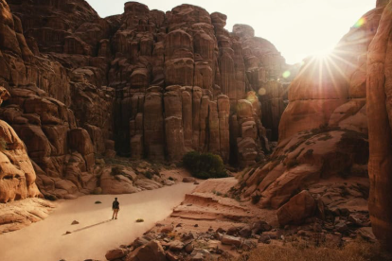
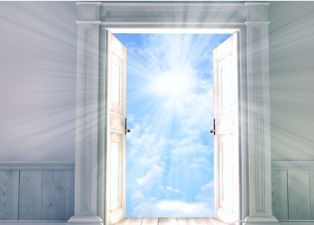
Psalm 23:4-5
Yea, though I walk through the valley of the shadow of death, I will fear no evil: for thou art with me; thy rod and thy staff they comfort me.
Surely goodness and mercy shall follow me all the days of my life: and I will dwell in the house of the Lord for ever.
The Lord will nourish us, even during difficult situations
Psalm 23:4-5

Slide 6
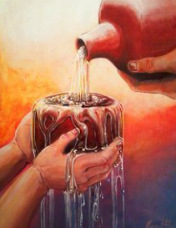
Psalm 23:6
Thou preparest a table before me in the presence of mine enemies: thou anointest my head with oil; my cup runneth over.
Psalm 23:6

Slide 7
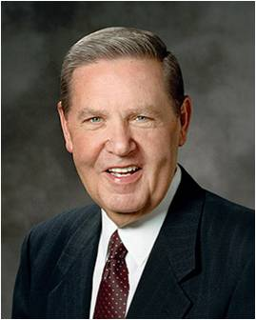
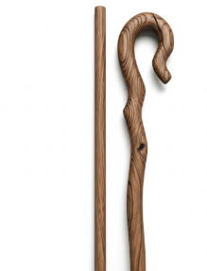
The Shepherd’s Staff and Rod
“In ancient days the only instruments a shepherd carried were a rod and a staff. The rod was a short, stout, club-like weapon used to defend oneself or the flock from an intruder. It was meant to be—and to convey—strength and power in the hand of a strong shepherd who knew how to use it. …
“The staff was a longer, lighter piece, usually with a hook (or crook) on the end used for rescuing a stranded sheep. It, more than the rod, is associated in both art and myth with the shepherd and his vigilant watchcare. …
Everything about the staff speaks of safety and care. It is the great scriptural instrument of rescue and redemption.
(2)

Slide 8
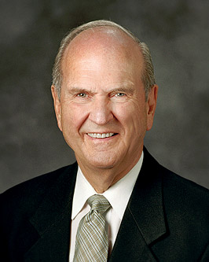
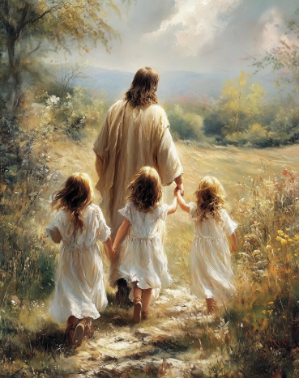
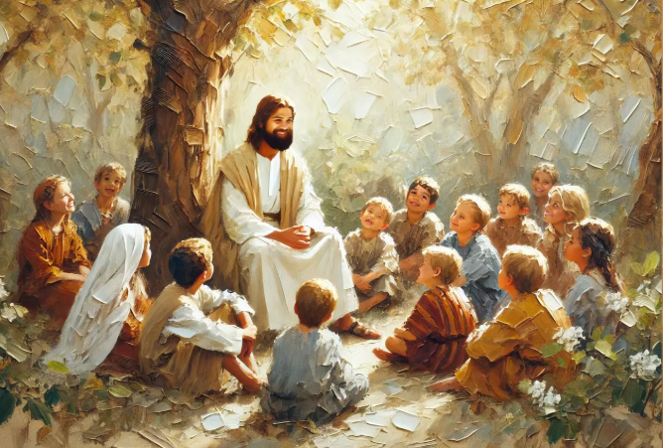
The Good Shepherd lovingly cares for all sheep of His fold, and we are His true undershepherds.
Our privilege is to bear His love and to add our own love to friends and neighbors—feeding, tending, and nurturing them—as the Savior would have us do (1)

Slide 9
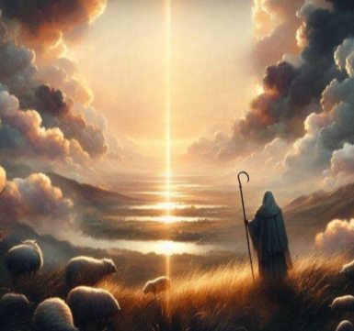
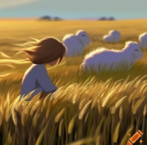

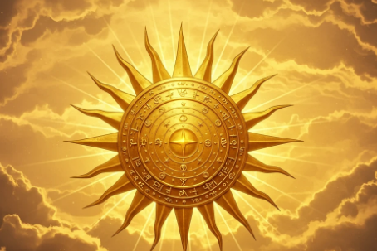
Other Visual Scriptures
“The Lord is my light” (Psalm 27:1)
“Thou art my hiding place” (Psalm 32:7)
“He only is my rock” (Psalm 62:2)
“For the Lord God is a sun and shield” (Psalm 84:11)
(2)

Slide 10
Sources:
President Russell M. Nelson (“Shepherds, Lambs, and Home Teachers,” Ensign, Aug. 1994, 19)
Presentation by http://fashionsbylynda.com/blog/
2. Elder Jeffrey R. Holland (For Times of Trouble [2012], 7–8, 204, 217-218).

