Slide 1

Cleanse Me From My Sin
Psalm 51

Slide 2
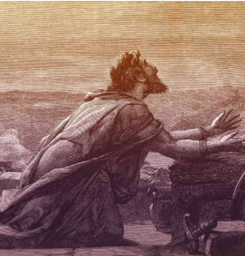
A Desire to Be Forgiven
David “was guilty of grave crimes; but … he was capable of true contrition and was therefore able to find forgiveness, except in the murder of Uriah”
And now, behold, I speak unto the church. Thou shalt not kill; and he that kills shall not have forgiveness in this world, nor in the world to come.
D&C 42:18
David recorded a psalm to God in which he expressed his feelings of remorse following his sin with Bathsheba.

Slide 3


To Restore God’s Graces
David’s humility and heartfelt desire to be restored to God’s grace and acceptance demonstrate the attitude of one who is seeking to truly repent.
Ask For Forgiveness
Acknowledge Your Sin
Have mercy upon me, O God, according to thy lovingkindness: according unto the multitude of thy tender mercies blot out my transgressions.
Wash me throughly from mine iniquity, and cleanse me from my sin.
For I acknowledge my transgressions: and my sin is ever before me.
Against thee, thee only, have I sinned
Psalm 51:1-4

Slide 4
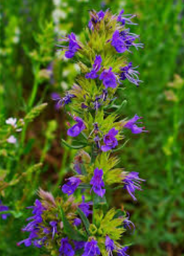
Hyssop
A plant primarily associated with ritual and symbolic cleansing and purification
Old Testament Uses
New Testament Uses
Passover: The Israelites used hyssop branches to apply the blood of a lamb to their doorposts to be spared from the plague of the firstborn (Exodus 12)
Leprosy and defilement: Priest used hyssop to sprinkle blood or water to cleanse individuals and houses from impurity, such as leprosy (Leviticus 14) or after contact with a dead body. (Numbers 19)
Covenant: Hyssop was used by Moses to ritually cleanse the Israelites and seal them in a covenant after receiving the law
Crucifixion: A sponge soaked in sour wine was placed on a stalk of hyssop and held to Jesus's lips (John 19:29), symbolizing the fulfillment of Old Testament rituals in His final sacrifice.
Spiritual cleansing: The plant's role in physical purification points to the spiritual cleansing from sin available through Christ's blood.
Spiritual cleansing: The psalmists' prayer, "Purge me with hyssop, and I shall be clean" (Psalm 51:7), highlights the desire for spiritual purification that is now fully realized through Jesus Christ, as opposed to the older, physical rituals.
Psalm 51:7

Slide 5
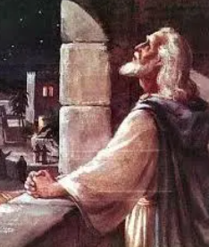

David’s Plea VS Our Plea
Make me to hear joy
Hide thy face from my sins
Create in me a clean heart
Cast me not away from thy presence;
Take not thy holy spirit from me.
Restore unto me the joy of thy salvation
David’s poor choices progressively hindered his ability to be filled with and use the precious gift of the Holy Ghost.
In our own lives, it is critical that we live worthy of the companionship of the Spirit so that this precious gift may help us navigate the difficult roads of life. (1)
Psalm 51:8-13

Slide 6
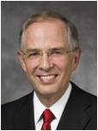
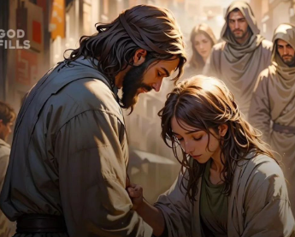

Broken and Contrite Heart
To have a broken heart is to be humble, repentant, and meek, eagerly receptive to the will of God.
A contrite spirit puts one’s own interests in the hands of God, believing that His will, not our own, will help us become who we should become. (4)
Psalm 51:16-17

Slide 7
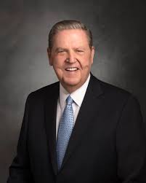
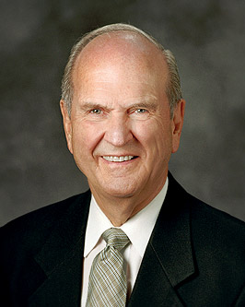
Repentance
[H]owever many mistakes you feel you have made … or however far from home and family and God you feel you have traveled, I testify that you have not traveled beyond the reach of divine love. It is not possible for you to sink lower than the infinite light of Christ’s Atonement shines. (2)
When we choose to repent, we choose to change! We allow the Savior to transform us into the best version of ourselves. We choose to grow spiritually and receive joy—the joy of redemption in Him. When we choose to repent, we choose to become more like Jesus Christ! (3)

Slide 8
Sources:
Video:
“The Prodigal Son” (5:36).
Frank F. Judd Jr. What We Can Learn from King David’s Fall
President Jeffrey R. Holland (“Laborers in the Vineyard,” Ensign or Liahona, May 2012, 33)
President Russell M. Nelson “We Can Do Better and Be Better,” Liahona, May 2019, 67)
Presentation by http://fashionsbylynda.com/blog/
4. Neil L. Andersen (The Divine Gift of Forgiveness [2019], 153)

Slide 9
Repentance:
Repentance requires that sins be confessed to Heavenly Father. …
When Church members commit serious sins, their repentance also includes confession to their bishop or stake president. He is then able to exercise the keys of the gospel of repentance on their behalf (see Doctrine and Covenants 13:1; 84:26–27; 107:18, 20). This helps them heal and return to the gospel path through the power of the Savior’s Atonement.
… Voluntary confession shows that a person desires to repent. (General Handbook: Serving in The Church of Jesus Christ of Latter-day Saints, 32.4.1, Gospel Library)
Committing the same sin after repentance:
Even after sincere repentance, however, we may stumble. Stumbling does not mean that the repentance was inadequate but may simply reflect human weakness. How comforting to know that “the Lord sees weaknesses differently than He [sees] rebellion.” We should not doubt the Savior’s ability to help us with our weaknesses, because “when the Lord speaks of weaknesses, it is always with mercy” [Richard G. Scott, “Personal Strength through the Atonement of Jesus Christ,” Ensign or Liahona, Nov. 2013, 83]. Elder Dale G. Renlund (“Your Divine Nature and Eternal Destiny,” Liahona, May 2022, 76)

Slide 10

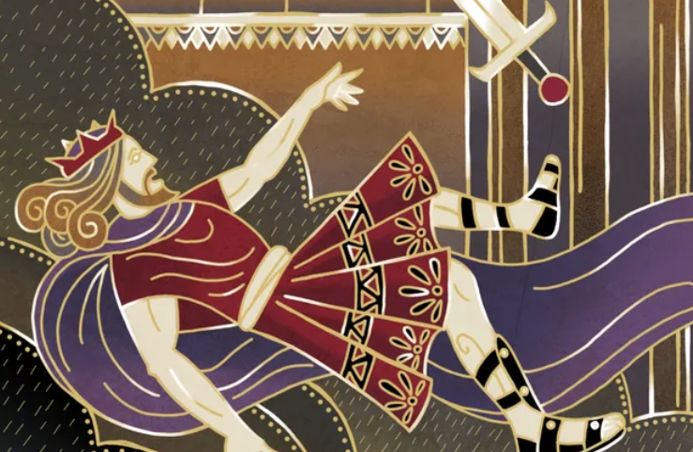
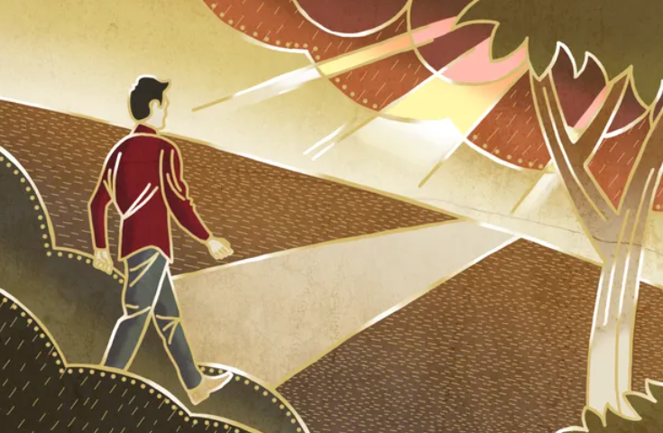
“God foresaw the fall of His beloved David but did not cause it. (See D&C 132:39.)
David’s failure, however, did not come all at once but by degrees. A series of bad choices ultimately led to his downfall. Examining
King David was foreordained to accomplish great things. And as a young man he had great zeal for the Lord and rose to great heights. But foreordination is no guarantee. Rather, it is an opportunity that depends upon faithfully living the gospel.
Spencer W. Kimball (1895–1985) counseled: “The time to protect against the calamity is when the thought begins to shape itself. Destroy the seed and the plant will never grow.”
Spencer W. Kimball, The Miracle of Forgiveness (1969), 114
As President Ezra Taft Benson (1899–1994) taught, “It is better to prepare and prevent than it is to repair and repent.” Teachings of Presidents of the Church: Ezra Taft Benson (2014), 221.

