Slide 1

Give Ear to My Prayer, O God
Psalm 68-86

Slide 2

Prayer-A Powerful Tool
Many of the Psalms are heartfelt prayers that provide an example of approaching Heavenly Father in humble faith.
Prayer is a powerful tool that allows anyone at any time to call upon God for comfort, strength, or guidance.

Slide 3
Careful VS Casual
Careful
Done with thought or attention.
Casual
Relaxed or unconcerned
Learning an instrument
Playing a Sport
Having a picnic
School Work
What about praying?

Slide 4
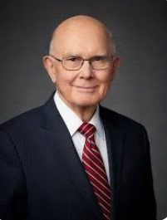
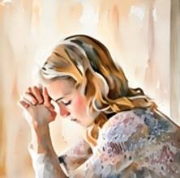
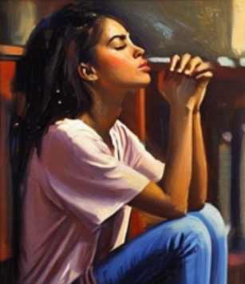
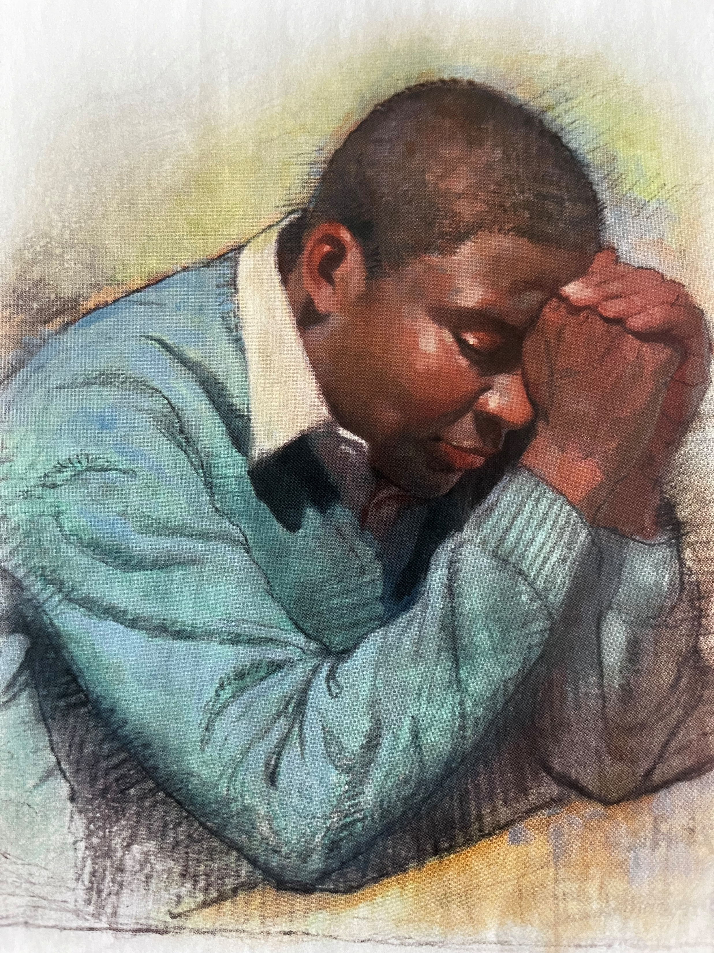
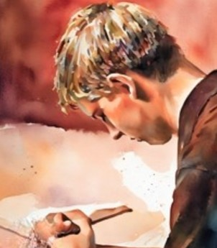
More Meaningful Prayers
The special language of prayer follows different forms in different languages, but the principle is always the same.
We should address prayers to our Heavenly Father in words which speakers of that language associate with love and respect and reverence and closeness. …
But when ye pray, use not vain repetitions, as the heathen do: for they think that they shall be heard for their much speaking. Matthew 6:7
Our prayers should be simple, direct, and sincere. (1)

Slide 5
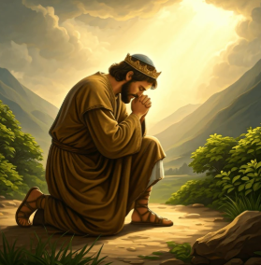
Pray At Any Time of the Day?
Psalm 55:16-17
As for me, I will call upon God; and the Lord shall save me.
Evening, and morning, and at noon, will I pray, and cry aloud: and he shall hear my voice. Psalm 55:16-17

Slide 6
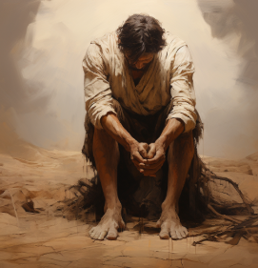
Pray When Feeling Overwhelmed
Psalm 66:1:1-3
Hear my cry, O God; attend unto my prayer.
From the end of the earth will I cry unto thee, when my heart is overwhelmed: lead me to the rock that is higher than I.
For thou hast been a shelter for me, and a strong tower from the enemy.

Slide 7

Pray With An Attitude of Love, Reverence, and Praise
Psalm 63:1-7
You can almost feel the emptiness and longing for the holy spirit to return
"But whosoever drinketh of the water that I shall give him shall never thirst; but the water that I shall give him shall be in him a well of water springing up into everlasting life.“ John 4:14

Slide 8
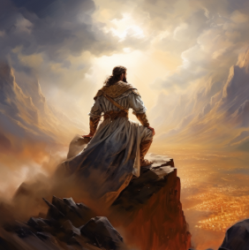
Pray for Deliverance
Psalm 69:13-18
But as for me, my prayer is unto thee, O Lord, in an acceptable time: O God, in the multitude of thy mercy hear me, in the truth of thy salvation.
Deliver me out of the mire, and let me not sink: let me be delivered from them that hate me, and out of the deep waters.

Slide 9
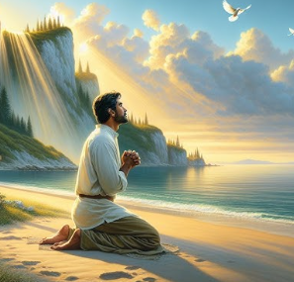
Pray for Mercy
Psalm 88:3-5
Be merciful unto me, O Lord: for I cry unto thee daily.
Rejoice the soul of thy servant: for unto thee, O Lord, do I lift up my soul.
For thou, Lord, art good, and ready to forgive; and plenteous in mercy unto all them that call upon thee.

Slide 10
What would you like to stop doing?
What would you like to start doing?
Prayer
What is going well?

Slide 11
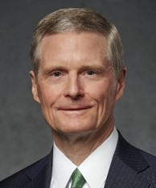


Pray for Mercy
I testify that prayer becomes more meaningful as we counsel with the Lord in all of our doings, as we express heartfelt gratitude, and as we pray for others with real intent and a sincere heart.
I witness Heavenly Father lives and that He hears and answers every earnest prayer. (2)

Slide 12
Sources:
Video:
“I Pray When” (1:56)
“Are You Really There?” (3:46)
1. President Dallin H. Oaks(“The Language of Prayer,” Ensign, May 1993, 16
Presentation by http://fashionsbylynda.com/blog/
2. . Elder David A. Bednar (“Pray Always,” Ensign or Liahona, Nov. 2008, 44)

