Slide 1

“Thy Word Is a Lamp unto My Feet, and a Light unto My Path”
Psalm 119

Slide 2
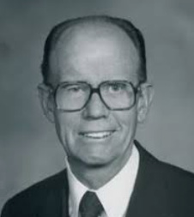
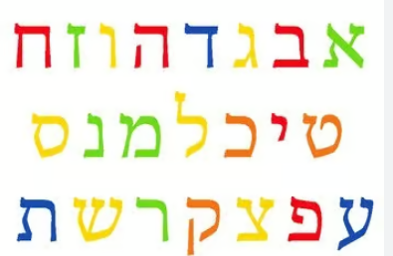
Hebrew Alphabet
Psalm 119 is divided into eight-verse sections. This psalm is “an acrostic poem with eight verses for each of the twenty-two letters of the Hebrew alphabet. …
One Hebrew letter and its name appears above each eight-verse segment”
Each eight-verse segment of the psalm begins with its corresponding letter of the Hebrew alphabet. (1)

Slide 3
The next 26 slides is my own interpretation of the verses. This may be overwhelming and a lot of information.
The best way to study 119 is to dive into it yourself and learn your own understanding of what the psalmist is trying to convey.

Slide 4

Blessed are they who keep the commandments
Psalm 119:1-8
א Aleph
Walk in the law of the Lord
Keep his testimonies close
Stay away from sin
Be moral and virtuous in dealing with others
Keep God’s statutes (laws)
Do not be ashamed in keeping God’s commandments
Learn righteous judgments
Meaning:
Master
Teacher
Wonderous

Slide 5

Ponder the precepts and ways of the Lord
Psalm 119:9-16
ב Beth
Taking heed thereto according to the word
Seek thee with thy whole heart and don’t wander from commandments
Hide thy word in thy heart so as not to sin
Teaching thy statutes
Testifying the word of God
Rejoice in thy testimonies
Mediate in thy precepts
Delight in thy words and not to forget
Meaning:
House

Slide 6

O Lord, open our eyes, that we may behold wondrous things out of Thy law
Psalm 119:17-24
ג Gimel
Deal bountifully with thy servant
Opening your eyes
Hide not the commandments from me
Longing for His judgments at all times
Rebuked are those who wander from commandments
I have kept your commandments
Rulers (Kings) are speaking against me, but I have kept the laws and statutes
Testimonies of others are important
Meaning:
Nourish
Wean
Camel
Bridge
It is easier for a camel to go through the eye of a needle, than for a rich man to enter into the kingdom of God. Matthew 19:24

Slide 7

O Lord, grant us Thy law, and make us to understand Thy precepts
Psalm 119:25-32
ד Daleth
Overwhelmed with earthly things, a plea for spirituality
A desire to be taught God’s ways
An ability to connect spiritually and praise God’s works
Strengthening with His works
A desire to be truthful in keeping God’s commandments
A personal commitment of righteousness
Asking for divine support
A desire for a deeper meaning of God’s commandments
Meaning:
Poor
Door
Lift Up

Slide 8

O Lord, teach us Thy statutes, Thy law, and Thy commandments
Psalm 119:33-40
ה He
Asking for guidance and understanding and obey during a lifetime
Obedience to God's commandments is not possible through human effort alone, but requires God's divine guidance and assistance
A prayer asking for God’s guidance to live the law, and expressing deep love and delighting in commandments
A desire for inner guidance rather than focusing on selfish gain
Turning away from the vain things of the world
Confirm and support His promises to His servant
Define protection from sin
Devotion and spiritual renewal
Meaning:
Here is
To be disturbed
Behold

Slide 9

O Lord, give us mercy, truth, and salvation
Psalm 119:41-48
ו Vau
Divine comfort and protection of God’s promises
A trust in God’s word of truth and faithfulness
Never take the truth out of my mouth and having hope in His judgments
Keeping the laws (commandments) forever
Walking morally
Testifying to authorities (Kings and rulers) and not be ashamed
A love for the commandments
Praise and keep God’s commandments
Meaning:
Hook
The Word
In front of a word, transforms past into future or future to past

Slide 10

The Lord’s statutes and judgments comfort us during our pilgrimage
Psalm 119:49-56
ז Zain
Asking God to remember His Promises, a source of hope and comfort
In a time of suffering to remember His promises and comfort through God’s word
Mocked by the proud we can find comfort in God’s word
Remembering those prophets of old and being comforted in their words
Fear for those who have been wicked and abandoning God’s law
Singing praises to God and His laws
Keeping the commandments
Meaning:
Crown
Weapon
Sustain

Slide 11

Make faithful people our companions
Psalm 119:57-64
ח Cheth
Declaration of devotion in keeping God’s word in receiving an inheritance (portion)
A sincere desire for mercy and grace
Through our lives we are directed back to God
Keeping the commandments with no delay
The wicked may constrain but commitment is with us for God’s law
Deep religious commitment to pray always
I am a friend to those who reverence God
Teach me more of God’s law, help me more to understand
Meaning:
Life

Slide 12
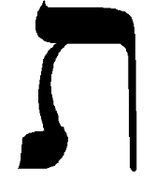
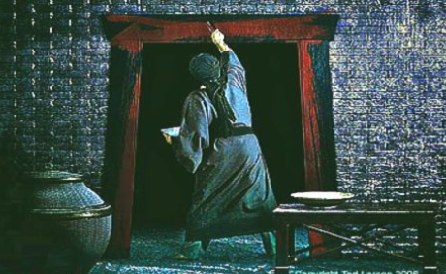
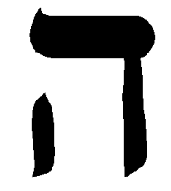
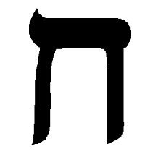
To Protect
Psalm 119:57-64
ח Cheth 8th number
The original pictograph for Cheth was a tent wall or fence, which served to guard and protect from the elements or intruders. In Psalm 119, this symbolizes God's Word as a protective boundary that separates His people and keeps them safe from the ways of the wicked.
As seven often represents completion, eight can symbolize a new beginning or true life.
And they shall take of the blood, and strike it on the two side posts and on the upper door post of the houses, wherein they shall eat it. Exodus 12:7
The Chet, or "fence," symbolized a barrier or divine protection around the homes of the Israelites, causing the "destroying angel" to pass over them.
The Hey and the Daleth also have the same signs

Slide 13

O Lord, teach us Thy statues
Psalm 119:65-72
ט Teth
Acknowledging God’s goodness and faithfulness
Teach me understanding to deal with others
In our lives we have sinned, but we repent we will be forgiven
Teach me more understanding of Thy word
Others have different opinions, but we can not stray
The spirituality and wickedness of others will not persuade me to sin
We learn through afflictions
The word of the Lord is more precious than gold and silver
Meaning:
Good or Best

Slide 14

O Lord, let Thy tender mercies come upon us
Psalm 119:73-80
י Jod
God has created all, given us knowledge of His commandments
God has given us hope
God will fairly judge us righteously
If we faithfully pray, we will have God’s mercy
Keep the commandments
A prayer asking God to bring shame on those who persecute others
Those that believe God and reference him will testify of Him
We should not be ashamed of the gospel
Meaning:
Jew
Hand (of God)
Continuity—Yehudah

Slide 15


All God’s commandments are faithful
Psalm 119:81-88
כ Caph
Even though we are tired (Physically or Spiritually) we should remember God’s promises
Those waiting for God’s comfort
Metaphor of an ancient animal-skin bottle, or wineskin, that becomes dried out and shriveled when exposed to smoke=those who are afflicted by trials but still keeping God’s commandments
How long do our trials last?
Those who are wicked still remain wicked
We have been wronged by those who are wicked but continue to observe God’s commandments
Help us with keeping Thy commandments
Meaning:
Palm
Spoon
Crown

Slide 16

All God’s commandments are faithful
Psalm 119:89-96
ל Lamed
God’s word is forever
God has established His word throughout the generations
The prophets have preached the word of God
God’s word has provided us with a guide and a source for righteousness
We are to remember the word of God and His promises
We are to keep the word of God
With other’s testimonies I can withstand the wickedness around me
We can foresee what is in store for us if we live righteously
Meaning:
Learn
Teach

Slide 17

The Lord’s law and His testimonies should be our meditation all the day
Psalm 119:97-104
מ Mem
To study and ponder God’s words
We can become wise (learned) while studying God’s word
Understanding much while leaders testify of God
Because we keep the commandments we understand it’s precepts
Staying on the path of righteousness
Because of God’s word and understanding we shall not stray
Sweet are the words of God
Being truthful to thyself we can understand God’s word
Meaning:
Water
Moshiach=(lit. “the anointed one”) the Messiah. One of the 13 principles of the Jewish faith is that G-d will send the Messiah to return the Jews to the land of Israel, rebuild the Holy Temple and usher in the utopian Messianic Era.

Slide 18

The Word is a lamp unto our feet
Psalm 119:105-112
נ Nun
Walking into the light
Solemn oath to keep the commandments
Hardships and afflictions will be eased
We can teach the gospel and share our testimonies
Despite the trials of our lives we can remember God’s love
Your enemies my cause you trouble but you can overcome them
Our testimonies can make us stronger
Endure to the end
Meaning:
Deceit
Kingship
Fish
Miscarriage
Miracle

Slide 19
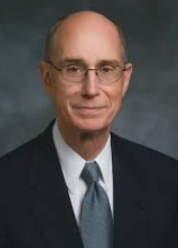
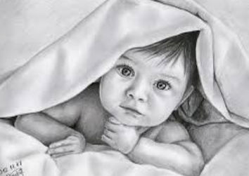
Walking in the Light
Psalm 119:105-106
“How is walking in the light different from walking in the dark?”
Every child of Heavenly Father born in the world is given at birth, as a free gift, the Light of Christ. You have felt that. It is the sense of what is right and what is wrong and what is true and what is false. That has been with you since your journey in life began. The fact that you were baptized and received the Holy Ghost is evidence that you chose to walk in the Light of Christ. (2)
Wherefore, I beseech of you, brethren, that ye should search diligently in the light of Christ that ye may know good from evil; and if ye will lay hold upon every good thing, and condemn it not, ye certainly will be a child of Christ. Moroni 7:19

Slide 20

Depart from evildoers and keep the commandments of God
Psalm 119:113-120
ס Samech
Disdain from deceitful thoughts and love for God’s law
God is our protector
Trying to live righteously
Forgive our wrongdoings that we may repent
God’s love and protection for us
The unrighteous will be held accountable to God
God will separate the wicked (dross= any waste
We can honor and respect God and his laws
Meaning:
Support
Medicine

Slide 21

O Lord, we are Thy servants; give us understanding
Psalm 119:121-128
ע Ain
Those who act righteously ask for God’s protection from sin
A prayer asking God for protection from enemies
Waiting patiently for divine help from God
Have mercy and help us understand the word of God
We can testify of the gospel with understanding what we have learned
Asking for the Lord to intervene because of the wicked practices of others
The commandments of God can be precious for those who understand
We can be righteous and truthful about God’s word
Meaning:
Eyes
Salvation

Slide 22

The Lord’s testimonies are wonderful
Psalm 119:129-136
פ Pe
A strong testimony can help you make righteous decisions
The word of God is light and knowledge
Testify of the word of God
Praising God’s law and seeking His guidance
Seek God’s direction before making decisions
Pleading for God’s direction and protection
A request for God’s divine wisdom and guidance in following God’s commandments
Weeping for those who do not follow in righteous ways
Meaning:
Mouth

Slide 23

The Lord’s law is the truth
Psalm 119:137-144
צ Tzaddi
Righteous in the Lord
Being righteous and faithful
Testify of being righteous
Devotion and enemies of the Lord have been forgotten
God’s word is pure
Even though we are small and insignificant we can not forget God’s law
Righteous law is everlasting
Trials will not overpower us
Righteousness and truthfulness is everlasting
Meaning:
Righteous
Hunt

Slide 24

O Lord, hear the voice of Thy servants according to Thy loving kindness
Psalm 119:145-152
ק Koph
Ernest praises to keep God’s commandments
Ernest praises to keep your testimony
Ernest prayer and study before the sun rises
Prayer and meditation throughout the day
Hear our praises, the Lord is loving and kind
There are those who live unrighteously
The Lord’s commandments are true
The testimonies that have been spoken by prophets of old are forever
Meaning:
Monkey

Slide 25

Great are Thy tender mercies, O Lord
Psalm 119:153-160
ר Resh
We should not forget God’s law in your afflictions
Divine intervention and spiritual renewal
Those who live contrary to God’s will
God’s mercy and pleading to be given life
Persecution from others
Saddened for those who do not keep God’s commandments
Truth and eternal nature of a loving and kind God
God’s word has been truthful from the beginning and will be to the end
Meaning:
Poor
Evil
Head

Slide 26

Those who love the Lord’s law have peace
Psalm 119:161-168
ש Schin
During afflictions and trials we should remain true to the commandments
Intense joy and value placed on God’s word
Being true to one’s self
Pray 7 times a day. 7 means complete, pray as often as needed to feel secure
Those who love the Lord’s law will have peace
A plea for salvation unto the Lord
Testify of these things
Keep the commandments and testify of them
Meaning:
Tooth
Steadfast
Change
Return
Year

Slide 27

All the Lord’s commandments are righteous
Psalm 119:169-175
ת Tau
Prayer to God to be heard and for spiritual enlighten
Deep love for God’s word and asking for understanding
Receiving gratitude and joy in understanding God’s instructions
God’s commands are the standard of righteousness
Help for those who keep God’s commandments
Salvation for those who long for God’s approval
God’s divine instructions
The full context of Psalm 119 is a meditation on the beauty, wisdom, and importance of God's law and commandments in the life of a believer. The final verse cited serves as a heartfelt plea for God to seek out the speaker who feels lost, while simultaneously affirming their unwavering devotion to divine principles
Meaning:
Truth
Sign
Life and Death

Slide 28
Sources:
Ellis T. Rasmussen, A Latter-day Saint Commentary on the Old Testament [1993], 455
2. President Henry B. Eyring April 2007 Gen. Conf. “Walk in the Light”

Slide 29
Other Sources:
https://www.chabad.org/library/article_cdo/aid/137073/jewish/Aleph.htm#Meaning

