Slide 1

Yesterday, Today, and Tomorrow
Introduction to Isaiah
And now, behold, I say unto you, that ye ought to search these things. Yea, a commandment I give unto you that ye search these things diligently; for great are the words of Isaiah.
3 Nephi 23:1

Slide 2


Put in order from most likely to least likely to persuade someone to read a certain book.
Recommended by family member or friend
Has great online reviews
Looks very interesting
Assigned for a class at school
How would you recommend a book

Slide 3
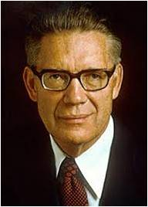
Why Study Isaiah?
If, as many suppose, Isaiah ranks with the most difficult of the prophets to understand, his words are also among the most important for u to know and ponder…(1)
And now I, Nephi, write more of the words of Isaiah for my soul delighteth in his word…
2 Nephi 11:2
The Book of Isaiah is a tract or our own times; our very aversion to it testifies to its relevance…Isaiah’s message has not been popular, and he tells us why. The wicked do not like to be told about their faults. But says Isaiah, the people of Israel (and our day) want to hear smooth things;
“Prophesy not unto us right things, speak unto us smooth things, prophesy deceits:
Isaiah 30:10 (2)
Yea, a commandment I give unto you that ye search these things diligently; for great are the words of Isaiah. 3 Nephi 23:1

Slide 4
The Old Testament
Old Testament
The Old Testament is organized into four sections: the Law, History, Poetry, and the Prophets.
Isaiah
The book of Isaiah is the first book of the Prophets, the final section of the Old Testament, which concludes with Malachi.

Slide 5
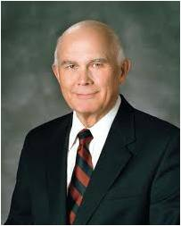
The Book of Isaiah
The book of Isaiah was written sometime during the ministry of Isaiah (approximately 740–701 B.C.).
Since Isaiah’s ministry was centered in Jerusalem, this is the most likely location of the book’s origin.
“The book of Isaiah contains numerous prophecies that seem to have multiple fulfillments. One seems to involve the people of Isaiah’s day or the circumstances of the next generation. Another meaning, often symbolic, seems to refer to events in the meridian of time, when Jerusalem was destroyed and her people scattered after the crucifixion of the Son of God. Still another meaning or fulfillment of the same prophecy seems to relate to the events attending the Second Coming of the Savior.
The fact that many of these prophecies can have multiple meanings underscores the importance of our seeking revelation
from the Holy Ghost to help us
interpret them.” (4)
“Isaiah is the most quoted of all the prophets, being more frequently quoted by Jesus, Paul, Peter, and John (in his Revelation) than any other Old Testament prophet.
Likewise, the Book of Mormon and the Doctrine and Covenants quote from Isaiah more than from any other prophet” (3)

Slide 6
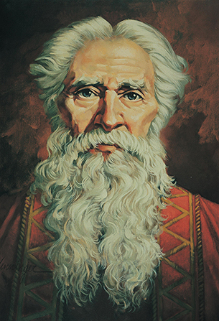
Isaiah’s Time
Isaiah lived in Judah
The other prophets during his time were: Micah, Hosea, and Jonah
During Isaiah’s time Jerusalem Judah was taken captive by Babylonia
In Isaiah’s time were performing outward acts of righteousness but were inwardly sinful and unrepentant
Ted Henninger
Isaiah ministered in Jerusalem for about 40 years. He died approximately 100 years before Lehi and his family departed from Jerusalem.
(3)

Slide 7
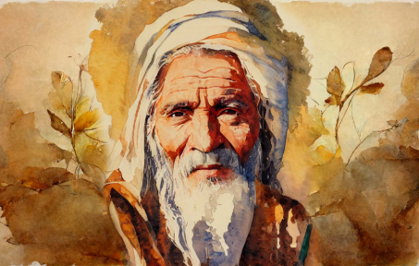
Isaiah as a Prophet
The prophet Isaiah preached to people who had turned away from faith in Jehovah (Jesus Christ).
Isaiah’s message to them is reflected in his own name which means, “The Lord is salvation.”
Isaiah’s teachings also apply to other periods when people would turn away from Jesus Christ—such as the time of Christ and the present day, as we prepare for His Second Coming.
(3)

Slide 8
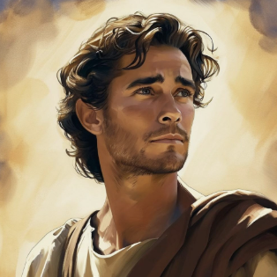
Nephi…
And I did read many things unto them which were written in the books of Moses; but that I might more fully persuade them to believe in the Lord their Redeemer I did read unto them that which was written by the prophet Isaiah; for I did liken all scriptures unto us, that it might be for our profit and learning. 1 Nephi 19:23
(3)

Slide 9
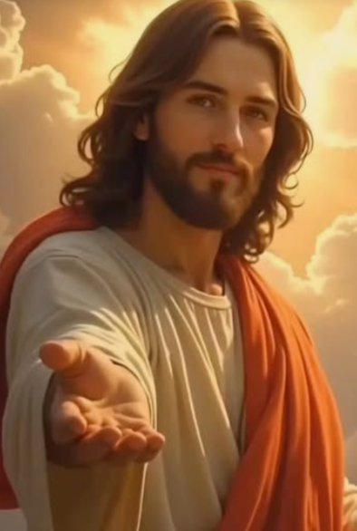
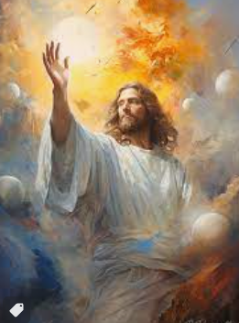
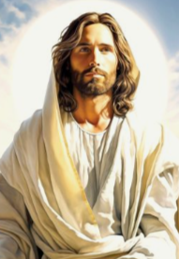
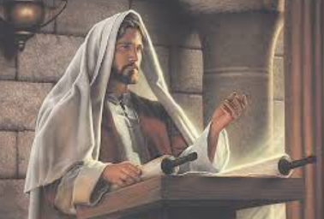
Titles of Jesus
Isaiah 7:14
Immanuel
Isaiah 33:2
Lord
King
Lawgiver
Isaiah 9:6
Wonderful
Counsellor
Mighty God
Everlasting Father
Prince of Peace
Isaiah 40:28
Creator
(3)

Slide 10
White As Snow
Isaiah 1-2

Slide 11


Those Who Might Struggle Spiritually
A young man attends church every Sunday and regularly attends seminary. He also frequently uses foul language, watches inappropriate media, and is cruel to his younger brothers and sisters.
A young woman never misses a day of seminary, always attends church, and recently earned her Personal Progress Award. However, she does righteous things primarily to please her parents and to receive recognition from others. When she is at school, she and her friends make fun of people they see as being different from them.
What indicators suggest this young man and young woman may be struggling spiritually, even though they both regularly attend church and seminary?

Slide 12
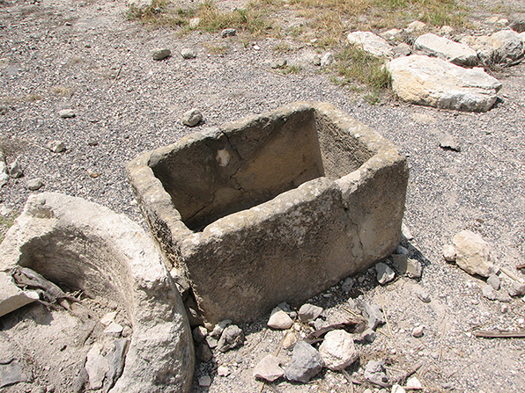
Parallelism
Parallelism occurs when a writer expresses an idea and then repeats or contrasts the idea using a similar sentence structure with different words.
Example:
Hear, O heavens, and give ear, O earth.”
He invited all people everywhere to listen to the words the Lord had given him.
Isaiah also uses familiar images of his time to explain ideas
Stone Crib for Feeding Animals
Isaiah 1:2

Slide 13

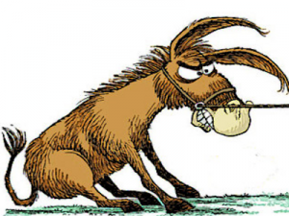
The Ox and the Donkey
Isaiah contrasted the ox and the donkey with the rebellious Israelites, who did not know the Lord and were not aware of the physical and spiritual nourishment He had provided for them.
Isaiah 1:3

Slide 14
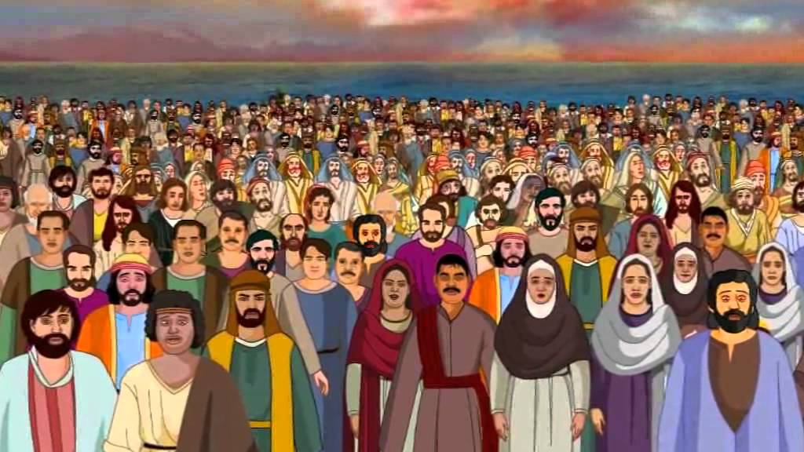
Those Affected By Wickedness
“daughter of Zion” in verse 8 refers to Jerusalem and its inhabitants.
Isaiah contrasted the ox and the donkey with the rebellious Israelites, who did not know the Lord and were not aware of the physical and spiritual nourishment He had provided for them.
Every part of the body, the least as well as the chiefest was plagued (wicked).
Their plagues were so grievous that they were incurable, and yet they would not repent. (5)
Isaiah 1:5-9

Slide 15
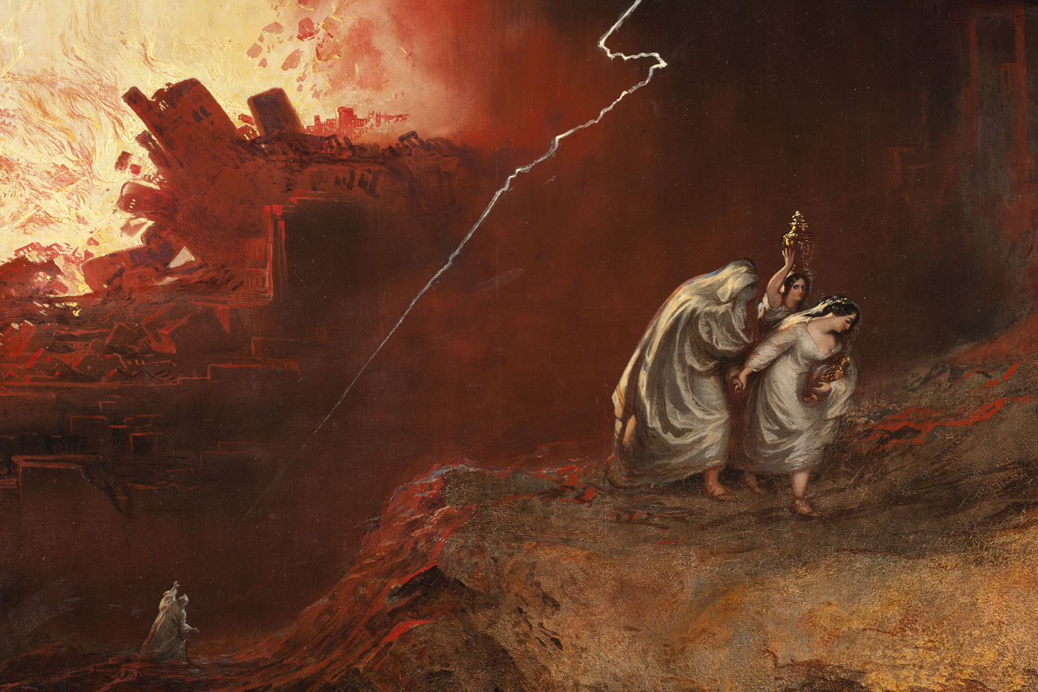
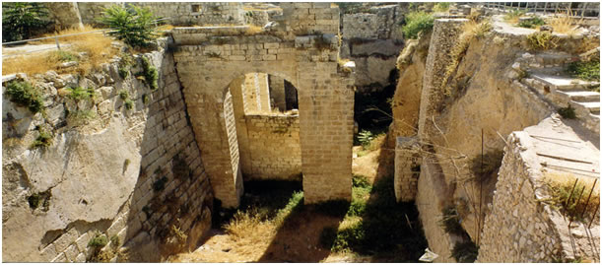
Desolate Cities
The description of the ruined and desolate state of the country in these verses does not suit with any part of the prosperous times of Uzziah and Jotham. It very well agrees with the time of Ahaz, when Judea was ravaged by the joint invasion of the Israelites and Syrians, and by the incursions of the Philistines and Edomites. (6)
Sodom and Gomorrah
Isaiah 1:5-9

Slide 16
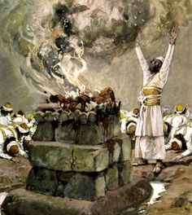
Outward Observances
Even though the Israelites were wicked at this time, they continued to offer sacrifices at the temple and they outwardly observed sacred occasions such as the Passover and other religious feasts.
Isaiah 1:10-15

Slide 17


Intentions of the Heart
Their outward behavior of the Israelites were clean on the outside.
The intentions of their hearts had become contaminated by sin
However
Isaiah 1:10-15

Slide 18
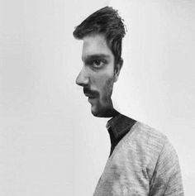

Insincere
hypocritical
Evasive
Put-on
Unfaithful
Deceitful
Deceptive
Untruthful
Isaiah 1:10-15

Slide 19
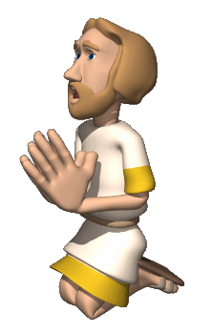
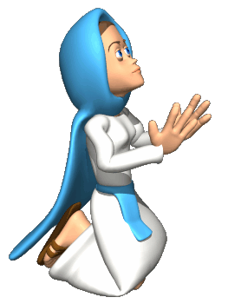

Hypocrisy
The following is a rough, latter-day paraphrasing of Isaiah's denunciation of hypocrisy:
When ye make your offerings, if your heart is still set on riches, what good is thy tithing unto me?
When ye come to church, seek ye my face or seek ye to be seen of men?
"To what purpose is the multitude of your church meetings unto me? Saith the Lord: I am full of shallow prayers, feigned gratitude, and trite testimonies.
What of your Sabbath days? They are a trouble unto me; I am weary to bear them. Your holidays are no longer holy and your feasts my soul hateth.
Are not the heavens and the earth my footstool? Do I need thy money or require thy heart?
Ye speak evil of mine anointed and reveal the malice of thine heart. I will hide mine eyes from you: yea, when ye make many prayers, I will not hear: your heart is full of deceit."
Isaiah 1:10-15

Slide 20

Real Intent
For behold, God hath said a man being evil cannot do that which is good; for if he offereth a gift, or prayeth unto God, except he shall do it with real intent it profiteth him nothing.
For behold, it is not counted unto him for righteousness.
For behold, if a man being evil giveth a gift, he doeth it grudgingly; wherefore it is counted unto him the same as if he had retained the gift; wherefore he is counted evil before God.
And likewise also is it counted evil unto a man, if he shall pray and not with real intent of heart; yea, and it profiteth him nothing, for God receiveth none such.
Moroni 7: 6-9
Real intent means doing the right thing for the right reasons
Our outward acts of devotion to God are more meaningful to Him when the intentions of our hearts are pure.
Isaiah 1:10-15

Slide 21
Doctrinal Mastery
Isaiah 1:18
Come now, and let us reason together, saith the Lord: though your sins be as scarlet, they shall be as white as snow; though they be red like crimson, they shall be as wool.

Slide 22
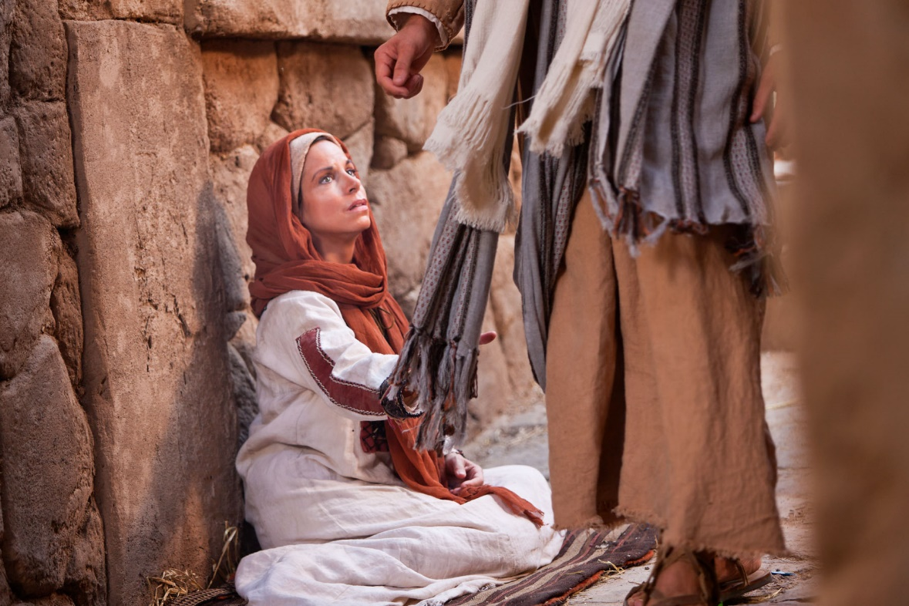
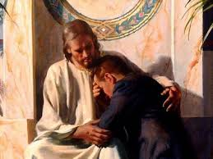
The Savior’s Atonement
…has the power to purify, but we must choose to apply the Atonement in our lives by exercising faith in Christ and repenting of our sins
If we sincerely repent, we can be purified of all of our sins through the Atonement of Jesus Christ.
Isaiah 1:16-19

Slide 23
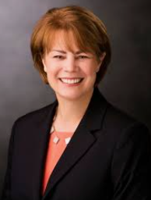
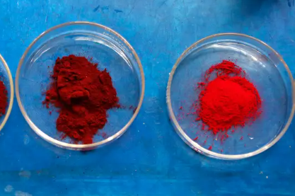
Scarlet and Crimson
scarlet is a bright red with an orange tinge, while crimson is a deeper, more purplish-red
Both colors were originally made from the bodies of small insects, such as the Kermes or Cochineal, which are a type of worm
The scarlet dye of the Old Testament was not only colorful but also colorfast, meaning that its vivid color stuck to the wool and would not fade no matter how many times it was washed.
Satan wields this reasoning like a club: white wool stained scarlet can never go back to being white.
But Jesus Christ declares, “My ways [are] higher than your ways,” and the miracle of His grace is that when we repent of our sins, His scarlet blood returns us to purity. It isn’t logical, but it is nevertheless true. (9)
If we sincerely repent, Jesus Christ will cleanse us from our sins.
Isaiah 1:18

Slide 24
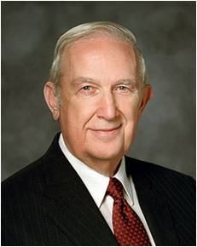

As White As Snow
When repentance is full and one has been cleansed, there comes a new vision of life and its glorious possibilities. How marvelous the promise of the Lord: "Behold, he who has repented of his sins, the same is forgiven, and I, the Lord, remember them no more." The Lord is and ever will be faithful to His words.
If you have a troubled conscience from broken laws, I plead, please come back. Come back to the cool, refreshing waters of personal purity. Come back to the warmth and security of Father in Heaven's love. Come back to the serenity and peace of conscience that come from living the commandments of God. (7)
Through the Holy Ghost the Savior can cleanse us from our sins.
Isaiah 1:18

Slide 25
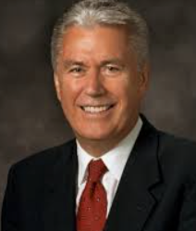
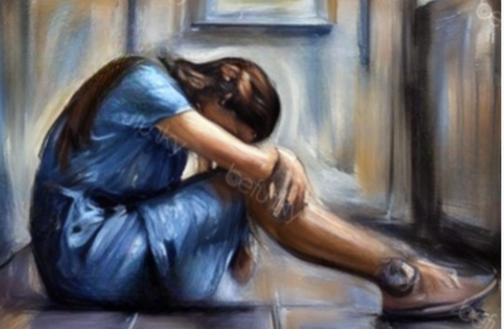
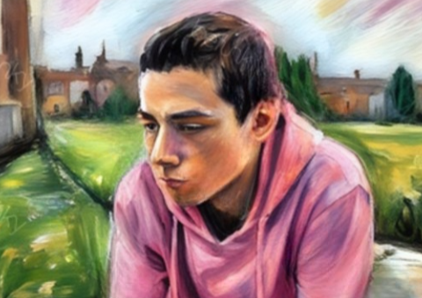
Willing to Repent
No matter how terribly off course you are, no matter how far you have strayed, the way back is certain and clear. Come, learn of the Father; offer up a sacrifice of a broken heart and a contrite spirit.
Have faith, and believe in the cleansing power of the infinite Atonement of Jesus the Christ.
If we confess and repent of our sins, God is faithful and just to forgive and to cleanse us from all unrighteousness. “Though your sins be as scarlet, they shall be [made] as white as snow.” (10)
Isaiah 1:18

Slide 26

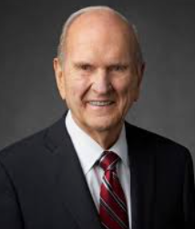


How to Repent
Fifth, whatever the cost of repentance, it is swallowed up in the joy of forgiveness.
Fourth, repentance requires a seriousness of purpose and a willingness to persevere, even through pain
Third, repentance means not only abandoning sin but also committing to obedience.
Second, repentance means striving to change.
First, the invitation to repent is an expression of love.
(11)

Slide 27
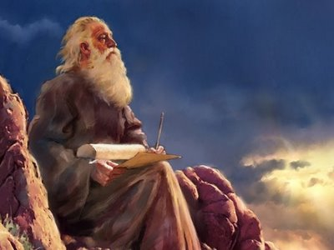
In the Latter Days
Isaiah prophesied of many events of the latter days, and he often used symbolism in expressing his prophecies.
As is often the case in prophetic declarations, some of Isaiah’s writings have dual or multiple meanings.
That is, they can apply to more than one situation or may be fulfilled at more than one time. This is sometimes called dualism. (3)
Isaiah 2:1-5

Slide 28
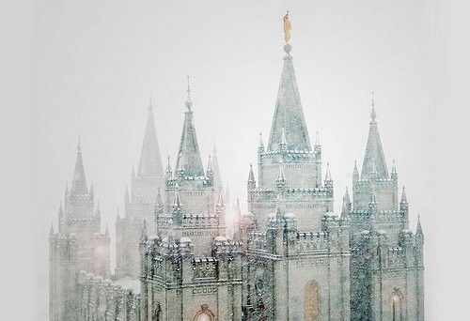
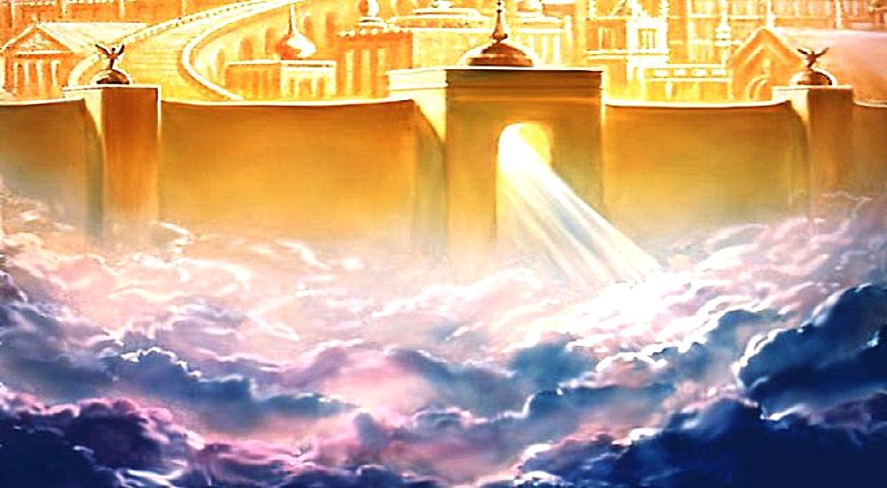
Mountain of the Lord’s House
Isaiah is making reference to the mountain of the Lord's house.
That means that these temples will be built on a hill or mountain to represent the spiritual journey toward God.
"And the temple in Jerusalem was on the temple mountain, on Mt. Moriah. We find all the sacred places are the mountains, and they are very important here as the place of pilgrimage." (2)
Franklin D. Richards explains that the prophecy has reference to both Salt Lake and the New Jerusalem or Zion:
Isaiah 2:1-5

Slide 29
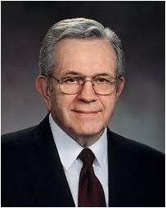
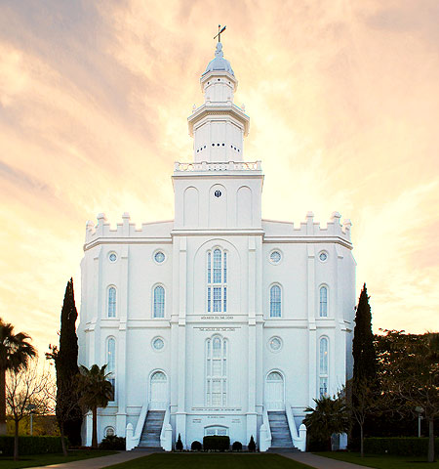
“The temple is a great school. It is a house of learning. In the temples the atmosphere is maintained so that it is ideal for instruction on matters that are deeply spiritual. …
If you will go to the temple and remember that the teaching is symbolic, you will never go in the proper spirit without coming away with your vision extended, feeling a little more exalted, with your knowledge increased as to things that are spiritual” (8)
St. George, Utah Temple
Isaiah 2:1-5

Slide 30

An Invitation
Come ye, and let us walk in the light of the Lord.
Ye have all gone astray/wicked ways = He (Jesus) walks of where we are today. He wants us to see what it will take to move us from our present-day.
Forsaken thy people =
God never abandons but relies on our agency. He withdraws his Spirit only when He is rejected.
Influences from the East =
Which way do we go back into the presence of God?
The East was always a symbol of the world. Moroni beacons to the East (world) to come unto Christ and to herald His coming from the East. (Moroni 7:31)
Isaiah means that we’re looking to the world for our inspiration and direction instead of the prophets and the Gospel
Isaiah 2:5-6

Slide 31
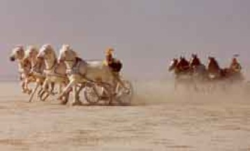

Materialism
Accumulation of Wealth
Land/treasures
Horses/Chariots---warfare
Idols—worshipping what we make with our own hands---
How are much of our material creations marketed today?
Through sexual advertisement
We perceive God through spiritual senses and idols through physical senses.
God speaks to us through our spirits
Satan speaks to us through our bodies
Isaiah 2:7-8

Slide 32
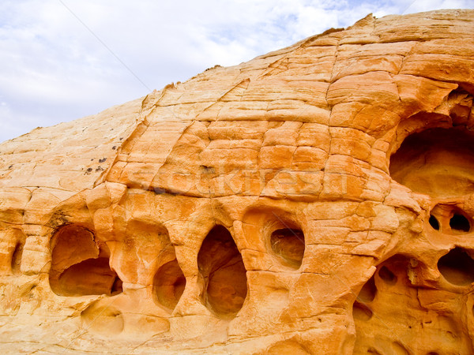
Hiding
Isaiah says if they don’t repent, they will hide to avoid God’s wrath
Imagery: High—things that are of the way of prideful men will be brought low.
Into holes of rocks—How do we hide the evidence of idols that we have?
The proud and haughty men of the last days which will be cut down by the power of the Lord,
"And the mean man boweth not down, and the great man humbleth himself not, therefore, forgive him not."
2 Nephi 12:9
They will be humbled by the Lord because they would not humble themselves.
Mean Man = ordinary man
Where do we hide from God?
Isaiah 2:8-19

Slide 33



In That Day—Our Day
Isaiah warns us that we must cease placing confidence in man and his status symbols and idols
Isaiah 2:20

Slide 34
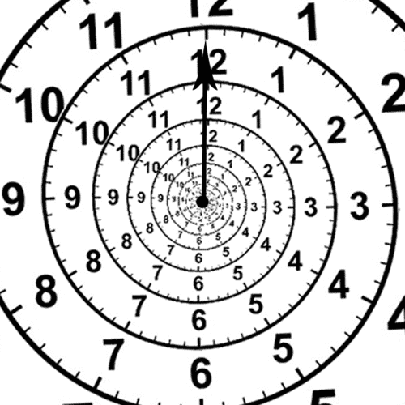
Isaiah is Giving Us a Choice
1. A vision of who we are in the Ideal and our hope for the future
2. A view of where we are now in Reality
3. Where we will end up if we don’t make a change in our lives
Isaiah 2-3

Slide 35
Sources:
Video: Look to the Light (4:28)
Bruce R. McConkie Ten Keys to Understanding Isaiah p. 78-80
Hugh Nibley
Hugh Nibley (Ancient Documents and the Pearl of Great Price, Lecture 16, p. 3)
3. Bible Dictionary
Presentation by ©http://fashionsbylynda.com/blog/
4. Elder Dallin H. Oaks “Scripture Reading and Revelation,” Ensign, Jan. 1995, 8
5. Bible Hub (KJV)
6. Adam Clarke Bible Commentary Isaiah 1:7
7. Elder Richard G. Scott ("Peace of Conscience and Peace of Mind," Ensign, Nov 2004, 15-18)
8. President Boyd K. Packer (“The Holy Temple,” Ensign, Oct. 2010, 31–32).
9. Sister Sharon Eubank (“Christ: The Light That Shines in Darkness,” Ensign or Liahona, May 2019, 75)
10. President Dieter F. Uchtdorf (“A Matter of a Few Degrees,” Ensign or Liahona, May 2008, 60)
11. (“We Can Do Better and Be Better,” Ensign or Liahona, May 2019, 67)
Other titles of Jesus
https://www.churchofjesuschrist.org/comeuntochrist/believe/jesus/50-names-for-jesus

Slide 36
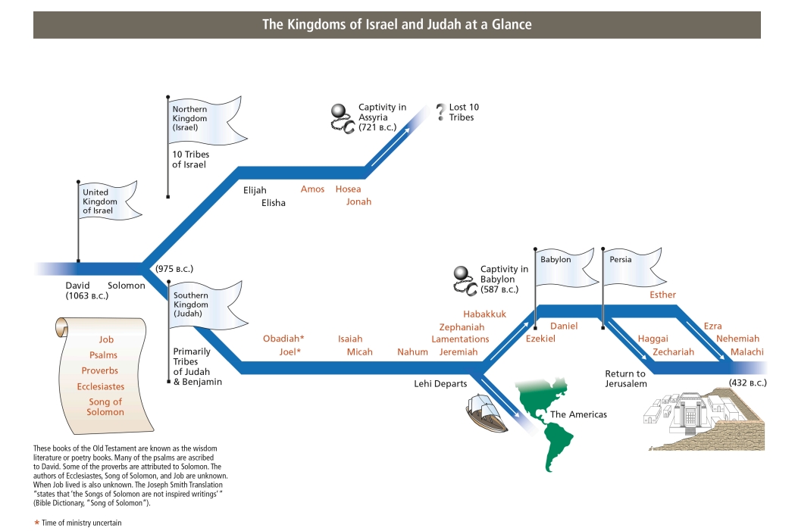

Slide 37
A Need for Spiritual Health, The sole of the foot even to the head:
This passage declares the total depravity of human nature. While sin remains unrepented, nothing is done toward healing these wounds, and preventing fatal effects. Jerusalem was exposed and unprotected, like the huts or sheds built up to guard ripening fruits. These are still to be seen in the East, where fruits form a large part of the summer food of the people. But the Lord had a small remnant of pious servants at Jerusalem. It is of the Lord's mercies that we are not consumed. The evil nature is in every one of us; only Jesus and his sanctifying Spirit can restore us to spiritual health. Bible Hub
Dualism and esoteric terms:
“Dualism and esoteric terms. As is often the case in prophetic declarations, some of Isaiah’s writings have a dual meaning. That is, they can apply to more than one situation or may be fulfilled at more than one time. He also at times combined dualistic phrases with terms that were intended for or understood by only a certain group. Such esoteric language brings to mind religious concepts that only those who have the proper religious background readily understand without further explanation. For example, Isaiah 2:2 refers to the ‘mountain of the Lord’s house’ being ‘established in the top of the mountains.’ President Harold B. Lee said that the phrase ‘mountain of the Lord’s house’ referred to both ‘a place as well as a definition of a righteous people’ (“The Way to Eternal Life,” Ensign, Nov. 1971, p. 15).
The establishment of the ‘mountain of the Lord’s house in the top of the mountains’ has been fulfilled by the coming of the pioneers to establish the Church and temple in the tops of the mountains in Utah (see Lee, “The Way to Eternal Life,” p. 15) and will be further fulfilled [by the temple that will be built in the New Jerusalem (see D&C 57:1–3) and] by the return of Judah to Jerusalem, where the Lord’s house will be built (see D&C 133:13). It applies generally to those places where God’s power and authority reside and where He communicates with His people.
The phrase ‘all nations shall flow unto it’ (Isaiah 2:2) can refer both to the early gathering of the Saints to the valleys of the mountains in Utah and also to the general gathering of Saints to Zion. The term Zion (v. 3), as well, has several applications. It refers to the New Jerusalem in America, the Jerusalem of Judah, and also the Lord’s people or their places of gathering in all parts of the world. By using such terms as these, Isaiah conveys profound spiritual meaning to those who understand the special significance of his language. …
“This richness of language and meaning seems to be what Nephi meant when he spoke of the manner of prophesying among the Jews. There is frequent reference to the law of Moses and extensive use of imagery, figurative language, and phrases that have dualistic and esoteric meanings. Though modern readers cannot fully grasp the culture and times of ancient Israel, understanding the methods Isaiah used to convey his meaning can give the reader a far greater understanding of Isaiah” (Old Testament Student Manual: 1 Kings–Malachi, 3rd ed. [Church Educational System manual, 2003], 133).
The term "mountain of the Lord's house" refers to the temple. But which temple is Isaiah speaking about? Many of the brethren have interpreted this passage as having reference to the building of temples amongst the Rocky Mountains, specifically, the Salt Lake Temple. Certainly, many have come to Salt Lake from all over the world to learn of His ways and walk in His paths.
Elder LeGrand Richards, while speaking of this prophecy said, "Can you go anywhere in the world and find a record of the fulfillment of that promise of Isaiah except in the gathering of the Latter-day Saints here to these valleys of the mountains?" (BYU Speeches of the Year, Feb, 10, 1960, p. 9) If this statement is true regarding the Salt Lake Temple, it must also refer to the many other temples now in use.
Prophesy quoted by Isaiah 2:2-3, 5
During the dedication of the Conference Center in Salt Lake City on October 8, 2000, President Gordon B. Hinckley quoted Isaiah 2:2–3, 5 and stated: “I believe that prophecy applies to the historic and wonderful Salt Lake Temple. But I believe also that it is related to this magnificent hall. For it is from this pulpit that the law of God shall go forth, together with the word and testimony of the Lord” (“This Great Millennial Year,” Ensign, Nov. 2000, 69).

Slide 38
Cedars of Lebanon:
Thus you will find, in many other places besides this before us, that cedars of Lebanon and oaks of Bashan, are used in the way of metaphor and allegory for kings, princes, potentates of the highest rank; high mountains and lofty hills, for kingdoms, republics, states, cities; towers and fortresses, for defenders and protectors, whether by counsel or strength, in peace or war; ships of Tarshish and works of art, and invention employed in adorning them, for merchants, men enriched by commerce, and abounding in all the luxuries and elegances of life, such as those of Tyre and Sidon; for it appears from the course of the whole passage, and from the train of ideas, that the fortresses and the ships are to be taken metaphorically, as well as the high trees and the lofty mountains. Adam Clarke
Isaiah Teaches Us:
That the greatest blessings will go to the meek, the lowly, the oppressed, afflicted, and the needy because they will be those with virtue.
The only thing we should put our faith in is God.
The Savoir Jesus who walked the earth and who wrought the atonement. He saw him in vision an prophesied details of His Life. (Isaiah 53)
Events of the last days:
a. Establishment of Zion
b. The Gathering
c. Return of the 10 Tribes
d. The building of New Jerusalem in America
e. Rebuilding of Old Jerusalem
f. Second Coming
g. New Heaven and Earth
h. Millennium
Ships of Tarshish:
As Tarshish was the most celebrated mart of those times, frequented of old by the Phoenicians, and the principal source of wealth to Judea and the neighboring countries. The learned seem now to be perfectly well agreed that Tarshish is Tartessus, a city of Spain, at the mouth of the river Baetis, whence the Phoenicians, who first opened this trade, brought silver and gold, ( Jeremiah 10:9; Ezekiel 27:12;), in which that country then abounded; and, pursuing their voyage still farther to the Cassiterides, (Bogart, Canaan, 1 c. 39; Huet, Hist. de Commerce, p. 194), the islands of Scilly and Cornwall, they brought from thence lead and tin.
Tarshish is celebrated in Scripture, 2 Chronicles 8:17, 2 Chronicles 8:18; 2 Chronicles 9:21, for the trade which Solomon carried on thither, in conjunction with the Tyrians. Jehoshaphat, 1 Kings 22:48; 2 Chronicles 20:36, attempted afterwards to renew their trade. And from the account given of his attempt it appears that his fleet was to sail to Ezion-geber on the Red Sea; they must therefore have designed to sail round Africa, as Solomon's fleet had done before, (see Huet, Histoire de Commerce, p. 32), for it was a three years' voyage, ( 2 Chronicles 9:21;), and they brought gold from Ophir, probably on the coast of Arabia; silver from Tartessus; and ivory, apes, and peacocks, from Africa.“ Adam Clarke

Slide 39
Isaiah was a prophet-statesman who ministered during the reigns of four kings of Judah. The historical records of this time come from three major sources: the second book of Kings, the second book of Chronicles, and the writings of Isaiah.
792 B.C. | 2 Kings 15:1-4 | 2 Chronicles 26:1-4 | Azariah, or Uzziah (probably his royal or throne name), was made king in Judah. He ruled twenty-four years jointly with his father, fifty-two years total.
768-750 B.C. |  | 2 Chronicles 26:5-7 | Uzziah sought counsel from the prophet Zechariah (not the Zechariah who wrote the Old Testament book). Uzziah subjugated the Philistines and the Arabians.
 |  | 2 Chronicles 26:8-15 | Judah was established as a strong military power. Jerusalem was well fortified and the army well equipped. Agriculture was also improved. Some neighbors paid tribute to this powerful state.
750. B.C. | 2 Kings: 15:5-6 | 2 Chronicles 26:16-21 | Uzziah, lifted up in pride, assumed the right to officiate in the temple. His unauthorized acts brought the judgment of God against him: leprosy. His son Jotham ruled jointly with him for ten years.
 |  | 2 Chronicles 26:22 | Isaiah is mentioned as having recorded the history of Uzziah’s reign. We do not have this record today.
740 B.C. | 2 Kings 15:7 2 Kings 15:32-35 | 2 Chronicles 26:23 2 Chronicles 27:1-6 | Jotham began his sole reign. continuation of Jotham’s reign.
753 B.C. | 2 Kings 15:8-12 |  | Zachariah ruled six months as king in Israel (Northern Kingdom) after his father Jeroboam II.
752 B.C. | 2 Kings 15:13-15 |  | Shallum ruled one month in Israel before his assassination.
752 B.C. | 2 Kings 15:16-18 |  | Menahem began a ten-year reign of terror and wickedness in the Northern Kingdom.

Slide 40
743 B.C. | 2 Kings 15:19-21 |  | The Northern Kingdom was attacked by the Assyrians. Tiglath-pileser III (also known as Pul) secured tribute from the king of Israel, who had exacted the money from the wealthy of his kingdom. The ancient historical texts of Tiglath-pileser III at Nimrod confirm this scriptural account. These texts report tribute of gold and silver paid by “Menahem of Samaria” (see James B. Pritchard, ed., Ancient Near Eastern Texts Relating to the Old Testament,p. 283).
742 B.C. | 2 Kings 15:22-26 |  | Pekahiah ruled two years in Israel before being assassinated by his successor
740 B.C. | 2 Kings 15:27-31 |  | Pekah, son of Remaliah, reigned over the Northern Kingdom. The king formed an alliance with the Syrians against the Assyrians. The coalition also threatened
740 B.C. | 2 kings 15:37; 16:5-6 | Isaiah 9:1 | Finally Tiglath-pileser III captured the northern regions and took many of the inhabitants hostage. This action opened the way for Hoshea to obtain the throne of the Northern Kingdom. Isaiah referred to this conquest in warning of further threats to the nations of God—both Israel and Judah.
740 B.C. | 2 Kings 15:32-36 | 2 Chronicles 27:1-6 | Jotham enlarged the temple gate and strengthened the fortifications of the nation of Judah. The Ammonites attempted to overthrow the tribute of Judah begun by King Uzziah, but they were not successful
735 B.C. | 2 Kings 15:36-38 | 2 Chronicles 27:7-9 | The coalition of Pekah, king of Israel, and Rezin, king of Syria, began an attempt to subjugate Judah during this era.
732 B.C. |  | 2 Chronicles 27:9; 28:1 | Ahaz ruled jointly with his father for three years until Jotham’s death.
735 B.C. | 2 Kings 16:1-4 | 2 Chronicles 28:1-4 | Ahaz adopted idolatrous practices, including human sacrifice of some of his own children
735-720 B.C. | 2 Kings 16:5-6 | 2 Chronicles 28:5-15 | The coalition of Israel (Ephraim) and Syria attacked Judah and Jerusalem. They were not successful in their conquest, although they gained some territory.
 |  | Isaiah 7:1-8 | Isaiah was directed to go to King Ahaz and warn him against making any political alliances with Assyria.
743 B.C. | 2 Kings 15:19-21 | Isaiah 7:6:9; 8:9-18 | Isaiah prophesied that the threatened conquest would not be successful. He further warned that Ephraim (Israel) would be destroyed as a nation.

Slide 41
743 B.C. |  | Isaiah 7:10-16; 9:6-7 | The prophet testified that Judah would be preserved to fulfill its foreordained destiny as the house of the Messiah.
 |  | Isaiah 7:17-25; 8:1-8; 9:8-12 Isaiah 17:1-4 Isaiah 28:1-4 | Isaiah prophesied that Judah would be overrun by the Assyrians but would not be destroyed as would the people of Israel and Syria. He also prophesied the fall of Syria and Damascus and even the people of Israel (Samaria and Ephraim.
 |  | Isaiah 10:5-19 | Isaiah prophesied not only of Assyria’s destruction of Samaria but also of the eventual fall of Jerusalem and of all wickedness. Assyria’s destruction was also shown.
 | 2 Kings 16:7 | 2 Chronicles 28:16 | Ahaz rejected the counsel of the prophet Isaiah and sought an alliance with Assyria.
 |  | 2 Chronicles 28:17-18 | Judah, with her weak leadership, was attacked by Edom and Philistine neighbors, who occupied some cities and territory of the nation.
 | 2 Kings 16:8-9 | 2 Chronicles 28:20-21 | In an attempt to secure the aid of the Assyrians, Ahaz offered tribute from the treasures of the temple and the throne. Wealthy people were forced to contribute. Ancient Assyrian texts also report this tribute from Ahaz. (See D. Winton Thomas, ed.,Documents of Old Testament Times, pp. 55–56.) The Assyrians did not, however, aid Judah against her enemies.
 | 2 Kings 16:10-16 | 2 Chronicles 28:1-4 | Ahaz visited Tiglath-pileser III in the conquered city of Damascus. He directed that a pagan, altar-like throne patterned after one he saw in Damascus be erected at the temple complex in Jerusalem.
 |  | 2 Chronicles 28:22-23 | Ahaz offered sacrifices to the idols of Damascus
 | 2 Kings 16:17-20 | 2 Chronicles 28:24-27 | Ahaz destroyed or altered some of the temple vessels and closed the temple. He also established places of idolatry throughout the land.
732 B.C. | 2 Kings 15:30; 17:1-2 |  | Hoshea was made king over Israel by the Assyrians. The historical annals of the Assyrian kings found at Calah, or Nimrod, attest to the enthronement of Hoshea as vassal king by the Assyrians (see Pritchard, Ancient Near Eastern Texts, pp. 283–84).

Slide 42
725 B.C. | 2 Kings 17:3-4 |  | In time King Hoshea rebelled against the Assyrians. When Shalmaneser V became king of Assyria in 727 B.C., Hoshea used the change of rulers to break the tribute agreement, and he conspired to obtain assistance from Egypt. Messengers were sent to So of Egypt. This king is generally believed to be the Ethiopian conqueror of Egypt who ruled there as founder of the twenty-fifth dynasty. (See Thomas, Documents of Old Testament Times, p. 63; Alan Gardiner, Egypt of the Pharaohs, p. 450.)
724-721 B.C. | 2 Kings 17:5 |  | The land of Israel and its capital Samaria were besieged for three years. Near the end of this period, Sargon II became ruler in Assyria.
722 B.C. | 2 Kings 17:8-17 |  | The destruction of Samaria came at the hands of Sargon II. The people of Israel were taken captive by Sargon and exiled to Assyria. Some question Sargon’s rule, but palace inscriptions about this ruler list him as “conqueror of Samaria” (Pritchard ,Ancient Near Eastern Texts, p. 284). These ancient writings likewise affirm the exile of the inhabitants of the ten northern tribes (see Pritchard, Ancient Near Eastern Texts, pp. 284–85). This large group later escaped from their captivity and were lost to the scriptural narrative, hence the designation “lost tribes” of Israel.
721 B.C. | 2 Kings 17:18–19 |  | The nation of Judah was the only nation remaining after the Assyrian devastation.
 | 2 Kings 17:24 |  | The Assyrians resettled the conquered and depopulated territory of Israel, particularly the region of Samaria, the capital. The wall inscriptions from Sargon’s palace affirm that people from Mesopotamia were relocated in Israel to be a new tribute state to Assyria.
 | 2 Kings 17:25–41 2 Kings 17:26 | Ezra 4:1-3 | The new settlers experienced much difficulty there. Their superstitious conclusion was that they did not know the “God of the land”. Finally, the Assyrians sent Levites and priests from captivity into Israel to teach the new inhabitants of their God. They worshiped both the Lord and the gods they had brought with them. Eventually the new settlers worshiped chiefly Jehovah and intermarried with the priestly families. In time they became known as the Samaritans.
720 B.C. |  | Isaiah 19:1–15;20:1–6 | Assyrian texts report a number of rebellions in the conquered territories and even in the newly-conquered Samaria. Gaza and Damascus were reestablished as Assyrian provinces. (See Pritchard, Ancient Near Eastern Texts,p. 285.) The rebellious vassals of Assyria sought aid from Egypt. In the face of such action, the prophet Isaiah warned Judah against the unstable Egyptians. The prophet further warned of Assyria’s defeat of weakened Egypt, now dominated by foreign (Ethiopian) rulers. The Babylonians were also rebelling, eventually causing Assyria to shift her attention and presence from the land of Israel. (See John Bright, A History of Israel, p. 263.)

Slide 43
715 B.C. | 2 Kings 18:1–6 | 2 Chronicles 31:1–32:12 Numbers 21:8-9 | Hezekiah succeeded his father, Ahaz, as king. He attempted to purge the land of the idolatry of his father. Even the brazen serpent from the days of Moses (see Numbers 21:8–9) had become an object of false worship, so Hezekiah destroyed it.
715–701 B.C. |  | 2 Chronicles 29:1–11 | Hezekiah reopened the temple and challenged the Levites to prepare themselves to administer there.
 |  | 2 Chronicles 29:12–19 | The Levites carried out the work of cleansing and restoring the temple.
 |  | 2 Chronicles 29:20–36 | True worship and sacrifice were reestablished in the nation of Judah.
 |  | 2 Chronicles 30:1–12 | Hezekiah sent messengers inviting all the nation to come to Jerusalem for the reinstitution of the feast of the Passover. Many throughout the land scorned and rejected his call.
 |  | 2 Chronicles 30:13–27 | The faithful who responded to the invitation rejoiced in the celebration in Judah of the sacred festival of the Passover.
 |  | 2 Chronicles 31:1 | The worshipers continued their efforts to rid the land of the institutions of false worship.
 |  | 2 Chronicles 31:2–10 | The priesthood was organized and appointed to their continuing functions. Tithes were given for the support of the priests.
 |  | 2 Chronicles 31:11–21 | The administration of temporal affairs was appointed, the rights of the Levites being established by lineal descent and birthright.
705 B.C. | 2 Kings 18:7 | Isaiah 30:1-7; 31:1-3 | Sargon, king of Assyria, was killed in battle, and revolutions followed throughout the Assyrian Empire. Hezekiah refused to pay the heavy tribute that his father had begun, and he sought an Egyptian alliance. Isaiah had warned the people of the folly of expecting help from Egypt.
(722 B.C.) | 2 Kings 18:9–12 |  | The account of the fall of Israel and Samaria in the north to Shalmaneser V and Sargon II is repeated. This account was a reminder of the power of the Assyrians.

Slide 44
701 B.C. | 2 Kings 18:13–16 |  | Sennacherib, the successor to Sargon, swept into Judah and the territory of the Philistines to enforce the tribute agreements. The annals of this invader king record the capture of forty-six cities or forts and many villages. The extended siege of Hezekiah at Jerusalem is described: “Himself I made a prisoner … like a bird in a cage” (Pritchard, Ancient Near Eastern Texts,p. 288). The Assyrians were headquartered in Lachish, twenty-five miles southwest of Jerusalem. Hezekiah sent tribute, mostly from the temple, to sue for peace. The receipt of the tribute is confirmed in ancient texts. (See Pritchard, Ancient Near Eastern Texts,p. 288.)
 | 2 Kings 20:20 | 2 Chronicles 32:1–8, 30 Isaiah 22:8-11 | In spite of the offering, the siege continued. Hezekiah sought to strengthen the fortifications of the city and moved to protect the water supply. A conduit or water course was dug out of limestone rock to bring the water safely into the city where it could be stored. In warning of the future destruction of Jerusalem, Isaiah spoke of these preparations made by Hezekiah. This tunnel exists today and is known as Hezekiah’s, or the Siloam, Tunnel. An ancient inscription in the tunnel tells of the construction and is generally associated with Hezekiah’s project. (See Pritchard, Ancient Near Eastern Texts, p. 321; Bible Dictionary, s.v. “Hezekiah’s Tunnel.”)
 | 2 Kings 18:17–18 | 2 Chronicles 32:9–10 Isaiah 36:2-3 | As the siege continued, the Assyrians sent representatives of Sennacherib to demand the surrender of the city. Hezekiah sent his officials outside the city walls to negotiate.
 | 2 Kings 18:19–25 | 2 Chronicles 32:11–12 Isaiah 36:4-10 | The Assyrian spokesman challenged the people’s ability to withstand his forces. He criticized the alliance Judah had attempted to make with Egypt. Finally he blasphemously claimed that the God of Judah had commanded Judah’s destruction.
 | 2 Kings 18:26 | Isaiah 36:11 | The representatives of Hezekiah requested that the negotiations be carried out in the Syrian language (Aramaic) rather than Hebrew, so the people would not understand the exchange.
 | 2 Kings 18:27–35 | Isaiah 36:12-20 | The Assyrian official ignored the plea and, speaking loudly in the language of the people of Judah, declared the futility of trusting Hezekiah or their God for deliverance. He challenged the power of Judah’s God with the results of Assyria’s victories.
 | 2 Kings 18:36–37 | 2 Chronicles 32:16–17 Isaiah 36:21-22 | Since Hezekiah’s representatives had been ordered to remain silent, they said nothing at all but returned and reported to the king. In addition to the spoken challenges, the Assyrians sent written messages.

Slide 45
701 B.C. | 2 Kings 19:1–5 | 2 Chronicles 32:20 Isaiah 37:1-5 | Upon receiving these challenges and the report of his representatives, Hezekiah sought counsel and direction from the prophet Isaiah
 | 2 Kings 19:6–13 | Isaiah 37:6-13 | Isaiah prophesied the departure of the Assyrians and Sennacherib’s death upon his return to his homeland. The chief negotiator for the Assyrians returned to Sennacherib to report, and he found that the main force was engaged against Tibnah, not far from Lachish. The Assyrians were also threatened by attack from the Ethiopian pharaoh of Egypt. As a result, the pressure upon Jerusalem for surrender was increased.
 | 2 Kings 19:14–35 | 2 Chronicles 32:21 Isaiah 37:14-36 | Hezekiah, upon receiving the message from the Assyrians, sought the Lord in prayer for deliverance. The Lord’s response was revealed to the king though the prophet Isaiah, who declared the destruction of the Assyrians and the future blessing and prosperity of Judah. Hezekiah stood firm and faithfully obeyed the prophet’s direction. The people of Judah were delivered by the Lord. The Assyrians encamped around Jerusalem were smitten and suffered many casualties.
 | 2 Kings 19:36–37 | 2 Chronicles 32:21–23 Isaiah 37:37-38 | The Assyrians who survived broke off the campaign and withdrew to their homeland. There Sennacherib was assassinated, as Isaiah had prophesied. This miraculous deliverance brought Hezekiah and his God recognition and tribute from neighboring nations.
 | 2 Kings 20:1–11 | 2 Chronicles 32:24 1 Isaiah 38 Helaman 12:13-15 | Hezekiah became very proud and became deathly ill. The prophet Isaiah declared that he would die. Hezekiah pleaded with the Lord, and before the prophet had left the courts of the king, Isaiah was inspired to return and tell Hezekiah that his life would be extended fifteen years. The treatment for his illness was also revealed. Isaiah also prophesied a sign as a witness of God’s hand in Hezekiah’s recovery. The daylight was extended, as indicated by the sundial of Ahaz, Hezekiah’s father.
701–686 B.C. |  | 2 Chronicles 32:25–26 | Hezekiah continued to struggle with his pride, which had brought the Lord’s wrath upon him and his people. The Lord’s wrath was appeased only when Hezekiah became sufficiently humble.
 |  | 2 Chronicles 32:27–30 | The people and the king were richly blessed with material wealth.

Slide 46
701 B.C. | 2 Kings 20:12–13 | 2 Chronicles 32:31 Isaiah 39:1-2 | Merodach-baladan (a Babylonian prince called Marduk-apal-iddina in his own land), who had earlier rebelled against Assyrian domination, sent messengers of good will with gifts for the king of Judah. Hezekiah responded by showing them all the state treasures and armaments.
 | 2 Kings 20:14–19 | Isaiah 39:3-8 | The prophet Isaiah upbraided the king for openly revealing the wealth and defense of the kingdom. He also prophesied the future subjugation and destruction of Judah by the Babylonians.
 | 2 Kings 20:20–21 | 2 Chronicles 32:20, 32–33 | The water tunnel in Jerusalem is mentioned as being one of Hezekiah’s significant accomplishments.
697 B.C. | 2 Kings 21:1–2 | 2 Chronicles 33:1–2 | Manasseh joined his father as king. He apparently ruled jointly with his father during the last eleven years of his father’s reign.
686 B.C. | 2 Kings 21:3–16 | 2 Chronicles 33:3–10 | When Manasseh began to reign alone, upon the death of his father, he led the prosperous nation deep into apostasy and idolatry. They did “more evil than did the nations whom the Lord destroyed before the children of Israel”. Prophets foretold the judgments and destruction that were to come upon this rebellious nation. Manasseh shed much innocent blood.
679 B.C. |  | 2 Chronicles 33:11–17 | Essarhaddon, the Assyrian ruler and one of the sons of Sennacherib, again overran the land of Judah, placing twenty-one cities, including Jerusalem, under tribute. After this defeat and punishment at the hands of the Assyrians, Manasseh attempted some reforms among the people, but without result.
Tradition records that Isaiah died as a martyr by being sawed in two at the hands of Manasseh (see R. H. Charles, ed., The Apocrypha and Pseudepigrapha of the Old Testament in English, 2:162; Hebrews 11:37).
Chart from: Old Testament Institute Manual –The World of Isaiah

Slide 47

Important Warnings in Isaiah for us Today
We tend to not “see” our own weakness because we choose to deny them. We have deliberately cut the wires and then complain that we get no messages from God.
2. The true danger of idol worship is that a dumb image would offer no opposition to
any course the worshipper chose to take. That is the beauty of idols: They are as
impersonal and unmoral as money in the bank is for us.
3. The worst of vices are without exception those of successful people. The wicked
of the last days are not the lazy, sloppy dressed, long haired, nonconformists, those
who are irreverent to customs. The wickedest people are the proud, independent,
industrious, enterprising, prosperous people who attend strictly to their weekly
religious duties with the proper observance of dress standards. They are sustained
in all their doings by a perfectly beautiful self-image and yet all the while their
thoughts and focus are not on God but anything else.
4. That God hates the competitive and predatory society of the last days. (Isa 56:11)
5. The last days will be filled with people, dressed in costly fashions, who are out to
impress and impose themselves on others. Everyone is after a career and aspiring
to climb the corporate ladder. They are all out for themselves. Everything will get
out of control. (Isa 3 :2-8)
6. No one will be able to trust anyone else in our freely competitive society. It is
profitable to break the rules only as long as there are enough gullible people who
are willing to keep them. If you don't play the game, you can expect to become a
victim. (Isa 59:4,8,13,15)
7. Those of the last days will begin to call evil good and good evil. They will use the
law to punish the righteous while the wicked go free. (Isa 5:20,21,23, 10:1)
8. Those of the last days will put their faith in wealth and military power as their
security.
https://www.churchofjesuschrist.org/study/manual/old-testament-student-manual-kings-malachi/chapter-14?lang=eng
Poway Institute—handout (Becky Davies and Lesley Mecham)

