Slide 1

Prophecy to the People
Isaiah 6-9
And if men come unto me I will show unto them their weakness. I give unto men weakness that they may be humble; and my grace is sufficient for all men that humble themselves before me; for if they humble themselves before me, and have faith in me, then will I make weak things become strong unto them.
Ether 12:27

Slide 2

Uzziah
He was the son of Amaziah
He was the 9th king over Judah and ascended the throne at age 16 and ruled for 52 years around from 810 to 759 B.C.
Isaiah and Joel(Hosea), and Amos were prophets during his time and they called him Azariah
He ruled somewhat in righteousness and accomplished much good for Israel by defeating the Philistines, the Arabian, making tributary vassals of the Ammonites, fortifying Jerusalem, and making great advances in farming and cattle-raising, and devising innovative weapons of defense
At the height of his career he desired to participate with the priest in offering incense.
The priest would not allow it because Uzziah did not hold the priesthood
He ignored the priests and offered incense and was struck with leprosy
His son, Jotham, reigned in his stead until he died
(1)

Slide 3
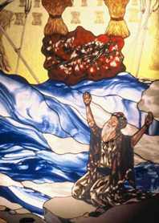
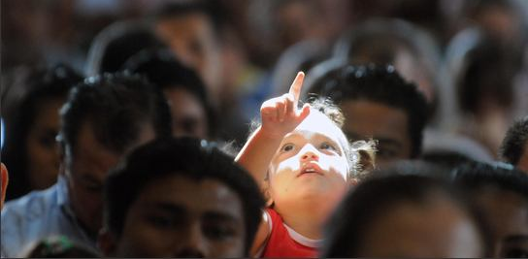
The Vision
Here we see that Isaiah was given the privilege of seeing the throne of God.
In the Old Testament, there is ample evidence that the righteous saw God. Seventy of the elders of Israel were privileged to see God,
"And they saw the God of Israel: and there was under his feet as it were a paved work of sapphire stone, and as it were the body of heaven in his clearness" (Ex 24:10).
Moses spoke with the Lord, "face to face, as a man speaketh unto his friend" (Ex 33:11).
Grace Baptist Church in North Tampa Bay
In this instance, it is apparent that Isaiah also was given the same privilege, "for mine eyes have seen the King" (v. 5).
Modern scripture helps us understand that this is only possible if one has become sufficiently purified and has exhibited sufficient faith.
Isaiah 6:1,5
(2)

Slide 4
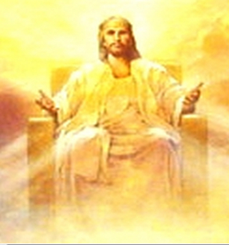
The Blazing Throne of God
Also the blazing throne of God, whereon was seated the Father and the Son. D&C 137:3
Train: the royal robe which was so long that it filled the temple.
Hems of the robe = God is clothed in purity, and the robe of righteousness
His purity and righteousness fills the temple
Wherefore, we shall have a perfect knowledge of all our guilt, and our uncleanness, and our nakedness; and the righteous shall have a perfect knowledge of their enjoyment, and their righteousness, being clothed with purity, yea, even with the robe of righteousness.
2 Nephi 9:14
Isaiah 6:1

Slide 5
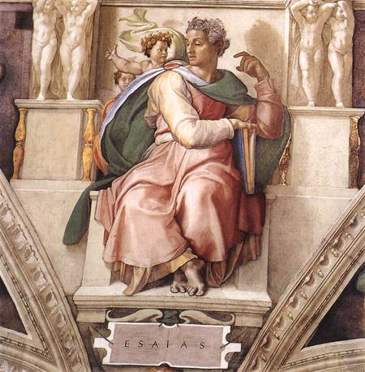
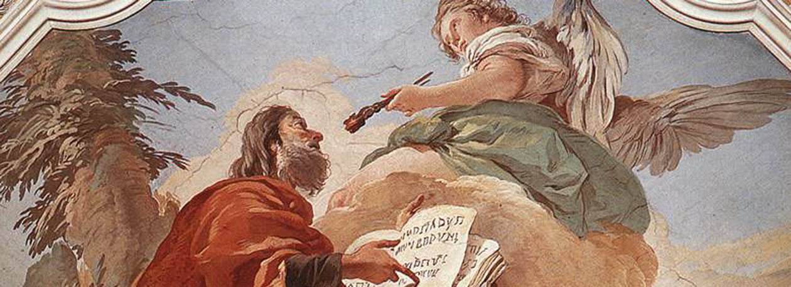
Seraphims
Wings—a symbol of power to move or act
It is clear that seraphs include the unembodied spirits of pre-existence, for our Lord
‘looked upon the wide expanse of eternity, and all the seraphic hosts of heaven, before the world was made.’ (D. & C. 38:1.)
Whether the name seraphs also applies to perfected and resurrected angels is not clear.
While petitioning on behalf of the saints, the Prophet prayed that:
‘we may mingle our voices with those bright, shining seraphs around thy throne, with acclamations of praise, singing Hosanna to God and the Lamb!’
(D. & C. 109:79.)
Michaelangelo
“Seraphs are angels who reside in the presence of God, giving continual glory, honor, and adoration to him.
The Prophet Isaiah by Giovanni Battista Tiepolo
Isaiah 6:2, 6-8
(2)

Slide 6

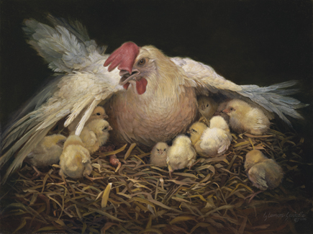
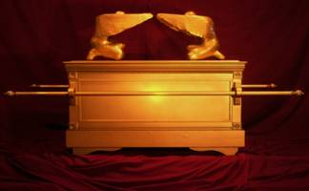
Covering Face/Feet
A protection from God’s full glory
“The multiple wings perhaps represent the protective veil that separates the Lord from mortals.
The ark of the covenant,… was adorned with cherubim similar to the seraphim, who had wings that spread over the mercy set upon the ark.
“If the ark was indeed a symbolic representation of the Lord and a place where He reveled Himself to His servants, then the cherubic wings would technically cover the Lord as He descended upon the seat of the ark, acting as a sort of barrier, or veil, between the Lord and His servants.”
Isaiah 6:2
(3)

Slide 7
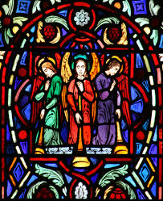
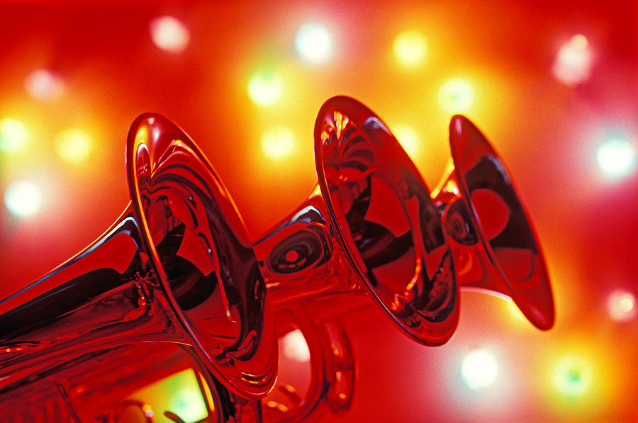
Holy, Holy, Holy
A Triumphant Praise
“The word ‘holy’ defines a person, object, or place that is dedicated or consecrated for a sacred purpose…
…repeated 3 times = most holy (a superlative grammatical form used in the Semitic languages)
“The manifestation of His glory is shown in His power and love for us.”
Isaiah 6:3
(3)

Slide 8
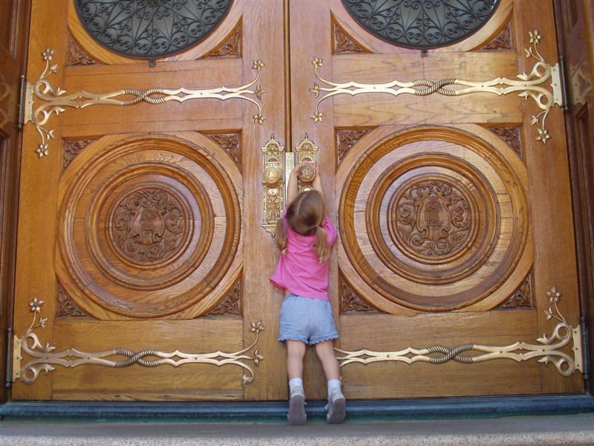
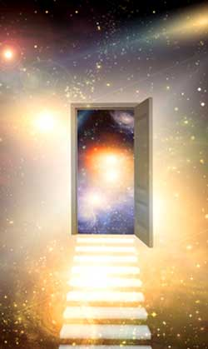
Posts of the Door Moved
Symbolic of the entrance that leads to God’s presence
…that ye might know the gate by which ye should enter. For the gate by which ye should enter is repentance and baptism by water; and then cometh a remission of your sins by fire and by the Holy Ghost.
2 Nephi 31:17
Our doors to heaven will include covenants, that we must all pass through in order to come into the presence of the Lord.
“We must keep ourselves pure to be able to pass through the doors of the heavenly kingdom.”
Isaiah 6:4
(3)

Slide 9


I Am Undone
Isaiah’s Fear of His Imperfections
Unclean lips—a feeling that one has not lived up perfectly
Everyone has strengths and weaknesses.
It’s wonderful that you have strengths.
And it is part of your mortal experience that you do have weaknesses.
God wants to help us to eventually turn all of our weaknesses into strengths,¹ but He knows that this is a long-term goal.
He wants us to become perfect,² and if we stay on the path of discipleship, one day we will. It’s OK that you’re not quite there yet. Keep working on it, but stop punishing yourself.
Isaiah 6:5
(4)

Slide 10
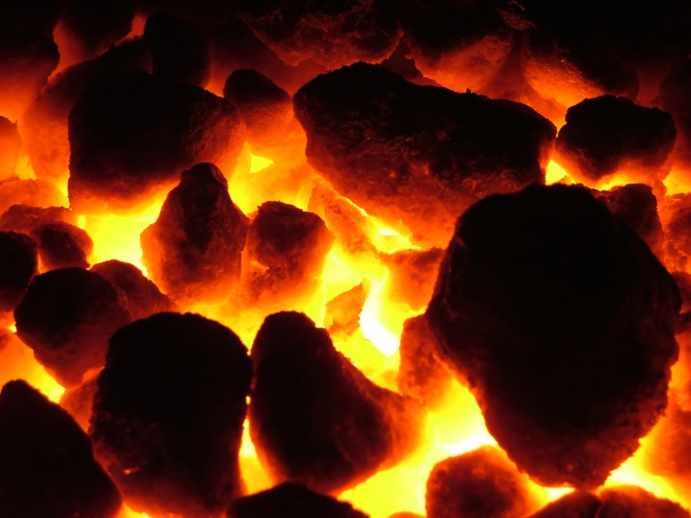
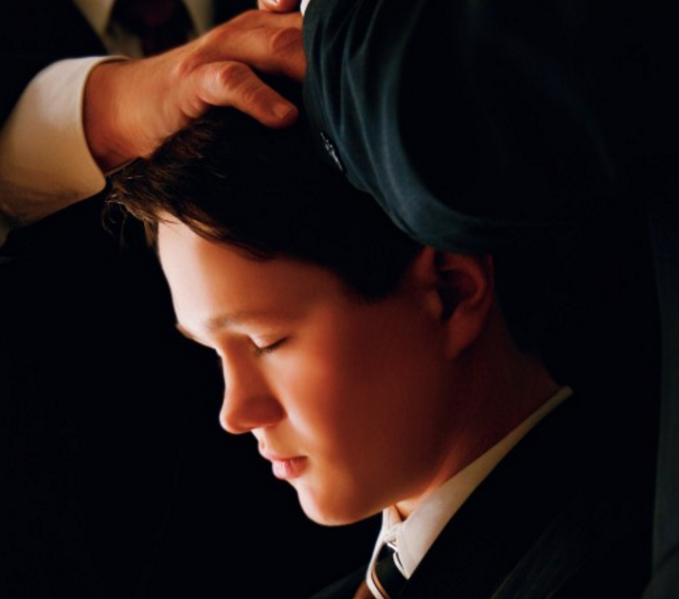
Purging of One’s Sins
Symbolic of the Atonement and the Holy Ghost
“Often it is when we undergo difficult and heated ordeals in life that we turn to the Lord and look to His counsel”
Hot coals = “The trials of fire”
Purging
Cleansing
Forgiveness
Isaiah’s lips embody his sin. His lips, or his words, are most essential to his calling as a prophet.
The Lord often strengthens men through overcoming their imperfections, making “weak things become strong unto them” (Ether 12:27).
Isaiah 6:6-7
(3)

Slide 11
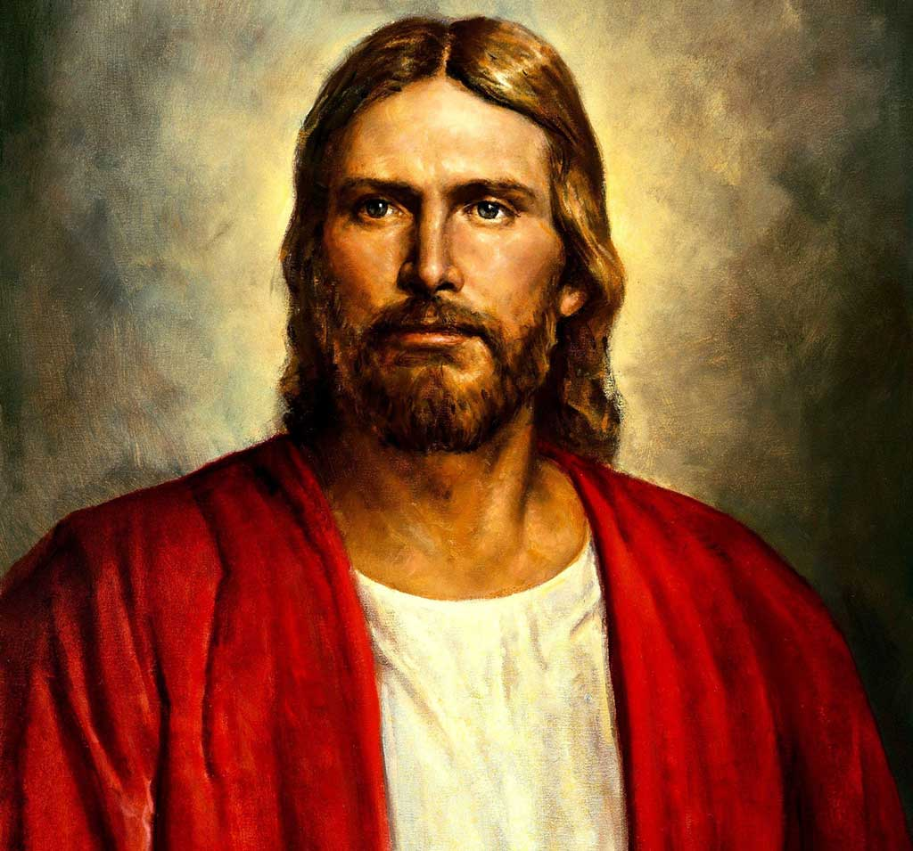
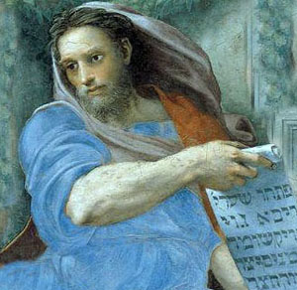
An Invitation
Isaiah is called to be a Prophet
And the Lord said: Whom shall I send? And one answered like unto the Son of Man: Here am I, send me. And another answered and said: Here am I, send me…
Abraham 3:27
Also I heard the voice of the Lord, saying, Whom shall I send, and who will go for us? Then said I, Here am I; send me.
Isaiah 6:8

Slide 12
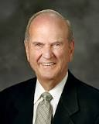
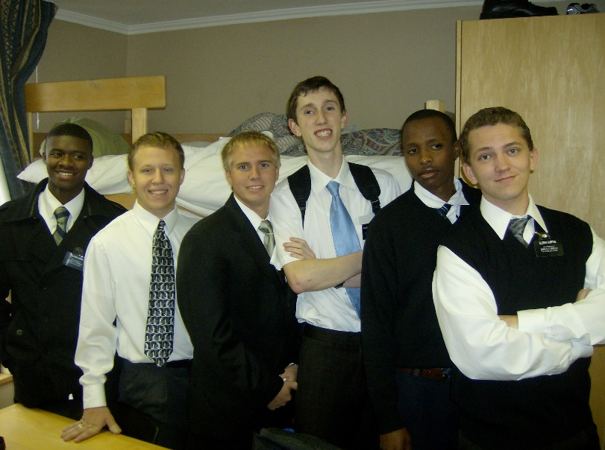
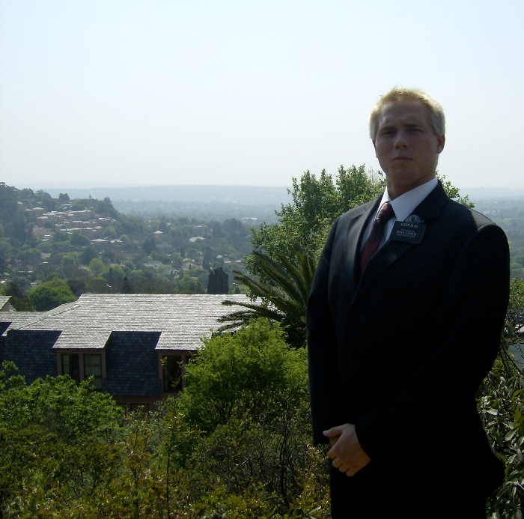
Therefore, if ye have desires to serve God ye are called to the work D&C 4:3
“A desire to serve is a natural outcome of one’s conversion, worthiness, and preparation.”
“Our young missionaries set aside their education, occupation, dating, and whatever else young adults would typically be doing at this stage of life. For 18 to 24 months they put it all on hold because of their deep desire to serve the Lord.”
(5)

Slide 13
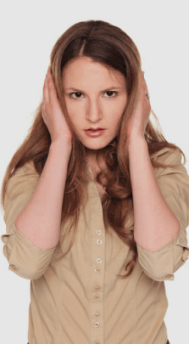
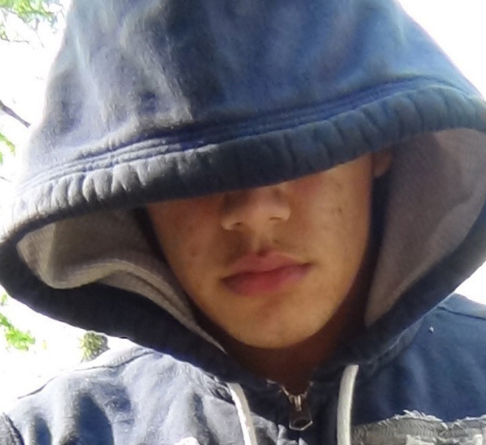
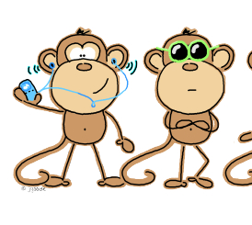
Isaiah’s Audience—Deaf and Blind
“shut their eyes”
“make their ears heavy”
Spiritually Blind:
“The Lord commands Isaiah to help the people perceive truth, but they refuse to see.”
Spiritually Deaf:
“The Lord tells Isaiah to preach to the people while telling them that they don’t (or won’t) understand.”
The Lord did not want the people to harden their hearts and become spiritually deaf and blind. Rather, the Lord’s words in verse 10 describe the people’s response to Isaiah’s preaching—they would choose not to listen.
The people claimed to hear and see, but they did not understand the spirit of the message.
Isaiah 6:9-10

Slide 14
Ahaz
He was the son of Jotham—who ruled in righteousness.
He began his reign at the age of 20 and ruled in wickedness
His name means possessor
He was the king of Judah in 730 and 720 BC
He was given to the life of idolatry and evil and corrupted the temple rites and subjected his own son to walk in fire (human sacrifice * see notes)
Isaiah was the prophet at that time and he said that Ahaz was like Ahab
The nation during his reign was vexed by the aggression of the alliance between Syria and the northern kingdom of Israel (under King Pekah)---the Lord commanded Isaiah to counsel him to be calm…and Isaiah prophesied of the coming Messiah, which Ahaz did not acknowledge
He made an alliance with the king of Assyria (Tiglath-pileser) and the consequences were devastating
(1)

Slide 15
What’s In A Name?
Isaiah
Isaiah’s wife
The Lord is salvation
Or
Jehovah saves
“prophetess” is used here only to designate the prophet’s wife, not a prophetic office or gift
Maher-shalal-hash-baz
Shear-jashub
To speed to the spoil (destruction)
Or
Destruction is imminent
The remnant shall return
The Lord commanded the prophet to give this name to his newborn son.
This is the longest proper name in the Bible, and in the Hebrew it has a meaning that was a message of warning to Judah.
He and Maher-shalal-hash-baz accompanied their father in visiting the king (Azaz)
Isaiah 7

Slide 16
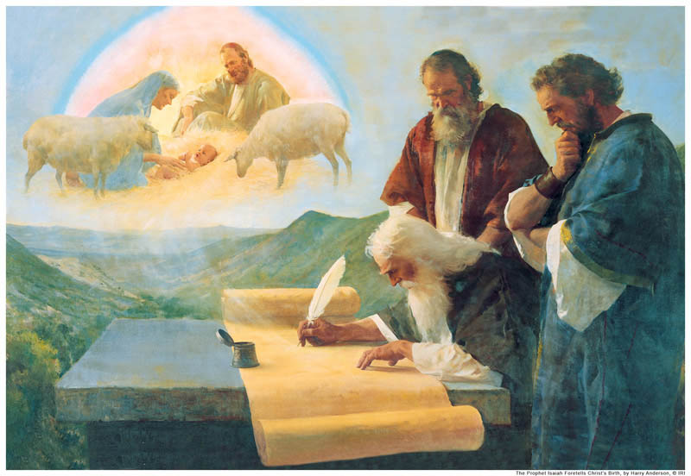
Son’s Names Were Signs
Their names represent three themes that are prevalent in Isaiah’s writings:
(1) the destruction the people would face if they persisted in wickedness,
(2) the eventual gathering of Israel back to the promised land and God’s covenant, and
(3) the power of Jesus Christ to save His people.

Slide 17
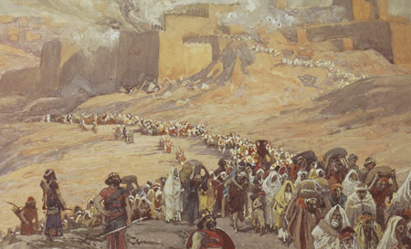
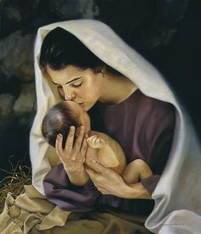
The Prophecies
Isaiah 6:11-13
Isaiah 7:14-16
Israel will be scattered and taken into captivity
A sign shall be given and a virgin will conceive the Son of God and call his name “Immanuel”
And shall come through humble circumstances
The House of Israel will survive and Christ will be born through this lineage

Slide 18
A Choice to Obedience or Rebellion
Isaiah 8: 13, 16-17
Isaiah 8:15
Sanctify
Fear—Reverence the Lord
Many will fall and get caught up with the worldly ways or have misplaced allegiances
Bind up
Secure your testimony and be witnesses for Christ

Slide 19
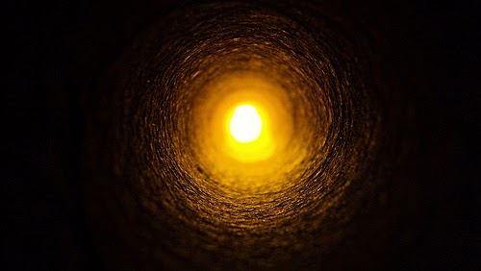
The Dark and the Light
Isaiah 8:22
Isaiah 9:2
Those who will not seek wisdom and truth will be driven into darkness (Assyrian take over)
There is no peace in the end for the unholy
Israel had seen the ‘light’
And repented for a short while during King Hezekiah’s reign and Isaiah’s preaching
Darkness represents wickedness and apostacy
Light represents Christs, who would bring peace and redemption from sin

Slide 20
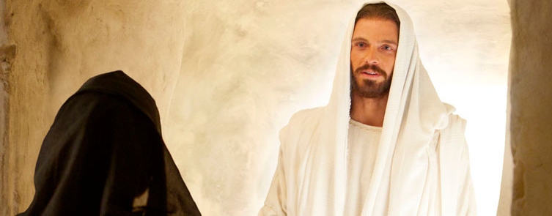
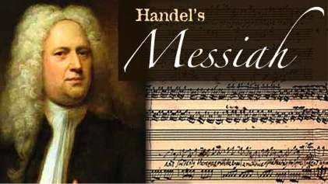
A Child is Given
Isaiah 9:6-7
Wonderful
Counsellor
The mighty God
The everlasting Father
The Prince of Peace
Christ’s mission to bring salvation to all who will receive Him as their Savor

Slide 21
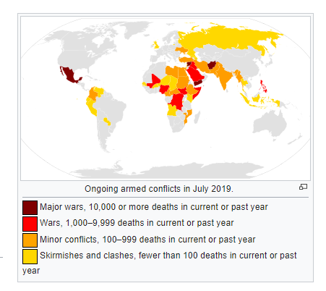
Wickedness-- Yesterday and Today
Isaiah 9:18-21
Isaiah 9:13-16
Isaiah is saying that the king is leading the people into wickedness
Burning—refers to both Isaiah’s time of the unrighteous 10 tribes and ell as the people in the latter days.
Some of our leaders today set bad examples on our own society and try to turn us away from the truth
The destruction will be so devastating that people will not help one another.
By the power of the Holy Ghost we can determine if we are being led astray
However, “His hand is stretched out still”.

Slide 22
His Hand is Stretched Out Still
One meaning may be that because the people of Isaiah’s time did not turn away from sin they would experience the Lord’s hand in the form of destruction.
Isaiah may have also been teaching that the Lord still offered hope for eventual mercy if the people would repent.
Justice
Mercy
The justice of God demands punishment for sin, but the Atonement brings about the plan of mercy to appease the demands of justice
If we repent, the Lord is willing to extend His mercy to us and forgive our sins
Isaiah 9:12–16

Slide 23

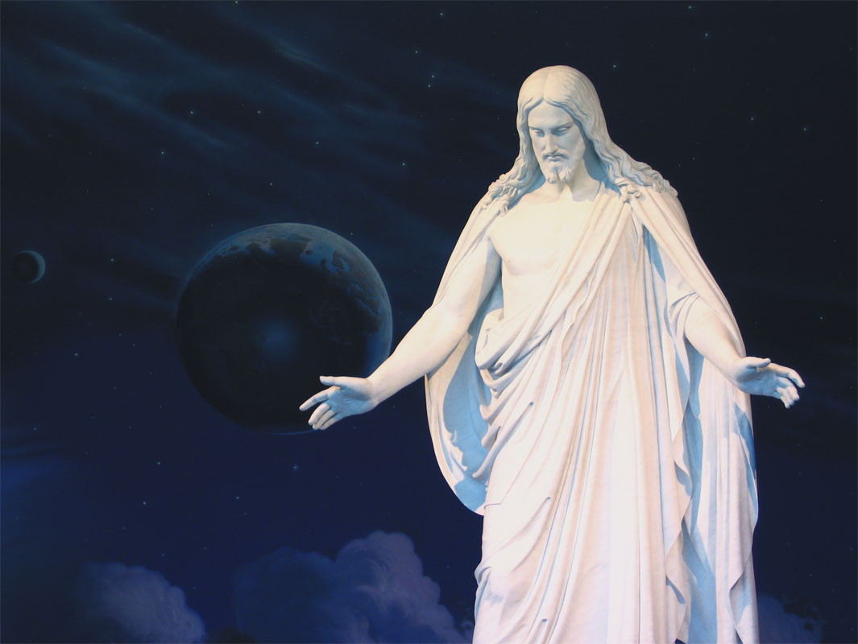
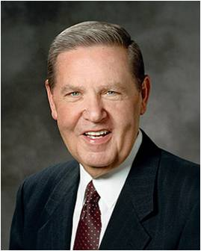
“To all of you who think you are lost or without hope, or who think you have done too much that was too wrong for too long, to every one of you who worry that you are stranded … , this conference calls out Jehovah’s unrelenting refrain,
‘[My] hand is stretched out still’
‘I shall lengthen out mine arm unto them,’
He said, ‘[and even if they] deny me; nevertheless, I will be merciful unto them, …
…if they will repent and come unto me; for mine arm is lengthened out all the day long, saith the Lord God of Hosts’.
His mercy endureth forever, and His hand is stretched out still. His is the pure love of Christ, the charity that never faileth, that compassion which endures even when all other strength disappear.
“I testify of this reaching, rescuing, merciful Jesus, that this is His redeeming Church based on His redeeming love.”
[Isaiah 5:25; 9:17, 21 2 Nephi 28:32 Moroni 7:46-47]

Slide 24
Sources:
Videos:
Repentance and Conversion (1:28)
Prophets in the Land Again (1:32)
Who’s Who in the Old Testament by Ed J. Pinegar and Richard J. Allen pp. 12-13, 182-83
Old Testament Institute Manual The Establishment of Zion (Isaiah 1-12)
Unlocking Isaiah in the Book of Mormon by Victor L. Ludlow pp. 115-116
Deiter F. Uchtodorf Forget Me Not October 2011 Gen. Conf.
Presentation by ©http://fashionsbylynda.com/blog/
Elder Russell M. Nelson Ask the Missionaries! They Can Help You! Oct. 2012 Gen. Conf.
Elder Jeffrey R. Holland (“Prophets in the Land Again,” Ensign or Liahona, Nov. 2006, 106–7).

Slide 25
Seraphims:
“In Hebrew the plural of seraph is seraphim or, as incorrectly recorded in the King James Version of the Bible, seraphims . Isaiah saw seraphim in vision and heard them cry one to another ‘Holy, holy, holy, is the Lord of hosts; the whole earth is full of his glory.’ ([JST], Isa. 6:1–8.)
The fact that these holy beings were shown to him as having wings was simply to symbolize their ‘power, to move, to act, etc.’ as was the case also in visions others had received. (D. & C. 77:4.)” (Bruce R. McConkie, Mormon Doctrine, pp. 702–3.) Old Testament Student Manual The Establishment of Zion (Isaiah 1-12)
Messiah
(HWV 56) is an English-language oratorio composed in 1741 by George Frideric Handel, with a scriptural text compiled by Charles Jennens from the King James Bible, and from the version of the Psalms included with the Book of Common Prayer. It was first performed in Dublin on 13 April 1742 and received its London premiere nearly a year later. After an initially modest public reception, the oratorio gained in popularity, eventually becoming one of the best-known and most frequently performed choral works in Western music.
Handel's reputation in England, where he had lived since 1712, had been established through his compositions of Italian opera. He turned to English oratorio in the 1730s in response to changes in public taste; Messiah was his sixth work in this genre. Although its structure resembles that of opera, it is not in dramatic form; there are no impersonations of characters and no direct speech. Instead, Jennens's text is an extended reflection on Jesus Christ as Messiah. The text begins in Part I with prophecies by Isaiah and others, and moves to the annunciation to the shepherds, the only "scene" taken from the Gospels. In Part II, Handel concentrates on the Passion and ends with the "Hallelujah" chorus. In Part III he covers the resurrection of the dead and Christ's glorification in heaven.
Handel wrote Messiah for modest vocal and instrumental forces, with optional settings for many of the individual numbers. In the years after his death, the work was adapted for performance on a much larger scale, with giant orchestras and choirs. In other efforts to update it, its orchestration was revised and amplified by (among others) Mozart. In the late 20th and early 21st centuries the trend has been towards reproducing a greater fidelity to Handel's original intentions, although "big Messiah" productions continue to be mounted. A near-complete version was issued on 78 rpm discs in 1928; since then the work has been recorded many times.
Wikipedia
To See the Lord:
Doctrine and Covenants 88:68
Therefore, sanctify yourselves that your minds become single to God, and the days will come that you shall see him; for he will unveil his face unto you, and it shall be in his own time, and in his own way, and according to his own will.
Doctrine and Covenants 93: 1
Verily, thus saith the Lord: It shall come to pass that every soul who forsaketh his sins and cometh unto me, and calleth on my name, and obeyeth my voice, and keepeth my commandments, shall see my face and know that I am;
Doctrine and Covenants 97:16
Yea, and my presence shall be there, for I will come into it, and all the pure in heart that shall come into it shall see God.
Ears Heavy and Shut eyes:
The command to “make the heart of this people fat, … their ears heavy, and shut their eyes” is used to describe the process of making the people accountable. The command, of course, refers to “their spiritual sight, spiritual hearing, and spiritual feeling.” (Keil and Delitzsch, Commentary, 7:1:200). “There is a self-hardening in evil. … Sin from its very nature bears its own punishment. … An evil act in itself is the result of self-determination proceeding from a man’s own will.” (Keil and Delitzsch, Commentary, 7:1:201). An individual cannot resist or reject the truth without eventually becoming spiritually hardened (see History of the Church, 4:264). Isaiah’s indictment of the kingdom of Judah was cited again in the New Testament to show that the people of that time were no different. The inability of many to understand the parables is a fulfillment of Isaiah’s prophecy (see Matthew 13:10–17; Luke 8:9–10). The significance of many of the miracles was also misunderstood (see John 12:37–41). The testimony of the Messiah and His Sonship was understood, at least in part, by the disciples, but it was rejected by others (see Luke 10:21–24).
The prophet Isaiah asked the Lord how long some men would be hardened against truth (v. 11); the answer—until mortal man no longer exists (see Isaiah 6:11a ).

Slide 26
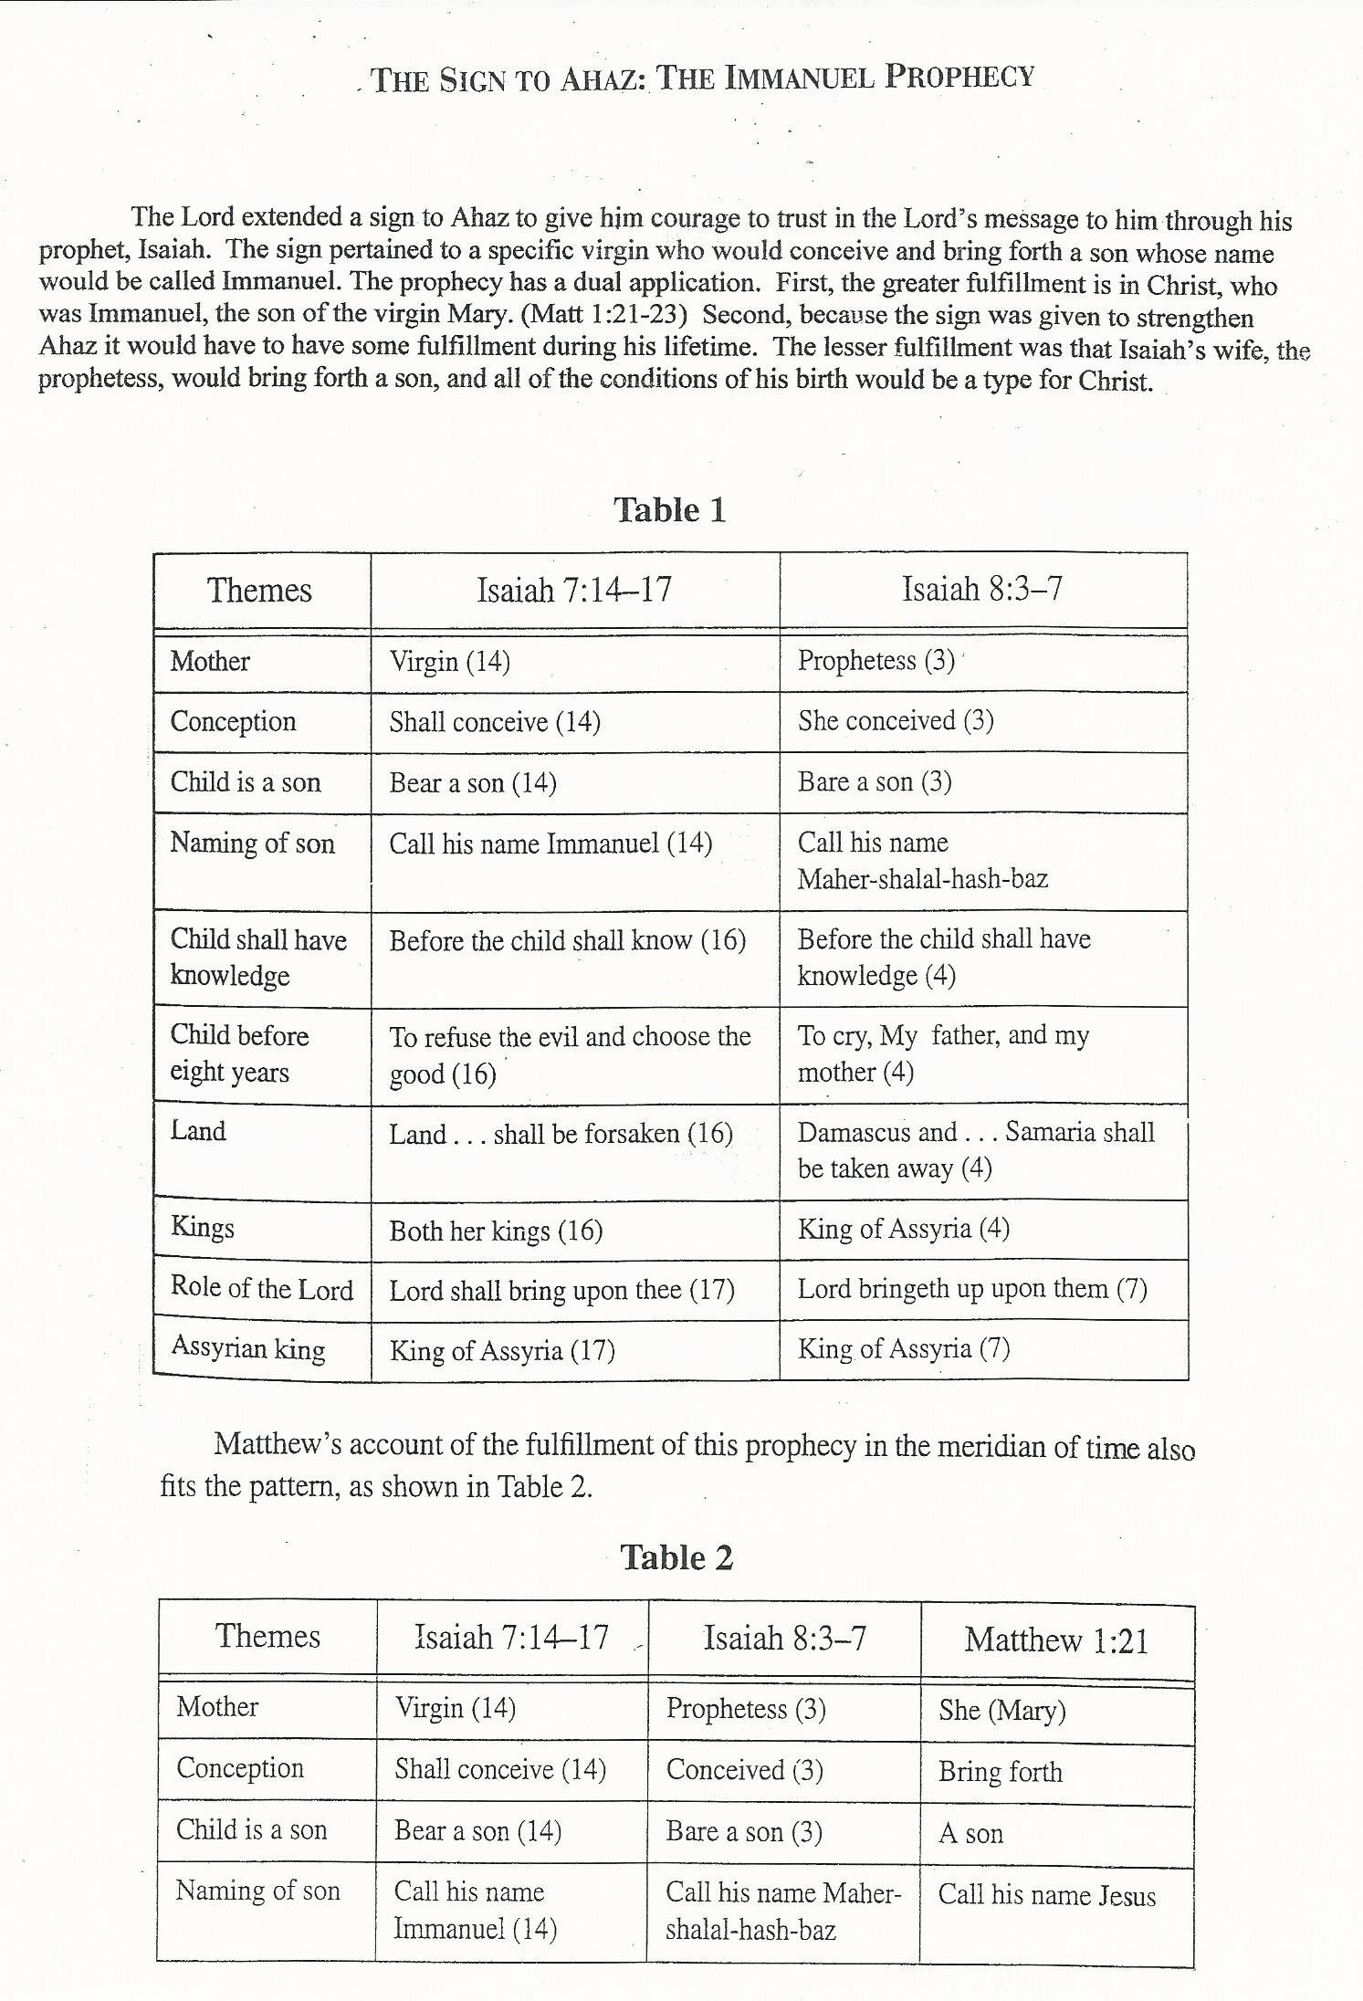
The Lord extended a sign to Ahaz to give him courage to trust in the Lord’s message through the prophet, Isaiah. The sign pertained to a specific virgin who would conceive and bring forth a son whose name would be called Immanuel.
The prophecy has a dual application:
First, the greater fulfillment is in Christ, who was Immanuel, the son of the virgin Mary. (Matt. 1:21-23)
Second, because the sign was given to strengthen Ahaz it would have to have some fulfillment during his lifetime.
The lesser fulfillment was that Isaiah’s wife, the prophetess, would bring forth a son, and all the conditions of his birth would be a type for Christ.
The sign to Ahaz:
The Immanuel Prophecy
Poway Institute Handout Becky Davies and Lesley Meacham

