Slide 1

Assyria, Babylon, and the
Second Coming of Christ
Isaiah 10-16
Behold, the days come, saith the Lord, that I will raise unto David a righteous Branch, and a King shall reign and prosper, and shall execute judgment and justice in the earth.
In his days Judah shall be saved, and Israel shall dwell safely: and this is his name whereby he shall be called, THE LORD OUR RIGHTEOUSNESS. Jeremiah 23:5-6

Slide 2

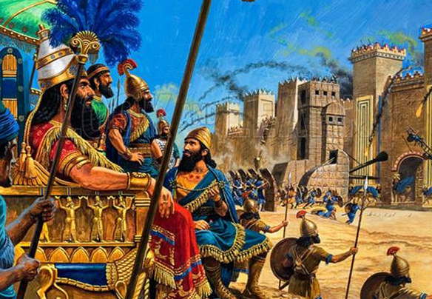
Woe
Misery, intense sorrow and suffering, distress, sadness, unhappiness, heartache, heartbreak, regret
What actions bring suffering?
The leaders and people of Israel had turned away from the Lord through their wickedness, they would be punished and not have the Lord’s help.
The Lord allowed the Assyrian army to be a tool to remind Israel of their broken covenants with God.
Isaiah describes the pride of the Assyrians king, which would be the downfall of Judah. (1)
Isaiah 10:1-4

Slide 3
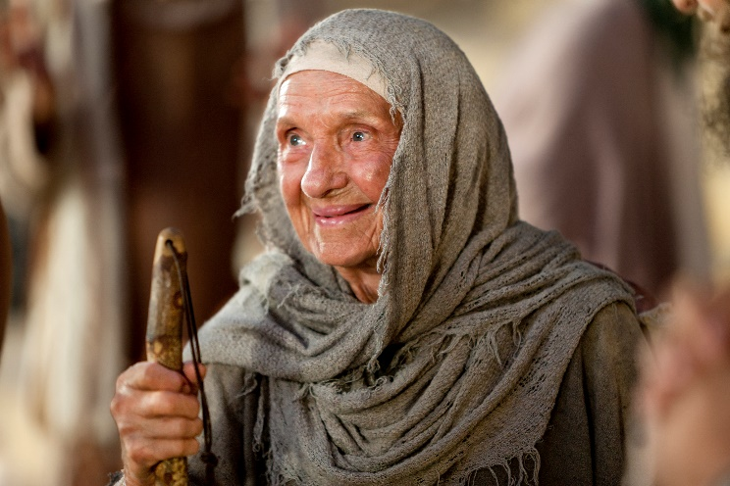
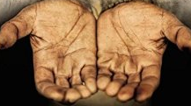
Israel Hardened Their Hearts Against The Poor
The Israelites repeatedly turned away “the needy from judgment” and took away “the right from the poor…that widows may be their prey, and that they may rob the fatherless”
This went against the counsel of the Lord given centuries earlier to the tribes of Israel.
If there be among you a poor man of one of thy brethren within any of thy gates in thy land which the Lord thy God giveth thee, thou shalt not harden thine heart, nor shut thine hand from thy poor brother:
For the poor shall never cease out of the land: therefore I command thee, saying, Thou shalt open thine hand wide unto thy brother, to thy poor, and to thy needy, in thy land.
Deuteronomy 15:7,11
Isaiah 10:2

Slide 4
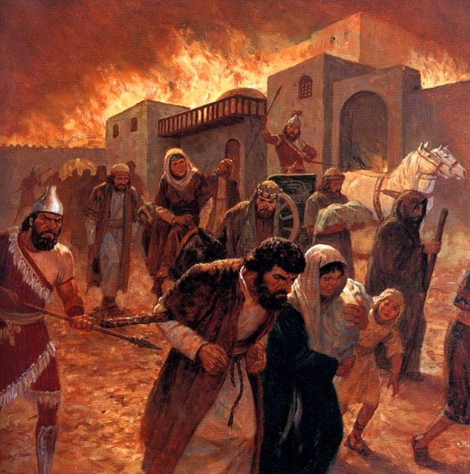
Who Would Be Punished?
Isaiah prophesied that after the Assyrians had fulfilled the Lord’s purposes in punishing Judah and the Northern Kingdom of Israel, the Lord would destroy the Assyrians as well because of their pride and wickedness.
This destruction is symbolic of the destruction the proud and wicked will experience at the Second Coming.
Isaiah 10:5-6

Slide 5
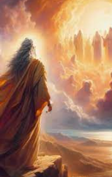
After the Destruction of Israel
Isaiah gave a prophecy concerning the destiny of Assyria lest anyone conclude that this heathen nation was righteous and noble because of its success against Israel and Judah.
The fulfillment of this detailed prophecy has been historically confirmed.
Isaiah mentioned some of the successful military campaigns of Assyria and prophesied of the eventual intrusion and success against Judah, even listing the names of many of the cities of Judah that would fall to Assyria.
The destruction both of Israel and of Assyria is described as complete.
The destruction of Israel and Assyria is also a type of the destruction of the wicked in any age and has its prophesied parallel even for the latter days.
Isaiah 10:7-19

Slide 6
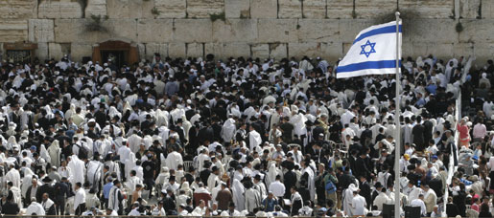
Jerusalem Spared
Isaiah foretold that the Assyrian army would destroy many cities as it marched toward Jerusalem; however, Jerusalem would be miraculously spared
Modern covenant Israel need not live in fear, even when these trials are at their doors because, “at the last minute,” the Lord will intervene and redeem covenant Israel. (2)
Therefore, dearly beloved brethren, let us cheerfully do all things that lie in our power; and then may we stand still, with the utmost assurance, to see the salvation of God, and for his arm to be revealed. D&C 137:17
Isaiah 10:20-34

Slide 7
Jesse
He was of the line of Judah’s son, (son of Leah and Jacob) Pharez, the elder of the twin sons of Judah with his former daughter-in-law Tamar (Genesis 29:32-35)
His name is pronounced yee-shaw-ee…which meant ‘to hold out, as in to extend
He was the grandson of Ruth (Ruth 4:18-22)
He was the son of Obed
He was from Bethlehem (1 Samuel 17:58)
He was the father of David, the boy who slayed Goliath and became King of Israel
Jesse became renowned throughout the land because of David’s heroic act
His direct line of descents leads to Christ (Matthew 1:5-6)

Slide 8
Ephraim
Fruitful
He was the younger of the two sons born to Joseph and Asenath, grandson of Jacob and Rachel
He would be the one to receive the birthright
When the aged Israel (Jacob) was about to give a blessing to Joseph’s sons, he place his hands in such a way as to favor Ephraim
He was given the birthright in Israel
He received a portion of Joseph’s land with prime and fertile regions
The Tribe of Ephraim had a colorful history marked at times by an envious nature concerning the other tribes
Ephraim is mentioned a number of times in the D&C and in connection with the Book of Mormon as the “stick of Ephraim” and also connected with the “rod” (connected with Joseph Smith) that should come forth “out of the stem of Jesse”
Ephraim is primarily responsible for conveying the truths of the gospel of Jesus Christ to all the world under provisions of the Abrahamic covenant
Ephraim is also mentioned in connection with the return of the ten tribes and the glorious blessings to be poured out upon Israel
Ishmael and his family were descendants of Ephraim (Book of Mormon)
v

Slide 9

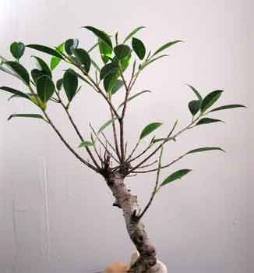

Stem of Jesse (Christ)
The Rod:
It is a servant in the hands of Christ, who is partly a descendant of Jesse as well as of Ephraim, or of the house of Joseph, on whom there is laid much power. D&C 133:4
Stem of Jesse= Most powerful part of tree providing support for the network of branches and twigs
Hebrew word for stump (Root word—geza)
Rod = shoot = A servant
Branch= a Great Leader among the Jews
Hebrew—natzar
Daniel 11:7
Jeremiah 23:5-6
Hosea 3:5
Isaiah 11:1 SEE D&C 113:1-6
2 Nephi 21:1

Slide 10
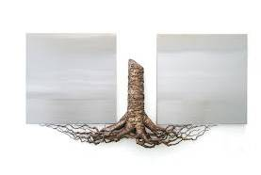
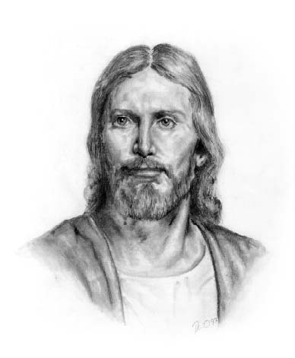
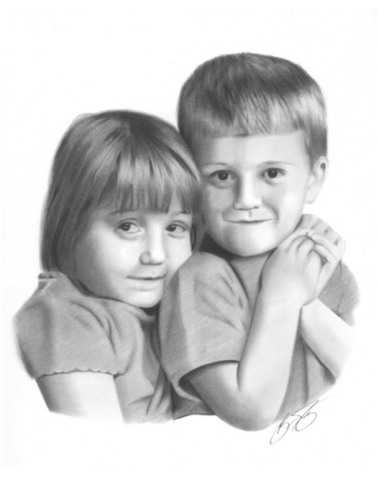
Faithful Followers
Branches and twigs symbolize His faithful followers that have developed from His care. We can be part of this network of branches if we choose to be grafted in through the ordinance of baptism and obedience to the commandments of God. (1)
Isaiah 11:1
2 Nephi 21:1

Slide 11
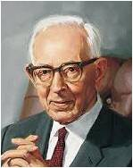
“It is Ephraim, today, who holds the priesthood. It is with Ephraim that the Lord has made covenant and has revealed the fulness of the everlasting gospel.
It is Ephraim who is building temples and performing the ordinances in them for both the living and for the dead.
When the ‘lost tribes’ come—and it will be a most wonderful sight and a marvelous thing when they do come to Zion—in fulfilment of the promises made through Isaiah and Jeremiah, they will have to receive the crowning blessings from their brother Ephraim, the ‘firstborn’ in Israel.” (3)

Slide 12
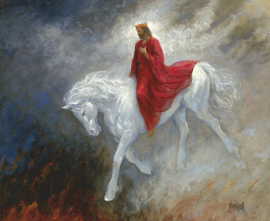
Joseph-an Ephraimite
Revelation given through Joseph Smith the Prophet, at Hiram, Ohio, November 3, 1831.
The Second Coming of the Messiah: He will stand on Mount Zion, the continents will become one land, and the lost tribes of Israel will return;
30. And they shall bring forth their rich treasures unto the children of Ephraim, my servants.
32. And there shall they fall down and be crowned with glory, even in Zion, by the hands of the servants of the Lord, even the children of Ephraim.
34. Behold, this is the blessing of the everlasting God upon the tribes of Israel, and the richer blessing upon the head of Ephraim and his fellows.
D&C 133:30-34

Slide 13
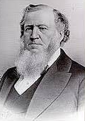
“It is the house of Israel we are after, and we care not whether they come from the east, the west, the north, or the south; from China, Russia, England, California, North or South America, or some other locality; and it is the very lad on whom father Jacob laid his hands, that will save the house of Israel.
The Book of Mormon came to Ephraim, for Joseph Smith was a pure Ephraimite, and the Book of Mormon was revealed to him, and while he lived he made it his business to search for those who believed the Gospel.” (4)

Slide 14
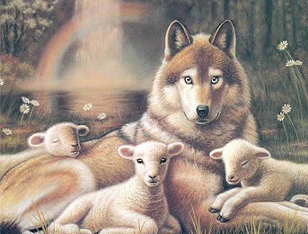


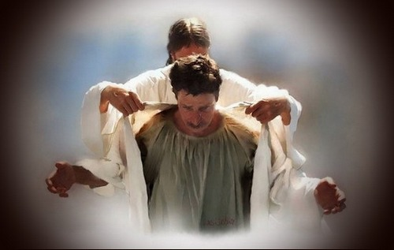
Conditions of the Millennium
A child will play with an asp and a cockatrice (possibly a lizard—traditionally is a mythical beast, essentially a two-legged dragon or serpent-like creature with a rooster's head)
Girdle of his loins (waist)
The righteous should strive to live their lives in purity and harmony…
The robes of righteousness
Animals will interact with each other
No longer will they prey or have to flee from their predator
The pure in heart and innocent will be the leaders of the converted wild ones.
“Isaiah is testifying that life will become as it was before the Fall.” (1)
Isaiah 11:5-8

Slide 15


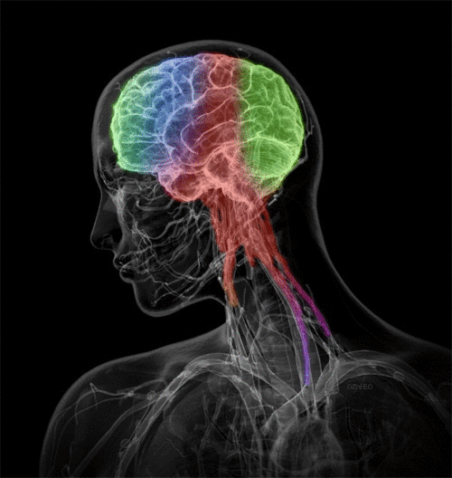
The Earth Full of Knowledge
They shall not hurt nor destroy in all my holy mountain; for the earth shall be full of the knowledge of the Lord as the waters cover the sea.
Wherefore, the things of all nations shall be made known; yea, all things shall be made known unto the children of men.
There is nothing which is secret save it shall be revealed; there is no work of darkness save it shall be made manifest in the light; and there is nothing which is sealed upon the earth save it shall be loosed.
Wherefore, all things which have been revealed unto the children of men shall at that day be revealed; and Satan shall have power over the hearts of the children of men no more, for a long time. And now, my beloved brethren, I make an end of my sayings.
Isaiah 11:5-9 2 Nephi 30:15-18

Slide 16
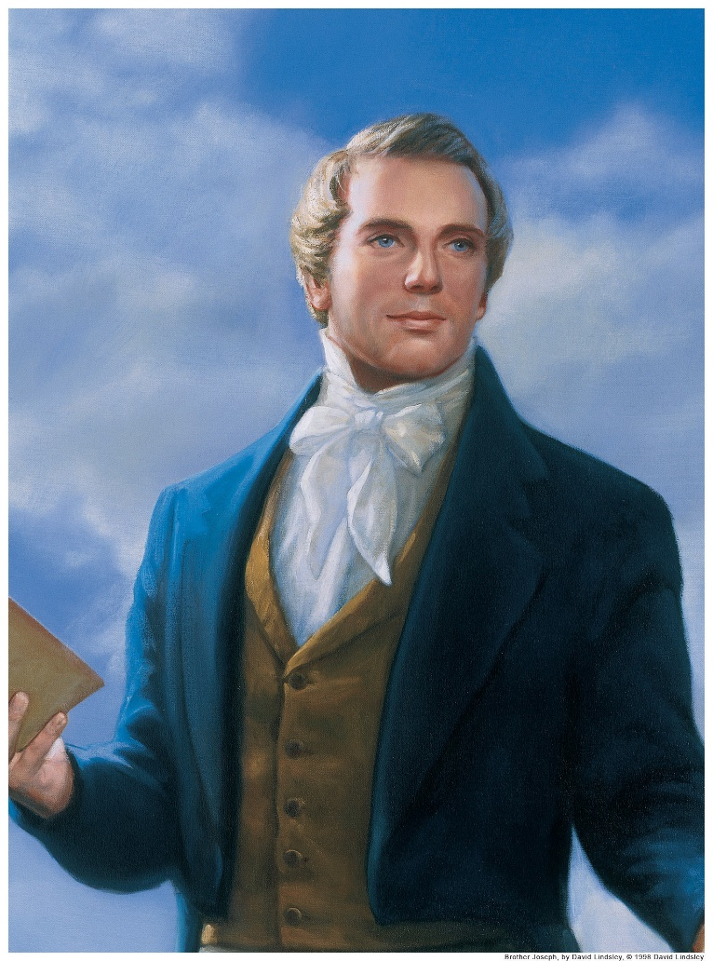
An Ensign
A flag or banner that an army may sometimes gather under or march behind
The Root is generally understood to be the Prophet Joseph Smith
Another great servant of the Lord, a ‘root of Jesse’ would come forth when the true knowledge of God and His truths were missing form the earth, and he would ‘stand for an ensign of the people.’
Joseph Smith filled both requirements:
He was a rightful heir of the priesthood and was given all the keys of the kingdom throughout his life as part of the restoration of all things.
See D&C 86:8-10
Isaiah 11:11
(1)

Slide 17
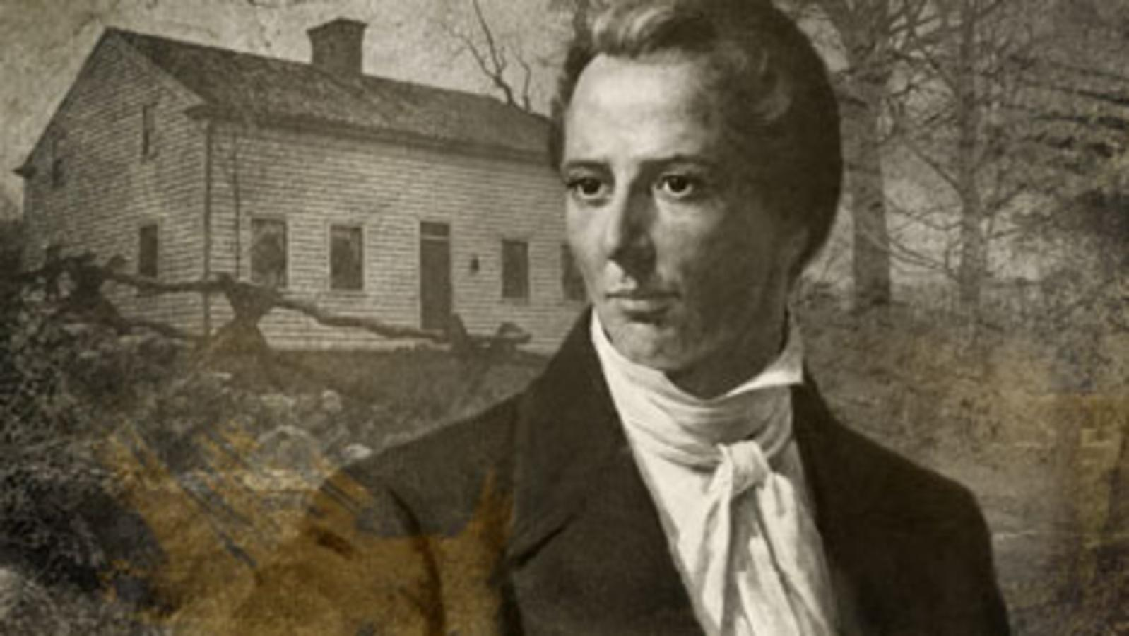
The Standard
The Gospel of Jesus Christ so that all will see
And even so I have sent mine everlasting covenant into the world, to be a light to the world, and to be a standard for my people, and for the Gentiles to seek to it, and to be a messenger before my face to prepare the way before me. D&C 45:9
Isaiah 11:10
(1)

Slide 18
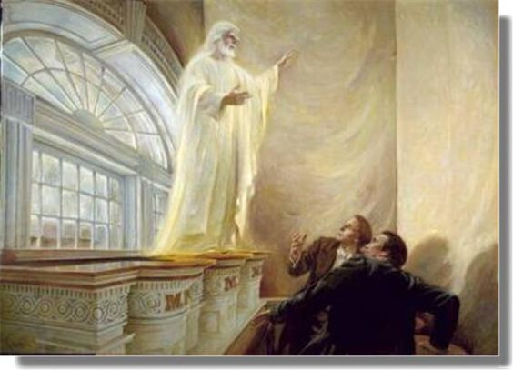
Set His Hand the Second Time
The first gathering of Israel occurred about 6 centuries before Isaiah’s time when Moses led the Israelite people out of Egyptian captivity (Exodus 12-14)
The second gathering began on April 3, 1836, a week after Joseph Smith dedicated the Kirtland Temple.
On this Sunday, many prophets of previous dispensations appeared to Joseph and bestowed upon him necessary keys for the building of the kingdom of God. One set of keys that Joseph Smith received that day were the “keys of the gathering of Israel.”
(D&C 110:11)
Isaiah 11:11-12
(1)

Slide 19
The Gathering
Three important events were to transpire:
He shall set up an ensign for the nations;
He shall assemble the outcasts of Israel;
He shall gather together the dispersed of Judah from the four corners of the earth. (5)
The restored Church is an ensign to gather scattered Israel back to the gospel of Jesus Christ
And marveled how it was that he had obtained an inheritance in that kingdom, seeing that he had departed this life before the Lord had set his hand to gather Israel the second time, and had not been baptized for the remission of sins.
D&C 137:6
Isaiah 11:11-12

Slide 20
Ephraim and Judah Gather Together
Ephraim represented the tribe of Israel—the more dominant tribe
The kingdom of Judah represented those who split from Israel after the death of King Solomon
“The latter-day gathering of Israel within the gospel of peace will result in a healing reunion of all members of the house of Israel.” (2)
Isaiah 11:13-16

Slide 21
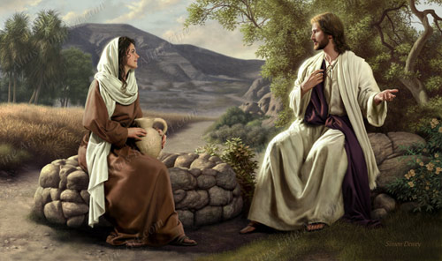
The Wells of Salvation
Water
It gives life
It sustains
It saves
Whosoever drinketh of this water shall thirst again:
But whosoever drinketh of the water that I shall give him shall never thirst; but the water that I shall give him shall be in him a well of water springing up into everlasting life.
John 4:13-14
Isaiah 12

Slide 22
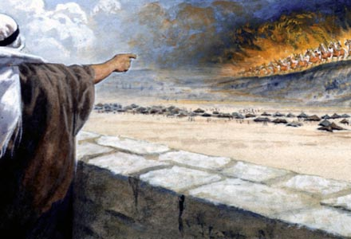
Babylon
The destruction of Babylon to the destruction of the wicked at the Savior’s Second Coming.
Babylon refers generally to the wickedness of the world.
Isaiah prophesied that ‘great destruction’ would come upon the wicked in Babylon and in the last days.
The Burden of Babylon—The message of doom (weighty judgments )
Lift ye up a banner—standard around which armies gather
Gates of the Nobles—Often represent the entire city—or the proud
My sanctified ones—Saints
I’ll be your host---”Lord of Hosts” = “Lord of Sabaoth” = title of Jehovah = hosts were armies of Israel…also angelic armies of heaven
Isaiah 13-14
2 Nephi 23:1-4

Slide 23
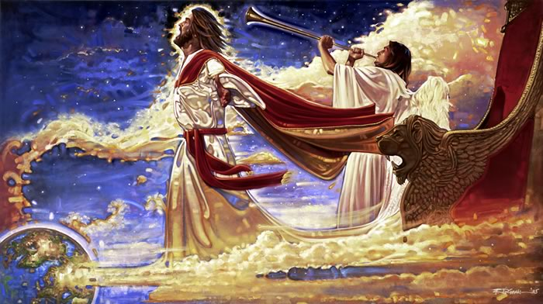
When the Lord comes again, He will destroy the wicked
When the Lord comes again, He will be merciful to His people and give them rest
Satan will loose his influence and power over mankind, and he will be cast out forever
Isaiah 13-14

Slide 24

Sources:
Video:
By Small and Simple Things: Sharing the Gospel (3:19)
Victor L. Ludlow Unlocking Isaiah in the Book of Mormon p. 155, 168, 171-173
John Bytheway Isaiah for Airheads p. 137, 142
President Joseph Fielding Smith (Doctrines of Salvation, 3:252–53).
Presentation by ©http://fashionsbylynda.com/blog/
4. President Brigham Young (In Journal of Discourses, 2:268–69.)
5. Elder LeGrand Richards (A Marvelous Work and a Wonder, pp. 207–9)
Presentation by ©http://fashionsbylynda.com/blog/

Slide 25
Descendants of Ephraim:
Are we amiss in saying that the prophet here mentioned is Joseph Smith, to whom the priesthood came, who received the keys of the kingdom, and who raised the ensign for the gathering of the Lord’s people in our dispensation? And is he not also the “servant” in the hands of Christ, who is partly a descendant of Jesse as well as of Ephraim, or of the house of Joseph, on whom there is laid much power” (D&C 113:4–6)?
Elder Bruce R. McConkie (The Millennial Messiah: The Second Coming of the Son of Man [1982], 339–40)
Ensign:
Over 125 years ago, in the little town of Fayette, Seneca County, New York, the Lord set up an ensign to the nations. It was in fulfilment of the prediction made by the Prophet Isaiah…. That ensign was the Church of Jesus Christ of Latter-day Saints, which was established for the last time, never again to be destroyed or given to other people [see Daniel 2:44]. It was the greatest event the world has seen since the day that the Redeemer was lifted upon the cross and worked out the infinite and eternal atonement. It meant more to mankind than anything else that has occurred since that day. President Joseph Fielding Smith (Doctrines of Salvation, comp. Bruce R. McConkie, [1955], 3:254–55)
Ensign:
In a scriptural context an ensign, or a standard, is a flag around which people would gather in a unity of purpose. In ancient times a standard served as a rallying point for soldiers in battle. Symbolically speaking, the Book of Mormon and the restored Church of Jesus Christ are standards to all nations. (See Guide to the Scriptures, “Ensign,” Gospel Library.)
Without a doubt, one of the great standards of these latter days is this magnificent general conference, where the great work and plan of our Heavenly Father “to bring to pass the immortality and eternal life of man” (Moses 1:39) is continually proclaimed. (“That Our Light May Be a Standard for the Nations,” Ensign or Liahona, May 2017, 125)

Slide 26
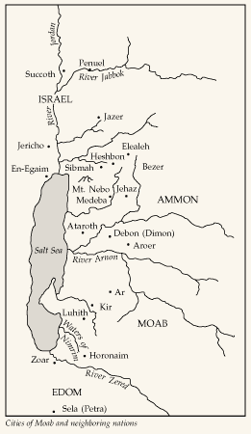
Moab was the eldest son of Lot’s older daughter (see Genesis 19:37). His people settled east of the Dead Sea from the Zered River northward. The Moabites were cousins of the Israelites; but there was continual strife between them, and the Lord used them as His chastening rod against Israel.
Nevertheless, lest Israel feel that the wickedness of the Moabites was preferred before the Lord, Isaiah revealed the Moabites’ destiny in these two chapters.
Isaiah promised that some day the Lord would remember His covenants with Israel and gather them from the world and establish His covenant with them forever, while Moab would receive the sentence of destruction.
In this sense Moab was also a symbol for the wicked world, and none of her powerful cities nor her lucrative trade routes nor her prominence among her sister nations would be able to stand in that day, but all would be destroyed.
The cry of destruction of Moab is universal, even beyond her borders to Eglaim (En-Eglaim) northwest of the Salt Sea. To show the extent of the tragedy that Moab would experience, Isaiah prophesied that the heart of the rich pastoral land around Dibon would have its waters (called Dimon) stained with the blood of the people. In other words, there would be widespread slaughter and destruction of the people, the enemy penetrating even the very heart of Moab.
In the Hebrew text, the word translated “lion” is actually a single lion. Isaiah revealed that the relationship of Judah and Moab would change, for the “lion,” Judah, would come upon the remnant of Moab that was spared and make them her vassal.
The nations of the earth who are likened to Moab are high and mighty forces but will be brought to howl and mourn. Their defenses will come to naught, their wealth and abundance of food will fail, and in place of their joy, as they suppose, they will be pierced with sorrow to the center. At that day all the world will finally come to understand that wickedness never was happiness.
Although Moab was Israel’s bitter enemy, Isaiah still wept over the great tragedy of her sin and resulting destruction within three years.
Old Testament Institute Manual A Voice of Warning to the Wicked
Isaiah 15-16

Slide 27
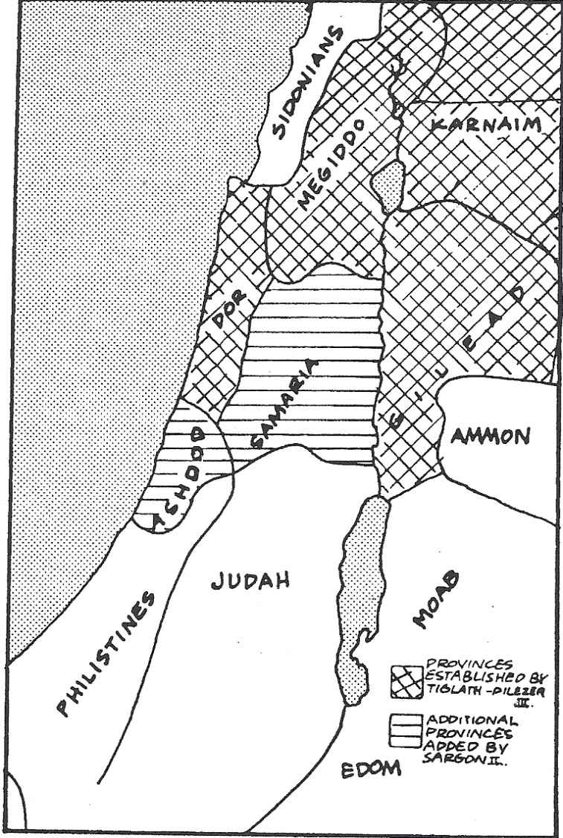
The wicked will bow down (vs. 1-4)
B. Assyria raised by the Lord (5)
C. The Assyrian king speaks against Jerusalem (6-11)
D. The Lord will punish proud Assyria (12-14)
E. An ax is used as a tool (15)
F. The Lord is a burning fire in the land (16-17)
G. Out of all the (multitudes)—only a remnant returns (18-19)
H. A remnant of Israel shall return to the Lord (20-21)
G. Out of the ‘sand of the sea’—only a remnant returns (22)
F. A divine consumption is in the land (23)
E. A rod is used as an instrument (24-26)
D. Assyria’s yoke will be lifted (27)
C. Assyrian army approaches Jerusalem (28-32)
B. Assyria humbled by the Lord (33)
A. The haughty will be cut down (34)
Chiasmus Isaiah 10:1-34/2 Nephi 20 Victor Ludlow
Assyrian Provinces in Palestine

Slide 28
Isaiah 10: The destiny of Assyria
Immediately after the prophecy of the destruction of Israel, Isaiah gave a prophecy concerning the destiny of Assyria lest anyone conclude that this heathen nation was righteous and noble because of its success against Israel and Judah. The fulfillment of this detailed prophecy has been historically confirmed. Isaiah mentioned some of the successful military campaigns of Assyria (see v. 9) and prophesied of the eventual intrusion and success against Judah, even listing the names of many of the cities of Judah that would fall to Assyria (see vv. 28–32). The destruction both of Israel and of Assyria is described as complete (vv. 15–19). The destruction of Israel and Assyria is also a type of the destruction of the wicked in any age and has its prophesied parallel even for the latter days. Old testament Institute Manual The Establishment of Zion
Joseph Smith, An Ensign:
“In the little town of Fayette, Seneca County, New York, the Lord set up an ensign to the nations. It was the fulfillment of the prediction made by the Prophet Isaiah…that ensign was the Church of Jesus Christ of Latter-day Saints, which was established for the last time, never again to be destroyed or given to other people. It was the greatest event the world has seen since the day that the Redeemer was lifted upon the cross and worked out the infinite and eternal atonement. It meant more to mankind than anything else that has occurred since that day.”
Joseph Fielding Smith Doctrines of Salvation 3:254-55
The Gathering:
“When speaking of Israel, most people have the Jews in mind, and when referring to the gathering of Israel, they have in mind the return of the Jews to the land of Jerusalem. It should be remembered that the Jews, the descendants of Judah, represent but one of the twelve branches, or tribes, of the house of Israel—the family of Jacob.” Elder LeGrand Richards(A Marvelous Work and a Wonder, pp. 207–9).
The Animals during the Millennium:
And in that day the enmity of man, and the enmity of beasts, yea, the enmity of all flesh, shall cease from before my face. D&C 101:26
“All animals shall mingle together in peace, and the appetites of the carnivorous beast shall be changed so that the grass of the field becomes the common diet of the animal world” Elder Bruce R. McConkie Mormon Doctrine p. 496
“Six animals are listed: 3 wild carnivores: Wolf, Leopard, Lion that feed on 3 tame animals: lamb, kid, calf.
The wild animals, which are ferocious, aggressive, and vicious, are a threat to mankind; the tame animals are docil, submissive, and useful to man. This passage may be taken literally; or the wolf, leopard, and lion may represent those who foment war and murder; the lam, kid, and calf may symbolize meek and peaceful people.” (Parry, Understanding Isaiah , 119) found in Isaiah for Airheads by John Bytheway p. 140
Water: Isaiah 12
“It was water from a Bethlehem well for which David in the wilderness longed. To appreciate his desire, one needs to know what thirst in the wilderness means, and also be acquainted with the cool water of Bethlehem wells and cisterns….The men of Bethlehem boast of their cool water. One man was given a drink, but expressed a longing for water out of his father’s vineyard, saying that it was so cold that he couldn’t drink an entire glassful without taking it away from his lips at least three times.
Fred H. Wight: (manners and Customs of the Bible Lands, 281
The Earth During the Millennium:
“There will be no place of ignorance, no place of darkness, no place for those that will not serve God, Why?
Because Jesus…will be himself on the earth,
and His holy angels will be on the earth,
and all the resurrected Saints that have died in former dispensations…will be on the earth.
What a happy earth this creation will be, when this purifying process shall come, and the earth be filled with the knowledge of God as the waters cover the great deep! What a change!
Orson Pratt
Warnings to Babylon:
The Lord showed through these burdens that the world too would be brought to judgment. Here, as in the previous chapters, Isaiah often used dualism to prophesy simultaneously to his own people and to us in modern times. Though chapters 13–23 were given to nine different nations, giving them notice that the divine timetable for their repentance had run out and that they were to reap the judgments of God, each nation was also a symbol of the modern world. You may feel a spirit of doom associated with the condition and future of Babylon and the other nations, but you should also realize that ancient Babylon with its evil and judgment was a shadow and a type of present-day Babylon, or the world. It is to present-day Babylon that Isaiah delivered the sharpest warnings. Old Testament Institute Manual A Voice of Warning to the Wicked (Isaiah 13–23)

Slide 29
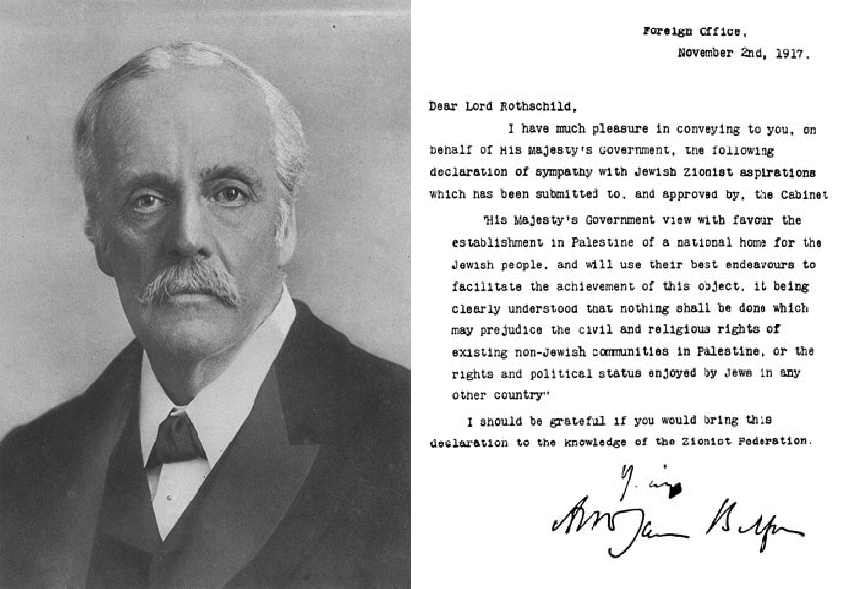
It’s a Start
The Balfour Declaration (dated 2 November 1917) was a letter from the United Kingdom's Foreign Secretary Arthur James Balfour to Walter Rothschild, 2nd Baron Rothschild, a leader of the British Jewish community, for transmission to the Zionist Federation of Great Britain and Ireland.
It read:
His Majesty's government view with favour the establishment in Palestine of a national home for the Jewish people, and will use their best endeavours to facilitate the achievement of this object, it being clearly understood that nothing shall be done which may prejudice the civil and religious rights of existing non-Jewish communities in Palestine, or the rights and political status enjoyed by Jews in any other country.
The text of the letter was published in the press one week later, on 9 November 1917.The "Balfour Declaration" was later incorporated into both the Sèvres peace treaty with the Ottoman Empire, and the Mandate for Palestine. The original document is kept at the British Library.
The declaration was in contrast to the McMahon-Hussein correspondence, which promised the Arab independence movement control of the Middle East territories "in the limits and boundaries proposed by the Sherif of Mecca" in exchange for revolting against the Ottoman Empire.
The issuance of the Declaration had many long lasting consequences, and was a key moment in the lead-up to the Israeli–Palestinian conflict, often referred to as the world's "most intractable conflict"
Purpose: Confirming support from the British government for the establishment in Palestine of a "national home" for the Jewish people

Slide 30
The Lord Gathers His Forces Isaiah 13:1-5
Scripture | Phrases | Isaiah’s Day | Second Coming
Isaiah 13:1 | Burdon of Babylon | The Destruction of Babylon—a prophecy | Destruction of the wicked
Isaiah 13:2 | The Banner on the High Mountain | A standard around which armies gather | A standard or ensign being lifted up in the last days as a “banner” to which the world may gather (Temple Image)
Isaiah 13:2 | Shake the Hand | Beckon those to return to the gospel | Inviting others to come out of the world
Isaiah 13:2 | Gates of the nobles | The entire city and the proud | Those who have lifted themselves up through the worldly pleasures
Isaiah 13:3 | Sanctified Ones | “saints” those who are valiant and repentant | Those who are clean through the blood of the atonement
Isaiah 13:4 | Multitude | Great people who come together | The Saints who will be gathered from every nation in the last days and enlisted in the army of the living God to wage war against wickedness
Isaiah 13:4 | Be Your Host | The Hosts were the armies of Israel | The angelic armies of Heaven “Sabaoth” Bible Dictionary
Isaiah 13:5 | Noise/ Multitude/ mountains | The righteous who will gather together | The many who are preparing to preach the gospel of peace by being in the temple. The righteous from all nations including the angels and Christ
Ideas taken from scriptures, Old Testament Institute Manual IA Voice of Warning to Israel, John Bytheway Isaiah for Airheads, Poway Institute Handouts Becky Davies and Lesley Meacham

Slide 31
The Lord Brings His Power Against (Spiritual) Babylon Isaiah 13:6-13
Scripture | Phrases | Isaiah’s Day | Second Coming
Isaiah 13:6 | The day of the Lord | Days of Judgment | Days of Judgment
Isaiah 13:7 | Heart[s] shall melt | Men’s hearts will fail them | Men’s hearts will fail them…sorrow, pain, suffering, terror
Isaiah 13:8 | Faces shall be as flames | Faces flushed with shame and guilt | Faces witnessing the burning at the Second Coming
Isaiah 13:9 | Wrath and fierce anger | God’s justice doing His work. The wrath of God will come upon the people of that day enough to become a desolate land | The Lord’s judgments come only after repeated invitations to repent are ignored
Isaiah 13:10 | Stars/sun/moon and no light | The darkness in the people | Great wonders to be manifest in the heavens (D&C 45:42)
Isaiah 13:11 | Arrogance/ Haughtiness Ceases | The Lord will “level the playing field” | It is better to learn to “be humble” than to be humbled”
Isaiah 13:12 | More Precious Than Gold | Gold comes from a purifying process that burns away all dross and what is left is incorruptible, pure, and valuable | The righteous men will become as difficult to find as precious gold and will be treasured as highly. Many will be destroyed, righteous and evil
Isaiah 13:13 | Heavens be shaken and Earth removed | calamity and disaster—the fall of Babylon | All things are to be restored. The heavens will flee as the earth is brought back to a condition it once enjoyed. The earth will then receive its paradisiacal glory.
Ideas taken from scriptures, Old Testament Institute Manual IA Voice of Warning to Israel, John Bytheway Isaiah for Airheads, Poway Institute Handouts Becky Davies and Lesley Meacham

Slide 32
The Lord Brings the Medes against (Physical) Babylon Isaiah 13:14-22
Scripture | Phrases | Isaiah’s Day | Second Coming
Isaiah 13:14 | Chased roe and fleeing sheep | A hunted deer…they run swiftly when frightened. A sheep with no shepherd | The wicked will run away to hide, and will have no one to guide them
Isaiah 13:15-16 | Thrust through and fall by the sword/ children and wives destroyed | Medes as a weapon of war against physical Babylon…the week and defenseless will be massacred | The destruction of Satan’s army/ Babylon of the latter days and destroy its proud, its wicked, and its confederates
Isaiah 13:19 | When God overthrew Sodom and Gomorrah | The greatest cities were completely destroyed overnight | The Second Coming will also come where cities will be destroyed quickly, either by man or the Lord
Isaiah 13:20-22 | Doleful creatures/ wild beasts | The wild beasts that remain in the once great city They are some type of howling animal (jackel, owl, or wild dogs) | After the destruction beasts may roam the cities and terrorize the inhabitants
Isaiah 13:22 | I will be merciful unto my people | The only ray of hope in a rather dismal prophecy | Christ will reign again on the earth and peace will remain for 1,000 years
Ideas taken from scriptures, Old Testament Institute Manual IA Voice of Warning to Israel, John Bytheway Isaiah for Airheads, Poway Institute Handouts Becky Davies and Lesley Meacham

Slide 33
The Lord Will Restore Covenant Israel Isaiah 14:1-3 “Taunt Song” Isaiah 14:7-20
Fill in your own interpretation
Scripture | Phrases | Isaiah’s Day | Second Coming
Isaiah 14:1-3 | Israel set in their own land
Isaiah 14:7 | A Rest Hymn
Isaiah 14:8 | No More Deforestation | Forrest or tree = people
Isaiah 14:9-10 | Do all former world leaders wind up in hell?
Isaiah 14:11 | Worms Cover Thee
Isaiah 14:12 | How art thou fallen
Isaiah 14:12-16 | Lucifer, son of the morning
Isaiah 14:17 | Opened not the house of his prisoners
Isaiah 14:18 | Lie in glory…in his own house
Isaiah 14:19-20 | Thou art cast out of thy grave

Slide 34
The Fate of those who follow Lucifer Isaiah 14:21-23 And The Fall of Palestina
Fill in your own interpretation
Scripture | Phrases | Isaiah’s Day | Second Coming
Isaiah 14:21 | Prepare slaughter for his children…that they do not rise
Isaiah 14:22 | Cut off
Isaiah 14:23 | Possession for the bittern
Isaiah 14:25 | The Assyrian in my land
Isaiah 14:25 | His yoke depart from off them | Removed from the covenant
Isaiah 14:29 | Palestina | Philistia—a kingdom west of Judah and Israel
Isaiah 14:29 | Rejoice not
Isaiah 14:30 | Lie down in safety
Isaiah 14:30 | I will kill thy root
Isaiah 14:31 | Smoke | Dust kicked up by invading armies
Isaiah 14:31 | None shall be alone

Slide 35
Avoiding the Trap of Sin
“We must be alert because small choices can bring great consequences.
What may appear to be of little importance, such as going to bed late, not praying for a day, skipping fasting, or breaking the Sabbath—such little slips—will make us lose sensitivity little by little, allowing us to do worse things.
Often, becoming prey to sin starts with someone choosing friends whose standards are not consistent with the gospel; and in order to be popular or to be accepted by peers, the person then compromises gospel principles and laws, going down a path that will bring only pain and sadness to this person and to his or her loved ones.
We must be alert not to let sin grow around us. Forms of sin are everywhere—even, for example, in a computer or cell phone. These technologies are useful and can bring great benefits to us. But their inappropriate use—such as involvement in time-wasting games, programs that would drive you to carnal pleasure, or much worse things such as pornography—is destructive. Pornography destroys character and makes its user sink in the quicksand of filth, out of which the person can escape only with much help.
This terrible monster causes pain and suffering both to the user and to his or her innocent children, spouse, father, and mother.”
2010 Oct. Gen. Conf. by Jairo Mazzagardi

