Slide 1

The Savior, A Sure Foundation
Isaiah 24-28

Slide 2

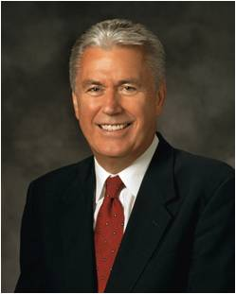

What Happened?
But as time went on, he kept track of the children and began to notice an interesting correlation: the children who could not wait struggled later in life and had more behavioral problems, while those who waited tended to be more positive and better motivated, have higher grades and incomes, and have healthier relationships.
(1)

Slide 3
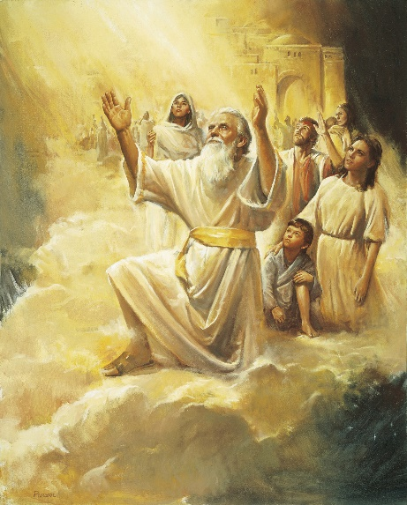
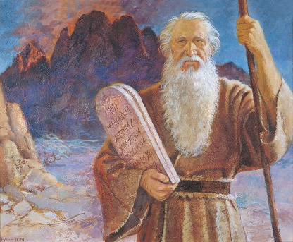
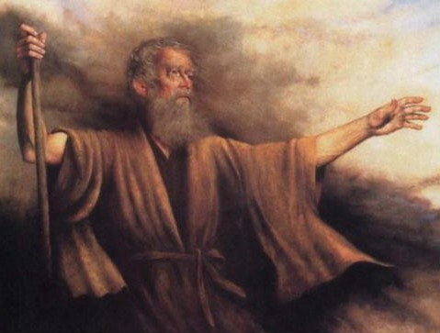
Search the Revelations of Seers and Prophets
Study the prophecies
They are they who saw the mysteries of godliness
They saw the flood before it came
They saw angels ascending and descending upon a ladder that reached from earth to heaven
They saw the stone cut out of the mountain, which filled the whole earth
They saw the son of God come from the regions of bliss and dwell with men on earth
They saw the deliverer come out of Zion, and turn away ungodliness from Jacob
They saw the glory of the Lord when he showed the transfiguration of the earth on the mount
They saw every mountain laid low and every valley exalted when the Lord was taking vengeance upon the wicked
They saw truth spring out of the earth, and righteousness look down from heaven in the last days, before the Lord came the second time to gather his elect
They saw the end of wickedness on earth, and the Sabbath of creation crowned with peace;
(2)

Slide 4
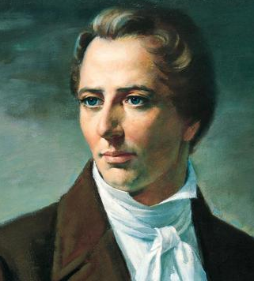
Prophets Saw The Second Coming
They saw the end of the glorious thousand years, when Satan was loosed for a little season
They saw the day of judgment when all men received according to their works, and they saw the heaven and the earth flee away to make room for the city of God, when the righteous receive an inheritance in eternity
“And, fellow sojourners upon earth, it is your privilege to purify yourselves and come up to the same glory, and see for yourselves, and know yourselves.”
(2)

Slide 5
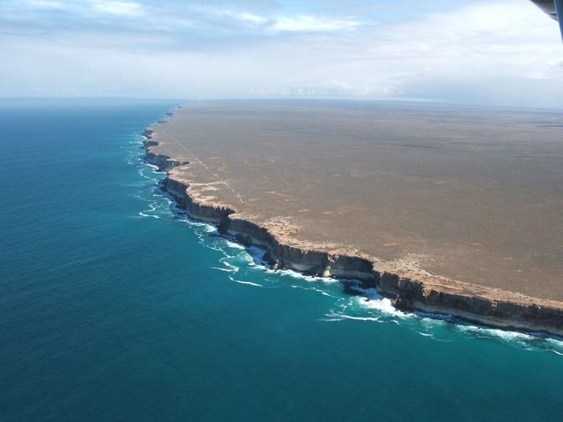
Empty Earth
Could Be Used for Apostasy Today
The inhabitants will be scattered abroad because they have defiled the earth.
Isaiah 24:1

Slide 6
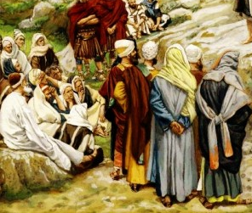
Priests—the Religious Leaders
Of all Faiths
“…we discover a like calamity awaiting priests and people, rich and poor, bond and free, insomuch that they are all to be burned up but a few; and the complaint is that the earth is defiled under the inhabitants thereof,…” (4)
Isaiah 24:2

Slide 7
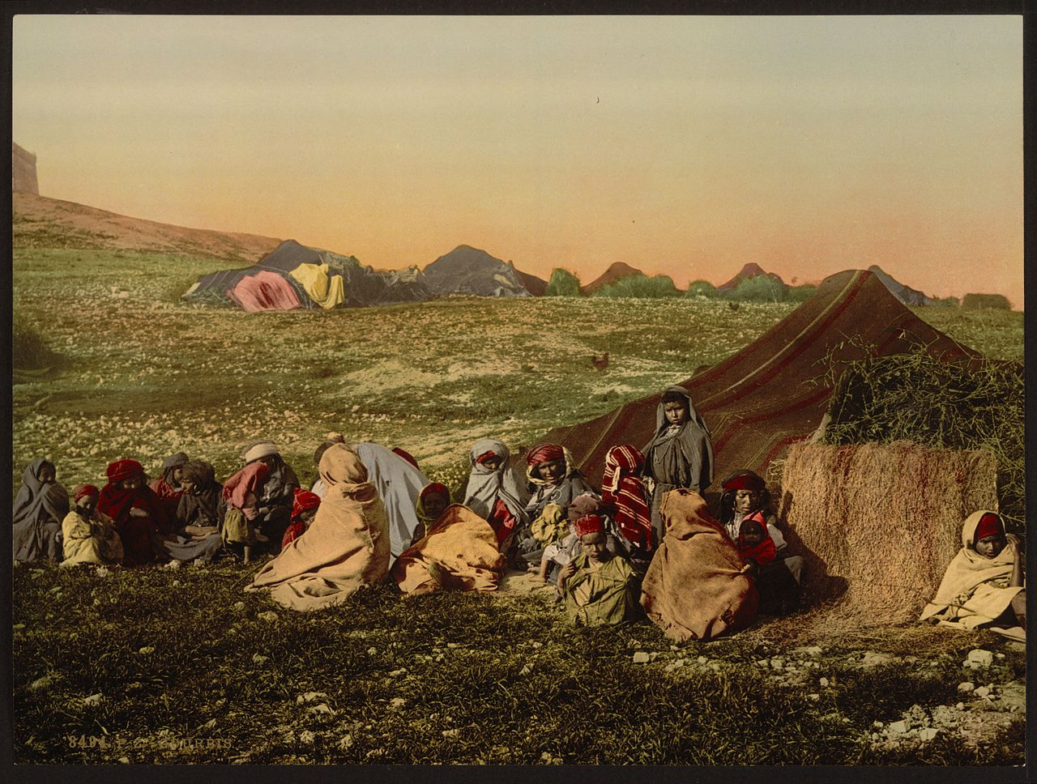
Isaiah 24
Could Be Used for Apostasy Today
They have transgressed the laws
They have changed the ordinance
They have broken the everlasting covenant
“Therefore, the covenant was no longer in effect. As a result, the Lord withdrew his spirit from his people and left them desolate. They became wanderers and strangers in strange lands, for the Lord scattered his people among all the nations of the earth-a tragic testimony that the guardians of the covenant had failed to keep faith with the Lord their God.” (3)
Isaiah 24:5

Slide 8
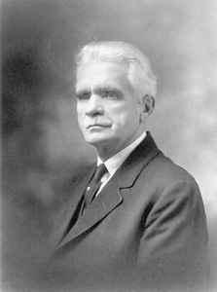
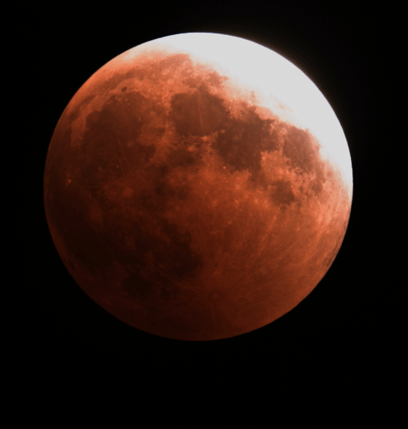
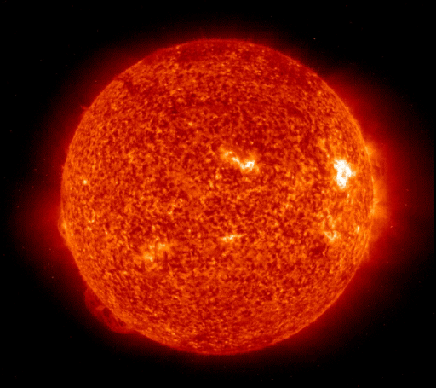
Results of Apostasy
The punishment decreed for breaking God’s everlasting covenant is to be burned with fire. These verses describe the great mourning that will accompany the destruction.
“Clearly all this prophecy of Isaiah's has not yet been fulfilled; for the earth, however much it may have been defiled under the inhabitants thereof, has not yet been burned, and but few men left. That is a judgment that still hangs over the world; and will come upon it as sure as the Lord has spoken the word; …
In other words, they have broken the Gospel covenant-departed from the Gospel faith-hence the predicted judgment.” (5)
“The moon will be confounded and the sun will be ashamed because the brilliance which attends Christ in His return to earth will be a “superior light,” one which will make all else seem dark by comparison.” (6)
Isaiah 24:6-23

Slide 9
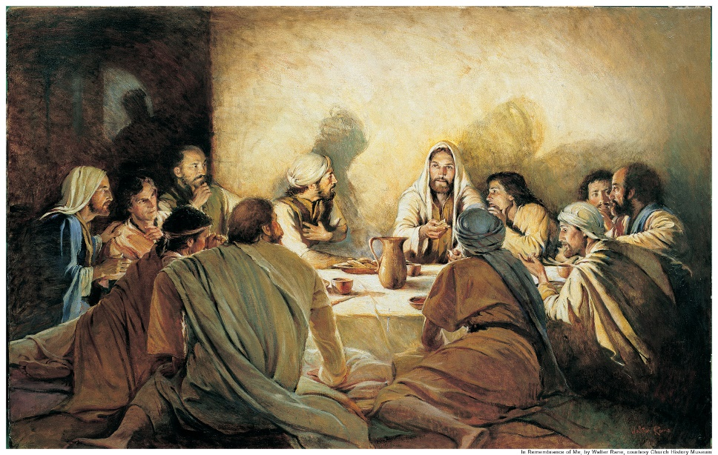
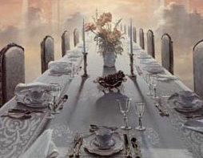
Burst of Hymn
Because the Lord would finally come and reign in Zion and Jerusalem
At the Last Supper, the Savior promised his disciples, "I will not drink henceforth of this fruit of the vine, until that day when I drink it new with you in my Father's kingdom.”
The Master was referring to the great Millennial feast when the Lord makes a great and terrible feast. It is great for the saints who will sup at his table, feasting both temporally and spiritually on "fat things" and "wines on the lees well refined."
The Second Coming will be a time of great rejoicing that follows “much tribulation.”
A great “feast of fat things” will also attend the Lord’s return, meaning that men will feast upon the fruits of the gospel until they are full.
Isaiah 25: 1-11 Matthew 26:29 D&C 58:3-4,8

Slide 10
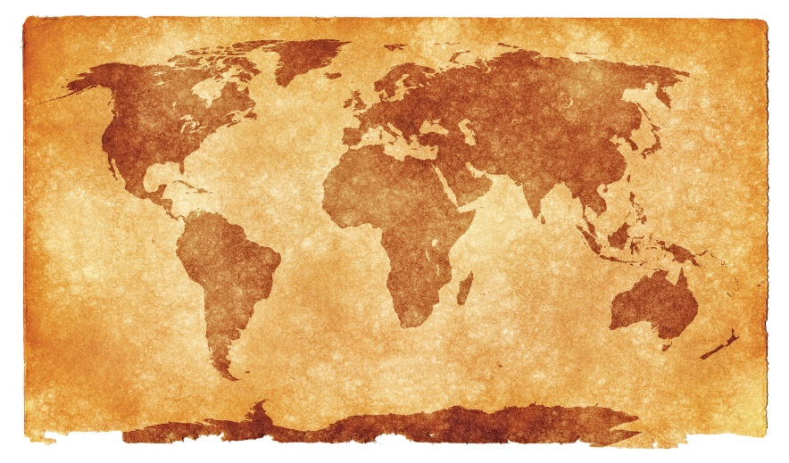
Symbolic Feast
People of all nations will be invited to partake of the blessings of the gospel.
Isaiah 25:6-12

Slide 11
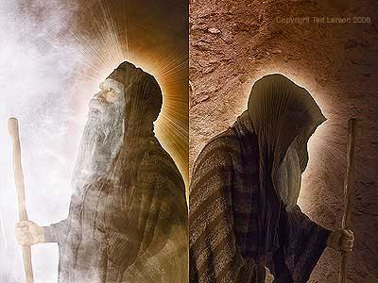
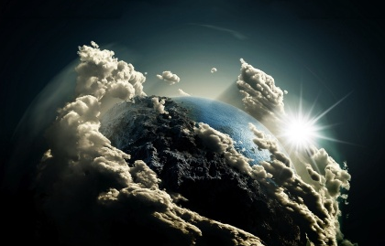
Dark Veil Over the Earth
“the vail that is spread over all nations”
This veil may be the “dark veil of unbelief” which characterizes those of the latter days who reject the gospel.
Or, it could be a more literal “veil of darkness,” such as that described in Moses 7:61 when the heavens shall be darkened and “shall shake, and also the earth.”
But great joy will also follow, for the time will come when “the Lord God will wipe away tears from off all faces.”
This figure is used twice in the book of Revelation and obviously represents a millennial condition.
Isaiah 25:7-8 Alma 19:6 Ether 4:15 Moses 7:61 Revelation 7:17; 2:4

Slide 12
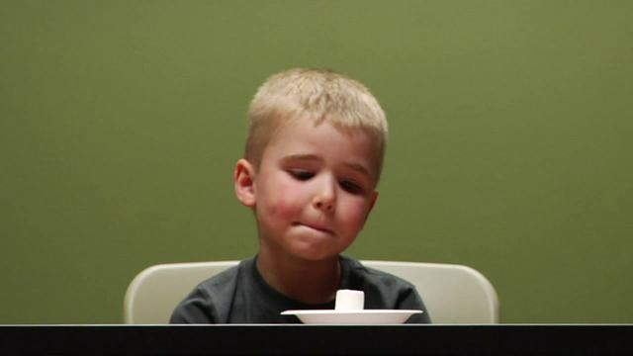
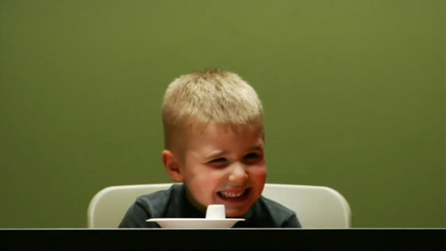
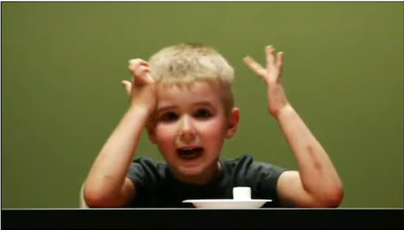
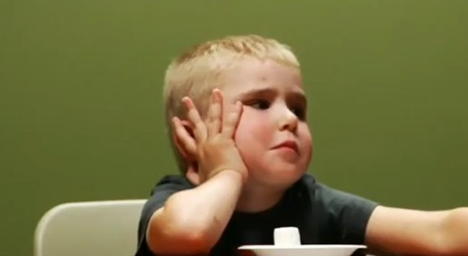
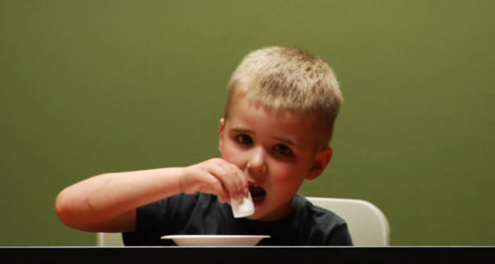
The Marshmallow Experiment
In the late 1960s and early 1970s a professor conducted an experiment in which he showed three- to five-year-old children a marshmallow.
He told them that they could eat that one marshmallow right away, or they could get two marshmallows if they waited 20 minutes.
He then left the children alone and watched what happened behind a two-way mirror.
Some of the children ate the marshmallow immediately; some could wait only a few minutes before giving in to temptation.
Only 30 percent were able to wait.

Slide 13
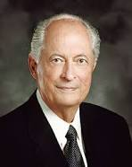
“In the scriptures, the word wait means to hope, to anticipate, and to trust.
To hope and trust in the Lord requires faith, patience, humility, meekness, long-suffering, keeping the commandments, and enduring to the end.”
Isaiah 25:6-12
(7)

Slide 14

What Do We Need to Wait For?
Faith
Revelation
Answers to prayers
Physical or spiritual healing
Help in overcoming temptation
Marriage and children
Answers to question we struggle with
Testimony
Isaiah 25:6-12
(7)

Slide 15
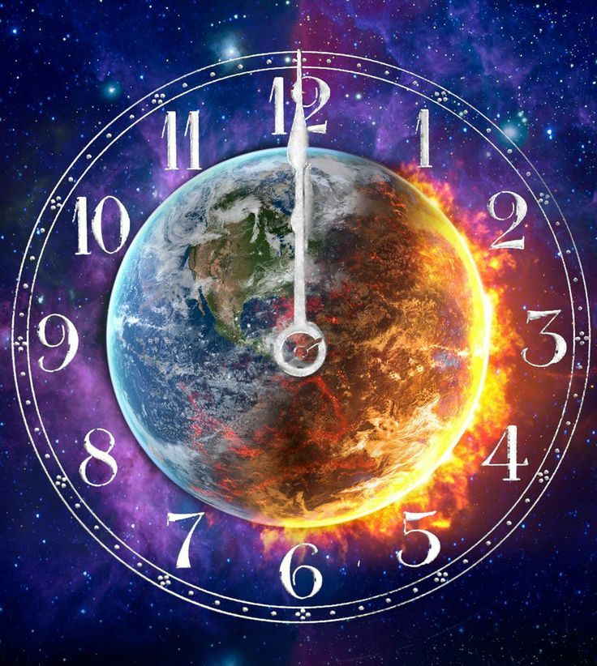
A Psalm
In that day shall this song be sung in the land of Judah
The day when the Lord humbles the haughty and "the lofty city" is an apocalyptic day.
The day when "the inhabitants of the world" learn righteousness is a millennial day.
The day when the Lord only has dominion is a millennial day.
The day when the wicked "poured out a prayer when thy chastening was upon them" was an apocalyptic day.
The day when "dead men shall live" is a millennial day.
The day when "the Lord cometh out of his place to punish the inhabitants of the earth for their iniquity" is an apocalyptic day.
Isaiah 26:1, 5, 9, 13, 15, 21
(8)

Slide 16
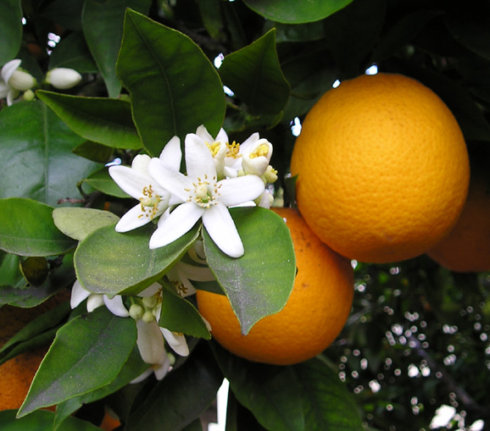
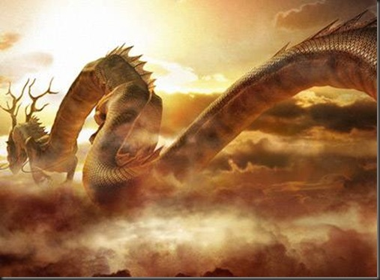
Leviathan, Dragon, and Serpent
When Israel is restored, she “shall blossom and bud, and fill the face of the world with fruit.”
That fruit is the gospel of peace.
At the same time the Lord “shall punish leviathan the piercing serpent, … and he shall slay the dragon.”
Both dragon and serpent are scriptural terms for Satan, the common enemy of God and all mankind.
Leviathan probably includes not only Satan personally but all who serve him. In other words, what Isaiah saw is the necessary destruction of Babylon, or the world, before Zion can be fully established.
Isaiah is so taken with the joy of that future day that he couches his words in a hymn of praise.
Isaiah 27:1-9 Revelation 12:9
(9)

Slide 17
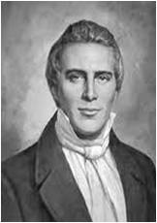
Try to climb the ladder by skipping four rungs at a time
“It is not wisdom that we should have all knowledge at once presented before us; but that we should have a little at a time; then we can comprehend it.
“When you climb up a ladder, you must begin at the bottom, and ascend step by step, until you arrive at the top; and so it is with the principles of the gospel—you must begin with the first, and go on until you learn all the principles of exaltation.”
The Lord reveals truth to us precept upon precept and line upon line
Isaiah 28:13
(3)

Slide 18
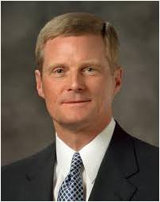
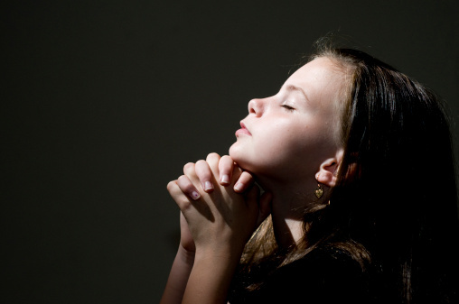

“….Let me suggest that many of us typically assume we will receive an answer or a prompting to our earnest prayers and pleadings.
And we also frequently expect that such an answer or a prompting will come immediately and all at once.
Thus, we tend to believe the Lord will give us A BIG ANSWER QUICKLY AND ALL AT ONE TIME.
However, the pattern repeatedly described in the scriptures suggests we receive ‘line upon line, precept upon precept,’ or in other words, many small answers over a period of time.
Recognizing and understanding this pattern is an important key to obtaining inspiration and help from the Holy Ghost.”
GET IT NOW!
(10)

Slide 19
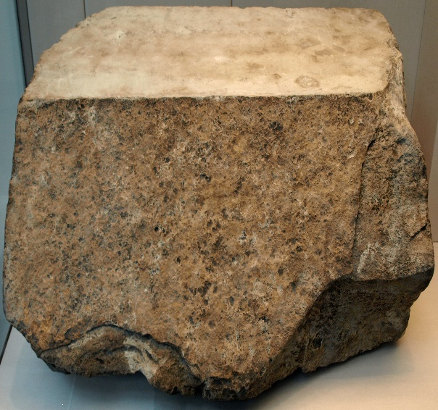
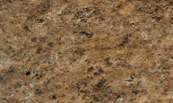
Zion for a foundation as stone, a tried stone, a precious corner stone, a sure foundation
Isaiah declares that faith in God is the only secure foundation of Zion’s security, and that his justice and righteousness alone can erect a building that will stand. (9)
The Savior is the only sure foundation upon which to build our lives
The Lord told the inhabitants of the Northern Kingdom of Israel that they would be swept away because they believed they could build on something other than the Savior.
Isaiah 28:16-20

Slide 20


A Man Too Short For His Bed
If we are not covered by the atoning blood of Jesus Christ, we will find ourselves like a man in a bed too short for him with a blanket that is too small to cover him.
No matter how appealing sin may look at first, it can never satisfy our inner needs. The sinful person will be ever like the man in a short bed with inadequate covers.
He will twist and turn and constantly seek comfort, but he cannot find it.
The Atonement of Christ for sin covers, or is efficacious for, only those who trust in God with all their hearts and keep His holy commandments.
Isaiah 28:20
(9)

Slide 21
Why does the plowman plow his fields?
Plowing opens the soil, and turns it up in furrows, and the harrowing … which breaks the clods, and prepares the ground to receive the seed.
Because the Lord knows each of us individually, He gives us personalized experiences to help us grow.
The Lord often gives us experiences that will help soften our hearts to prepare us to receive His word.
Isaiah 28:23-29

Slide 22
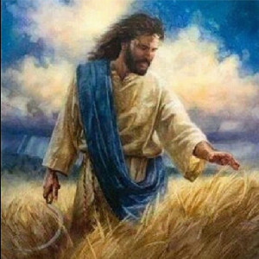
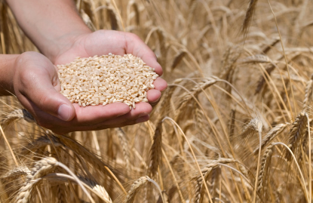
Threshed, Beaten, and Bruised
He sifts, but He does not destroy.
He does not thresh His own people, but He knocks them;
…and even when He threshes, they may console themselves in the face of the approaching period of judgment,
that they are never crushed or injured.”
Isaiah 28:26-29
(11)

Slide 23
Sources:
Suggested Hymn: #85 How Firm a Foundation
Videos: Line Upon Line (0:51)
Come unto Christ: 2014 Theme Song (4:48)
The Marshmallow Test (2:41)
https://www.youtube.com/watch?v=m7Tu4zRBBSo
Dieter F. Uchtdorf Continue in Patience April 2010 Gen. Conf.
Prophet Joseph Smith (Teachings of the Prophet Joseph Smith, pp. 12–13.)
Joseph Smith (Teachings of Presidents of the Church: Joseph Smith[2007], 268).
Mary Pratt Parrish, "Guardians of the Covenant," Ensign, May 1972, 28
Parley P. Pratt (A Voice of Warning [New York City: Eastern States Mission], 37 - 38)
B.H. Roberts (History of The Church of Jesus Christ of Latter-day Saints, 7 vols., introduction and notes by B. H. Roberts [Salt Lake City: The Church of Jesus Christ of Latter-day Saints, 1932-1951], 1: xciii.)
Elder Orson Pratt Journal of Discourses, 20:12.
Elder Robert D. Hales (“Waiting upon the Lord: Thy Will Be Done,” Ensign or Liahona, Nov. 2011, 72).
Gospeldoctrine.com Isaiah 26
Old Testament Institute Manual (Prophecies of the Dispensation of the fullness of Times)
Elder David A. Bednar (“Line upon Line, Precept upon Precept,” New Era, Sept. 2010, 3–4; emphasis in original).
Keil and Delitzsch Commentary, 7:2:14–17. Found in Old Testament Institute Manual (Prophecies of the Dispensation of the fullness of Times)
Presentation by ©http://fashionsbylynda.com/blog/

Slide 24
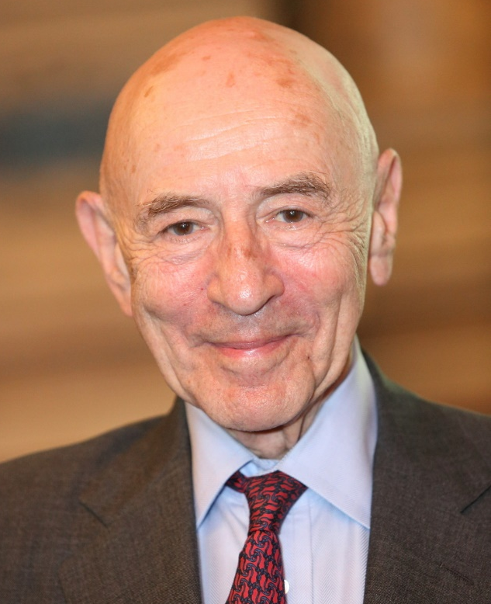
The Stanford marshmallow experiment was a series of studies on delayed gratification in the late 1960s and early 1970s led by psychologist Walter Mischel, then a professor at Stanford University. In these studies, a child was offered a choice between one small reward provided immediately or two small rewards (i.e., a larger later reward) if they waited for a short period, approximately 15 minutes, during which the tester left the room and then returned. (The reward was sometimes a marshmallow, but often a cookie or a pretzel.) In follow-up studies, the researchers found that children who were able to wait longer for the preferred rewards tended to have better life outcomes, as measured by SAT scores, educational attainment, body mass index (BMI), and other life measures
Priests: Isaiah 24:2
“The term priest is here used to denote all religious leaders of any faith. Isaiah said: ‘The earth also is defiled under the inhabitants thereof; because they have transgressed the laws, changed the ordinance, broken the everlasting covenant.’ (Isa. 24:5.) From among the discordant voices we are shocked at those of many priests who encourage the defilement of men and wink at the eroding trends and who deny the omniscience of God. Certainly these men should be holding firm, yet some yield to popular clamor.
“I give some quotes from the press:
“‘Many churchmen are reluctant to give a definite yes or no to marijuana.’ ‘It depends upon circumstances.’ (Time, August 16, 1968.)
“They have developed ‘situation ethics,’ which seem to cover all sins.
“Other religious leaders are saying: ‘… precise rules of Christian conduct should not necessarily apply to problems of sexuality.’ (London—British Council of Churches.)
“In contrast hear the strong voice of a prophet. Peter prophesied:
“‘But there were false prophets also among the people, even as there shall be false teachers among you, who privily shall bring in damnable heresies, even denying the Lord that bought them. …
“‘And many shall follow their pernicious ways. …’ (2 Pet. 2:1–2.)” President Spencer W. Kimball (In Conference Report, Apr. 1971, p. 9.)
Isaiah’s Apocalypse:
"Isaiah 24 through 35 are sometimes called Isaiah's apocalypse because they reveal events in the last days of this earth, alternately describing the terrible destruction of the wicked and the blessing and rejoicing of the righteous as they welcome the Messiah and His millennial theocracy of peace. Isaiah 24 begins the apocalypse, graphically describing the sorrow and suffering of the wicked in the opening and closing verses (24:1-12, 16-23). The middle of the chapter describes the joy of the righteous remnant who, rather than fearing and suffering at that time, 'sing for the majesty of the Lord' (24:14)." (Terry Ball and Nathan Winn, Making Sense of Isaiah, [SLC: Deseret Book, 2009], 69)
The storm of desolation and destruction has barely commenced; and all who would avoid it must come back to the original platform, beginning with faith, repentance, and baptism for the remission of sins, and lie according to the principles of that Gospel that was revealed from heaven, with apostles and prophets, with powers and blessings, accompanied by the gifts of wisdom, of knowledge and understanding, to bless, and save, and exalt mankind, and which will spread among the honest in heart of every nation, kindred, tongue, and people, until the kingdoms of this world become the kingdoms of our Lord and his Christ. George Albert Smith (Journal of Discourses, 26 vols. [London: Latter-day Saints' Book Depot, 1854-1886], 11: 50, January 22, 1865)
Ordinances Changed, a Serious Thing:
The gospel ordinances are part of the specific means outlined by the Lord whereby one can overcome his natural state, receive a spiritual rebirth, and become like God. Each ordinance was designed by God to teach spiritual truths and move His children toward godliness. When the ordinances are changed, their power to save is lost. The Prophet Joseph Smith said of the ordinances: “If there is no change of ordinances, there is no change of Priesthood. Wherever the ordinances of the Gospel are administered, there is the Priesthood.” (Teachings, p. 158.)

Slide 25
Earth shall reel to and fro:
As a prelude to our Lord's glorious return, such transcendent events shall occur, both in heaven and on earth, that there is no language known to mortals, nor any imagery or illustration, which can convey to them the wonders of that dreadful day.
"The earth shall reel to and fro like a drunkard" (Isa. 24:20), causing such an earthquake as has never before been known (Rev. 16:17-21), and it shall appear to man on earth as though the stars in the sidereal heavens are falling. And in addition, as here recorded, some heavenly meteors or other objects, appearing as stars, will fall "unto the earth." Indeed, the events of that day shall be so unprecedented and so beyond human experience, that the prophets are and have been at an almost total loss for words to describe those realities pressed in upon them by the spirit of revelation. And we can envision only in small measure the great events which they saw and understood by the power of the Spirit; that is, we are so limited unless and until we enjoy the same Spirit and see the same things which that God who is no respecter of persons revealed to them. Elder Bruce R. McConkie (Doctrinal New Testament Commentary, 3 vols. [Salt Lake City: Bookcraft, 1965-1973], 3: 487)
Setting a Goal for a lifetime:
Every accountable child of God needs to set goals, short- and long-range goals... Now, there is a lifetime goal-to walk in his steps, to perfect ourselves in every virtue as he has done, to seek his face, and to work to make our calling and election sure.
"Brethren," said Paul, "but this one thing I do, forgetting those things which are behind, and reaching forth unto those things which are before,
"I press toward the mark for the prize of the high calling of God in Christ Jesus." (Philip. 3:13-14.)
Let your minds be filled with the goal of being like the Lord, and you will crowd out depressing thoughts as you anxiously seek to know him and do his will. "Let this mind be in you," said Paul. (Philip. 2:5.) "Look unto me in every thought," said Jesus. (D&C 6:36.) And what will follow if we do? "Thou wilt keep him in perfect peace, whose mind is stayed on thee." (Isa. 26:3.) Ezra Taft Benson ("Do Not Despair," Ensign, Oct. 1986, 5)
The Marriage Supper:
"According to ancient and modern scripture, Jesus Christ, the bridegroom (Matt. 25:1-13), will host a 'marriage supper' at his second coming when he symbolically claims his bride, the faithful members of his Church (Rev. 19:5-9; D&C 109:73-74).
"In Jesus' parable of the marriage of the king's son (Matt. 22:1-14), 'the king' represents God, and 'his son' is Jesus. The guests first 'bidden to the wedding,' are the house of Israel. Guests invited later from 'the highways' are the gentiles to whom the gospel went after most Jews rejected it in the meridian of time (JC, pp. 536-40).
"Latter-day Saints believe that by teaching and exemplifying the gospel of Jesus Christ throughout the world they are extending to all mankind the invitation to come to the marriage feast. 'For this cause I have sent you...that the earth may know that...all nations shall be invited. First, the rich and the learned, the wise and the noble; ...then shall the poor, the lame, and the blind, and the deaf, come in unto the marriage of the Lamb, and partake of the supper of the Lord' (D&C 58:6-11).
"After partaking of the Sacrament with his apostles, Jesus said, 'I will not drink henceforth of this fruit of the vine, until that day when I drink it new with you in my Father's kingdom' (Matt. 26:29). In latter days, the Lord declared, 'The hour cometh that I will drink of the fruit of the vine with you' (D&C 27:5-12). 'There is to be a day when...those who have kept the faith will be...admitted to the marriage feast; ...they will partake of the fruit of the vine,' or the sacramental emblems of Christ's atoning sacrifice, and reign with him on the earth (TPJS, p. 66)." (John M. Madsen, Encyclopedia of Mormonism, 1-4 vols., edited by Daniel H. Ludlow, 860.)
The Stone:
“One of Isaiah’s great Messianic prophecies was that the promised Messiah would be ‘for a stone of stumbling and for a rock of offence to both the houses of Israel, for a gin and for a snare to the inhabitants of Jerusalem. And many among them shall stumble, and fall, and be broken, and be snared, and be taken.’
Elder Bruce R. McConkie (Isa. 8:14–15.) Both Paul (Rom. 9:33) and Peter (1 Pet. 2:7–8) record the fulfilment of this prophecy.” (Mormon Doctrine, p. 657.)
Jacob referred to this figure when he said that “by the stumbling of the Jews they will reject the stone upon which they might build and have safe foundation” (Jacob 4:15)
Paul also used the same imagery when he said the foundation of the Church of Jesus Christ was Apostles and prophets, with Christ Himself being the chief cornerstone (Ephesians 2:19–20).

