Slide 1

Kings of Divided Israel
2 Kings 14-17
Yet the Lord testified against Israel, and against Judah, by all the prophets, and by all the seers, saying, Turn ye from your evil ways, and keep my commandments and my statutes, according to all the law which I commanded your fathers, and which I sent to you by my servants the prophets. 2 Kings 17:13

Slide 2

2 Kings 14-17
2 Kings 14:1,3
2 Kings 15:1,3
2 Kings 15:23-24
2 Kings 15:17-18
Amaziah (Judah)—son of Joash and Jehoaddan
25 years old & reigned 29 years
“he did that which was right”
Azariah (Judah)--son of Amaziah and Jecholiah
Reigned at age 6 for 52 years
“he did that which was right”
Pekahiah(Israel)--son of Menahem
Reigned 2 years
“he did that which was evil”
Menahem the son of Gadi
Reigned 10 years
“he did that which was evil”
2 Kings 14:23-24
2 Kings 15:8-9
2 Kings 15:32,34
2 Kings 15:27-28
Jeroboam (Israel)--son of Joash
Reigned 41 year
“he did that which was evil”
Zachariah (Israel)--son of Jeroboam
Reigned for 6 months
“he did that which was evil”
Jotham(Judah)--son of Uzziah and Jerusha
25 years old & reigned 16 years
‘he did that which was right”
Pekah(Israel) the son
of Remaliah
Reigned 22 years
“he did that which was evil”

Slide 3
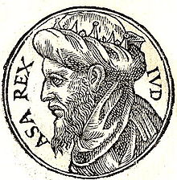
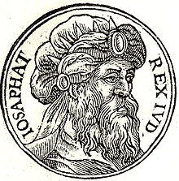
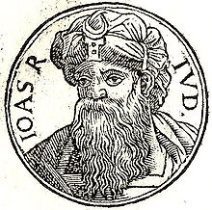
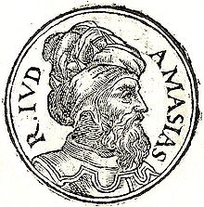
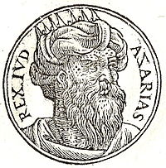
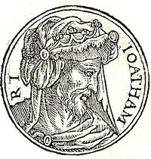
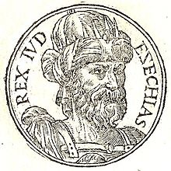
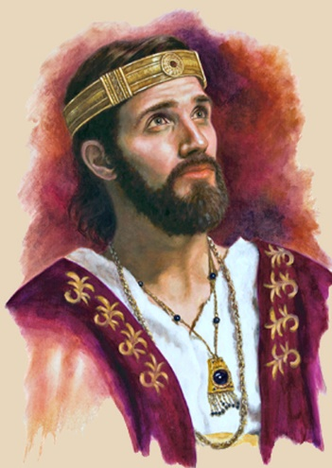
The Righteous Kings of Judah
Asa
Jehosephat
Jehoash
Amaziah
Uzziah
Jotham
Hezekiah
Josiah

Slide 4
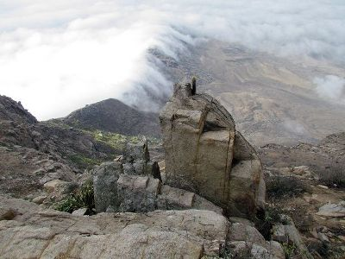
“High Places”
Locations where idol worship took place.
They may also have been places where other wicked acts were committed (like human sacrifice and sexual immorality).
The failure to remove these high places allowed wicked practices to continue within the kingdom of Judah.
Altar of Human Sacrifice of Inca Culture
2 Kings 14:4; 15:4;15:35

Slide 5


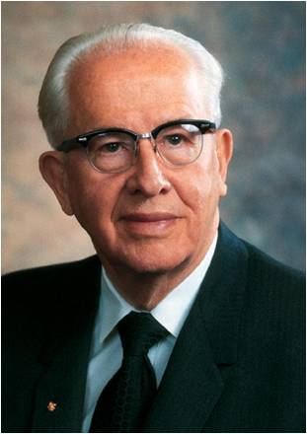
To Remove Evil Influences From Our Lives
Remove yourself immediately from any situation you are in that is either causing you to sin or that may cause you to sin.
Plead with the Lord for the power to overcome.
Let your priesthood leaders help you resolve the transgression and come back into full fellowship with the Lord.
It is not enough simply to try to resist evil or empty our lives of sin.
We must also fill our lives with righteousness.
We must engage in activities that
bring spiritual power.
Drink from the divine fountain, and fill your lives with positive sources of power.
(1)

Slide 6

Activities That Lead to Righteousness
I speak of such activities as immersing ourselves in the scriptures. There is a power that flows into our lives when we read and study the scriptures on a daily basis that cannot be found in any other way.
Daily prayer is another source of great power.
Fasting for specific strength or special blessings can strengthen us beyond our normal ability.
Christian service, church attendance, service in the kingdom—all can add to our storehouse of strength and power.
We must do more than simply remove the negative influences from our lives. We must replace them with righteous activities that fill us with the strength and determination to live as we should.
(1)

Slide 7
If we do not remove evil influences from our lives, we place ourselves and our families in spiritual danger
(1)

Slide 8
Ahaz
He was the son of Jotham—who ruled in righteousness.
He began his reign at the age of 20 and ruled in wickedness
His name means possessor
He was the king of Judah in 730 and 720 BC
He was given to the life of idolatry and evil and corrupted the temple rites and subjected his own son to walk in fire (human sacrifice * see notes)
Isaiah was the prophet at that time and he said that Ahaz was like Ahab
The nation during his reign was vexed by the aggression of the alliance between Syria and the northern kingdom of Israel (under King Pekah)---the Lord commanded Isaiah to counsel him to be calm…and Isaiah prophesied of the coming Messiah, which Ahaz did not acknowledge
He made an alliance with the king of Assyria (Tiglath-pileser) and the consequences were devastating
(2)

Slide 9
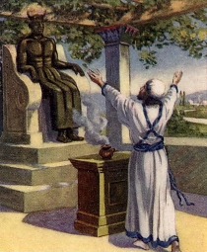
Ahaz Seeks Favor With King of Assyria
Ahaz also went to the city of Damascus (the capital of Syria, north of Judah and Israel) to meet with the king of Assyria and further seek his favor and help.
Ahaz offered sacrifices to the idols in Damascus and ordered that the altar in the temple at Jerusalem be replaced with an altar designed like one he had seen in Damascus.
He also made unauthorized changes to the holy priesthood ordinances, destroyed or altered sacred temple lavers and the “sea” (font), had the temple closed, and set up places of idolatry in Jerusalem.
Who was Ahaz trying to please…or make an impression upon?
2 Kings 16
(2)

Slide 10
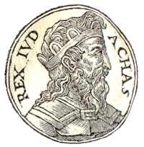
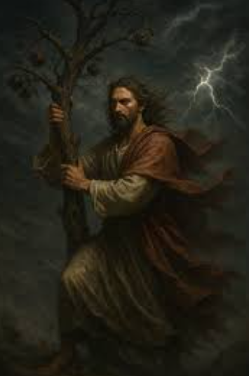
Disrespect in the Holy Temple
Ahaz “turned” or changed the furnishings in the Lord’s house to please the Assyrian king and win his favor.
These actions show that Ahaz sought to please the world instead of Jehovah.
And his heart was moved, and the heart of his people, as the trees of the wood are moved with the wind.
(Isaiah 7:2)
2 Kings 16:17-18
(2)

Slide 11
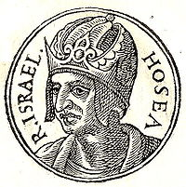
Hoshea
He was the son of Elah
He was the last king of Israel prior to the Assyrian deportation of the ten tribes of Israel beyond the Euphrates River around 721 BC
Hoshea placed himself at the head of the Assyrian party in Samaria and removed Pekah by assassination
Hoshea offended the Assyrian king and was put in prison, and his people were conquered after three years of siege
Hosea, the prophet during Hoshea’s time, writings have been handed down to us as part of the canon
Hoshea ruled 9 years
(2, 3)

Slide 12
Hosea
He was the son of Beeri
He was the only prophet of the northern kingdom in which his writings have been handed down to us as part of the canon
He prophesied during the reign of Jeroboam II and just prior to the ministry of Isaiah
He lived during a time of national decline and ruin, the result of the sin of Israel.
Hosea’s fundamental idea is the love of God for His people
He teaches that God the holy and supreme and that happiness and joy can flow to mankind only through obedience to His laws and commandments
(2)

Slide 13
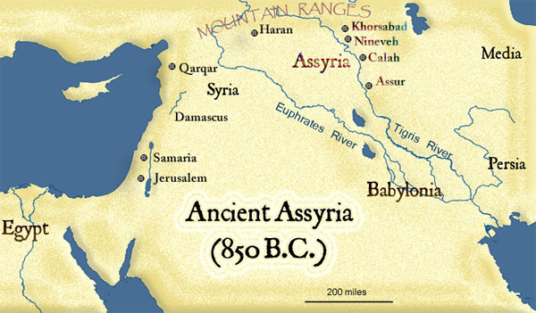
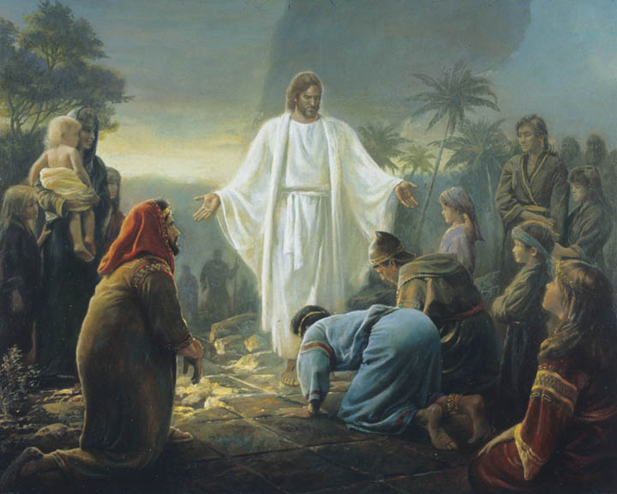
Conquered by Assyrians
Their identity as distinct tribes and as the covenant people of Jehovah was lost. However, the ten tribes are not lost to the Lord, and some of them were visited by Jesus Christ after His Resurrection
Because they hardened their hearts against the Lord’s servants, the people of the kingdom of Israel were conquered and taken captive by Assyria.
Neither at any time hath the Father given me commandment that I should tell unto them concerning the other tribes of the house of Israel, whom the Father hath led away out of the land. 3 Nephi 15:15
2 Kings 17:13-14

Slide 14
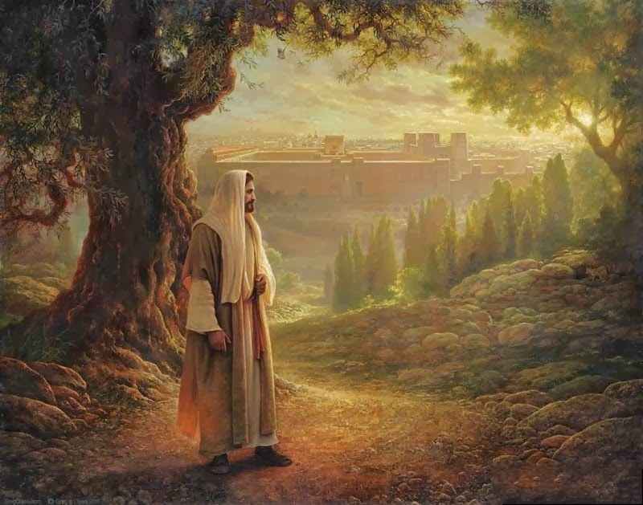
The Scattering
Because of iniquity, the Lord’s people in Jerusalem do not know of the scattered sheep of Israel. (4)
Read 1 Nephi 22:3–5
The scattering of the ten tribes began with the Assyrians, and they were eventually scattered and lost among other peoples of the earth.
They will remain lost until they turn their hearts to Jesus Christ as part of the Restoration and gathering in the latter days.
2 Kings 17:13-14
(2)

Slide 15
Seeking to Please
2 Kings 17:15
2 Kings 17:16
What did the Israelites reject?
What did they follow?
What did the Israelites leave?
Whom did they serve?
2 Kings 17:17
When we seek to please others above God, we lose His protection
What did the Israelites do to their children?
What things did they turn to for revelation?
2 Kings 17:15-17
(2)

Slide 16

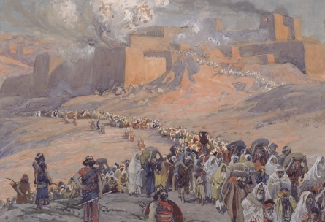
Loss of Protection
2 Kings 17:18
2 Kings 17:23
Removed them (Israel) out of his sight
Israel was taken captive by Assyria
2 Kings 17:19
2 Kings 17:21
Judah followed the statutes of Israel
2 Kings 17:20
Jeroboam made Israel sin
All of Israel was rejected and delivered into the hands of their enemies
2 Kings 17:18-23
(2)

Slide 17
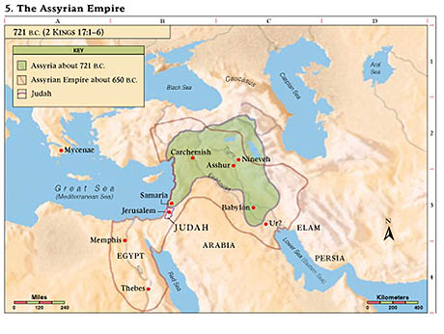
Who Were Lost?
Assyria practiced a policy of deporting and relocating conquered peoples. Thus, they moved Israelites to foreign lands and brought other foreign captives into the land Israel had possessed.
The foreign peoples that the Assyrians moved into the land of Israel after the conquest were the ancestors of the people who became the Samaritans.
These chapters relate the origins of the animosity between Jews and Samaritans.
“The statement that ‘there was none left but the tribe of Judah only’ can be understood correctly only if one realizes that at this time Benjamin, Levi, and all other Israelites who had left the nation of Israel and joined Judah were included under the title of Judah [for Judah was the chief tribe in the south].
2 Kings 17:18
(6)

Slide 18

The Scattering
The ten tribes carried into captivity at this time were Reuben, Simeon, Issachar, Zebulon, Gad, Dan, Asher, Naphtali, Ephraim, and Manasseh. [Ephraim was the chief tribe in this northern kingdom and as such the northern tribes or the tribes of Israel were often collectively called Ephraim.]
The three remaining tribes were Judah, Benjamin, and Levi. Some of the tribe of Levi were still with Israel (the ten tribes), however, and some of Ephraim, Manasseh, and other tribes were with Judah, [such as Lehi, who was descended from Manasseh (see Alma 10:3)]. So, the division is not as clear as a superficial reading might indicate”
v
(6)

Slide 19
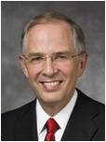
A Young Woman’s Facebook
“I spoke with a Laurel from the United States. I quote from her email:
“‘I decided to declare my belief in traditional marriage in a thoughtful way.
“‘With my profile picture, I added the caption “I believe in marriage between a man and a woman.” Almost instantly I started receiving messages. “You are selfish.” “You are judgmental.” One compared me to a slave owner.
And I received this post from a great friend who is a strong member of the Church: “You need to catch up with the times. Things are changing and so should you.”
“‘I did not fight back,’ she said, ‘but I did not take my statement down’”
“‘This past year some of my friends on Facebook began posting their position on marriage. Many favored same-sex marriage, and several LDS youth indicated they “liked” the postings. I made no comment.
(5)

Slide 20
Sources:
Videos: Things as They Really Are (3:27)
Spiritual Whirlwinds ((7:42–9:14)
President Ezra Taft Benson Excerpts from: The Law of Chastity Oct. 1988 Devotional Address BYU
Who’s Who in the Old Testament by Ed J. Pinegar and Richard J. Allen pp. 12-13, 75
Wikipedia
Heading for 3 Nephi 15
Presentation by ©http://fashionsbylynda.com/blog/
5. Elder Neil L. Andersen (“Spiritual Whirlwinds,” Ensign or Liahona, May 2014, 19–20).
6. (Old Testament Student Manual: 1 Kings–Malachi, 3rd ed. [Church Educational System manual, 2003], 127).
Note to Seminary Teacher: I found that while I was reading in 2 Kings it was handy to have a handout of the list of Kings and prophets during this time period in the history of the Divided Kingdom. Below is a good reference to the kings of Judah and Israel
https://www.lds.org/manual/old-testament-student-manual-kings-malachi/enrichment-a?lang=eng

Slide 21
Asa (911–869 B.C.). see 1 Kings 15:9–24; 2 Chronicles 14:1–16:14. Son of Abijam. Began religious reform in the nation with the encouragement of Ahijah the prophet. Destroyed the idols of the people of Judah and banned idolatrous worship. Was attacked by Baasha of Israel but defeated him. Withstood the attack of an Ethiopian force. Allied with Syria late in his reign against further attacks from Israel. Because of his sickness, three years before his death he appointed his son Jehoshaphat to reign jointly with him.
Jehoshaphat (870–848 B.C.). see 1 Kings 22:41–50; 2 Chronicles 17:1–20:37. Son of Asa. Ruled jointly with his father for three years before becoming king. Strengthened military fortifications in the kingdom and promoted further religious reform. Established instructional programs directed by the priesthood. Received tribute from the Philistines and Arabians as a guarantee of peace because of Judah’s great military presence as a nation. Joined in an alliance with King Ahab of Israel against the Syrians. King Ahab was killed in the war, but the Syrians were defeated. The marriage of Jehoshaphat’s son Jehoram to Ahab’s daughter Athaliah promoted idolatrous worship and eventually threatened the continuation of David’s line on the throne of Judah. Established a system of religious and civil courts. Miraculously withstood an attack from the Ammonites and their allies. Continued the alliance with Israel in an attempt to jointly establish ships for trade, but the venture failed.
Elijah’s ministry, though primarily in the Northern Kingdom, took place during Jehoshaphat’s reign.
Joash/Jehoash (835–796 B.C.). see 2 Kings 12; 2 Chronicles 24. Son of Ahaziah. Supported the priesthood and renewed the worship of Jehovah. Repaired the temple. Turned to idolatrous worship after the death of the leading priest, who had saved his life and his throne. Murdered his cousin Zechariah, who was a prophet raised up by God to call the people to repentance (see 2 Chronicles 22:10–11; 24:20–21). Was severely wounded in an attack on Judah by the Syrians. Gave tribute from the treasures and sacred furnishings of the temple to the Syrians to secure the safety of his people. Was assassinated by his own servants for his wicked deeds, especially those against the priestly family that had preserved his life.
Amaziah (796–767 B.C.). see 2 Kings 14:1–22; 2 Chronicles 25. Son of Joash. Prepared his people and led them victoriously against their long-time enemies, the Edomites, who had been weakened by Assyrian attacks. Reestablished the worship of idols among the people of Judah. Challenged the kingdom of Israel for power and was defeated. As had been prophesied, Jerusalem’s walls were partially destroyed and the temple ransacked. Because of that destruction, an insurrection arose against Amaziah. Fled to Lachish for safety but was discovered and put to death.
Old Testament Institute Manual: The Divided Kingdoms

Slide 22

Azariah/Uzziah (767–740 B.C.). see 2 Kings 15:1–7; 2 Chronicles 26. Son of Amaziah. Became king at the age of sixteen and reigned for a total of fifty-two years, jointly occupying the throne with his father for over twenty years. Strengthened the nation of Judah. Sought to obey God in his early years but could not purge the land of idolatry. Destroyed the Philistine strongholds and controlled the Philistines and the Arabians. Received tribute from the country of Ammon, which recognized Judah’s strength. Built up the defenses of Jerusalem and established a large military force. Unlawfully entered the sanctuary of the temple to officiate in priestly rites and was afflicted of the Lord with leprosy for his presumptuous act. Lived in isolation until his death. Ruled jointly with his son Jotham for the last ten years of his life.
Jotham (740–732 B.C.). see 2 Kings 15:32–38; 2 Chronicles 27. Son of Azariah. Continued to strengthen the fortifications of Jerusalem and the cities of Judah. Constructed an addition to the temple complex. Put down a rebellion of the Ammonites when they attempted to free themselves from being a tribute state. Ruled in righteousness all his days, but idolatry continued among the people.
Josiah (640–609 B.C.). see 2 Kings 22–23:30; 2 Chronicles 33:25–35:27. Son of Amon. Was upheld by the people as king at the age of eight years. Turned his heart continually to the Lord as he grew. Purged the land of idolatrous practices and sanctuaries. Renovated and restored the temple. Discovered sacred records in the temple during its renovation. Established religious reform and administered by covenant to the people.
Although outward changes came to the kingdom, it was prophesied that Judah would be spared until after Josiah’s day. Assyria fell to Babylonia, and Judah was freed from tribute. The Egyptians, however, were allied with Babylonia and marched through Judah to assist with the conquest. Josiah attempted to stop the Egyptians but was defeated in the process and died of wounds received in the battle at Megiddo. Judah then became a vassal of Egypt.
Zephaniah, and probably Nahum, prophesied during the early years of Josiah’s reign. Lehi was living in the land of Jerusalem about that time. Jeremiah’s ministry began in the thirteenth year of Josiah’s reign (see Jeremiah 1:1–2), and Habakkuk seems to have prophesied shortly after Josiah’s reign ended.
Hezekiah (715–686 B.C.). see 2 Kings 18:1–20:21; 2 Chronicles 29:1–32:33. Instituted religious reforms and restored the temple to the worship of Jehovah. Destroyed the brazen serpent Moses had made because the people misused it as an object to be worshiped. Besieged in the fourteenth year of his reign by the Assyrian emperor Sennacherib, the successor of Sargon II. Repaired Jerusalem’s defenses and constructed a water tunnel for the security of the city. Sought help from the Lord on this occasion, and Judah was miraculously delivered from the invading Assyrians as Isaiah had predicted. Became very sick, but his pleading with the Lord brought him a blessing through Isaiah that lengthened his days of kingship. Ruled in goodness until his death.
Old Testament Institute Manual: The Divided Kingdoms

Slide 23
Ahaz (732–715 B.C.). see 2 Kings 16; 2 Chronicles 28. Son of Jotham. Ruled jointly with his father for four years. Encouraged Judah to engage in idolatrous worship after the death of his father. Even offered human sacrifice by burning his own children. Warned by the prophet Isaiah of the consequences of doing this evil deed, but refused to follow Isaiah’s counsel. Defeated by the alliance of Israel under King Pekah and Syria.
Thousands of his people were taken captive into the Northern Kingdom, though they were later released at the request of the prophet Oded. Attacked by the Edomites and Philistines, who gained control of some villages. Finally sought aid from Assyria. Became an Assyrian vassal, paying high tribute. Sacrificed to the Assyrian gods, desecrated the temple in Jerusalem, and gave of its sacred treasures to the Assyrians. Established places of idol worship throughout Judah. Was refused a royal burial by the people at the time of his death.
The prophet Micah’s ministry continued through Ahaz’s reign and into the reign of Hezekiah. Old Testament Institute Manual (The Divided Kingdoms)
Hosea, the Prophet:
Son of Beeri, and the only prophet of the northern kingdom who has left written prophecies. He began to prophesy during the latter part of the reign of Jeroboam Ⅱ. He probably died before the accession of Pekah, 736 B.C., for he makes no allusion to the Syro-Ephraimitic war nor to the deportation of the northern tribes by Tiglath-pileser two years later. He lived during a time of national decline and ruin, the result of the sin of Israel. Hosea’s fundamental idea is the love of God for His people. In love God redeemed them from Egypt (Hosea 11:1); their history has been but an illustration of His love (11–13); all His chastisements are inflicted in love (2:14; 3); and their restoration shall be due to His love (2:19; 14:4). In contrast with this moral Being, who is Love, Hosea sets Israel, characterized always by want of affection, by treachery and infidelity. Yet he is able to look forward to a final redemption (2:19; 11:12–14:9). The profound thought and pathos of this prophet of the north deeply influenced succeeding writers (see Isa. 40–66; Jer. 2–3; Ezek. 16; 33). Bible Dictionary
Ahaz and his son; Walk in fire:
2 Kings 16:3 “This verse leaves some doubt about what Ahaz did. Did he kill his son or merely initiate him into the worship of a false god? Second Chronicles 28:3 supports the idea of an actual human sacrifice, and the commentators generally agree that Ahaz did murder some of his children in this fashion.
“‘So far as the fact is concerned, we have here the first instance of an actual Moloch-sacrifice among the Israelites, i.e. of one performed by slaying and burning. …
“‘The offering of his son for Moloch took place, in all probability, during the severe oppression of Ahaz by the Syrians, and was intended to appease the wrath of the gods, as was done by the king of the Moabites in similar circumstances [2 Kings 3:27].’ [C. F. Keil and F. Delitzsch, Commentary on the Old Testament,10 vols. (n.d.; repr., 1975), 3:1:399–400]” (Old Testament Student Manual: 1 Kings–Malachi, 3rd ed. [Church Educational System manual, 2003], 126).

Slide 24
Judah—931 BC to 586 BC
Israel—931 BC to 722 BC
Approximate dates
Kings | Year | Years Reigned | Prophets | Kings | Year | Years Reigned | Prophets
Jeroboam | 930-909 BC | 22 | Ahijah, man of God Iddo | Rehoboam | 930-913 BC | 17 | Shemaiah, Iddo
Nadab | 909-908 BC | 2 |  | Abijam/Abijah | 913-910 BC | 3 | Iddo
Baasha | 908-886 BC | 24 | Jehu | Asa | 910-869 BC | 41 | Azariah, Hanani
Elah | 886-895 BC | 2 |  | Jehoshaphat | 872-848 BC | 25 | Jehaziel
Zimri, Tibni, Omri | 885 BC | 7 days, 12 |  | Jehoran | 848-841 BC | 8 | Obadiah ?
Ahab | 874-853 BC | 22 | Elijah, Michaiah | Ahazaih | 841 BC | 1
Ahaziah | 853-852 | 2 | Elijah | Athaliah | 841-835 BC | 6
Jehoram/Joram | 852-841 BC | 12 | Elisha | Jehoash/Joash | 835-796 BC | 40 | Joel
Jehu | 841-814 BC | 28 | Elisha | Amaziah | 796-767 BC | 29 | Joel
Jehoahaz | 814-798 BC | 17 | Elisha | Azariah/Uzziah | 792-740 BC | 52 | Joel, Isaiah
Jehoash/Joash | 798-782 BC | 16 | Elisha Jonah | Jotham | 750-735 BC | 16 | Isaiah, Micah
Jeroboam II | 793-753 BC | 41 | Jonah, Amos, Hosea | Ahaz | 735-715 BC | 16 | Isaiah, Micah
Zechariah | 753 BC | 6 mon | Hosea | Hezekiah | 715-686 BC | 29 | Isaiah, Micah
Shallum | 752 BC | 1 mon | Hosea | Manasseh | 697-642 BC | 55 | Nahum
Menahem | 752-742 BC | 10 | Hosea | Amon | 642-640 BC | 2 | Nahum
Pekahiah | 742-740 BC | 2 | Hosea | Josiah | 640-609 BC | 31 | Naham, Zephaniah, Habakkuk, Jeremiah, Huldah
Pekah | 752-732 BC | 20 | Hosea, Micha | Jehoahaz | 609 BC | 3 mon | Habakkuk, Jeremiah
Hoshea | 732-722 BC | 9 | Hosea, Micha | Jehoiakim | 609-598 BC | 11 | Habakkuk, Jeremiah, Daniel
 |  |  |  | Jehoiachin | 598 BC | 3 mon | Jeremiah, Daniel
 |  |  |  | Zedekiah | 597-586 BC | 11 | Jeremiah, Ezekiel, Daniel
http://gen2revarg.com/gentorevkingsandprophets.html
Red indicates Righteous Kings
Mark Barry—the kings of Judah and Israel

