Slide 1

Hezekiah and Isaiah
2 Kings 18-20
Behold, the days come, that all that is in thine house, and that which thy fathers have laid up in store unto this day, shall be carried into Babylon: nothing shall be left, saith the Lord.
2 Kings 20:17

Slide 2

During Hard Times
What are situations where a you might feel one or more of these emotions?
Where might you turn to for help when they experience these emotions?
Helpless
The Lord can help you when you experience these emotions now or in the future.
It helps to pay attention to the impressions that come to your mind and heart from the Holy Ghost.
Doubtful
(
(
Overwhelmed
Discouraged
Fearful

Slide 3
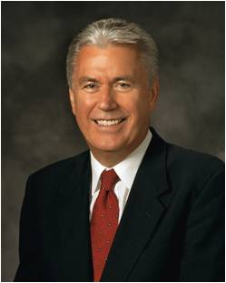


Rather than dwelling on the immensity of our challenges, would it not be better to focus on the infinite greatness, goodness, and absolute power of our God, trusting Him and preparing with a joyful heart for the return of Jesus the Christ?
As His covenant people, we need not be paralyzed by fear because bad things might happen. Instead, we can move forward with faith, courage, determination, and trust in God as we approach the challenges and opportunities ahead. (5)

Slide 4
Hezekiah
Was the son of Ahaz and Abi (Abijah, daughter of Zechariah) and reigned around 726 to 697 BC (29 years) at age 25
His reign is, in part, concurrent with the ministry of the prophet Isaiah who served him as a religious and political counselor.
He instituted religious reforms and restored the temple to the worship of Jehovah.
He destroyed the brazen serpent Moses had made because the people misused it as an object to be worshiped.
He besieged in the fourteenth year of his reign by the Assyrian emperor Sennacherib, the successor of Sargon II.
He repaired Jerusalem’s defenses and constructed a water tunnel for the security of the city.
He sought help from the Lord on this occasion, and Judah was miraculously delivered from the invading Assyrians as Isaiah had predicted.
He became very sick, but his pleading with the Lord brought him a blessing through Isaiah that lengthened his days (15 years) of kingship.
He ruled in goodness until his death.
(1,2)

Slide 5
Isaiah
He was the son of Amoz, and one of the greatest prophets in any dispensation and his name means Lord of Salvation
He is the most quoted of all the prophets in holy writ
Jesus said of him, “Great are the words of Isaiah” (3 Nephi 23:1)
His ministry in Jerusalem was in the time frame 740-701 BC
He was chief advisor to Hezekiah, king of Judah
Tradition states that he was “sawn asunder” during the reign of Manasseh; for that reason he is often represented in art holding a saw.
The writings of Isaiah deal with events of his day as well as events beyond his time, some of which have already come to pass, and others are yet to be. The bulk of Isaiah’s prophecies deal with the coming of the Redeemer, both in His first appearance “For unto us a child is born”
He was the prophet for 40 years in Jerusalem
(1, 3)

Slide 6
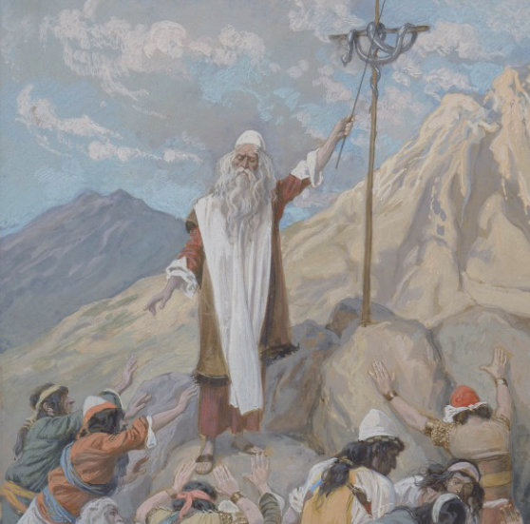
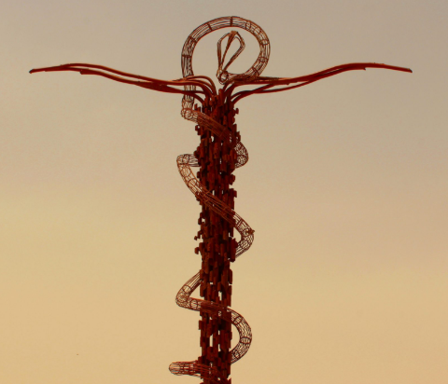
Turning to the Lord
He removed the high places, and brake the images, and cut down the groves, and brake in pieces the brazen serpent that Moses had made: for unto those days the children of Israel did burn incense to it: and he called it Nehushtan.
The word nehushtan comes from the Hebrew and means an object made of brass.
The implication may be that Hezekiah was speaking contemptuously of the object being worshiped, saying it was merely a “thing of brass” and nothing more.
The Israelites kept the brass serpent. They eventually began to worship it and “burn incense to it”, forgetting the symbolism and true source of healing, the Lord. Hezekiah wanted to eliminate all forms of idolatry in Judah.
2 Kings 18:4
(2)

Slide 7
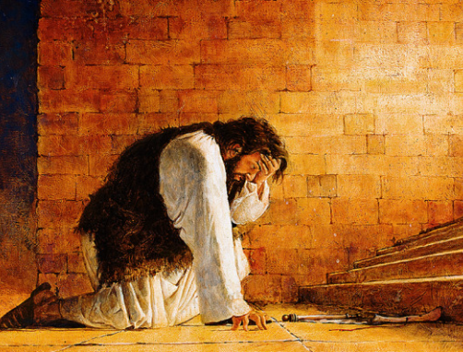
Trust in the Lord
He trusted in the Lord God of Israel; so that after him was none like him among all the kings of Judah, nor any that were before him.
As we trust in the Lord and keep His commandments, then He will be with us
2 Kings 18:4-5

Slide 8
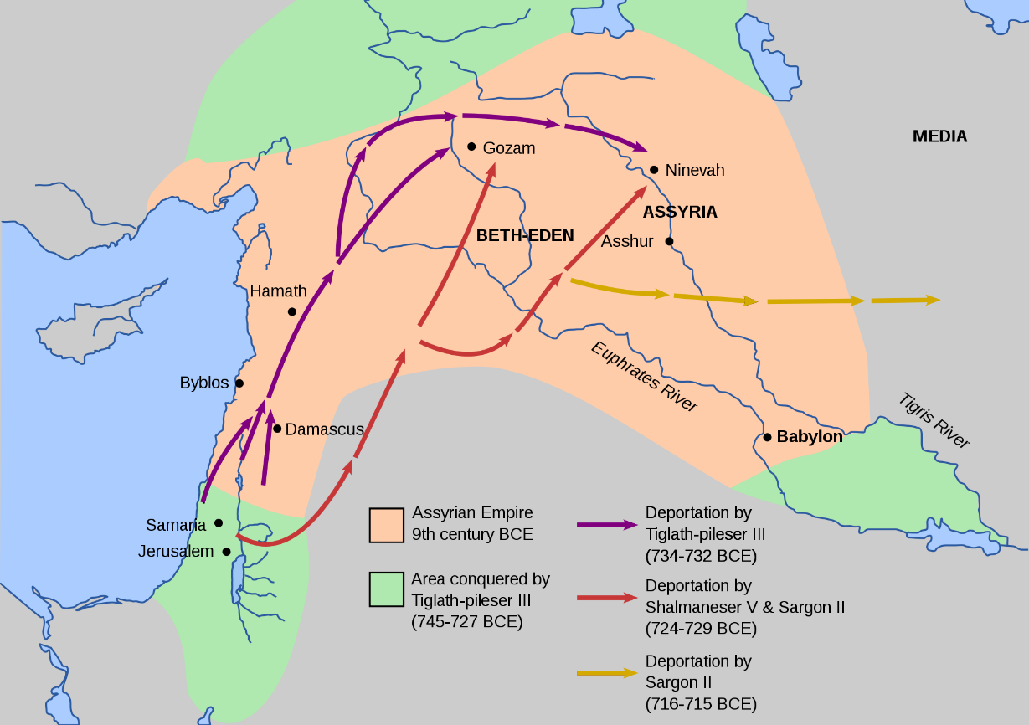
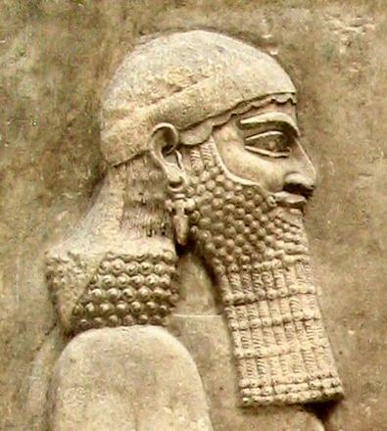
Meanwhile in Israel
Assyria conquered the Northern Kingdom of Israel—the 10 tribes who mostly lived in the regions of Samaria and Galilee—“because they obeyed not the voice of the Lord their God but transgressed his covenant.”
About seven years after the Assyrian king Sargon (who succeeded Shalmaneser conquered the Northern Kingdom of Israel and carried the people away into captivity, Sennacherib succeeded him as the king, (722 BC)
Sennacherib planned to conquer Jerusalem—the capital of the kingdom of Judah. The Assyrian army appeared to be unstoppable. They had a reputation of viciously desolating the lands and torturing the people they conquered, thus inspiring fear in those who opposed them.
2 Kings 18:9-12

Slide 9
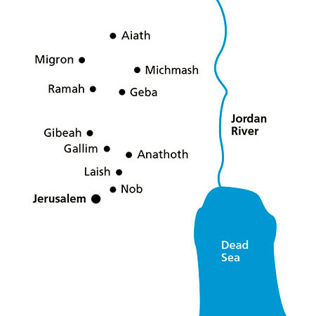
Isaiah’s Prophecy
The prophet Isaiah prophesied of the Assyrian invasion
He is come to Aiath, he is passed to Migron; at Michmash he hath laid up his carriages:
They are gone over the passage: they have taken up their lodging at Geba; Ramah is afraid; Gibeah of Saul is fled.
Lift up thy voice, O daughter of Gallim: cause it to be heard unto Laish, O poor Anathoth.
Madmenah is removed; the inhabitants of Gebim gather themselves to flee.
As yet shall he remain at Nob that day: he shall shake his hand against the mount of the daughter of Zion, the hill of Jerusalem.
The city of Nob was less than one mile (1.6 km) north of Jerusalem. This means that the Assyrian army came extremely close to Jerusalem.
Isaiah 10:28-32

Slide 10
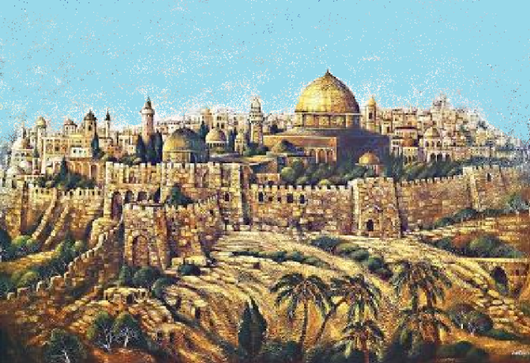
The Threat Against Judah
The Assyrian army arrived outside of Jerusalem after conquering the cities along the way. One of the Assyrians’ strategies was to send negotiators to a city before their army would attack.
The Assyrians used their reputation as brutal, ruthless warriors to intimidate cities and persuade them to surrender. Sennacherib sent negotiators to Jerusalem, where they were met by Hezekiah’s representatives.
“shake his hand against … Jerusalem”
He would threaten it but not destroy it.
2 Kings 18:32

Slide 11
Negotiations
What did Rab-shakeh say to try to convince the people of Jerusalem to surrender?
Assyria--Rab-shakeh
Judah--Eliakim
They wished him to come out that they might get possession of his person.
This was well calculated to stir up a seditious spirit. Ye cannot be delivered; your destruction, if ye resist, is inevitable; Sennacherib will do with you, as he does with all the nations he conquers, lead you captive into another land: but if you will surrender without farther trouble, he will transport you into a land as good as your own.
He wanted Rab-shakeh to not talk in the Jewish language.. So the people of Jerusalem would not be able to understand his threats.
Rab-shakeh then scoffed at Judah’s alliance with Egypt and mocked the Lord
2 Kings 18:18-35

Slide 12
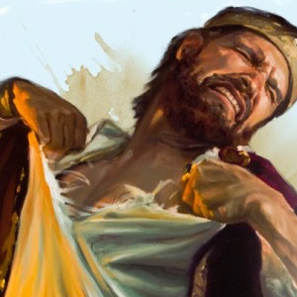
Clothes Rent
Outward symbols of distress and humility
Then came Eliakim - and Shebna - and Joah - to Hezekiah with their clothes rent -
It was the custom of the Hebrews, when they heard any blasphemy, to rend their clothes, because this was the greatest of crimes, as it immediately affected the majesty of God, and it was right that a religious people should have in the utmost abhorrence every insult offered to the object of their religious worship.
These three ambassadors lay the matter before the king as God's representative; he lays it before the prophet, as God's minister; and the prophet lays it before God, as the people's mediator. (4)
2 Kings 18:37

Slide 13
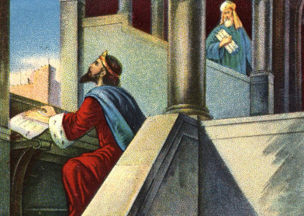
Assyrian Threats
Hezekiah sent messengers to inform the prophet Isaiah of the Assyrians’ threats, to seek his counsel, and to ask him to pray for the people.
O Assyrian, the rod of mine anger, and the staff in their hand is mine indignation.
I will send him against an hypocritical nation, and against the people of my wrath will I give him a charge, to take the spoil, and to take the prey, and to tread them down like the mire of the streets.
Howbeit he meaneth not so, neither doth his heart think so; but it is in his heart to destroy and cut off nations not a few. Isaiah 10:5-7
2 Kings 19:2-5

Slide 14
Hezekiah’s Prayer
Rab-shakeh
Hezekiah needed to choose whether to believe the words of the prophet Isaiah and trust in the Lord or to believe the words of Rab-shakeh and surrender the city of Jerusalem.
Hezekiah
Hezekiah:
Went to the temple
He sought the counsel of the prophet
He prayed to the Lord
Isaiah again reassured Hezekiah that the Lord would defend Jerusalem against the Assyrian army.
2 Kings 19:10-34

Slide 15
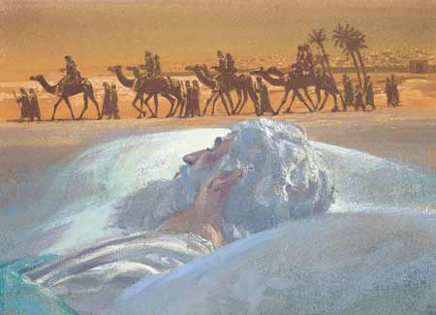
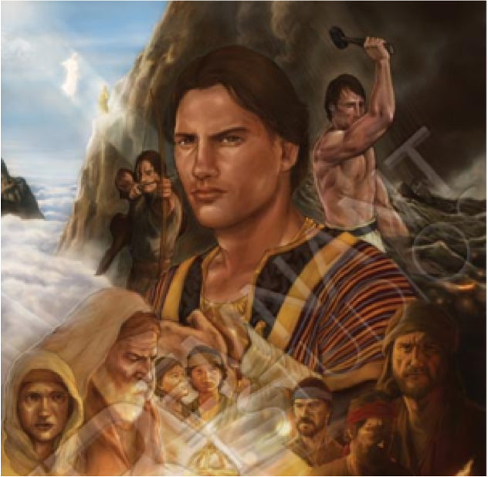
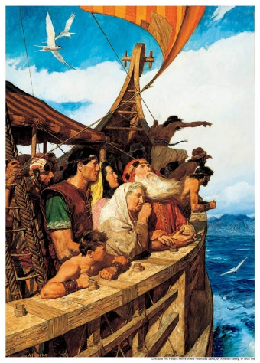
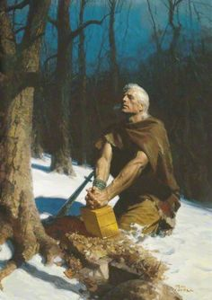
Isaiah’s Prophecy
And the remnant that is escaped of the house of Judah shall yet again take root downward, and bear fruit upward.
For out of Jerusalem shall go forth a remnant, and they that escape out of mount Zion: the zeal of the Lord of hosts shall do this.
2 Kings 19:30-31

Slide 16
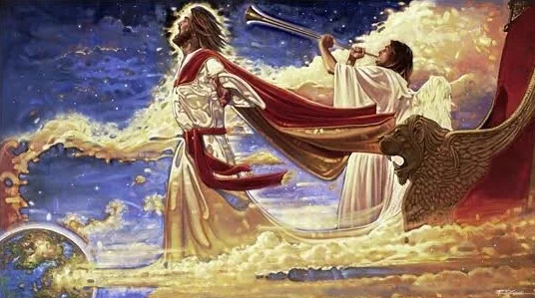
Deliver
For I will defend this city, to save it, for mine own sake, and for my servant David’s sake.
The Lord’s deliverance will come in His own time and his own way
Therefore, sanctify yourselves that your minds become single to God, and the days will come that you shall see him; for he will unveil his face unto you, and it shall be in his own time, and in his own way, and according to his own will. D&C 88:68
2 Kings 19:34

Slide 17
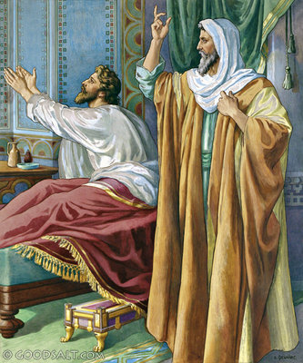
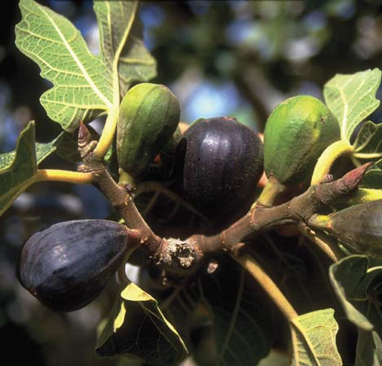
The Lord Extends Hezekiah’s Life
I beseech thee, O Lord, remember now how I have walked before thee in truth and with a perfect heart, and have done that which is good in thy sight. And Hezekiah wept sore.
I have heard thy prayer, I have seen thy tears: behold, I will healthee: on the third day thou shalt go up unto the house of the Lord.
And I will add unto thy days fifteen years;
Lump of figs--This, however, was the natural means which God chose to bless to the recovery of Hezekiah's health; and without this interposition he must have died.
If we exercise faith in the Lord, we can be healed according to His will
2 Kings 20:1-7

Slide 18
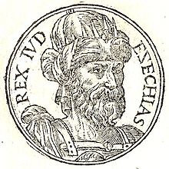

Turn Back Time
The Lord showed Hezekiah a sign to confirm that He would heal him.
And Isaiah said, This sign shalt thou have of the Lord, that the Lord will do the thing that he hath spoken: shall the shadow go forward ten degrees, or go back ten degrees?
And Hezekiah answered, It is a light thing for the shadow to go down ten degrees: nay, but let the shadow return backward ten degrees.
And Isaiah the prophet cried unto the Lord: and he brought the shadow ten degrees backward, by which it had gone down in the dial of Ahaz.
2 Kings 20:9-11

Slide 19
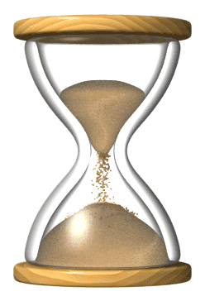
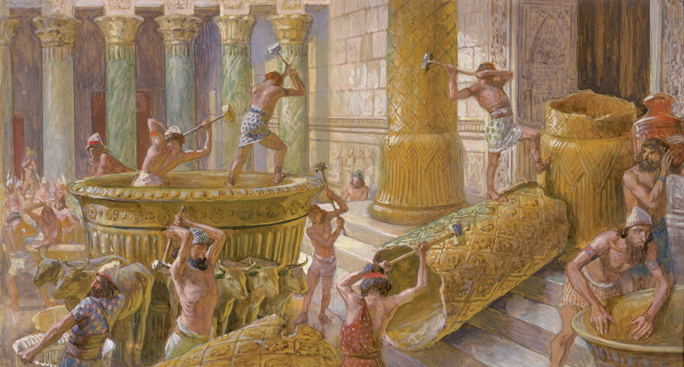
Babylon
Isaiah prophesied that Babylon eventually would conquer the kingdom of Judah.
Behold, the days come, that all that is in thine house, and that which thy fathers have laid up in store unto this day, shall be carried into Babylon: nothing shall be left, saith the Lord.
2 Kings 20:17-18

Slide 20
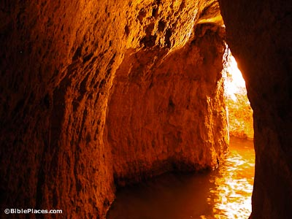
Hezekiah’s Tunnel (Pool)
An elaborate engineering scheme extending about 1770 feet through limestone rock, bringing the waters of Gihon spring inside the walls of Jerusalem to the pool of Siloam. The tunnel was built in the days of Hezekiah, about 701 B.C., as a defense against possible attack from the Assyrian army under.
Workmen dug from both ends, in a zig-zag course, until they met. A dramatic account of the meeting of the workmen is told by an inscription carved in stone near the Siloam end of the tunnel.
It reads: “The boring through is completed. Now this is the story of the boring through. While the workmen were still lifting pick to pick, each toward his neighbor, and while three cubits remained to be cut through, each heard the voice of the other who called his neighbor, since there was a crevice in the rock on the right side. And on the day of the boring through the stonecutters struck, each to meet his fellow, pick to pick, and there flowed the waters to the pool for a thousand and two hundred cubits, and a hundred cubits was the height of the rock above the heads of the stonecutters.”
The inscription has been removed from its original location and is now kept in the Turkish Archaeological Museum at Istanbul. The tunnel is still in use today.
(2 Kgs. 20:20; 2 Chr. 32:4, 30).
(4)

Slide 21

Sources:
Video: show “Heavenly Father Knows Me” (3:18)
Old Testament Institute Manual The Divided Kingdoms and The Fall of the Northern Kingdoms 2 Kings 14-20
Presentation by ©http://fashionsbylynda.com/blog/
Who’s Who in the Old Testament by Ed J. Pinegar and Richard J. Allen pp. 69-70, 79-80
Bible Dictionary
Adam Clarke Bible Commentary 2 Kings 18:37
President Dieter F. Uchtdorf, (“Perfect Love Casteth Out Fear,” Ensign or Liahona, May 2017, 106)

Slide 22
Prayer:
Consider the example given by Elder David A. Bednar of the Quorum of the Twelve Apostles of a young father who learned that his four-year-old daughter was critically ill:
“The father was found on his knees in prayer, asking that the life of his daughter be spared. Yet her condition worsened. Gradually, this father sensed that his little girl would not live, and slowly his prayers changed; he no longer prayed for healing but rather for understanding. ‘Let Thy will be done’ was now the manner of his pleadings. …
“Discerning and accepting the will of God in our lives are fundamental elements of asking in faith in meaningful prayer. However, simply saying the words ‘Thy will be done’ is not enough. Each of us needs God’s help in surrendering our will to Him.
“‘Prayer is the act by which the will of the Father and the will of the child are brought into correspondence with each other’ [Bible Dictionary, “Prayer”]. Humble, earnest, and persistent prayer enables us to recognize and align ourselves with the will of our Heavenly Father” (“Ask in Faith,” Ensign or Liahona, May 2008, 96–97).
Sources we can turn to when we need to be physically healed:
“Latter-day Saints believe in applying the best available scientific knowledge and techniques. We use nutrition, exercise, and other practices to preserve health, and we enlist the help of healing practitioners, such as physicians and surgeons, to restore health.
“The use of medical science is not at odds with our prayers of faith and our reliance on priesthood blessings. …
“Of course we don’t wait until all other methods are exhausted before we pray in faith or give priesthood blessings for healing. In emergencies, prayers and blessings come first. Most often we pursue all efforts simultaneously.” Elder Dallin H. Oaks(“Healing the Sick,” Ensign or Liahona, May 2010, 47).

Slide 23
The Brazen Serpent:
During their forty-year journey in the desert, the ancient Israelites often murmured against God and His prophet, Moses. The Lord sent among the people “fiery serpents” that threatened great destruction as a punishment. As a means of physical salvation and as a type of the spiritual salvation to be wrought by Jesus Christ (see John 3:14–15; 2 Nephi 25:20; Helaman 8:13–15), Moses made a serpent of brass, placed it on a pole, and taught his people that if they would gaze upon the serpent when they were bitten, physical healing would follow (see Numbers 21:4–9). The brass serpent was preserved in Israel and, in time, became an object of adoration and was worshiped by the Israelites much as they worshiped idols. In his zeal to eradicate all forms of idolatry in Judah, King Hezekiah had the brazen serpent destroyed along with the idols.
The word nehushtan comes from the Hebrew and means an object made of brass. The implication may be that Hezekiah was speaking contemptuously of the object being worshiped, saying it was merely a “thing of brass” and nothing more.
Hezekiah went on a righteous rampage, getting rid of all the idol worship that was going on in complete disobedience to the second commandment. He even destroyed the brazen serpent because the people were worshipping it like an idol.
We aren’t specifically told why and how the people started worshipping the ancient object, but we can infer what likely happened. The people forgot that the brazen serpent was merely a symbol of God’s mercy and power. They began, perhaps, to believe that the object itself had the ability to heal the sick. They began giving it offerings of incense that were most definitely NOT in the Law of Moses.
Assyria, named for the god Ashur (highest in the pantheon of Assyrian gods), was located in the Mesopotamian plain. It was bordered on the west by the Syrian desert, on the south by Babylonia, and on the north and east by the Persian and Urarthian hills (see J. D. Douglas, ed., The Illustrated Bible Dictionary,s.v. “Assyria,” 1:137). This area today is primarily the nation of Iraq.
The most vital part of the Assyrian government was its army. Warfare was a science to the leaders of Assyria. Infantry, chariots, cavalry (introduced by Ashurnasirpal to aid the infantry and chariots), sappers, armor made from iron, siege machines, and battering rams were all developed or perfected by the Assyrians. Strategy and tactics were also well understood by the Assyrian officers. (See Durant, Our Oriental Heritage, 1:270–71.)
But it was not just Assyrian effectiveness in warfare that struck terror to the hearts of the Near Eastern world. They were savage and brutal as well.
“A captured city was usually plundered and burnt to the ground, and its site was deliberately denuded by killing its trees. The loyalty of the troops was secured by dividing a large part of the spoils among them; their bravery was ensured by the general rule of the Near East that all captives in war might be enslaved or slain.
Soldiers were rewarded for every severed head they brought in from the field, so that the aftermath of a victory generally witnessed the wholesale decapitation of fallen foes. Most often the prisoners, who would have consumed much food in a long campaign and would have constituted a danger and nuisance in the rear, were dispatched after the battle; they knelt with their backs to their captors, who beat their heads in with clubs, or cut them off with cutlasses.
Scribes stood by to count the number of prisoners taken and killed by each soldier and apportioned the booty accordingly; the king, if time permitted, presided at the slaughter. The nobles among the defeated were given more special treatment: their ears, noses, hands and feet were sliced off, or they were thrown from high towers, or they and their children were beheaded, or flayed alive, or roasted over a slow fire. …
For more information read:
https://www.lds.org/manual/old-testament-student-manual-kings-malachi/enrichment-d?lang=eng
King of Assyria:
Sennacherib was the son of Sargon II and had numerous conquests to his credit. Clay tablets recording his various campaigns have been preserved and deciphered. The portion of one tablet that relates to the partial conquest of Judah reads as follows: “As for Hezekiah the Jew, who did not submit to my yoke, forty-six of his strong, walled cities, as well as the small cities in their neighborhood, which were without number—by constructing a rampart out of trampled earth and by bringing up battering-rams, by the attack of infantry, by tunnels, breaches, and [the use of] axes, I besieged and took [those cities]. Two hundred thousand, one hundred and fifty people, great and small, male and female, horses, mules, asses, camels, cattle, and sheep without number, I brought away from them and counted as spoil. Himself like a caged bird I shut in Jerusalem his royal city. Earthworks I threw up against him; the one coming out of the city gate I turned back to his misery.” (In Madeleine S. Miller and J. Lane Miller, Harper’s Bible Dictionary, s.v. “Sennacherib.”) found in Old Testament Institute Manual The Fall of the Northern Kingdom

Slide 24
JERUSALEM: A Threat to King Hezekiah:
In approximately 701 B.C., when his victory at Lachish seemed certain, “the king of Assyria sent Tartan and Rabsaris and Rabshakeh from Lachish to king Hezekiah with a great host against Jerusalem.” (2 Kgs. 18:17.)
This terrible threat caused Hezekiah to seek counsel from the prophet Isaiah, who said, “Thus saith the Lord God of Israel, That which thou hast prayed to me against Sennacherib king of Assyria I have heard. …
“And it came to pass that night, that the angel of the Lord went out, and smote in the camp of the Assyrians an hundred fourscore and five thousand: and when they arose early in the morning, behold, they were all dead corpses.” (2 Kgs. 19:20, 35.)
About a hundred years later, the Lord commanded Jeremiah and Lehi to warn the city to repent upon the pain of utter destruction. (See 1 Ne. 1:4.) This time the people did not repent, but rejected the prophets. A few years after Lehi fled Jerusalem with his family, in the ninth year of the reign of king Zedekiah, Nebuchadnezzar besieged Jerusalem. (See Jer. 52:1–5.)
During the Jews’ captivity in Babylon, while officiating in the palace at Shushan, Nehemiah received the news that “the wall of Jerusalem also is broken down, and the gates thereof are burned with fire.” In great sorrow he “sat down and wept, and mourned certain days.” (See Neh. 1:3–4.)
Ancient Israel under Siege
By David H. Garner Sept. 1986 Ensign
Hezekiah and Assyria:
“Now in the fourteenth year of King Hezekiah did Sennacherib king of Assyria come up against all the fenced cities of Judah, and took them” (2 Kgs. 18:13). The Assyrian Prism Inscription of King Sennacherib sheds further light on this biblical account: “As for Hezekiah, the Judaean, who had not submitted to my yoke, I besieged forty-six of his fortified walled cities and surrounding small towns. … I conquered [them]. … Himself, I locked him up within Jerusalem, his royal city, like a bird in a cage” (Mordechai Cogan and Hayim Tadmor, “II Kings: A New Translation with Introduction and Commentary,” Anchor Bible, ed. W. F. Albright and D. N. Freedman, 44 vols., Garden City, N.Y.: Doubleday & Co., 1984, 11:338).
The Bible says King Hezekiah, who had returned righteousness to Judah, went to the temple to plead with the Lord for protection. In answer to his prayer, the Lord told Hezekiah that his petition would be granted: “For I will defend this city, to save it, for mine own sake, and for my servant David’s sake.
“And it came to pass that night, that the angel of the Lord went out, and smote in the camp of the Assyrians an hundred fourscore and five thousand” (2 Kgs. 19:34–35).
This miraculous display of divine intervention had a tremendous impact on future generations, particularly on those who dwelt securely in Jerusalem from the time following this deliverance in 701 B.C. until the Babylonian captivity in 586 B.C. Jerusalem’s deliverance led to the erroneous belief that the holy city was impregnable. The Jews believed the city enjoyed divine protection, even if they did not abide the law of the covenant. Isaiah observed, “They call themselves of the holy city, but they do not stay themselves upon the God of Israel” (Isa. 48:2).
“There came many prophets, prophesying unto the people that they must repent, or the great city Jerusalem must be destroyed” (1 Ne. 1:4). Prophets like Lehi and Jeremiah were threatened with death when they spoke what many Jews considered to be blasphemous words against the holy city.
Priests and false prophets said of Jeremiah, “This man is worthy to die; for he hath prophesied against this city, as ye have heard with your ears” (Jer. 26:11). Jeremiah responded, “The Lord sent me to prophesy against this house and against this city. …
“Therefore now, amend your ways and your doings, and obey the voice of the Lord your God; and repent, and the Lord will turn away the evil that he hath pronounced against you” (JST, Jer. 26:12–13).
Judah did not repent. The great city and the holy temple were destroyed, and the Jews were exiled. The chosen people forgot that the Lord is bound only when they do what he says (see D&C 82:10). The peace that prevailed in Salem during Melchizedek’s day and the divine intervention Jerusalem enjoyed during the reign of Hezekiah were conditioned only on obedience to the covenants. Dec. 1995 I Have a Question

Slide 25
Judah—931 BC to 586 BC
Israel—931 BC to 722 BC
Approximate dates
Kings | Year | Years Reigned | Prophets | Kings | Year | Years Reigned | Prophets
Jeroboam | 930-909 BC | 22 | Ahijah, man of God Iddo | Rehoboam | 930-913 BC | 17 | Shemaiah, Iddo
Nadab | 909-908 BC | 2 |  | Abijam/Abijah | 913-910 BC | 3 | Iddo
Baasha | 908-886 BC | 24 | Jehu | Asa | 910-869 BC | 41 | Azariah, Hanani
Elah | 886-895 BC | 2 |  | Jehoshaphat | 872-848 BC | 25 | Jehaziel
Zimri, Tibni, Omri | 885 BC | 7 days, 12 |  | Jehoran | 848-841 BC | 8 | Obadiah ?
Ahab | 874-853 BC | 22 | Elijah, Michaiah | Ahazaih | 841 BC | 1
Ahaziah | 853-852 | 2 | Elijah | Athaliah | 841-835 BC | 6
Jehoram/Joram | 852-841 BC | 12 | Elisha | Jehoash/Joash | 835-796 BC | 40 | Joel
Jehu | 841-814 BC | 28 | Elisha | Amaziah | 796-767 BC | 29 | Joel
Jehoahaz | 814-798 BC | 17 | Elisha | Azariah/Uzziah | 792-740 BC | 52 | Joel, Isaiah
Jehoash/Joash | 798-782 BC | 16 | Elisha Jonah | Jotham | 750-735 BC | 16 | Isaiah, Micah
Jeroboam II | 793-753 BC | 41 | Jonah, Amos, Hosea | Ahaz | 735-715 BC | 16 | Isaiah, Micah
Zechariah | 753 BC | 6 mon | Hosea | Hezekiah | 715-686 BC | 29 | Isaiah, Micah
Shallum | 752 BC | 1 mon | Hosea | Manasseh | 697-642 BC | 55 | Nahum
Menahem | 752-742 BC | 10 | Hosea | Amon | 642-640 BC | 2 | Nahum
Pekahiah | 742-740 BC | 2 | Hosea | Josiah | 640-609 BC | 31 | Naham, Zephaniah, Habakkuk, Jeremiah, Huldah
Pekah | 752-732 BC | 20 | Hosea, Micha | Jehoahaz | 609 BC | 3 mon | Habakkuk, Jeremiah
Hoshea | 732-722 BC | 9 | Hosea, Micha | Jehoiakim | 609-598 BC | 11 | Habakkuk, Jeremiah, Daniel
 |  |  |  | Jehoiachin | 598 BC | 3 mon | Jeremiah, Daniel
 |  |  |  | Zedekiah | 597-586 BC | 11 | Jeremiah, Ezekiel, Daniel
http://gen2revarg.com/gentorevkingsandprophets.html
Red indicates Righteous Kings
Mark Barry—the kings of Judah and Israel

Slide 26
Assyrian Kings | Time period | Kings of Israel | Kings of Judah
Tiglath-Pileser 111 | 745-727 BC | Menahem, Pekahiah, Pekah, Hosea | Azariah, Jotham, Ahaz
Shalmanesaer V | 727-722 BC | Hosea | Hezekiah
Sargon II | 722-705 BC | Taken into captivity | Hezekiah
Sennacherib | 705-681 BC |  | Hezekiah
Esarhaddon | 681-669 BC |  | Hezekiah, Manassah
Rehoboam (Judah) | Forsook the law of the Lord
Jeroboam (Israel) | Set up idols and false priesthood
Nadab (Israel) | Followed Jeroboam’s pattern
Abijam (Judah) | “Walked in all the sins of his father”
Baasha (Israel) | Followed the pattern of Jeroboam
Jehoshaphat (Judah) | Did not take down high places, but was otherwise right
Elah (Israel) | Was a drunkard—”made Israel to sin”
Zimri (Israel) | Was a murderer, idolater (reigned seven days)
Omri (Israel) | Was a worse idolater than all before him
Ahab (Israel) | Was even worse than Omri; married Jezebel
Wikipedia and Mark Barry’s The Kings of Judah and Israel Chart
Israel’s Kings:
What made the case of these kings even worse was that accepting the throne of either Israel or Judah meant accepting a position of agency or trust. The earthly king should always have been the embodiment of the Heavenly King, the only true king in Israel. The earthly king should have accepted the responsibility of leading the people to obey the Heavenly King and of punishing all who disobeyed Him. But apostasy set in; kings were no longer chosen by revelation and anointed by prophets. Therefore, it is not surprising that the rulers of both kingdoms so often led their people in a way directly opposed to the ways of God.
Old Testament Institute Manual The Kingdom Divided Against Itself

