Slide 1

1 and 2 Chronicles
And these plates of brass, which contain these engravings, which have the records of the holy scriptures upon them, which have the genealogy of our forefathers, even from the beginning—
Alma 37:3

Slide 2
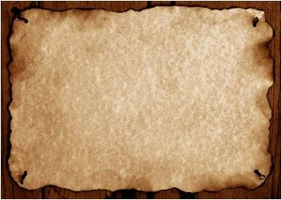
2 Chronicles
Judges
1 Chronicles
Joshua
Ruth
1 Kings
2 Kings
2 Samuel
1 Samuel
Nehemiah
Ezra
Esther
The books of 1 and 2 Chronicles contain a brief history of the Lord’s people from the time of Adam to the time of King Cyrus of Persia.
1 Chronicles provides a genealogy of the Lord’s people from the time of Adam to the time of the Babylonian captivity as well as a brief account of the reign of King David.

Slide 3
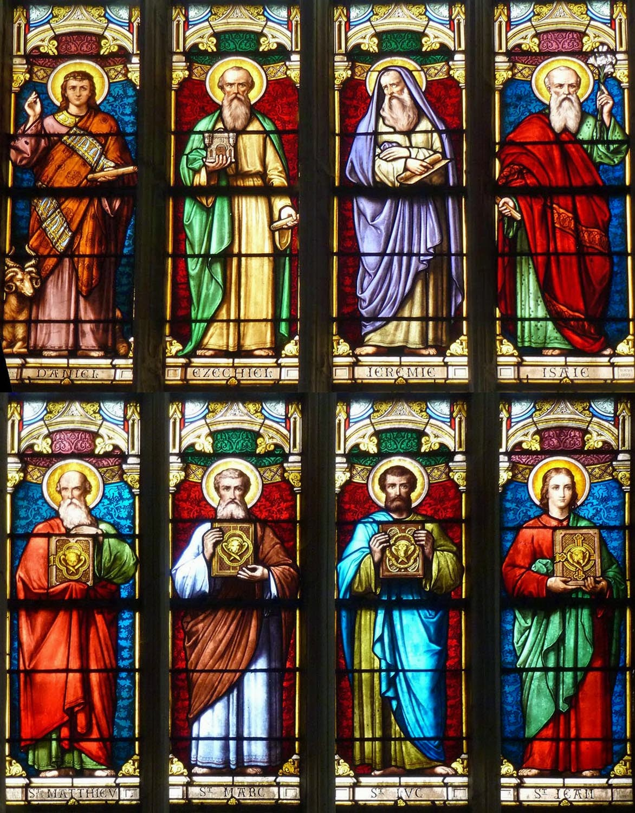
Prophets During the Reign of the Kings
NORTH
Ahijah
Jehu
Elijah
Michaiah
Jonah
Amos
Hosea
Micha
SOUTH
Iddo
Azariah
Obediah
Joel
Isaiah
Micah
Nahum
Zephaniah
Habakkuk
Jeremiah
Ezekiel
Daniel
Hanani
Jehaziel

Slide 4
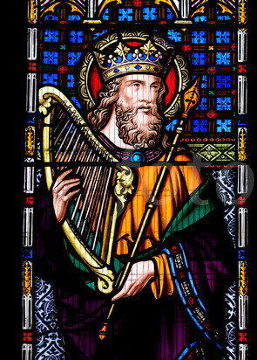
Psalm
A poem of praise, worship, or lamentation, often set to music.
David wrote some of the psalms contained in the book of Psalms
Give thanks unto the Lord, call upon his name, make known his deeds among the people.
Sing unto him, sing psalms unto him, talk ye of all his wondrous works.
Glory ye in his holy name: let the heart of them rejoice that seek the Lord.
Seek the Lord and his strength, seek his face continually.
Remember his marvellous works that he hath done, his wonders, and the judgments of his mouth;
1 Chronicles 16:8-12

Slide 5
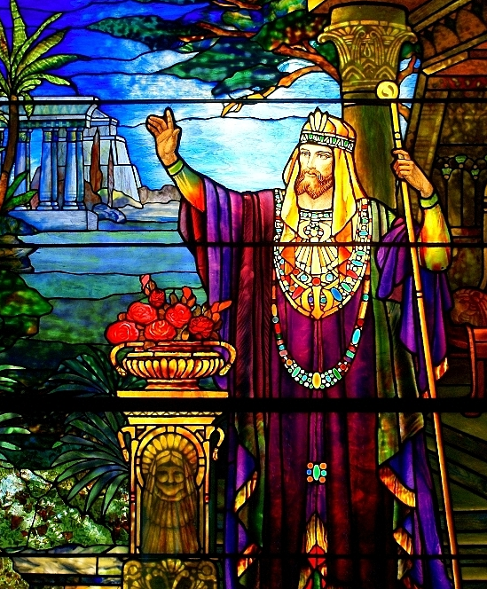
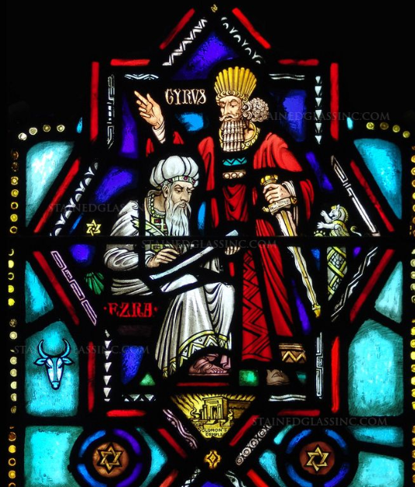
2 Chronicles
This book provides a history of events from the time of King Solomon until the time when King Cyrus of Persia allowed the Jews to return to Jerusalem
King Cyrus of Persia, recognized for his pivotal role in biblical history, is shown entrusting the scribe Ezra with authority to restore worship in Jerusalem. This powerful moment reflects divine providence through earthly rulers, as Cyrus fulfills prophetic scripture by supporting the rebuilding of the temple. Ezra, seated and pen in hand, represents faithfulness to the law of God and the sacred task of guiding the people in righteousness. The Star of David, temple image, and sacrificial symbols surrounding the figures enrich the spiritual gravity of this sacred commission.

Slide 6
Asa
His name means: healer or physician
He was the king of Judah around 956 to 916 BC
His heart was “perfect with the Lord all his days” (1 King 15:14)
He strengthened Israel’s defenses and held off enemies aggression
Inspired by the prophet Azariah, he took action to cleanse the land of idolatry
He caused the people to renew their vows to Jehovah
He died in the 45th year of his reign and was succeeded by his son Jehoshaphat
(2)

Slide 7
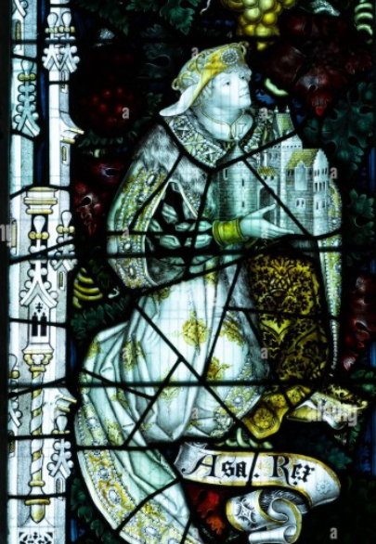
A Time of Peace
ASA
He took away the idols away from the mountains.
He commanded that the people turn to the Lord
He built fences, walls and towers around the cities for protection
The land was at rest
2 Chronicles 14:3-7

Slide 8
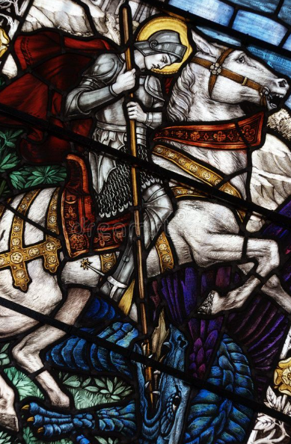
Ethiopians Attack
Zerah the Ethiopian with an host of a thousand thousand, and three hundred chariots
Asa prayed to the Lord to protect them in battle in the valley of Zephathah at Mareshah
The Lord helped them in the battle and the Ethiopians fled; Asa’s army went after them until they were “destroyed”
2 Chronicles 14:9-13

Slide 9
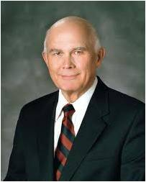
Azariah
He was the son of Oded
He inspired the king of Judah, Asa, to restore righteous worship and renew their covenants with the Lord (2)
Hear ye me, Asa, and all Judah and Benjamin; The Lord is with you, while ye be with him; and if ye seek him, he will be found of you; but if ye forsake him, he will forsake you.
The peace the gospel brings is not just the absence of war. It is the opposite of war. Gospel peace is the opposite of any conflict, armed or unarmed. It is the opposite of national or ethnic hostilities, of civil or family strife. (3)
2 Chronicles 15:1-9

Slide 10
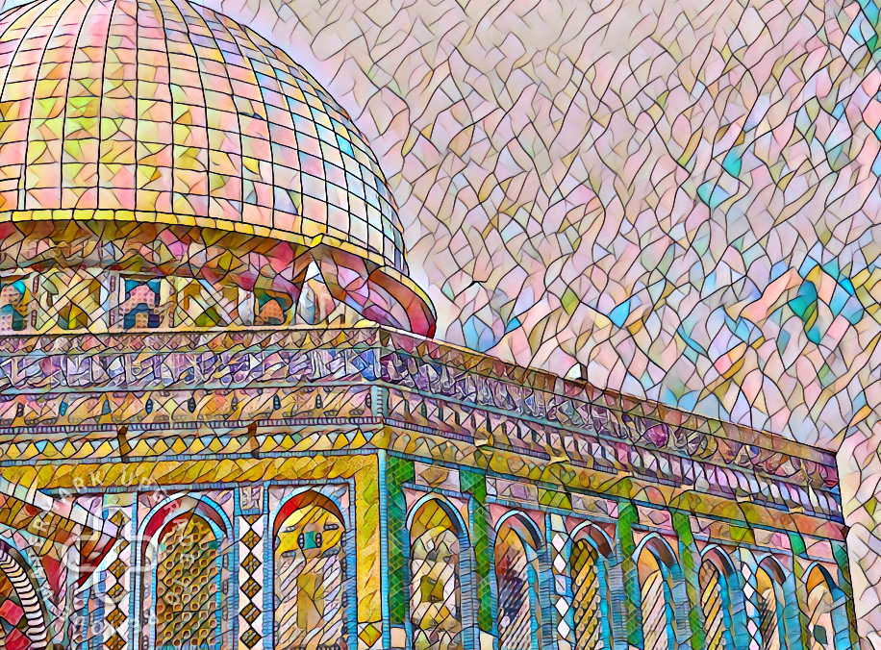
Gathering at a Time of Peace
So they gathered themselves together at Jerusalem in the third month, in the fifteenth year of the reign of Asa.
And all Judah rejoiced at the oath: for they had sworn with all their heart, and sought him with their whole desire; and he was found of them: and the Lord gave them rest round about.
And they offered unto the Lord the same time, of the spoil which they had brought, seven hundred oxen and seven thousand sheep.
And they entered into a covenant to seek the Lord God of their fathers with all their heart and with all their soul;
2 Chronicles 15:10-12, 15

Slide 11
Jehoshaphat
He was the son of Asa and Asubah, and great-great-great grandson of Solomon
He ruled Judah twenty years at the same time Ahab ruled Israel
When he came into power Judah was in apostasy
During this time, the enemies of Jehoshaphat came up to battle against his people
Like his father he was a reformer of righteousness
He “sought the Lord with all his heart” (2 Chronicles 22:9)
1 Chronicles 3:10; 1 Kings 22:41-42
(2)

Slide 12
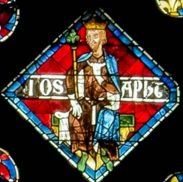
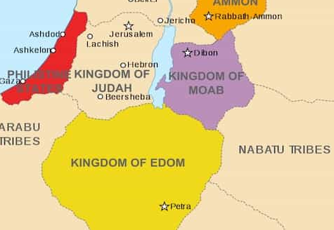
Jehoshaphat and His People
Jehoshaphat and the people of Judah went to war with the people of Ammon, Moab, and Mount Seir, also called the land of Edom.
They approached the war singing praises to God. God then blessed them by causing confusion among their enemies, who turned on and killed one another.
Jehoshaphat’s people then collected significant treasures from their deceased enemies. (4)
1 Chronicles 20:26-30

Slide 13
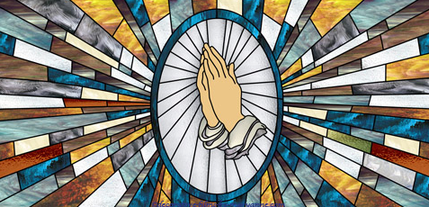
Fasting and Praying
And Jehoshaphat feared, and set himself to seek the Lord, and proclaimed a fast throughout all Judah.
And Judah gathered themselves together, to ask help of the Lord: even out of all the cities of Judah they came to seek the Lord.
Be not afraid nor dismayed by reason of this great multitude; for the battle is not yours, but God’s.
As we fast and pray for deliverance, the Lord will be with us in our challenges
1 Chronicles 20:3-4,15

Slide 14
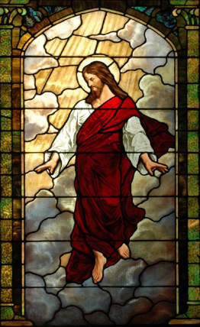
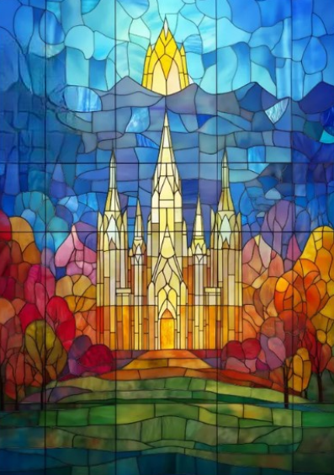
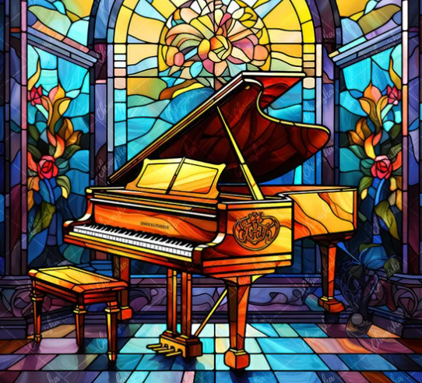
Seek, Believe, and Praise
As we seek the Lord in His temple, He will hear and help us
As we believe in the Lord and his prophets, we will prosper
As we praise the Lord through music, He will bless us
1 Chronicles 20:9,20,22

Slide 15
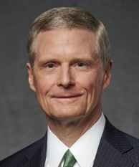
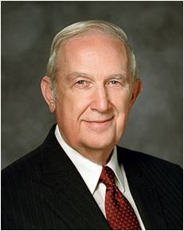
Gospel Principles
Stated succinctly, a gospel principle is a doctrinally based guideline for the righteous exercise of moral agency. Principles derive from broader gospel truths and provide direction and standards as we press forward on the covenant path. (5)
Principles are concentrated truth, packaged for application to a wide variety of circumstances. A true principle makes decisions clear even under the most confusing and compelling circumstances. It is worth great effort to organize the truth we gather to simple statements of principle. (6)

Slide 16
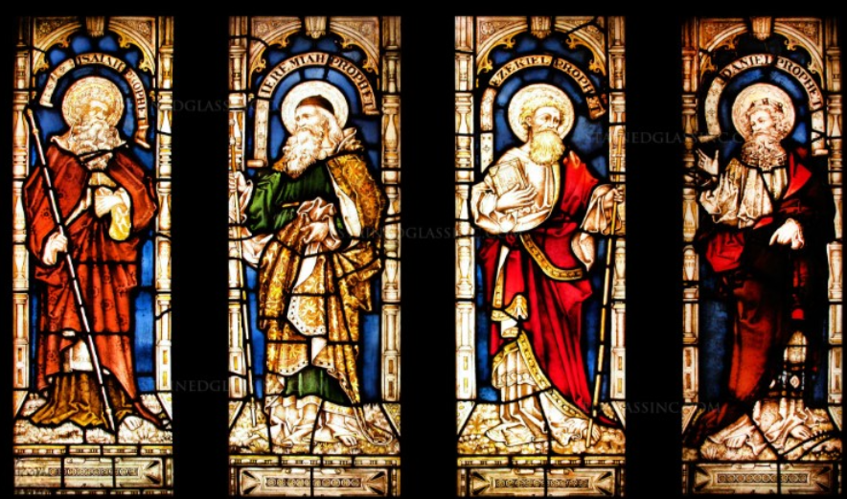
The next slides are from the Bible Dictionary that don’t necessarily have to do with 1 and 2 Chronicles but they point out the importance of scriptures and who was what during this time period.
It also shows the prophets during this time.

Slide 17
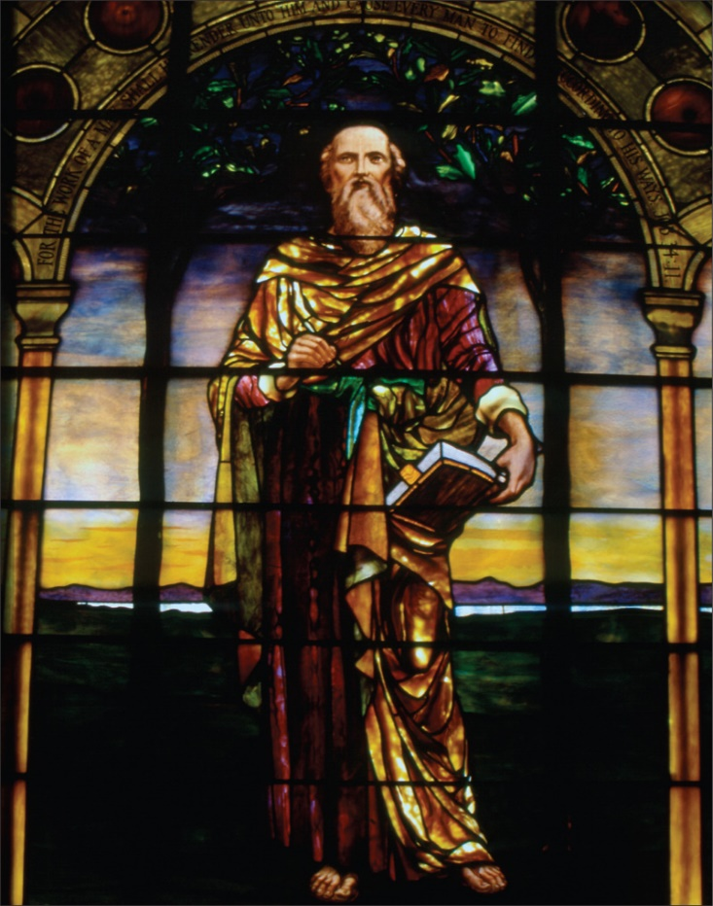
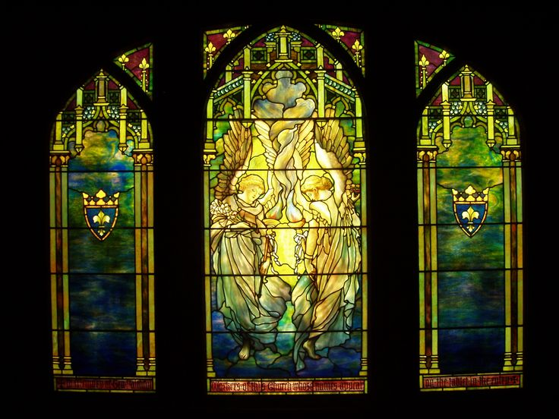
Wisdom in Literature
Psalms and Proverbs, along with Job, Ecclesiastes, and the Song of Solomon, are collectively known as the wisdom literature or the poetry books.
"Job" (detail) Tiffany Glass and Decorating Company, 1897, Restored by Bovard Studio, 2000
Ecclesiastes Angels, Stained Glasses. Louis Comfort Tiffany Glass

Slide 18
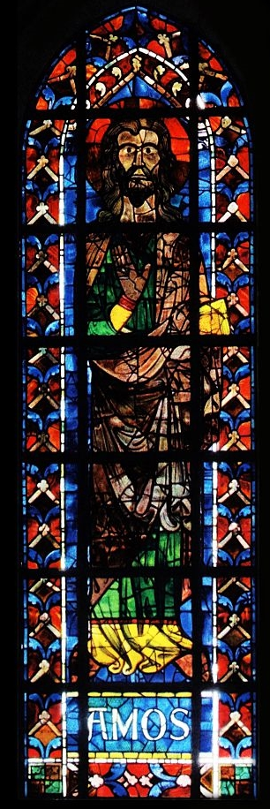
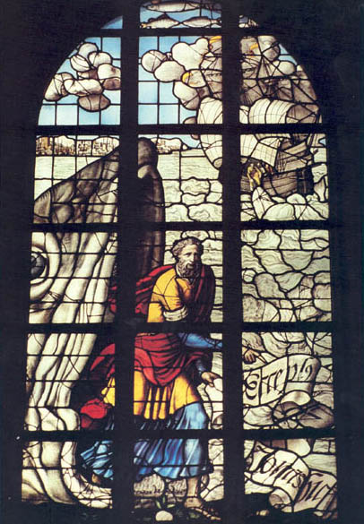
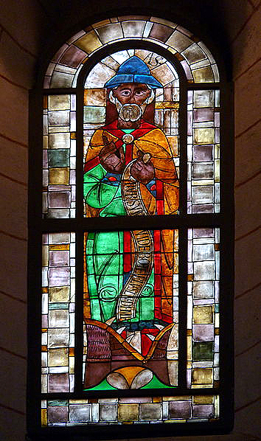
Amos, Jonah, and Hosea
The Lord called prophets to minister to the people in the Northern Kingdom

Slide 19
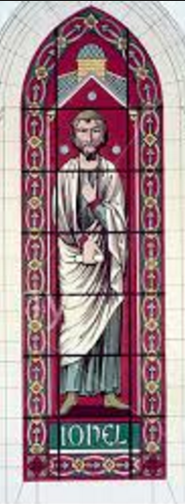
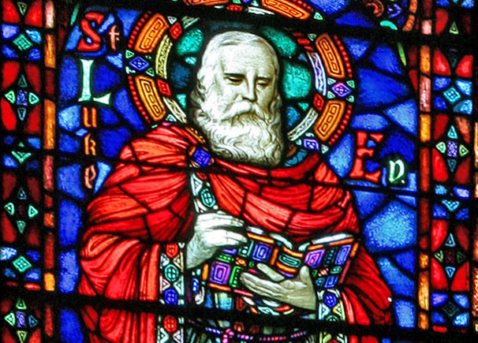
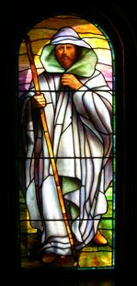
Joel, Isaiah, and Micah
The Lord called prophets to minister to the people in the Southern Kingdom

Slide 20
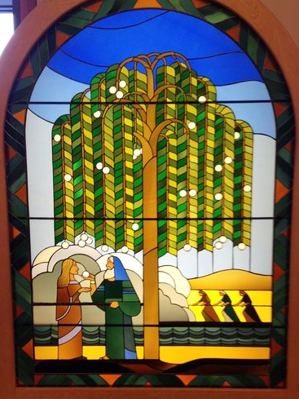
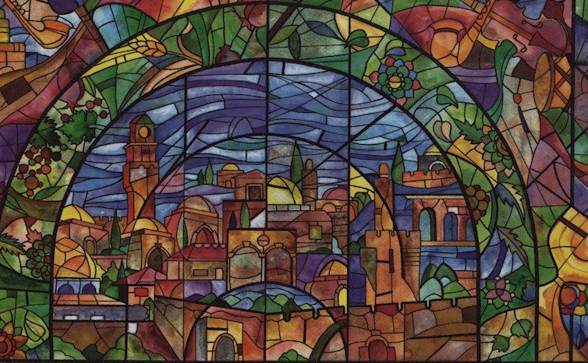
Lehi
The Lord called Lehi to leave Jerusalem before the captivity of Judah
Lehi and his family left Jerusalem shortly before the Babylonians destroyed Jerusalem in 586 B.C.

Slide 21
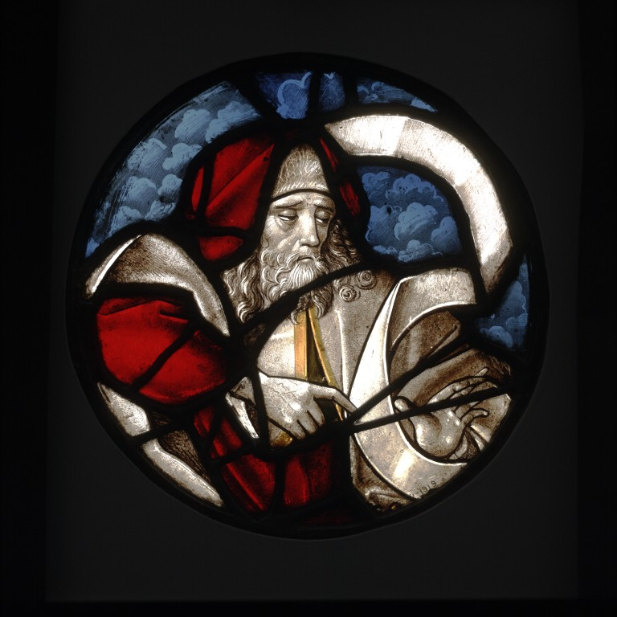
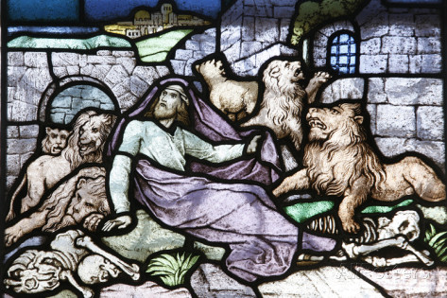
Daniel and Ezekiel
While the Jews were in captivity in Babylon the Lord continued to call Prophets

Slide 22
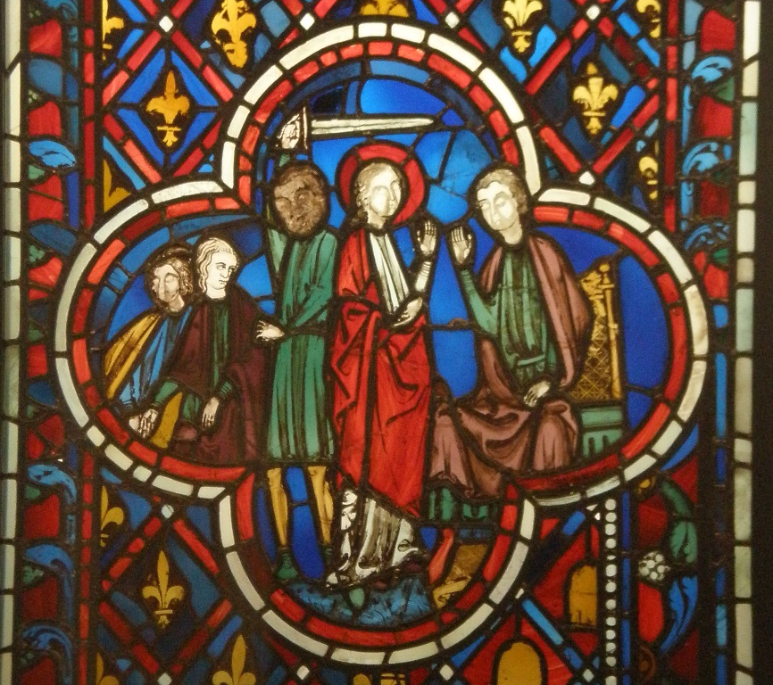
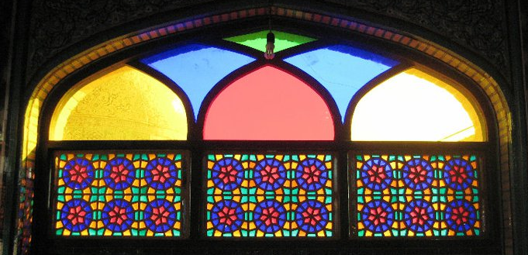
The Persians
The Persians conquered the Babylonian Empire and allowed the Jews from the former Kingdom of Judah to return to Jerusalem to rebuild the temple

Slide 23
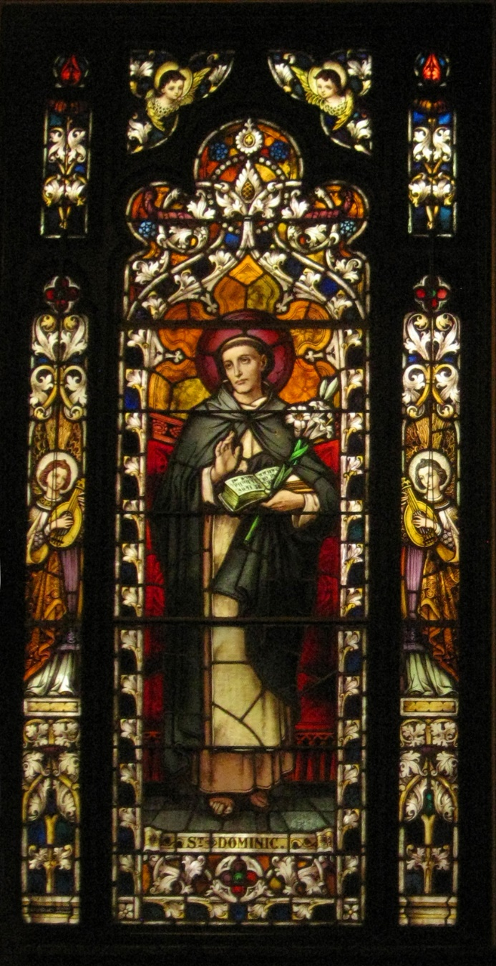
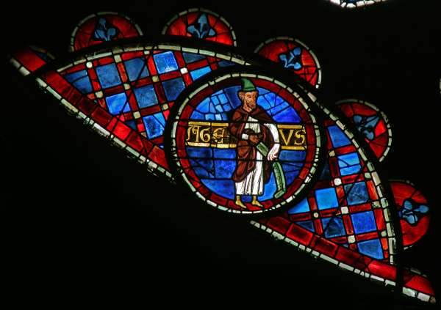
Haggai and Zechariah
They administer to the Jews who returned to Jerusalem

Slide 24
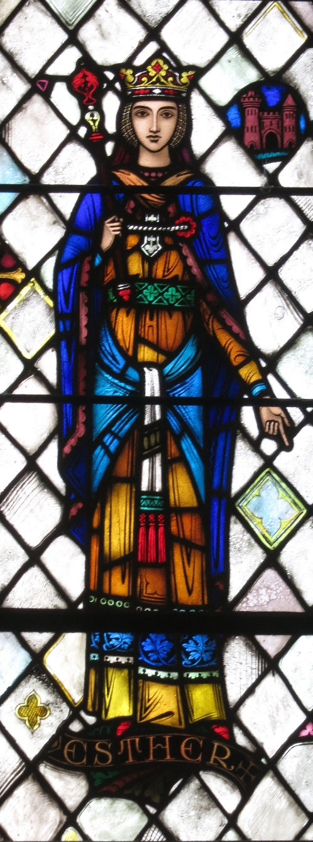
Esther--Queen of Persia
Some years later, a Jew named Esther became the queen of Persia.

Slide 25
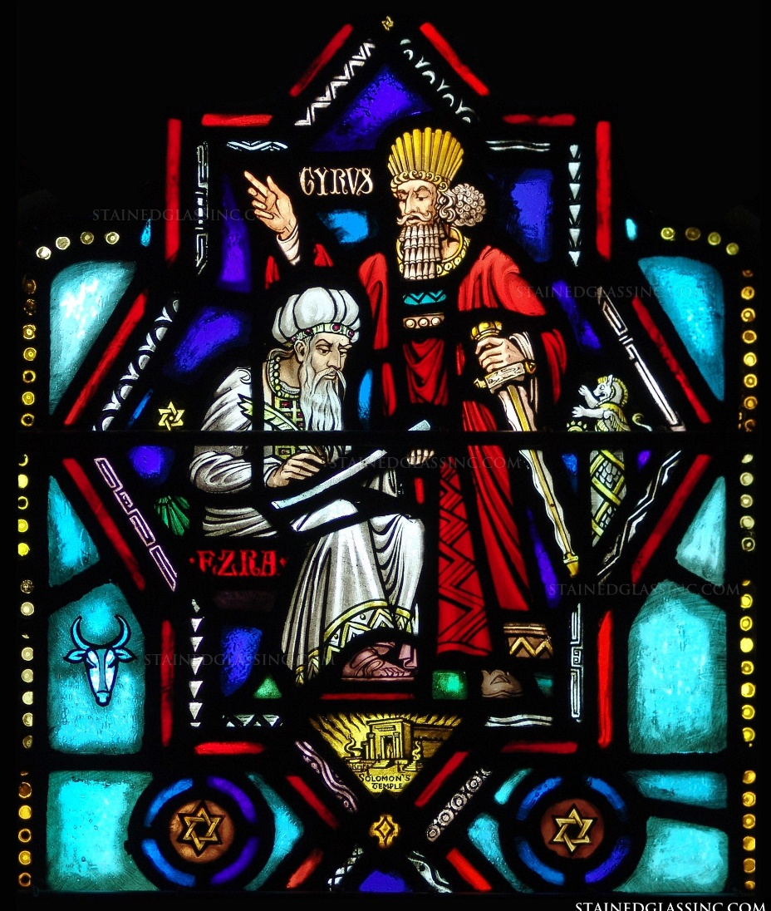
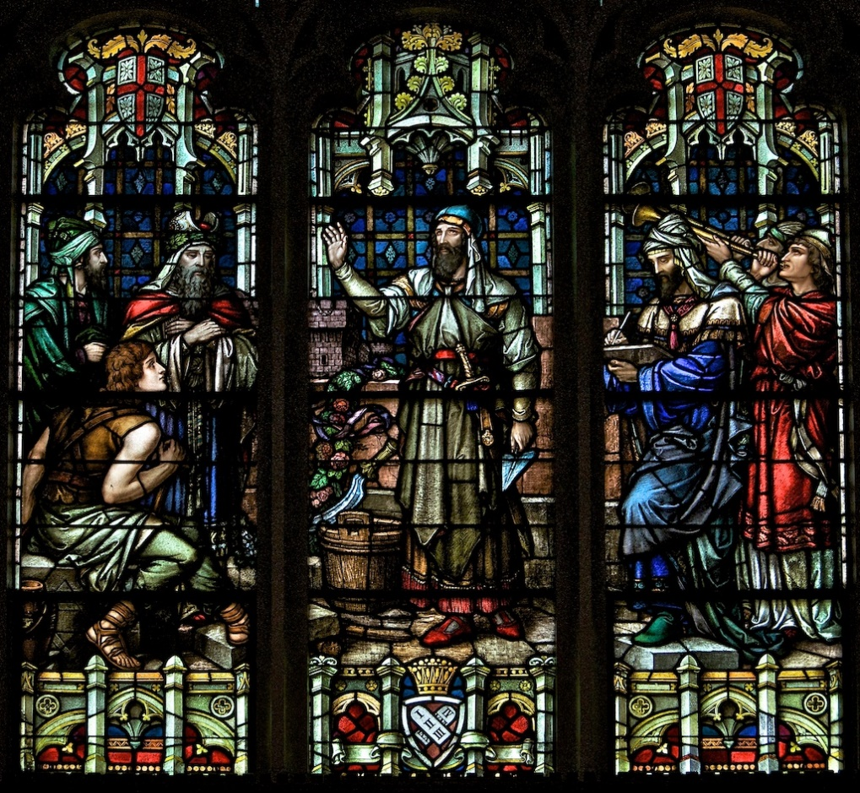
Ezra and Nehemiah
Ezra led most of the Jews back to Jerusalem and sought to reestablish the law of Moses among the people.
Nehemiah also came to Jerusalem and led the Jews in rebuilding the walls of the city
St. Vincent de Paul Chapel, St. Louis, MO

Slide 26
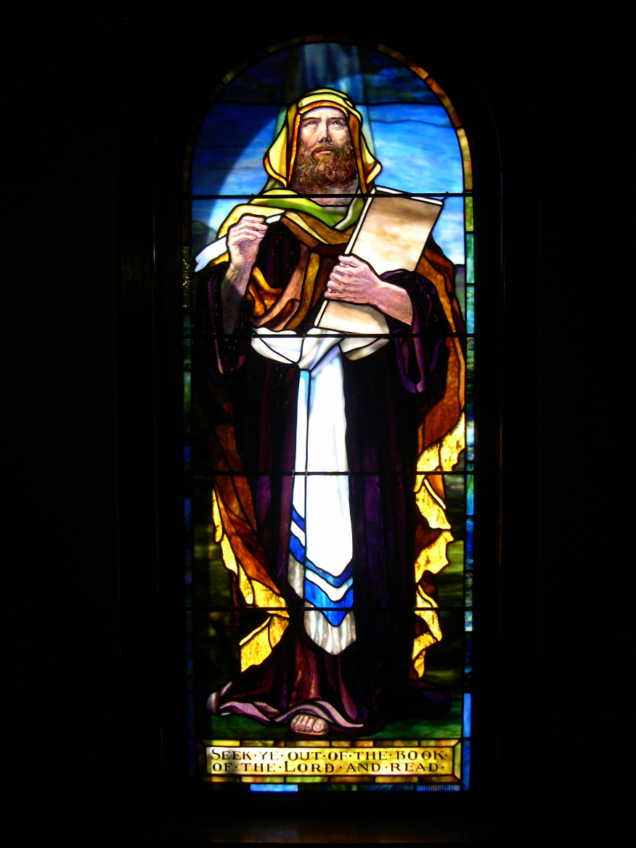
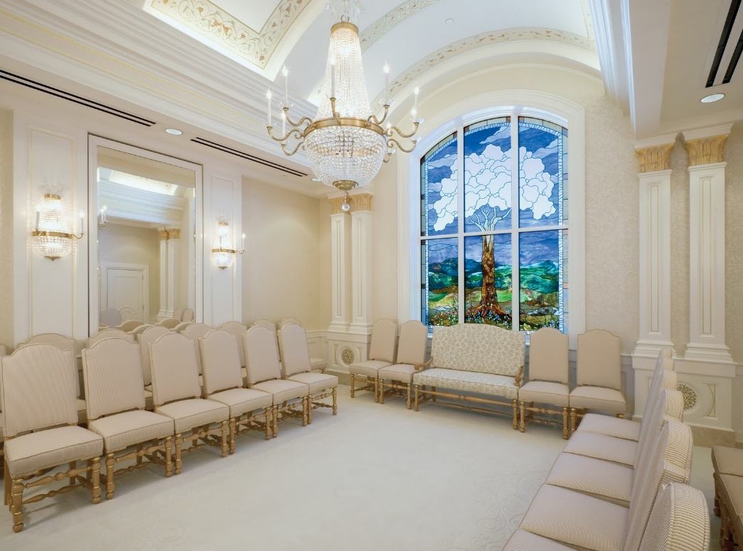
Malachi
The Last Prophet in the Old Testament
The prophecy of Malachi was spoken about 430 BC
The Old Testament prophet Malachi foresaw Elijah’s role in latter-day temple and family history work.
(Malachi 4:5-6)
(1)

Slide 27
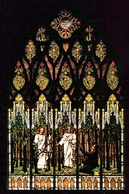
Sources:
Videos: The Lord Communicates Through Prophets (1:52)
God’s Laws Bless His Children (2:08)
Bible Dictionary
Who’s Who in the Old Testament pg. 19,88 Pinegar and Allen
World Peace by Elder Dallin H. Oaks April 1990 Gen. Conf.
Presentation by ©http://fashionsbylynda.com/blog/
4. Seminary manual 2026 Lesson 91
5. Elder David A. Bednar (“The Principles of My Gospel,” Liahona, May 2021, 123)
6. Elder Richard G. Scott (“Acquiring Spiritual Knowledge,” Ensign, Nov. 1993, 86)
Liberty Park Ward, Utah

Slide 28
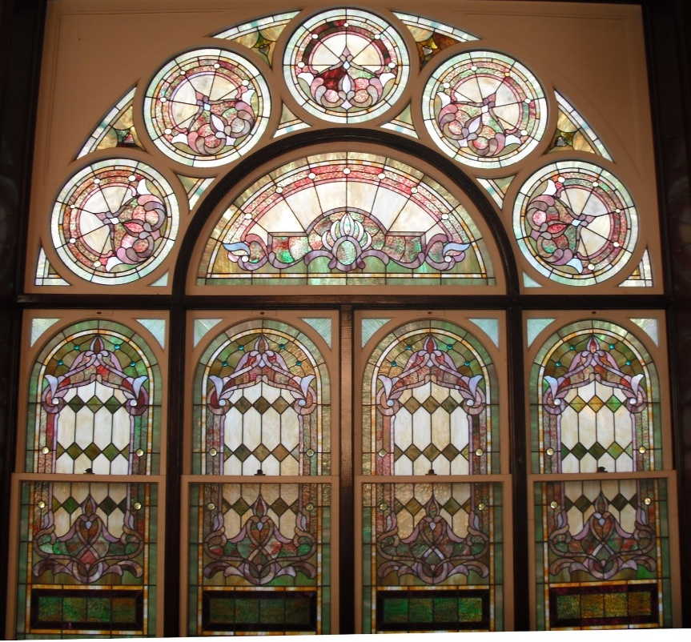
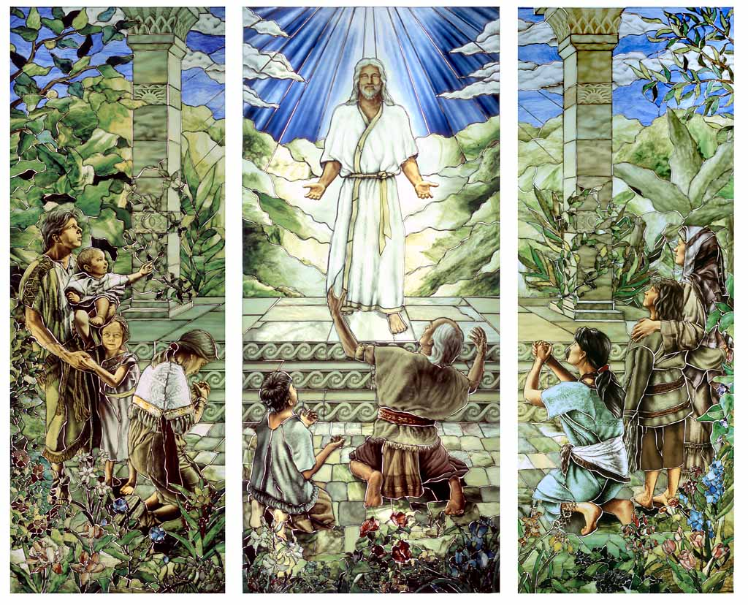
Kaysville Utah Tabernacle
Sao Paulo Brazil—LDS Temple

Slide 29
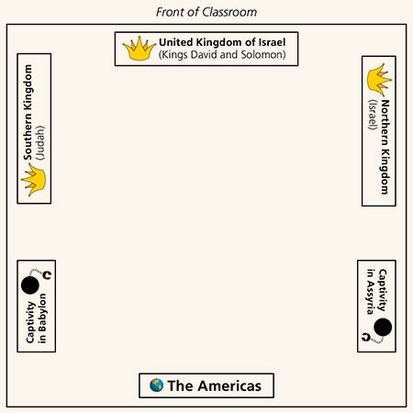

Slide 31
Elhanan—also son of Dodo of Bethleham and apparently a brother of Eleazar
Shammoth—the Harorite, sometimes spelled Shmmah, the Harodite
Helez—the Pelonite
Ira—the son of Ikkesh the Tekoite
Abiezer—the Antothite
Sibbecai—the Hushathite, identified as Mebunnai in 2 Samuel 23:27
Ilai—the Ahohite identified as Zalmon in 2 Samuel 23:28
Maharai—the Netphathite
Heled—son of Baanah the Netophathite identified as Heleb in 2 Sam. 23:29
Ithai—son of Ribai of Gibeah in Benjamin
Benaiah—the Pirathonite
Hurai—of the brooks of Gaash, identified as Hiddai in 2 Samuel 23:30
Abiel—the Arbathite, identified as Abialbon in 2 Sam. 23:31
Azmaveth—the Baharumite
Eliahba—the Shaalbonite
Jonathan—the son of Shage the Hararite
Ahiam—son of Sacar the Hararite
Eliphal—son of Ur, identified as Elephelet in 2 Sam. 23:34
Hepher—the Mecherathite
Ahijah—the Pelonite
Hezro—the Carmelite, identified as Hezrai in 2 Sam. 23:35
Naarai—son of Ezbai
Joel—the brother of Nathan
Mibhar—the son of Haggeri
Zelek—the Ammonite
Naharai—the Berothite, who served as the armor-bearer for Joab, the chief commander.
Ira—the Ithrite
Gareb—the Ithrite
Uriah—the Hittite, husband of Bath-sheba and a loyal soldier to David
Joab—Commander-in-chief under David. He was King David’s nephew who murdered Abner but was rehabilitated in the minds of the people after going up the water way and capturing Jerusalem (Jebus) from the inside
Abishai—elder brother of Joab and therefore another nephew of David. He accompanied David on the dangerous night mission into the camp of Saul. He saved David’s life when he was about to be killed by Goliath’s son. In one battle he slew 300 Philistines. He was loyal to David during Absalom’s rebellion.
Jashobeam—a Hachmonite who was chief of David’s captains and famed for having taken on a large body of Philistines single-handedly
Eleazar—son of Dodo, the Ahohite, who was with David at Pasdammin, and when the other soldiers had fled he was one of the few that stood his ground and drove the Philistines away.
Benaiah—son of Jehoiada. He slew two lion-like men of Moab; also he went down and slew a lion in a pit in a snowy day. And he slew an Egyptian, man of great stature.
Asahel—youngest brother of Joab and Abishai, a nephew of David. He was extremely fleet-footed and was overtaking Abner, commander of the northern Kingdom when Abner thrust his spear into Asahel so that the butt-end pierced him through and killed him.
David’s Mighty Ones
David moved his 600 band and their families from place to place
He called them his “mighty ones”
Found in 1 Chronicles 11
W. Cleon Skousen
The Fourth Thousand Years pp. 98-100

Slide 32
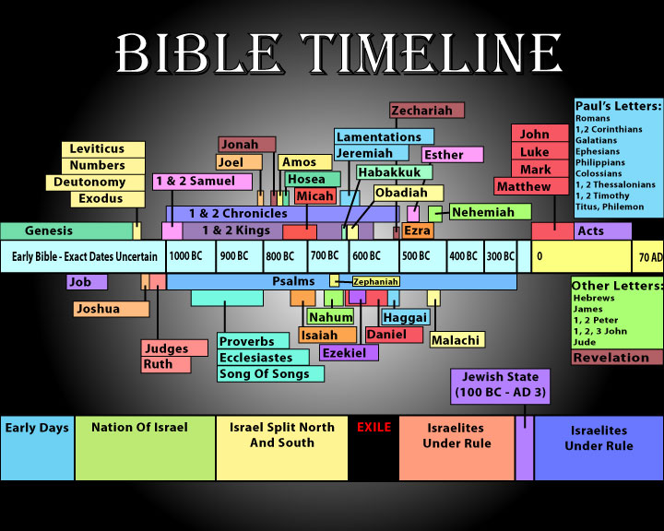

Slide 33
Judah—931 BC to 586 BC
Israel—931 BC to 722 BC
Approximate dates
Kings | Year | Years Reigned | Prophets | Kings | Year | Years Reigned | Prophets
Jeroboam | 930-909 BC | 22 | Ahijah, man of God Iddo | Rehoboam | 930-913 BC | 17 | Shemaiah, Iddo
Nadab | 909-908 BC | 2 |  | Abijam/Abijah | 913-910 BC | 3 | Iddo
Baasha | 908-886 BC | 24 | Jehu | Asa | 910-869 BC | 41 | Azariah, Hanani
Elah | 886-895 BC | 2 |  | Jehoshaphat | 872-848 BC | 25 | Jehaziel
Zimri, Tibni, Omri | 885 BC | 7 days, 12 |  | Jehoran | 848-841 BC | 8 | Obadiah ?
Ahab | 874-853 BC | 22 | Elijah, Michaiah | Ahazaih | 841 BC | 1
Ahaziah | 853-852 | 2 | Elijah | Athaliah | 841-835 BC | 6
Jehoram/Joram | 852-841 BC | 12 | Elisha | Jehoash/Joash | 835-796 BC | 40 | Joel
Jehu | 841-814 BC | 28 | Elisha | Amaziah | 796-767 BC | 29 | Joel
Jehoahaz | 814-798 BC | 17 | Elisha | Azariah/Uzziah | 792-740 BC | 52 | Joel, Isaiah
Jehoash/Joash | 798-782 BC | 16 | Elisha Jonah | Jotham | 750-735 BC | 16 | Isaiah, Micah
Jeroboam II | 793-753 BC | 41 | Jonah, Amos, Hosea | Ahaz | 735-715 BC | 16 | Isaiah, Micah
Zechariah | 753 BC | 6 mon | Hosea | Hezekiah | 715-686 BC | 29 | Isaiah, Micah
Shallum | 752 BC | 1 mon | Hosea | Manasseh | 697-642 BC | 55 | Nahum
Menahem | 752-742 BC | 10 | Hosea | Amon | 642-640 BC | 2 | Nahum
Pekahiah | 742-740 BC | 2 | Hosea | Josiah | 640-609 BC | 31 | Naham, Zephaniah, Habakkuk, Jeremiah, Huldah
Pekah | 752-732 BC | 20 | Hosea, Micha | Jehoahaz | 609 BC | 3 mon | Habakkuk, Jeremiah
Hoshea | 732-722 BC | 9 | Hosea, Micha | Jehoiakim | 609-598 BC | 11 | Habakkuk, Jeremiah, Daniel
 |  |  |  | Jehoiachin | 598 BC | 3 mon | Jeremiah, Daniel
 |  |  |  | Zedekiah | 597-586 BC | 11 | Jeremiah, Ezekiel, Daniel
http://gen2revarg.com/gentorevkingsandprophets.html
Red indicates Righteous Kings
Mark Barry—the kings of Judah and Israel

