Slide 1

Return to Jerusalem
The First Group
Ezra 1-6
For thus saith the Lord, That after seventy years be accomplished at Babylon I will visit you, and perform my good word toward you, in causing you to return to this place.
Jeremiah 29:10

Slide 2

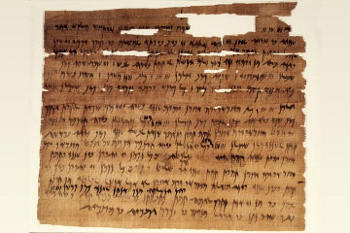
1 Chronicles
Judges
2 Kings
2 Chronicles
Joshua
Ruth
1 Kings
2 Samuel
1 Samuel
Nehemiah
Ezra
Esther
The Book of Ezra covers the period of time from the decree of Cyrus authorizing the Jews to return to Palestine (537 BC) down to the personal ministry of Ezra
The Book of Ezra emphases the process of recovery, rebuilding, repentance, and reform—based on faith and devotion to the statutes of the Lord
The later history of Ezra is found in the book of Nehemiah, which is a sequel to the book of Ezra.
(1, 2)

Slide 3
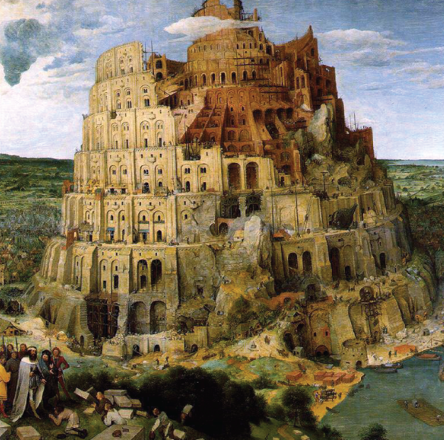
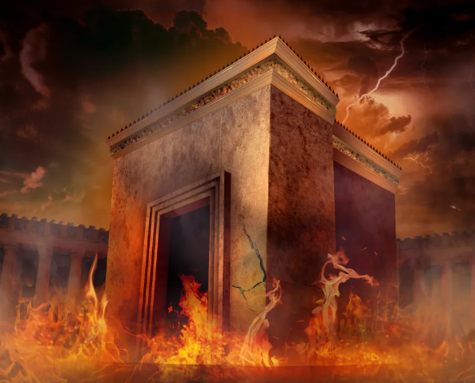
Previously…
Around 605 BC Babylonians conquered Jerusalem and began deporting captive Jews to Babylon.
In 587 BC, they destroyed the temple, and the deportations escalated. About 50 years later, Persia conquered Babylon under the command of King Cyrus.

Slide 4
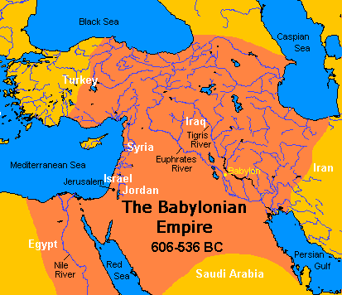
Babylonian Empire
Judah had served Babylonia for 70 years
Nabopolassar
(founder of dynasty)
Nebuchadnezzar
Ameil-Marduk
Neriglissar
(son in-law of Nebuchadnezzar)
Nabonidus
(son in-law of Nebuchadnezzar)
Labashi-Marduk
Belshazzar

Slide 5
Cyrus—King of Persia
He was the son of Cambyses I, King of Anshan and Mandane, daughter of Astyages, King of Media
His name means—the sun
He is known as Cyrus the Great who took over Babylonia and defeated the Chaldean dynasty that had been elevated to power by Nebuchadnezzar
Cyrus issued a decree in 537 BC allowing the Jewish people to return from captivity in Babylon to rebuild the temple at Jerusalem
Cyrus even gave back to them 5,400 gold and silver “vessels of the house of the Lord” that Nebuchadnezzar had taken out of Jerusalem
Daniel was well received in the court of Cyrus
He died on the battlefield in 529 BC while fighting the Scythian tribes on his northern frontier
(1,4)

Slide 6
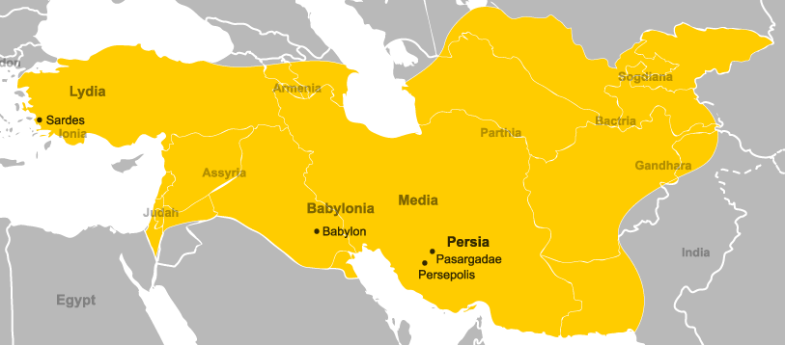
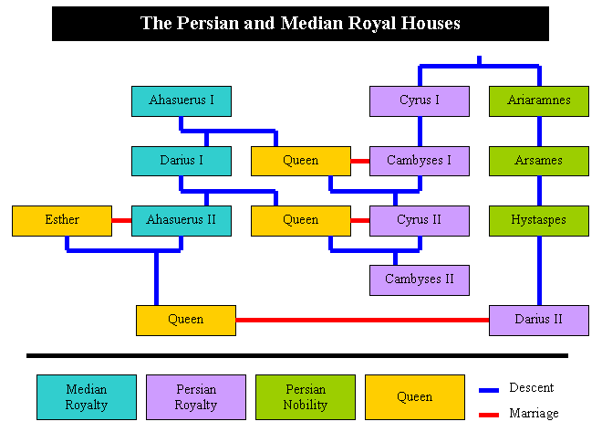
Persia Empire
559–530 BC

Slide 7
Ezra
He was a direct descendant of Aaron
He was a noted priest and scribe who accompanied a portion of the people of Judah back to their land after the Babylonian captivity
In 458 B.C. he obtained from Artaxerxes an important edict allowing him to take to Jerusalem any Jewish exiles who cared to go, along with offerings for the temple with which he was entrusted, and giving to the Jews various rights and privileges
He was also directed to appoint magistrates and judges
His first reform was to cause the Jews to separate from their foreign wives
Along with Nehemiah he took steps to instruct the people in the Mosaic law
A good many traditions have gathered around the name of Ezra
He is said to have formed the canon of Hebrew scripture and to have established an important national council, called the Great Synagogue, over which he presided
(1, 2, 4)

Slide 8
Nehemiah
He was from the tribe of Judah
He was in the office of the court of Artaxerxes of Persia-his cupbearer (Nehemiah 1:11)
His Jewish colleagues, Ezra being one of them, visited him and obtained from the king a commission to rebuild the walls and structures of Jerusalem
He was the governor of Judah (Nehemiah 5:14, 18; 12:26)
The book of Nehemiah is the sequel to the book of Ezra
The time span of the book of Nehemiah is either contemporaneous with the later ministry of Ezra or shortly thereafter, beginning perhaps around 444 BC
The book of Nehemiah closes with the historical account of the Old Testament, as the prophet Malachi, the last book, was contemporary with Nehemiah.
The book of Nehemiah contains: records of rebuilding the wall of Jerusalem, the return of the people from Babylon and their religious practices, and the reforms and civic practices, and dedication of the wall
(1, 2)

Slide 9
Jeremiah
He was born of a priestly family in Anathoth
He was a prophet of the Lord during the days of Lehi and Daniel
He prophesied during a 40-year periods, from around 626 to 585 BC, including the 70-year captivity of Judah
He declared with power and authority the central governing principles of the gospel—that peace and happiness depend on obedience and honoring the covenants of the Lord
He witnessed the fall of Jerusalem
His writings are included in the brass plates of Laban (1 Nephi 5:10-13) and also mentioned two other times in the Book of Mormon (1 Ne. 7:14; Hel. 8:20)
He prophesied of a ‘new and everlasting covenant’ that would be fulfilled in the return of the kingdom of God to earth prior to the Second Coming (Jeremiah 31:31-34)
After the fall of Jerusalem, the Jews who escaped into Egypt took Jeremiah with them as a kind of fetish (Jeremiah 43:6), and at last, according to tradition, stoned him to death
(1, 2)

Slide 10
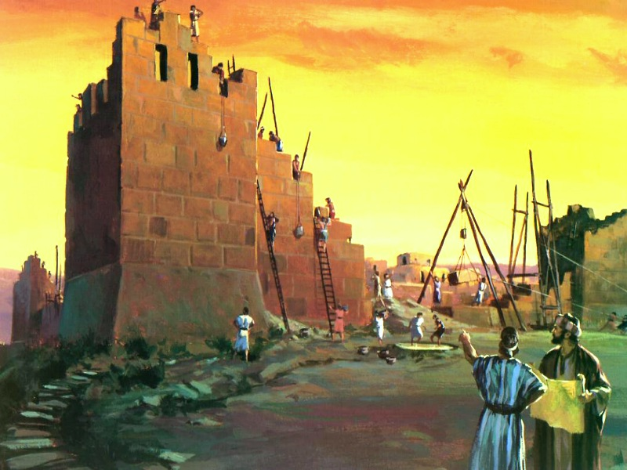
Rebuilding Jerusalem
Eventually, around 50,000 Jews returned to Jerusalem to rebuild the temple under the direction of Zerubbabel
The Jews first rebuilt the altar of the temple and began offering sacrifices.
They were directed by Zerubbabel, the Jewish man appointed by the Persians to serve as the governor of the Jews, and Jeshua, the presiding high priest of the Aaronic Priesthood.
Many Jews contributed time and resources to the reconstruction of the temple.
Zerubbabel was the grandson of Jehoiachin, and son of Pedaiah and was appointed governor of Judah by the Persian authorities when Cyrus issued his decree…he is called by Persian name Sheshbazzar, prince of Judah (1)
Ezra 2 and 3

Slide 11
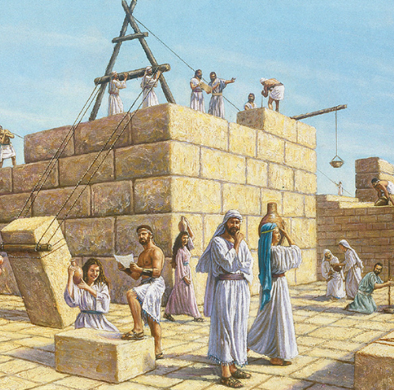
Fulfillment of Prophecy
The temple was rebuilt 70 years after it had been destroyed.
That saith of Cyrus, He is my shepherd, and shall perform all my pleasure: even saying to Jerusalem, Thou shalt be built; and to the temple, Thy foundation shall be laid. Isaiah 44:28
For thus saith the Lord, That after seventy years be accomplished at Babylon I will visit you, and perform my good word toward you, in causing you to return to this place. Jeremiah 29:10

Slide 12


How can the opposition someone faces in a soccer match be like what we experience as we try to keep the Lord’s commandments?
Immorality
Media
Worldly Views
Peer pressure

Slide 13
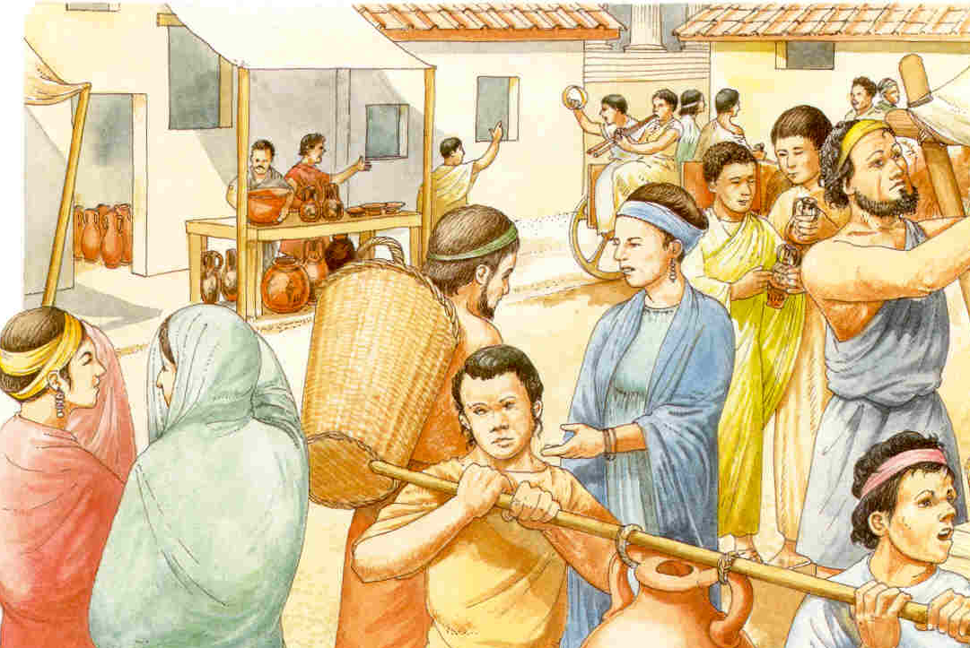
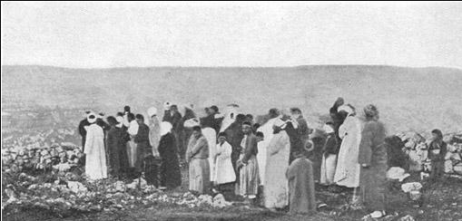
Opposition From Samaritans
When the Jews returned to Jerusalem, there was a group of people living nearby called Samaritans.
The Samaritans were “people who lived in Samaria after the northern kingdom of Israel was captured by the Assyrians.
The Samaritans were partly Israelite and partly Gentile. Their religion was a mixture of Jewish and pagan beliefs and practices.” (3)
Ezra 4:1-2

Slide 14
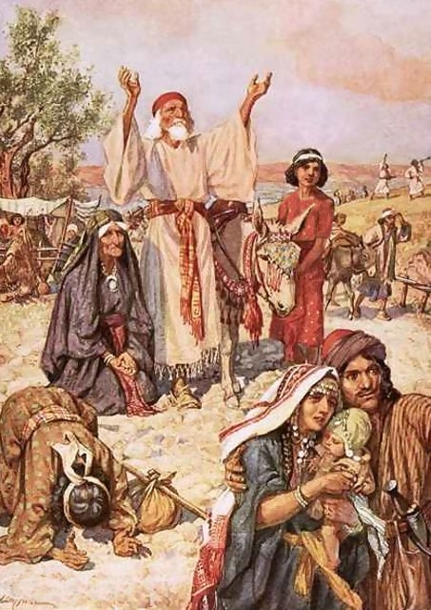
The Jews Were the Ones To Build
Jewish leaders cited King Cyrus’s decree that the Jews were the ones who were to rebuild the temple.
The leaders of the Jews may have rejected the Samaritans’ offer because the Samaritans were not faithful worshippers of Jehovah.
Furthermore, the Samaritans’ participation could have led to future conflicts if they claimed shared ownership of the reconstructed temple.
Ezra 4:3

Slide 15
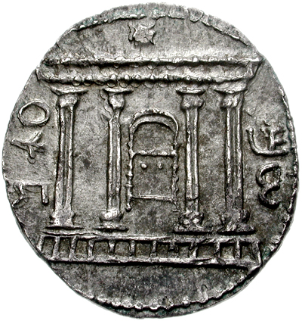
The Time is Not Come
The reconstruction of the temple halted for several years, largely because of the opposition of the Samaritans.
After years of not working on the reconstruction, some Jews lost interest in rebuilding the temple.
The time is not come, the time that the Lord’s house should be built.
Then came the word of the Lord by Haggai the prophet, saying,
Is it time for you, O ye, to dwell in your ceiled houses, and this house lie waste?
Haggai 1:2-4
Ezra 4:3-24

Slide 16
Haggai and Zechariah
Haggai was called, ‘the prophet unto Zerubbabel’
In the second year of King Darius, Haggai received 5 dated revelations which are in the Book of Haggai
Around 520 BC Haggai was told that the people were preaching to one another that this was no longer a time to build a temple.
They were told that if they went to work on this project again that they would be blessed
They finished the foundation
Haggai told Zerubbabel that the Lord had chosen him (Haggai 2:23)
Zechariah labored alongside Haggai who was the son of Berechiah, the son of Iddo, the prophet
Zechariah prophesied the 2nd and 4th years of King Darius
In a single night Zechariah had 8 visions which are recorded in Zechariah 1-6

Slide 17
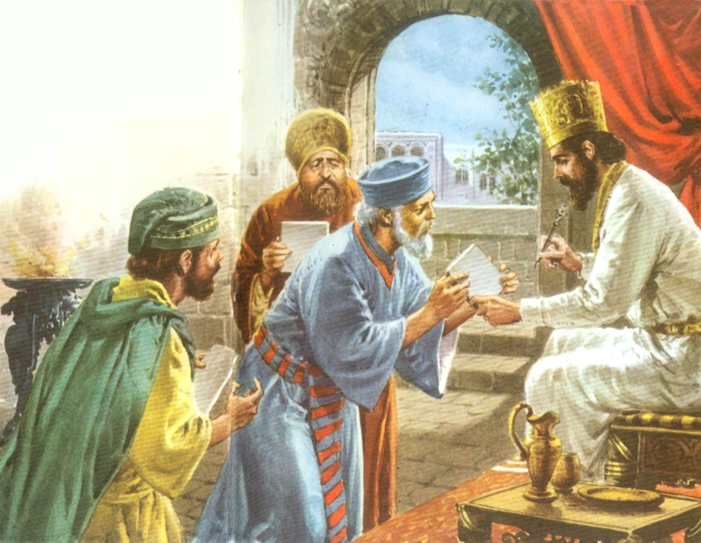
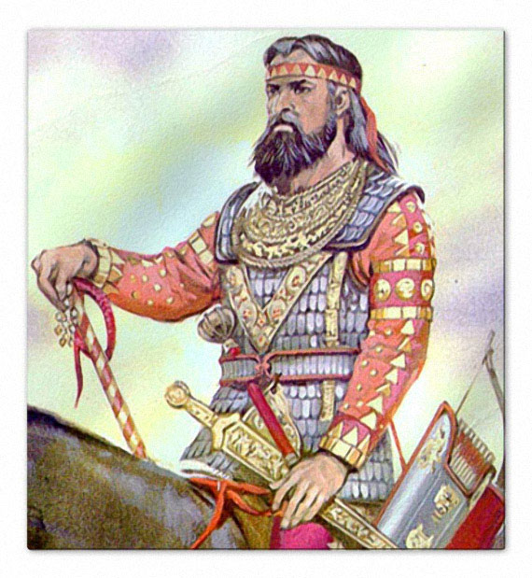
Resume Building the Temple
A new king, Darius, ruled the Persian Empire
When local Persian-appointed governors learned that the Jews had resumed building the temple, they questioned the Jews’ authority to do so and opposed the Jews’ renewed efforts.
However, King Darius made inquiries as to the decree of the temple issued by King Cyrus.
King Darius said, “Also I have made a decree, that whosoever shall alter this word, let timber be pulled down from his house, and being set up, let him be hanged thereon; and let his house be made a dunghill for this.”
Ezra 6:11

Slide 18
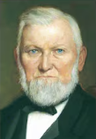
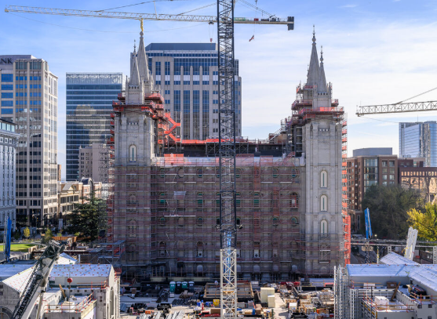
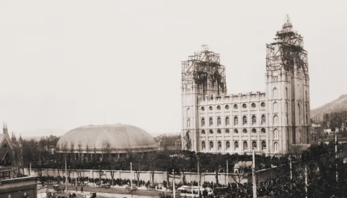
Looking Forward to a Temple
[At the dedication of the Salt Lake temple] President Wilford Woodruff then arose to address the Saints. “I have looked forward to this day for the last fifty years of my life,” he said. (5)
1892
2025

Slide 19

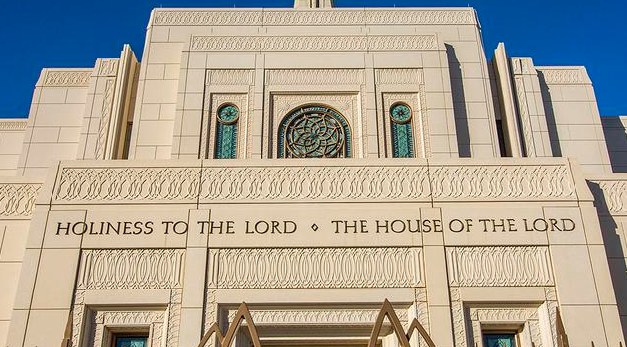
Preparing for a Temple
In some respects, it is easier to build a temple than it is to build a people prepared for a temple. (6)
Inscribed on each temple are the words “holiness to the Lord.”
That statement designates both the temple and its purposes as holy.
Those who enter the temple are also to bear the attribute of holiness.
As temples are prepared for the people, the people need to prepare themselves for the temple.
(6)

Slide 20
Sources:
Video: “A Voice of Gladness,” from time code 5:42 to 6:39.
Who’s Who in the Old Testament by Ed J. Pinegar and Richard J. Allen pp. 57-58, 90-91, 142,189
Bible Dictionary
Presentation by ©http://fashionsbylynda.com/blog/
3. Guide to the Scriptures, “Samaritans”; scriptures.lds.org
4. W. Cleon Skousen The Fourth Thousand Years p. 760
5. President Wilford Woodruff (1807–98), (Saints: The Story of the Church of Jesus Christ in the Latter Days, vol. 2, No Unhallowed Hand, 1846–1893 [2020], 663–64)
See: https://www.thechurchnews.com/2019/5/3/23215011/salt-lake-temple-brigham-young-surprising-stories-fun-facts/
6. President Russell M. Nelson (“Closing Remarks,” Ensign or Liahona, Nov. 2019, 122–23); (“Prepare for the Blessings of the Temple,” Liahona, Oct. 2010, 41)

Slide 21
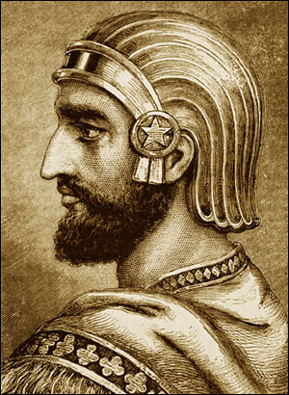
The book of Ezra contains also an introductory section (Ezra 1–6) describing events that happened from 60 to 80 years before the arrival of Ezra in Jerusalem, that is, the decree of Cyrus, 537 B.C., and the return of Jews under Zerubbabel; the attempt to build the temple and the hindrances due to the Samaritans; the preaching of Haggai and Zechariah and the completion of the temple, 516 B.C. There is no record in the book of any events between this date and the mission of Ezra.
Religious values in the book of Ezra are found in the teaching that (1) the promises of the Lord through His prophets shall all be fulfilled (Ezra 1:1; see also Jer. 25:13; 29:10; D&C 1:37–38; 5:20); (2) discipline and patience are born of disappointment, as one expectation after another was frustrated; (3) there is eternal significance in everyday life; (4) preparation is needed for the rule of Messiah, the law being the schoolmaster to bring men to Christ.
Folklore of Cyrus the Great:
Cyrus was born to Cambyses I, King of Anshan and Mandane, daughter of Astyages, King of Media during the period of 600-599 BC or 576-575 BC. According to Herodotus, Astyages had two dreams in which a flood, and then a series of fruit bearing vines, emerged from her pelvis, and covered the entire kingdom. These were interpreted by his advisers as a foretelling that his grandson would one day rebel and supplant him as king. Astyages summoned his daughter Mandane, at the time pregnant with Cyrus, back to Ectabana to have the child killed. Harpagus delegated the task to Mithradates, one of the shepherds of Astyages, who raised the child and passed off his stillborn son to Harpagus as the dead infant Cyrus. Cyrus lived in secrecy, but when he reached the age of 10, during a childhood game, he had the son of a nobleman beaten when he refused to obey Cyrus's commands. As it was unheard of for the son of a shepherd to commit such an act, Astyages had the boy brought to his court, and interviewed him and his adopted father. Upon the shepherd's confession, Astyages sent Cyrus back to Persia to live with his biological parents. However, Astyages summoned the son of Harpagus, and in retribution, chopped him to pieces, roasted some portions while boiling others, and tricked his adviser into eating his child during a large banquet. Following the meal, Astyages' servants brought Harpagus the head, hands and feet of his son on platters, so he could realize his inadvertent cannibalism.
In another version, Cyrus was presented as the son of a poor family that worked in the Median court. These folk stories are, however, contradicted by Cyrus's own testimony, according to which he was preceded as king of Persia by his father, grandfather and great-grandfather. Upon his return, Cyrus married Cassandane who was an Achaemenian and the daughter of Pharnaspes who bore him two sons, Cambyses II and Bardiya along with three daughters, Atossa, Artystone, and Roxane. Cyrus and Cassandane were known to love each other very much - Cassandane said that she found it more bitter to leave Cyrus than to depart her life. After her death, Cyrus insisted on public mourning throughout the kingdom. The Nabondius Chronicle states that Babylonia mourned Cassandane for six days (identified from 21–26 March 538 BC). After his father's death, Cyrus inherited the Persian throne at Pasargadae which was a vassal of Astyages. It is also noted that Strabo has said that Cyrus was originally named Agradates by his stepparents; therefore, it is probable that, when reuniting with his original family, following the naming customs, Cyrus's father, Cambyses I, named him Cyrus after his grandfather, who was Cyrus I.
--Wikipedia
King of Persia--Cyrus
Reign | 559–530 BC
Predecessor | Cambyses I
Successor | Cambyses II
King of Media
Reign | 549–530 BC
Predecessor | Astyages
Successor | Cambyses II
King of Lydia
Reign | 547–530 BC
Predecessor | Croesus
Successor | Cambyses II
King of Babylon
Reign | 539–530 BC
Predecessor | Belshazzar
Successor | Cambyses II

Slide 22
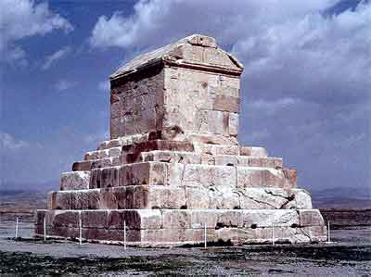
God inspires others:
President Ezra Taft Benson on King Cyrus:
“God, the Father of us all, uses the men of the earth, especially good men, to accomplish his purposes. It has been true in the past, it is true today, it will be true in the future” (“Civic Standards for the Faithful Saints,” Ensign, July 1972, 59).
Elder Dallin H. Oaks “No denomination—not even the restored Church—has a monopoly on the blessings of the Lord. He loves and blesses all of His children” (“Miracles,” Ensign, June 2001, 12).
Elder Robert D. Hales:
“While some were inspired to translate the Bible, others were inspired to prepare the means to publish it. By 1455 Johannes Gutenberg had invented a press with movable type, and the Bible was one of the first books he printed. For the first time it was possible to print multiple copies of the scriptures and at a cost many could afford.
“Meanwhile, the inspiration of God also rested upon explorers. In 1492 Christopher Columbus set out to find a new path to the Far East. Columbus was led by the hand of God in his journey. He said, ‘God gave me the faith, and afterwards the courage’ [quoted in Mark E. Petersen, The Great Prologue (1975), 29]” (“Preparations for the Restoration and the Second Coming: ‘My Hand Shall Be over Thee,’” Ensign or Liahona, Nov. 2005, 89).
President Ezra Taft Benson:
“God inspired … Christopher Columbus, who testified that he was inspired in what he did.
“‘Our Lord,’ said Columbus, ‘unlocked my mind, sent me upon the sea, and gave me fire for the deed. Those who heard of my enterprise called it foolish, mocked me, and laughed. But who can doubt but that the Holy Ghost inspired me?’ (Jacob Wasserman, Columbus, Don Quixote of the Seas, pp. 19–20.)” (The Teachings of Ezra Taft Benson [1988], 577).
Tomb of King Cyrus--This tomb of the great Persian ruler, Cyrus, was discovered in 1951 at the ruins of Pasargadae (south-central Iran). Over 2500 years old, the tomb is in decent condition, made of white limestone and stands a total of 36 feet high. The tomb itself is 18 feet high resting on a 6 level base, also 18 feet high. It was built like a Ziggurat with Ionian and Lydian features. There is a small entrance and double doors leading to a room with no windows which once contained the "golden sarcophagus" of Cyrus, it is now an empty shell. Five huge stones make up its roof, which was slanted (gabled) to shed heavy rains. These Nordic gables were the architectural style of lands far to the north. The inscription was seen and recorded by Plutarch in AD 90.
Biblehistory.com

Slide 23
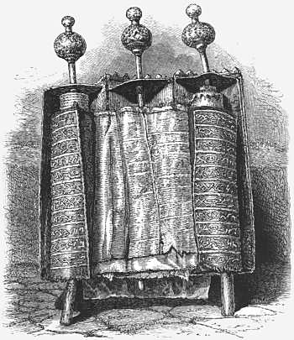
Rebuilding the Temple:
Following the Babylonian captivity, Cyrus the Persian king authorized the Jews to build a temple 60 cubits (90 feet) in height and breadth (Ezra 6:3; Josephus, Antiquities XI. 4, 6; cf. XV. 11, 1), in place of the one destroyed by Nebuchadnezzar in 500 B.C. The temple was probably begun about the second year after their return from captivity (537 B.C.?), but the Jews met difficulties, including much opposition from the Samaritans, and discontinued building. But in the second year of Darius the king (520 B.C.), the Lord gave word to the Jews to finish the sacred structure. The whole prophecy of Haggai is in relation to this project.
The plan of Solomon’s temple was followed in general, but due to the poverty of the people, not on such a lavish scale. Many of the vessels used in the former temple were restored. (Ezra 1:7–11.) The Holy of Holies was empty, for the Ark of the Covenant disappeared when Nebuchadnezzar’s forces invaded Palestine.
This temple, called after Zerubbabel, and sometimes known as the Second Temple, was completed in the sixth year of Darius, 515 B.C. (Ezra 3:8; Ezra 6:15.) Sidney B. Sperry Ancient Temples and Their Functions” Ensign Jan. 1972
Kings of Persia
Cyrus | 559-530 BC
Cambyses II | 530-522 BC
Bardiya | 522 BC
Darius I | Sept. 522- Oct. 486 BC
Xerxes I | 486-465 BC
Artaxerxes II | 465-424 BC
Xerxes II | 424 BC
The Samaritans:
The Torah (Pentateuch) is the only portion of the Bible which the Samaritans hold sacred. It is their sole guide and rule of life. Their version differs in many points from the Hebrew version. The other historic portions of the Hebrew Scriptures they regard as spurious, and especially resent the account given therein of their origin. They describe themselves as "Children of Israel," but trace their origin chiefly to the two sons of Joseph. They date their separation from the Jews from the time of Eli the priest, whom they regard as a usurper, he not having been of the priestly family of Eleazar, but a descendant of Thamar, Aaron's fourth son. According to the Samaritan Chronicle their high priests were true descendants of the sacredly appointed branch of the family until A.D. 1624, when the last male representative of the line died. Then, as it is recorded, "the consecration of Levites commenced;" sacrifices ceased to be offered up, and the ministrations were limited to such services as may legally be performed by them. (Source: Picturesque Palestine, vol. 2, p. 16.)
Within the veil [of the Samaritan synagogue] are preserved with jealous care, among other literary treasures, three very ancient copies of the Samaritan Pentateuch, one of which is said to have been written by Abishua, the great-grandson of Aaron. This celebrated Roll of the Law, which is probably of the third century of our era, is preserved in a cylindrical silver-gilt case, opening as a triptych does on two sets of hinges . . . .The roll itself is composed of prepared goat-skins twenty-five inches high and about fifteen feet wide; they are neatly joined together, but in many places have been torn and rather clumsily repaired with parchment of various qualities. . . . A crimson satin cover, on which Samaritan inscriptions are embroidered in gold thread, envelopes the treasure. (Source: Picturesque Palestine, vol. 2, p. 16.)
Life in the Holy Land. Com

Slide 24
King Artaxerxes in the Bible is primarily Artaxerxes I, a Persian king who reigned from 465–424 BC and is featured in the books of Ezra and Nehemiah. He played a significant role in the post-exilic Jewish community by issuing decrees that permitted Ezra to return to Jerusalem and led religious restorations, and later allowed Nehemiah to rebuild the city walls.
Supporting Ezra:
In the seventh year of his reign, Artaxerxes I issued a decree that allowed Ezra, a priest and scribe, to lead a group of exiles back to Jerusalem. The decree granted Ezra authority to appoint magistrates and judges, teach the Law of God, and ensure the proper worship in the temple.
Supporting Nehemiah:
Later, in his twentieth year, Artaxerxes I granted Nehemiah, his cupbearer, permission to return to Jerusalem to rebuild the city walls. The king provided Nehemiah with letters for safe passage and resources needed for the construction.
Historical Context:
During his reign, Artaxerxes I also faced revolts, such as a major rebellion in Egypt, but ultimately maintained control of his vast empire.
Connection to the Book of Esther:
Some ancient sources, like the Septuagint and Josephus, identify the Ahasuerus mentioned in the book of Esther with Artaxerxes I, though this is not the prevailing modern view, which identifies Ahasuerus as Xerxes I.

