Slide 1

Return to Jerusalem, the Second Group
Ezra 7-10
And all the people gathered themselves together as one man into the street that was before the water gate; and they spake unto Ezra the scribe to bring the book of the law of Moses, which the Lord had commanded to Israel.
Nehemiah 8:1

Slide 2

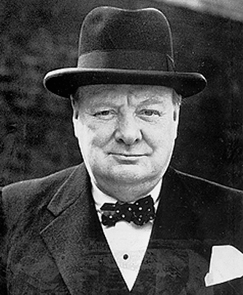
“To every man there comes … that special moment when he is figuratively tapped on the shoulder and offered the chance to do a special thing unique to him and fitted to his talent. What a tragedy if that moment finds him unprepared or unqualified for the work which would be his finest hour.”
(1)

Slide 3
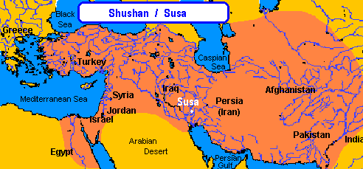
Ezra
The books of Ezra and Nehemiah tell the story of Israel’s history from the first return to Jerusalem until the end of Nehemiah’s second term as governor of Judah
The books of Ezra and Nehemiah are the last two historical books of the Old Testament.
Ezra, who prepared and qualified himself to have God’s help as he faced challenges and fulfilled his mission in life.
The events in Ezra 7 occurred more than 60 years after the temple in Jerusalem was finished and dedicated.
Ezra, a descendant of Aaron who held the priesthood, lived in Shushan, the capital of the Persian Empire, when Artaxerxes reigned as king of Persia.

Slide 4
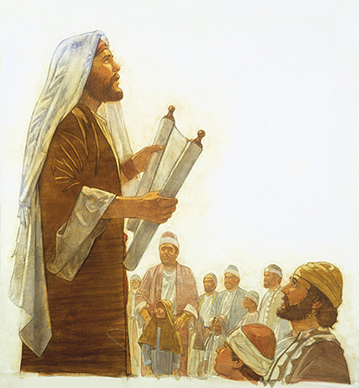
“A Ready Scribe”
Scribes had the responsibility to study and teach the scriptures.
A “ready scribe in the law of Moses” was someone who was skillful in explaining the law.
In the seventh year of Artaxerxes, king of Persia, Ezra goes up to Jerusalem; and with him certain of the priests
Ezra 7:1-6

Slide 5
Artaxerxes
He was the son of Xerxes and king of Persia around 465-425 BC
He was called Longimanus (long-handed)
At first, he hindered the Jews from restoring Jerusalem because the enemies of the Jewish sate had raised warning of sedition against the loss of revenues to the king
Later he permitted the rebuilding of the temple to go forward
He eventually appointed Nehemiah as governor of Judea and permitted him to rebuild the wall of the city of Jerusalem
(2)

Slide 6
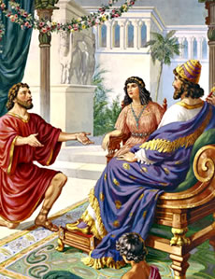
Leading Another Group
Born in captivity, Ezra was inspired to ask Artaxerxes, king of Persia, for permission to lead another group of Jews back to Jerusalem in 459 B.C.
The king granted him everything he asked, providing him with an impressive letter of introduction and credentials that entitled Ezra to whatever he and his group needed during their journey. (3)
Ezra 7:11-27

Slide 7
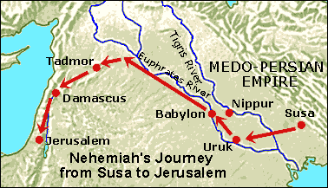
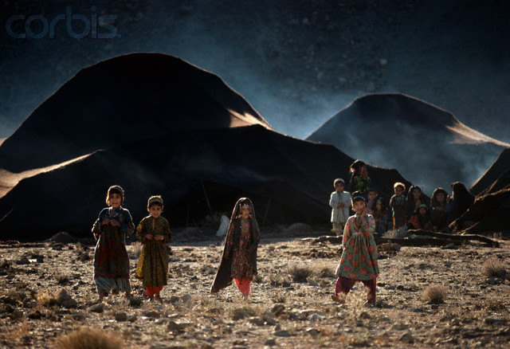
Shushan to Jerusalem
Ezra and hundreds of Jews were allowed to leave captivity and travel approximately 900 miles from Shushan to Jerusalem.
This journey was extremely dangerous because the Israelites had to travel through thief-infested deserts carrying the large amounts of gold, silver, and other treasure that Artaxerxes had given them to beautify the temple in Jerusalem
Ezra 7:15-23

Slide 8
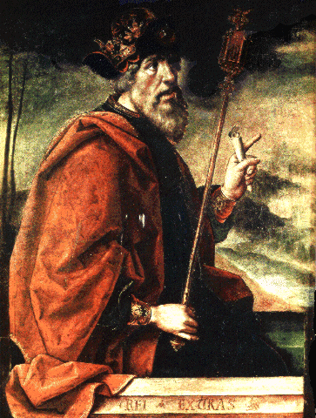
“Good Hand Upon Him”
Ezra had prepared his heart” implies that Ezra had tried his best to seek to know and live God’s commandments and to teach them to others.
As we try our best to fully live and teach the commandments, then the Lord’s hand will be upon us to bless our lives
Ezra 7:10

Slide 9
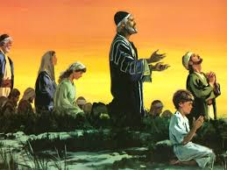
Before the Journey
Ezra and the people fast and pray for and gain guidance and protection in going to Jerusalem.
“Ezra’s party of over 1700 includes priests, people and, somewhat reluctantly, Levites. With them they take gifts valuing more than £1,000,000 [about $2,225,000].
Ezra is faced with a long and dangerous journey at a time of great unrest. And having boasted his confidence in God, he can hardly now apply to the king for an escort! His prayer is heartfelt, and his faith rewarded by God’s own safe-conduct.” (4)
The Levites are called to accompany them
Ezra 8

Slide 10
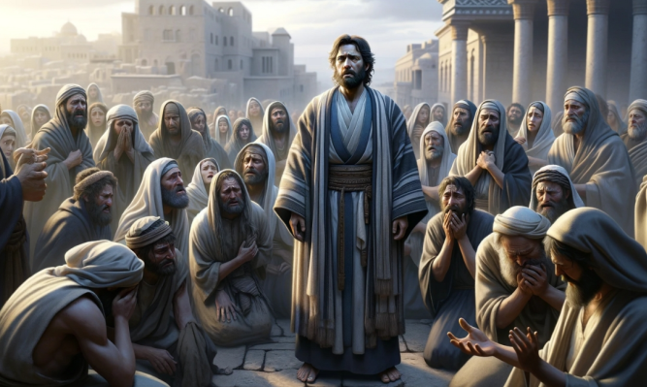
The Power of Fasting and Prayer
More than 60 years after the completion of the temple in Jerusalem, King Artaxerxes of Persia sent a Jewish scribe named Ezra to Jerusalem to appoint government leaders and present an offering to beautify the temple. Seeking the Lord’s guidance and protection, Ezra decided that he and his people should fast and pray.
Then I proclaimed a fast there, at the river of Ahava, that we might afflict ourselves before our God, to seek of him a right way for us, and for our little ones, and for all our substance.
So we fasted and besought our God for this: and he was entreated of us.
Then we departed from the river of Ahava on the twelfth day of the first month, to go unto Jerusalem: and the hand of our God was upon us, and he delivered us from the hand of the enemy, and of such as lay in wait by the way.
Ezra 7:25; 8:21,23,31

Slide 11
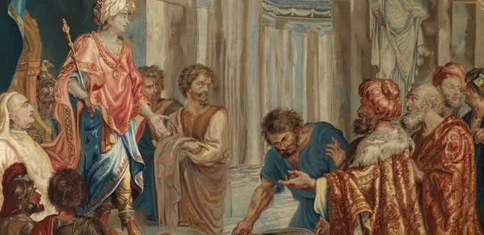
Why didn’t Ezra ask the king for a military escort from Babylon to Jerusalem?
Ezra had testified to the king that God’s hand would be upon all those who seek Him.
Ezra was unwilling to ask the king for an escort because he was concerned that the king would then question Ezra’s words
Ezra 8:22

Slide 12
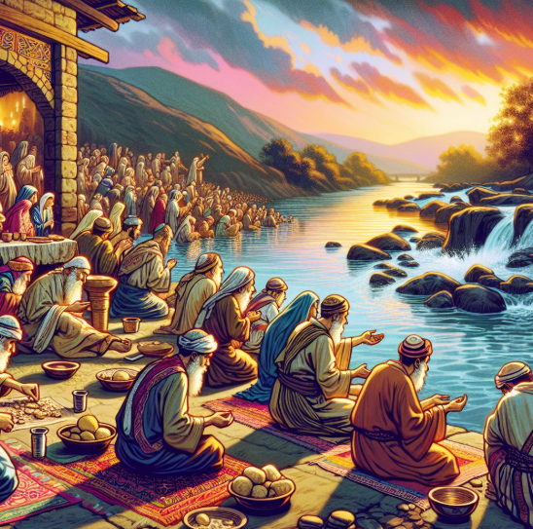
At the River Ahava
So we fasted and besought our God for this: and he was entreated of us.
Ezra divided the treasure among several people and gave them charge to deliver it safely to Jerusalem.
“enemy” and “such as lay in wait by the way”
If we fast and pray, we can receive the Lord’s help with challenges we face
Ezra 8:24-32

Slide 13
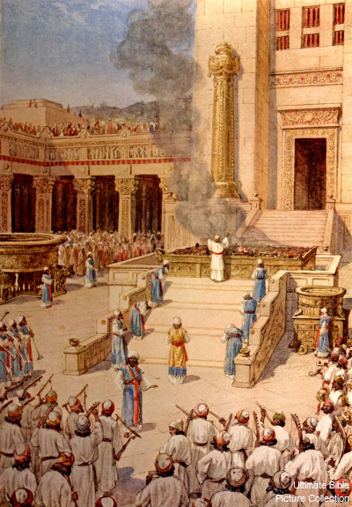
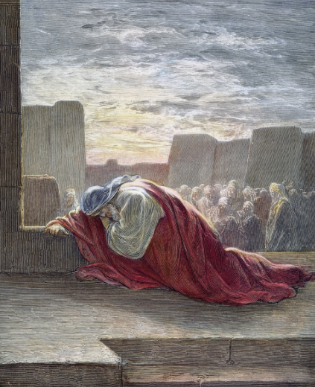
The Sins of the People
Shortly after Ezra arrived in Jerusalem, he commenced his priestly duties of putting affairs in order.
The priests and Levites in Jerusalem had allowed the temple service to seriously deteriorate.
Many of them had gone out to make a living because the temple was not supported sufficiently to allow them to serve full time.
Some of them had even taken wives of the pagan nations, as had many other Jewish citizens.
All of this horrified Ezra and many of the faithful who had told him of the problem. (5)
Ezra 9

Slide 14
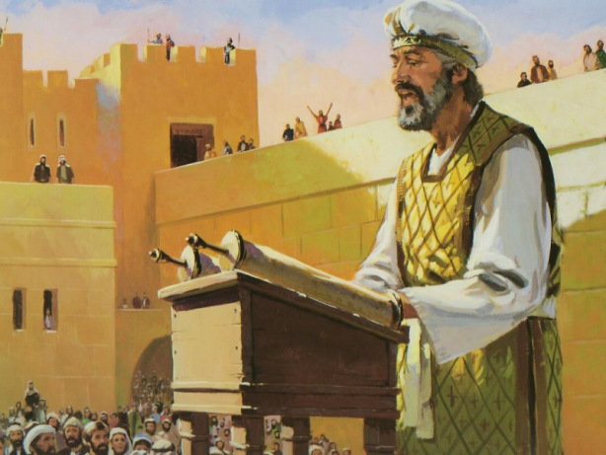
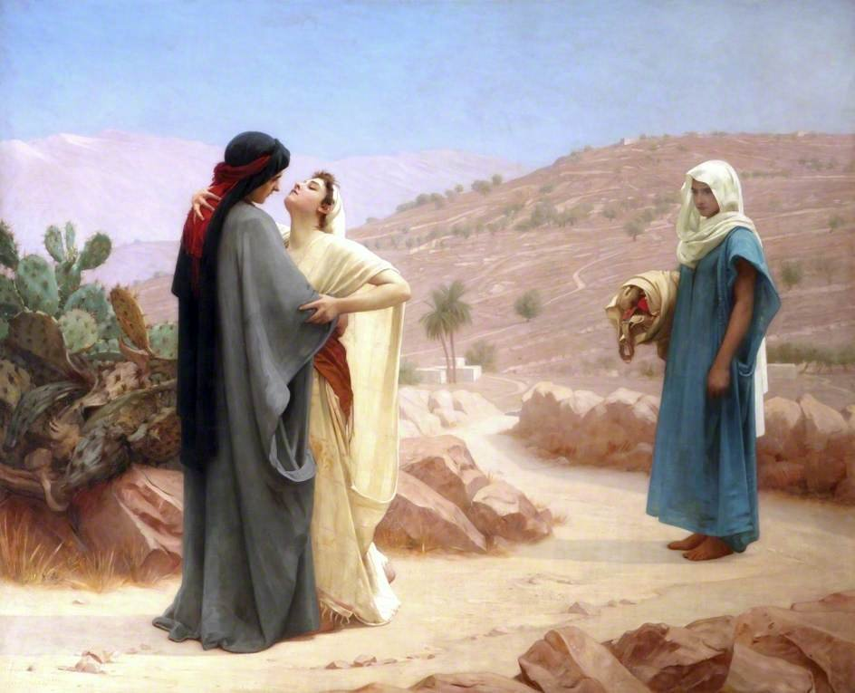
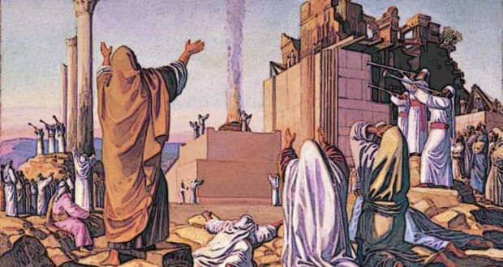
Put Away Your Wives
Ezra told them that they needed to confess their sins and separate themselves from their “strange wives’ who worshipped idols (see *notes)
Ezra called for all of the Israelites living throughout Judah to meet together at Jerusalem in three days.
And they gave their promise that they would put away their wives
And they gave their hands that they would put away their wives; and being guilty, they offered a ram of the flock for their trespass.
Ezra 10:19

Slide 15

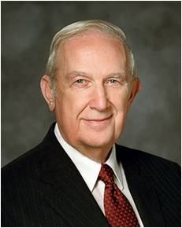
“I testify that of all the necessary steps to repentance, the most critically important is for you to have a conviction that forgiveness comes in and through Jesus Christ. It is essential to know that only on His terms can you be forgiven. You will be helped as you exercise faith in Christ.
That means you trust Him and His teachings.” (6)

Slide 16
Sources:
Videos: Hope of God’s Light (6:46)
Atonement—Not a One-Time Thing (3:01)
Sir Winston Churchill, prime minister of the United Kingdom during World War II (as quoted by Jeffrey R. Holland, “Sanctify Yourselves,” Ensign, Nov. 2000, 40).
Presentation by ©http://fashionsbylynda.com/blog/
2. Who’s Who in the Old Testament by Ed J. Pinegar and Richard J. Allen p. 19
3. Brian D. Garner Ezra Unfolds the Scriptures Dec. 2002 Ensign
4. Alexander and Alexander, Eerdmans’ Handbook, p. 308.) found in Old Testament Institute Manual: Exiles Return: Ezra
5. Old Testament Institute Manual: Exiles Returns: Ezra
6. Elder Richard G. Scott (“Peace of Conscience and Peace of Mind,” Ensign or Liahona, Nov. 2004, 17).

Slide 17
Shushan:
Susa is also mentioned in the Ketuvim of the Hebrew Bible by the name Shushan,
mainly in Esther, but also once each in Nehemiah and Daniel. Both Daniel and Nehemiah lived in Susa during the Babylonian captivity of the 6th century BCE. Esther became queen there, married to King Ahasueurus, and saved the Jews from genocide. A tomb presumed to be that of Daniel is located in the area, known as Shush-Daniel. The tomb is marked by an unusual white stone cone, which is neither regular nor symmetric. Many scholars believe it was at one point a Star of David. Susa is further mentioned in the Book of Jubilees (8:21 & 9:2) as one of the places within the inheritance of Shem and his eldest son Elam; and in 8:1, "Susan" is also named as the son (or daughter, in some translations) of Elam.
Wikipedia
Ezra as Esdras:
Josephus spoke of the circumstances in Jerusalem at the time of Ezra and how he was assigned to correct the situation (Ezra is known as Esdras in the Josephus account). Ezra was a man of great faith, and one moved by the Spirit of the Lord. He petitioned King Xerxes for permission to return with more Jews. Xerxes agreed and wrote a letter to the governors of Judah. Josephus wrote:
“When Esdras had received this epistle, he was very joyful, and began to worship God, and confessed that he had been the cause of the king’s great favour to him, and that for the same reason he gave all the thanks to God. … So he gathered those that were in the captivity together beyond Euphrates, and staid there three days, and ordained a fast for them, that they might make their prayers to God for their preservation, that they might suffer no misfortunes by the way, either from their enemies, or from any other ill accident; for Esdras had said beforehand, that he had told the king how God would preserve them. …
“Now these things were truly done under the conduct of Esdras; and he succeeded in them, because God esteemed him worthy of the success of his conduct, on account of his goodness and righteousness.” (Antiquities, bk. 11, chap. 5, par. 3.) Found in Old Testament Student Manual “The Exiles Return: Ezra”
Artaxerxes was probably born in the reign of his grandfather Darius I, to the emperor's son and heir, Xerxes I. In 465 BC, Xerxes I was murdered by Artabanus, the commander of the royal bodyguard and the most powerful official in the Persian court (Hazarapat/commander of thousand), with the help of a eunuch, Aspamitres. Greek historians give contradicting accounts of events. According to Ctesias (in Persica 20), Artabanus then accused the Crown Prince Darius, Xerxes's eldest son, of the murder and persuaded Artaxerxes, to avenge the patricide by killing Darius. But according to Aristotle (in Politics 5.1311b), Artabanus killed Darius first and then killed Xerxes. After Artaxerxes discovered the murder he killed Artabanus and his sons
Kings of Persia
Cyrus | 559-530 BC
Cambyses II | 530-522 BC
Bardiya | 522 BC
Darius I | Sept. 522- Oct. 486 BC
Xerxes I | 486-465 BC
Artaxerxes II | 465-424 BC
Xerxes II | 424 BC
The Levites in Ezra 8:15
Any male member of the tribe of Levi was a Levite, but a priest had to be a descendant of Aaron, who was also of the tribe of Levi. Priests were thus a subgroup of the Levites. The sons referred to in Ezra 8:15 are those of the Levites who were not priests, that is, those Levites who were not descendants of Aaron.
Intermarriage with people from some of the surrounding nations was expressly forbidden by the Lord because it led to idolatry (see Deuteronomy 7:1–5). Idolatry had led to the downfall of the Israelite nation, but even the horrors of defeat and exile had not taught the people their lesson.

Slide 18
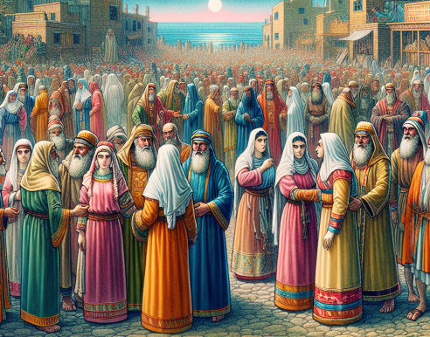
*Put Away Your Wives:
As thou hast said, so must we do - They all resolved to do what Ezra then commanded, they did put away their wives, even those by whom they had children; Ezr 10:44 : this was a great hardship on the women and children. Though by the Jewish laws such marriages were null and void, yet as the women they had taken did not know these laws, their case was deplorable. However, we may take it for granted that each of them received a portion according to the circumstances of their husbands, and that they and their children were not turned away desolate, but had such a provision as their necessities required. Humanity must have dictated this, and no law of God is contrary to humanity. After all, there is some room to doubt whether they did put them finally away, for several years after Nehemiah found Jews that had married wives of Ashdod, Ammon, and Moab; Neh 13:23. And if these were not the same women, we find that the same offense was continued.
Ezra 10:17
The first day of the first month - So they were three whole months in examining into this affair, and making those separations which the law required.
Ezra 10:19
They gave their hands - They bound themselves in the most solemn manner to do as the rest of the delinquents had done; and they made all acknowledgment of their iniquity to God by offering each a ram for a trespass-offering.
Ezra 10:44
Some of them had wives by whom they had children - This observation was probably intended to show that only a few of them had children; but it shows also how rigorously the law was put in execution.
Commentary on the Bible, by Adam Clarke, [1831], at sacred-texts.com
The phrase is used in Ezra 10, where Ezra commands the people to send away their foreign wives and children. (Foreign wives=those not of the covenant faith) Many Israelites, including priests and Levites, had married women from surrounding pagan lands, like the Canaanites, Moabites, and Egyptians.
This was seen as a violation of the covenant to remain separate from these peoples and was believed to corrupt their faith and the Messianic line.
This action was prompted by the concern that these marriages were leading to the worship of foreign gods and a departure from the worship of Yahweh.
This was a directive to maintain the religious purity of the community after the Babylonian exile.

