Slide 1

I Know That My Redeemer Lives
Job 14-19
But they that wait upon the Lord shall renew their strength; they shall mount up with wings as eagles; they shall run, and not be weary; and they shall walk, and not faint.
Isaiah 40:31

Slide 2

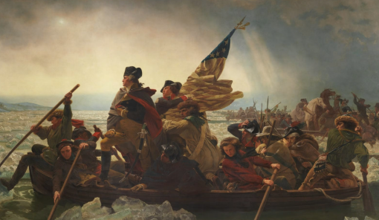
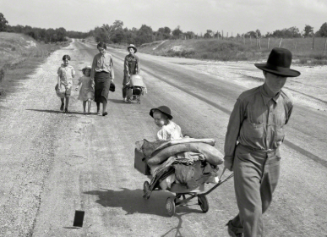
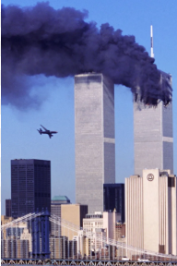
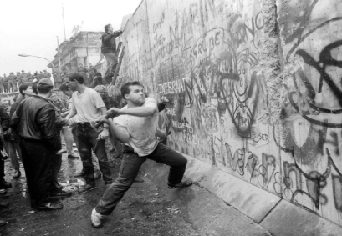
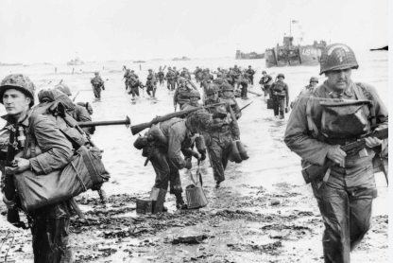
American Revolution
American Revolution
What is the greatest event in history?
Great Depression
9/11
Fall of the Berlin Wall
World War II

Slide 3
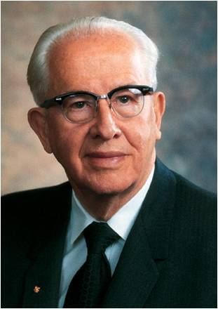
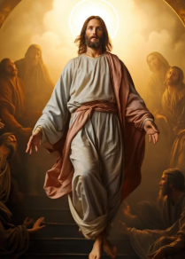
The greatest events of history are those that affect the greatest number of people for the longest periods.
By this standard, no event could be more important to individuals or nations than the resurrection of the Master. (5)

Slide 4
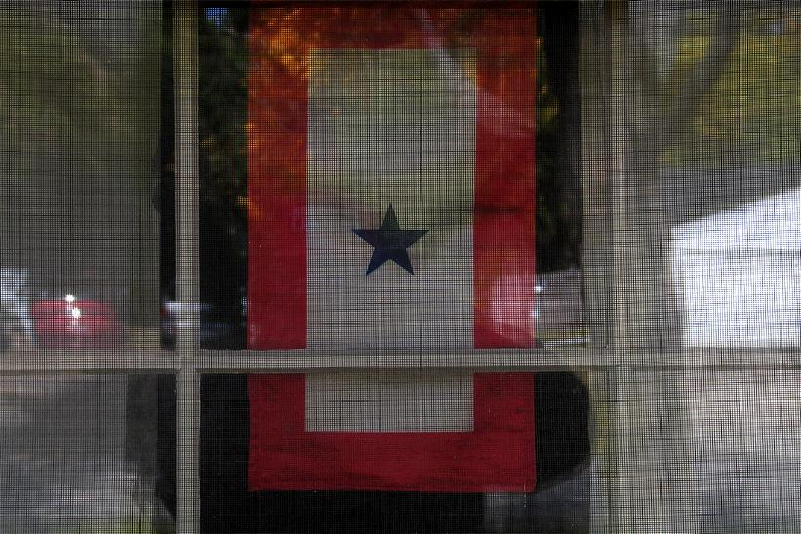
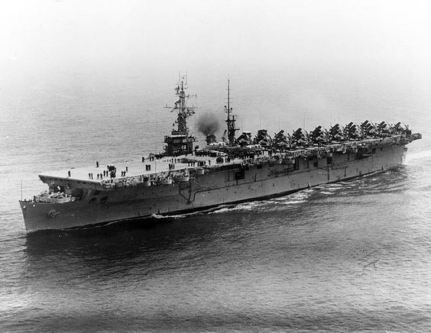
“Arthur’s mother was so proud of the blue star which graced her living room window. It represented to every passerby that her son wore the uniform of his country and was actively serving. When I would pass the house, she often opened the door and invited me in to read the latest letter from Arthur. Her eyes would fill with tears; I would then be asked to read aloud. Arthur meant everything to his widowed mother. …
“… While at Saipan in the South Pacific, the ship [Arthur served on] was attacked. Arthur was one of those on board who was lost at sea.
(1)

Slide 5
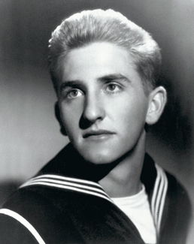
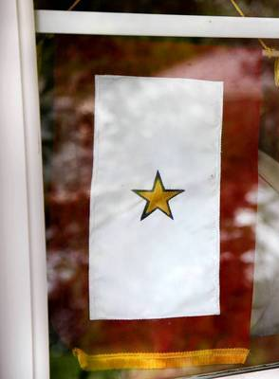
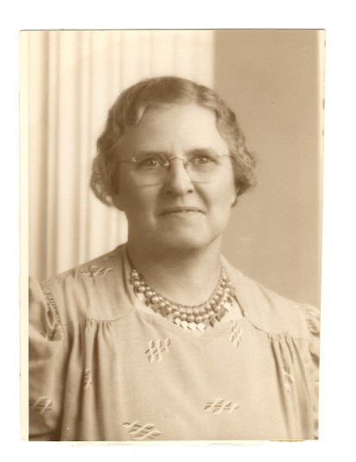
“The blue star was taken from its hallowed spot in the front window of the Patton home. It was replaced by one of gold, indicating that he whom the blue star represented had been killed in battle. A light went out in the life of Mrs. Patton. She groped in utter darkness and deep despair.
“With a prayer in my heart, I approached the familiar walkway to the Patton home, wondering what words of comfort could come from the lips of a mere boy”
“Mrs. Patton gazed into my eyes and spoke: ‘Tommy, I belong to no church, but you do. Tell me, will Arthur live again?’ To the best of my ability, I testified to her that Arthur would indeed live again”
(1)

Slide 6
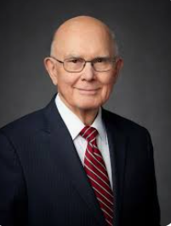
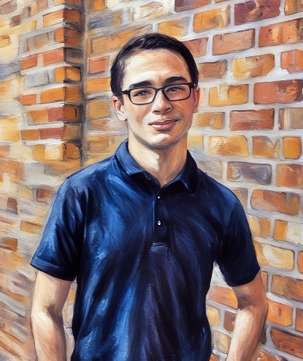
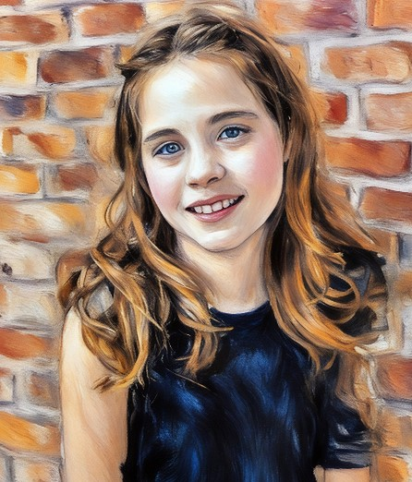
The Resurrection from the dead is the reassuring personal pillar of our faith. It adds meaning to our doctrine, motivation to our behavior, and hope for our future. …
The Resurrection gives us the perspective and the strength to endure the mortal challenges faced by each of us and those we love.
It gives us a new way to view the physical, mental, or emotional deficiencies we have at birth or acquire during mortal life.
It gives us the strength to endure sorrows, failures, and frustrations. Because each of us has an assured resurrection, we know that these mortal deficiencies and oppositions are only temporary. (6)
(6)

Slide 7
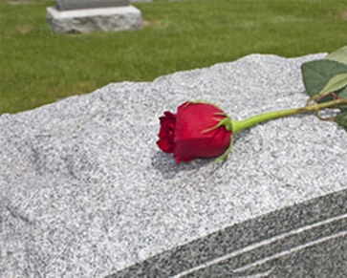
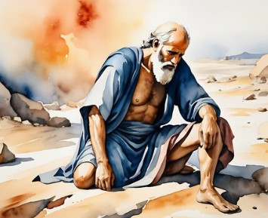
Near Death
Like Mrs. Patton, we may experience times when we will grieve the death of a loved one. In addition, each of us at some time will die.
Job had lost his children and was physically ill with sores
My breath is corrupt, my days are extinct, the graves are ready for me.
Job felt that he was near death
Job 17:1

Slide 8

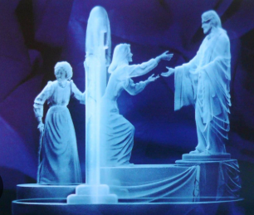
Hope in a Tree
If a man die, shall he live again? all the days of my appointed time will I wait, till my change come.
Because of Jesus Christ, we will be resurrected and see God again.
Job 14:7-14, 23,24
(2)

Slide 9
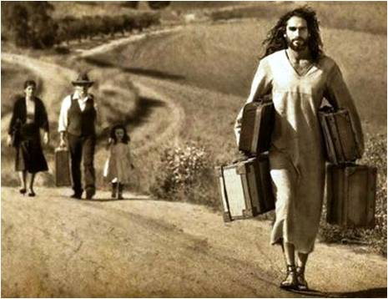
Where Is Hope?
And where is now my hope? as for my hope, who shall see it?
Each one of us carries a load. These loads can weigh us down or give us enough spiritual traction to keep us moving forward along the path to Heavenly Father.
When our burden is Christ’s burden, we receive the enabling power of the Atonement in our lives and will be blessed with spiritual traction.
Read Matthew 11:28-30
Job 17:15
(2)

Slide 10
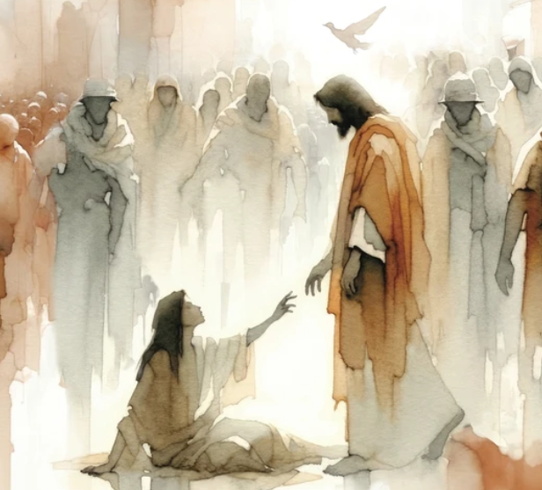
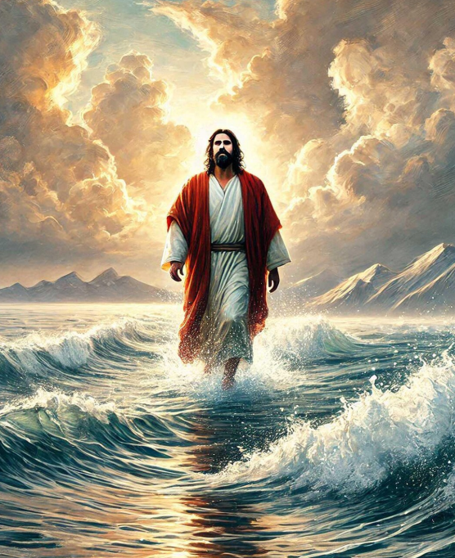



Resurrection
Helaman 14:17
1 Corinthians 15:20–22
Alma 11:42–44
Moroni 7:41
Mosiah 16:7–8
(1)

Slide 11
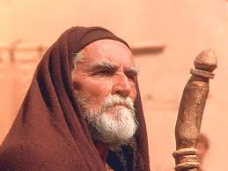
Bildad
He talked about the state of the wicked who do not know God, implying that Job was also wicked.
2nd speech
Bildad, in a speech of passionate invective, accuses Job of impatience and impiety, Job 18:1-4; shows the fearful end of the wicked and their posterity; and apparently applies the whole to Job, whom he threatens with the most ruinous end,
1st speech
Bildad answers, and reproves Job for his justifying himself.
3rd and final speech
Bildad, the Shuhite, in an irregular speech, shows that God's dominion is supreme, his armies innumerable, and his providence extended over all, Job 25:1-3; that man cannot be justified before God; that even the heavenly bodies cannot be reputed pure in his sight; much less man, who is naturally weak and sinful, Job 25:4-6.
His third speech marked the silencing of the friends.
Job 18
(2)

Slide 12
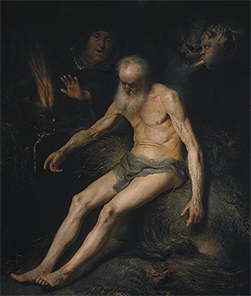
Job’s Complaints
Not one of them seems to have been touched with a feeling of tenderness towards him, nor does a kind expression drop at any time from their lips! (3)
Verse 6: Know now that God hath overthrown me, and hath compassed me with his net. (*see notes)
Verse 2—when Job was a man of influence and prosperous they claimed him as a friend
Verse 7—He complained of the violence and injustice
Verse 9—He had lost his respect and honor
Verse 10—There is no more hope
Verse 11-13—His enemies are there to destroy him and what he has
Verse 14—His family abandon’s him
Verse 17—His children are gone
Verse 20—”bone cleaveth to skin”—His skin is wasted away
---”skin of my teeth”– a narrow escape from death
Job 19
(3)

Slide 13
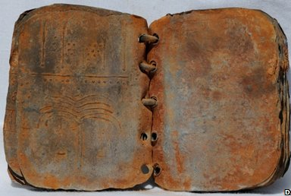
Iron Pen and Lead
Some suppose that the meaning of this place is this: the iron pen is the chisel by which the letters were to be deeply cut in the stone or rock; and the lead was melted into those cavities in order to preserve the engraving distinct.
But this is not so natural a supposition as what is stated above; that Job refers to the different kinds of writing or perpetuating public events, used in his time.
Job not only possessed a testimony of the Savior but also desired to write it down, preserve it, and share it with others
Job 19:24
(3)

Slide 14
Oh that my words were now written! oh that they were printed in a book!
That they were graven with an iron pen and lead in the rock for ever!
For I know that my redeemer liveth, and that he shall stand at the latter day upon the earth:
And though after my skin worms destroy this body, yet in my flesh shall I see God:
Whom I shall see for myself, and mine eyes shall behold, and not another. (Job 19:23–27.)

Slide 15
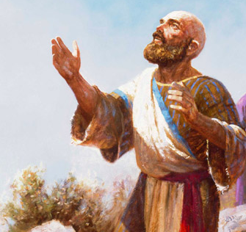
I Know…
For I know that my redeemer liveth, and that he shall stand at the latter day upon the earth:
“after my skin worms destroy this body” -- the death and decay of Job’s physical body.
“yet in my flesh I shall see God.”
Because of the Resurrection of Jesus Christ, we too will be resurrected
Our testimony of the Savior and the Resurrection can give us hope in the midst of our trials
Job 19:25-27

Slide 16
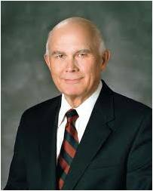
“The assurance of resurrection gives us the strength and perspective to endure the mortal challenges faced by each of us and by those we love, such things as the physical, mental, or emotional deficiencies we bring with us at birth or acquire during mortal life.
Because of the resurrection, we know that these mortal deficiencies are only temporary!”
(4)

Slide 17
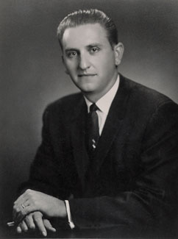

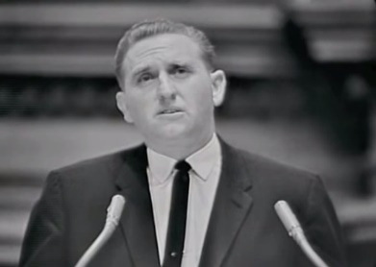
The Story Continues…
Twenty-five years later, after President Monson had lost contact with Mrs. Patton, he gave a talk during a general conference of the Church entitled “Mrs. Patton, Arthur Lives!”
“… I had little or no hope that Mrs. Patton would actually hear the talk. I had no reason to think she would listen to general conference. As I have mentioned, she was not a member of the Church. And then I learned that something akin to a miracle had taken place.
Having no idea whatsoever who would be speaking at conference or what subjects they might speak about, Latter-day Saint neighbors of Mrs. Terese Patton in California, where she had moved, invited her to their home to listen to a session of conference with them. She accepted their invitation and thus was listening to the very session where I directed my remarks to her personally.
(1)

Slide 18
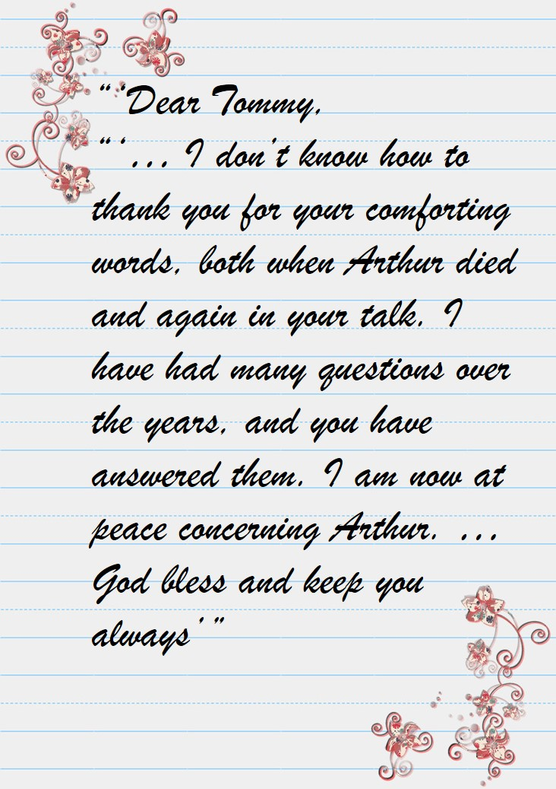
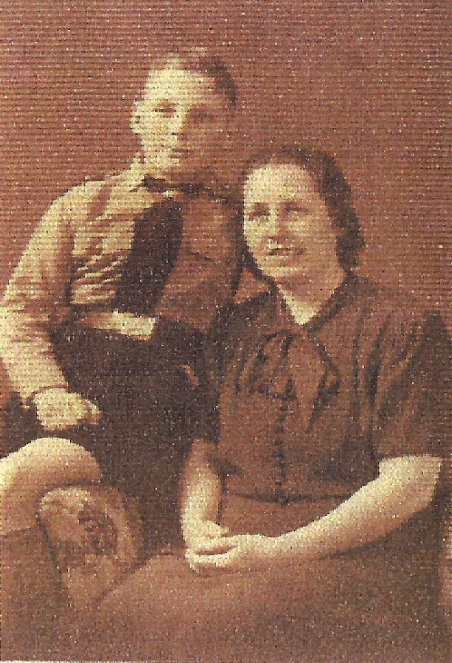

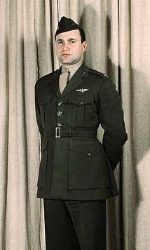

“… To my astonishment and joy, I received a letter … from Mrs. Terese Patton. I share with you a part of that letter:
These are not the actual pictures
(1)

Slide 19
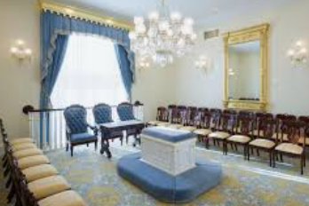
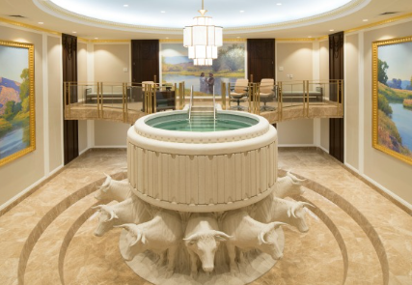
Our temples are living, working testimonies to our faith in the reality of the resurrection. They provide the sacred settings where living proxies can perform all of the necessary ordinances of mortal life in behalf of those who live in the world of the spirits.
None of this would be meaningful if we did not have the assurance of universal immortality and the opportunity for eternal life because of the Resurrection of our Lord and Savior, Jesus Christ. (5)
(1)

Slide 20
Sources:
Suggested Hymn: #136 I Know That My Redeemer Lives
Videos:
Until We Meet Again (3:39)
Bearing Our Burdens With Hope (8:46)
“What Happens after We Die?” (1:40).
President Thomas S. Monson (“Mrs. Patton—the Story Continues,” Ensign or Liahona, Nov. 2007, 22).
For the Strength of the Youth (Bearing our Burdens With Hope)
Presentation by ©http://fashionsbylynda.com/blog/
3. Adam Clarke Bible Commentary
4. Elder Dallin H. Oaks “Resurrection,” Ensign, May 2000, 15; “Resurrection,” Ensign, May 2000, 16.
5. (Teachings of Presidents of the Church: Ezra Taft Benson [2014], 94)
6. President Dallin H. Oaks (“What Has Our Savior Done for Us?,” Liahona, May 2021, 75)

Slide 21
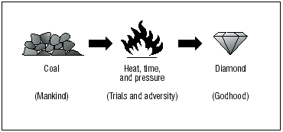
According to the ship’s own “Report of Changes of U.S.S. White Plains (CVE 66) for the month ending 19th day of July 1944,” Patton was declared as “missing” on 4 July 1944, not in March 1944. Moreover, that “missing” designation was ascribed in Patton’s case to the “result of own misconduct.” In other words, Patton was not classified by his ship’s crew log as having been killed during, or as a result of, battle action.
Superficial readers have imagined that the art of printing existed in Job's time, and that it was not a discovery of the fifteenth century of the Christian era: whereas there is no proof that it ever existed in the world before a.d. 1440, or thereabouts, for the first printed book with a date is a psalter printed by John Fust, in 1457, and the first Bible with a date is that by the same artist in 1460. Three kinds of writing Job alludes to, as being practiced in his time:
Writing in a book, formed either of the leaves of the papyrus, already described, (see on Job 8:11; (note)), or on a sort of linen cloth. A roll of this kind, with unknown characters, I have seen taken out of the envelopments of an Egyptian mummy. Denon, in his travels in Egypt, gives an account of a book of this kind, with an engraved facsimile, taken also out of an Egyptian mummy.
2. Cutting with an iron stile on plates of lead.
3. Engraving on large stones or rocks, many of which are still found in different parts of Arabia.To the present day the leaves of the palm tree are used in the East instead of paper, and a stile of brass, silver, iron, etc., with a steel point, serves for a pen. By this instrument the letters are cut or engraved on the substance of the leaf, and afterwards some black colouring matter is rubbed in, in order to make the letters apparent. This was probably the oldest mode of writing, and it continues among the Cingalese to the present day. It is worthy of remark that Pliny (Hist. Nat., lib. xiii., c. 11) mentions most of these methods of writing, and states that the leaves of the palm tree were used before other substances were invented. After showing that paper was not used before the conquest of Egypt by Alexander the Great,. "At first men wrote on palm tree leaves, and afterwards on the bark or rind of other trees. In process of time, public monuments were written on rolls of lead, and those of a private nature on linen books, or tables covered with wax."
The Net:
"Know, therefore, that God hath encompassed me with his net, and overthrown me;"
the allusion may be to an ancient mode of combat practiced among the ancient Persians, ancient Goths, and among the Romans. The custom among the Romans was this: "One of the combatants was armed with a sword and shield, the other with a trident and net. The net he endeavored to cast over the head of his adversary, in which, when he succeeded, the entangled person was soon pulled down by a noose that fastened round the neck, and then despatched. The person who carried the net and trident was called Retiarius, and the other who carried the sword and shield was termed Secutor, or the pursuer, because, when the Retiarius missed his throw, he was obliged to run about the ground till he got his net in order for a second throw, while the Secutor followed hard to prevent and despatch him."
The Persians in old times used what was called (Persic) kumund, the noose. It was not a net, but a sort of running loop, which horsemen endeavored to cast over the heads of their enemies that they might pull them off their horses. That the Goths used a hoop net fastened to a pole, which they endeavored to throw over the heads of their foes, is attested by Olaus Magnus,
"Some use elastic ropes, formed like hunting nets, which they throw aloft; and when they come in contact with the enemy, they throw these ropes over the head of their opponent, and by this means they can then drag either man or horse to themselves." At the head of the page he gives a wood-cut representing the net, and the manner of throwing it over the head of the enemy. To such a device Job might allude, God hath encompassed me with his Net, and overthrown me.
Adam Clarke Bible Commentary

Slide 22
Oh that my words were now written? Oh that they were printed in a book!
That they were graven with an iron pen and lead in the rock for ever!
For I know that my redeemer liveth, and that he shall stand at the latter day upon the earth:
And though after my skin worms destroy this body, yet in my flesh shall I see God:
Whom I shall see for my self, and mine eyes shall behold, and not another.
Job 19:23-27
Oh that my words were now written? Oh that they were printed in a book!
That they were graven with an iron pen and lead in the rock for ever!
For I know that my redeemer liveth, and that he shall stand at the latter day upon the earth:
And though after my skin worms destroy this body, yet in my flesh shall I see God:
Whom I shall see for my self, and mine eyes shall behold, and not another.
Job 19:23-27
Oh that my words were now written? Oh that they were printed in a book!
That they were graven with an iron pen and lead in the rock for ever!
For I know that my redeemer liveth, and that he shall stand at the latter day upon the earth:
And though after my skin worms destroy this body, yet in my flesh shall I see God:
Whom I shall see for my self, and mine eyes shall behold, and not another.
Job 19:23-27
Oh that my words were now written? Oh that they were printed in a book!
That they were graven with an iron pen and lead in the rock for ever!
For I know that my redeemer liveth, and that he shall stand at the latter day upon the earth:
And though after my skin worms destroy this body, yet in my flesh shall I see God:
Whom I shall see for my self, and mine eyes shall behold, and not another.
Job 19:23-27

Slide 23
Elihu the son of Barachel the Buzite - Buz was the second son of Nahor, the brother of Abram (Genesis 22:21)
Of the kindred of Ram - Kemuel was the third son of Nahor; and is called in Genesis (see above) the father of Aram, which is the same as Ram. A city of the name of Buz is found in Jeremiah 25:23, which probably had its name from this family; and, as it is mentioned with Dedan and Tema, we know it must have been a city in Idumea, as the others were in that district. Instead of the kindred of Ram, the Chaldee has of the kindred of Abraham. But still the question has been asked, Who was Elihu? I answer, He was "the son of Barachel the Buzite, of the kindred of Ram:" this is all we know of him. But this Scriptural answer will not satisfy those who are determined to find out mysteries where there are none. Some make him a descendant of Judah; St. Jerome, Bede, Lyranus, and some of the rabbins, make him Balaam the son of Beor, the magician; Bishop Warburton makes him Ezra the scribe; and Dr. Hodges makes him the second person in the glorious Trinity, the Lord Jesus Christ, and supposes that the chief scope of this part of the book was to convict Job of self-righteousness, and to show the necessity of the doctrine of justification by faith! When these points are proved, they should be credited. (Adam Clarke Bible Commentary)
According to the Book of Job, Elihu is one of Job's friends, descended from Nahor (Job 32:2, 34:1). He is said to have descended from Buz who may be from the line of Abraham(Genesis 22:20-21 mentions Buz as a nephew of Abraham). (Wikipedia)

