Slide 1

Prophecy:
The Coming of the Savior
Isaiah 36-41
My righteousness is near; my salvation is gone forth, and mine arms shall judge the people; the isles shall wait upon me, and on mine arm shall they trust.
Isaiah 51:5

Slide 2






Placing Trust In the Lord
Dating issues
Computer issues
What are some situations you might face in which you will need to know that you can trust in the Lord?
Peer pressure issues
Defending your faith issues
Parent issues

Slide 3
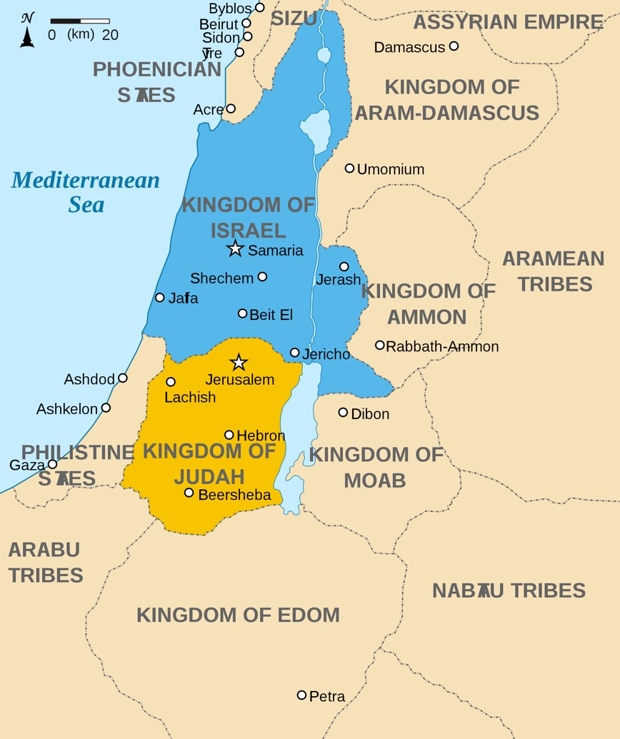
Recap
1095 B.C.
975 B.C.
721 B.C.
587 B.C.
United Kingdom Under Saul
Kingdoms Divide
Rehoboam— Israel
Jeroboam— Judah
Assyrians capture Israel
(lost 10 tribes)
Judah is spared
Judah (Jerusalem) is taken captive by Babylonians
Isaiah told the people of Judah that if they trusted in the Lord, they would be saved from the Assyrian army.
The people followed Isaiah’s counsel and were spared. However, Isaiah then prophesied that the Babylonians would eventually capture and plunder Jerusalem.
Isaiah 36-39
(2)

Slide 4
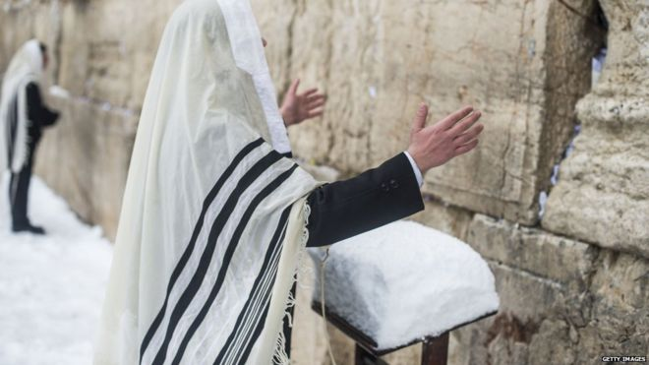
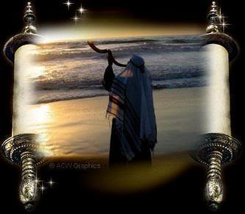
A Message of Comfort
“The message of comfort to Jerusalem, ‘that her warfare is accomplished, that her iniquity is pardoned,’ clearly refers to the latter days.
The Millennium will bring peace to a city that has known no peace. Ever since Israel was established as a state, there has been war and rumors of war for Jerusalem.
Isaiah 40:1-2
(4)

Slide 5
A Voice in the Wilderness—Isaiah Or John?
The New Testament (Greek) form of the name Isaiah, as in Luke 4:17 and Acts 8:30.
Also an ancient prophet who lived in the days of Abraham and who was blessed by him. He was a bearer of the Melchizedek Priesthood. Bible Dictionary
The Savior clearly identified the “voice in the wilderness” as John the Baptist (1)
For this is he that was spoken of by the prophet Esaias, saying, The voice of one crying in the wilderness, Prepare ye the way of the Lord, make his paths straight.
Matthew 3:3
But if this forerunner was to prepare the way for the person who was to tell Jerusalem that times of trial were over (see Isaiah 40:1), then the prophet clearly could not be referring only to John the Baptist’s mortal ministry. (1)
He said, I am the voice of one crying in the wilderness, Make straight the way of the Lord, as said the prophet Esaias.
John 1:3
Conclusion:
Esaias is a forerunner, a messenger of the coming of the Savior, those who preach the gospel*
Yea, even he should go forth and cry in the wilderness: Prepare ye the way of the Lord, and make his paths straight; for there standeth one among you whom ye know not; and he is mightier than I,
1 Nephi 10:8-9 referring to Esaias as John the Baptist
Isaiah 40:3-5

Slide 6
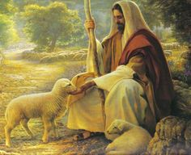



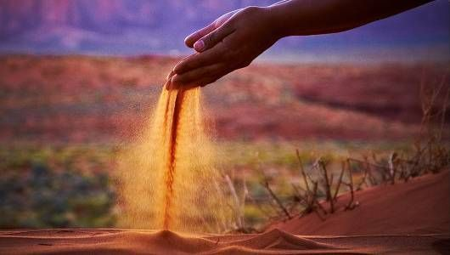

Continuing Comfort--imagery
Isaiah 40:6–8
Isaiah 40:10–11
Isaiah 40:12–15
Isaiah 40:22–25

Slide 7
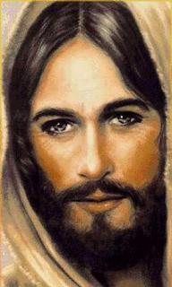
Endless, Eternal, and Everlasting
Signifying that he endures forever, for ‘his years never fail
And God spake unto Moses, saying: Behold, I am the Lord God Almighty, and Endless is my name; for I am without beginning of days or end of years; and is not this endless? Moses 1:3
Endless and Eternal:
Moses 1:3
Moses 7:35
D&C 19:10
Everlasting:
Gen. 21:33
Isaiah 9:6, 40:28 Jeremiah 10:10 Romans 16:26
D&C 133:34
Isaiah 40:28-31

Slide 8
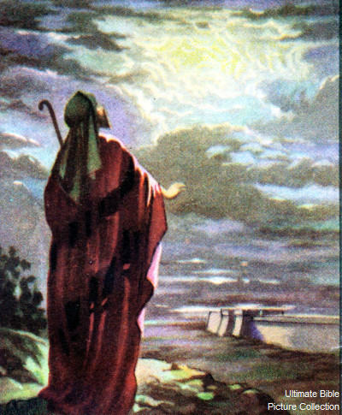
“Isles” Include the Americas
From time to time the Lord has led away remnants of Israel to “isles” from which He will eventually gather them before the Second Coming.
…but we have been led to a better land, for the Lord has made the sea our path, and we are upon an isle of the sea. 1 Nephi 19:10
“isles”—not known to others
And behold, there are many who are already lost from the knowledge of those who are at Jerusalem. Yea, the more part of all the tribes have been led away; and they are scattered to and fro upon the isles of the sea; and whither they are none of us knoweth, save that we know that they have been led away.
1 Nephi 22:4
Isaiah alluded to scattered Israel when he used the metaphor “isles” and suggested that there, in the isles, they would learn to trust Him and wait upon His word and be renewed together. All of this would come near the time of the harvest.
Then scattered Israel will learn a new song, the song of the redeemed, as they are gathered into the kingdom.
Isaiah 41:1, 5
(1)

Slide 9
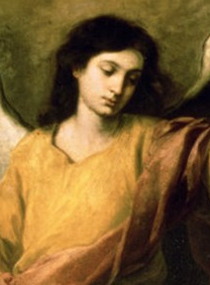
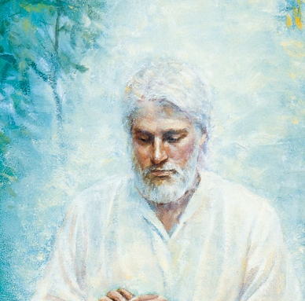
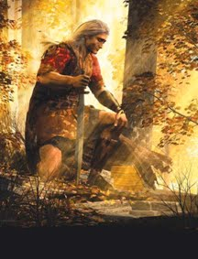
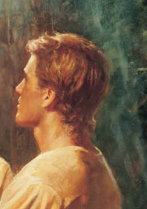
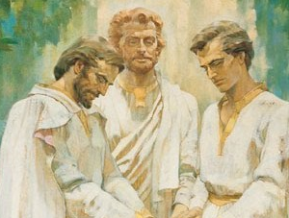
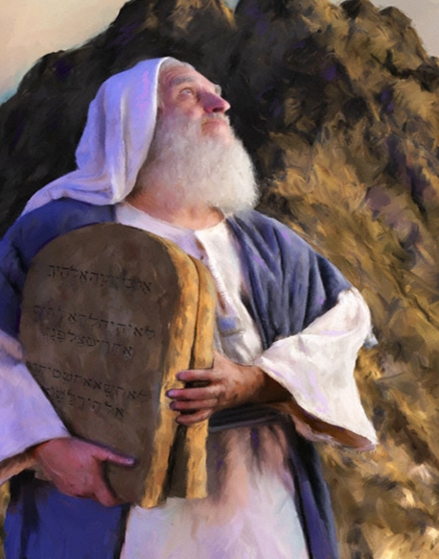
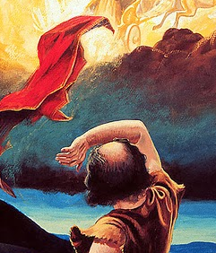
‘A Righteous Man”
Elias which was to come to gather together the tribes of Israel and restore all things. D&C 77:9
Many angelic ministrants have been sent from the courts of glory to confer keys and powers, to commit their dispensations and glories again to men on earth.
At least the following have come: Moroni, John the Baptist, Peter, James and John, Moses, Elijah, Elias, Gabriel, Raphael, and Michael.
Isaiah 41:2
(1)

Slide 10
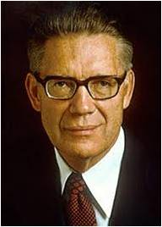
An Elias
Since it is apparent that no one messenger has carried the whole burden of the restoration, but rather that each has come with a specific endowment from on high, it becomes clear that Elias is a composite personage.
The expression must be understood to be a name and a title for those whose mission it was to commit keys and powers to men in this final dispensation.
The “man from the east” seems to mean angels of the Restoration, who are grouped together under the composite title of Elias. (1)
Isaiah 41:2
(4)

Slide 11
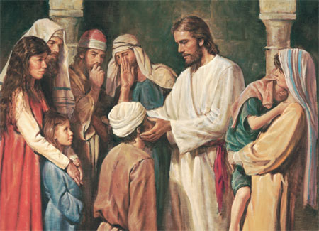
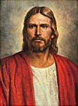

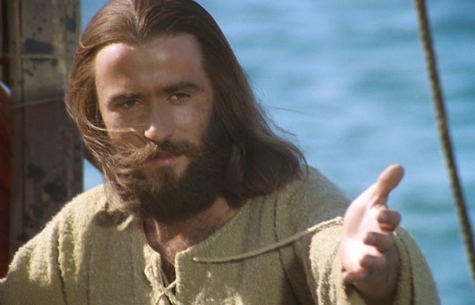
Desire to Strengthen
1. How firm a foundation, ye Saints of the Lord,
Is laid for your faith in his excellent word!
What more can he say than to you he hath said,
Who unto the Savior, who unto the Savior,
Who unto the Savior for refuge have fled?
2. In ev'ry condition—in sickness, in health,
In poverty's vale or abounding in wealth,
At home or abroad, on the land or the sea—
As thy days may demand, as thy days may demand,
As thy days may demand, so thy succor shall be.
3. Fear not, I am with thee; oh, be not dismayed,
For I am thy God and will still give thee aid.
I'll strengthen thee, help thee, and cause thee to stand,
Upheld by my righteous, upheld by my righteous,
Upheld by my righteous, omnipotent hand.
7. The soul that on Jesus hath leaned for repose
I will not, I cannot, desert to his foes;
That soul, though all hell should endeavor to shake,
I'll never, no never, I'll never, no never,
I'll never, no never, no never forsake!
Isaiah 41
(3)

Slide 12


Fear Not
God will not abandon His covenant people. Through His prophet Isaiah, God comforted those who would eventually be taken captive into Babylon. God offers us, His covenant people today, the same words of comfort:
Fear is not new. The disciples of Jesus Christ, out on the Sea of Galilee, feared the “wind, and the waves” in the dark of the night (Mark 4:34). As His disciples today, we too have fears. (5)
Isaiah 41:10
(3)

Slide 13
What Are Our Fears?
Grades
Marriage
Mission
Making a mistake
Relationships with family
Change
Rejection
Isaiah 41:10
(3)

Slide 14
Our single adults fear making commitments such as getting married. Young marrieds … can fear bringing children into an increasingly wicked world. Missionaries fear lots of things, especially approaching strangers. Widows fear going forward alone.
Teenagers fear not being accepted; grade schoolers fear the first day of school; university students fear getting back a test.
We fear failure, rejection, disappointment, and the unknown.
We fear hurricanes, earthquakes, and fires that ravage the land and our lives.
We fear not being chosen, and on the flip side, we fear being chosen.
We fear not being good enough; we fear that the Lord has no blessings for us.
We fear change, and our fears can escalate to terror. Have I included just about everyone?
Isaiah 41:10
(5)

Slide 15

Fear not, thou worm Jacob, and ye men of Israel; I will help thee, saith the Lord, and thy redeemer, the Holy One of Israel.
Worm=meek and humble
God promises to provide help, salvation, and redemption.
We don’t need to fear, because God will be with and strengthen His covenant people.
Isaiah 41:14
(5)

Slide 16
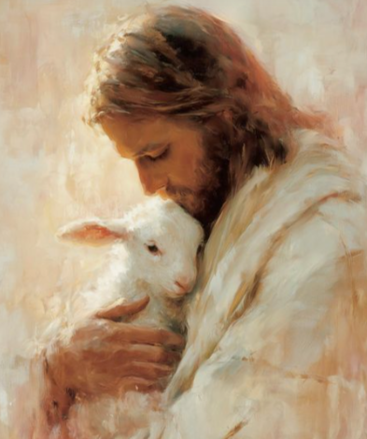


Comforting Others
Isaiah 40:9-11
Isaiah 40:28-31
Isaiah 41:17-20
(5)

Slide 17

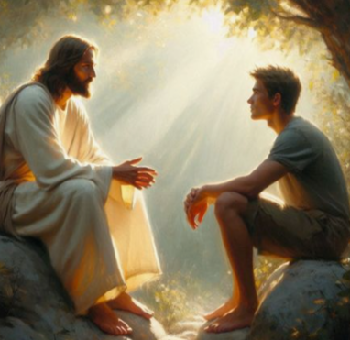
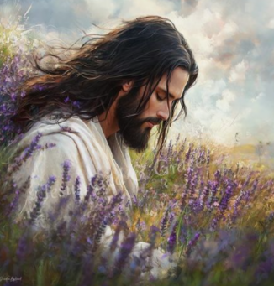
Comforting Others
Isaiah 42:5-7
Isaiah 43:1-2
Isaiah 43:25-26
(5)

Slide 18
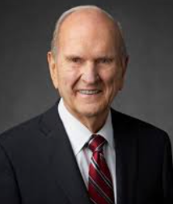
I know that life without God is a life filled with fear. I also know that life with God is a life filled with peace, joy, and power. Resolve to live your life with God.
My dear young people, our Heavenly Father and His Beloved Son, Jesus Christ, are ready to bless you. They will not forsake you. (6)
(5)

Slide 19
Sources:
Suggested Hymn: #85 How Firm A Foundation
Video:
Growing Through Life’s Trials(1:01)
Old Testament Institute Manual (Prophecies of the Dispensation of the fullness of Times) Chapter 15
Bible Chronology
Presentation by ©http://fashionsbylynda.com/blog/
3. Text: Attr. to Robert Keen, ca. 1787. Included in the first LDS hymnbook, 1835.Music: Attr. to J. Ellis, ca. 1889
Elder Bruce R. McConkie (Doctrines of Salvation, vol. 1, pp. 170–174.)” (Mormon Doctrine, p. 221.)
Elder Ronald A. Rasband (“Be Not Troubled,” Ensign or Liahona, Nov. 2018, 18)
President Russell M. Nelson (“Worldwide Day of Testimony: I Can Do All Things Through Christ,” Oct. 22, 2023)

Slide 20
*Who is Esaias?
Elder George Teasdale said: “Instead of speaking comforting words to Jerusalem, He [Christ] exclaimed: ‘O Jerusalem, Jerusalem, thou that killest the Prophets, and stonest them which are sent unto thee, how often would I have gathered thy children together, even as a hen gathereth her chickens under her wings, and ye would not! Behold, your house is left unto you desolate.’ Were these comforting words to Jerusalem? I think not. It is very evident that John the Baptist was not only the forerunner of His first coming, but also of His second advent. The Scriptures are plain on this matter.” (In Journal of Discourses, 25:16.)
Only with the Second Coming of the Lord will Jerusalem find forgiveness and peace. Therefore, the reference to the voice in the wilderness (John the Baptist) making a straight way in the desert applies to his ministry as a forerunner for both the former and the latter days. Luke quoted Isaiah 40:3–5(see Luke 3:4–6)—not only verse 3 but also verses 4 and 5, which are clearly millennial in application. When Joseph Smith revised Luke’s passage, he added five verses that also apply to the Second Coming and clearly identify the Savior as Him for whom the forerunner would prepare the way.
Since the five verses the Prophet Joseph added were put in the middle of Luke’s quotation of Isaiah, it can be assumed they were part of Isaiah’s original text. They are therefore cited here (they were inserted between verses 3 and 4 of Luke).
“For behold, and lo, he shall come, as it is written in the book of the prophets, to take away the sins of the world, and to bring salvation unto the heathen nations, to gather together those who are lost, who are of the sheepfold of Israel;
“Yea, even the dispersed and afflicted; and also to prepare the way, and make possible the preaching of the gospel unto the Gentiles;
“And to be a light unto all who sit in darkness, unto the uttermost parts of the earth; to bring to pass the resurrection from the dead, and to ascend up on high, to dwell on the right hand of the Father,
“Until the fulness of time, and the law and the testimony shall be sealed, and the keys of the kingdom shall be delivered up again unto the Father;
“To administer justice unto all; to come down in judgment upon all, and to convince all the ungodly of their ungodly deeds, which they have committed; and all this in the day that he shall come.” (JST, Luke 3:5–9.)
Clearly John the Baptist fulfilled this prophecy twice. But there was to be yet another fulfillment of the prophecy.
Another forerunner who prepared for Christ’s coming was the Prophet Joseph Smith. President Joseph Fielding Smith observed that “Malachi [as does Isaiah] speaks of the Lord sending his messenger to prepare the way before him, and while that does have reference to the coming of John the Baptist, it is one of those prophecies in the scriptures that has a double fulfilment. It has reference also to the coming of the Prophet Joseph Smith, because that messenger which was to come and prepare the way before him, was to come in this day. I am going to take just a moment for that because it is important, and I will show you when this messenger was to deliver his message. …
“The Lord declared, through one of his prophets, that before his second coming a messenger should be sent to prepare the way and make it straight. You may apply this to John if you will, and it is true. John, the messenger who came to prepare the way before the Lord in the former dispensation, also came in this dispensation as a messenger to Joseph Smith; so it applies, if you wish to apply it so, to John who came as a messenger to prepare the way before the Lord.
“But I go farther and maintain that Joseph Smith was the messenger whom the Lord sent to prepare the way before him. He came, and under direction of holy messengers laid the foundation for the kingdom of God and of this marvelous work and a wonder that the world might be prepared for the coming of the Lord.” (Doctrines of Salvation, 1:193–95.)
Found in source (1)

Slide 21
Grass and flowers:
The metaphors the prophets drew from the land of Canaan had poignant spiritual messages. The spring rains, called the “latter rains” (Jeremiah 3:3), fall through April and May. During these rains the grass springs up in Israel as a spontaneous, green carpet over the land in such abundance and splendor that it seems it could never fail. Within a very short time the rains end, however, and the fierce summer heat turns the grass brown almost overnight. It simply seems to disappear across the barren hills. The withered, lifeless grass was the metaphor Isaiah chose to describe the wicked whose ways seem to be so attractive to the world but cannot endure long. Only those sanctified of the Lord will withstand the glory of His coming, for the wicked will be as the dried grass before a blazing fire. (Compare D&C 101:24–25.) (1)
A. O islands... let the people... come near
B. Who raised up the righteous man from the east? (Rhetorical question suggesting the Lord)
C. He gave them as the dust to his sword (might and power of the man)
C. He pursued them and passed safely (might and power repeated)
B. Who hath wrought and done it? (Rhetorical question suggesting the Lord repeated)
A. The isles saw it... drew near, and came
Isaiah 41:10 Strengthen:
We do not know the challenges and adversities that life will give us. But the scriptures promise us that "with God nothing shall be impossible" (Luke 1:37), and we can say with the Apostle Paul, "I can do all things through Christ which strengtheneth me" (Philip. 4:13).
The scriptures are filled with testimonies of the strength that comes from the Savior. I always feel a lift of the heart that comes to me when I read these rejoicings of the prophets:
Moses exulted, "The Lord is my strength and song, and he is become my salvation" (Ex. 15:2).
David sang, "God is my strength and power: and he maketh my way perfect" (2 Sam. 22:33).
To Isaiah, the Lord promised, "Fear thou not; for I am with thee: be not dismayed; for I am thy God: I will strengthen thee; yea, I will help thee; yea, I will uphold thee with the right hand of my righteousness" (Isa. 41:10).
How can we build this kind of faith in the strength of the Savior? David had counsel for the people of his time that I repeat to you: "Seek the Lord and his strength ... continually" (1 Chr. 16:11). "Blessed is the man [or woman] whose strength is in thee. ... Go from strength to strength" (Ps. 84:5, 7).
Sisters, strengthen yourselves by seeking the source of true strength-the Savior. Come unto him. He loves you. He desires your happiness and exults in your desires for righteousness. Make him your strength, your daily companion, your rod and your staff. Let him comfort you. There is no burden we need bear alone. His grace compensates for our deficiencies.
Your strength will strengthen others-your children, your husband, your friends, and your sisters in the gospel. That strength will flow back from them to you when you need it. Chieko N. Okazaki ("Strength in the Savior," Ensign, Nov. 1993, 95-96)
Waters and Sand:
Isaiah’s poetic way of saying that God knows the world so intimately that He knows even the measure of the waters of the ocean and the dust of the earth. (See Brigham Young, in Journal of Discourses,7:141.)
The other verses emphasize through the impressive use of contrasts the greatness of God and the nothingness of mortal nations and the gods they worship. (1)
Wisdom of the Wicked Futile: Isaiah 41
The Lord challenged the wisest of the world to produce the smallest insight into the future (see vv. 21–23) and reminded them that their works are “nothing” (v. 24) and that in the end their values “are all vanity” and will only bring “confusion” (v. 29). (1)

Slide 22
Israel and the Wars Between 1949-2009
Israeli War of Independence/ "al-Nakba" (The Disaster) | 1948-1949 | Upon independence, Israel was invaded by the armies of six Arab nations: Egypt, Syria, Transjordan (later Jordan), Lebanon, Iraq and Saudi Arabia. In addition, local Arab Palestinian forces also fought the Jewish Israelis.
Qibya Raid | October, 1951 | Israeli troops, led by Major Ariel Sharon (Israeli Prime Minister 2001-2006) destroyed dozens of buildings in the West Bank (Jordan) town of Qibya. Civilian deaths reached 69.
Egyptian Seizure of the Israeli ship Bat Galim | Summer, 1954 | Egypt seized the Israeli ship Bat Galim as it attempted to enter the Suez Canal. According to various international agreements, the Suez Canal is supposed to be accessible to ships of all nations. This provoked worsening tensions between Israel and Egypt
Gaza Raid | Feb. 28, 1955 | Israeli forces conducted a raid, a response to repeated guerrilla attacks and the seizure of an Israeli ship by Egypt, resulted in the deaths of 51 Egyptian soldiers and 8 Israeli troops. This raid was the largest of its kind against Arab forces since the end of the First Arab-Israeli War in 1949.
The Sinai War | 1956 | Also known as the Suez War]--The invasion and temporary conquest of Egypt's Sinai Peninsula by Israel, while France and Great Britain seized the Suez Canal.
Palestinian-Israeli Conflict | 1960-Present
First al-Fatah (PLO) Raid | Dec. 31, 1964 | Yassir Arafat's al-Fatah faction of the Palestine Liberation Organization conducted its first raid into Israel from Lebanon.
Israeli-Syrian Border and Air Battle | Nov. 13, 1964
West Bank Raids | May 1965 | After Palestinian guerrilla raids resulting in the deaths of 6 Israelis, the Israeli military conducted raids on the West Bank towns of Qalqilya, Shuna and Jenin. 1966 Israel reported 93 incidents along its borders
West Bank Raid | April 30 1966 | Israeli forces destroyed over two dozen houses in the West Bank town of Rafat, killing 11 civilians. This attack was in response to Palestinian raids on Israel. Most of these attacks on Israel
West Bank Raids | 1966 | Israeli forces raided the Hebron area of the West Bank. These raids resulted in 8 civilian deaths and firefights with the Jordanian Army.

Slide 23
Israeli-Syrian Border Battles | Summer, 1966 | Continued artillery and tank duels along the Golan Heights front led to—Israeli-Syrian Air Battles
Israeli-Syrian Air Battle | July 7, 1966 | Responding to the continued fighting along the border, Israeli planes attacked Syrian forces, resulting in the loss of one Syrian MiG fighter plane.
Israeli-Syrian Air/Sea Battle | Aug. 15, 1966 | After an Israeli patrol boat ran aground on the eastern shore of the Sea of Galilee (according to the 1949 cease-fire agreement, Israeli forces were not supposed to approach within 250 meters of the eastern shore, which was a Demilitarized Zone), Syrian planes attacked it. Israel responded, shooting down two MiG planes.
Samu Raid (West Bank) | November 13, 1966
The Six-Day War | 1967 | In a rapid pre-emptive attack, Israel crushed the military forces of Egypt, Jordan and Syria and seized large amounts of land from each. Iraq also participated in the fighting on the Arab side.
The War of Attrition | 1968-1970 | The War of Attrition was a limited border war fought between Egypt and Israel in the aftermath of the Six-Day War. It was initiated by Egypt as a way to recapture the Sinai Peninsula after losing it to Israel in 1967. A cease-fire in 1970 ended the fighting, but left the borders unchanged
The Yom Kippur (Ramadan) War | 1973 | In a surprise attack launched on the Jewish Yom Kippur holiday (the dates also fell on the Muslim Ramadan holiday), Egypt and Syria attacked Israel. Despite aid from Iraq, the Arab forces failed to defeat Israel.
Israeli Invasion of Lebanon | 1978 | Operation Litani was the official name of Israel's 1978 invasion of Lebanon up to the Litani river. The invasion was a military success, as the Israeli military expelled the PLO from Southern Lebanon, where they had created a de facto state within a state. An international outcry over the invasion forced a partial Israeli retreat and the creation of a United Nations patrolled buffer zone between the Arab guerrillas and the Israeli military
The Osirak Raid | 1981 | An Israeli air attack on Iraq's Osirak nuclear reactor
The Israeli Invasion of Lebanon | 1982-1984 | In response to repeated guerrilla attacks by the PLO, which were launched from South Lebanon, Israel invaded with the intent of destroying Arafat's forces. Syria, which maintained a large army in Lebanon, fought Israel and suffered an embarrassing defeat
The Israeli Occupation of South Lebanon | 1984-2000 | )--As they withdrew from most of Lebanon seized in the 1982 invasion, Israel held onto a large part of Southern Lebanon with the aid of the "South Lebanon Army (SLA)," a militia set up and supported by Israel. This occupation was opposed by the PLO and other Palestinian groups as an extension of their long-running conflict with Israel. Also, other militia armies (mostly Lebanese Muslim groups), such as Hezbollah (supported by Iran and Syria), stepped up attacks on the Israeli-occupied region as well as on settlements and military targets in northern Israel. In 2000, Israel withdrew from Lebanon and the SLA disbanded

Slide 24
The First Intifada | 1987-1993 | Urban uprising against Israeli rule in the West Bank and Gaza. The Oslo Peace Accords end the Intifada and lead to the formation of the Palestinian Authority with PLO Chief Yasser Arafat as the official leader of the Palestininans
The Second Persian Gulf War | 1991 | While Israel took no offensive action in this war, Iraq did launch Scud missiles which struck Israel and almost caused Israel's intervention in the Gulf War.
The "Al-Aqsa" Intifada- | Sept. 2000-Sept. 2007 | Urban guerrilla/commando war waged between Israel and various Palestinian groups, including Hamas. Between September, 2000 and, September, 2007: 4,453 Palestinians and 1,114 Israelis have been killed due to the escalating violence.
Israeli Air Strike on Syria | October, 2003 | Israeli warplanes hit the Syrian village of Ain al-Saheb, near Damascus
The Israeli-Hezbollah War (also known in Israel as "The Second Lebanon War) | 2006 | In response to repeated guerrilla attacks by the the Shiite Lebanese militia Hezbollah, Israel invaded southern Lebanon, set up a naval blockade, and launched a powerful bombing campaign in order to win the release of two captured Israeli soldiers.
Israeli Air Strike on Syria | Sept. 6, 2007 | Israeli warplanes overflew northern Syria, dropping ordnance on a (publicly) unknown target. According to both the New York Times and ABC News, the target was a nuclear facility being built with North Korean aid and assistance. See War and Conflict Journal's article on this attack.
The Gaza War | 2008-2009 | War between the Palestinian Hamas rulers of the Gaza Strip and Israel. Began in December, 2008
Threat of an Israeli-Iran War- |  | Scenarios for a possible Israeli attack on Iran, or an Iranian attack on Israel. Emphasis on the nuclear threat from Iran.
“The conflicts between the Arab nations (as a group), and Israel. As a rule, a legal state of war has existed between Israel and her Arab enemies since the beginning of the first war in 1948. Egypt signed a peace treaty with Israel in 1979, and Jordan made peace in 1994. The Palestine Authority, headed by Yassir Arafat and his Al-Fatah faction of the Palestine Liberation Organization negotiated a semi-peace, which, from mid-2000 on, has been destroyed through the "Al-Aqsa" Intifada violence. Other Palestinian groups, most notably Hamas, have been at war with Israel continuously. Although Israel and most Arab nations are technically in a continuous state of war, unless otherwise noted, specific outbreaks of fighting are considered to be separate wars...
The ongoing conflict between Israel and the Palestinians is both simple to understand, yet deeply complex. At the heart of this conflict is a basic idea that both sides believe:
The Israelis believe that they are entitled to the land now known as Israel, while the Palestinians believe that they are entitled to the land they call Palestine. Unfortunately, both sides claim the same land; they simply call the land by different names. For religious Jewish Israelis and religious Muslim Palestinians, the belief is deeper still, for both sides believe that God (called Jehovah by the Jews and Allah by the Muslims), gave them the land, and that to give it away or to give it up to another people is an insult to God and a sin.
(http://www.historyguy.com/arab_israeli_wars.html(link is external))
Found in:
http://www.gospeldoctrine.com/content/isaiah-40

