Slide 1

Song of the Suffering Servant
The Salvation of Jehovah
Isaiah 53

Slide 2

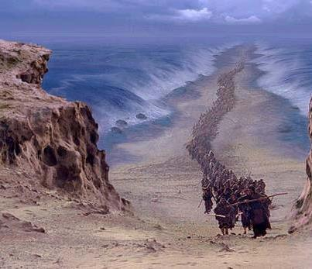

Skeptics of the World
Israel and modern scholars
“There are two main skeptics who refuse to believe that the literal Son of God would descend to a life of mortality.”
“Although prophets had foretold the Messiah’s coming for hundreds of years, many Jews of Jesus’ time could not recognize Jesus of Nazareth as the embodiment of these Messianic prophecies.”
“…some Jewish and Christian scholars believe that Isaiah’s great messianic hymn refers to the house of Israel and not the Savior.”
(1)

Slide 3
Conversation Between Abinadi and Priests of Noah
Mosiah 12:21-24
Abinadi--If you’re a real prophet you would tell us good and happy things like we tell King Noah
If you’re teaching the Law of Moses why aren’t you living it?
Does salvation come by the Law of Moses? (Mosiah 12:12-14)
You pretend to be teachers of these people and you don’t understand what this means? What are you teaching the people?
Yes
Salvation doesn’t come by the Law of Moses alone. If it was not for the atonement which God Himself shall make—they all should perish (Mosiah 13:28)
The Law of Moses
Abinadi then gives them an introduction about the mortal Messiah in Isaiah 53/Mosiah 14

Slide 4
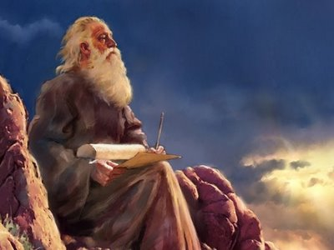
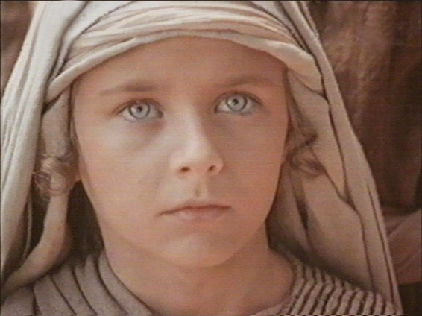
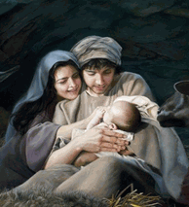
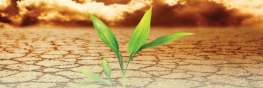
The Messiah
Who hath believed our report?—Many did not believe the report about the works and mission of Christ (John 12:37-41)
For he--Christ
Shall grow up before him--God
As a tender plant—Child, humble innocent. God would watch over the young Jesus as a careful gardener watches a tender plant
As a root out of dry ground—You wouldn’t expect a root to grow out of dry ground. Spiritual barrenness of the Jewish Apostasy, grew up in Nazareth, a nowhere town
He hath no form nor comeliness = He will come into a humble family
Isaiah 53:1-2

Slide 5
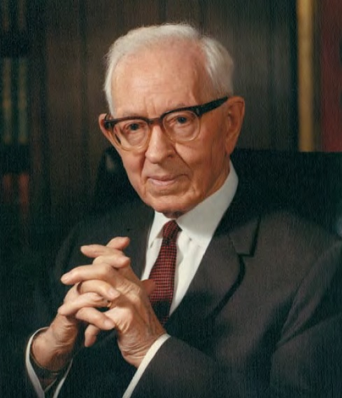
“There was nothing about [Jesus] to cause people to single him out.
In appearance he was like men; and so it is expressed here by the prophet that he had no form or comeliness, that is, he was not so distinctive, so different from others that people would recognize him as the Son of God.
He appeared as a mortal man.”
(2)
Isaiah 35

Slide 6
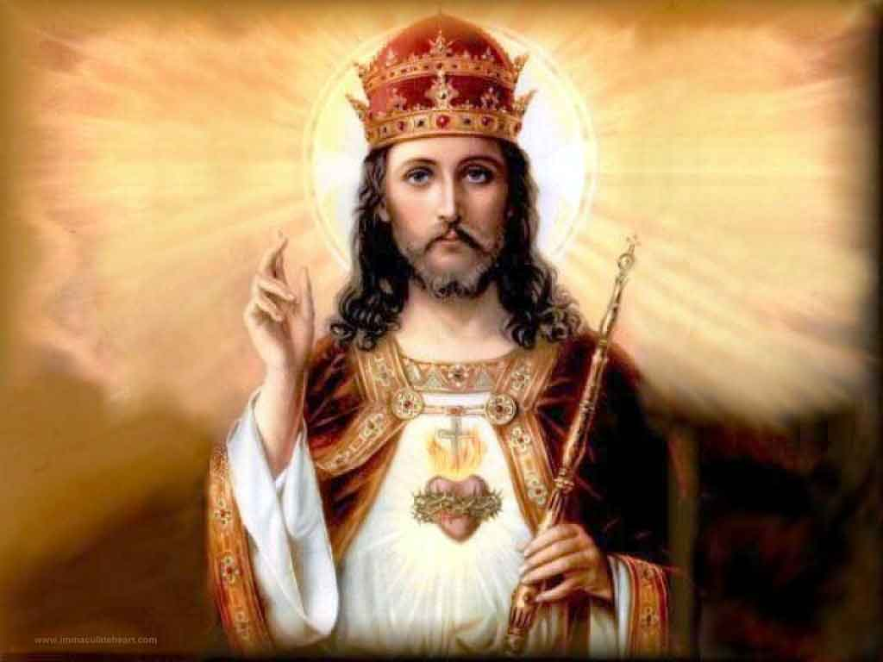
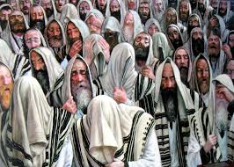
What Kind of Messiah Was Expected Among Israel?
A Messiah who would deliver them from all of their enemies including Rome
“The Savior’s humble birth and simple life are what led many to ignore or deny His divine identity. Those who were expecting a great and glorious king completely overlooked the physical Son of God, who appeared as the inconspicuous son, [growing up as the son of a carpenter]”(1)
Isaiah 53:2

Slide 7
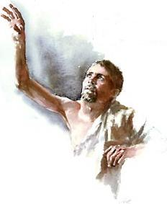
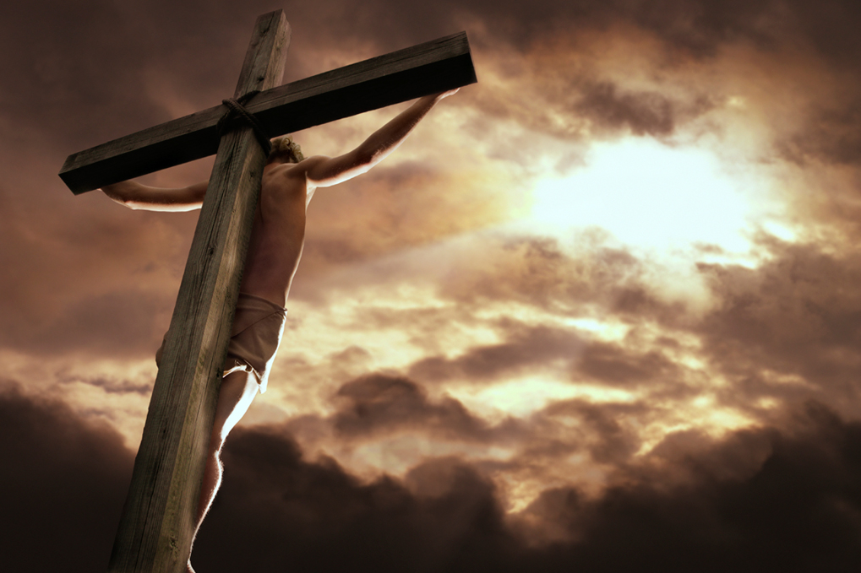
“Esteem Him Not”
Despised/Rejected—They knew the mortal Messiah would be largely rejected.
He was excommunicated by the people of Nazareth
“We hid our faces from him”
A reaction of coming face to face with a leper—shunning in disgust and fear
Isaiah 53:3
(7)

Slide 8
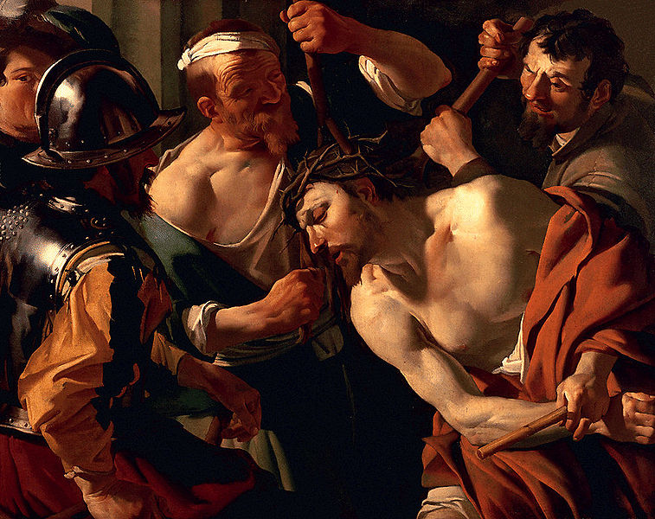
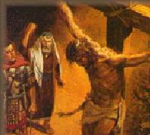
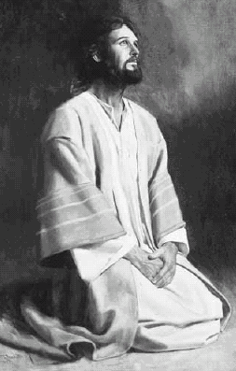
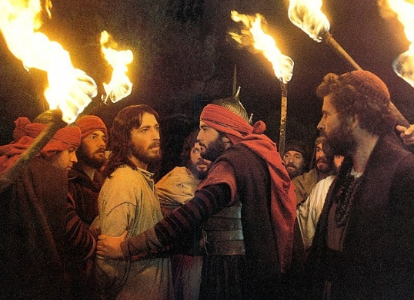
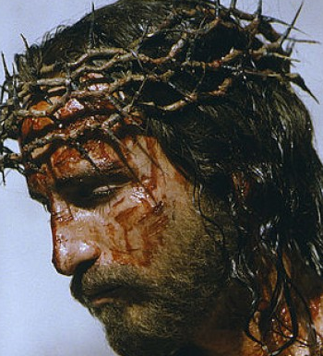
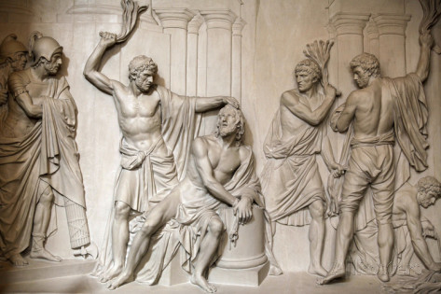
His Experience On This Earth
Ridiculed
Spat upon
Had a crown of thorns place on His head
Stripped
Whipped and beaten
Nailed to a cross
Betrayal
Jesus Christ suffered for the transgressions and iniquities of all so that we can be forgiven and healed
Isaiah 53:3

Slide 9
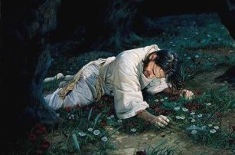
To Succor
In Gethsemane he took upon himself our griefs and sorrows as well as our sins
And he shall go forth, suffering pains and afflictions and temptations of every kind; and this that the word might be fulfilled which saith he will take upon him the pains and the sicknesses of his people.
And he will take upon him death, that he may loose the bands of death which bind his people; and he will take upon him their infirmities, that his bowels may be filled with mercy, according to the flesh, that he may know according to the flesh how to succor his people according to their infirmities.
Alma 7:11-12
Smitten of God/afflicted—Anciently it was believed if a person suffered it was because they were being punished by God. They believed Jesus was being punished for sin.
Ironically, they are correct…
But whose sin caused him to suffer?
All of ours
Isaiah 53:4
(3)

Slide 10
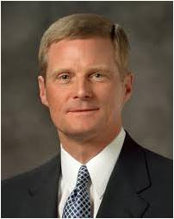
“There is no physical pain, no spiritual wound, no anguish of soul or heartache, no infirmity or weakness you or I ever confront in mortality that the Savior did not experience first. In a moment of weakness we may cry out, ‘No one knows what it is like.
No one understands.’ But the Son of God perfectly knows and understands, for He has felt and borne our individual burdens.
And because of His infinite and eternal sacrifice, He has perfect empathy and can extend to us His arm of mercy. He can reach out, touch, succor, heal, and strengthen us.” (4)
Isaiah 53:4 Alma 34:14

Slide 11
Doctrinal Mastery
He is despised and rejected of men; a man of sorrows, and acquainted with grief: and we hid as it were our faces from him; he was despised, and we esteemed him not.
Surely he hath borne our griefs, and carried our sorrows: yet we did esteem him stricken, smitten of God, and afflicted.
But he was wounded for our transgressions, he was bruised for our iniquities: the chastisement of our peace was upon him; and with his stripes we are healed.
Isaiah
53:3-5

Slide 12
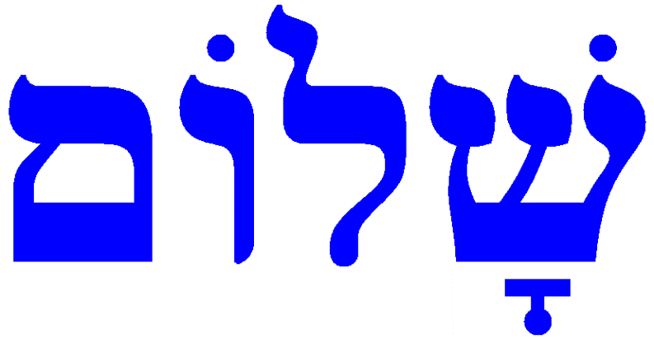
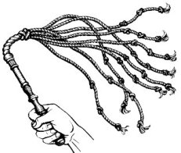
Chastisement of Our Peace
Shalom = Peace in Hebrew
Whole = Through Christ’s suffering, we can be made whole (5)
“with His strips we are healed” = Through the whipping of Jesus another’s wounds are healed
Are we automatically healed?
No
We must return to Christ, repent, be converted, and then he heals us
Isaiah 53:5-6

Slide 13
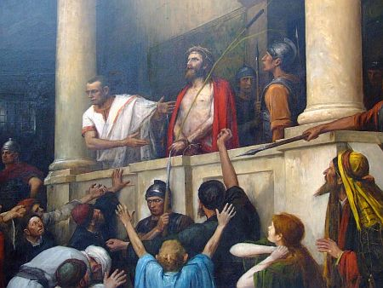
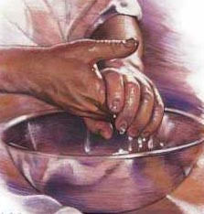
Oppressed and Afflicted
The abuse and false trial of Jesus
Jesus was falsely accused, illegally tried, unjustly humiliated, and inhumanly executed Jesus did not speak as he stood before Herod and Pilate (Luke 23;9)
He submitted himself
Pilate still could find no reason to kill Jesus. He still wanted to release Him. But the priests and the people cried loudly that they wanted Him crucified. (Luke 23:22-23)
Pilate washed his hands, saying he was not responsible for Jesus’ death. But he gave the crowd permission to crucify Jesus. (Matt. 27:24–26)
Isaiah 53:7

Slide 14
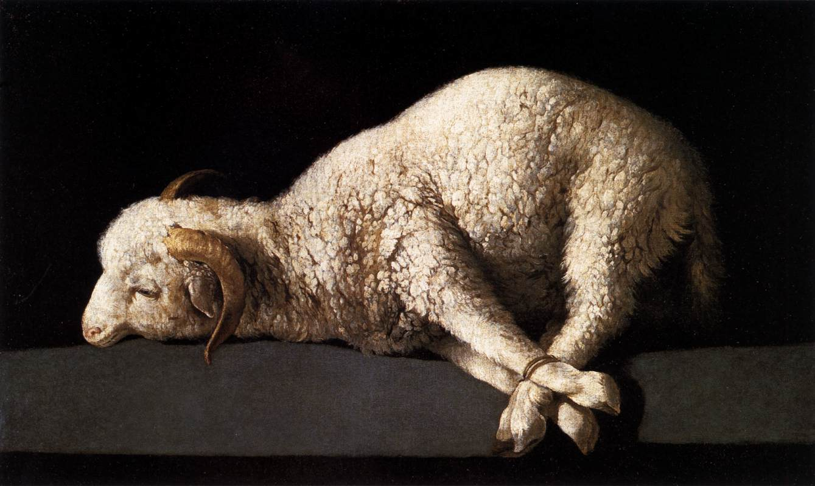
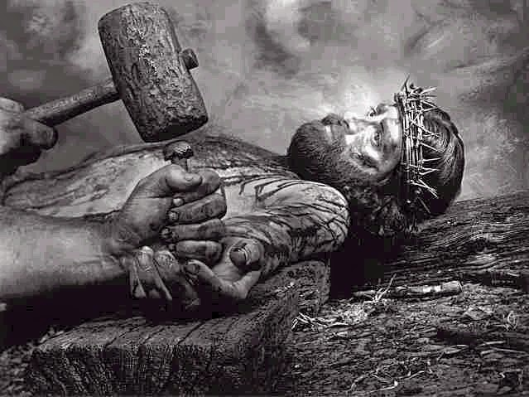
Submitted-- “as a sheep before the shearers”
Isaiah’s Prophecy is Fulfilled
At His crucifixion, Jesus’ weak body bore additional torture.
12 hours—suffering in Gethsemane, (D&C 19:18)
Then placed on the cross--Golgotha
“He was laid down upon the implement of torture. His arms were stretched along the cross-beam; and at the center of the open palms, the point of a huge iron nail was placed, which, by the blow of a mallet, was driven home into the wood. Then through either foot separately, or possible through both together as they were placed one over the other, another huge nail tore its way through the quivering flesh.” (6)
Isaiah 53:7

Slide 15
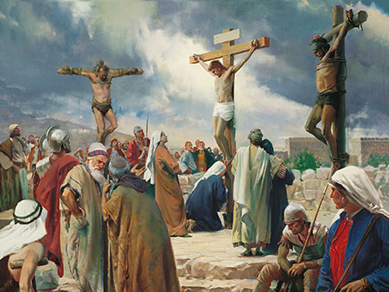
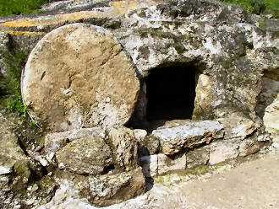
The Innocent
Isaiah’s Prophecy is Fulfilled
Cut off out of the land of the living = The death of Jesus
A Grave With The Wicked = Jesus was placed between two thieves
He was laid to rest in the tomb of a wealthy man (John 18:38-42)
Isaiah 53:8-9

Slide 16
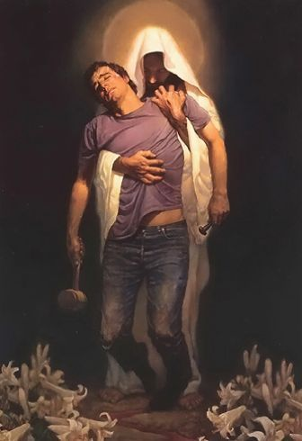
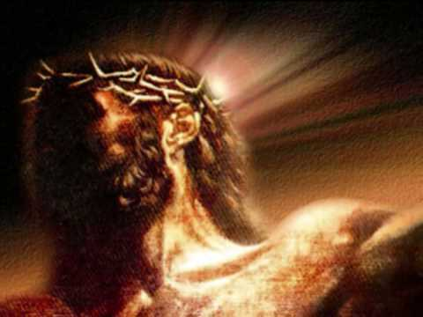
“It Pleased the Lord”
To Bruise Him
Pleased = Accepting
For God so loved the world, that he gave his only begotten Son, that whosoever believeth in him should not perish, but have everlasting life.
(John 3:16)
The Father was pleased that his Son would obediently offer such a sacrifice according to His will
“The Son’s suffering were part of the integral part of the plan.” (1)
Isaiah 53:10

Slide 17
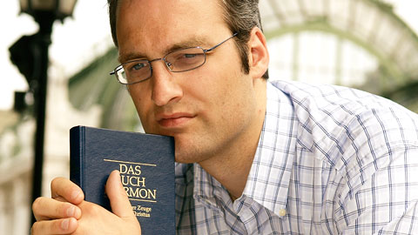
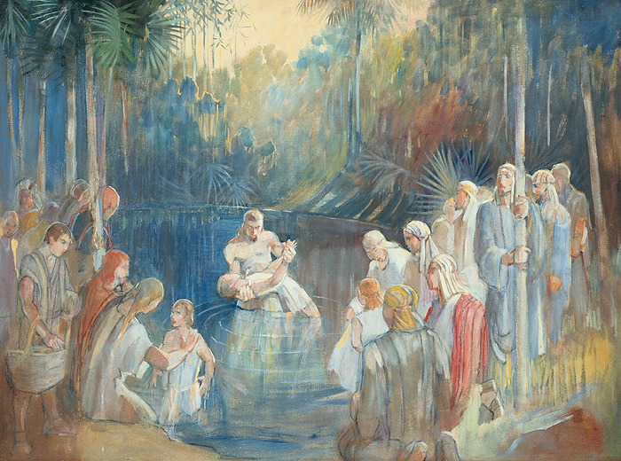
Who Are His Seed?
Those who are spiritually begotten of Christ
Behold I say unto you, that whosoever has heard the words of the prophets, yea, all the holy prophets who have prophesied concerning the coming of the Lord—I say unto you, that all those who have hearkened unto their words, and believed that the Lord would redeem his people, and have looked forward to that day for a remission of their sins, I say unto you, that these are his seed, or they are the heirs of the kingdom of God. Mosiah 15:11
And now, because of the covenant which ye have made ye shall be called the children of Christ, his sons, and his daughters; for behold, this day he hath spiritually begotten you; for ye say that your hearts are changed through faith on his name; therefore, ye are born of him and have become his sons and his daughters. Mosiah 5:7
Isaiah 53:10

Slide 18
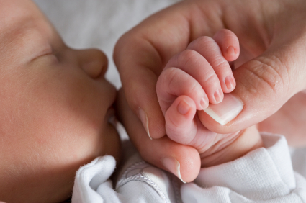
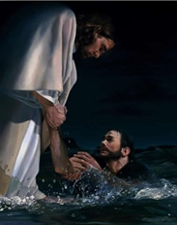
Travail of His Soul
Literally Christ suffers as a woman suffers in laboring to deliver her child.
As He dies He “gives birth” to us as His spiritual offspring. (1)
To Justify = to be found innocent
The righteous servant will “justify” those who will receive Christ. Justification takes place when the Savior vindicates our worthiness to come into God’s presence. Jesus fulfills this function when He serves as our Mediator and Advocate with the Father. (1)
Isaiah 53:11
Liz Lemon Swindle

Slide 19
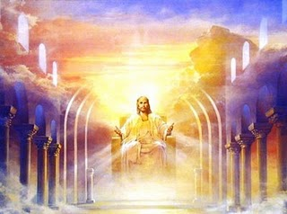
Portion/Spoil
Portion with the Great” and “Divide the Spoil with the Strong”
The inheritance of eternal life that Jesus Christ has received from Heavenly Father
All things that the Father hath are mine: therefore said I, that he shall take of mine, and shall shew it unto you.
John 16:15
If we accept the Atonement of Christ and live worthy lives, we may become “joint-heirs” with Christ
And if children, then heirs; heirs of God, and joint-heirs with Christ; if so be that we suffer with him, that we may be also glorified together.
Romans 8:17
“A joint-heir is one who inherits equally with all other heirs including the Chief Heir who is the Son. Each joint-heir has an equal and an undivided portion of the whole of everything. If one knows all things, so do all others. If one has all power, so do all those who inherit jointly with him. If the universe belongs to one, so it does equally to the total of all upon whom the joint inheritances are bestowed.(7)
Isaiah 53:12

Slide 20
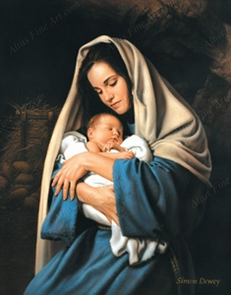
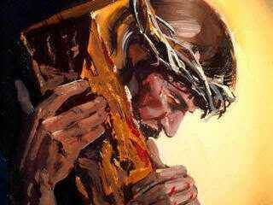
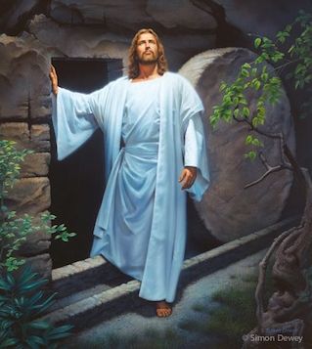
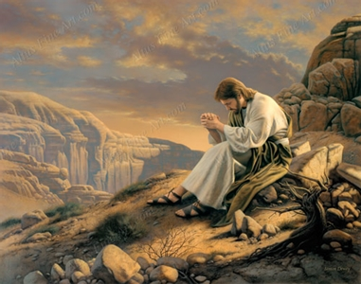
Isaiah 53
Isaiah describes the Saviors’ humble beginning, his life and ministry, his betrayal and suffering, and his ultimate triumph
Abinadi’s used Isaiah’s words to teach that the law alone will not save and that we all just rely on the atonement of Christ in order to enjoy the blessings of eternal life…
The message is that “Jehovah is salvation” to all people in all times and all places.”
Simon Dewey Artist
Simon Dewey Artist
Simon Dewey Artist
Compare Mosiah 14

Slide 21
Sources:
Suggested Hymn: #196 Jesus Once of Humble Birth
Videos:
Bear Up Their Burdens with Ease (1:06)
Isaiah Prophesied of Christ(4:51)
Victor L. Ludlow Unlocking Isaiah in the Book of Mormon pp. 216-217, 219. 225-227
Joseph Fielding Smith (Doctrines of Salvation, comp. Bruce R. McConkie, 3 vols. [1954–56], 1:23)
Poway Institute Handout Becky Davies and Lesley Meacham
Presentation by ©http://fashionsbylynda.com/blog/
Elder David A. Bednar (“Bear Up Their Burdens with Ease,” Ensign or Liahona, May 2014, 90).
Book of Mormon Reference Companion, 394 found in Isaiah for Airheads by John Bytheway p. 168
Bruce R. McConkie Mortal Messiah p. 4:211
Old Testament Institute Manual The Gathering of Israel and the Coming of the Messiah Chapter 17

Slide 22
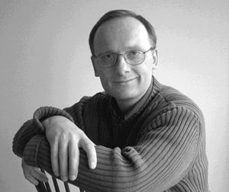
The Atonement:
“The utter loneliness and excruciating pain of the Atonement begun in Gethsemane reached its zenith when, after unspeakable abuse at the hands of Roman soldiers and others, Christ cried from the cross, “Eli, Eli, lama sabachthani? That is to say, My God, my God, why hast thou forsaken me?”
In the depths of that anguish, even nature itself convulsed. “There was a darkness over all the earth. … And the sun was darkened.”
“And, behold, the veil of the temple was rent in twain from the top to the bottom; and the earth did quake, and the rocks rent ”causing many to exclaim, “The God of nature suffers.” Finally, even the seemingly unbearable had been borne, and Jesus said, “It is finished.”
“Father, into thy hands I commend my spirit.” Someday, somewhere, every human tongue will be called upon to confess as did a Roman centurion who witnessed all of this, “Truly this was the Son of God.”
Jeffrey R. Holland Do This In Remembrance of Me Ensign Nov. 1995
Jesus Christ Suffered:
“He suffered so much pain, ‘indescribable anguish,’ and ‘overpowering torture’ [John Taylor, The Mediation and Atonement (1882), 150] for our sake. His profound suffering in the Garden of Gethsemane … caused Him ‘to tremble because of pain, and to bleed at every pore, and to suffer both body and spirit’ [D&C 19:18]. …
“… No one has ever suffered in any degree what He did” President James E. Faust (“The Atonement: Our Greatest Hope,” Ensign, Nov. 2001, 19).
Simon Dewey is a portrait painter, primarily of religious art. Born in 1962, he is the only son of a London bus driver and part-time artist and left home at age seventeen to attend London Art College. His earliest memory of drawing was at age five when his father gave him an old roll of wallpaper and a pencil and told him to fill the entire roll with sketches, which he covered with every thing he could think to draw.
He worked for a time as a corporate visual aids illustrator. His exceptional skills earned him a position as the sole illustrator in a small design firm. After he married, he became a freelance illustrator and worked on projects for Scholastic and Penguin Book. He has worked for well-known clients Hasbro/Milton Bradley, RCA Columbia, Warner Home Video, and CBS Fox. His work has appeared on the covers of numerous magazines.
In 1997, he released his painting “He Lives,” and quickly gained popularity with a Latter-day Saint audience and became a bestselling artist of LDS religious art. He is a member of The Church of Jesus Christ of Latter-day Saints. Many of his paintings illustrate the stories of the New Testament and the life and ministry of Jesus Christ. He has also painted themes from the life of Joseph Smith.
Dewey and his wife, Lorraine, are the parents of five children and live in Alberta, Canada. Mormonwiki.com
Who Shall Declare His Generation?:
The question might be translated, “Who shall testify of His life mission?” Unfaithful children of God fail to “declare his generation: or testify as their Savior. We must “declare his generation,” or His life, mission, and gospel.
President David O. McKay teaches that people who know in their heart that Heavenly Father and Jesus Christ restored the gospel to the earth have “the greatest possession that the human mind can possess.” (Man May Know For Himself) p. 145
Latter-day Saints with a testimony are the ones who can clearly and powerfully declare Jesus Christ and His gospel to the world.” Victor L. Ludlow (Unlocking Isaiah in the Book of Mormon) p. 224

