Slide 1

Judah’s Fallen State
Jeremiah 17-29
Wo, wo, unto Jerusalem, for I have seen thine abominations! Yea, and many things did my father read concerning Jerusalem—that it should be destroyed, and the inhabitants thereof; many should perish by the sword, and many should be carried away captive into Babylon.
1 Nephi 1:13

Slide 2

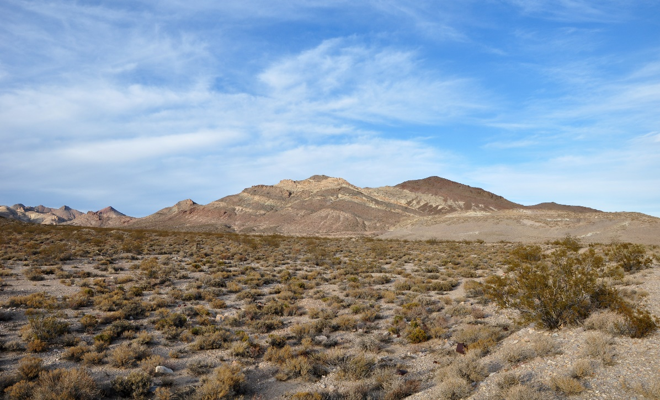
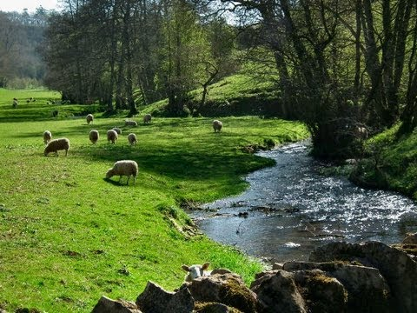
Which Location Would You Choose to Live In?
These landscapes could represent the spiritual condition of our lives
Is your spiritual condition more like a desert or a fertile valley or somewhere in between?

Slide 3
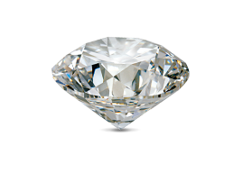
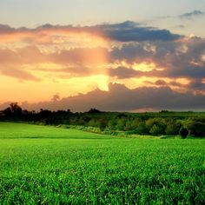
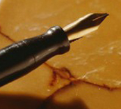
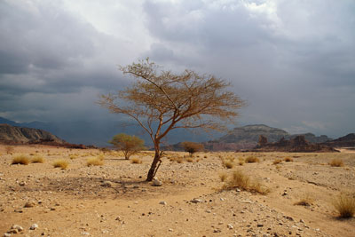
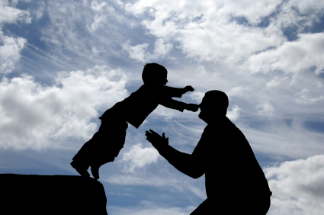
Judah’s Sin
“with a pen of iron and with the point of a diamond” = sin was deeply imbedded in Judah’s consciousness
“O my mountain in the field” = a reference to Jerusalem, which is nestled in the hill country of Judea.
The focus of one’s trust = determining whether he is cursed or blessed.
“The heath in the desert” = Judah as a withered tree without moisture or sustenance.
Jeremiah 17:1-6

Slide 4

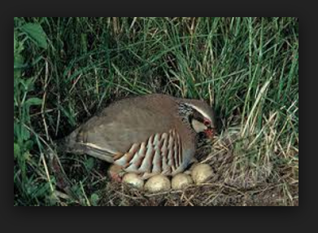
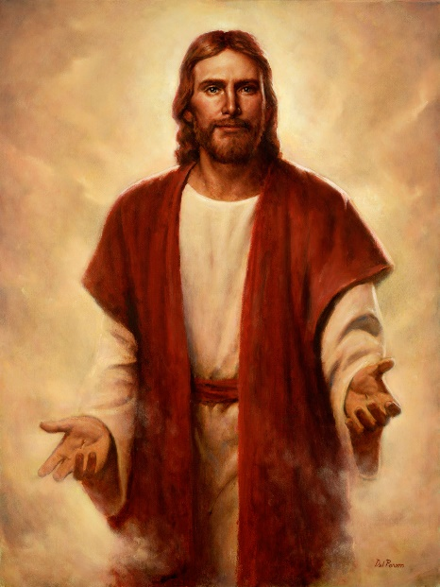
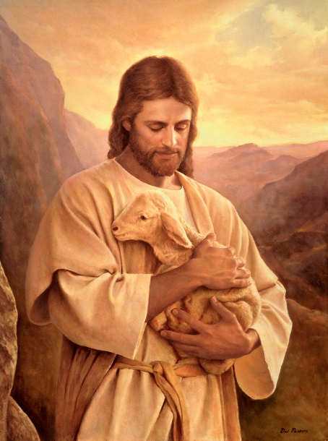
Hope For Israel
The Lord searches the heart and tries the reins = (the inner self) to determine directions
Like a bird (partridge) that sits on eggs that will not hatch, so those of Judah who get rich by being dishonest = will leave empty-handed
“hope of Israel” = Jesus Christ (Jehovah in the Old Testament)
A Pastor = Like the Good Shepherd…Those who will follow Him
Del Parson
Del Parson
Jeremiah 17:10-16

Slide 5
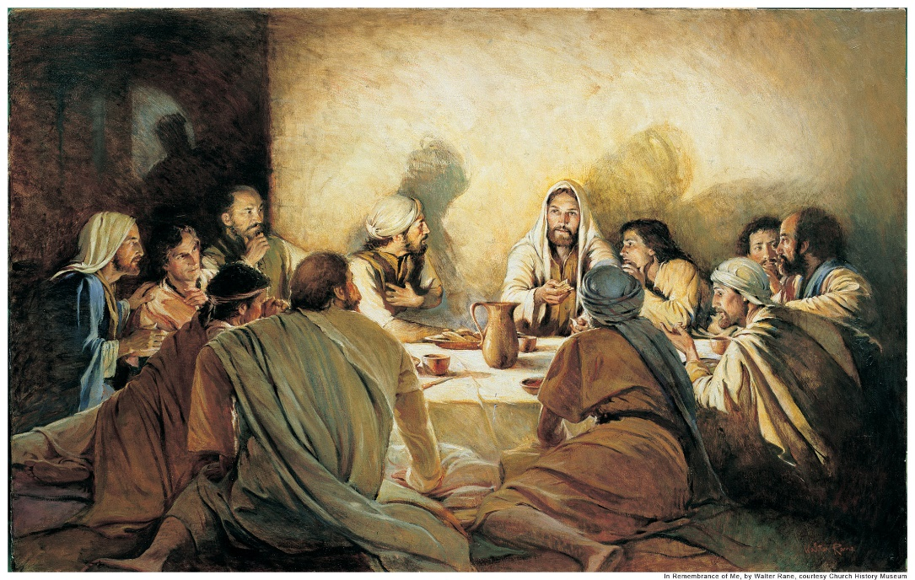
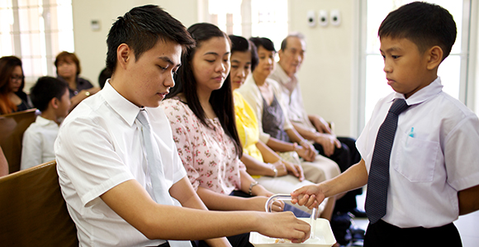
Jeremiah Teaches Judah About Observing the Sabbath
“Living as we do in an age when the spirit of Sabbath observance is so flagrantly violated, it may be well for us to observe the remarkable importance attached by Jeremiah to keeping this day holy.
“Not only did the prophet command the people to hallow the day and not do any work therein, but he went so far as to promise that the city of Jerusalem would remain or be inhabited forever: …” (1)
Jeremiah 17:19-27

Slide 6
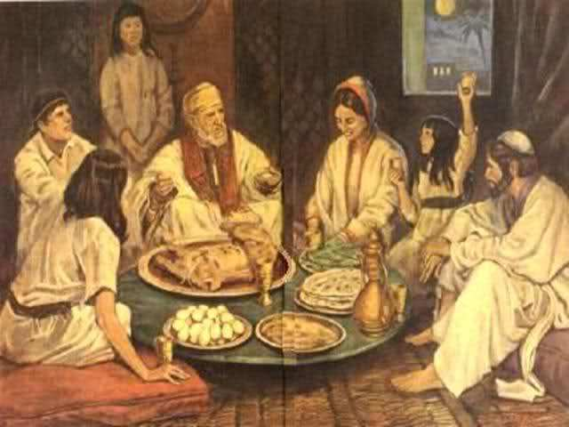

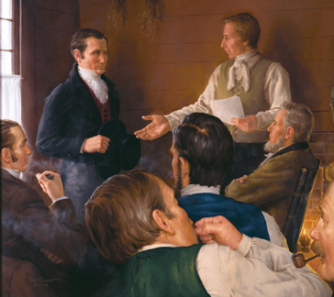
Jeremiah Teaches Judah About Observing the Sabbath
But remember that on this, the Lord’s day, thou shalt offer thine oblations and thy sacraments unto the Most High, confessing thy sins unto thy brethren, and before the Lord. D&C 59:12
If we keep the Sabbath day holy, then the Lord will preserve us and help us prosper
Jeremiah 17:19-27; D&C 9-24

Slide 7
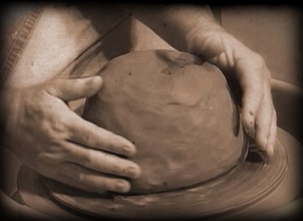
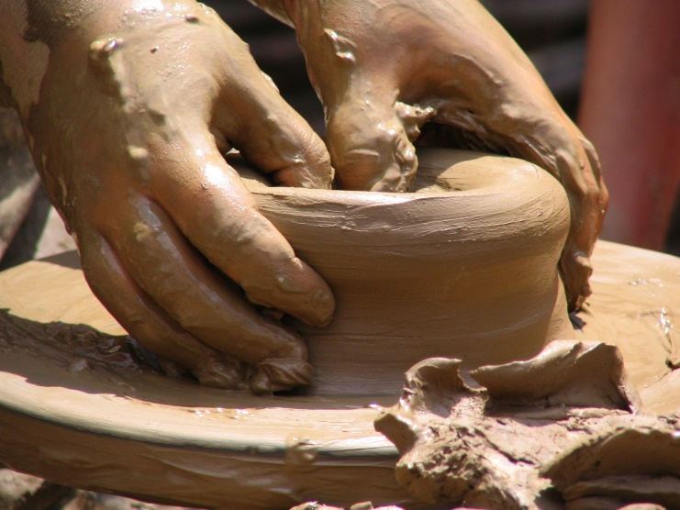
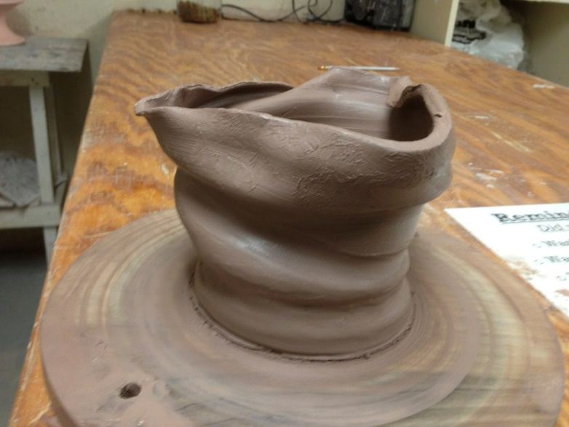
Potter’s Clay
What can you do if you do not like the look of the pot you have just made?
Jeremiah 18:6-10

Slide 8
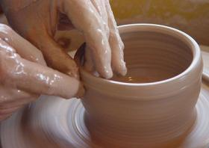
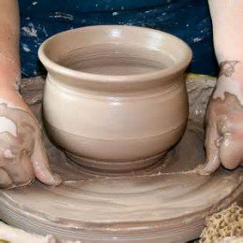
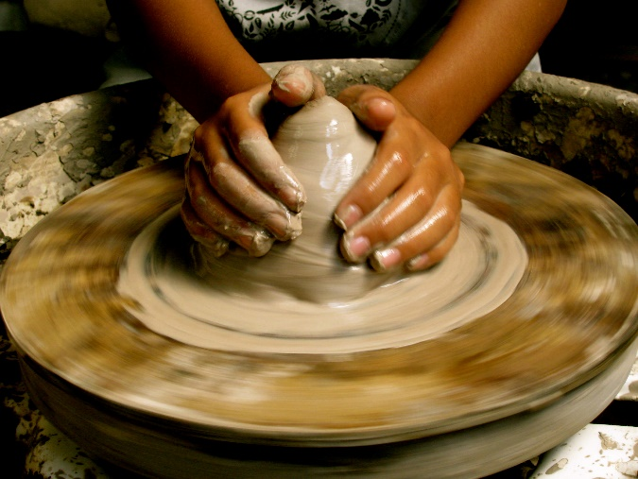
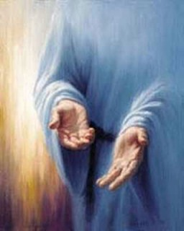
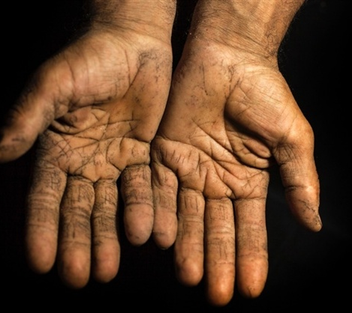
Reshaping
If we choose to repent, the Lord can mold and reshape our lives
Jeremiah 18:6-10

Slide 9
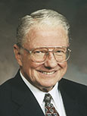
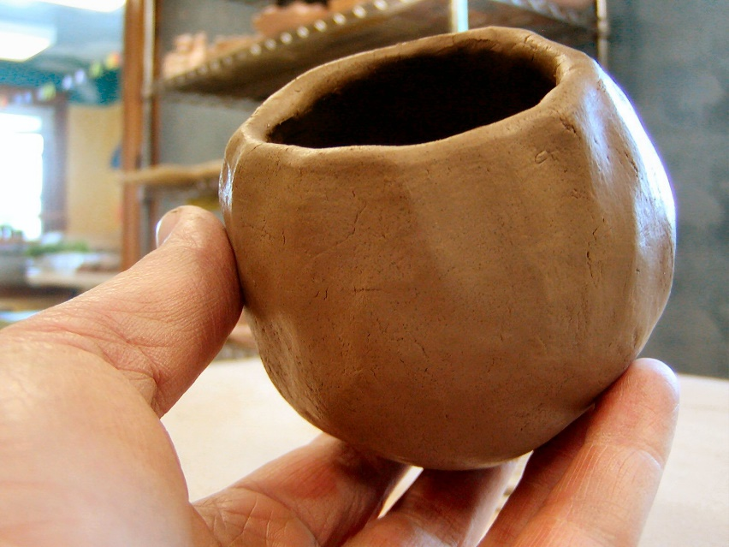

“The Lord explained to Jeremiah that when we make mistakes, as ancient Israel was making, we can take what we have marred and begin again.
The potter did not give up and throw the clay away, just because he had made a mistake.
And we are not to feel hopeless and reject ourselves?
Yes, our task is to overcome our problems, take what we have and are, and start again.
“Some of you who are listening have sinned in ways that are significant, embarrassing, and destructive. Yet, by following the simple instruction given by the Master, you can talk with your bishop, when necessary, and begin again as a renewed person.” (2)
Jeremiah 18:6-10

Slide 10

Smite Him
Because of Jeremiah’s boldness, the people entered into a league to punish the prophet. The phrase “let us smite him with the tongue” is better translated “smite him on the tongue.”
“Lying and false testimony are punished in the eastern countries … by smiting the person on the mouth with a strong piece of leather like the sole of a shoe.” (3)
Because the people rejected the words of the Lord, He said that they would suffer and be scattered.
The Jews then plotted to harm Jeremiah.
Though he mourned over their wickedness, Jeremiah asked the Lord to let the Jews suffer for their sins.
Jeremiah 18:17-23
(4)

Slide 11
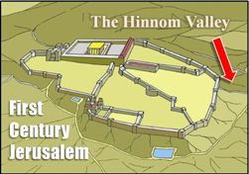
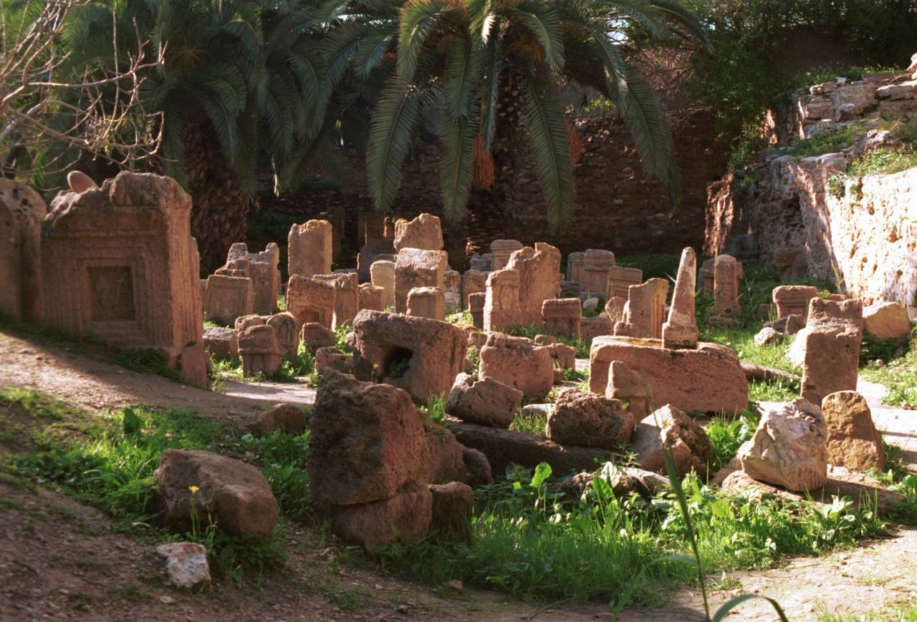
Hardened Clay Pot
The Lord told Jeremiah to take a hardened clay pot to the valley of Hinnom, which was just outside of the walls of Jerusalem.
In this valley was a place called Tophet, which means the place of burning. There some of the Israelites had built altars and sacrificed their children as burnt offerings to false gods.
Jeremiah 19:1-9
(4)

Slide 12
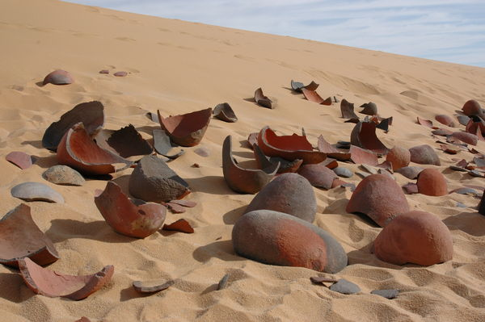
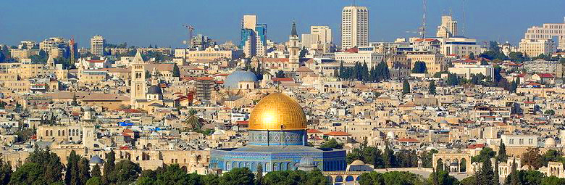
Judah Broken and Scattered
By the breaking of a potter’s bottle or jar, Jeremiah represented the sacking and captivity of Judah. Once broken, the bottle “cannot be made whole again.”
Although the Jews did return from Babylonian captivity at the end of 70 years, nearly 1,900 years have elapsed since Jerusalem was destroyed and its inhabitants scattered by the Romans, and Israel is only now finally being gathered back into the covenant.
Jeremiah 19:10-15
(4)

Slide 13
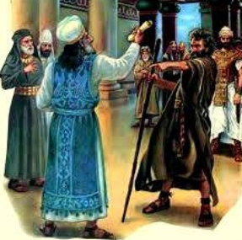
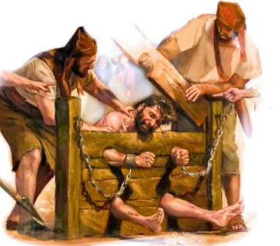
Jeremiah is Put in Prison
After Jeremiah preached in the valley of Hinnom, he declared his warnings in the court of the temple.
The chief governor of the house of the Lord, Pashur, was angry with Jeremiah because of his message. Pashur smote him and imprisoned him by putting him into the stocks until the next day, but Jeremiah continued to warn about the Lord’s impending judgments.
Stocks were an instrument of torture by which the body was forced into an unnatural position, much as the wooden stocks of medieval times confined parts of the body, such as the arms, legs, or head, by means of wooden beams that locked them into place. (4)
Magor-missabib = Fear on every side (4)
Jeremiah 20:1-6

Slide 14
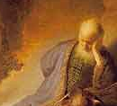
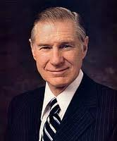
The Weight of God’s Word
“deceived” = “enticed” or “persuaded.”
The power that persuaded the prophet to continue to preach God’s word at such great personal cost was “as a burning fire shut up in [his] bones”
(4)
Why did Jeremiah refuse to be silent even though at one time he wanted to stop declaring the Lord’s message?
“You must know that Lucifer will oppose you, and be prepared for his opposition.
Do not be surprised. He wants you to fail. Discouragement is one of the devil’s tools. Have courage and go forward. Recognize that the gospel has been preached with some pain and sorrow from the very beginning of time. Do not expect that your experience will be otherwise.” (5)
As our testimonies of the gospel deepen, our desire to do the Lord’s will increases.
Jeremiah 20:7-9

Slide 15
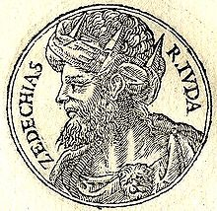
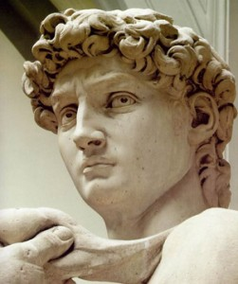
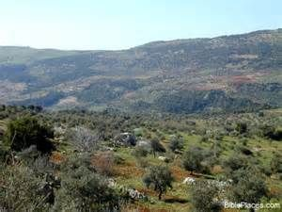
However…Jeremiah Continues to Preach
King Zedekiah sent Pashur to inquire of the Lord through Jeremiah concerning Jerusalem. Jeremiah’s response had three parts:
The answer to the king’s hope that the Lord would intervene to save Jerusalem from the Chaldeans was clear: there was no hope.
Counsel on how the people and the royal family could preserve their lives by surrendering to the Chaldeans rather than fighting them.
A prophecy concerning the house of David, to which Jeremiah gave an alternative: If the king and his people would turn back to righteousness, the throne of David would be preserved, but if not, it would “become a desolation”.
Gilead symbolized the richest soil Israel knew, and Lebanon the highest mountain and the finest trees. But the Lord sent His destroyers, and the finest lands were desolated.
Jeremiah 21:4-14; 22:4-5
(4)

Slide 16
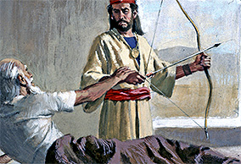
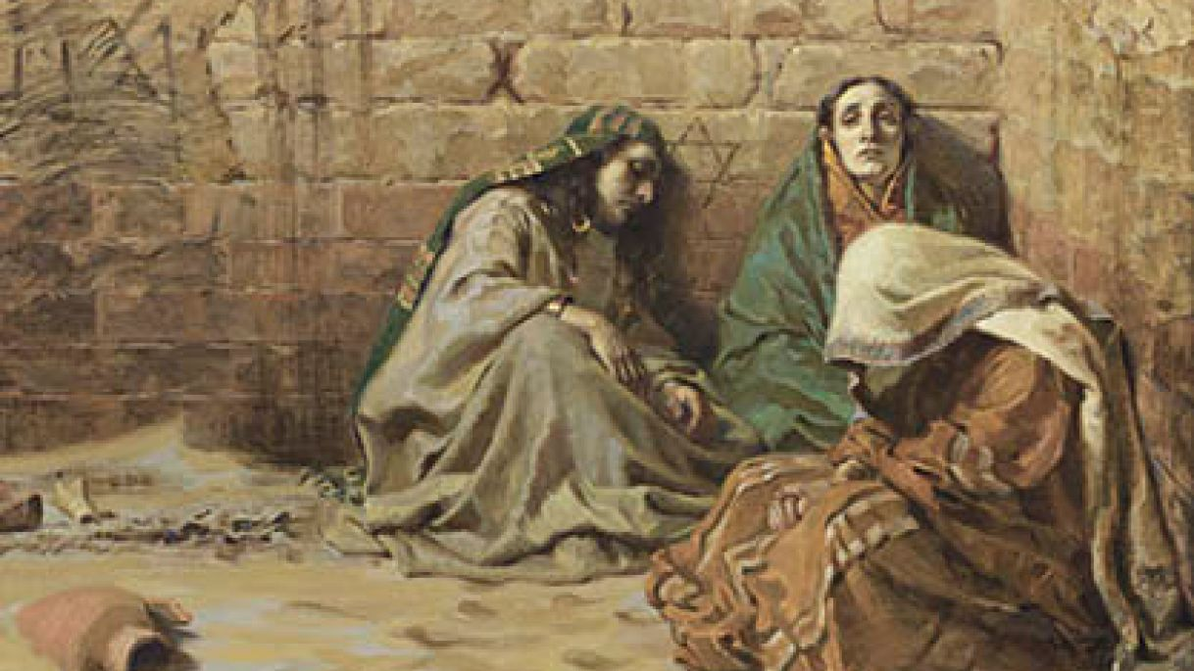
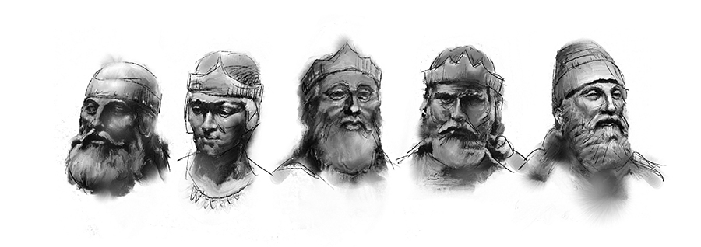
Weep Not
“Weep not for the dead” = Josiah, king of Israel, who died of a wound received in the battle of Megiddo.
“Weep sore for him that goeth away” = Shallum, or Jehoahaz, the son of Josiah and successor to the throne, who was carried away to Egypt.
Judah, faced great tragedy because of their iniquity. The people were not to mourn for their lost kings. Rather, they should mourn the impending tragedy and turn aside from their evil ways.
Jeremiah 22:10-12
(4)

Slide 17
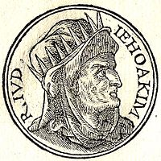
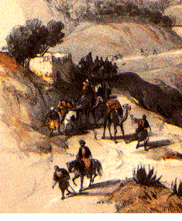
Jeremiah Rebuked Jehoiakim
Rebuke = express sharp disapproval or criticism of (someone) because of their behavior or actions.
Jeremiah rebuked Jehoiakim for his self-centered life and his injustices to his people, which were particularly evident when compared to the righteous deeds of his father, Josiah.
An ass’s burial meant to be left unburied in the open field.
This prophecy probably was fulfilled when Jehoiakim was taken captive during Nebuchadnezzar’s siege of Jerusalem.
Jeremiah 22:13-19
(4)

Slide 18
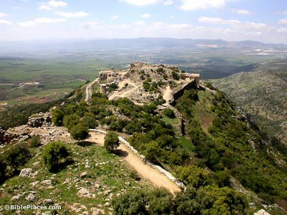
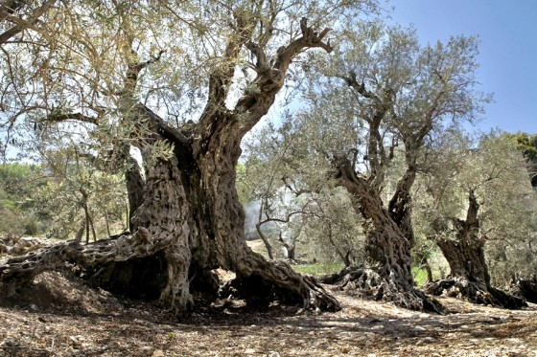
Lebanon and Bashan
Were described as the passage of Israel from Judah into Babylon. Just as the dry wind destroys the grazing land by eating the pastors, or pastures, so would Babylon destroy Judah’s shepherds and leaders.
Because of their loftiness and beauty, the cedars of Lebanon often were used as a symbol of pride. Here they are symbols of Judah’s leaders, who are told to consider just how great they will be when the pains of war come.
Jeremiah 21:20-23
(4)

Slide 19
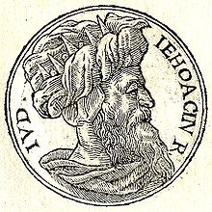
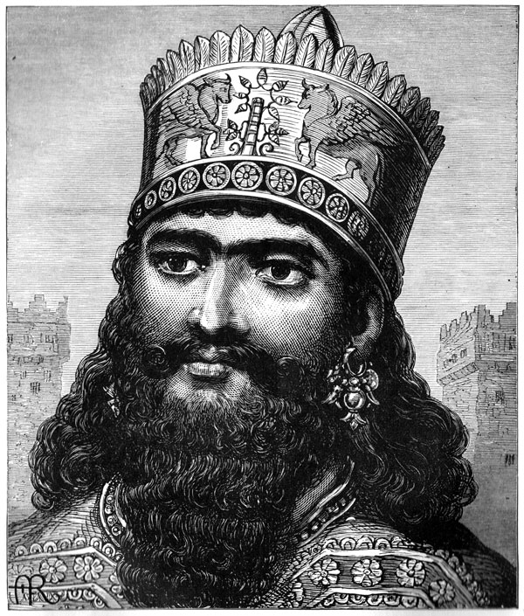
Jehoiachin
Jehoiachin, the son of Jehoiakim, was called Coniah by Jeremiah.
Coniah was likened to a signet, which is a seal or ring that is valued both as a symbol of power and as a jewel.
Then Coniah, or Jehoiachin, was told that if he were all that God had of value, in Jehoiachin’s present state of unrighteousness, Jehoiachin still would have to be delivered into the hand of Nebuchadnezzar, never to return.
Jeremiah 21:25-27
(4)

Slide 20
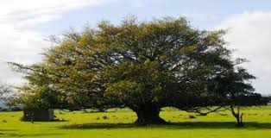
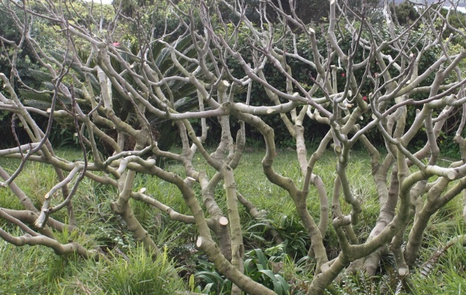
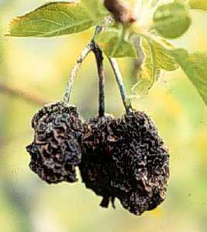
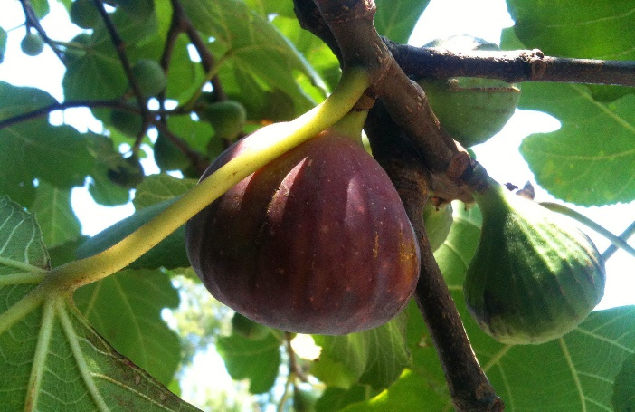
Parable of the Figs
“Under the type of good and bad figs, God represents the state of the persons who had already been carried captives into Babylon, with their king Jeconiah, compared with the state of those who should be carried away with Zedekiah.
Those already carried away, being the choice of the people, are represented by the good figs: those now remaining, and soon to be carried into captivity, are represented by the bad figs, that were good for nothing.
Jeremiah 24
(6)

Slide 21
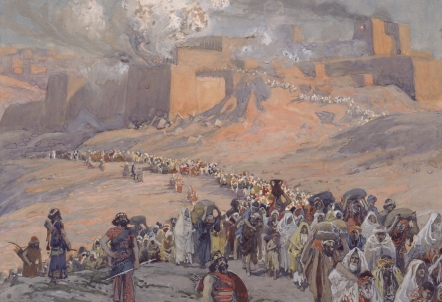
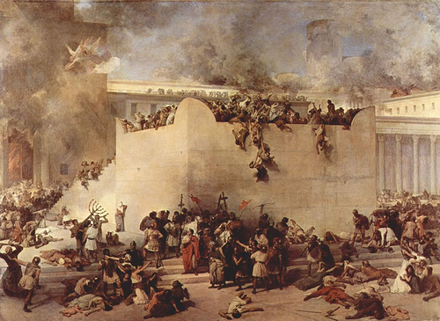
Those Who Were Captured First
“The state also of the former in their captivity was vastly preferable to the state of those who were now about to be delivered into the hand of the king of Babylon.
The latter would be treated as double rebels; the former, being the most respectable of the inhabitants, were treated well; and even in captivity, a marked distinction would be made between them, God ordering it so. But the prophet sufficiently explains his own meaning. …
“[The Lord says,] Those already carried away into captivity, I esteem as far more excellent than those who still remain in the land. They have not sinned so deeply, and they are now penitent; and therefore, I will set mine eyes upon them for good, (ver. 6).
I will watch over them by an especial providence, and they shall be restored to their own land.”
Jeremiah 24
(6)

Slide 22


Who Will Drink of the Cup?
Battle of Armageddon
That battle is depicted here to show Judah that the wicked nations will not escape the Lord’s judgment.
The language of these scriptures shows that what Jeremiah saw was the time when all nations shall gather together against the Lord’s people and be brought into judgment.
That the battle before the Millennium, which is known as the battle of Armageddon, makes reference to Gog and Magog may at first be confusing since the last great battle at the end of the Millennium is called the battle of Gog and Magog by John.
But the names “Gog” and “Magog” are used for both battles because they symbolize an alliance of great, evil power.
“Before the coming of Christ, the great war, sometimes called Armageddon, will take place as spoken of by Ezekiel. Another war of Gog and Magog will be after the millennium.” (7)
Jeremiah 25:32-33 Revelation 20:7-9 Ezekiel 38-39
(6)

Slide 23


Jeremiah’s Trial
Words of Jeremiah
As for me, behold, I am in your hand: do with me as seemeth good and meet unto you.
Jeremiah 26:14
Words of Abinadi
Yea, and I will suffer even until death, and I will not recall my words, and they shall stand as a testimony against you. And if ye slay me ye will shed innocent blood, and this shall also stand as a testimony against you at the last day.
Mosiah 17:10
Jeremiah 26:14-15

Slide 24

Urijah
Recounted at Jeremiah’s trial, shows the wickedness of King Jehoiakim.
When Urijah heard of the king’s intent to kill him, he fled into Egypt. But, evidently, Egypt offered him no asylum, for he was extradited and slain by Jehoiakim himself. That this is the only account there is of Urijah and his ministry suggests that there were probably many prophets of whom we know nothing.
Verse 24 implies that Jeremiah, although acquitted, would likely have suffered Urijah’s fate at the hands of the populace had it not been for Ahikam, who protected him.
Jeremiah 26:20-24
(4)

Slide 25

Make a Yoke
Thus saith the Lord to me; Make thee bonds and yokes, and put them upon thy neck,.
A yoke is something put on the neck for the purpose of carrying burdens.
The yoke symbolized captivity or slavery.
Jeremiah taught the people that Judah and her surrounding nations would be under the “yoke” of Babylon.
Jeremiah told King Zedekiah that if he and the people would humbly submit to the “yoke” of Babylon, they would not be destroyed.
As a sign that his words would be fulfilled, he prophesied that Nebuchadnezzar, king of Babylon, would carry away the rest of the treasures and holy articles from the temple.
The prophecy was fulfilled.
Jeremiah 27:2
(10)

Slide 26
False Prophet--Hananiah
He was the son of Azur from Gibeon and a second-generation pseudo-holy man
(Jeremiah 28:1)
He claimed to know from God that not only would Zedekiah’s people not go into captivity, but that Babylonia’s power (yoke) had been broken, and the temple treasures and the captives would be returned within 2 years
He gained a vast amount of people that believed in him and they wanted to hear the great news
His words were opposite of what Jeremiah was preaching, and Jeremiah was willing to wait the 2 years
He dragged the wooden yoke off Jeremiah’s neck and smashed it
The Lord was displeased and had Jeremiah make a yoke of iron and professed that Hananiah would die
Within 2 months Hananiah died. With the death of Hananiah it should have convinced Zedekiah and the people which of these two men was the true prophet, but they were too hardened to respond
Jeremiah 28
(4, 8)

Slide 27

Jeremiah’s Letters To Those In Captivity
About 606 B.C.
During Jeremiah’s day, a select group of Jews was carried away captive to Babylon.
Jeremiah promised these captives that if they searched after God with all their hearts, they would find Him, and the Lord would hearken unto them .
He exhorted them to yield and submit their lot God had assigned to them
He counseled them to prepare by establishing their household there, for a long time in Babel
He told them to seek the welfare of that country as the necessary condition of their own (maintain peace)
They were to not be deceived by the false prophets
They were to reside there in captivity until after 70 years
Jeremiah 29
(9)

Slide 28

The Prophet Lehi
About 600 B.C.
This was about the same time that Lehi left Jerusalem during the first year of King Zedekiah’s reign and that Lehi was told that in 600 years the Messiah would be born.
Lehi and his family were apparently there when Nebuchadnezzar swept down on Jerusalem, raided the temple and carried off more than 10,000 hostages. (8)
1 Nephi 1:4-6

Slide 29
Sources:
Video: Keeping the Sabbath (1:05)
Sperry, Voice of Israel’s Prophets, pp. 172–73.
Presentation by ©http://fashionsbylynda.com/blog/
Elder Hugh W. Pinnock (“Beginning Again,” Ensign, May 1982, 12).
(Clarke, Commentary, 4:303.)
Old Testament Institute Manual The Babylonian Captivity Chapter 24
James E. Faust What I Want My Son to Know before He Leaves on His Mission April 1996 Gen. Conf.
Adam Clarke The Holy Bible … with a Commentary and Critical Notes, 4:316–17
Joseph Fielding Smith (Doctrines of Salvation, 3:45.)
W. Cleon Skousen The Fourth Thousand Years pp. 696-698, 701-702
(C. F. Keil and F. Delitzsch, Commentary on the Old Testament, 8:1:408–9.)
Old Testament Seminary Student Study Guide, (2002), 161

Slide 30
Transgression: Jeremiah 18:1-8
“Transgression brings pain and sorrow. But there is a way out of ‘the gall of bitterness and bonds of iniquity’ (Mosiah 27:29). If we will turn to the Lord and believe on His name, we can change. He will give us the power to change our lives, the power to put away bad thoughts and feelings from our hearts. We can be taken from ‘the darkest abyss’ to ‘behold the marvelous light of God’ President James E. Faust (Mosiah 27:29). We can be forgiven. We can find peace” (“The Power to Change,” Ensign or Liahona, Nov. 2007, 123).
Who is Pashur or Pashhur? (Hebrew: פשחור pash-hur) was the name of at least two priests contemporary with the prophet Jeremiah and who are mentioned in the Book of Jeremiah. The Name is of Egyptian origin, Pš-Ḥr
(1). Pashur the son of Immer (possibly the same as Amariah, Nehemiah 10:3 ; 12:2), was deputy chief priest [Heb. paqid nagid] of the temple (Jeremiah 20:1, 2). (At this time, the nagid, or "governor", of the temple would have been Seraiah - 1 Chronicles 6:14). Apparently enraged at the plainness with which Jeremiah uttered his solemn warnings of coming judgements because of the abounding iniquity of the times, Pashur "smote Jeremiah the prophet" (this could mean that he ordered the temple police to seize him and inflict the corporal punishment of up to forty stripes found in Deuteronomy 25:3); then he placed him in the stocks in the high gate of Benjamin, where he remained all night.
Upon being set free in the morning, Jeremiah went to Pashur (Jeremiah 20:3, 5) and announced to him that God had changed his name to Magor-missabib, i.e., "terror on every side" and that he would be later carried captive to Babylon and die there.
(2). Pashur, the son of Malchiah, was another priest, who was sent by king Zedekiah to Jeremiah to inquire of the Lord regarding the impending attack of King Nebuchadnezzar II of Babylon (Jeremiah 21:1). In Jeremiah 38:1 - 6, this Pashur was also one of four men who advised Zedekiah to put Jeremiah to death for his prophecies of doom but who ended up throwing him into a cistern.
(3). Pashur the father of Gedaliah (Jeremiah 38:1), possibly the same Pashur as (1) above. Gedaliah was another of the four men who threw Jeremiah into the cistern.
Wikipedia
Bearing the Burdens of Warnings Jeremiah 20:7-9:
“So here we have the burden of those called to bear the messianic message. In addition to teaching, encouraging, and cheering people on (that is the pleasant part of discipleship), from time to time these same messengers are called upon to worry, to warn, and sometimes just to weep (that is the painful part of discipleship). They know full well that the road leading to the promised land ‘flowing with milk and honey’ [Exodus 3:8] of necessity runs by way of Mount Sinai, flowing with ‘thou shalts’ and ‘thou shalt nots’ [see Exodus 20:3–17].
“Unfortunately, messengers of divinely mandated commandments are often no more popular today than they were anciently” (“The Cost—and Blessings—of Discipleship,” Ensign or Liahona, May 2014, 7).

Slide 31
Buying the Field Jeremiah 25:11
The Lord’s purpose in having Jeremiah buy the field was to demonstrate to the Israelites that the Babylonian captivity was not permanent. Having the purchase documents preserved would allow Jeremiah’s heirs to establish their claim to the land once the captivity was over. Jeremiah had earlier prophesied that the captivity would last for 70 years (Jer. 25:11) and the purchase provided “real world” confirmation that after the 70 years were over, the Jews would come back and reestablish the nation. Otherwise recording the purchase and preserving the documents would have made no sense. Gracethrufaith
see also: http://copper-scroll-project.com/the-copper-scroll-project-and-jeremiahs-deed/ for an interesting article of Jeremiah’s Cave. The Copper Scroll and Jeremiah’s Deed

Slide 32
Jeremiah At A Glance – Bible Dictionary
Jeremiah 1-6 | Prophecies of reign of Josiah | Jeremiah 1:4-5 Jeremiah 3:12-19 | Premortal Condition and Jeremiah’s Calling Prophecy of the return of Israel from the scattered condition, gathering one of a city and two of a family to Zion, a pleasant land where Israel and Judah can dwell in safety and peace
Jeremiah 7-20 | Prophecies under Jehoiakim
Jeremiah 21-38 | Prophecies under Zedekiah | Jeremiah 21-23 | On pastors or rulers of people, with promise of king Messiah
 |  | Jeremiah 24 | Exiles carried away with Jehoiachin
 |  | Jeremiah 26-29 | False prophets and containing the prophet’s letter to the exiles in Babylon, warning against the prophets there
 |  | Jeremiah 30-33 | Prophecies of the latter-day restoration of Israel and the gospel covenant, containing the story of the prophet’s buying a field, showing the firmness of his faith in the people’s restitution
 |  | Jeremiah 34-38 | Narratives of the treatment of the prophet and other events during the last times of the siege
Jeremiah 39-44 | The prophet’s history and other events after the fall of the city
Jeremiah 46-51 | Prophecies against foreign nations | Jeremiah 50-51 | In their present form are later than Jeremiah
Jeremiah 52 | Historical conclusion

