Slide 1

Jeremiah and the Word of God
Jeremiah 34-41
And the spirit of the Lord shall rest upon him, the spirit of wisdom and understanding, the spirit of counsel and might, the spirit of knowledge and of the fear of the Lord;
Isaiah 11:2

Slide 2

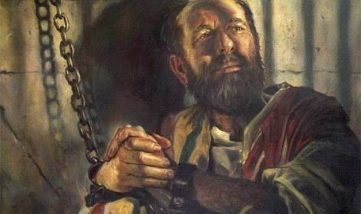
Previously…
Jeremiah was first taken in chains with all the other captured Jews as far as Ramah, a town about five miles north of Jerusalem.
The Babylonian ‘captain of the guard’ loosed his bonds, ‘gave him an allowance and a present,’ and sent him back to Gedaliah, the new governor of Judah, with instructions permitting him to dwell among the people or to go wherever he chose.
Jeremiah 30:3
(1)

Slide 3
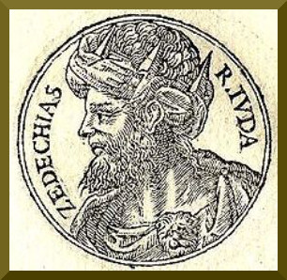
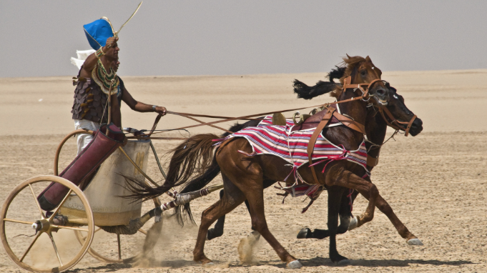
Zedekiah Breaks A Covenant
And if thy brother, an Hebrew man, or an Hebrew woman, be sold unto thee, and serve thee six years; then in the seventh year thou shalt let him go free from thee. Deut. 15:12
“During the early period of the siege of Jerusalem, the men of the city released their Hebrew slaves. This may have been done partly because the old law required the release of slaves as provided for, and partly because of the need of manpower to defend the besieged city.
“The release was guaranteed by a solemn covenant. Then the advance of the Egyptians seems to have caused the Babylonians to lift the siege. In spite of their solemn oath, and by ignoring the claims of brotherly love and ordinary justice, the men of the city proceeded to re-enslave their unfortunate brethren. This unrighteous act immediately brought down the Lord’s denunciation and terrible condemnation.”
Jeremiah 34; Exodus 21:1
(2)

Slide 4
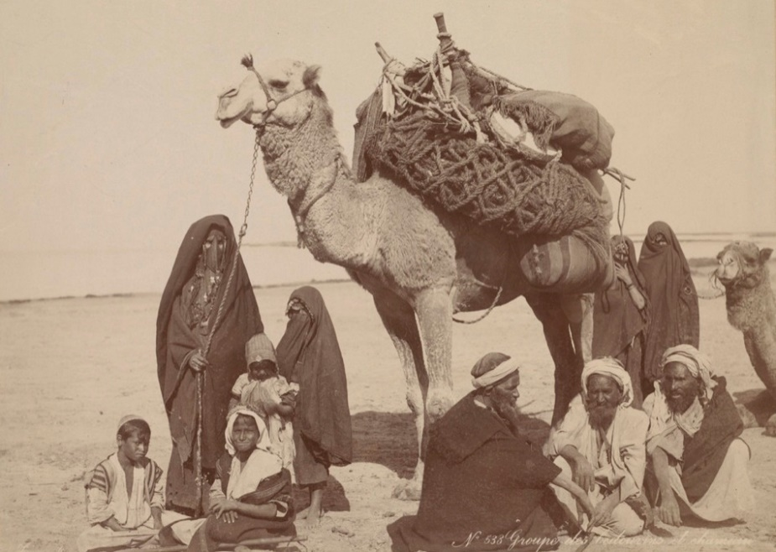
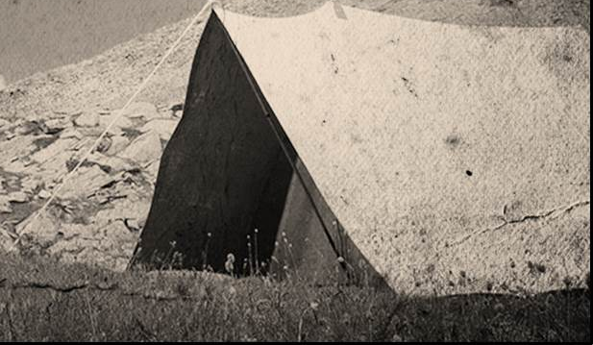
Who Are the Rachabites?
During the reign of Jehoiakim
The Rechabites made a covenant never to drink wine, refused to drink it when offered it by Jeremiah in the house of God. (These people had moved to Jerusalem to escape the invading Babylonians.)
They dwelt in tents
The Rechabites observed their covenants faithfully, even though they were not the covenant people of the Lord.
Jeremiah 35; 2 Kings 10:15; 1 Chr. 2:55
(2)

Slide 5
Jehoiakim
He was originally called Eliakim
He was elevated by the king of Egypt to the throne of Judah in place of his brother Jehoahaz (2 Kings 23:34)
He was 25 years old when he ascended to the throne
He reigned in wickedness for 11 years
Nebuchadnezzar invaded Judah carrying away Jehoiakim to prison but later restoring him as a *vassal king (Daniel 1:1-2)
Jeremiah, a prisoner of the state at this time caused prophecies to be written down which Jehoiakim destroyed by fire
In a prophecy by Jeremiah, Jehoiakim would not be mourned for his death (Jeremiah 22:18)
*A vassal king is a monarch who owes allegiance to a more powerful ruler, known as a suzerain or overlord
(7)

Slide 6
Baruch
He was the son of Neriah from the tribe of Judah
His name means blessed
He served as a scribe for the prophet Jeremiah and recorded the prophet’s words of inspiration as they were given
He read the prophecies before the people as a warning to repent (Jeremiah 36:4-6)
After the king burned the records, Jeremiah had Baruch rewrite the words, manifesting that the word of the Lord cannot be annulled or destroyed
He accompanied Jeremiah to Egypt
Because of his faithfulness Jeremiah promised him that his life would be preserved (Jeremiah 45)
(7)

Slide 7
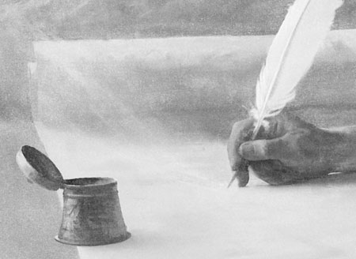
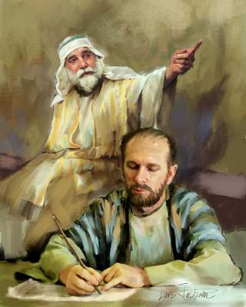
Baruch--Scribe
“In the fourth year of the reign of Jehoiakim the word of the Lord came to Jeremiah, bidding him commit to writing all the addresses he had previously delivered, that Judah might, if it were possible, still regard the threatenings and return.
In accordance with this command, he got all the words of the Lord written down in a book by his attendant Baruch, with the further instruction that this should be read on the fast-day in the temple to the people who came out of the country into Jerusalem.
Jeremiah 36:1-8
(3)

Slide 8

Return From Evil Ways
The scriptures help us turn to the Lord and receive His forgiveness
2 Timothy 3:16
Alma 37:8
Helaman 15:7
All scripture is given by inspiration of God, and is profitable for doctrine, for reproof, for correction, for instruction in righteousness:
And behold, ye do know of yourselves, for ye have witnessed it, that as many of them as are brought to the knowledge of the truth, and to know of the wicked and abominable traditions of their fathers, and are led to believe the holy scriptures, yea, the prophecies of the holy prophets, which are written, which leadeth them to faith on the Lord, and unto repentance, which faith and repentance bringeth a change of heart unto them—
And now, it has hitherto been wisdom in God that these things should be preserved; for behold, they have enlarged the memory of this people, yea, and convinced many of the error of their ways, and brought them to the knowledge of their God unto the salvation of their souls.
Jeremiah 36:3
(3)

Slide 9
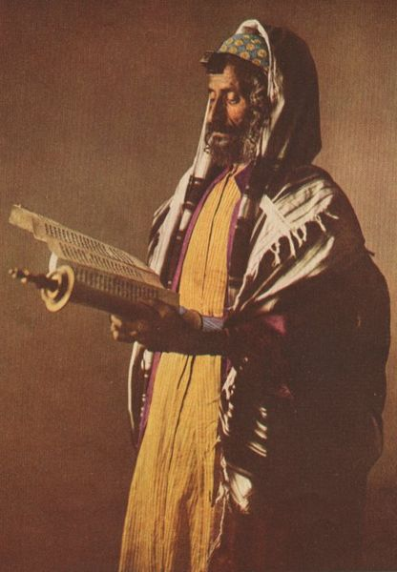
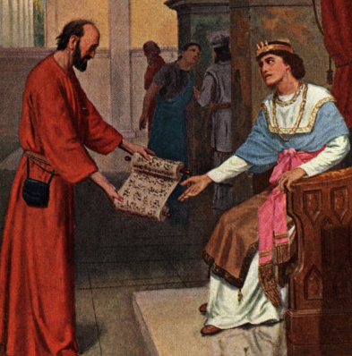
Baruch Reads Prophecy
When, after this, in the ninth month of the fifth year of Jehoiakim, a fast was appointed, Baruch read the prophecies to the assembled people in the chamber of Gemariah in the temple.
Michaiah the son of Gemariah mentioned the matter to the princes who were assembled in the royal palace; these then sent for Baruch with the roll and made him read it to them. But they were so frightened by what was read to them that they deemed it necessary to inform the king regarding it.
Jeremiah 36:9-19
(3)

Slide 10
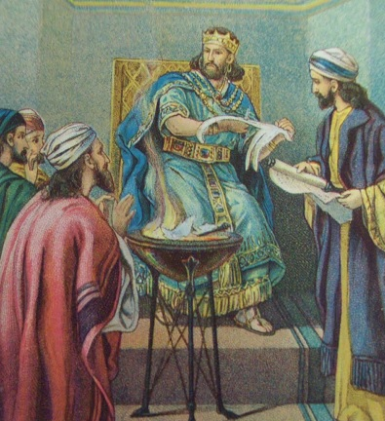
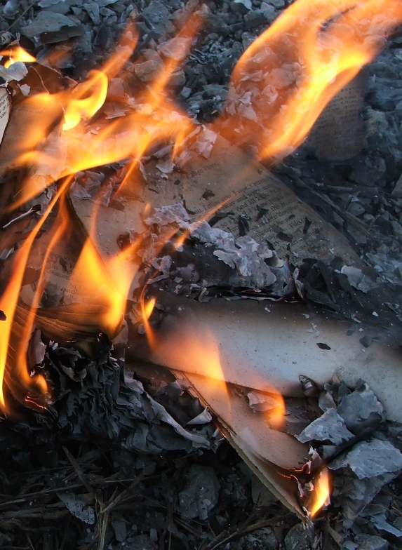
King (Jehoiakim) Cuts the Roll Destroying It
At their advice, the king had the roll brought and some of it read before him; but scarcely had some few columns been read, when he cut the roll into pieces and threw them into the pan of coals burning in the room, at the same time commanding that Baruch and Jeremiah should be brought to him; but God hid them.
After this roll had been burnt, the Lord commanded the prophet to get all his words written on a new roll, and to predict an ignominious fate for King Jehoiakim; whereupon Jeremiah once more dictated his addresses to Baruch.”
The Lord’s words will be fulfilled regardless of whether we believe in them
Jeremiah 36:20-32
(3)

Slide 11
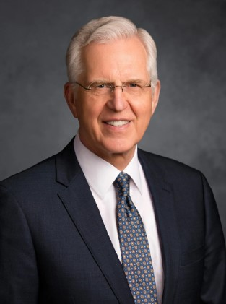
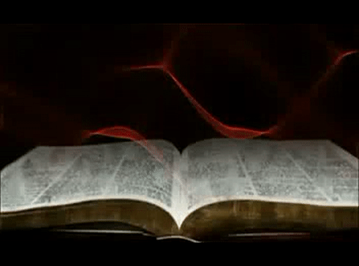
The Purpose of the Scriptures
Through the scriptures, God does indeed “show forth his power” to save and exalt His children.
By His word … He enlarges our memory, sheds light on falsehood and error, and brings us to repentance and to rejoice in Jesus Christ, our Redeemer.
In the end, the central purpose of all scripture is to fill our souls with faith in God the Father and in His Son, Jesus Christ
(6)

Slide 12
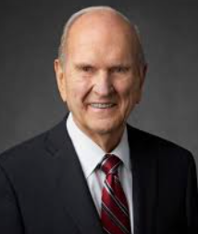

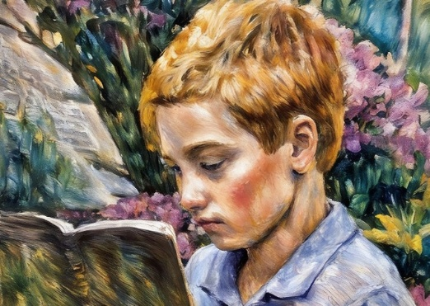
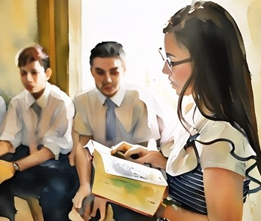

Blessings of the Scriptures
I promise that as you prayerfully study the Book of Mormon every day, you will make better decisions—every day.
I promise that as you ponder what you study, the windows of heaven will open, and you will receive answers to your own questions and direction for your own life.
I promise that as you daily immerse yourself in the Book of Mormon, you can be immunized against the evils of the day
(8)

Slide 13
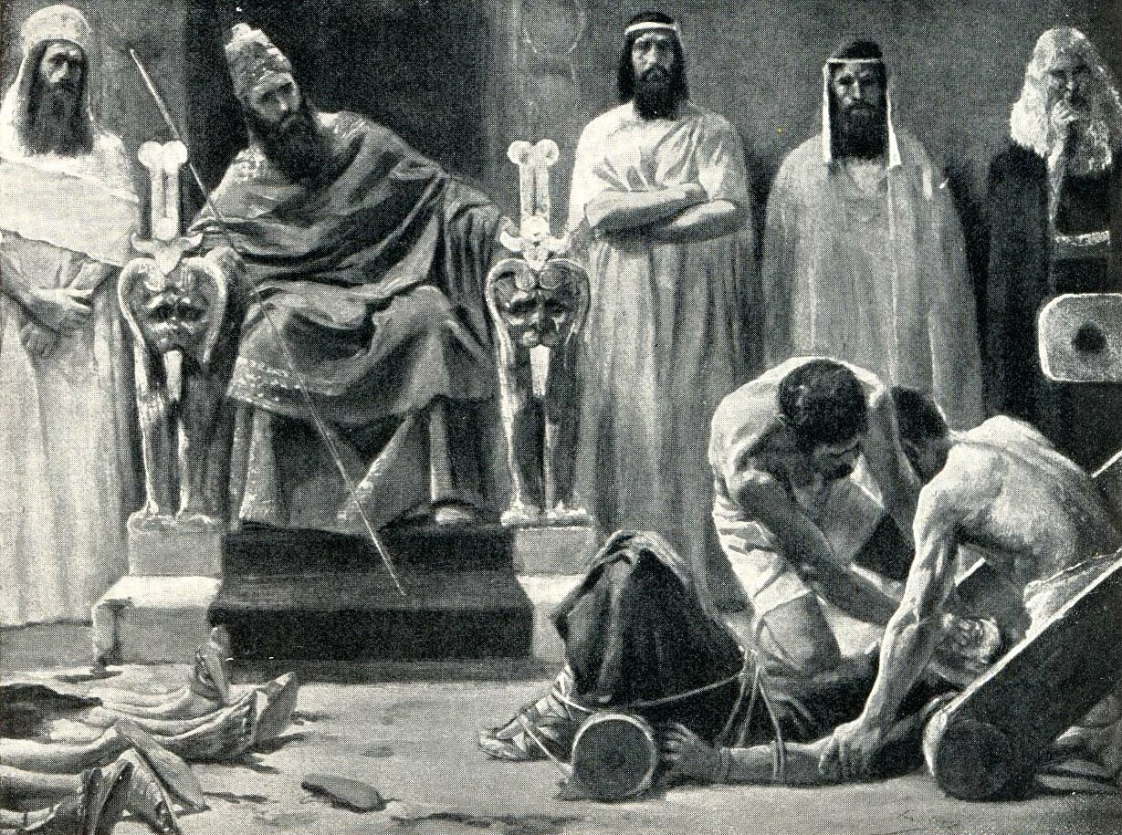
King (Jehoiakim) Rebels Against Babylon
When King Jehoiachin rebelled against Babylon, he was deposed and his uncle, Zedekiah, was placed on the throne.
By this time, it should have been obvious that Jeremiah’s prophecies were coming to pass.
Twice Nebuchadnezzar had come, and twice he had humbled Judah. But Zedekiah was no wiser than his brother, Jehoiakim, and his nephew, Jehoiachin.
He too began to look for ways to break the Babylonian yoke. Ignoring the repeated warnings of Jeremiah, he rebelled, and once again the Babylonians came against Jerusalem.
Jeremiah 37-39
(1)

Slide 14
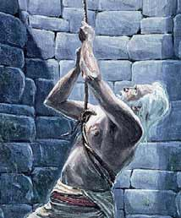
Siege Is Lifted Temporarily
The approaching Egyptian army--Zedekiah wants Egypt as an ally
Jeremiah returns to the land of Benjamin—probably his hometown.
He was accused of joining the Chaldeans and arrested by the Jewish leaders. They beat him and threw him into a muddy dungeon.
Zedekiah called to Jeremiah secretly and asked Jeremiah about Jerusalem’s fate. When the accusers demanded Jeremiah’s death Zedekiah said that Jeremiah was in their hands…but when Jeremiah’s friends pleaded for his life, Zedekiah had him secretly removed from prison.
Jeremiah 37-39
(1)

Slide 15
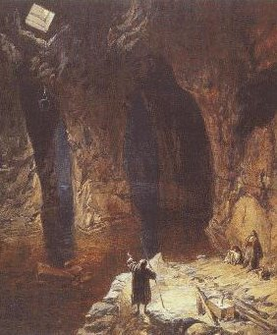
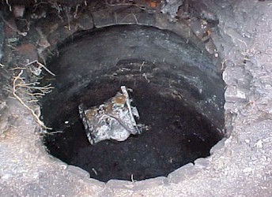
Dungeon of Malchiah
Then took they Jeremiah, and cast him into the dungeon of Malchiah the son of Hammelech, that [was] in the court of the prison: and they let down Jeremiah with cords. And in the dungeon [there was] no water, but mire: so Jeremiah sunk in the mire.
(4)
The dungeon - The cistern. Every house in Jerusalem was supplied with a subterranean cistern, so well constructed that the city never suffered in a siege from want of water. So large were they that when dry they seem to have been used for prisons.(5)
As for thee also, by the blood of thy covenant I have sent forth thy prisoners out of the pit wherein is no water. Zechariah 9:11
Jeremiah 38:6
(1)

Slide 16
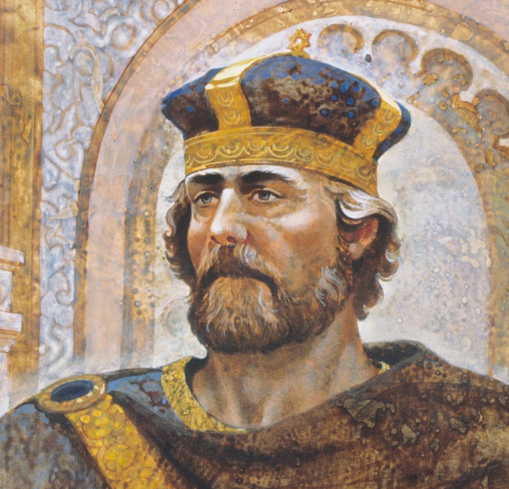
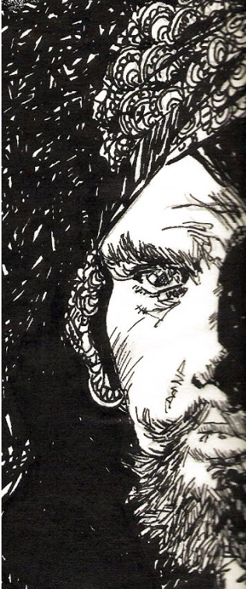
Jeremiah Sent to Governor of Judah
Jeremiah was first taken in chains with all the other captured Jews as far as Ramah, a town about five miles north of Jerusalem. Here the Babylonian ‘captain of the guard’ loosed his bonds, ‘gave him an allowance and a present,’ and sent him back to Gedaliah, the new governor of Judah, with instructions permitting him to dwell among the people or to go wherever he chose.
“Following Gedaliah’s appointment as governor of Judah, many Jews in the lands round about regained confidence and returned to their own country.
But one of them, Ishmael the son of Nethaniah, seems to have been sent by Baalis, the king of Ammon, for the express purpose of slaying Gedaliah.
Jeremiah 40:1-14
(1)

Slide 17
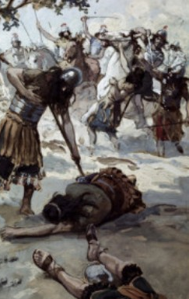
Gedaliah is Warned But Killed
The good governor was warned of this, but he would not believe those who had informed him of the plot. The result was that he and the Jews and Chaldeans with him at Mizpah were slain in cold blood by Ishmael and his fellow conspirators.
Other Jews met their death at the hands of Ishmael, but he escaped to Ammon before he could be apprehended.
After this incident, Jeremiah was approached by the people of Judah, who asked him to pray to God in their behalf and ask His advice and counsel…
Which you will learn in the next lesson…
Jeremiah 41:1-15
(1)

Slide 18
Sources:
Video:
Which Way Do You Face? (1:30)
Old Testament Institute Manual The Babylonian Captivity Chapter 24
Sidney B. Sperry, The Voice of Israel’s Prophets, pp. 182–83.
Keil and Delitzsch, Commentary, 8:2:93 found in (source 1)
Bible History.com
Presentation by ©http://fashionsbylynda.com/blog/
5. BibleHub.com
6. . Elder D. Todd Christofferson (“The Blessing of Scripture,” Ensign or Liahona, May 2010, 33)
7. Who’s Who in the Old Testament by Ed J. Pinegar and Richard J. Allen pg. 25, 87
8. President Russell M. Nelson (“The Book of Mormon: What Would Your Life Be Like without It?,” Ensign or Liahona, Nov. 2017, 62–63)

Slide 19
Other Events Preceding Jeremiah Under the new Governor Jeremiah 40
“Following Gedaliah’s appointment as governor of Judah, many Jews in the lands round about regained confidence and returned to their own country. But one of them, Ishmael the son of Nethaniah, seems to have been sent by Baalis, the king of Ammon, for the express purpose of slaying Gedaliah. (40:14) The good governor was warned of this, but he would not believe those who had informed him of the plot. The result was that he and the Jews and Chaldeans with him at Mizpah were slain in cold blood by Ishmael and his fellow conspirators. (41:1–3) Other Jews met their death at the hands of Ishmael, but he escaped to Ammon before he could be apprehended. (41:4–15) OT Institute Manual Chapter 24
More Information about Jeremiah and the Siege: Jeremiah 37-39:
It was in this setting that the events of these chapters took place. Jerusalem was under siege, and Jeremiah’s counsel to surrender was not welcome. He was viewed as a traitor and a subversive. At this point an army of the pharaoh moved north to meet Nebuchadnezzar’s forces (see Jeremiah 37:5). Nebuchadnezzar temporarily pulled away from Jerusalem to meet the threat from the south. The hopes of the Jews soared, but again Jeremiah dashed them to pieces. He prophesied that the Egyptian army would return to Egypt (see v. 7) and that the siege would be reimposed. So helpless would Judah be, according to Jeremiah, that even if the entire Chaldean army were wounded in the battle with Egypt, they would still succeed in destroying Jerusalem (see vv. 8–10).
During the time that the siege was lifted, Jeremiah decided to return to the land of Benjamin, probably to visit his hometown. His enemies seized this opportunity to make their move. Accusing him of fleeing to join the Chaldeans, the Jewish leaders had Jeremiah arrested, beaten, and thrown into prison (see vv. 11–15).
The weak, vacillating character of King Zedekiah manifested itself. He called Jeremiah to him secretly, asking if there was any word from the Lord concerning Jerusalem’s fate (see vv. 16–17). Yet when the other leaders demanded Jeremiah’s death for preaching surrender (see Jeremiah 38:1–4), Zedekiah responded weakly, “Behold, he is in your hand: for the king is not he that can do any thing against you” (v. 5). But when Jeremiah’s friends pleaded for his life, Zedekiah relented and had him secretly delivered out of the prison (see vv. 7–13).
Jeremiah’s sarcastic question to Zedekiah is recorded in Jeremiah 37:19. The false prophets had promised that the Babylonians would not come against Jerusalem and the captives already taken would be returned. At that time Jeremiah cited the words of Moses for determining the true from the false prophets. Now, with the Babylonians surrounding the city, Jeremiah asked where all those other prophets were. Jeremiah’s word had been proven true, and he was in prison. Their word had been proven false, and where were they?
Chapter 39 of Jeremiah details the fall of Jerusalem and the tragic end of Zedekiah and his family. Because Jeremiah had foretold Babylon’s eventual success, he was released by the Chaldeans and allowed to remain in Jerusalem as a free person (see vv. 11–14).
OT Institute manual chapter 24
The Rachabites:
are a biblical clan, the descendants of Rechab through Jehonadab. They belonged to the Kenites, who accompanied the Israelites into the Holy Land and dwelt among them. The main body of the Kenites dwelt in cities and adopted settled habits of life but Jehonadab forbade his descendants to drink wine or to live in cities. They were commanded to always lead a nomadic life.
The Rechabites adhered to the law laid down by Jonadab, and were noted for their fidelity to the old-established custom of their family in the days of Jeremiah (Jeremiah 35); and this feature of their character is referred to by God for the purpose of giving point to his message to the King of Judah. Wikipedia
Members of a family descended from Hammath, the progenitor of the house of Rechab; otherwise known as the Kenites (I Chron. ii. 55), who were the descendants of Hobab (Jethro), the father-in-law of Moses (Judges iv. 11). In Jeremiah (xxxv.) it is recorded that the prophet took some Rechabites into the Temple and offered them wine to drink, and that they declined on the ground that Jehonadab, son of Rechab, their ancestor, had commanded them not to drink wine or other strong drink, or to live in houses, or to sow seed, or to plant vineyards, and had enjoined them to dwell in tents all their days. Jeremiah used this fidelity of the Rechabites to their principles as an object-lesson in his exhortations to his contemporaries.
Jewish Encyclopedia
“ For example, the recurring “flight of the righteous into the wilderness” was a noteworthy practice. Lehi’s flight from Jerusalem, and Alma’s departure to the Waters of Mormon, are consistent with a repeated pattern of bands of people going out into the wilderness to live in righteousness. The same pattern is seen in the histories of the Jewish desert sectaries, the Rechabites, and the Dead Sea community at Qumran. ” April 1985 Ensign Hugh Nibley and the Book of Mormon By John W. Welch
For more information see:
http://inthecavityofarock.blogspot.com/2013/08/correlations-between-book-of-mormon-and.html

Slide 20
Following the Prophet:
“The prophet tells us what we need to know, not always what we want to know. …
“‘You may not like what comes from the authority of the Church. It may conflict with your political views. It may contradict your social views. It may interfere with some of your social life. … Your safety and ours depends upon whether or not we follow. … Let’s keep our eye on the President of the Church.’ [In Conference Report, October 1970, pp. 152–153]
“But it is the living prophet who really upsets the world. ‘Even in the Church,’ said President Kimball, ‘many are prone to garnish the sepulchers of yesterday’s prophets and mentally stone the living ones’ (Instructor, 95:257).
“Why? Because the living prophet gets at what we need to know now, and the world prefers that prophets either be dead or mind their own business. Some so-called experts of political science want the prophet to keep still on politics. Some would-be authorities on evolution want the prophet to keep still on evolution. And so the list goes on and on.
“How we respond to the words of a living prophet when he tells us what we need to know, but would rather not hear, is a test of our faithfulness.”
President Ezra Taft Benson quoted Presidents Harold B. Lee and Spencer W. Kimball (“Fourteen Fundamentals in Following the Prophet,” [Brigham Young University devotional, Feb. 26, 1980], 3–4; speeches.byu.edu).

Slide 21
Jeremiah At A Glance – Bible Dictionary
Jeremiah 1-6 | Prophecies of reign of Josiah | Jeremiah 1:4-5 Jeremiah 3:12-19 | Premortal Condition and Jeremiah’s Calling Prophecy of the return of Israel from the scattered condition, gathering one of a city and two of a family to Zion, a pleasant land where Israel and Judah can dwell in safety and peace
Jeremiah 7-20 | Prophecies under Jehoiakim
Jeremiah 21-38 | Prophecies under Zedekiah | Jeremiah 21-23 | On pastors or rulers of people, with promise of king Messiah
 |  | Jeremiah 24 | Exiles carried away with Jehoiachin
 |  | Jeremiah 26-29 | False prophets and containing the prophet’s letter to the exiles in Babylon, warning against the prophets there
 |  | Jeremiah 30-33 | Prophecies of the latter-day restoration of Israel and the gospel covenant, containing the story of the prophet’s buying a field, showing the firmness of his faith in the people’s restitution
 |  | Jeremiah 34-38 | Narratives of the treatment of the prophet and other events during the last times of the siege
Jeremiah 39-44 | The prophet’s history and other events after the fall of the city
Jeremiah 46-51 | Prophecies against foreign nations | Jeremiah 50-51 | In their present form are later than Jeremiah
Jeremiah 52 | Historical conclusion

