Slide 1
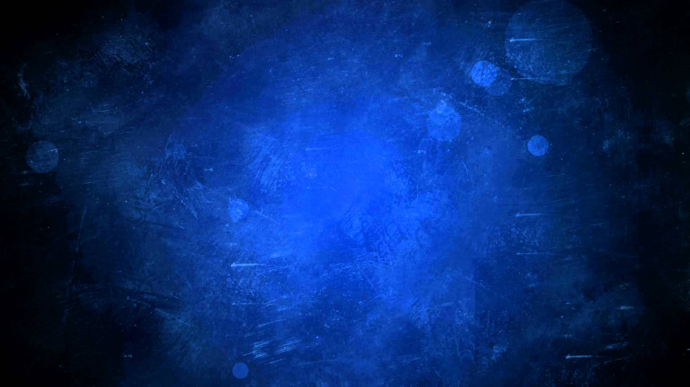




The Great and Mighty Battle
Ezekiel 38-48
Including a Vision of the Latter-day Temple
And now ye behold this temple which is in Jerusalem, which ye call the house of God, and your enemies say that this house shall never fall.
D&C 45:18
THE HOUSE OF THE LORD
Built by
THE CHURCH OF JESUS CHRIST OF LATTER-DAY SAINTS
COMMENCED APRIL 6, 1841
HOLINESS TO THE LORD
Presentation by ©http://fashionsbylynda.com/blog/

Slide 2
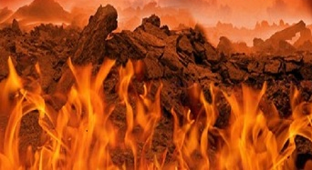
Premillennial War
Gog and Magog are the prophetic names given in the scriptures to that combination of nations which will fight against the purposes of the Lord on two separate and future occasions:
At the time of and incident to the second coming of the Lord and the ushering in of the millennial era; and
2. At the end of the Millennium, plus a little season, when the final overthrow of evil and the destruction of the wicked shall take place.
The Lord has not revealed who the nations are, but his prophets have described, in general terms, what they will do in the great battles that shall hereafter be fought.
Ezekiel 38

Slide 3
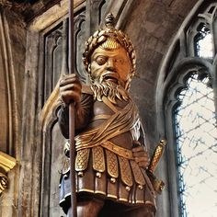
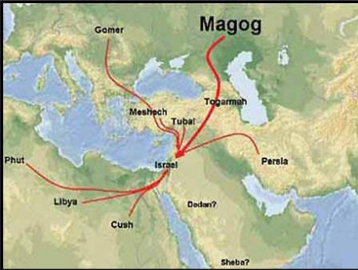
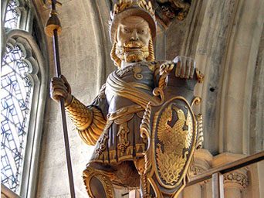
Gog and Magog
Participants in Armageddon
Ezekiel named Gog of the land of Magog, the prince of Meshech and Tubal, as the leader of the forces that would come against Israel (see Ezekiel 38:1–3).
Magog, Meshech, and Tubal were ancient peoples in the northern part of Asia Minor.
Gog is a symbolic name for the leader or leaders of this great evil power that will arise in the last days.
Ezekiel 38:1–3; 2-6

Slide 4
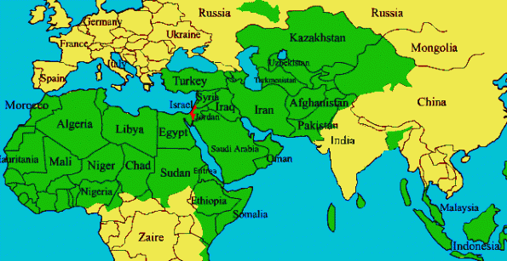
Alliances With Gog
Ezekiel named Persia, Ethiopia, Libya, Gomer, and Togarmah as being in alliance with Gog
Gomer
Togarmah
Persia
Libia
These designations refer to general areas of the ancient world, so a list of modern nations fighting in Armageddon cannot be compiled from these sources.
Elder Bruce R. McConkie said: “The prophecies do not name the modern nations which will be fighting for and against Israel, but the designation Gog and Magog is given to the combination of nations which are seeking to overthrow and destroy the remnant of the Lord’s chosen seed.” (Mormon Doctrine, p. 298.)
Ethiopia
Ezekiel 38:2-6

Slide 5
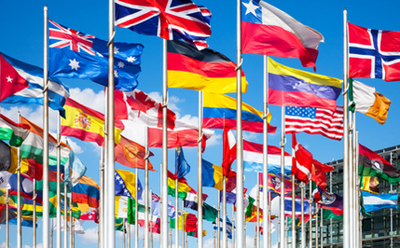

Alliances
The prophets agreed that all nations should be joined in this alliance in one way or another.
Ezekiel 38:8; Jeremiah 25:26; Joel 3:1; Zechariah 14:2; Revelation 16:14

Slide 6
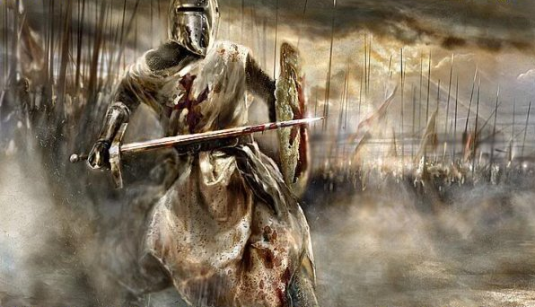
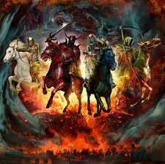
Ezekiel’s Army of Armageddon
“Clothed with all sorts of armour, even a great company with bucklers and shields, all of them handling swords” and as coming like “a storm” and “a cloud to cover the land”, having “many people” with him, “all of them riding upon horses [a symbol of power in war], a great company, and a mighty army.”
Ezekiel 38:4

Slide 7
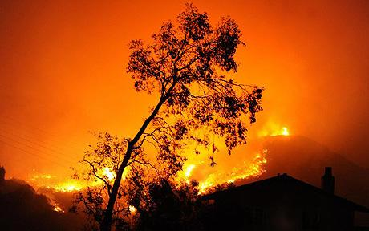
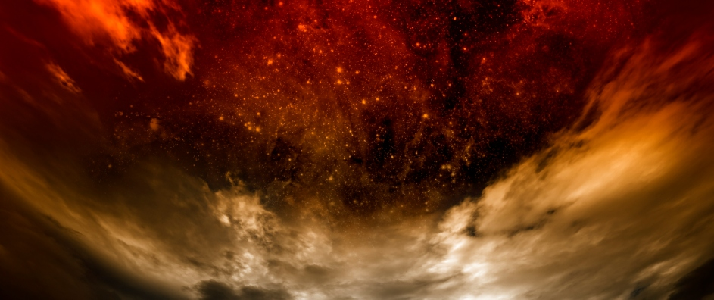
Joel’s Army of Armageddon
Joel stated that the army would be the greatest army in the history of the world up to that point.
He described it as being like a “fire” that devours the land, leaving what had looked like the “garden of Eden” before their coming as “a desolate wilderness”.
Joel also said that the army would be highly disciplined in warfare and virtually invincible: “When they fall upon the sword, they shall not be wounded”.
Joel 2:2-9

Slide 8
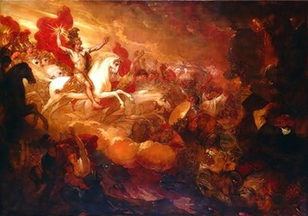
Daniel’s Army of Armageddon
Daniel described the “king of the north” as coming with a “great army” which others have no “strength to withstand” and as coming “like a whirlwind, with chariots, and with horsemen, and with many ships; and he shall enter into the countries, and shall overflow and pass over”.
Elder Joseph Fielding Smith specifically identified Daniel as referring to the last days (see Signs of the Times, p. 156).
Daniel 11-12

Slide 9
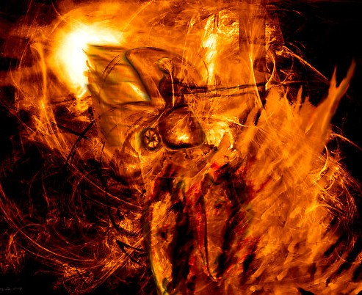
John the Revelator’s Army of Armageddon
John the Revelator used the imagery of a cloud of locusts (vast numbers that bring great devastation) and described the army as having the “teeth of lions,” “breastplates of iron,” and “wings” that sounded like the “sound of chariots of many horses running to battle”.
The army was numbered “two hundred thousand thousand”, having “breastplates of fire, and of jacinth, and brimstone” and with “fire and smoke and brimstone” issuing “out of their mouths”.
Revelation 9:8-9

Slide 10
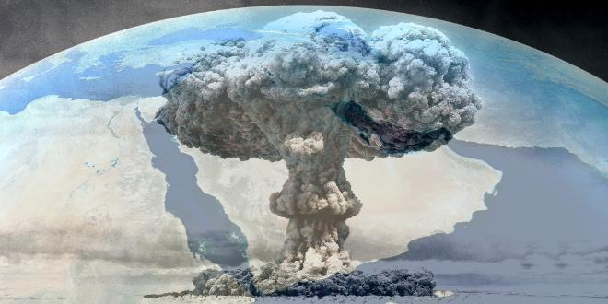
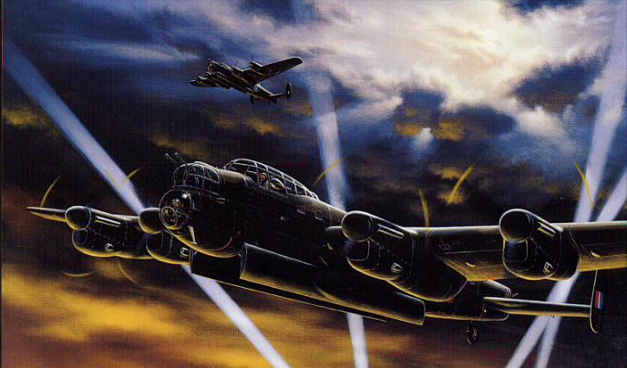
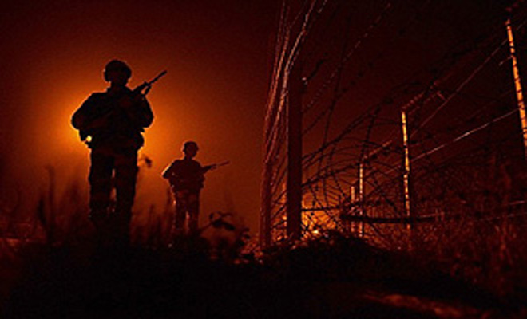
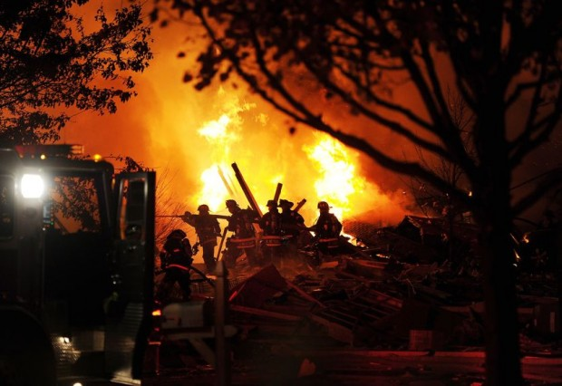
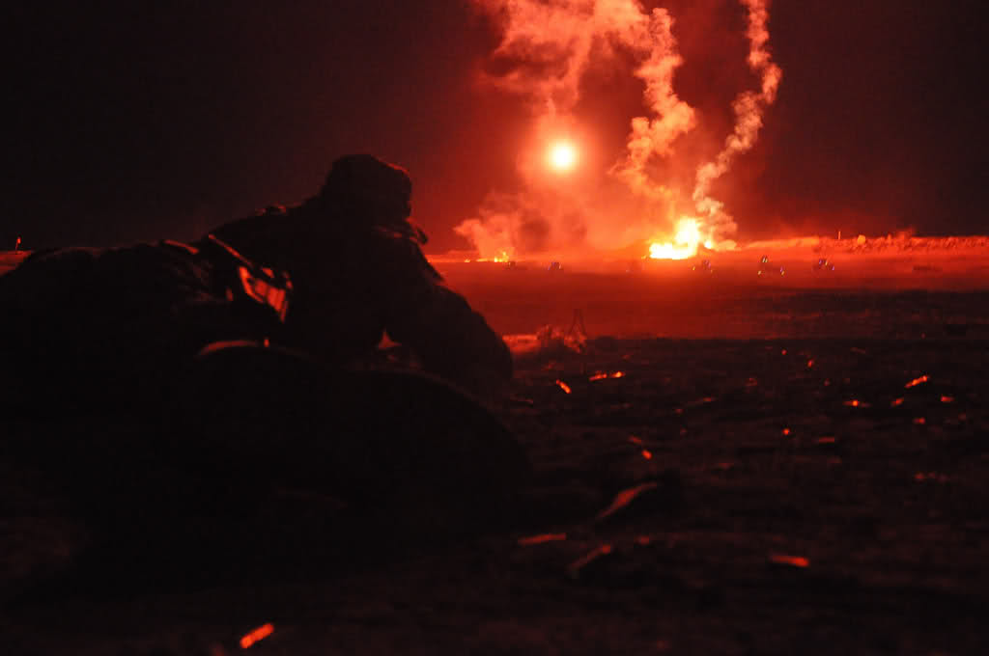
Imagery of Armageddon
“Referring to the imagery of John and Joel, suggested that “it is not improbable that these ancient prophets were seeing such things as men wearing or protected by strong armor; as troops of cavalry and companies of tanks and flame throwers; as airplanes and airborne missiles which explode, fire shells and drop bombs; and even other weapons yet to be devised in an age when warfare is the desire and love of wicked men” (2)

Slide 11
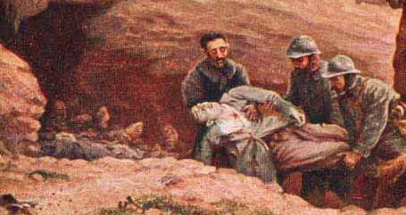
Army of Gog Destroyed
שֶׁבַע
7 in Hebrew = compete
Most of the army of Gog is destroyed, it will take seven months for the house of Israel to bury the dead and seven years to clean up after the battle.
Sometimes in the scriptures, writers use numbers to convey symbolic meaning beyond the literal understanding.
Thus, the number seven may refer to a long time or to the land becoming complete and whole again.
The trilliteral root (Shin-Bet-Ayin) carries three fundamental meanings
1 Seven
2 Full/complete
3 Oath/Sware
Ezekiel 39

Slide 12
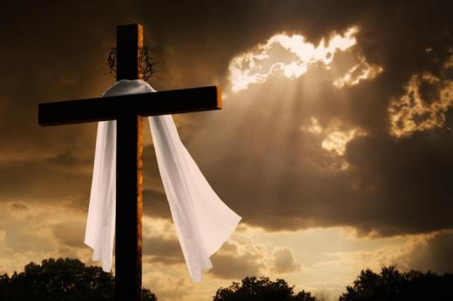
My Holy Name Will Be Known
So will I make my holy name known in the midst of my people Israel; and I will not let them pollute my holy name any more: and the heathen shall know that I am the Lord, the Holy One in Israel.
All people will know that Jesus Christ is the Lord
Ezekiel 39:7

Slide 13
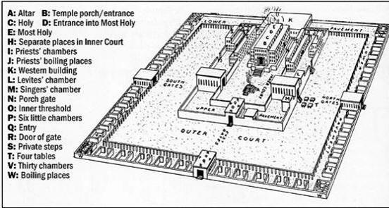
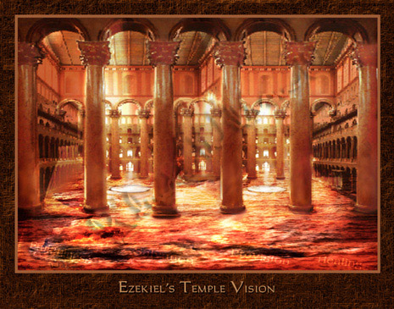
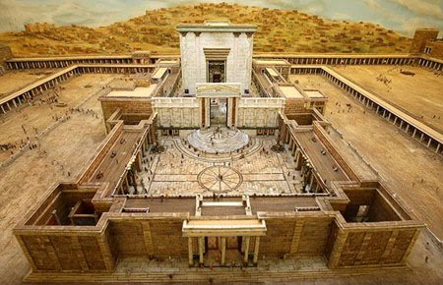
The Temple
To be built in Jerusalem in the last days
Ezekiel was brought to the door of the temple, where he saw in vision an event that the Prophet Joseph Smith taught would occur before the Savior’s Second Coming. (3)
Ezekiel 40-43, 47

Slide 14
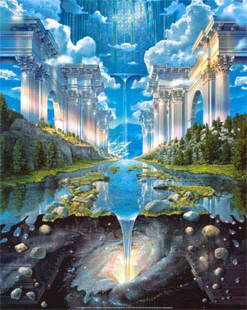
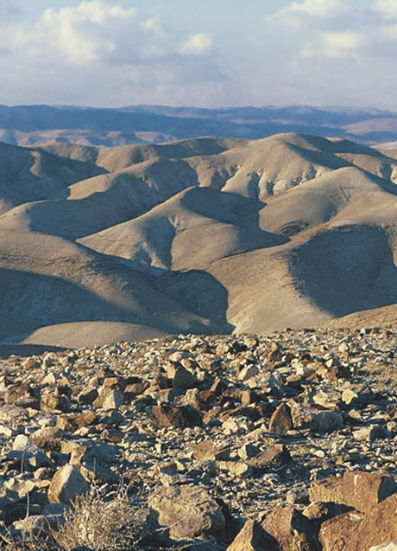
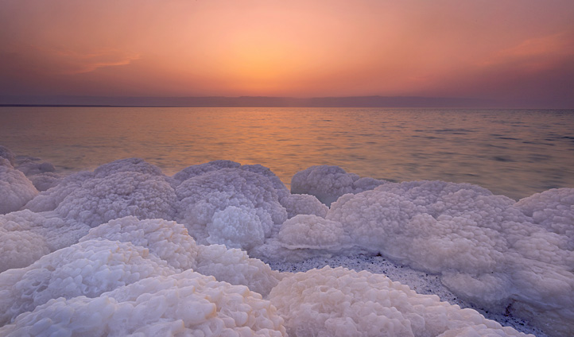
Ezekiel’s Vision of the Water
In Ezekiel’s vision, this was the area through which the water ran.
The sea Ezekiel saw was the Dead Sea, so named because of its inability to sustain animal or plant life.
The Judean wilderness lies east of Jerusalem and descends to the Dead Sea.
Ezekiel 47:1-9

Slide 15
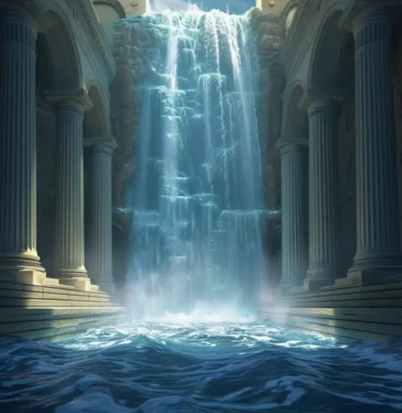
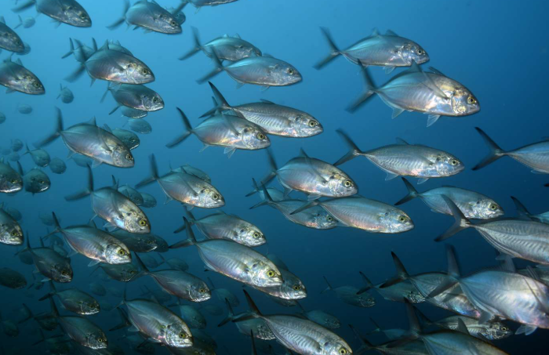
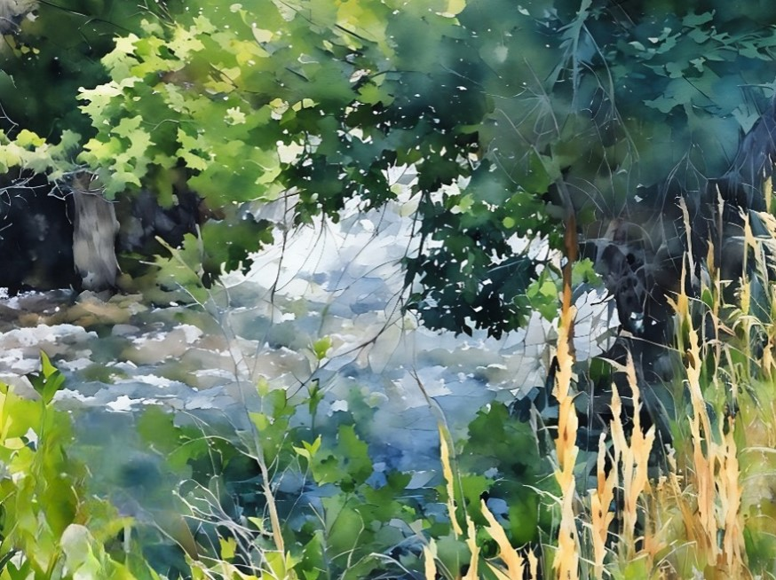
Waters Shall Be Healed/We Will Be Healed
As we worship the Lord in the temple, He blesses us with healing, new life, and growth.
Ezekiel 47:8,9,12

Slide 16
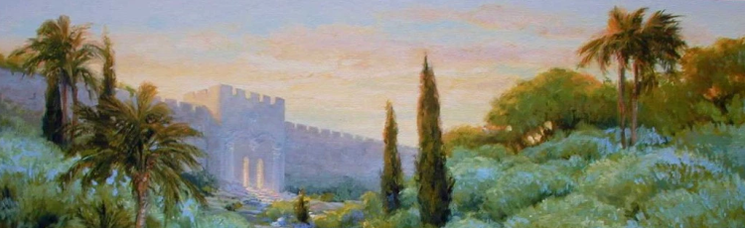
Jerusalem Rebuilt
“Judah must return, Jerusalem must be rebuilt, and the temple, and water come out from under the temple, and the waters of the Dead Sea be healed. It will take some time to rebuild the walls of the city and the temple, … and all this must be done before the Son of Man will make His appearance.” (3)
The blessings of the temple heal and give life to those who keep the sacred covenants they make in the temple
Ezekiel 47:1-9

Slide 17
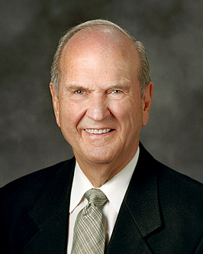
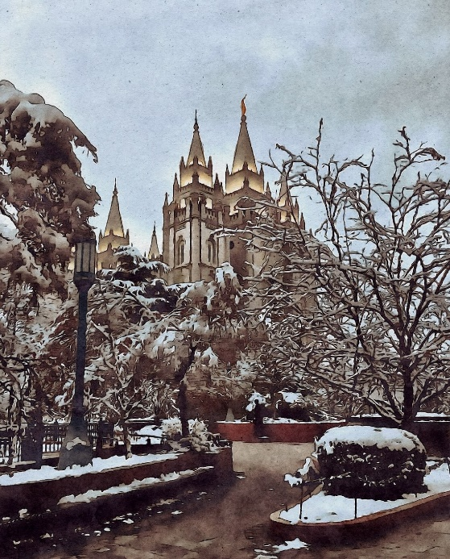
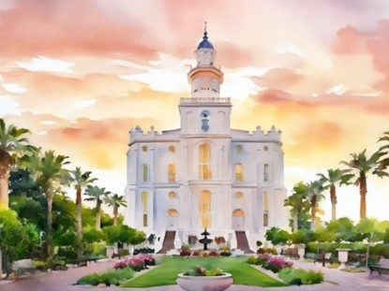
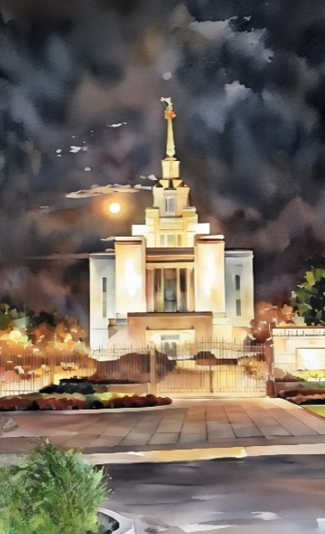
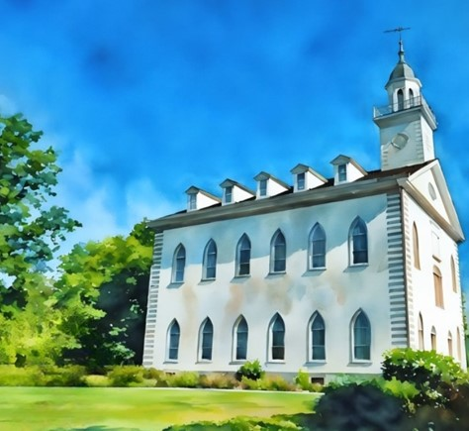
The temple is the house of the Lord.
The basis for every temple ordinance and covenant—the heart of the plan of salvation—is the Atonement of Jesus Christ.
Every activity, every lesson, all we do in the Church, point to the Lord and His holy house. (4)

Slide 18
Sources:
Videos:
Highlight: Blessings of the Temple (0:52)
And the River Will Grow (3:43)
Unlocking the Door to the Blessings of Abraham (2:42)
The Blessings of the Temple(3:38)
Old Testament Seminary The Battle of Armageddon: A Prophetic View
Bruce R. McConkie Questions and Answers March 1971 Ensign
(Doctrinal New Testament Commentary, 3:503).
Presentation by ©http://fashionsbylynda.com/blog/
Prophet Joseph Smith (Teachings of Presidents of the Church: Joseph Smith [2007], 252).
President Russell M. Nelson (“Personal Preparation for Temple Blessings,” Ensign, May 2001, 32

Slide 19
Ezekiel 1-3 | Ezekiel 4-24 | Ezekiel 25-32 | Ezekiel 33-48
Ezekiel sees the Lord and His glory. He is called as a watchman to the house of Israel to warn, reprove, and call them to repentance. | The Lord instructs Ezekiel to use symbols to represent the wickedness of Israel and the destruction of Jerusalem. Ezekiel prophesies of the Lord’s judgments on Jerusalem and explains why famine, desolation, war, and pestilence will sweep the land of Israel. | The Lord commands Ezekiel to declare the wickedness of the nations surrounding Israel and prophesy of their destruction. | The Lord reproves the leaders of Israel for being poor shepherds over their people. The Lord will be a true shepherd to Israel. Ezekiel records his vision of Israel’s restoration after the exile and in the latter days. The Lord promises to gather the Israelites from captivity, return them to their promised lands, renew His covenant with them, and reunite the kingdoms of Israel and Judah.

Slide 20
Armageddon: According to the prophets, some important events must take place before the battle actually begins:
Ezekiel 36:24; 37:21 | Ezekiel 36:10-12, 33-36 | Ezekiel 36:8, 29-30, 34-35 | Ezekiel 27:22 | Zechariah 1:16-17; 2:12; 12:6; 3 Nephi 20:46 | Isaiah 19:16-17 Zechariah 10:3, 5-6 | Revelation 13:1; 17:8-14
The house of Israel will be gathered from among the heathen (the Gentiles) and returned to their own land | The land of Israel will be rebuilt and inhabited by the covenant people | The land will become highly productive and fruitful, even like the Garden of Eden | There will be one nation in the land of Israel again | Jerusalem will be reestablished as the capital city of the Israelites | Judah will become powerful in politics and warfare | A great combination of organizations serving Satan will arise in the last days. This combination has several names: the “beast … out of the sea representing the kingdoms of the earth
Bruce R. McConkie, Doctrinal New Testament Commentary
3:520
“The Savior recognized the domination of Satan over the world generally, and called him the prince of the world, but in a special way—in the way that Brother [Ezra Taft] Benson has referred to—he has entered into the politics of the world among the nations of the world, and already subjugated about one billion people of the world, and by a dire, sanguinary, and deadly philosophy has brought death to millions and has brought slavery to almost a billion people.” (In Conference Report, Apr. 1960, p. 100.)

Slide 21
Premillennial:
Because we are living in the last days, immediately preceding the second coming of the Lord, our chief interest in Gog and Magog centers in the pre-millennial war. The following quotation summarizes what is to take place:
“Our Lord is to come again in the midst of the battle of Armageddon, or in other words during the course of the great war between Israel and Gog and Magog. At the Second Coming all the nations of the earth are to be engaged in battle, and the fighting is to be in progress in the area of Jerusalem and Armageddon. (Zech. 11; Zech. 12; Zech. 13; Rev. 16:14–21.) The prophecies do not name the modern nations which will be fighting for and against Israel, but the designation Gog and Magog is given to the combination of nations which will seek to overthrow and destroy the remnant of the Lord’s chosen seed. (2)
Early Saints and the Millennium Article https://www.lds.org/ensign/1979/08/early-saints-and-the-millennium?lang=eng
Side Note on the Gog and Magog:
Ezekiel 38–39 speaks of a great battle that will occur in Israel in the “latter days” and that will involve a people from “Magog” led by a king named Gog. Ezekiel described this war as being waged in the “mountains of Israel” against the children of Israel gathered to these lands. The Lord also told Ezekiel He would miraculously save His people from the armies of Magog so that all nations may “know that I am the Lord” (Ezekiel 38:23). Because of these descriptions, Ezekiel seems to be describing the great battle before the Second Coming, commonly known as “Armageddon.”
What can be confusing is that John the Revelator described a battle between good and evil at the end of the Millennium as the battle of Gog and Magog (see Revelation 20:7–9). So there are two battles referred to as Gog and Magog, the first right before the Second Coming and the other at the end of the Millennium. They are similar in that they will be massive battles involving great destruction that completely destroys the enemies of God and makes significant changes in the earth.
OT seminary student manual
Gog—Bible Dictionary
King of Magog, whose invasion of Israel was prophesied by Ezekiel (Ezek. 38–39). The prophecy points to a time when the gentile nations of the north would set themselves against the people of God and would be defeated and led to recognize Jehovah as King. All this appears to be at the Second Coming of the Lord. Another battle, called the battle of Gog and Magog, will occur at the end of the 1,000 years. This is described by John in Rev. 20:7–9; see also D&C 88:111–16.
Magog—Bible Dictionary
A country or people near the Black Sea, and equivalent to Scythian
Guide to the scriptures: In the Bible, a land and people near the Black Sea. Their king, Gog, shall lead the armies of Magog in a last great battle before the second coming of Christ (Ezek. 38:2; 39:6). The scriptures speak of another great battle of Gog and Magog at the end of the Millennium between the forces of God and the forces of evil
“Statement on Armageddon:
So great will be the darkness resting upon Christendom, and so great the bonds of priestcraft with which they will be bound, that they will not understand, and they will be given up to the hardness of their hearts. Then will be fulfilled that saying, That the day shall come when the Lord shall have power over his Saints, and the Devil shall have power over his own dominion. He will give them up to the power of the Devil, and he will have power over them, and he will carry them about as chaff before a whirlwind. He will gather up millions upon millions of people into the valleys around about Jerusalem in order to destroy the Jews after they have gathered. How will the Devil do this? He will perform miracles to do it. The Bible says the kings of the earth and the great ones will be deceived by these false miracles. It says there shall be three unclean spirits that shall go forth working miracles, and they are spirits of devils. Where do they go? To the kings of the earth; and what will they do? Gather them up to battle unto the great day of God Almighty. Where? Into the valley of Armageddon.” Elder Orson Pratt (In Journal of Discourses, 7:189.)
Significant Events: The Judean wilderness was an important refuge in many periods of early history. David hid from King Saul (1 Sam. 26:1–3). Jesus fasted 40 days and 40 nights (Matt. 4:1–11; Mark 1:12–13). Jesus used the route from Jerusalem to Jericho through the Judean wilderness as the setting for the parable of the good Samaritan because lone travelers were easy prey in that area (Luke 10:25–37). (See BD Dead Sea.)

