Slide 1

Faith and Wisdom
Daniel 1
And shall find wisdom and great treasures of knowledge, even hidden treasures;
And shall run and not be weary, and shall walk and not faint.
And I, the Lord, give unto them a promise, that the destroying angel shall pass by them, as the children of Israel, and not slay them. Amen.
D&C 89:19-21

Slide 2

Mateo and the Challenges
Mateo is an active member of The Church of Jesus Christ of Latter-day Saints. He has a reputation for trying new things, so his friends often give him challenges…
Once a friend challenged him to run a marathon. Mateo took the challenge.
Once a friend challenged him to introduce himself to a new girl at school. Mateo took the challenge.
Once a friend challenged him to dive into an ice-cold lake. Mateo took the challenge.
One day Mateo’s friends challenge him to drink alcohol at a party.
How do you think Mateo might respond? Why?

Slide 3
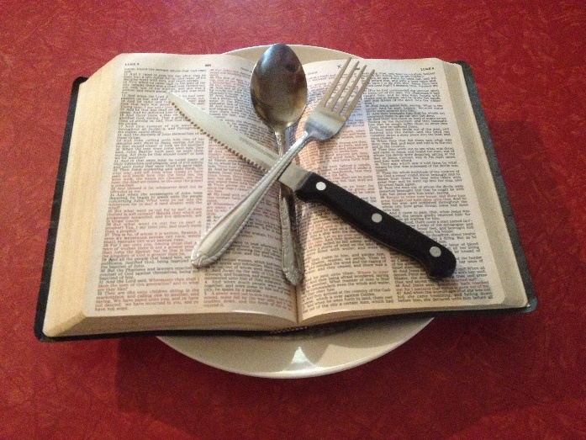
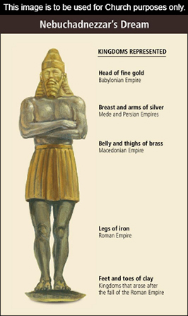
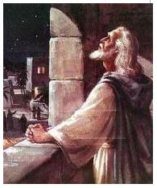
Daniel
Daniel
The book of Daniel provides an account of the experiences of Daniel and other faithful Jews who were taken captive to Babylon.
It also contains the interpretation of an important dream that King Nebuchadnezzar had about the kingdom of God in the last days.
The prophet Daniel is the author of this book. likely written around 530 B.C. while Daniel was living in Babylon. Daniel may have been 90 years old when he wrote this book. (1)
Daniel 1-6 | Daniel 7-12
Contains narratives regarding Daniel and his three companions | Contains prophetic visions seen by Daniel and reported in his own name. some of these visions relate to the last days and the Second Coming of Jesus Christ. (2)

Slide 4
Daniel
He was apparently from royal heritage (Daniel 1:3) and taken captive 8 years before the 10,000 exiles were brought to the court of the Babylonian king, around 604-562 B.C.
He was one of the Old Testament’s great prophets and author of the book that bears his name
His writings are from the time of the Babylonian conquest of Jerusalem
He was renamed “Belteshazzar” by an officer of the royal court
He prophesied during his captivity around the same time as Jeremiah and Ezekiel
He was faithful and received blessings of wisdom and light and prophesied of future events
He interpreted King Nebuchadnezzar’s many dreams
He was loyal to his covenants and along with his companions, Shadrach, Meshach, and Abednego, who were with him during the fiery furnace experience
He also survived a time in a ‘lion’s den’
(2,4)

Slide 5
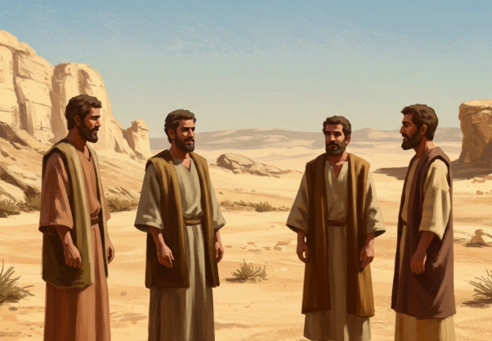
Daniel, Shadrach, Meshach, and Abed-nego
Around 606 BC, Nebuchadnezzar, king of Babylon, attacked Jerusalem and took certain Israelites captive into Babylon.
The king commanded that some of the Israelite youth be trained for service in his household.
Among these youth were four young men named Daniel, Hananiah, Mishael, and Azariah.
In Babylon, their names were changed to Belteshazzar, Shadrach, Meshach, and Abed-nego
Daniel 1:1-7

Slide 6
Nebuchadnezzar
He was the son of Nabopolassar, the founder of the empire
He was king of Babylon at approximately 605 B.C.
His conquests were: Defeating Necho, king of Egypt, at Carchemish then drives the Egyptians from Syria and subdues Judah, then besieges Jerusalem and takes it, carrying away the king (Jehoiakim) and the people
He took items from the temple and a select group of Jews back to Babylon
He burned down all the great houses and the Lord’s Temple in Jerusalem
He commanded an official in his palace to take certain captive Israelite youth and train them for service in his household which included Daniel, Shadrach, Meshach, and Abed-nego
He dreamed of a stone hewn from the mountain without hands that destroyed a mighty image in human form in which Daniel was able to interpret
He was for a time smitten with madness and on his recovery acknowledged God’s power and goodness
(2, 4)

Slide 7
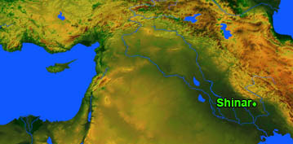
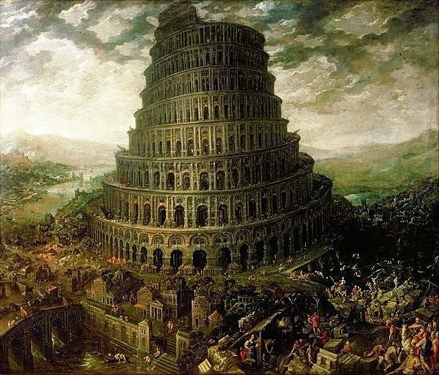
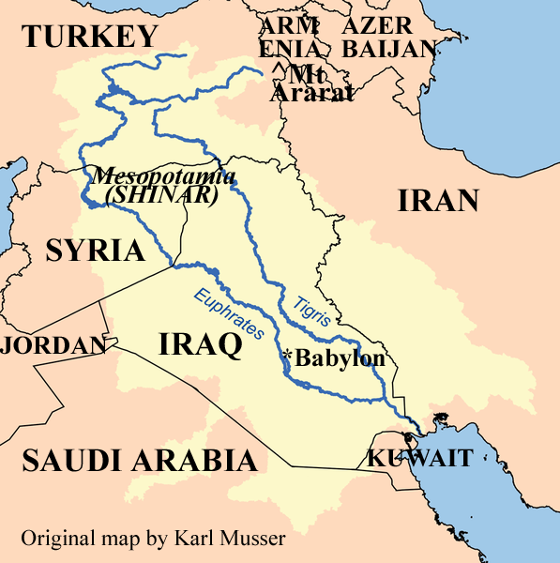
Shinar
Shinar was the plain of the lower delta country between the Tigris and the Euphrates rivers where they approach the Persian Gulf.
It was the ancient land of Chaldea, or Babylonia. (5)
Shinar is the site of the tower of Babel— Jewish encyclopedia
And it came to pass, as they journeyed from the east, that they found a plain in the land of Shinar; and they dwelt there. Genesis 11:2
Daniel 1:2

Slide 8
Shadrach, Meshach, and Abed-nego
Children of Judah
v
Hananiah, of Shadrach
Mishael, of Meshach
Azariah, of Abed-nego
Daniel– also called Belteshazzar
They were among the first group of Jews taken captive to Babylon and were selected to be trained for service in King Nebuchadnezzar’s household.
Daniel, Shadrach, Meshach, and Abed-nego refused to eat or drink the rich rations furnished to them on orders of the king.
Daniel 1:6-7

Slide 9
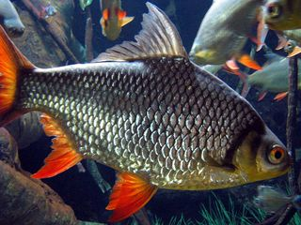
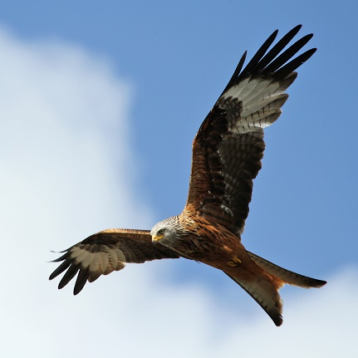
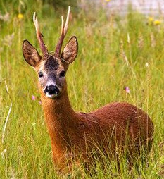
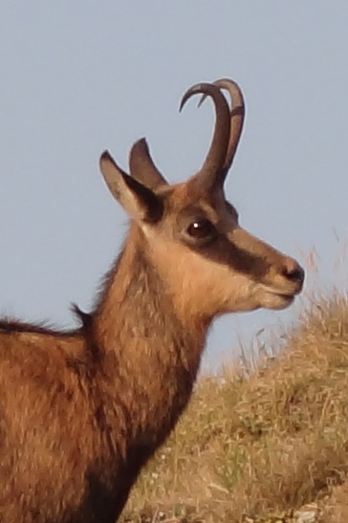
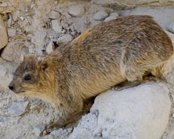
RECAP- Word of Wisdom in the Old Testament
Deuteronomy 14
Thou shalt not eat any abominable thing
Eagle
Ossifrage
Ospray
Glede
Kite
Vulture
Raven
Owl
Night hawk
Cuckow
Swan
Pelican
Stork
Heron
Lapwin
Bat
Birds of Prey
Camel
Hare
Coney
Swine
Fish with shells
These are the beasts which ye shall eat:
Ox
Sheep
Goat
Hart
Roebuck
Fallow deer
Wild goat
Pygarg
Wild ox
Chamois
Fish that have fins and scales
clean fowls—those that don’t eat other animals
Kite
Chamois
Roebuck
coney
Deuteronomy 14:3-20

Slide 10
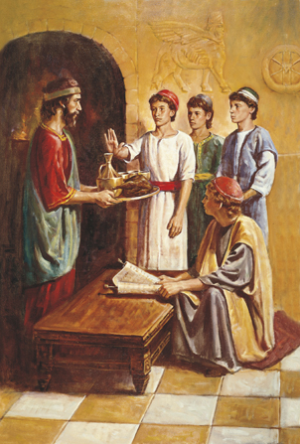
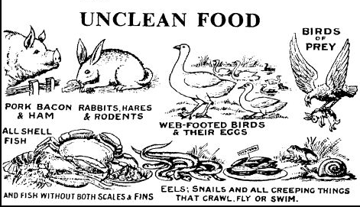
Refusal
Meat = food that graced the king’s table
Daniel, Shadrach, Meshach, and Abed-nego refused to drink or eat (daily provision of the king’s meat, and of the wine) of the rich rations furnished to them on orders of the king.
1. Some of the foods used by the Babylonians were likely among the items forbidden for consumption in the Mosaic law. (Leviticus 11; Deuteronomy 14)
2. Babylonians, like other heathens, ate beasts that had not been properly drained of blood (Leviticus 3:17) and thereby violated the Mosaic law.
3. The heathens consecrated the food of their feasts by offering up part of the food and drink as sacrifices to their gods. Consuming such food would be participating in the worship of false gods. Moreover, food was viewed as contaminated and unclean according to Jewish law when it was prepared by anyone considered unclean, such as the heathens. (Leviticus 7:19–21)
Daniel 1:5
(6)

Slide 11
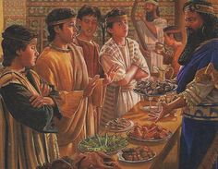
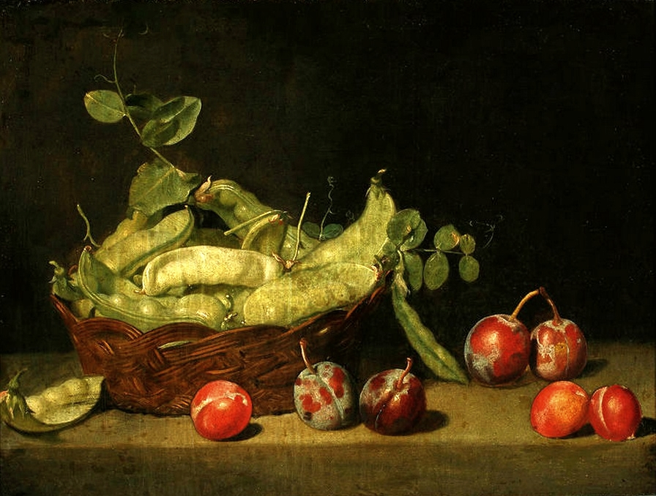
Pulse and Water
They did, however, say they partake in “pulse to eat, and water to drink” for 10 days
Pulse = usually means peas, beans and the seeds that grow in pods. Something from the ground (sown)
Also "seeds" of any kind. Seeds and grains as peas, wheat, barley, and rye.
And at the end of ten days their countenances appeared fairer and fatter in flesh than all the children which did eat the portion of the king’s meat.
Daniel 1:5, 15
William Merritt Chase

Slide 12
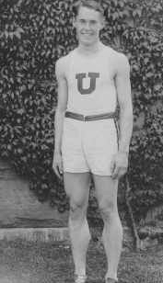

Creed Haymond
Creed Haymond, a member of the Church, was captain of his college track team. The night before a large track meet, Creed’s coach offered him some wine to refresh himself.
When Creed twice refused to drink the wine, his coach responded, “Remember, Creed, you’re captain of the team and our best point winner; fourteen thousand students are looking to you personally to win this meet. If you fail us we’ll lose. I ought to know what is good for you” (3)

Slide 13
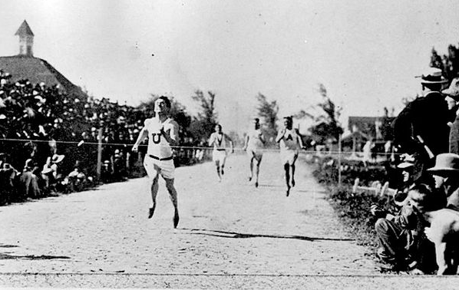
After Creed’s coach left, Creed worried that his refusal to drink the wine would cause him to lose the track meet for his school. He knelt and asked the Lord to give him a testimony regarding the source of the Word of Wisdom.
The next morning, all of the boys on his team were sick. They underperformed in their events, and one teammate was even too sick to participate. Despite falling at the beginning of the 100-yard (91-meter) dash, Creed caught up and won the race. Later in the day, he was forced to begin the 220-yard (201-meter) final despite having had only five minutes to rest following the semifinal. He won that race as well, finishing in the fastest time that race had ever been run.
That night, the question he asked the Lord about the Word of Wisdom came back into his mind. As he lay in bed contemplating on the events of the day, he received the assurance that the Word of Wisdom was from God.
The Story Continues…
(3)

Slide 14


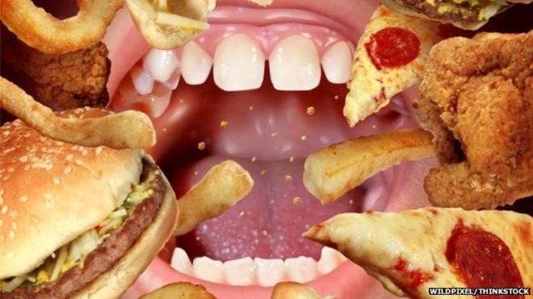
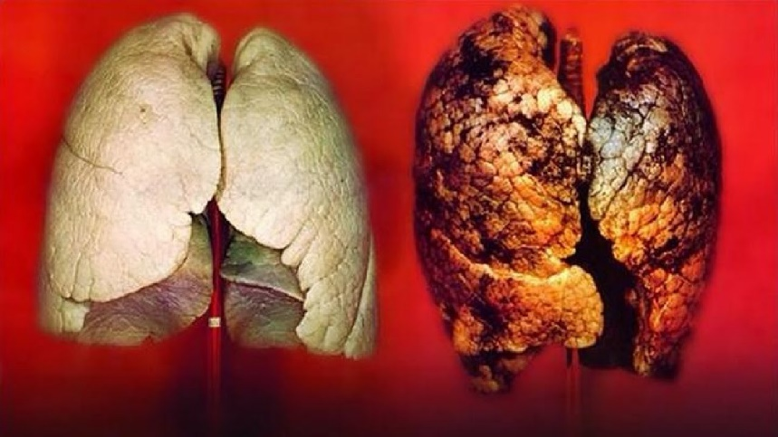
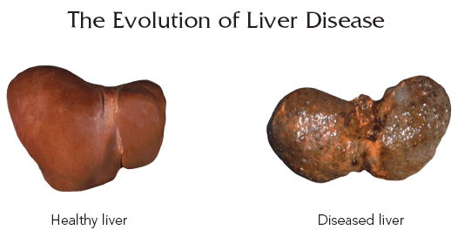
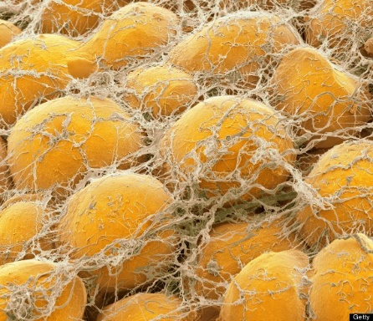
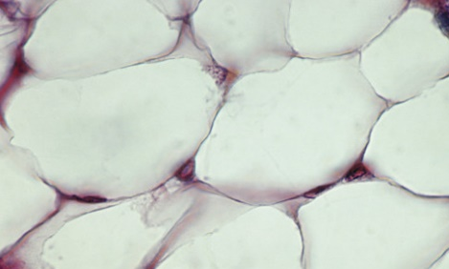
Food and Substances We Should Refuse
Excessive = lack of moderation in an activity, especially eating or drinking
Healthy lung
Diseased lung
Healthy fat cells that provide warmth and energy
Unhealthy fat cells that causes metabolic diseases

Slide 15
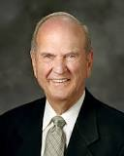

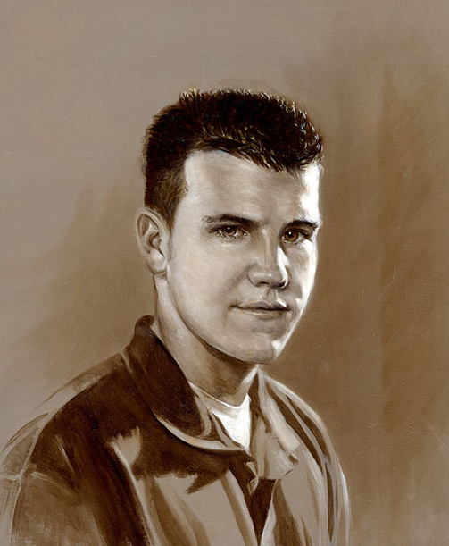
Out Bodies Are Our Temples
“When we understand our nature and our purpose on earth, and that our bodies are physical temples of God, we will realize that it is sacrilege to let anything enter the body that might defile it.”
Jessica Rockwell—cousin to Norman Rockwell
Amy Pond
(8)

Slide 16
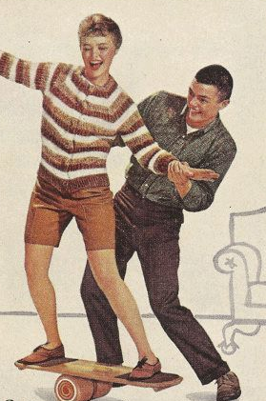
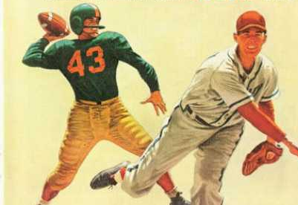
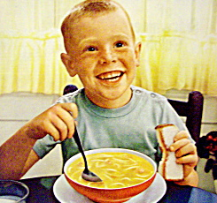
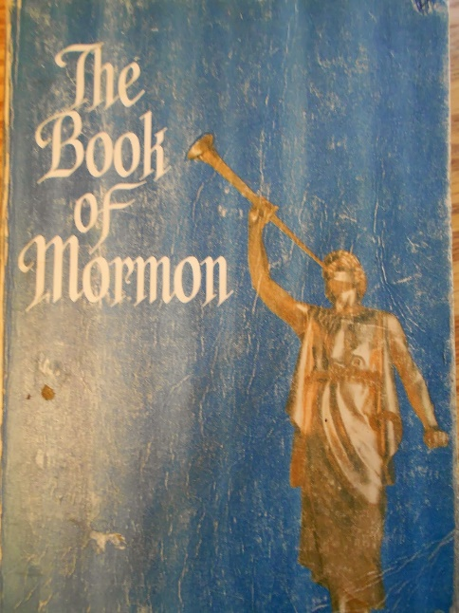

Physical and Emotional Health
As we keep the Lord’s commandment to obey the Word of Wisdom, He will bless us physically and spiritually.
Daniel 1:17

Slide 17


Run and Not Be Weary
And all saints who remember to keep and do these sayings, walking in obedience to the commandments, shall receive health in their navel and marrow to their bones;
And shall find wisdom and great treasures of knowledge, even hidden treasures;
And shall run and not be weary, and shall walk and not faint.
And I, the Lord, give unto them a promise, that the destroying angel shall pass by them, as the children of Israel, and not slay them. Amen.
D&C 89:18-21

Slide 18
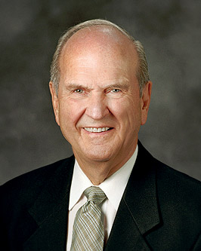
Remarkable as your body is, its prime purpose, as stated earlier, is of even greater importance—to serve as tenement for your eternal spirit.
Your spirit acquired your body and became a living soul to experience mortality and the associated trials and testing.
Part of that testing is to determine if the appetites of your body can become mastered by the spirit that dwells within it.
When we understand our nature and our purpose on earth and that our bodies are physical temples of God, we will realize that it is sacrilege to let anything enter that might defile the body. (7)

Slide 19
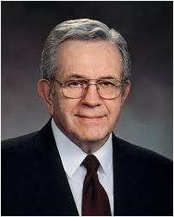

No Promises
The Word of Wisdom does not promise you perfect health, but it teaches how to keep the body you were born with in the best condition and your mind alert to delicate spiritual promptings. (9)
What physical or spiritual blessings have you or someone you know received by obeying the Word of Wisdom?

Slide 20
Sources:
Videos:
God Gave Them Knowledge (13:49)
“Run and Not Be Weary” (8:18)
“A Brand New Year: Physical Health”
Gleason L. Archer Jr., “Daniel,” in The Expositor’s Bible Commentary, ed. Frank E. Gaebelein, 12 vols. [1976–1992], 7:6.)
Bible Dictionary
Presentation by ©http://fashionsbylynda.com/blog/
Joseph J. Cannon, “Speed and the Spirit,” Improvement Era, Oct. 1928, 1001–7).
Who’s Who in the Old Testament by Ed J. Pinegar and Richard J. Allen pp. 36-37, 142
William Smith, A Dictionary of the Bible, s.v. “Shinar.”
Old Testament Institute Manual Daniel: Prophet of God, Companion of Kings Chapter 28
President Russell M. Nelson (“Your Body: A Magnificent Gift to Cherish,” New Era, Aug. 2019, 5-6
Elder Russell M. Nelson (“The Magnificence of Man,” Ensign, Jan. 1988, 68).
President Boyd K. Packer (“The Word of Wisdom: The Principle and the Promises,” Ensign, May 1996, 18)

Slide 21
Daniel 1 | Daniel 2 | Daniel 3 | Daniel 4-5 | Daniel 6 | Daniel 7-12
Daniel and his companions are faithful to the law of Moses and God blesses them with knowledge and wisdom. They receive positions of service in King Nebuchadnezzar’s court. | By revelation Daniel interprets King Nebuchadnezzar’s dream, which concerns the destinies of kingdoms of the earth and the kingdom of God in the last days. | Shadrach, Meshach, and Abednego refuse to worship King Nebuchadnezzar’s golden idol and are cast into a fiery furnace, but the Lord delivers them. | Daniel interprets another dream of King Nebuchadnezzar’s and later interprets writing on a wall regarding Babylon’s impending fall to the Medes and Persians. | Daniel is delivered from a den of lions. He was cast into the den for praying to the Lord rather than obeying King Darius’s decree forbidding petitioning any god or man other than the king. | Daniel has prophetic visions of events from soon after his time through the last days. These events include conquests of kingdoms of the earth, the coming of the Messiah, the distress and deliverance of God’s people in the last days, and the Resurrection of the dead.
Eunuch Daniel 1:3: Melzar-- The name or the official title of a butler or steward at the court of Nebuchadnezzar (BibleHub) Daniel 1:11
The word eunuch is “the English form of the Greek word which means bed-keeper. In the strict and proper sense, they were the persons who had charge of the bed-chambers in palaces and larger houses. But as the jealous and dissolute temperament of the East required this charge to be in the hands of persons who had been deprived of their virility, the word eunuch came naturally to denote persons in that condition. But as some of these rose to be confidential advisers of their royal masters or mistresses, the word was occasionally employed to denote persons in such a position, without indicating anything of their proper manhood.” (Smith, Dictionary of the Bible, s.v. “eunuch.”)
“This word eunuchs signifies officers about or in the palace, whether literally eunuchs or not” (Adam Clarke, The Holy Bible … with a Commentary and Critical Notes,4:563).
Nebuchadnezzar:
Most scholars agree that Nebuchadnezzar, as a Babylonian prince, was in command of his father’s troops in 605 B.C. when they soundly defeated the Egyptian forces at Carchemish (see Jeremiah 46:2). This defeat marked the beginning of the end of the Egyptian Empire as a world power and put the known world on notice that it would now have to reckon with Babylon.
Nebuchadnezzar pursued the Egyptians southward and dealt them a worse defeat near Hamath in Syria (see Harry Thomas Frank, Discovering the Biblical World ,p. 127), thus securing Syria and Judea for the expanded Babylonian Empire. As seen in Daniel 1:1, this drive resulted in the siege of Jerusalem in the third year of the reign of Jehoiakim and in Judah’s being made a vassal to Babylon for the next three years (see 2 Kings 24:1). At that time many of the finest vessels of the temple were taken to Babylon as tribute (see2 Chronicles 36:7). Selected members of Judah’s upper class, which included Daniel (see 2 Kings 20:14–18;Daniel 6:13), were carried captive to Babylon. Sometime during this campaign, Nebuchadnezzar learned of the death of his father, and within the year he returned to Babylon to be made king (see Jeremiah 25:1). Later he besieged Jerusalem twice more, carrying off additional captives both times, and eventually destroying Jerusalem about 587 B.C. All the evidence suggests that Daniel and his three companions were taken into captivity during the first exile to Babylon (see Daniel 1:6). Daniel lived in Jerusalem at the same time Lehi did, though there is no evidence to suggest that they knew each other. OT Institute Manual Daniel: Prophet of God, Companion of Kings (Daniel) Chapter 28

