Slide 1

The Dream of Nebuchadnezzar
Daniel 2
Wherefore, may the kingdom of God go forth, that the kingdom of heaven may come, that thou, O God, mayest be glorified in heaven so on earth, that thine enemies may be subdued; for thine is the honor, power and glory, forever and ever. Amen.
D&C 65:6

Slide 2

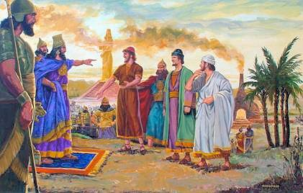
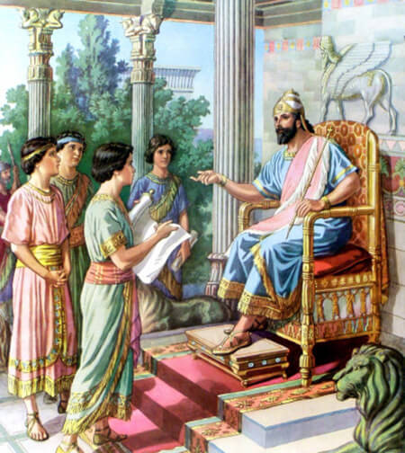
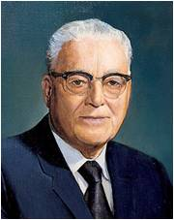
Magicians, Astrologers, and Sorcerers
The king makes the point that he knows what he dreamt; therefore, if the interpreters can tell him the dream, he will know that they know what they are talking about and he will know whether he can have confidence in their interpretation or not!” (1)
Daniel and friends “desire mercies of the God of heaven” = to seek Heavenly Father’s help.
“By faith in God you can be attuned to the Infinite and by power and wisdom obtained from your Heavenly Father harness the powers of the universe to serve you in your hour of need in the solution of problems too great for your human strength or intelligence.” (2)
Daniel 2:10-19

Slide 3
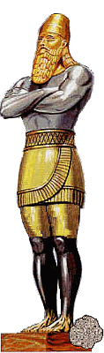
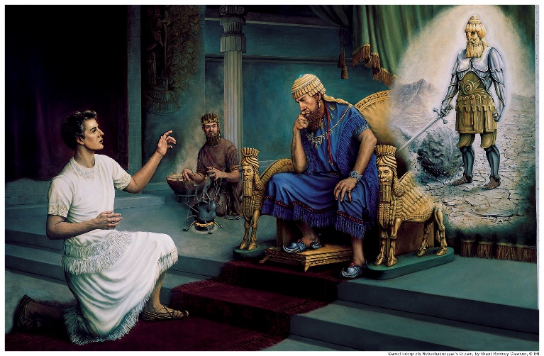
The Dream
The inspired interpretation of Nebuchadnezzar’s dream that Daniel gave made it clear that the fulfillment of the king’s dream would begin in the immediate future. Daniel said to Nebuchadnezzar
Head of fine gold = Babylonian Empire
Breast and Arms of Silver = Mede and Persian Empires
Belly and thighs of Brass = Macedonian Empire
Legs of Iron = Roman Empire
The dream revealed events that would take place over a long span of time. The culmination, however, was to take place in the last days
Feet and Toes of Clay = Kingdoms that arose after the fall of the Roman Empire
Daniel 2:28, 31-45

Slide 4
Doctrinal Mastery
And in the days of these kings shall the God of heaven set up a kingdom, which shall never be destroyed: and the kingdom shall not be left to other people, but it shall break in pieces and consume all these kingdoms, and it shall stand for ever.
Forasmuch as thou sawest that the stone was cut out of the mountain without hands, and that it brake in pieces the iron, the brass, the clay, the silver, and the gold; the great God hath made known to the king what shall come to pass hereafter: and the dream is certain, and the interpretation thereof sure.
Daniel 2:44-45

Slide 5
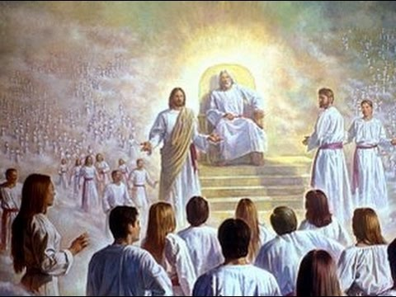

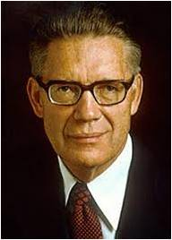
Fulfillment of Prophecy
The Prophet Joseph Smith prayed that the ecclesiastical kingdom of God, which was established on the earth in his day, might roll forth that the future kingdom of heaven might come.
The Church [of Jesus Christ of Latter-day Saints] is that prophesied latter-day kingdom, not created by man but set up by the God of heaven and rolling forth as a stone “cut out of the mountain without hands” to fill the earth. (5)
“During the millennium the kingdom of God will continue on earth, but in that day it will be both an ecclesiastical and a political kingdom. That is, the Church (which is the kingdom) will have the rule and government of the world given to it.” (3)
Daniel 2:44-45

Slide 6
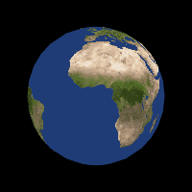
Fill the Whole Earth
The keys of the kingdom of God are committed unto man on the earth, and from thence shall the gospel roll forth unto the ends of the earth, as the stone which is cut out of the mountain without hands shall roll forth, until it has filled the whole earth.
D&C 65:2
God established the Church of Jesus Christ of Latter-day Saints, which will fill the whole earth and stand forever.
“filled the whole earth” does not mean that everyone will join the Lord’s Church, but that it will spread throughout the earth
And it came to pass that I, Nephi, beheld the power of the Lamb of God, that it descended upon the saints of the church of the Lamb, and upon the covenant people of the Lord, who were scattered upon all the face of the earth; and they were armed with righteousness and with the power of God in great glory. 1 Nephi 14:14
Daniel 2:35; D&C 65:2; 1 Nephi 14:14

Slide 7
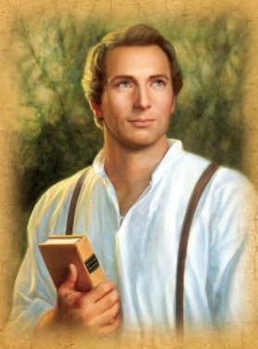
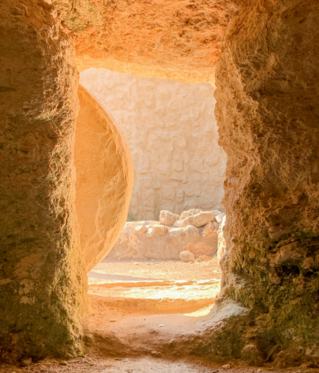
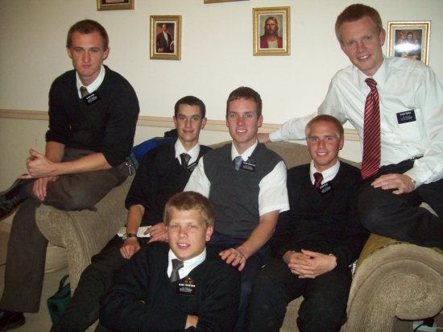
Stone Rolls Forth-Symbolism
The stone rolled away from Jesus' tomb symbolizes His victory over death and the removal of spiritual barriers, opening the way for salvation.
The "stone cut without hands" is the restored Church of Jesus Christ, which began with Joseph Smith and is prophesied to fill the earth.
The phrase is used to describe the missionary work and expansion of God's message, fulfilling prophecy as it reaches every nation. An effort to share the gospel as helping this stone roll forth.
Daniel 2:45

Slide 8
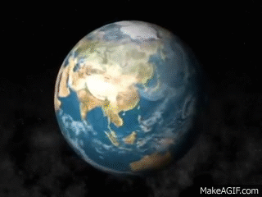
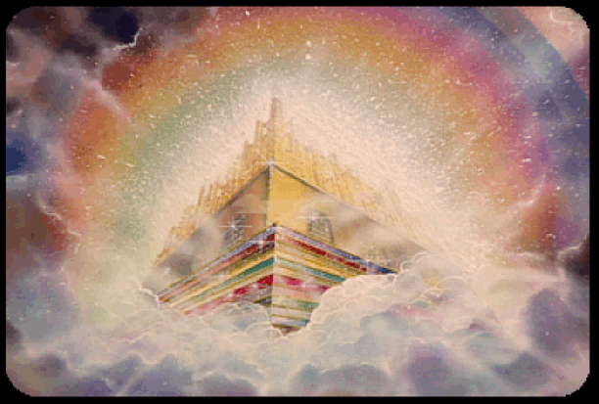
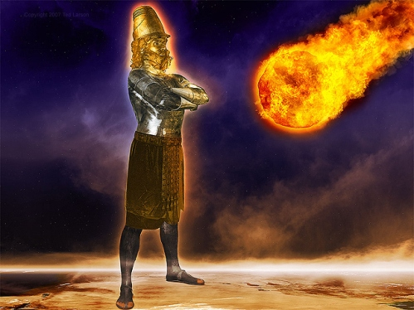
The Millennial Kingdom
That millennial kingdom can also be properly referred to as the kingdom of heaven, as Joseph Smith did in his inspired prayer recorded in Doctrine and Covenants 65.
The establishment of that kingdom is what the Lord taught the Saints to pray for in the Lord’s Prayer when He said, “Thy kingdom come” in Matthew 6:10. (4)
The coming forth of the kingdom on the earth is what Daniel saw when the stone rolled forth and smote the image, eventually filling the whole earth. (1)
Daniel 2:44-45

Slide 9

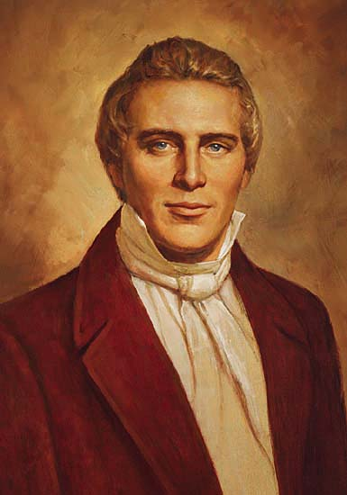
Interpreting a dream for Babylonian King Nebuchadnezzar, Daniel prophesied the Lord’s Church would rise in the last days as a small stone “cut out of the mountain without hands” “Without hands,” meaning by divine intervention, the Lord’s Church would increase in magnitude until it fills the whole earth, “never [to] be destroyed … [but to] stand for ever”. (6)
The Standard of Truth has been erected; no unhallowed hand can stop the work from progressing; persecutions may rage, mobs may combine, armies may assemble, calumny may defame, but the truth of God will go forth boldly, nobly, and independent, till it has penetrated every continent, visited every clime, swept every country, and sounded in every ear, till the purposes of God shall be accomplished, and the Great Jehovah shall say the work is done. (7)

Slide 10
Sources:
Videos: The Gospel Shall Roll Forth (2:44)
God Gave Them Knowledge (13:49)
Old Testament Institute Manual Daniel: Prophet of God, Companion of Kings Chapter 28
President Harold B. Lee (in Church News,15 Aug. 1970, p. 2).
(Bruce R. McConkie, Mormon Doctrine, p. 416.)
Presentation by http://fashionsbylynda.com/blog/
4. Joseph Fielding Smith, Doctrines of Salvation, 1:230).
5. Elder D. Todd Christofferson (“Why the Church,” Ensign or Liahona, Nov. 2015, 111)
6. Elder Ronald A. Rasband (“Fulfillment of Prophecy,” Ensign or Liahona, May 2020, 75)
7. President Joseph Smith (Teachings of Presidents of the Church: Joseph Smith [2007], 142)

Slide 11
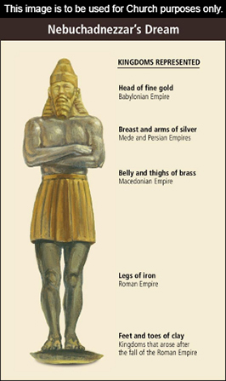
Daniel 1-6 | Daniel 7-12
contains narratives regarding Daniel and his three companions | contains prophetic visions seen by Daniel and reported in his own name. some of these visions relate to the last days and the Second Coming of Jesus Christ.
Daniel 1 | Daniel 2 | Daniel 3 | Daniel 4-5 | Daniel 6 | Daniel 7-12
Daniel and his companions are faithful to the law of Moses and God blesses them with knowledge and wisdom. They receive positions of service in King Nebuchadnezzar’s court. | By revelation Daniel interprets King Nebuchadnezzar’s dream, which concerns the destinies of kingdoms of the earth and the kingdom of God in the last days. | Shadrach, Meshach, and Abednego refuse to worship King Nebuchadnezzar’s golden idol and are cast into a fiery furnace, but the Lord delivers them. | Daniel interprets another dream of King Nebuchadnezzar’s and later interprets writing on a wall regarding Babylon’s impending fall to the Medes and Persians. | Daniel is delivered from a den of lions. He was cast into the den for praying to the Lord rather than obeying King Darius’s decree forbidding petitioning any god or man other than the king. | Daniel has prophetic visions of events from soon after his time through the last days. These events include conquests of kingdoms of the earth, the coming of the Messiah, the distress and deliverance of God’s people in the last days, and the Resurrection of the dead.

Slide 12
Nebuchadnezzar’s dream: Daniel 2:35-41:
President Rudger Clawson elaborated on Daniel’s interpretation of Nebuchadnezzar’s dream: “The … world of today is witness of the fact that the very things which the great image stood for have occurred so far as time has gone. History certifies to the fact that King Nebuchadnezzar was the head of gold.
The Medes and Persians, an inferior kingdom to Babylon, were the arms and breast of silver.
The Macedonian kingdom, under Alexander the Great, was the belly and thighs of brass; and the Roman kingdom under the Caesars was the legs of iron. For mark you, later on the kingdom, or empire of Rome, was divided.
The head of the government in one division was at Rome and the head of the government in the other division was at Constantinople. So these two great divisions represented the legs of iron. Finally, the Roman empire was broken up into smaller kingdoms, represented by the feet and toes of iron and clay.” (In Conference Report, Apr. 1930, p. 32).
Millennial Kingdom: D&C 65
“The Lord God Almighty has set up a kingdom that will sway the sceptre of power and authority over all the kingdoms of the world, and will never be destroyed, it is the kingdom that Daniel saw and wrote of. It may be considered treason to say that the kingdom which that Prophet foretold is actually set up; that we cannot help, but we know it is so and call upon the nations to believe our testimony. The kingdom will continue to increase, to grow, to spread and prosper more and more. Every time its enemies undertake to overthrow it, it will become more extensive and powerful; instead of its decreasing, it will continue to increase, it will spread the more, become more wonderful and conspicuous to the nations, until it fills the whole earth.” President Brigham Young (In Journal of Discourses, 1:202–3.)
The Stone President Gordon B. Hinckley emphasized that we are eyewitnesses to the fulfillment of Daniel’s prophecy:
“The Lord is fulfilling His promise that His gospel shall be as the stone cut out of the mountain without hands which would roll forth and fill the whole earth, as Daniel saw in vision (see Daniel 2:31–45; D&C 65:2). A great miracle is taking place right before our eyes” (“The Stone Cut Out of the Mountain,” Ensign or Liahona, Nov. 2007, 83).
Nebuchadnezzar’s dream: Daniel 2:35-41:
Elder Orson Pratt, in explaining why the toes were shown as being partly iron and partly clay, said that “the feet and toes were governments more modern to grow out of the iron kingdom [Roman Empire], after it should lose its strength. These are represented by the ten toes or ten kingdoms which should be partly strong and partly broken. They should not have the strength of the legs of iron, but they should be mixed with miry clay, indicating both strength and weakness.” (In Journal of Discourses, 18:337.)
Nebuchadnezzar’s dream: Daniel 2:35-41:
President Spencer W. Kimball further clarified the prophecy with the following explanation:
“Rome would be replaced by a group of nations of Europe represented by the toes of the image.
“With the history of the world delineated in brief, now came the real revelation. Daniel said:
“‘And in the days of these kings [that is, the group of European nations] shall the God of heaven set up a kingdom, which shall never be destroyed …
“This is a revelation concerning the history of the world, when one world power would supersede another until there would be numerous smaller kingdoms to share the control of the earth.
“And it was in the days of these kings that power would not be given to men, but the God of heaven would set up a kingdom—the kingdom of God upon the earth, which should never be destroyed nor left to other people.
“The Church of Jesus Christ of Latter-day Saints was restored in 1830 after numerous revelations from the divine source; and this is the kingdom, set up by the God of heaven, that would never be destroyed nor superseded, and the stone cut out of the mountain without hands that would become a great mountain and would fill the whole earth.” (In Conference Report, Apr. 1976, p. 10.)

