Slide 1

Daniel in the Lions’ Den and Other Prophecies
Daniel 6-12
And I heard the man clothed in linen, which was upon the waters of the river, when he held up his right hand and his left hand unto heaven, and sware by him that liveth for ever that it shall be for a time, times, and an half; and when he shall have accomplished to scatter the power of the holy people, all these things shall be finished.
Daniel 12:7

Slide 2


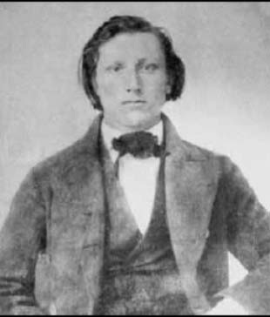
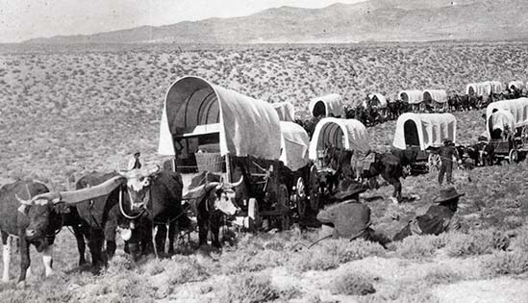
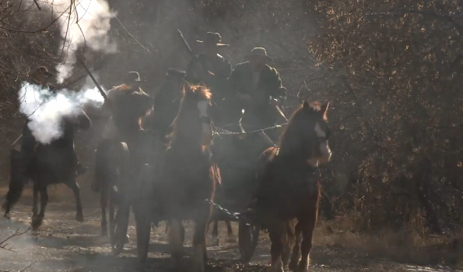
Joseph F. Smith
At age 19 Joseph F. Smith returned home from his first mission and joined a wagon train. One evening, a group of “drunken men rode into the camp on horseback, cursing and swearing and threatening to kill any ‘Mormons’ that came within their path.”
One evening, a group of “drunken men rode into the camp on horseback, cursing and swearing and threatening to kill any ‘Mormons’ that came within their path.
(9)

Slide 3
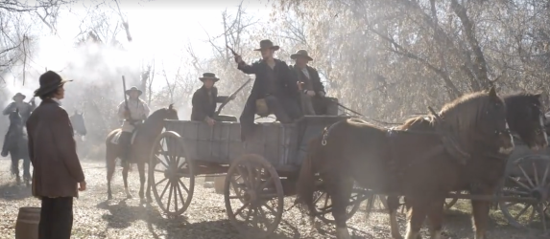
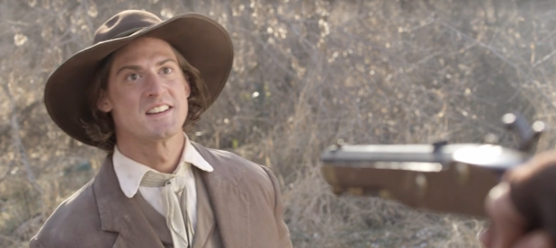
Joseph’s “first thought was to … seek shelter in the trees and in flight [as others had done]. Then the thought came to him, ‘Why should I run from these fellows?’ With that thought in mind he boldly marched up … to the campfire.” One of the drunk men, waving a pistol and pointing at Joseph, “demanded in a loud, angry voice, ‘Are you a “Mormon”?’
“Without a moment of hesitation and looking the ruffian in the eye, Joseph F. Smith boldly answered, ‘Yes, siree; dyed in the wool; true blue, through and through.’”
(9)

Slide 4

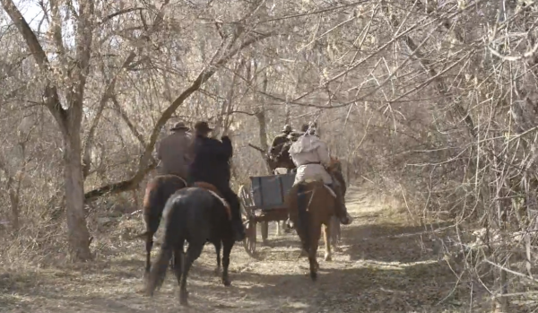

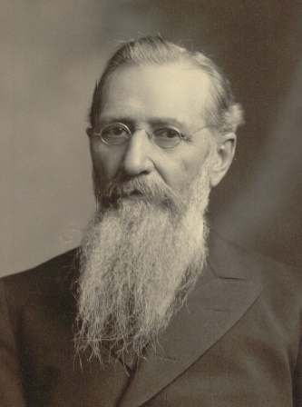
Joseph’s response “completely disarmed the belligerent man, and in his bewilderment, he grasped [Joseph] by the hand and said:
“‘Well, you are the [blankety-blank] pleasantest man I ever met! Shake hands, young fellow, I am glad to see a man that stands up for his convictions’”
Then they rode off. (2)
How did Joseph F. Smith show his faithfulness to the Lord?
(9)

Slide 5
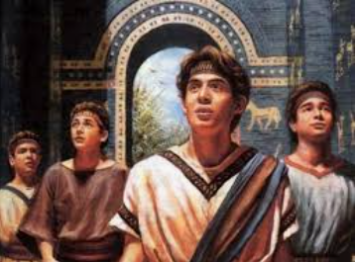
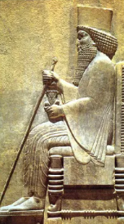
Previously…
Daniel and his friends were taken captive into Babylon
Babylon, the nation was conquered by the Medes and the Persians. Darius, a Mede, was made king of Babylon.
Daniel 5:30-31

Slide 6
Darius
Babylon was conquered by the Medes and the Persians, and Darius the Mede was made king over Babylon
He was the son of Ahasuerus and not only was referred to as a Mede but was said to have been of the "seed of the Medes“ (Daniel 9:1)
Darius was the king of Babylon after the death of Belshazzar
He ruled much of West Asia and most of the Black Sea region, and portions of North Africa
He organized a new uniform monetary system, along with making Aramaic the official language of the empire.
Biblical books of Haggai, Zechariah, and Ezra–Nehemiah
He made Daniel the leading president among three presidents overseeing the realm.
It has been suggested that the name of Darius in the book of Daniel was a throne name used in Babylon
(2,3,4)

Slide 7
Excellent Spirit
Daniel distinguished himself through an "excellent spirit" and was appointed as one of three high officials over 120 satraps.
King Darius planned to promote him to lead the entire kingdom.
As disciples of Christ, we will face opposition because of our beliefs
Daniel 6:1-5

Slide 8
Decree
Daniel’s associates in the government sought to conspire against Daniel.
This included a death decree against those who prayed to God.
Daniel resolved to pray only in his private quarters.
Upon finding Daniel praying to God the associates reported Daniel to Darius.
Daniel 6:4-11
(1)

Slide 9
Bound by the Law
Law of the Medes and Persians
Darius was deeply distressed and spent the day trying to find a legal loophole to save Daniel, but he was bound by the "law of the Medes and Persians," which could not be repealed.
The Lord will bless our efforts when we stand up to worldly pressure.
Daniel 6:12-17

Slide 10
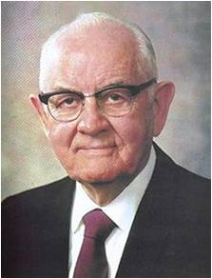
Those who are righteous do not fear other people. Their only desire is to serve and honor God. With the same faith that his brethren Shadrach, Meshach, and Abed-nego had shown in refusing to bow down to the idol, Daniel refused to follow the decree that condemned petitions to any god but the king. (1)
“This unalterable law of the Medes and Persians would have been terrifying to any man, but the faithful Daniel did not flinch.
Was there any question what he should do?
He could save his life by abandoning his prayers to the Living God.
A man of integrity could not fail. Daniel was the soul of integrity.”
(6)

Slide 11
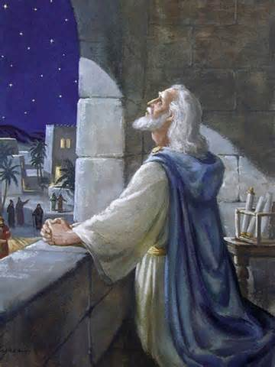
Three Times A Day—Toward Jerusalem
Solomon, in his dedicatory prayer of the temple in Jerusalem, referred to the people’s praying “toward the city which thou hast chosen, and toward the house that I have built for thy name”.
Jewish Law makes it our duty to pray three times daily: in the morning, in the afternoon and at nightfall.
These prayers are called morning prayer (shacharit), afternoon prayer (minchah) and evening prayer (arvith or maariv ).
Traditionally, the custom of praying three times a day was originally introduced by our Patriarchs, Abraham, Isaac and Jacob. Abraham introduced prayer in the morning, Isaac—in the afternoon, and Jacob added one at night. (7)
Daniel 6:10; 1 Kings 8:44
(1)

Slide 12
The Accusers
The eavesdropping enemies reported Daniel praying 3 times a day to his God.
Darius was forced by his own creed to put Daniel in a lions’ den. (3)
An absolute monarch would likely feel that any other course would slowly cause him to lose power. (1)
And a stone was brought, and laid upon the mouth of the den; and the king sealed it with his own signet, and with the signet of his lords; that the purpose might not be changed concerning Daniel.
Daniel 6:11-17

Slide 13
if we are continually faithful to the Lord, He will help us through challenges we may experience as a result of our faithfulness
As we do what is right and trust the Lord, our righteous example can influence others

Slide 14
Another Decree
Being fond of Daniel the king was overjoyed that Daniel had survived being in the lions’ den.
King Darius issued another decree ordering that all the people would fear and pay reverence to Daniel’s God, the God of Israel.
And the king commanded, and they brought those men which had accused Daniel, and they cast them into the den of lions, them, their children, and their wives; and the lions had the mastery of them, and brake all their bones in pieces or ever they came at the bottom of the den.
Daniel 6:18-28

Slide 15

The Dens of Today
if we are not afraid to show our obedience to the Lord, we can help others believe in Him
Daniel 6:25-28

Slide 16
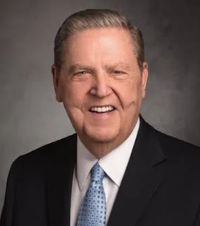
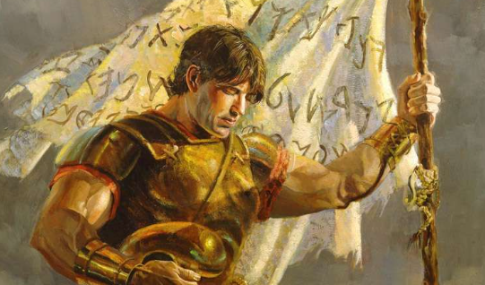
[Y]ou will one day find yourself called upon to defend your faith or perhaps even endure some personal abuse simply because you are a member of The Church of Jesus Christ of Latter-day Saints. Such moments will require both courage and courtesy on your part. …
… You may wonder if it is worth it to take a courageous moral stand in high school or to go on a mission only to have your most cherished beliefs reviled or to strive against much in society that sometimes ridicules a life of religious devotion. Yes, it is worth it. …
… Be strong. Live the gospel faithfully even if others around you don’t live it at all. Defend your beliefs with courtesy and with compassion, but defend them. (5)

Slide 17
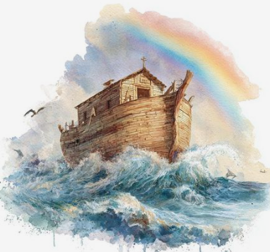
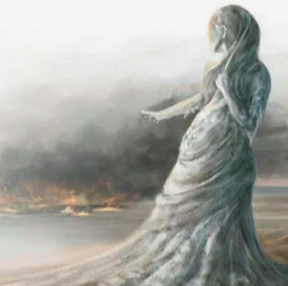
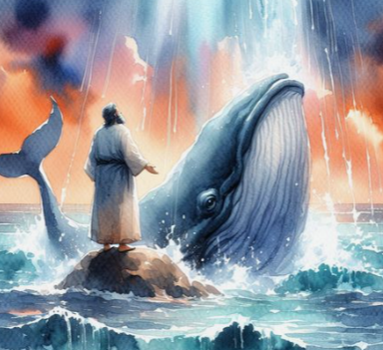
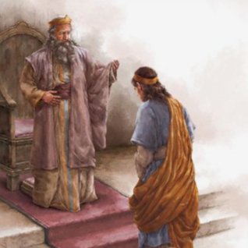
Jesus Uses Old Testament Stories To Teach
Matthew 12:38-40
Jonah 1:17
Luke 4:24-27
1 Kings 17:1, 8-16
2 Kings 5:1-14
Matthew 24:36-39
Genesis 6:13-22
Luke 17:28-33
Genesis 19:24-26

Slide 18
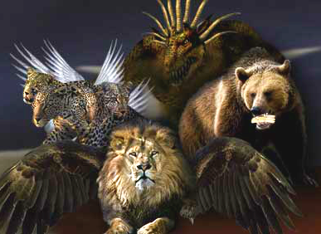
The Future Political Kingdoms
Daniel saw a vision representing different political kingdoms and evil that would be on the earth from his time through the last days.
“thrones,” or worldly governments?
Daniel saw a council in which priesthood holders from all the dispensations will account for their stewardships to Adam. Adam will then report to Jesus Christ, whose people will recognize Him as their King. (1)
Daniel 7:10-14

Slide 19
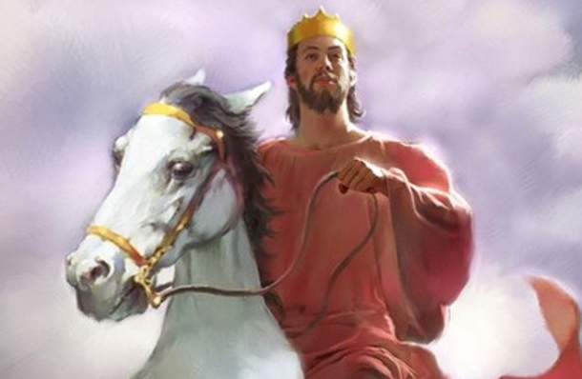
The Second Coming
The Savior will destroy the power of the wicked over the earth when He comes in His glory.
After the Second Coming, the Savior will reign on earth with His saints
What is a Saint?
“saints” means “holy ones” and refers to members of the Church who have faithfully kept the commandments.
The Savior’s glorious return and His millennial reign, the kingdom “shall be given to the people of the saints of the most High” and this earth in its celestial state will be their home forever.
Daniel 7:24-27

Slide 20
Some Prophecies of Daniel
Daniel 2:31-45 | Church and kingdom set up again
Daniel 2:44 | Growth of the church
Daniel 10 | Gathering at Adam-Ondi-Ahman
Daniel 12:1 | A time of Distress
Daniel 12:4 | Spirit to be poured out on all flesh
Daniel 12:11 | Daily Sacrifices will be take away (The Atonement)

Slide 21
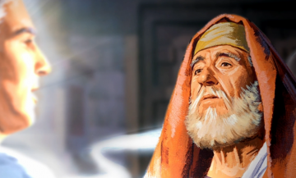
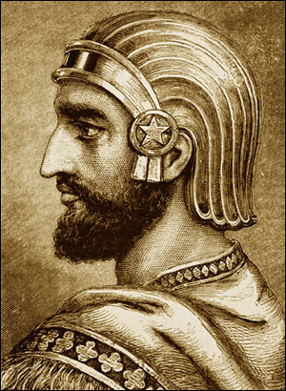
Daniel’s Last Visions
When Cyrus issued his edict to the Jews about 538 B.C. Daniel did not return to Jerusalem but continued his ministry among the remaining Exiles.
Cyrus died and others succeeded him in the empire.
This is when Daniel was associated with Darius
Daniel received a vision recorded in Chapter 10 of fasting and praying for 3 weeks. (8)
The last recorded vision Daniel received was
Gabriel – whom we know as Noah, visited him and told Daniel that the city would be redeemed and survive until the ministry of the Savior.
Following in which the city would be desolated again and remain in that forlorn condition until the great day of the Lord’s power (Millennium).
In that same year Daniel received the visions of Chapter 11 and 12 (the universal resurrection)
Daniel 10-12

Slide 22
Sources:
Videos:
Preparation of Joseph F. Smith: True Blue, Through and Through(1:31)
No Cussing Club (4:56)
“Daniel and the Lions’ Den” (1:46)
Old Testament Institute Manual Daniel: Prophet of God, Companion of Kings Chapter 28
Who’s Who in the Old Testament by Ed J. Pinegar and Richard J. Allen p. 37-38
Wikipedia
William A. Shea Andrews University Seminary Studies Darius the Mede Update p. 230-231
President Jeffrey R. Holland (“The Cost—and Blessings—of Discipleship,” Ensign or Liahona, May 2014, 6, 7, 9
Spencer W. Kimball, Teachings of Presidents of the Church: Spencer W. Kimball Integrity, p. 17
The Three Daily Prayers By Nissan Mindel chadba.org
Fourth Thousand Years W. Cleon Skousen pp. 761-765
Presentation by ©http://fashionsbylynda.com/blog/
9. Life of Joseph F. Smith, comp. Joseph Fielding Smith [1938], 187–89).
The Way to Perfection [1970], 289–91

Slide 23
Daniel 1-6 | Daniel 7-12
contains narratives regarding Daniel and his three companions | contains prophetic visions seen by Daniel and reported in his own name. some of these visions relate to the last days and the Second Coming of Jesus Christ.
Daniel 1 | Daniel 2 | Daniel 3 | Daniel 4-5 | Daniel 6 | Daniel 7-12
Daniel and his companions are faithful to the law of Moses and God blesses them with knowledge and wisdom. They receive positions of service in King Nebuchadnezzar’s court. | By revelation Daniel interprets King Nebuchadnezzar’s dream, which concerns the destinies of kingdoms of the earth and the kingdom of God in the last days. | Shadrach, Meshach, and Abednego refuse to worship King Nebuchadnezzar’s golden idol and are cast into a fiery furnace, but the Lord delivers them. | Daniel interprets another dream of King Nebuchadnezzar’s and later interprets writing on a wall regarding Babylon’s impending fall to the Medes and Persians. | Daniel is delivered from a den of lions. He was cast into the den for praying to the Lord rather than obeying King Darius’s decree forbidding petitioning any god or man other than the king. | Daniel has prophetic visions of events from soon after his time through the last days. These events include conquests of kingdoms of the earth, the coming of the Messiah, the distress and deliverance of God’s people in the last days, and the Resurrection of the dead.

Slide 24
Prayer: A Jewish Perspective Daniel 6:10
After the Holy Temple was destroyed and the Jews were led into captivity in Babylon, Jews continued to gather and pray in congregation. The places of prayer became like "small sanctuaries"—Beit Mikdash Me'at,⁹ during the years of exile, the children who were born and brought up in Babylon lacked adequate knowledge of the Holy Tongue (Hebrew) and spoke a mixed language. Therefore, when the Jews returned to their homeland after the seventy years' exile was over, Ezra the Scribe together with the Men of the Great Assembly (consisting of prophets and sages, 120 members in all) fixed the text of the daily prayer (Shemone Esrei—the "Eighteen Benedictions"), and made it a permanent institution and duty in Jewish life to recite this prayer three times daily. Ever since then it became part of Jewish Law (Halachah) for each and every Jew to pray this ordained and fixed order of prayer three times daily, corresponding to the daily sacrifices in the Holy Temple, with additional (musaf) prayers on Shabbat, Rosh-Chodesh and Festivals, and a special "closing" prayer (Neilah) on Yom Kippur.
Thus, the main parts of the daily prayers were formulated by our Sages. These included the Shema prayer and Shemone Esrei, which still are the main parts of our morning and evening prayers, while the Shemone Esrei isthe main part of the Minchah service also. The daily Psalm (from Tehillim)which used to be sung by the Levites in the Holy Temple, the Holy Temple in Jerusalem, became part of the morning prayer. Other Psalms of David were included in the morning prayer, and special benedictions before and after theShema were added. By the time the Mishnah was recorded by Rabbi Judah the Prince (about the year 3910—some 500 years after Ezra), and especially by the time the Talmud was completed (some 300 years later, or about 1500 years ago), the basic order of our prayers, as we know them now, had been formulated.
The Three Daily Prayers
By Nissan Mindel Chadbad.org
Darius’ Decree:
President Spencer W. Kimball spoke of Daniel’s integrity in following the Lord instead of Darius’s decree:
“This unalterable law of the Medes and Persians would have been terrifying to any man, but the faithful Daniel did not flinch. Was there any question what he should do? He could save his life by abandoning his prayers to the Living God. What was he to do? A man of integrity could not fail. Daniel was the soul of integrity” (“Integrity” [address to Brigham Young University student body, Feb. 25, 1964], 17).
The Great Gathering Daniel 7 9-14:
President Joseph Fielding Smith said that the council with the Ancient of Days (Adam) at Adam-ondi-Ahman (see D&C 27; 116), as prophesied in Daniel 7:9–14, will “be of the greatest importance to this world. … Judgment will be set and all who have held keys will make their reports and deliver their stewardships, as they shall be required. Adam will direct this judgment, and then he will make his report, as the one holding the keys for this earth, to his Superior Officer, Jesus Christ. Our Lord will then assume the reins of government; directions will be given to the Priesthood; and He, whose right it is to rule, will be installed officially by the voice of the Priesthood there assembled. This grand council of Priesthood will be composed, not only of those who are faithful who now dwell on this earth, but also of the prophets and apostles of old, who have had directing authority. Others may also be there [see D&C 27:5, 14], but if so they will be there by appointment, for this is to be an official council called to attend to the most momentous matters concerning the destiny of this earth” (The Way to Perfection[1970], 290–91; see also Old Testament Student Manual: 1 Kings–Malachi, 3rd ed. [Church Educational System manual, 2003], 305).
Knowledge Daniel 12:4 :
Concerning the fulfillment of Daniel’s prophecy about an increase of knowledge, President Spencer W. Kimball observed: “Nineteenth century theologians thought they saw the fulfillment of these predictions in the coming of the steam engine, the sewing machine, the motor car. What they saw was but the dim beginnings of the most spectacular increase of knowledge since men first dwelt upon the earth. Could they emerge from their graves today and behold a giant rocket in flight, a man-made satellite in orbit, and moving pictures of the moon or Mars appearing on a TV set, a famous choir in South Dakota singing to much of the earth through the satellite off in space, they would recognize in all these and numerous other space-age marvels a fulfillment far beyond their expectations but nonetheless valid for all of that.” (Talk given at the dedication of the Language Training Mission [Provo, Utah, 27 Sept. 1976], p. 5.)

Slide 25
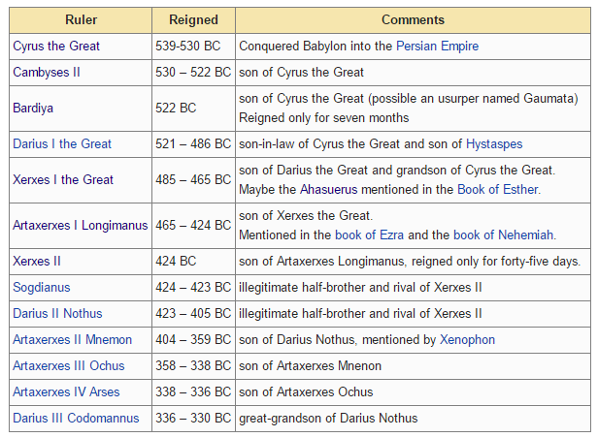
In 539 BC, Babylon was captured by Cyrus the Great. His son was later crowned formally as King of Babylonia. This list uses the Greek names of the Achaemenid Persian kings. Wikipedia

