Slide 1


The Marriage
A Story of Hope
Hosea
Presentation by ©http://fashionsbylynda.com/blog/

Slide 2
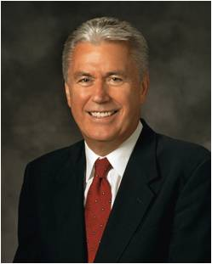

Point of No Return
He was the son
“Airplane flights over huge oceans, crossing extensive deserts, and connecting continents need careful planning to ensure a safe arrival at the planned destination.
“There is an important decision point during such long flights commonly known as the point of safe return.”
(3)

Slide 3
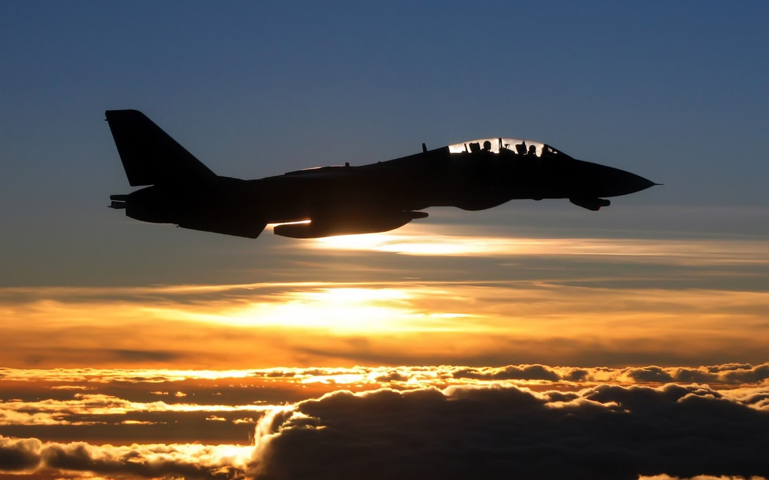
“Up to this point the aircraft has enough fuel to turn around and return safely to the airport of departure. Having passed the point of safe return, the captain has lost this option and has to continue on. “
He was the son
“That is why this point is often referred to as the point of no return. …”
“Satan wants us to think that when we have sinned we have gone past a ‘point of no return’ – That it is too late to change our course.”
(3)

Slide 4
Hosea
He was the son
He was the son of Beeri, and his name means ‘to help, deliverer and salvation derived from same root names as Joshua, and Jesus
He is the only prophet of the northern kingdom whose writing have been handed down to us as part of the canon and one of the few prophets who left written prophecies in the Northern Kingdom
His ministry extended from the days of King Uzziah to King Hezekiah about 23 years, and preached before and after the fall of Israel
He received his call during the latter part of Jeroboam II reign
Evidently his writings were collected and preserved in the Southern Kingdom of Judah after the fall of the Northern Kingdom
He uses the metaphor of marriage with the message of the relationship with God and Israel
He testifies of the Lord’s love for Israel as he waits for His return
He is a contemporary of Isaiah, Amos, and Micah
He probably died before the accession of Pekah, 736 B.C.
(1,2,4)

Slide 5
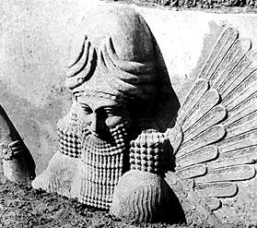
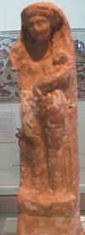
Worshiping the Ways of the Canaanites
He was the son
During the time of Hosea, the Israelites were influenced by the worship and ways of the Canaanites.
The Israelites were attracted by the fertility gods and goddesses and were deeply involved in the practices of their neighbors
(4)

Slide 6
The Marriage
He was the son
With this strange request he married Gomer (daughter of Diblaim) and by her Hosea had a son, Jezreel, then a daughter, Loruhamah, then another son, Loammi
Hosea was told to go and marry from among the common people even though they were in a state of apostasy
Diblaim
Hosea
Gomer
Jezreel
Loruhamah
Loammi
Hosea 1:3-9

Slide 7
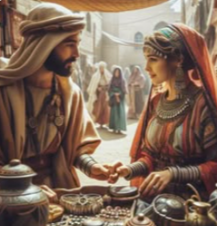
Interpretation #1
He was the son
The Lord commanded Hosea to marry Gomer, in spite of the fact that she had been an adulteress and a harlot… (10)
Scholars
This marriage served as an object lesson to call Israel’s attention to their carnal state
Some Others
God would not use sinful behavior even in an object lesson of this kind.
Others
The act of Hosea marrying a harlot would be inconsistent with God, who ‘cannot look upon sin with the least degree of allowance’ (Alma 45:16)
(5)

Slide 8
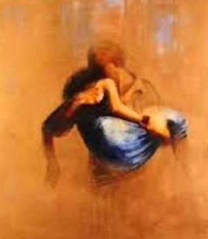
Interpretation #2
He was the son
The experience came to Hosea in a dream or vision
There was neither harlot nor marriage, but Hosea was asked to accept the burden of being prophet (husband) to immoral Israel (Gomer).
Scholars
Most reject this alternative because of the intensity of Hosea’s involvement with the imagery.
(6)

Slide 9
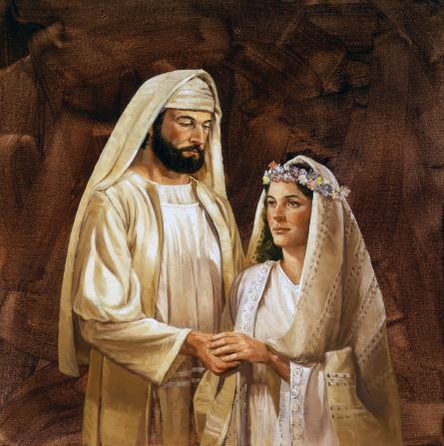
Interpretation #3
He was the son
Hosea married Gomer who had been faithful at that time but later became (a harlot)
Scholars
An ‘enacted parable’ with the phrase ‘wife of whoredoms’ (Hosea 1:2) refers to what Gomer became.
Hosea looked back on his experiences and all that he had suffered and learned through them, recorded incidents that helped illustrate his teaching..
However, if Gomer were faithful and true at the time of the marriage, this phrase would seem like a peculiar way to describe her..
(6)

Slide 10
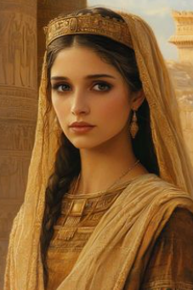
Interpretation #4
He was the son
Gomer was not actually a harlot, but a worshiper of Baal
She was guilty of spiritual harlotry
However, it seems peculiar that God would ask a prophet to marry a nonbelieving woman.
Some have questioned whether Hosea’s marriage to a harlot was literal or only an allegory.
Many details in the book point toward the marriage being literal, though we cannot be sure. (12)
(6)

Slide 11
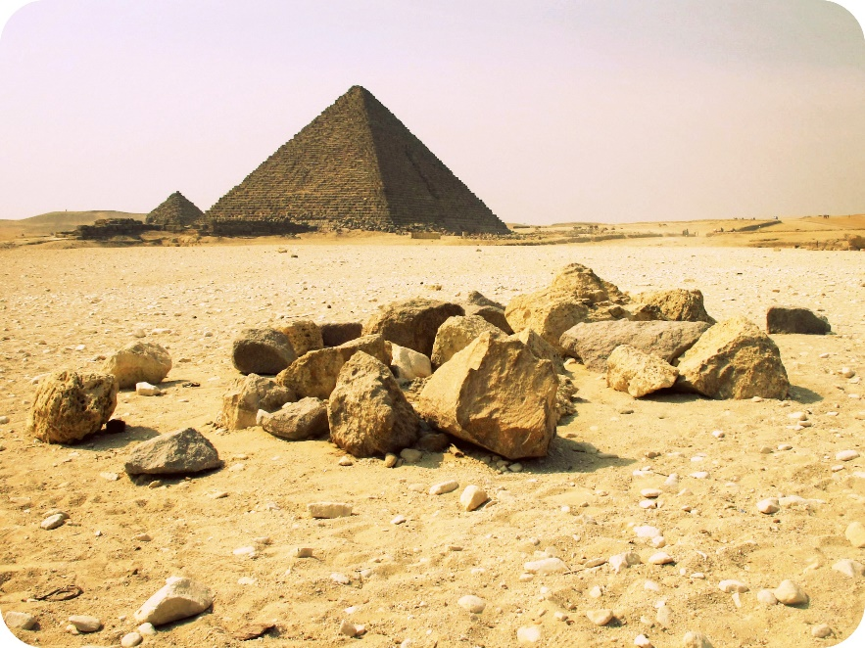
Interpretation #5
He was the son
An Allegory designed to teach the spiritual consequences of Israel’s unfaithfulness
Some Believe
This represents the prophet’s call to the ministry – a ministry to an apostate and covenant-breaking people
The children = a union of the coming of the judgments of the Lord upon Israel. A warning which was to be carried to the people by the prophet.
The children’s names symbolize the destruction that lies in Israel’s future as a result of her idolatrous ways
(5)

Slide 12
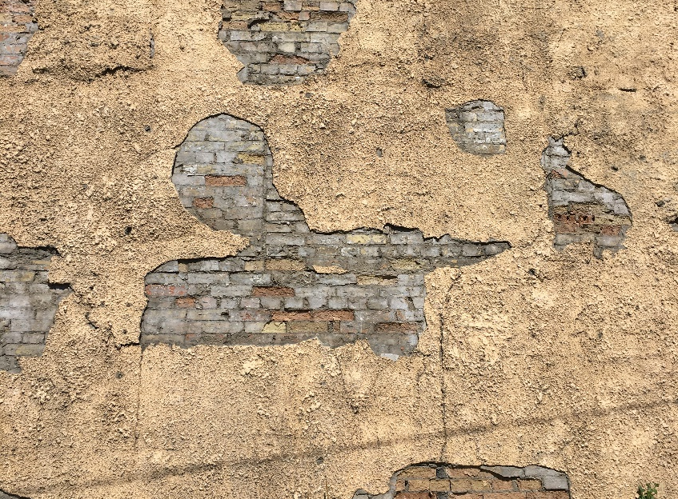
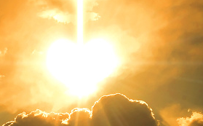
A Covenant Relationship
He was the son
Hosea and Gomer = The relationship between Jesus Christ and the Israelites who turned away from the Lord
Hedge up thy way and make a wall =
Israel being separated from their false gods when they were carried away by the Assyrians
If we violate our covenants with the Lord, we will suffer negative consequences
Hosea 2:6

Slide 13
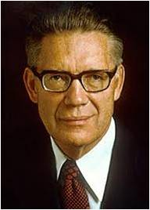
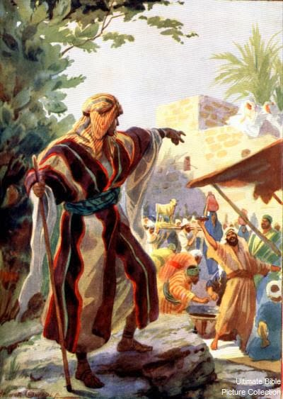
Worshipping Other Gods
He was the son
Israel turns away and breaks covenants with the Lord
Separates from the Lord
“In a spiritual sense, to emphasize how serious it is, the damning sin of idolatry is called adultery.
When the Lord’s people forsake him and worship false god, their infidelity to Jehovah is described as whoredoms and adultery.
By forsaking the Lord, his people are unfaithful to their covenant vows, vows made to him who symbolically is their Husband.” (7)
Hosea 2:6

Slide 14
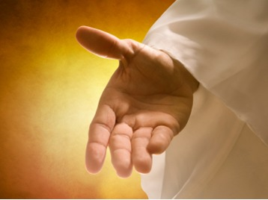
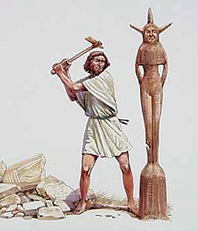
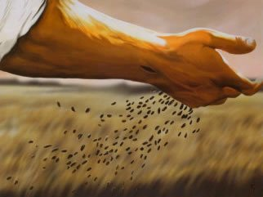

What did the Lord say He would eventually do for Israel?
He was the son
Hosea 2: 23
Hosea 2:14–15
Hosea 2:17
Hosea 2:19–20
Allure = and invitation to return to the Lord
Take away names of Baalim = They would no longer worship the idols (Baal)
Betroth = a binding commitment. To reestablish the Lord’s covenant with Israel…to bind
Sow = To scatter then to gather

Slide 15
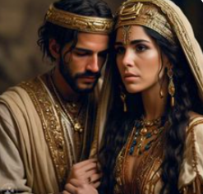
Bondage
Gomer had been placed in bondage
What did the Lord command Hosea to do for Gomer?
If Gomer would forsake her sins and remain faithful to her marriage covenant with Hosea, then Hosea would continue to love and care for Gomer as her husband in spite of her previous sins.
Hosea did for Gomer what the Lord does for all of His covenant people who turn to Him through repentance.
Hosea 3:1-3

Slide 16
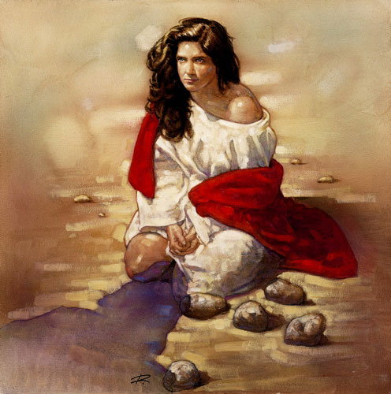
Gomer=Their mother=Israel
If we will repent and remain faithful to the covenants we have made with the Lord, then He will receive us and forgive our sins
Gomer had to purify her life before she could feel Hosea’s love.
In their captivity Israel would suffer without God’s help until she purified her life. Then she would know of God’s continued love.
Gomer’s unfaithfulness in her covenant marriage with Hosea represented Israel’s spiritual unfaithfulness in their covenant relationship with God.
Hosea 3:1-3

Slide 17
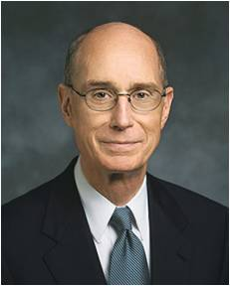
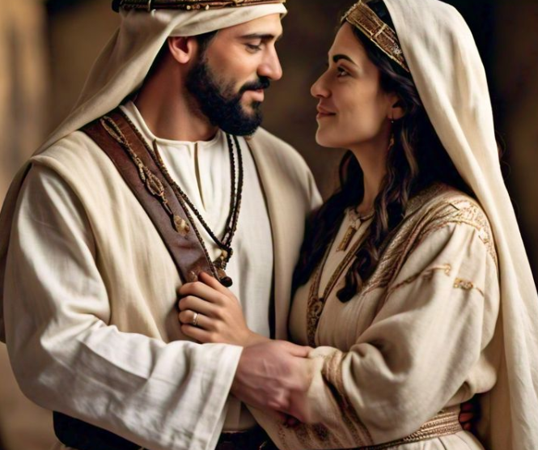
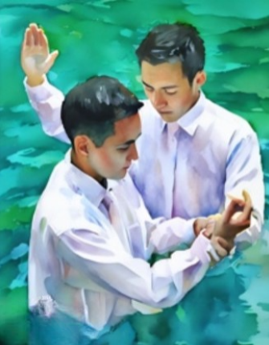
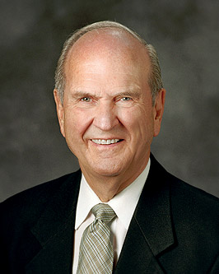
“This was not a story about a business deal between partners.
… This was a love story.
This was a story of a marriage covenant bound by love, by steadfast love.” (8)
The Lord often uses marriage as a symbol for our covenant relationship with Him.
President Russell M. Nelson taught that our covenants create “a covenant relationship in which [we and the Lord] are bound to be loyal and faithful to each other” (11)

Slide 18
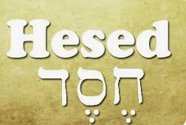
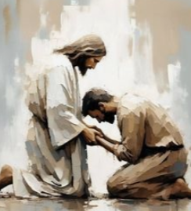
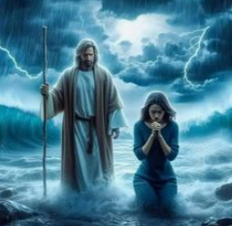
Hesed
Lovingkindness, Mercy, and Goodness
Hesed is a unique term describing a covenant relationship in which both parties are bound to be loyal and faithful to each other. …
Hesed is a special kind of love and mercy that God feels for and extends to those who have made a covenant with Him. And we reciprocate with hesed for Him.
Because God has hesed for those who have covenanted with Him, He will love them.
He will continue to work with them and offer them opportunities to change.
He will forgive them when they repent. And should they stray, He will help them find their way back to Him. (11)
Hosea 2:19; 4:1; 6:4, 6; 10:12; 12:6

Slide 19
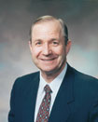
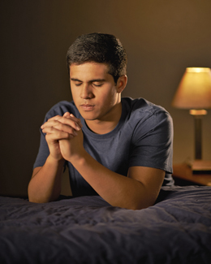
A Process of Purifying
First, go to the Lord.
Second, go to the one we have offended.
Third, if necessary, go to our judge in Israel.
And fourth, then put it away.
Our responsibility is to do the work of repentance. We must abandon our sins so the cleansing can begin.
He gave His life and suffered for all our sins. He can redeem us from our personal fall.
There is no such thing as
‘The Point of No Return’
(9)

Slide 20
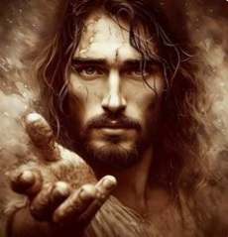

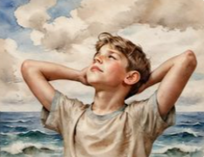
Hosea Represents The Lord
Jesus Christ is full of love and mercy, even when I stray from Him.
Jesus Christ invites His covenant people to repent and keep their covenants.
In what ways have you seen the Lord demonstrate His love and mercy in your life or the life of someone you know?

Slide 21
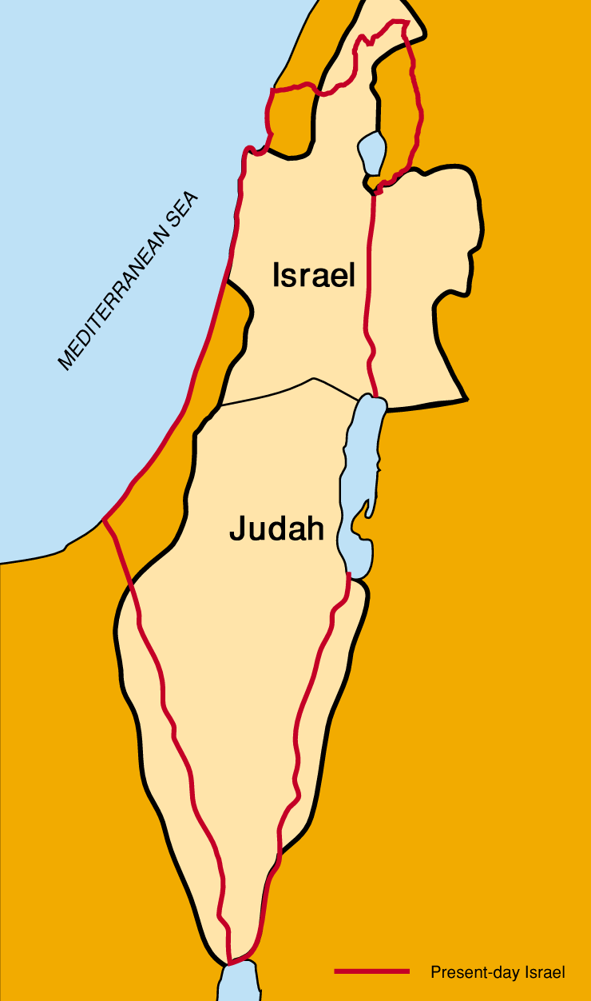
Speaking of Ephraim…
Why Is There So Much Emphasis on Ephraim and Judah and No Mention of the Other Tribes?
They were the two dominant tribes, Judah came to represent all the Israelites in the Southern Kingdom, and Ephraim came to represent the Israelites in the Northern Kingdom. Thus, as used here, Judah means the Southern Kingdom, and Ephraim the Northern Kingdom. (4)
Hosea 4:17; 5:3, 9, 11–14; 6:4
(9)

Slide 22
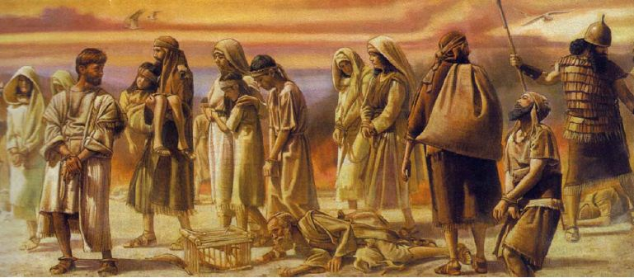
The Rest of Hosea
Hosea called upon Israel to return to the Lord and serve Him.
Hosea 12–13 records that Hosea explained that the Lord uses prophets to guide His people.
Hosea also taught that through the Savior, all people will overcome physical death.
In Hosea 13–14 we read that Hosea taught the Israelites that their decision to be unfaithful to the Lord was the reason for their impending destruction.
However, Hosea also extended a message of hope to them by teaching that in the last days, the Lord would heal them of their backsliding, or apostasy, when the people of Israel return to Him.
(9)

Slide 23
Sources:
Video: “Enduring Love” (4:16)
Who’s Who in the Old Testament by Ed J. Pinegar and Richard j. Allen p. 75
W. Cleon Skousen The Fourth Thousand Years p. 477
President Dieter F. Uchtdor Point of Safe Return Ensign May 2007
Old Testament Institute Manual The Ministry of Hosea: A Call to Faithfulness
Sidney B. Sperry The voice of Israel’s prophets: A Latter-day Saint Interpretation of the Major and Minor Prophets of the Old Testament (1952), 281
Seminary Teacher Manual – Old Testament
Elder Bruce R. McConkie Mormon Doctrine p. 25
Presentation by ©http://fashionsbylynda.com/blog/
8. President Henry B. Eyring Covenants and Sacrifice Address to religious educators 15 Aug 1995 pp. 1-2
9. Elder Lynn A. Mickelsen The Atonement, Repentance, and Dirty Linen October 2003 Gen. Conf.
10. Old Testament Teacher Manual 2025-2026
11. President Russell M. Nelson (“The Everlasting Covenant,” Liahona, Oct. 2022, 6)
12. (“Hosea 1,” The Essential Old Testament Companion: Key Insights to Your Gospel Study [2013], 476)
He was the son

Slide 24
Hosea 1-3 | Hosea 4-6 | Hosea 7-14
The Lord commands Hosea to marry, and Hosea selects a woman named Gomer. Gomer chooses to be unfaithful to Hosea and commits adultery. The Lord uses the symbol of this marriage to describe His relationship with Israel. Judgement would come upon the Israelites for breaking their covenants and the Lord mercifully invites them to repent and enter into the covenant again | The people of Israel rejected the knowledge and truth of the gospel they had received and committed great sins and iniquities. Hosea calls upon Israel to return back to the Lord | Through Hosea, the Lord proclaims how He will punish the people of Israel for their sins. However, He also expresses His mercy and kindness. The Lord recounts that He brought the people of Israel out of Egypt, but they rejected their god. Through prophets, visions, and similitudes, the Lord teaches and directs His people. The Lord will ransom us from death. The people of Ephraim will repent of their sins in the last days.

Slide 25
Marriage terms:
Throughout history every culture has prescribed ways to celebrate the covenants of marriage. Because most people had personal knowledge of marriage, they understood the Lord better when the prophets used marriage terms to describe symbolically the covenants God made with them and they with Him. The covenant relationship between Jehovah and His people Israel was likened to the relationship between a man and his wife. (4)
They Eat up the Sin of My People: Hosea 4:8
The sin-offering of the people, the flesh of which the priests were commanded to eat, to wipe away the sin of the people (Lev. 6:26), and the remarks upon this law in Leviticus 10:17. The fulfillment of this command became a sin on the part of the priests, from the fact that they directed their soul, their longing desire, to the transgression of the people. They wished the sins of the people to be increased in order that they might receive a good supply of sacrificial meat to eat. Keil and Delitzsch Commentary, 10:1:78-79.
Names:
Jezreel the same as that of the valley of former King Jehu’s bloody purge, and foreshadowed Israel’s overthrow in that strategic valley. It is a valley overlooked by Megiddo (new Testament “Armageddon” (Rev. 16:16) and famed for crucial battles past and future.
The name means God shall sow or scatter abroad. Anciently sowing was done by casting handfuls of seeds = scattering
Lo-ruhamah in Hebrew means “not having obtained mercy ‘ suggests that no amount of mercy from God would set aside divine justice and save northern Israel; the ten tribes would be taken captive and led away.
Lo-ammi in Hebrew means “not my people,” is like a lament and shows that by their harlotry Israel could not be thought of as God’s people
Stocks and Staffs Hosea 4:12
Stocks were wooden idols. The staffs were diving rods, instruments used to foretell the future, to find lost or hidden objects, and so forth. All were consulted within the Canaanite culture much like divining instruments are used in today’s Satanic cults. This, instead of seeking counsel from the living god, they looked to the idols. (4)
Purchase Price for Israel’s freedoms Hosea 3;2
Israel’s freedoms had been or would be lost, and in addition she suffered the slaver of sin, which also requires a purchase price before Israel can be reconciled with her Savior. Hosea desired to purchase his wife from slavery just as Heavenly Father seeks after His children to redeem them from Satan’s power with the blood of His Son Jesus Christ (4)
Hosea 3:4-5 Bondage::
This alludes to Israel’s impending captivity when they would be without leadership (“kings,” “princes”) and without the temple and the religious practices they believed in (“sacrifice”). They would also be without revelation (represented by the ephod, to which the Urim and Thummim were attached). The teraphim were worshiped by the Canaanites as givers of earthly prosperity and deities who revealed the future. Commentators believe that these objects of Canaanite worship were included with objects from the worship of Jehovah to show the people that the worship of idols would also be lost. “David their king” (v. 5) is one of the titles of the Messiah or Jesus Christ. OT Institute Manual

Slide 26
Hosea 2- Meaning of the Metaphors
Verse 1 | Ammi | My people
Verse 1 | Ruhamah | Having obtained mercy, or those who have obtained mercy
Verse 2 | Your mother | The nation Israel
Verse 3 | Wilderness | The captivity
Verse 5 | Lovers | The priests, priestesses, and idols of the Canaanite temples or, in the larger sense, any person one loves more than God
Verse 5-9, 13 | Bread, corn, wool, and jewels | Worldly values and treasures
Verses 9-10 | Her nakedness and her lewdness | Israel’s sin
Verses 11-14 | Allure her | Jehovah still cares for her and will try to win her back
Verses 15 | Valley of Achor, a rich valley north of Jericho, near Gilgal | The Lord will restore her to great blessings
Verse 16 | Ishi (Hebrew for my husband) and Baali Hebrew for my master | Eventually Israel will accept God as her Lord and her true Husband
Verse 19-20 | Betroth thee unto me forever | The fullness of the new and everlasting covenant restored to Israel in the later days and the eternal blessings that will result form Israel’s faithful marriage to Jehovah
Verse 22 | Jezreel – Hebrew for God shall sow | The downtrodden and poor Israel. Like the Jezreel Valley, they have great potential and will be resown and made fruitful by the Lord

Slide 27
Hosea 4- Commentary from OT Institute Manual
Verse 3 | Therefore Shall the Land Mourn | The Lord outlines the relationship between the bounties of the land and the righteousness or wickedness of the people.
Verse 8 | They Eat Up the Sin of My People | “the sin-offering of the people, the flesh of which the priests were commanded to eat, to wipe away the sin of the people. The fulfillment of this command, however, became a sin on the part of the priests, from the fact that they directed their soul, i.e. their longing desire, to the transgression of the people; in other words, that they wished the sins of the people to be increased, in order that they might receive a good supply of sacrificial meat to eat.”
Verse 12 | Stocks and Staffs | Wooden idols. The staffs were divining rods, instruments used to foretell the future, to find lost or hidden objects, and so forth. All were consulted within the Canaanite culture much like divining instruments are used in today’s Satanic cults. Thus, instead of seeking counsel from the living God, they looked to the idols.
Verse 15 | Avoid Gilgal and Bethaven | Gilgal was where the law of circumcision was renewed after Israel crossed over Jordan in Joshua’s day, but it had become polluted by idolatry since the days of Jeroboam. Bethaven means “house of iniquity,” and Bethel means “house of God.” Hosea applied the name Bethaven to the town Bethel to show that the house of God had now become the house of iniquity and idols.
Verse 16 | A Backsliding Heifer and a Lamb in a Large Place | One who refuses to follow when led and sets her feet and slides in the dirt. She is an unmanageable animal and will not pull together with the other ox yoked with her, nor will she submit to the guidance of the driver.
Verse 16 | A Lamb in a Large Place | A helpless animal lost in a large open area with no protection. This figure suggests Israel’s being scattered among the Gentiles.

Slide 28
Hosea 5- Commentary from OT Institute Manual
Verses 1-2 | Nets and Snares | Mizpah and Tabor, both mountains, were famous for hunting; hence, the “net” and “snare.” Revolters were those who drove animals into a pit that had been camouflaged. The metaphor depicts the rulers and priesthood in the bloody role of the hunters who spiritually killed their prey, Israel.
Verse 7 | Begotten Strange Children | “Israel ought to have begotten children of God in the maintenance of the covenant with the Lord; but in its apostasy from God it had begotten an adulterous generation, children whom the Lord could not acknowledge as His own” (Keil and Delitzsch, Commentary, 10:1:89).
Verse 10-11 | Remove the Bound | In ancient Israel, property was marked with stone markers or “landmarks.” To move such a mark was a serious offense, for it was the same as stealing land. If one who destroyed a neighbor’s boundaries was cursed,
Verse 11 | walked after the commandment | Ephraim was oppressed because it willingly walked after filth instead of walking after true commandments.
Hosea 6- Commentary from OT Institute Manual
Verses 1-3 | A Call to Return | may be a symbolic reference to the gathering of Israel and the Millennium. If a day is a thousand years (see 1 Peter 3:8), Israel is to be revived and blessed some two or three thousand years in the future.
Verse 3 | Come to us as his rain | A call to seek the knowledge of Jehovah, whose rising is fixed like the morning dawn and whose blessing is “as the latter and former rain unto the earth.” To the farmer in ancient Israel, two “rains” were very critical. The former (or first) rains softened the earth so that he could plow it and plant the seed; the latter (or second) rains gave the crop its growth.
Hosea 7- Commentary from OT Institute Manual
Verses 8-9 | Cake Not Turned | Because Ephraim (the Northern Kingdom) had mixed with other nations, worshiped their idols, and learned their ways, she had only fulfilled half the requisites for the conquest of Canaan, or she was only “half baked.” The image in Hebrew is of] a cake baked upon hot ashes or red-hot stones, which, if it be not turned, is burned at the bottom, and not baked at all above. The meaning of this figure is explained by ver. 9. As the fire will burn an ash-cake when it is left unturned, so have foreigners consumed the strength of Israel, partly by devastating wars, and partly by the heathenish nature which has penetrated into Israel in their train.” (Keil and Delitzsch, Commentary, 10:1:107–8.)
Verse 14 | Cry for Corn and Wine | When hardships come, some cry upon their beds. Rather than pray to God with all their heart, they look for corn and wine—something to take away the hurt. They do not seek that which brings the Lord’s help
Verse | A Deceitful Bow | One that flies back to its curved position while the archer is stringing it or breaks while he has it drawn. In either case, the archer can be wounded.

Slide 29
Hosea 8- Commentary from OT Institute Manual
Verses 8-9 | A Wild Ass | A wild ass is one of the most independent and unreliable beasts on earth. Because Israel wanted to go her own way and be alone, she was likened to a wild ass. She would go alone into Assyria and be swallowed up by the Gentiles. The “lovers” hired by Ephraim represent her continued attempt to find security and friends through political alliances rather than through obedience to God.
Verse 13 | Egypt | Egypt was the land of the first captivity—between the times of Joseph and Moses. The word here refers to captivity or bondage in general; thus, Assyria is the new Egypt.
Hosea 9- Commentary from OT Institute Manual
Verses 7 | Prophets who are fools | Hosea was referring to false prophets who were saying that all was well in Israel and that their enemies would not come against them..
Verse 10 | Grapes in the wilderness; first ripe fruit of the fig | Both grapes and figs were viewed as choice fruits by the people anciently. Jehovah found Israel, at first, a delightful thing.
Verse 10 | Baal-peor | Another way of saying the people were committing immoral acts (see Numbers 25:1–3; Psalm 106:28).
Verse 11 | Ephraim’s glory flies away | The Northern Kingdom shall see no conception, no pregnancy, no birth—Ephraim will be left totally desolate
Verse 12 | Have children but be bereaved | Even their grown-up sons shall be cut off.
Verse 13 | Ephraim and Tyre (Tyrus) | Tyre was renowned for its glory and splendor. God had chosen Ephraim for similar blessings, but because of their wickedness they would be barren.

Slide 30
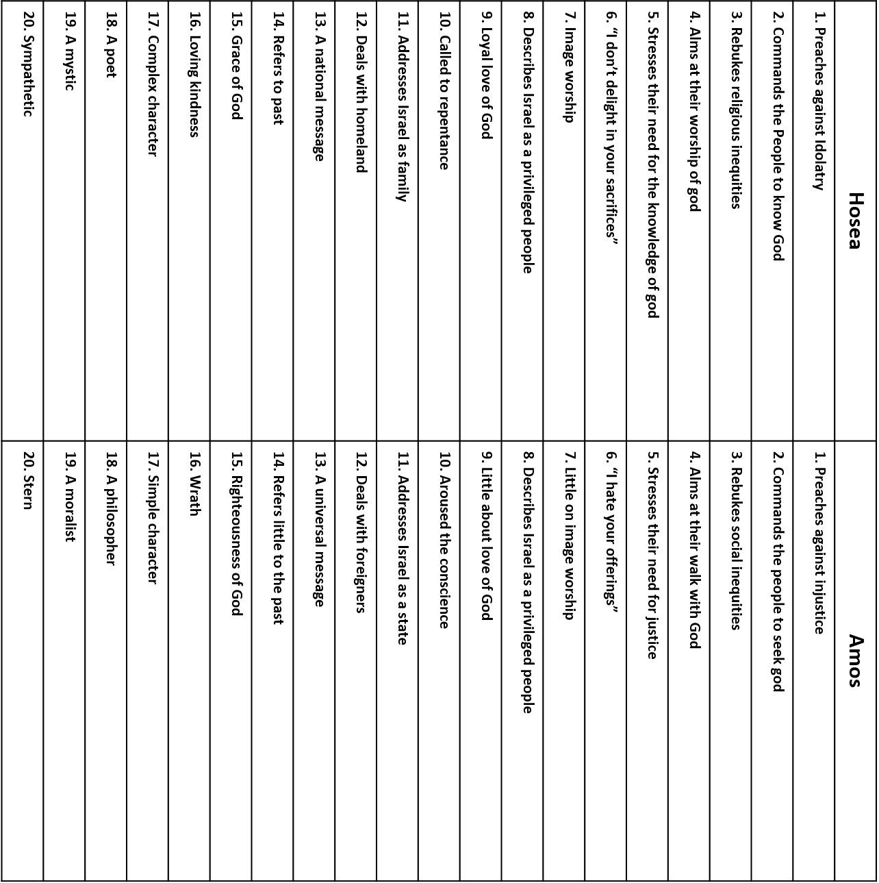
Amos was the first of the two writing prophets to the Northern Kingdom
Hosea was a resident of Israel and Amos was a resident of Judah
Talk thru the bible by Bruce Wikinson and Kenneth Boa
Here is a comparison chart between the two books

