Slide 1

Prophesies of Second Coming
Joel
For behold, he shall stand upon the mount of Olivet, and upon the mighty ocean, even the great deep, and upon the islands of the sea, and upon the land of Zion.
D&C 133:20

Slide 2

Joel
He was the son of Pethuel and a prophet of Judah
He may have lived sometime between the reign of Joash, before 850 B.C., and the return of the tribe of Judah from captivity in Babylon
The timespan of his writings are unknown, but could be as early as the 9th century or as late as the return from the Babylonian captivity following the decree of liberation of the Jewish people issued by Cyrus in 537 B.C.
He resided in Judah but wrote letters to Israel (traditionally)
The book of Joel centers on prophecies that Joel made after the land of Judah was afflicted with a severe drought and a plague of locusts
He prophesied of the Second Coming and the outpouring of the Spirit in the flesh
He was cited by Peter on the Day of Pentecost (Acts 2:17) and by Moroni in his visitation to the Prophet Joseph Smith (JS-H 1:41)
(1)

Slide 3
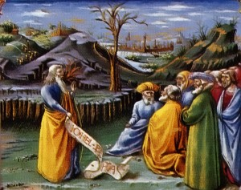
Prophets Have Been Called
Prophets of the Lord were called to labor among people whose lives remained in spiritual darkness. Joel was one of these prophets called to minister to a people who refused to repent. His prophecies have a common theme with those of Isaiah, Jonah, Amos, and others: repent or face destruction.
Joel is particularly significant to us because he prophesied of our day.
Joel is also a major source of information on the battle of Armageddon, one of the momentous events in the coming history of the world
(2)

Slide 4
Who Quoted Who?
Biblical scholars do not agree on when Joel lived. Some think he preceded Amos and Hosea because both men quoted him, but it is also possible that Joel quoted them, so this evidence is not conclusive.
Joel may have served before the time of Isaiah, for Isaiah quoted one of Joel’s prophecies, but it may be that Joel quoted Isaiah.
(2)

Slide 5
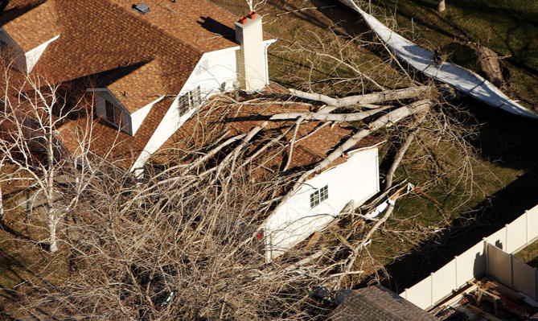
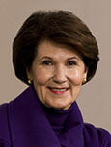
“Recently we experienced the worst windstorm Bountiful [in Utah] has seen in several decades. … Just as I was hearing news reports of semi trucks—twenty of them—being blown over on the roadside, I looked out my lovely back window down toward our creek and saw one of our large trees go down with a crash. …
“For a moment, I confess, I was truly fearful. It was very early in the morning, and Jeff was just leaving for the office. I said to him, ‘Do you think this is the end? Is it all over—or about to be?’”
(3)

Slide 6

Are we experiencing the signs today?

Slide 7
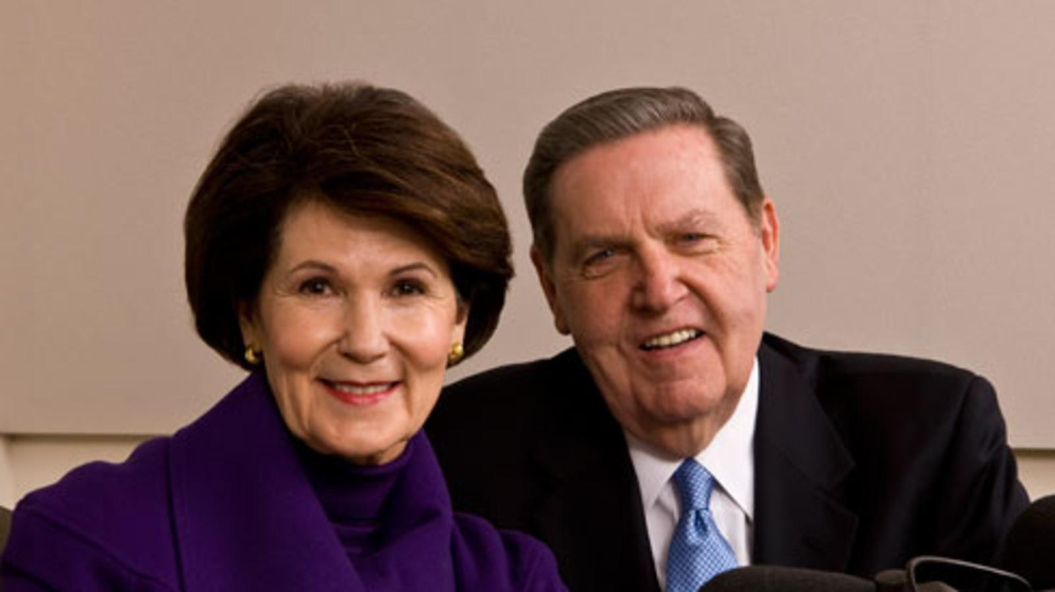
“My husband, who has deep faith and endless optimism, took me in his arms and said, ‘No, but wouldn’t it be wonderful if it were?
Wouldn’t it be wonderful if Christ really did come and his children really were ready for him?
Wouldn’t it be terrific if evil was finally conquered, once and for all, and the Savior of the world came down in the midst of the New Jerusalem to wipe away every tear from every eye?
Yes,’ my husband said, ‘in lots of ways I wish it were the end, but it’s not. It is just a stiff windstorm in Bountiful. We have got more work to do.’”
(3)

Slide 8
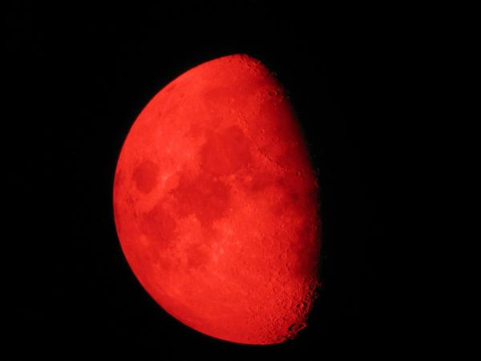
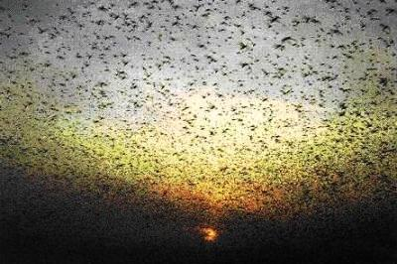
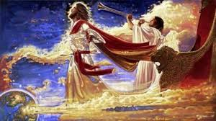
Joel Prophesied of the Second Coming
Joel, who prophesied to the people of Judah at a time when they were facing natural disasters and invading armies. Many of Joel’s prophecies relate to the time preceding the Second Coming, which will also be filled with natural disasters and wars.

Slide 9
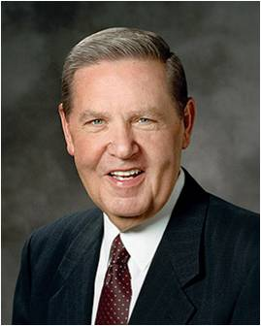
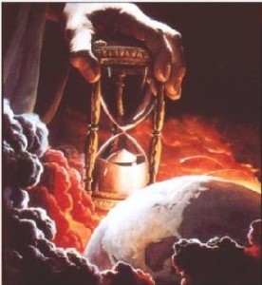
Fear of the Second Coming
Although some events associated with the Second Coming may cause people to feel afraid, Joel’s prophecies contain principles that can help us prepare for them.
Like Elder Holland, we can look forward to the Second Coming of the Savior with joy and confidence.

Slide 10
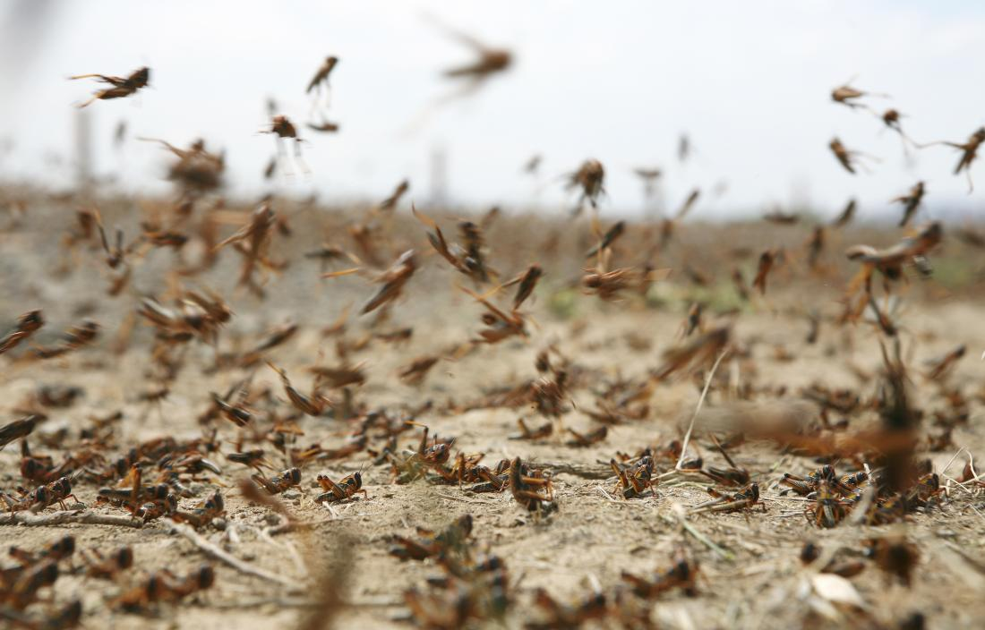
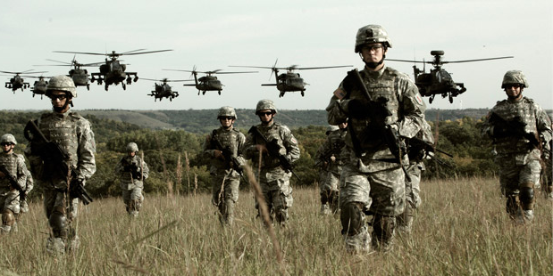
Plague of Locusts
Symbolizes the destruction that would come from invading armies if the people did not repent
The judgments will be so terrible that Joel calls on the Lord’s people to howl and cry for repentance. (2)
Joel 1:1-13

Slide 11
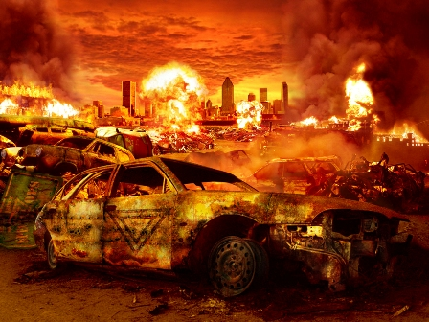
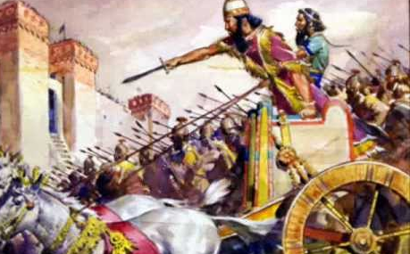
Dualistic Prophecy
They warn of an immediate and impending destruction (through the conquests of Assyria and Babylonia), but they also refer directly to the last days and the destruction that will again threaten Israel just before the Millennium.
Joel 1:1-13
(2)

Slide 12
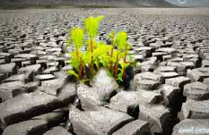

Physical VS Spiritual?
Famine (drink or fields)—nothing to eat or drink
Nations Upon You—enemies ready for battle
Meat cut off—sacrifices and offerings are either being desecrated or simply not done
Famine—The Lord has withdrawn His spirit
Nations Upon You—Satan has taken a hold of you
Meat cut off—inactivity or loss of temple worship
The Day of the Lord = a point in time that the Lord will administer rewards and penalties
Joel 1:5-13

Slide 13
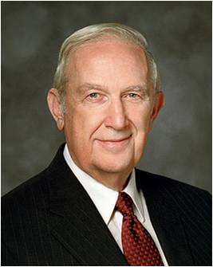

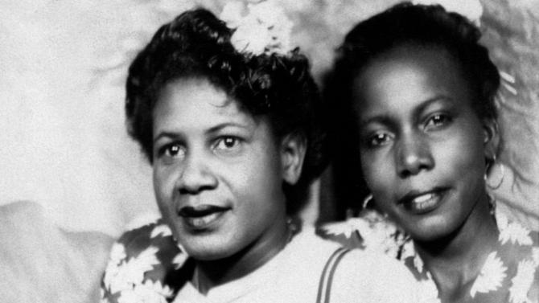
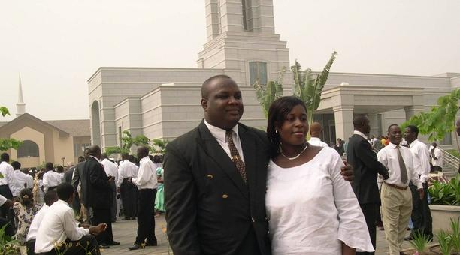
“Do you young people want a sure way to eliminate the influence of the adversary in your life?
Immerse yourself in searching for your ancestors, prepare their names for the sacred vicarious ordinances available in the temple, and then go to the temple to stand as proxy for them to receive the ordinances of baptism and the gift of the Holy Ghost.
As you grow older, you will be able to participate in receiving the other ordinances as well. I can think of no greater protection from the influence of the adversary in your life.” (4)

Slide 14
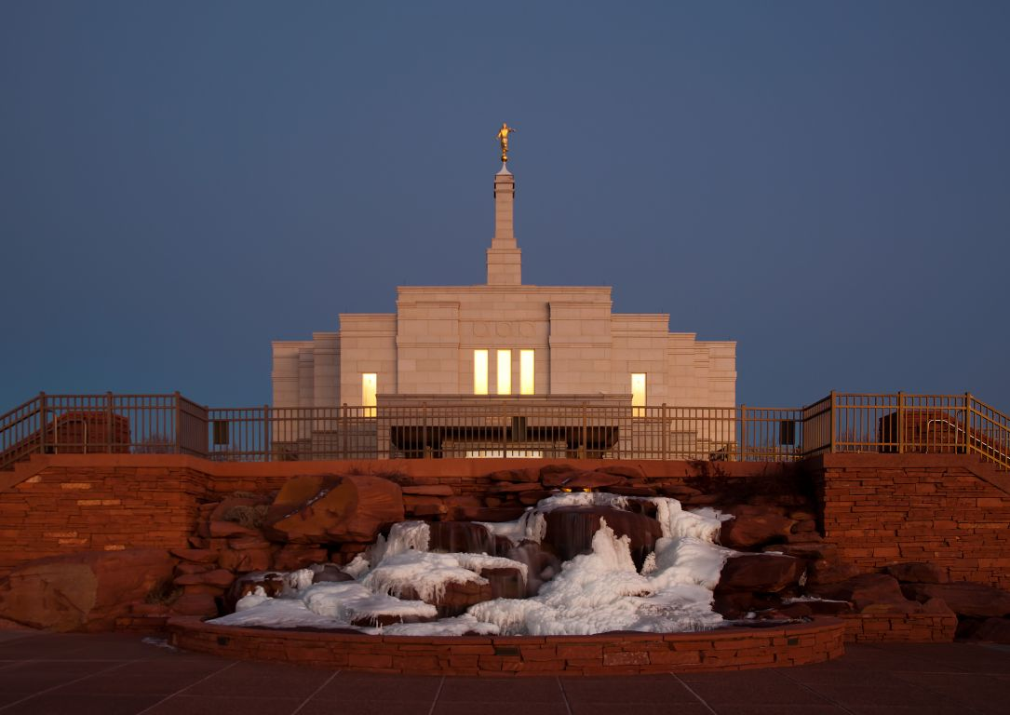
The Lord’s Holy Mountain
The Lord’s holy mountain is the place where His temple is, or the place from which He speaks to the people. Sometimes it is the temple or the New Jerusalem.
And it shall come to pass in the last days, that the mountain of the Lord’s house shall be established in the top of the mountains, and shall be exalted above the hills; and all nations shall flow unto it. Isaiah 2:2
…for the gathering of his saints to stand upon Mount Zion, which shall be the city of New Jerusalem. D&C 84:2
The Zion of the latter days, also frequently referred to in scripture as “my holy mount”, is a spiritual condition as well as a place. (2)
Snowflake Arizona Temple
. “Verily, thus saith the Lord, let Zion rejoice, for this is Zion—THE PURE IN HEART” D&C 97:21.
Joel 2:1-3; D&C 45:66-70; 82:14; 133:2, 13, 18, 26-32, 56

Slide 15
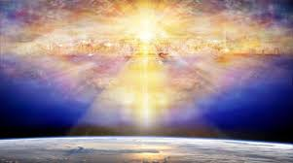
“Zion is people. Zion is the saints of God; Zion is those who have been baptized; Zion is those who have received the Holy Ghost; Zion is those who keep the commandments; Zion is the righteous; or in other words, as our revelation recites: ‘This is Zion—the pure in heart.’
“After the Lord called his people Zion, the scripture says that Enoch ‘built a city that was called the City of Holiness, even ZION’; that Zion ‘was taken up into heaven’ where ‘God received it up into his own bosom’; and that ‘from thence went forth the saying, Zion is fled.’
(5)

Slide 16

Better Homes in Zion
“After the Lord’s people were translated—for it was people who were caught up into heaven, not brick and mortar and stone, for there are better homes already in heaven than men can build on earth—after these righteous saints went to dwell beyond the veil, others, being converted and desiring righteousness, looked for a city which hath foundation, whose builder and maker is God, and they too ‘were caught up by the powers of heaven into Zion.’
“This same Zion which was taken up into heaven shall return during the Millennium, when the Lord brings again Zion; and its inhabitants shall join with the New Jerusalem which shall then be established.
(5)

Slide 17
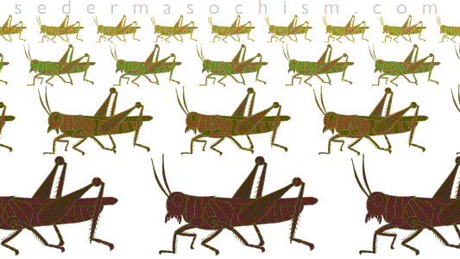
The Day of the Lord
Zion will be a reality, and the Battle of Armageddon will descend upon the land of Israel.
The Second Coming of Jesus Christ
Locusts will devour the crops and cover the heavens with blackness because of their numbers
And there came out of the smoke locusts upon the earth: and unto them was given power, as the scorpions of the earth have power.
Revelation 9:3
Joel 2:2

Slide 18
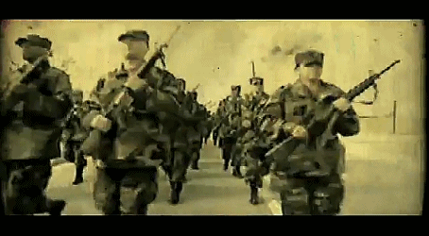
The Day of the Lord
The Second Coming of Jesus Christ
A great people and a strong” shall descend upon the land of Israel in the latter days. (Army?)
And they had tails like unto scorpions, and there were stings in their tails: and their power was to hurt men five months.
Revelation 9:10
Joel 2:2

Slide 19
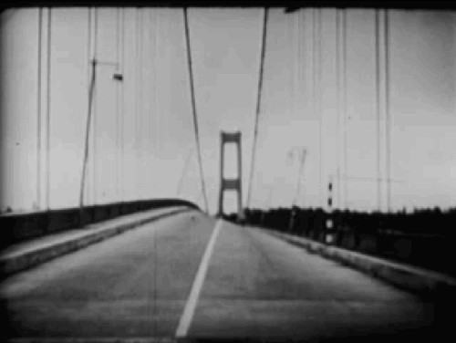
The Day of the Lord
The Second Coming of Jesus Christ
So great shall be the number of this people that “the earth shall quake before them”.
And the same hour was there a great earthquake, and the tenth part of the city fell, and in the earthquake were slain of men seven thousand: Revelation 11:13
Joel 2:2

Slide 20
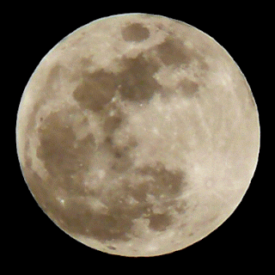
The Day of the Lord
The Second Coming of Jesus Christ
The sun, moon, and stars will be darkened.
And there arose a smoke out of the pit, as the smoke of a great furnace; and the sun and the air were darkened by reason of the smoke of the pit.
Revelation 9:2
Joel 2:2

Slide 21
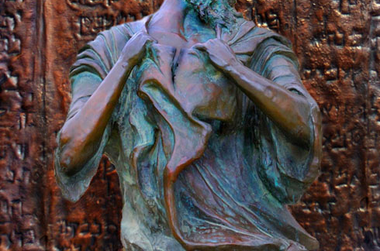
Turn Ye Even Unto Me
Repent
Joel taught the people to rend their hearts instead of their clothes.
As we turn to the Lord with all our hearts by sincerely repenting, He will show mercy and kindness to us
Joel 2:12-14

Slide 22
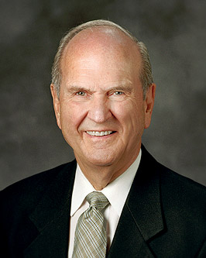


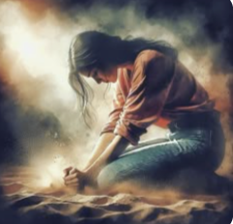
Increase Your Spiritual Capacity
Hear the voice of the Spirit more frequently and clearly
To be able to receive personal revelation
Choose to do spiritual work required to enjoy the gift of the Holy Ghost
Joel 2:28
(8)

Slide 23
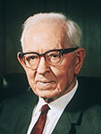

Pour Out His Spirit to All
“Now, my brethren and sisters, I am not going to confine this prophecy to the members of the Church.
The Lord said he would pour out his Spirit upon all flesh. …
[This means that] the Lord would pour out his blessings and his Spirit upon all people and use them to accomplish his purposes” (6)
The Lord will pour out His Spirit upon all people in the latter days
Joel 2:27-29

Slide 24
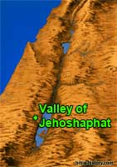
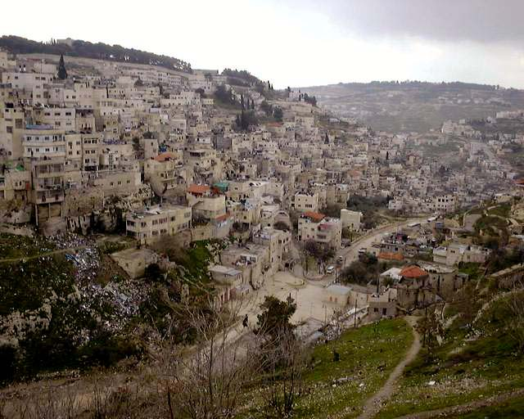
Valley of Jehoshaphat
Joel prophesied of the battle of Armageddon, which will occur just before the Second Coming. In this battle, all the nations of the earth will fight against the Lord’s people.
Valley of Jehoshaphat, literally, the “Valley of Decision” in Hebrew. Just where this valley is located is not entirely clear. Most likely it is the Kidron, a narrow valley between Jerusalem and the Mount of Olives. (7)
These will be the final scenes of the battle of Armageddon in Jerusalem, when the great earthquake will strike the massive army and Jesus will appear on the Mount of Olives to deliver Israel
Joel 3
(2)

Slide 25
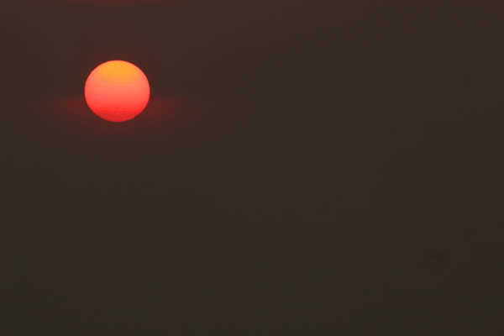
Prophets Proclaim Signs
We find Joel, Zephaniah, Zechariah, all proclaiming that in this last day, the day when the sun shall be darkened and the moon turned to blood and the stars fall from heaven, that the nations of the earth would gather against Jerusalem. All of them speak of it; and when that time comes, the Lord is going to come out of His hiding place.” (6)
…the Lord will smite all the people that have fought against Jerusalem; Their flesh shall consume away while they stand upon their feet, and their eyes shall consume away in their holes, and their tongue shall consume away in their mouth. Zechariah 14:12
Joel 3
(2)

Slide 26
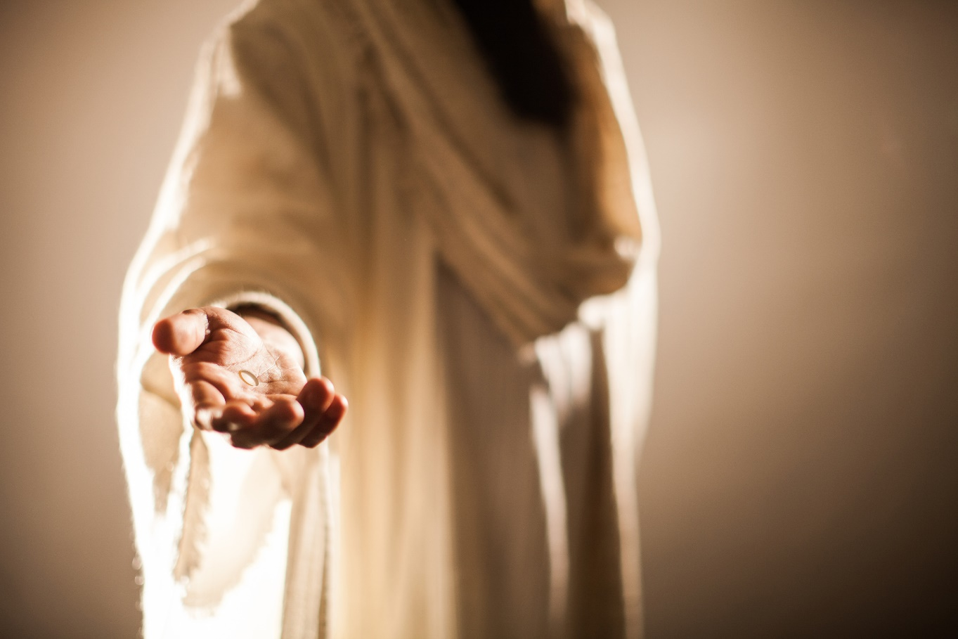
Judah Will Know
And then Judah will know that Christ is the Lord their God, for He will stand on the Mount of Olives, which will cleave in twain and Judah will see Him as their delivering Messiah.
They will ask about His wounds and learn that He is the Christ, and their mourning will know no bounds, for they will know that this is He for whom they have waited and whom their fathers crucified.
And one shall say unto him, What are these wounds in thine hands? Then he shall answer, Those with which I was wounded in the house of my friends. Zechariah 13:6
Joel 3:17; D&C 45:51-53
(2)

Slide 27
Sources:
Video:
RootsTech 2015: The Promised Blessings of Family History (2:42)
“The Joy of the Saints” from timecode 4:24 to 5:19.
1. Who’s Who in the Old Testament by Ed J. Pinegar and Richard J. Allen p. 105-106
Old Testament Institute Manual Joel: God Will Not Be Mocked Chapter 7
Sister Patricia T. Holland, the wife of Elder Jeffrey R. Holland (A Quiet Heart[2000], 129).
Elder Richard G. Scott The Joy of Redeeming the Dead” Ensign or Liahona No. 2012, 94.
Elder Bruce R. McConkie “Come: Let Israel Build Zion,” Ensign, May 1977, p. 117.
President Joseph Fielding Smith Salvation, 1:176
Signs of the Times, p. 170.
Presentation by ©http://fashionsbylynda.com/blog/
Robert Young, Analytical Concordance to the Bible, s.v. “Jehoshaphat”
President Russell M. Nelson Revelation for the Church, Revelation for Our Lives,” Ensign or Liahona, May 2018, 96

Slide 28
Joel 1 | Joel 2 | Joel 3
Joel describes a natural disaster caused by a plague of locusts. He calls for the people to fast and to gather at the temple for a solemn assembly to plead with the Lord for deliverance. | Joel describes the “day of the Lord” and the war and desolation that will accompany it and then asks, “Who can abide it?” (Joel 2:11). The Lord answers by telling the people to turn to Him with all their hearts. Joel prophesies of some of the blessings the Lord will give His people in the latter days. | Joel prophesies of the latter days and affirms that every country in the world will be at war shortly before the Second Coming. The Lord will dwell with His people when He comes again.
Joel 2:4-5 Horses and Chariots:
“Here we have a great, terrible army, marching with unbroken ranks and crushing everything before it, finding the garden like Eden before them, leaving the wilderness behind, causing mourning, causing suffering; and so the prophet raises the warning voice, and that voice is to us, if you please, that we might turn unto the Lord and rend our hearts.” Joseph Fielding Smith (The Signs of the Times, p. 160.)
When these events occur they will strike fear into the hearts of Jerusalem’s inhabitants. The siege against the city will be severe. The relentless army will overrun the land of Israel. The city walls will be breached and the houses plundered (see v. 9). The phrase “when they fall upon the sword, they shall not be wounded” (v. 8) may simply be a way of saying that the armaments used against the invaders will be ineffectual. But the Lord is strong, and He will keep His word. He has promised to rescue the people, and He will (see v. 11; see also Zechariah 14; Revelation 9, 11; Ezekiel 38–39).

Slide 29
Joel 3:16 | Amos 1:2 | Hosea 11:10
The Lord also shall roar out of Zion, and utter his voice from Jerusalem; and the heavens and the earth shall shake: but the Lord will be the hope of his people, and the strength of the children of Israel. | And he said, The Lord will roar from Zion, and utter his voice from Jerusalem; and the habitations of the shepherds shall mourn, and the top of Carmel shall wither. | They shall walk after the Lord: he shall roar like a lion: when he shall roar, then the children shall tremble from the west.
Comparisons of Joel’s writings to other Prophets—Who Quoted Who?
Isaiah 13:6 | Joel 1:15
Howl ye; for the day of the Lord is at hand; it shall come as a destruction from the Almighty. | Alas for the day! for the day of the Lord is at hand, and as a destruction from the Almighty shall it come.

Slide 30
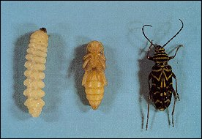
Stages of the development in the life of a locust
Scripture Joel 1:4 | Hebrew Word | Hebrew Meaning
Palmerworm | Gazam | gnawer
Locust | Arbeth | many
Cankerworm | Yeleq | licker
Caterpillar | Chasil | consumer
Adam Clarke, The Holy Bible … with a Commentary and Critical Notes, 4:658
Joel 1:5-7 Wine, the Lion, the Vine, and the Fig Tree:
Judah had become drunken with the wine of iniquity and would have cause to weep and to howl, for the Lord would not tolerate their glorying in sin. Judah’s security and wealth, which lay at the root of this wickedness, were compared to the vine from which the grapes for wine are taken. They vineyard was to be cut off: Judah would be humbled by the Lord’s almighty hand so they could be drunken no more.
The vine and the fig tree, among the most stable and enduring of the plants that nourished Israel anciently, represented the finest that the Lord had given His chosen people. But they had rejected the gift and the Giver, and all would be laid waste by the numberless nation of invaders who, as a lion, would not be denied. The lion is the most feared of animals and pulls down his prey with great savagery. A tree is barked by stripping the bark from the trunk, which kills the tree. The imagery was clear. The house of Israel would be pulled down, or cut off, and spoiled by powerful outside nations. Their vineyards and orchards would be desolate. OT Institute manual
Joel 1:8-20 The Loss of Temple Worship:
One of the consequences of Judah’s destruction and scattering as a nation was the loss of her temple worship, the source of joy and gladness.
At this time a husbandman was a person who tended an orchard, and a vinedresser was one who cultivated a vineyard. (In New Testament times a husbandman also took care of a vineyard.) The girding in verse 13 refers to putting on clothing of sackcloth (coarse cloth made of animal hair), which would constantly remind them of the great tragedy coming to their people. Joel called upon all the people to howl and lament because the temple would fall and the people of God would undergo national disaster.
Joel instructed Judah to learn the words they would cry in the last days as a reminder of her future sorrow. A solemn assembly was held to gather priesthood leaders and members to consider these sacred matters
These dire predictions were fulfilled when the covenant people fell, first to Assyria and then to Babylon, and then were ruled by a series of empires.
OT Institute Manual
Joel 2:1 Zion and Holy Mountain
The Prophet Joseph Smith also taught that the place of Zion, or the “land of Zion,” is North and South America (see Teachings of the Prophet Joseph Smith, p. 362).
Though the context makes it difficult to say in which sense Joel used the terms, Zion and holy mountain, they are probably yet another example of Hebrew dualism. Mount Zion was one of the names of Jerusalem, and thus it is a cry for the inhabitants to awaken. But Mount Zion also has a meaning in the latter days.

Slide 31
Adam Clarke’s Commentary on Joel 3 http://www.studylight.org/commentaries/acc/joel-3.html
Verse 2 | The valley of Jehoshaphat | There is no such valley in the land of Judea; and hence the word must be symbolical. It signifies the judgment of God, or Jehovah judgeth; and may mean some place where Nebuchadnezzar should gain a great battle, which would utterly discomfit the ancient enemies of the Jews, and resemble the victory which Jehoshaphat gained over the Ammonites, Moabites, and Edomites
Verse 3 | Have given a boy for a harlot | To such wretched circumstances were the poor Jews reduced in their captivity, that their children were sold by their oppressors; and both males and females used for the basest purposes. And they were often bartered for the necessaries or luxuries of life. Or this may refer to the issue of the Chaldean war in Judea, where the captives were divided among the victors. And being set in companies, they cast lots for them: and those to whom they fell sold them for various purposes; the boys to be slaves and catamites, the girls to be prostitutes; and in return for them they got wine and such things.
Verse 5 | Ye have taken my silver and my gold | The Chaldeans had spoiled the temple, and carried away the sacred vessels, and put them in the temple of their own god in Babylon.
Verse 6 | Sold unto the Grecians | Descendants of Javan, (Genesis 10:2-5). And with them the Tyrians trafficked, (Ezekiel 27:19).
Verse 8 | I will sell your sons | When Alexander took Tyre, he reduced into slavery all the lower people, and the women.
Verse 12 | The valley of Jehoshaphat | Any place where God may choose to display his judgments against his enemies.
Verse 15 | The sun and the moon shall be darkened | High and mighty states shall be eclipsed, and brought to ruin, and the stars - petty states, princes, and governors - shall withdraw their shining; withhold their influence and tribute from the kingdoms to which they have belonged, and set up themselves as independent governors.
Verse 17 | So shall ye know | All this may refer, ultimately, to the restoration of the Jews to their own land. It is a promise not ye fulfilled
Verse 18 | And a fountain shall come forth of the house of the Lord | the waters of salvation, that shall flow from Jerusalem, and water the valley of Shittim. Shittim was in the plains of Moab beyond Jordan; Numbers 33:49; Joshua 3:1; but as no stream of water could flow from the temple, pass across Jordan, or reach this plain, the valley of Shittim must be considered symbolical, as the valley of Jehoshaphat.
Verse 20 | But Judah shall dwell for ever | The promise may also belong to the full and final restoration of the Jews, when they shall dwell at Jerusalem as a distinct people professing the faith of our Lord Jesus Christ.
Verse 21 | For the Lord dwelleth in Zion | He shall be the life, soul, spirit, and defense of his Church for ever. This prophet, who has many things similar to Ezekiel, ends his prophecy nearly in the same way

