Slide 1








Behold the Days Come
Amos 1-7
“Behold, the days come, saith the Lord God, that I will send a famine in the land, not a famine of bread, nor a thirst for water, but of hearing the worlds of the Lord:”
Amos 8:11
Presentation by ©http://fashionsbylynda.com/blog/

Slide 2
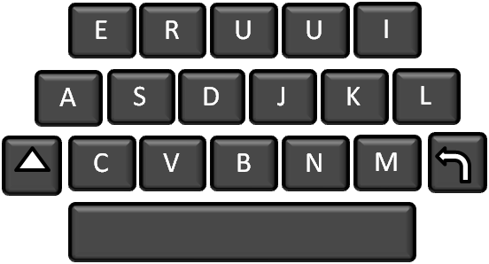
Social Media
“He has no business talking about this. He doesn’t understand.”
“He’s out of touch with what’s really happening.”
“With everything else I need to do, I don’t see how I could possibly apply this counsel to my very busy life.”
How do I feel about the prophet’s counsel? Do my feelings change depending on what counsel he gives?
What reasons might I give for following prophetic counsel? Are there any ways I struggle to follow prophetic counsel?

Slide 3
What Happened?
Have you ever tried to warn someone who did not heed your warning?
Has someone ever tried to warn you, but you did not heed the warning?
What Happened?

Slide 4
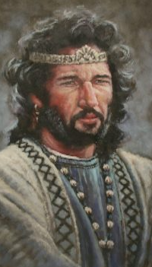
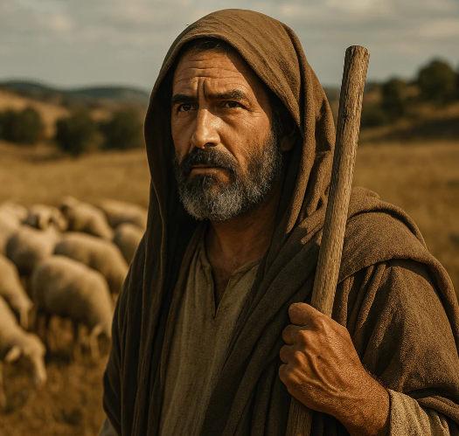
Preview:
The Lord Reveals His Plans Through His Prophets
By the time of Amos’s prophetic ministry to the northern kingdom of Israel, many of God’s covenant people had forsaken Him and His prophets and followed the wicked ways of neighboring nations.
The Lord chose Amos to call them to repentance.
Amos prophesied the destruction and captivity of King Jeroboam II and His people.
Amos 2:6-12; 7-9, 11,17

Slide 5
Amos
He was a shepherd from Tekoa, a small village in the hill country of Judah, six miles south of Bethlehem, but his ministry was in the Northern Kingdom of Israel
His name means “bearer” or “burden”
He prophesied during the reign of Uzziah, king of Judah and Jeroboam II, king of Israel
His ministry is estimated about 750 BC, so he may have preached about the same time as Isaiah and Hosea
Either Amos or scribes of Amos wrote the book of Amos
He warned the people of impending destruction and spiritual famine if they would not repent
He promised that the Lord would bring about a restoration of His work and gather the faithful together in the light and truth
(1,2)

Slide 6
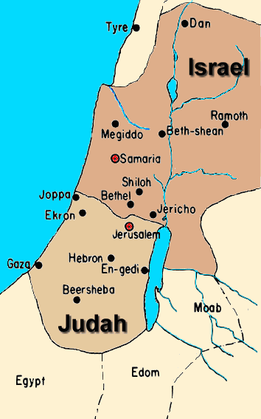
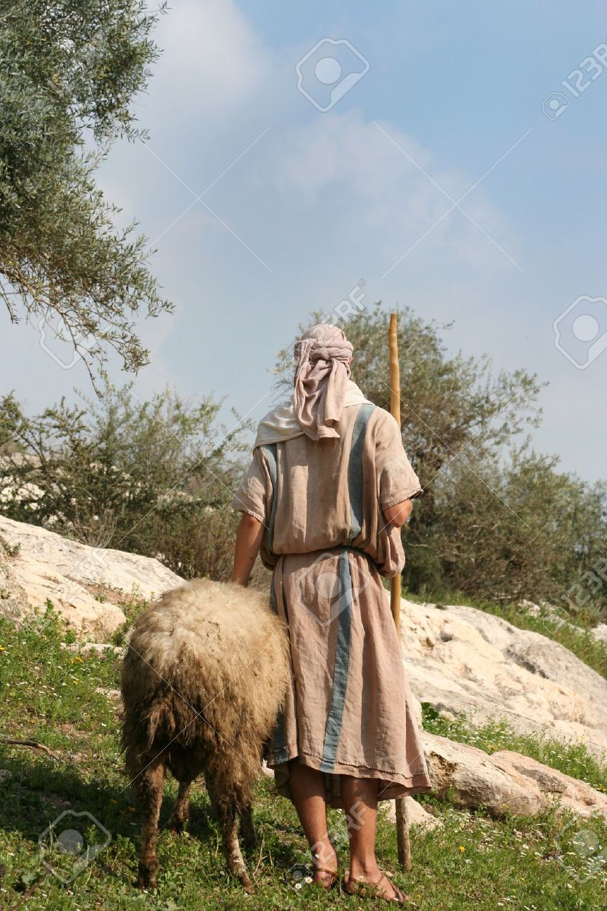
Called to Preach
Amos was called by the Lord to preach to the Northern Kingdom of Israel and warn the people of the consequences of their sins.
Tekon

Slide 7

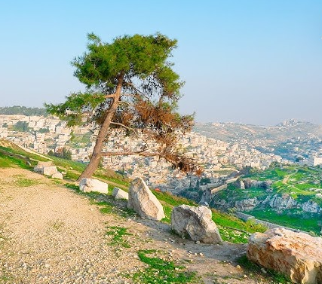
Roar From Zion
The mouth of a herdsman who was familiar with the roaring of lions, the bellowing of bulls, and the lowing of kine [cattle].
The roaring of the lion in the forest is one of the most terrific sounds in nature; when near, it strikes terror into the heart of both man and beast.” (3)
The term Zion sometimes refers to Jerusalem, where there is a hill by that name, but that is not always the case:
See Notes*
Amos 1:1-2

Slide 8
Judgments
Damascus = instruments of iron
Tyre or Tyrus = fire on the wall
Hazael was a court official and later a King of Syria = fire into the house of Hazael
Kir A wall or fortress, a place to which Tiglath-pileser carried the Syrians captive after he had taken the city of Damascus
Aven also in Syria, abbreviation of “Bethaven”
Carmel (an ancient Israelite town in Judea)= shall wither
Rabbah (Ammonite City) = battle and whirlwing
Gaza called also Azzah. (Ashtod) Stronghold on Mediterranean Sea. It was the southernmost of the five great Philistine cities = devour the palaces
Edom, Teman (Edomite Clan) = fire
Amos 1:3-15

Slide 9

For Three Transgressions…and For Four
The sins alluded to have been exceedingly abundant.
These six things doth the Lord hate: yea, seven are an abomination unto him:
Proverbs 6:16
Lord, how oft shall my brother sin against me, and I forgive him?
Jesus saith unto him, I say not unto thee, Until seven times: but, Until seventy times seven. Matthew 18:21-22
The number refers to an infinite number
Amos 1:3,6,11

Slide 10
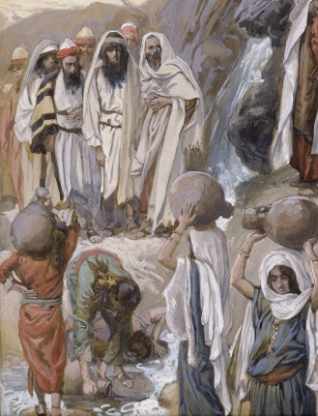
The Punishments
The reasons for the punishment of Judah and Israel differ from those for the punishment of the gentile nations.
No acts are mentioned except for the forsaking of the Lord and turning to wickedness. Israel had been given the law of God. Therefore, more was expected of them.
“after the dust of the earth upon the head of the poor” refers to the people being general oppressors of the poor, showing them neither justice nor mercy.
The idea is that the people longed to see the poor in such a state of misery that they threw dust on their heads (a sign of mourning).
Amos 2:4-6, 7
(1)

Slide 11
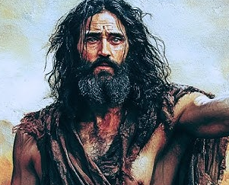
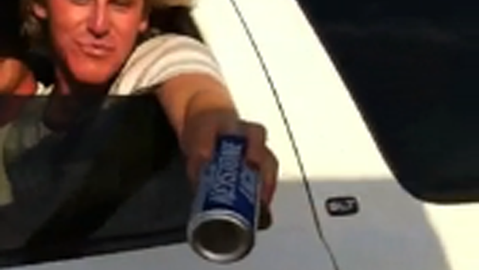
Polluting The Members
Nazarites, who were instituted by the Lord to show the spiritual nature of His religion.
Amos condemned Israel for polluting the Nazarites by giving them wine to drink.
There are some Church members today that encourage fellow members to break their covenants
Amos 2:11-12, Numbers 6:2-21
(1)

Slide 12
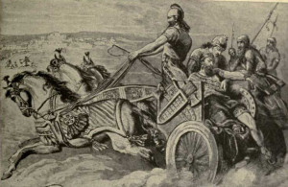
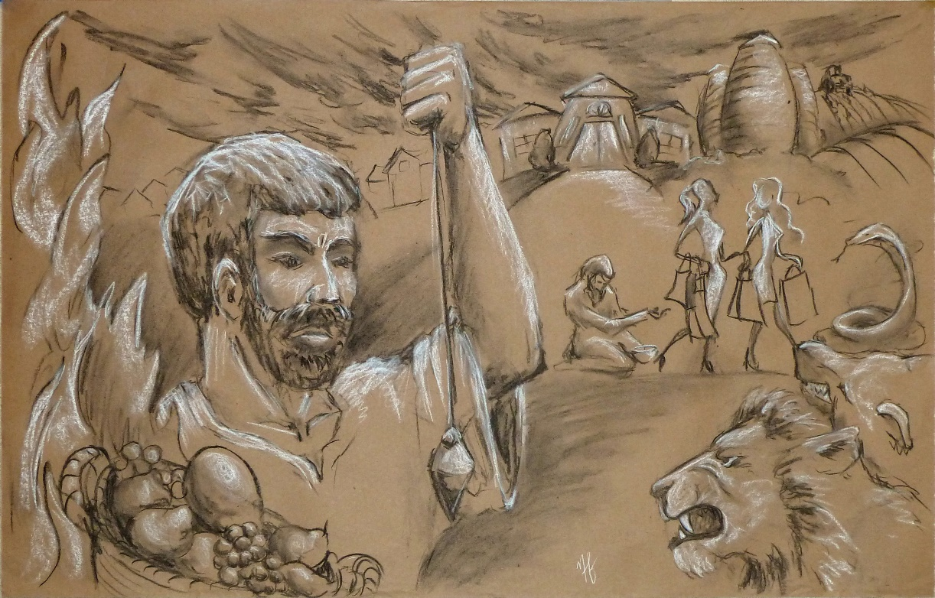
Prophecy Not
They (Israelites) told the prophets to stop warning them about the consequences of sin and the coming destructions of Israel and Judah.
Amos later personally experienced this rejection when Amaziah, a wicked priest of King Jeroboam, told Amos to return to Judah and stop prophesying to the people of Israel that they would be destroyed.
Amos 2:12
(1)

Slide 13
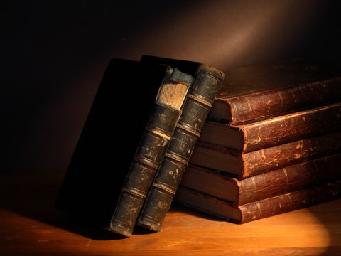
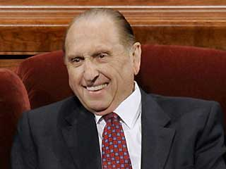
Prophecy—a Direct Revelation
God has knowledge of all His children and their doings and justly warns and threatens with His judgments.
The fact that the prophets prophesy correctly is an indication that they are in communion with God and that they do indeed walk together.
“There are many scriptures which assure us that God is as interested in us today as he has been in all his children from the beginning, and thus we believe in continuous revelation from God through his prophets to guide us in these latter days. The Prophet Amos said, ‘Surely the Lord God will do nothing, but he revealeth his secret unto his servants the prophets.’” (4)
Amos 3:7
(1)

Slide 14
Doctrinal Mastery
Amos 3:7
Surely the Lord God will do nothing, but he revealeth
his secret unto his servants the prophets.

Slide 15
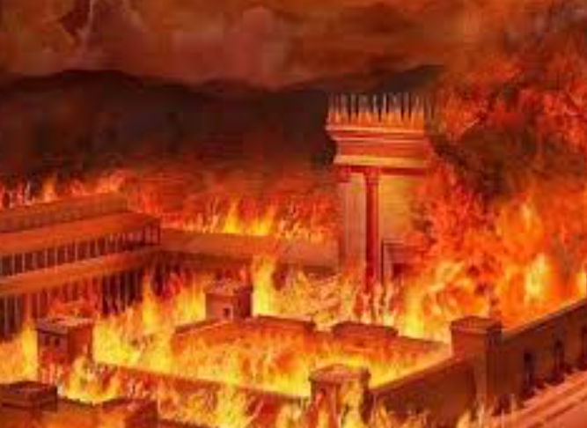
Secrets=Counsel and Plan
They will be punished for not keeping the commandments
The Lord reveals His plans through His prophets
He will send fire on Judah and devour the palaces of Jerusalem
He will punish them because they took bribes and they sold their poor into slavery
Before Judah and Israel were eventually destroyed because of the wickedness of the people, the Lord revealed what would happen if the people did not repent
Note: The Law of Moses (Torah) commanded protection for the poor and forbade taking bribes. By treating people as commodities, Israel violated the core ethical demands of their covenant with God
Amos 2:4-6

Slide 16
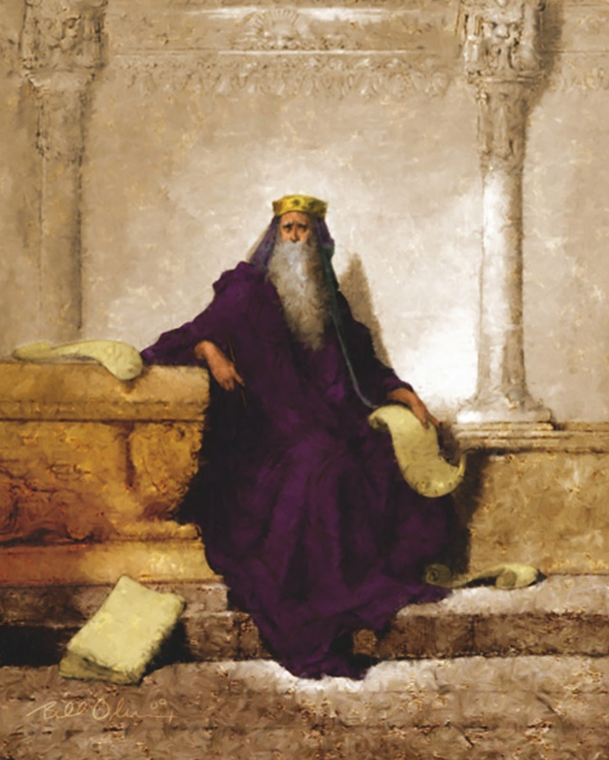
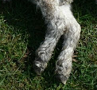
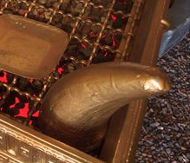
No Escape
It is like a shepherd who can recover no more of a sheep carried away by a lion than two of its legs or a piece of its ear, just enough to prove that they belonged to his sheep.
This prophecy saw fulfillment when Sargon took Samaria, part of the Northern Kingdom, captive about B.C. 721.
In the East the corner is the most honorable place, and a couch in the corner of a room is the place of greatest distinction.
These words were used to mean that even in the cities which were in the most honorable part of the land, whether Samaria in Israel, or Damascus in Syria, none would escape the judgments.
In that day the Lord would remove His power from among Israel, as symbolized by the cutting off of the horns of the altar. (5)
Amos 3:12-15
(1)

Slide 17
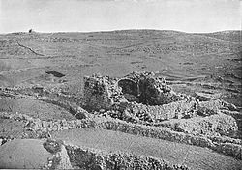
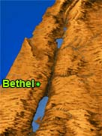
Bethel
The official religious capital of the Northern Kingdom.
The prophet was saying that not only the poor habitations of the villages and the country would be smitten but also those of the nobility, those who had summer and winter homes adorned with ivory vessels and carvings.
photographed by Daniel B. Shepp. 1894
Bethel was a border city described in the Hebrew Bible as being located between Benjamin and Ephraim and also a location named by Jacob. Wikipedia
Amos 3:14; Genesis 12-13
(1)

Slide 18
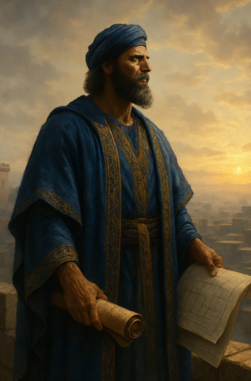
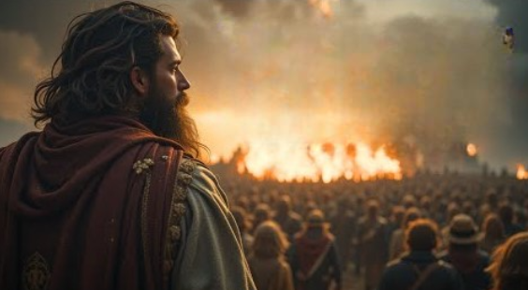
The Watchmen
Son of man, I have made thee a watchman unto the house of Israel: therefore hear the word at my mouth, and give them warning from me.
In the ancient Near East, watchmen were sentinels stationed on city walls or towers to scan the horizon for approaching enemies. If they saw danger and failed to blow the trumpet, the entire city could be destroyed, and the watchman was held responsible for the slaughter.
If the watchman delivers the warning and the person still refuses to repent, the sinner dies for their own sin, but the watchman has "delivered his soul" and is free from guilt
Ezekiel 3:16-17
(1)

Slide 19
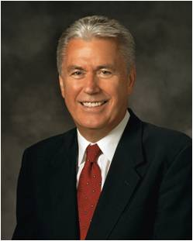
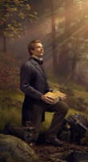
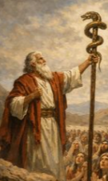
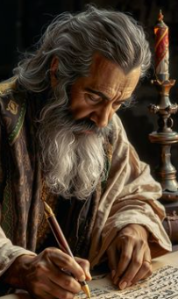
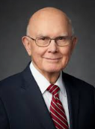
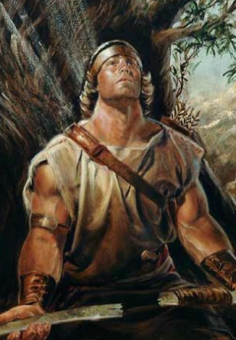
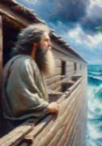
Voice of A Servant
What I the Lord have spoken, I have spoken, and I excuse not myself; and though the heavens and the earth pass away, my word shall not pass away, but shall all be fulfilled, whether by mine own voice or by the voice of my servants, it is the same.
The scriptures tell us that the first thing God did after creating man and woman was speak to them. He had vital information and precious instructions to give them. His purpose was not to burden or worry them but to guide them to happiness and eternal glory.
And that was just the beginning. From that day to this, God has continued to communicate with His children. His words have been preserved, treasured, and studied by disciples of every generation. They are revered by those who seek to know the will of God, and they bear witness to the truth that “the Lord God will do nothing, but he revealeth his secret unto his servants the prophets”.
This has been the pattern since the beginning of time, and the pattern continues today. It is not just a nice Bible story; it is God’s established way of communicating essential messages to His children. …
This is one of the most glorious, encouraging, and hopeful messages of the Restoration—God is not silent! He loves His children. He has not left us to wander in darkness. (9)
D&C 1:38
(1)

Slide 20
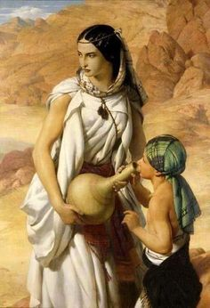
Israelite Women
The quality of life in any community is largely what its women make it
If women are cruel and covetous, their children will likely be the same.
Amos compared the women of Samaria with the cows (kine) which fed upon the rich pastures east of the Sea of Galilee, caring for little but eating and drinking.
Their sin consisted of urging their husbands to bring them food bought with money squeezed from the poor. Thus, in the same way that fish are caught with hooks and pulled from the pond, these women and their children would become ensnared by Israel’s enemies and violently torn from their affluence and debauchery. (6)
Amos 4
(1)

Slide 21
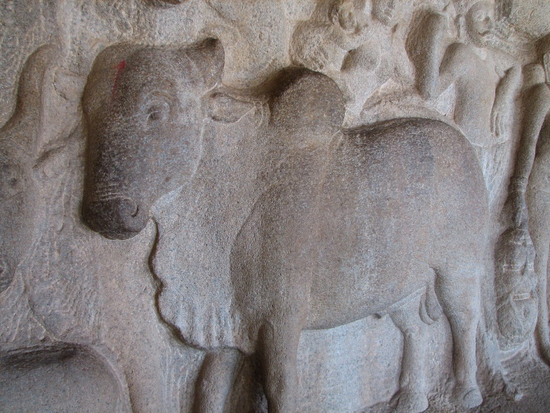
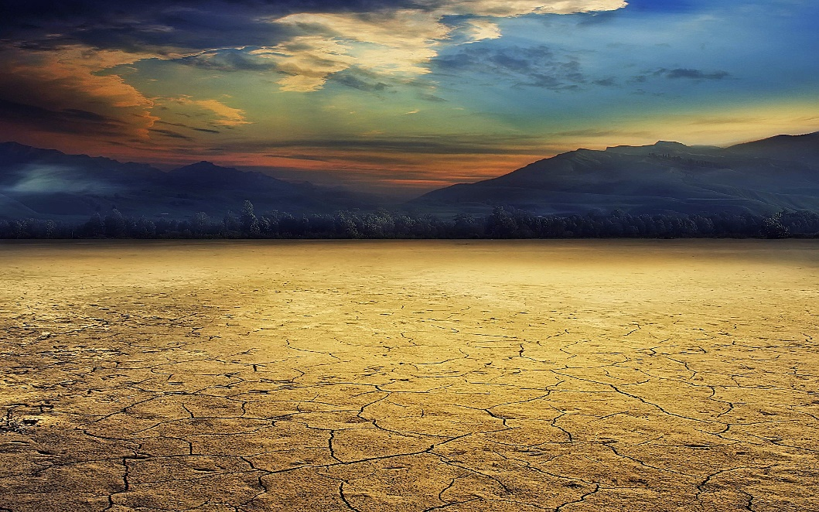
Outward Religion
Outward sacrifice without inward change is a mockery
Bethel and Gilgal = “Israel was meticulous in its performance of the outward requirements of its religion, but the inner and less tangible requirements of love, mercy, justice and humility either were not understood or were disregarded.
Cleanness of teeth = hunger
Withholden the rain = drought
Blasting and mildew = locust on the crops
Pestilence = insect pests, like those of the plagues of Egypt pestilence
Death by the sword = enemies attack and prevail over them
Amos 4:1-11
(3,7)

Slide 22
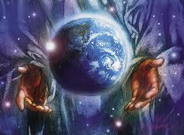
He That Formed the Earth
The Lord formed the earth, he created the wind; He knows the inmost thoughts of the heart, He is the Creator of darkness and light, he steps from mountain to mountain and has all things under his feet.
He has done all that He can.
Amos 4:13
(3,7)

Slide 23
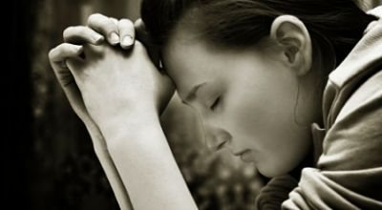
“Seek The Lord And Ye Shall Live”
In their sinful state, Amos could do nothing but warn the nation of Israel.
And he hath said that: Inasmuch as ye shall keep my commandments ye shall prosper in the land; but inasmuch as ye will not keep my commandments ye shall be cut off from my presence.
2 Nephi 1:20
Yea, and as often as my people repent will I forgive them their trespasses against me.
Mosiah 26:30
Amos 5
(3,7)

Slide 24

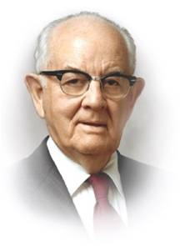
Continued Revelation
Continuous revelation is indeed the very lifeblood of the gospel of the living Lord and Savior, Jesus Christ.
We believe all that God has revealed, all that He does now reveal, and we believe that He will yet reveal many great and important things pertaining to the Kingdom of God. (AofF 9)
“We do not accept the theory of the so-called teachers of Christianity, that the Old Testament constituted the total words of God’s prophets; nor do we believe the New Testament to be the end of revelation. We testify that rather than an end of revelations of God, they continue to pour forth from God for the welfare and benefit of men…
For the prophecy came not in old time by the will of man: but holy men of God spake as they were moved by the Holy Ghost. 2 Peter 1:21
“How this confused world of today needs revelation from God. …How absurd it would be to think that the Lord would give to a small handful of people in Palestine and the Old World his precious direction through revelation and now, in our extremity, close the heavens.”
(8)

Slide 25
Sources:
Video: We Need Living Prophets (2:45)
God Reveals His Secrets (5:36)
Old Testament Institute Manual Amos: The Lord Reveals His Secrets to His Servants the Prophets Chapter 8
Who’s Who in the Old Testament by Ed J. Pinegar and Richard J. Allen pp. 16-17
Adam Clarke, The Holy Bible … with a Commentary and Critical Notes,4:672.)
Presentation by ©http://fashionsbylynda.com/blog/
President N. Eldon Tanner (In Conference Report, Apr. 1975, p. 52.)
(Old Testament Student Manual: Genesis–2 Samuel[religion 301, 2003], pp. 166–67 for an explanation of the horns as a symbol of power).
See Keil and Delitzsch, Commentary, 10:1:266–68.
Sidney B. Sperry The Voices of Israel’s Prophets p. 311
True to the Faith; A Gospel Reference [2004], 13
Elder Dieter F. Uchtdorf (“The Word of God to His Children,” Ensign or Liahona, Mar. 2018, 4)
10. President Spencer W. Kimball “Revelation: The Word of the Lord to His Prophets” April 1977 Gen. Conf.

Slide 26
* Reference to Zion in Amos 1:2
Joel 3:16-17 | Isaiah 2:2-3 | Isaiah 40:9 | Isaiah 64:10
The Lord also shall roar out of Zion, and utter his voice from Jerusalem; and the heavens and the earth shall shake: but the Lord will be the hope of his people, and the strength of the children of Israel. So shall ye know that I am the Lord your God dwelling in Zion, my holy mountain: then shall Jerusalem be holy, and there shall no strangers pass through her anymore. | And it shall come to pass in the last days, that the mountain of the Lord’s house shall be established in the top of the mountains, and shall be exalted above the hills; and all nations shall flow unto it. And many people shall go and say, Come ye, and let us go up to the mountain of the Lord, to the house of the God of Jacob; and he will teach us of his ways, and we will walk in his paths: for out of Zion shall go forth the law, and the word of the Lord from Jerusalem. Latter-day Reference | O Zion, that bringest good tidings, get thee up into the high mountain; O Jerusalem, that bringest good tidings, lift up thy voice with strength; lift it up, be not afraid; say unto the cities of Judah, Behold your God! | Thy holy cities are a wilderness, Zion is a wilderness, Jerusalem a desolation.
This Zion will be located on the American continent
Article of Faith 10
We believe in the literal gathering of Israel and in the restoration of the Ten Tribes; that Zion (the New Jerusalem) will be built upon the American continent; that Christ will reign personally upon the earth; and, that the earth will be renewed and receive its paradisiacal glory.

Slide 27
Amos 1-2 | Amos 3-4 | Amos 5-6 | Amos 7-9
Amos prophesies that the Lord would pour out judgments upon Syria, the Philistines, Tyre, Edom, the people of Ammon, and Moab because of their wickedness. Amos also preaches that Judah and Israel will be punished for embracing wickedness and rejecting the Lord. | Amos describes the various efforts of the Lord to save His people, including sending prophets to warn them, withholding rain, and allowing pestilence and war to trouble them. However, the people did not humble themselves and return to the Lord. | Amos teaches that if the people repent and sincerely seek the Lord, they can avoid destruction. In particular, he declares that the Lord does not accept the people’s offerings at the temple because the people’s hearts are focused on false gods. Amos prophesies that their casual approach to worshipping the Lord will lead them to destruction. | After prophesying of the doom and consequences Israel will face for rejecting the Lord, Amos delivers a message of hope promising that the Lord will gather His people together and restore them to their land.

Slide 28
Amos Chapter 1 and 2
Nation | Reason Mentioned | Scripture | Significance
Damascus (Syria) | They “threshed Gilead with threshing instruments of iron” | Amos 1:3 Deut. 3:10-13 2 Kings 10:32-33 2 Samuel 12:31 | Gilead was part of the land on the east side of the River Jordan inherited by the tribes of Gad, Reuben, and Manasseh. When the Syrians conquered it under Hazael, they evidently treated their captives with barbaric cruelty, crushing them under iron threshing sleds. (A similar incident is recorded in 2 Samuel
Gaza (Philistines) | They carried away “the whole captivity” to Edom | Amos 1:6 2 Chronicles 21:16-17 | This passage seems to refer to the time when the Philistines raided Judah under the reign of Joram. They sold all their captives to the archenemy of Israel, the Edomites.
Tyrus or Tyre (Phoenicia) | They delivered up the Israelite captives to Edom | Amos 1:9 | Like Gaza, Phoenicia also sold Israelite captives although it may be that Phoenicia bought the captives from other enemies of Israel such as Syria and then sold them to Edom, since there is no record of Tyre capturing Israelites directly.
Edom (Idumea) | Pursued his “brother” with the sword and kept his great wrath | Amos 1:11 Genesis 25:30 | The Edomites were the descendants of Esau, whose name was also Edo. Thus, they were closely related peoples (“brothers”) to Israel but showed only bitter hatred and hostility. The Edomites were some of Israel’s most determined enemies.
Ammon (Ammonites; Rabbah was the capital of Ammon) | They “ripped up the women with child of Gilead”. | Amos 1:13 | The incident mentioned here is not recorded in the Old Testament, but the Ammonites were a fierce desert people who often conquered parts of Israel. To kill pregnant women shows a particularly brutal nature.
Moab (Moabites) | The king of Moab burned the bones of the king of Edom. | Amos 2:1 2 Kings 3 | “The burning of the bones of the king of Edom is not burning while he was still alive, but the burning of the corpse into lime, i.e. so completely that the bones turned into powder like lime. … No record has been preserved of this event in the historical books of the Old Testament; but it was no doubt connected with the war referred to in 2 Kings 3., which Joram of Israel and Jehoshaphat of Judah waged against the Moabites in company with the king of Edom; so that the Jewish tradition found in Jerome, viz. that after this war the Moabites dug up the bones of the king of Edom from the grave, and heaped insults upon them by burning them to ashes, is apparently not without foundation.” (Keil and Delitzsch Commentary,10:1:250.)
Old Testament Institute Manual Chapter 8

Slide 29
Ashdod Amos 3:9-11:
“Ashdod, one of the Philistian capitals, is mentioned by way of example, as a chief city of the uncircumcised, who were regarded by Israel as godless heathen; and Egypt is mentioned along with it, as the nation whose unrighteousness and ungodliness had once been experienced by Israel to satiety [fulness]. If therefore such heathen as these are called to behold the unrighteous and dissolute conduct to be seen in the places, it must have been great indeed.” (Keil and Delitzsch, Commentary, 10:1:262–63.)
Bethel Amos 3:14:
Bethel is mentioned several times in Genesis. It is first mentioned in Genesis 12 and 13, as a place near where Abram stayed and built an altar on his way to Egypt and on his return. It is said to be close to Hai (Ai) and just to the west of it. More famously it is mentioned again in Genesis 28,[when Jacob, fleeing from the wrath of his brother Esau, falls asleep on a stone and dreams of a ladder stretching between Heaven and Earth and thronged with angels; God stands at the top of the ladder, and promises Jacob the land of Canaan; when Jacob awakes he anoints the stone (baetylus) with oil and names the place Bethel. Another account, from Genesis 35 repeats the covenant with God and the naming of the place (as El-Bethel), and makes this the site of Jacob's own change of name to Israel. Both versions state that the original name of the place was Luz, a Canaanite name. wikipedia
Famine, Amos 8:11-12:
“Many centuries passed and that day came when a blanket of disbelief covered this earth, not a blanket of cotton or wool, but a blanket of apostasy, and a hunger and a thirst by many which was not satisfied.
“It was the Lord our God who came to the earth and manifested himself and brought truth again to the earth with prophecy, revelations, authority, priesthood, organization and all of the benefits of mankind. It was the Lord our God who did all this for us.” President Spencer W. Kimball (In Conference Report, Temple View New Zealand Area Conference 1976, p. 4.)
Restoration:
“After centuries of spiritual darkness, … we solemnly announce to all the world that the spiritual famine is ended, the spiritual drought is spent, the word of the Lord in its purity and totalness is available to all men. One needs not wander from sea to sea nor from the north to the east, seeking the true gospel as Amos predicted, for the everlasting truth is available.” Spencer W. Kimball (In Conference Report, Apr. 1964, pp. 93–94.)

Slide 30
Amos Chapter 7 -9
Scripture | Phrase | Meaning
Amos 7:1-3 | A swarm of locusts | The king, who has had the early grass mown, is Jehovah; and the mowing of the grass denotes the judgments which Jehovah has already executed upon Israel. The growing of the second crop is a figurative representation of the prosperity which flourished again after those judgments; in actual fact, therefore, it denotes the time when the dawn had risen again for Israel (ch. iv. 13).” (Keil and Delitzsch, Commentary, 10:1:306–7.)
Amos 7:4-6 | Devouring fire | The fire that devoured the great deep (presumably the ocean) is symbolic of the partially destructive wars that Israel was later involved in. Like the fire which “did eat up a part” of the great deep, Israel’s land was partly despoiled and many of its people led away.
Amos 7:7-9 | The master builder with the plumbline | A plumbline is used to obtain exactness and accuracy in construction work. Here it seems to symbolize that God’s strict justice will prevail in judging Israel for her evil ways. All wickedness will be sought out, measured (judged), and destroyed.
Amos 8:1-9) | The basket of summer fruit | The harvest of summer fruit symbolized the ripening of Israel. Just as summer fruit must be eaten when picked or it will spoil, Israel was ripe for picking and spoiling by enemies.
Amos 8:9-14 | The sun going down at noon | A man’s sun can be said to set at noon if he is taken by death during the prime of his life. A nation’s sun figuratively sets at noon when the country is destroyed in the midst of prosperity. But Amos’ dual prophecy is also a reminder that before the Second Coming of the Lord, the sun will be darkened and refuse to give her light. Indeed, it will be a sign for the wicked of the latter days that their sun is about to set at noon. (See Keil and Delitzsch, Commentary, 10:1:317.)
Amos 9:1-6 | The smitten sanctuary | From His dwelling place, the Lord will smite the wicked. There is none to escape, hide where they may. Only the Second Coming of the Lord fulfills such a description, for when the Lord comes in His glory, the rewards of justice will be met. No mountain is high enough, no sea so deep that the unrepentant sinner can hide from the judgments of a just God.
Old Testament Institute Manual Chapter 8

