Slide 1

Overcoming Spiritual Hunger
Amos 8-9

Slide 2
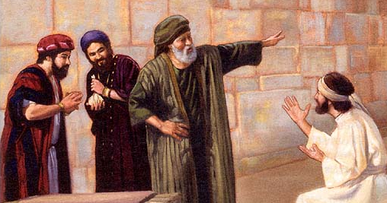
Previously…
Amos prophesied that his people would no longer be given His word because they had rejected it.
Losing the Lord’s word would lead to a spiritual famine.
The prophet Amos prophesied of spiritual hunger. He revealed the Lord’s words to the people of Israel, but they did not want to hear them.
Amos 2:12; 7:11–16

Slide 3

The Famine
Without revelation through a prophet, they would experience a spiritual famine
Amos predicted a famine of the word of the Lord, which famine certainly occurred during the period of apostasy in Israel and Judah. The hardness of their hearts reached such a state that from 400 B.C. until the ministry of John the Baptist, which began in A.D. 30, as far as we know there were no prophets in Israel.
But Amos’s prophecy was also fulfilled at a later time. After Christ reestablished His Church on earth, it too eventually fell into apostasy.
Again, revelation ceased, and there was a great famine of the word of God, this famine lasting for well over a thousand years. (1)
When people reject the Lord’s prophets, they lose the blessings of the word of the Lord. Without the word of God, we starve spiritually.
Amos 8:11-12

Slide 4
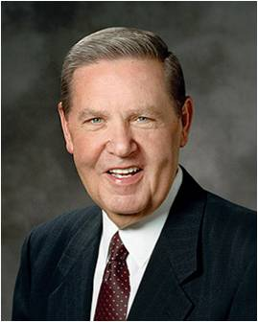
I pray this morning that all who are hungering and thirsting, and sometimes wandering, will hear this invitation from Him who is the Bread of Life, the Fountain of Living Water, the Good Shepherd of us all, the Son of God:
“Come unto me, all ye that labour and are heavy laden, … and ye shall find rest unto your souls” [Matthew 11:28–29].
Truly He does fill “the hungry with good things” [Luke 1:53], as His own mother Mary testified. (2)

Slide 5
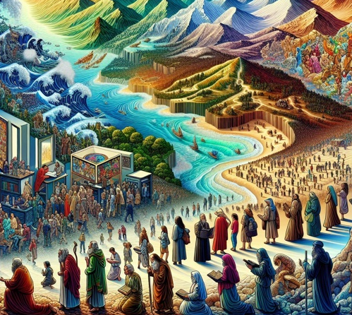
Wander
The phrase "from sea to sea, and from the north even to the east" symbolizes an exhaustive search across the entire land—covering every direction except the south, where the true worship of God was still located but which the northern tribes refused to seek.
Amos warns the people that the opportunity to hear and obey God's word is time-sensitive; if it is persistently ignored, the word may eventually be withheld
Many scholars link this to the 400-year period of prophetic silence between the Old and New Testaments (from Malachi to John the Baptist).
Amos 8:11-12

Slide 6
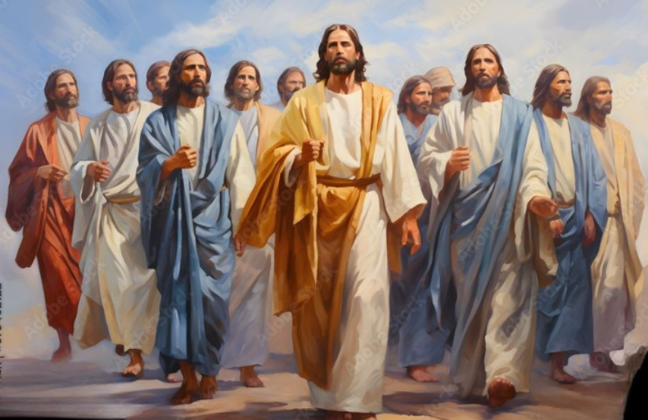

Apostasy
When individuals or groups of people reject the principles of the gospel and the Lord no longer sends prophets to them.
One fulfillment of Amos’s prophecy occurred after the Savior established His church and after the deaths of the Savior and His Apostles, men corrupted the principles of the gospel and made unauthorized changes in Church organization and priesthood ordinances. …
The Great Apostasy lasted until Heavenly Father and His Beloved Son appeared to Joseph Smith in 1820 and initiated the restoration of the fullness of the gospel.”
Restoration
Amos 8:11-12

Slide 7
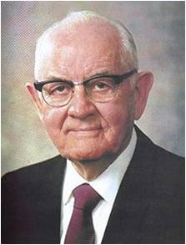
After centuries of spiritual darkness, … we solemnly announce to all the world that the spiritual famine is ended, the spiritual drought is spent, the word of the Lord in its purity and totalness is available to all men.
One needs not wander from sea to sea nor from the north to the east, seeking the true gospel as Amos predicted, for the everlasting truth is available.” (3)

Slide 8
Individual Apostasy
Group Apostasy
General Apostasy

Slide 9
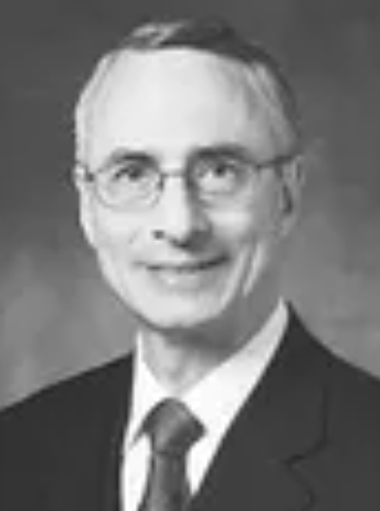
Individual Apostasy
Apostasy frequently results when a person commits serious sin but does not repent. To silence his conscience or justify his sinful actions, the individual moves away from the truth, looking for imperfections in others or questioning Church doctrine with which he no longer agrees.
Conflicts between Church members can also lead to apostasy. Some individuals begin to think the Church is not true when they feel that a leader did not treat them well. They become offended and, without considering what they are losing, they stray from the Church.
Faultfinding can be another source of personal apostasy. When we look for faults in others or begin to think we could make better decisions than our leaders, we should remember the experience of Oliver Cowdery, the second elder of the Church.
We can avoid the mists of darkness that lead to personal apostasy by repenting of our sins, overcoming offense, eliminating faultfinding, and following our Church leaders.
We can also avoid those mists by humbling ourselves, forgiving others, keeping our covenants, partaking of the sacrament worthily each week, and strengthening our testimonies through prayer, daily scripture study, temple attendance where possible, magnifying our Church callings, and serving our fellowmen. (4)

Slide 10
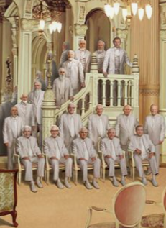
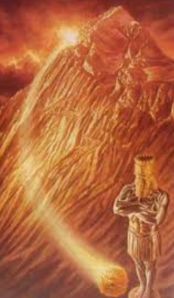


Gather in the Future
In the Lord’s lovingkindness, He made clear to His people through His prophets that He would save His people from the effects of apostasy and bless His people. The Lord prophesied through Amos that He will gather His people again in a future day and He will bless them in many ways
Daniel 2:44-45
Acts 3:19-21
Ephesians 1:3, 10
D&C 27:13; 112:30; 128:18
Amos 9:14-15

Slide 11
Sources:
Video:
“Daily Bread: Pattern” (252)
“The Great Apostasy” (16:36)
“Dispensations: The Pattern of Apostasy and Restoration”
Old Testament Teacher Manual 2018
President Jeffrey R. Holland (“He Hath Filled the Hungry with Good Things,” Ensign, Nov. 1997, 66)
President Spencer W. Kimball (in Conference Report, Apr. 1964, 93–94; see also Old Testament Student Manual, 3rd ed. [2003], 94)
4. Elder Claudio D. Zivic “Avoiding Personal Apostasy” June 2009

Slide 12
Amos Chapter 7 -9
Scripture | Phrase | Meaning
Amos 7:1-3 | A swarm of locusts | The king, who has had the early grass mown, is Jehovah; and the mowing of the grass denotes the judgments which Jehovah has already executed upon Israel. The growing of the second crop is a figurative representation of the prosperity which flourished again after those judgments; in actual fact, therefore, it denotes the time when the dawn had risen again for Israel (ch. iv. 13).” (Keil and Delitzsch, Commentary, 10:1:306–7.)
Amos 7:4-6 | Devouring fire | The fire that devoured the great deep (presumably the ocean) is symbolic of the partially destructive wars that Israel was later involved in. Like the fire which “did eat up a part” of the great deep, Israel’s land was partly despoiled and many of its people led away.
Amos 7:7-9 | The master builder with the plumbline | A plumbline is used to obtain exactness and accuracy in construction work. Here it seems to symbolize that God’s strict justice will prevail in judging Israel for her evil ways. All wickedness will be sought out, measured (judged), and destroyed.
Amos 8:1-9) | The basket of summer fruit | The harvest of summer fruit symbolized the ripening of Israel. Just as summer fruit must be eaten when picked or it will spoil, Israel was ripe for picking and spoiling by enemies.
Amos 8:9-14 | The sun going down at noon | A man’s sun can be said to set at noon if he is taken by death during the prime of his life. A nation’s sun figuratively sets at noon when the country is destroyed in the midst of prosperity. But Amos’ dual prophecy is also a reminder that before the Second Coming of the Lord, the sun will be darkened and refuse to give her light. Indeed, it will be a sign for the wicked of the latter days that their sun is about to set at noon. (See Keil and Delitzsch, Commentary, 10:1:317.)
Amos 9:1-6 | The smitten sanctuary | From His dwelling place, the Lord will smite the wicked. There is none to escape, hide where they may. Only the Second Coming of the Lord fulfills such a description, for when the Lord comes in His glory, the rewards of justice will be met. No mountain is high enough, no sea so deep that the unrepentant sinner can hide from the judgments of a just God.
Old Testament Institute Manual Chapter 8

