Slide 1

Prophecy of Edom
Obadiah
And also the Lord shall have power over his saints, and shall reign in their midst, and shall come down in judgment upon Idumea, or the world.
D&C 1:36
Presentation by ©http://fashionsbylynda.com/blog/

Slide 2



Scenarios
A young man is very intelligent and talented and feels that he can succeed in life without the Lord’s help.
A young woman feels resentful when a classmate receives an award and recognition that she hoped to get.
A young woman continues to associate with a group of friends who appear to like her, despite her parents’ concern that these friends do not have her best interests in mind.
(2)

Slide 3
Obadiah
His name means “Servant of the Lord”
He was a prophet of the Lord who prophesied the downfall of Edom, a worldly kingdom of degeneracy and godless values and a prophet in the Southern Kingdom
The time of his writing is not known with certainty, but the book was written in the contest of the capture of Jerusalem, around 586 B.C.
The book is only 1 chapter and is concerned with brotherly love and the shame of the Edomites concerning their attack on Jerusalem
He prophesied that Mount Zion is to prevail in the triumph of the Lord’s plan for redemption of the righteous and the victory of truth and right associated with the Second Coming
There are 13 other Obadiah’s in the Old Testament referred in 1 Kings, 1–2 Chronicles, Ezra, and Nehemiah, these are references to other persons
The book of Obadiah is the shortest book in the Old Testament
(1)

Slide 4
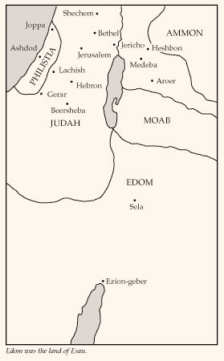
Edom/Idumea
Edom is another name for Esau, Jacob’s brother.
Those who settled in Edom were close kin to the residents of Judah.
Because of their wickedness and lasting hatred for Israel, Edom, like Babylon, became a symbol of the world
(2)

Slide 5
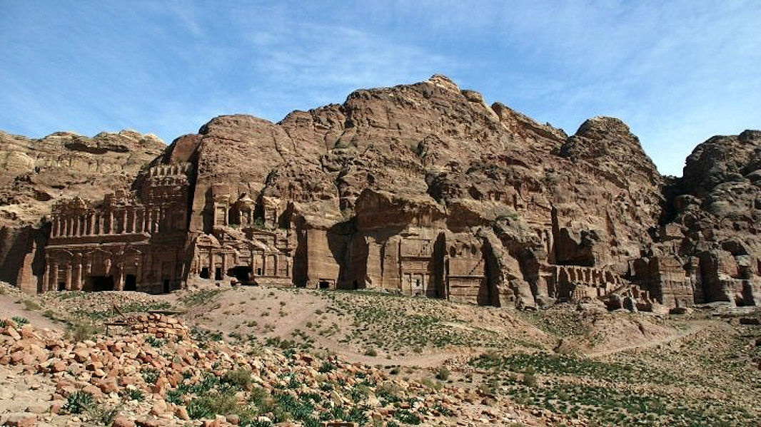
A City Carved Out of Rock
A whole city was carved out of rock cliffs. It could be entered only through a narrow gorge.
From the high cliffs, the Edomites could protect themselves from invading enemies with great success.
Petra, or Mount Seir, was in the land of Edom, and many scholars think it was the capital of Idumea. Though many of the ruins now visible at Petra date from a later period, they still give dramatic impact to Obadiah’s words.
Obadiah 1:3
(2)

Slide 6




Exalt Thyself As An Eagle
How can elevating ourselves above others cause us to be deceived?
What can we do to avoid being deceived into putting ourselves above others?
Obadiah 1:3-4

Slide 7
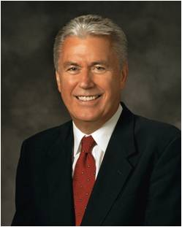
Yielding to pride can cause us to be deceived
“Pride is the great sin of self-elevation. …
“… It leads some to revel in their own perceived self-worth, accomplishments, talents, wealth, or position. They count these blessings as evidence of being ‘chosen,’ ‘superior,’ or ‘more righteous’ than others. …
“For others, pride turns to envy: they look bitterly at those who have better positions, more talents, or greater possessions than they do.
They seek to hurt, diminish, and tear down others in a misguided and unworthy attempt at self-elevation. When those they envy stumble or suffer, they secretly cheer.”
Obadiah 1:3-4
(4)

Slide 8
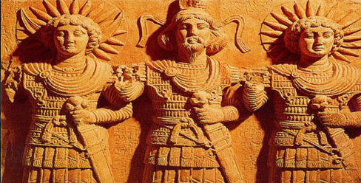
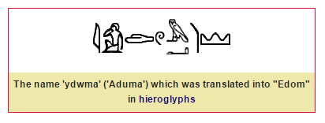
Prophecy For Edom
A Day of Distress
Edom would be destroyed, cut off, and slaughtered
Violence against thy brother Jacob = Edom was allies with Babylon and participated and assisted King Nebuchadnezzar in capturing Jerusalem
Obadiah 1:5-14
(2)

Slide 9
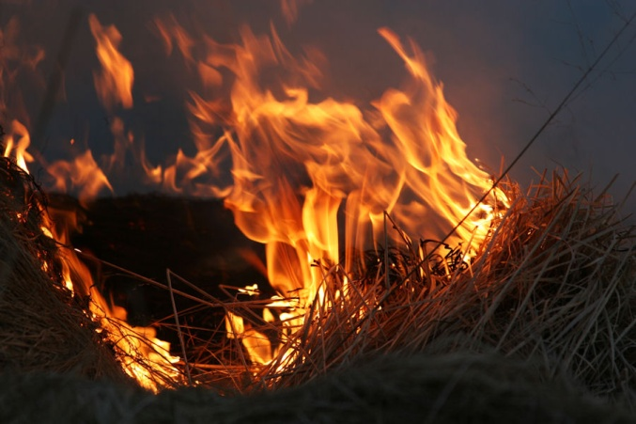
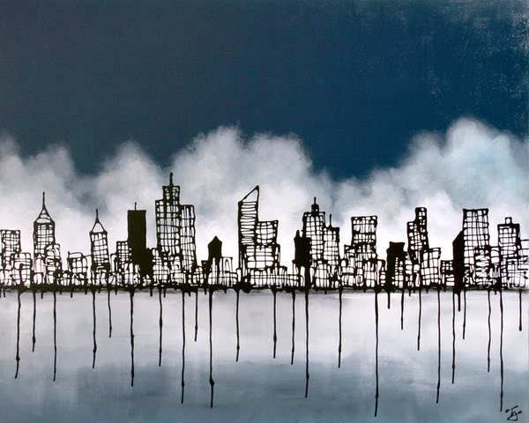
A Day of Deliverance
If Esau (Edom) represents the worldly wicked, these verses may be seen as referring to that day when Israel will be completely restored and evil eliminated.
Mount Zion, a symbol for deliverance and holiness, will be the inheritance of the “house of Jacob,” whereas the “house of Esau” will be stubble, fit only to be burned.
The “house of Jacob shall be a fire, and the house of Joseph a flame … and they shall kindle in them [Esau], and devour them; and there shall not be any remaining of the house of Esau”.
Eventually, “saviors shall come up on mount Zion to judge the mount of Esau; and the kingdom shall be the Lord’s
Obadiah 1:16-21
(2)

Slide 10
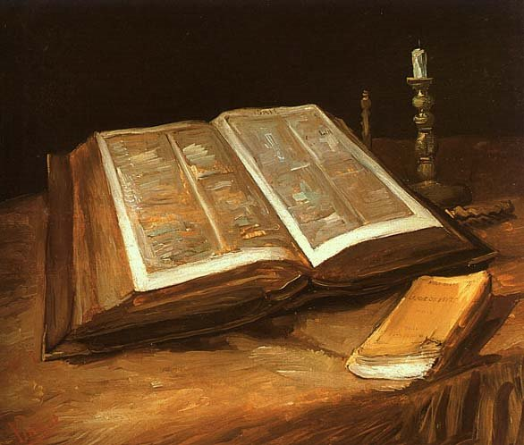
Saviors On Mount Zion
“As revealed by the scriptures, one of the characteristics of these last days is the appearance of saviors on the earth. This was prophesied in Old Testament times:
“It was prophesied by Paul in New Testament times, referring to people who had lived on the earth in times of old:
And these all, having obtained a good report through faith, received not the promise:
God having provided some better thing for us, that they without us should not be made perfect.
Hebrews 11:39-40
And saviours shall come up on mount Zion to judge the mount of Esau; and the kingdom shall be the Lord’s.
“It has also been prophesied of us who live today:
Therefore, blessed are ye if ye continue in my goodness, a light unto the Gentiles, and through this priesthood, a savior unto my people Israel. The Lord hath said it. Amen.
D&C 86:11
Obadiah 1:21
(3)

Slide 11
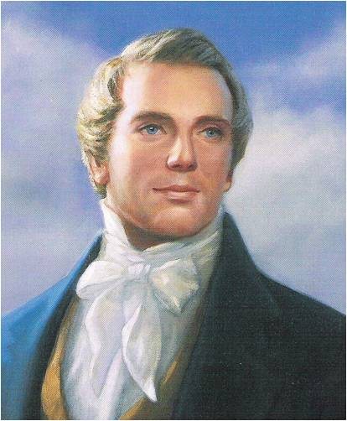
“As “But how are they to become saviors on Mount Zion?
By building their temples, erecting their baptismal fonts, and going forth and receiving all the ordinances, baptisms, confirmations, washings, anointings, ordinations and sealing powers upon their heads, in behalf of all their progenitors who are dead, and redeem them that they may come forth in the first resurrection and be exalted to thrones of glory with them.” (5)
Obadiah 1:21

Slide 12
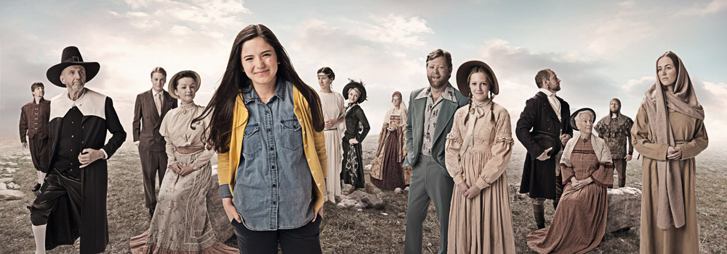

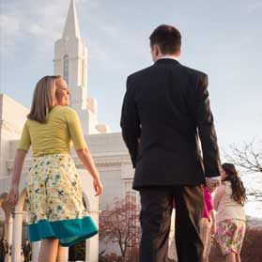

Can We Be Saviors?
The word saviour can refer to one who saves, rescues, or delivers.
Jesus Christ is the Savior because He saved and delivered us from sin and death, which we could not do for ourselves.
We become saviors on Mount Zion as we identify our deceased family members and perform ordinances for them in the temple.
(3)

Slide 13
Sources:
Video:
One Son or Daughter at a Time(3:17)
Who’s Who in the Old Testament by Ed J. Pinegar and Richard J. Allen p. 147
Old Testament Institute Manual Prophecies of a Latter-day Gathering Chapter 25
R. Dummelow A Commentary on the Holy Bible, p. 574).
Presentation by ©http://fashionsbylynda.com/blog/
4. President Dieter F. Uchtdorf Pride and the Priesthood, Ensign or Liahona, Nov. 2010, 56.
5. Joseph Smith Teachings of Presidents of the Church: Joseph Smith [2007], 473.

Slide 14
Obadiah 1:1–9 | Obadiah 1:10-16 | Obadiah 1:17-21
Obadiah speaks against Edom’s pride and prophesies of its downfall and destruction. | Edom will be cut off and destroyed because of its cruelty toward Judah. | Obadiah prophesies of Israel’s future restoration.
Edom:
“The history of the relations between Israel and Edom is from the beginning fraught with envy and hate. In Gen. 36:1 we have the following statement: ‘Now these are the generations of Esau—the same is Edom.’ This recalls to us the struggle for supremacy from birth, or even before, of Esau and his younger brother Jacob (Israel). … Esau sold his birthright to his brother for a mess of pottage and finally the holy patriarchal inheritance also. Esau, it will be recalled, married among the Canaanites, which fact was a great trial to his parents.”
Sidney B. Sperry (The Voice of Israel’s Prophets, pp. 318–19.)
Savior: Obadiah 1:21
“Just as our Redeemer gave His life as a vicarious sacrifice for all men, and in so doing became our Savior, even so we, in a small measure, when we engage in proxy work in the temple, become as saviors to those on the other side who have no means of advancing unless something is done in their behalf by those on earth” President Gordon B. Hinckley (“Closing Remarks,” Ensign or Liahona, Nov. 2004, 105).
Temple Work:
“Temple work enables us to do for others what they cannot do for themselves. It is a labor of love that permits our forefathers to continue their progress toward eternal life” (“Seeking the Good,” Elder Joseph B. Wirthlin Ensign, May 1992, 88).
Obadiah’s prophecy concerning Mount Zion Obadiah 1:17 Multiple Meanings:
The word deliverance in Obadiah 1:17 implies escape from danger and destruction. One fulfillment of this prophecy occurred when a remnant of Israel returned from captivity, rebuilt Jerusalem and the temple, and covenanted once more to serve and obey God (see Ezra 1–6; Nehemiah 10). Anciently the restoration of Israel served as a type and shadow of the great latter-day gathering of Israel and the deliverance that would come to God’s children through the restoration of the gospel, which included the ordinances and covenants of the temple.
Geographically, Mount Zion refers to the hill or mount upon which King Solomon built the temple in Jerusalem. However, the term can also refer more generally to the city of Jerusalem or to the entire land of Israel. Modern revelation also applies the term to the New Jerusalem, which will be built in America in the latter-days (see D&C 84:2; Articles of Faith 1:10), and also to the celestial kingdom of God (see D&C 76:66).

