Slide 1

Hiding From the Lord
Jonah
For as Jonas was three days and three nights in the whale’s belly; so shall the Son of man be three days and three nights in the heart of the earth.
The men of Nineveh shall rise in judgment with this generation, and shall condemn it: because they repented at the preaching of Jonas; and, behold, a greater than Jonas is here.
Matthew 12:40-41
Presentation by ©http://fashionsbylynda.com/blog/

Slide 2

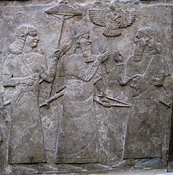
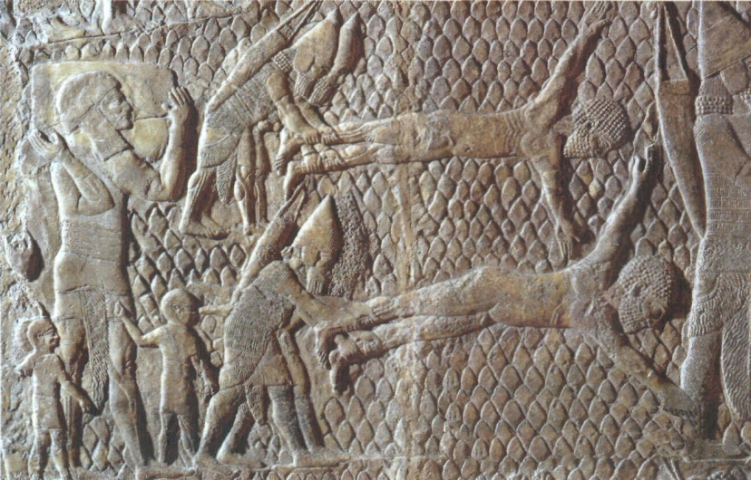
King Assurnasirpal II
The Assyrian power emerged in the 9th century B.
He reigned around 884 to 860 B.C.
He launch armies toward the 4 points of the compass and by using the most depraved forms of barbaric terror he succeeded in crushing resistance on all fronts.
He boasted of his tortures and torment of prisoners, which included blinding children before the eyes of their parents, flaying (skinning) men alive, roasting them in kilns, chaining them in cages where others could torture them.
“All the chiefs who had revolted I flayed, with their skins I covered the pillar, some in the midst I walled up [burned alive], others on stakes I impaled, still others I arranged around the pillar on stakes….As for the chieftains and royal officers who had rebelled, I cut off their members.” (3)
Assurnasirpal's military exploits may have increased Assyria's territories, but, just as importantly, they also added a great deal of wealth to the royal coffers, through both booty and tribute. (4)
(2)

Slide 3
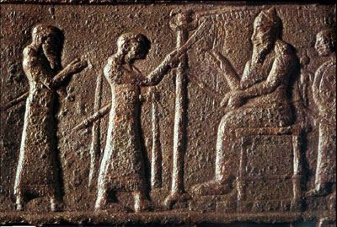
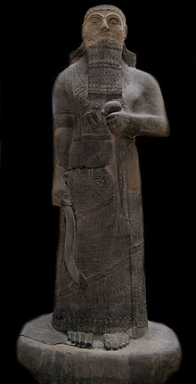
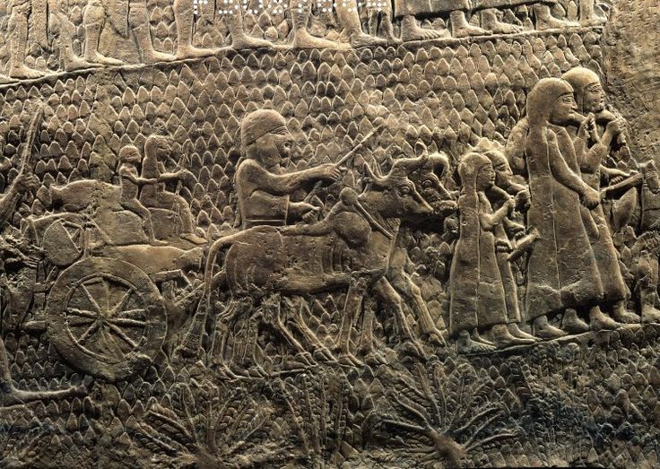
King Shalmaneser III
Son of Assurnasirpal
Reigned from 860 to 824 B.C.
Shalmanseser III still practiced the brutal tortures incorporated by his father.
King Ahab of Israel had joined with the king of Syria and many other neighboring states to stop Shalmanser at Qarqar (Karkar) on the Orontes river in 853 B.C.
On Shalmaneser II statues be boasts that he obtained heavy tribute not only from Ahab of Israel but in later years from Jehu (5)
(2)

Slide 4
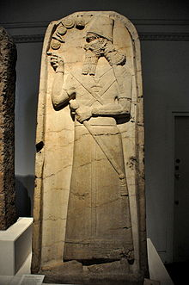
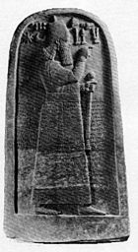
King Shamshi-Adad V
Son of Shalmanseser III
Reigned from 823 to 810 B.C.
He was named after the god Adad, who is also known as Hadad
A revolt was led by Shamshi-Adad's brother Assur-danin-pal, and had broken out already by 826 BC. The rebellious brother, according to Shamshi-Adad's own inscriptions, succeeded in bringing to his side 27 important cities, including Nineveh.
The rebellion lasted until 820 BC, weakening the Assyrian empire and its ruler; this weakness continued to reverberate in the kingdom until the reforms of Tiglath-Pileser III.
Shamshi-Adad B was succeeded by his son, Adad-nirari IV who held all of the eastern Mediterranean states in subjection from 810 to 781 B.C.
Over 100 years nations had been bullied and brutalized and this was the situation in which Jonah had to face by being called to Nineveh.
(2,6)

Slide 5
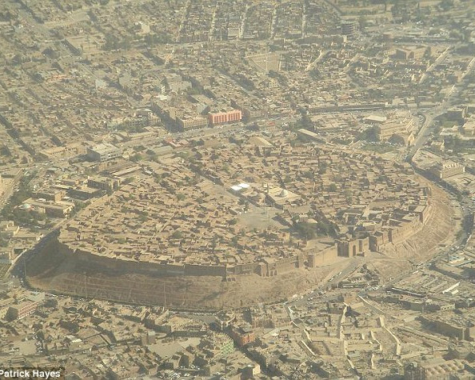
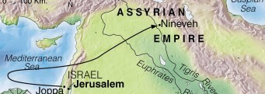
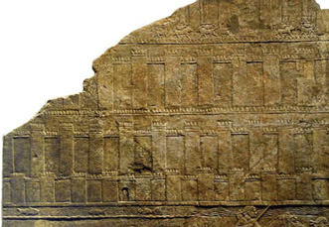
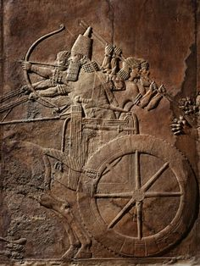
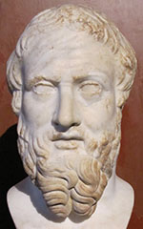
Nineveh, Assyrian Capitol
The city had been built on the upper Tigris shortly after the epic of the famous King Nimrod
The city was the size of a “three-day journey” Jonah 3:3=
It required three days of walking to cross them.
The population estimated from 300,000 to more than a million
Ancient writers describe the city as a fortress capital with walls 100 feet high and wide enough at the top to permit three chariots to be driven abreast around its battlements
The proud inhabitants of Nineveh would eventually broken into rubble in 3 centuries… in 500 B.C. Herodotus, a Greek historian round nothing remaining but mounds of ruins

Slide 6
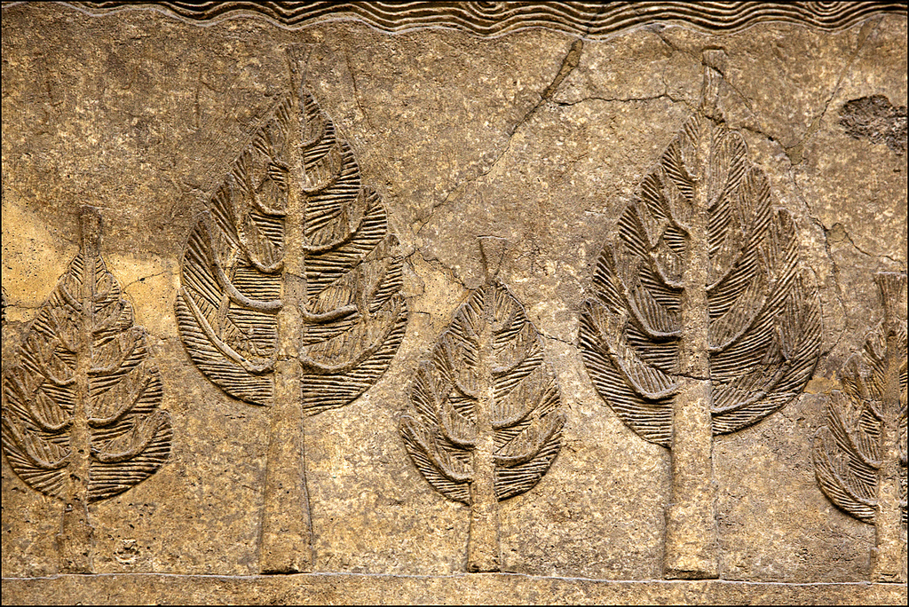
Jonah
He was the son of Amittai and came from a town called Gather-hepher, in the territory of the tribe of Zebulun, which is believed to be located in the lower portion of Galilee
He lived during the reign of Jeroboam II, King of Israel approximately 790 to 749 B.C. and during the same time as Hosea and Amos and shortly after the Prophet Elisha’s death
He prophesied that Israel would one day be dominated by the northern country, and fulfilled during the reign of Jeroboam II who was king from 782 to 753 B.C.
He was called on a mission to Nineveh, the Assyrian Capital but failed to obey and ran away to Joppa and boarded a ship
During a storm he was called to pray for the sailors. They drew lots as to who would had caused the storm. The lot fell on Jonah and he resumed responsibility.
Jonah took responsibility and after the sailors were rowing to the shore they threw Jonah overboard, then Jonah was swallowed by a great fish
After a miraculous save and spit out of the great fish, he then resumed the mission the Lord had intended him to do
(1,2,7)

Slide 7
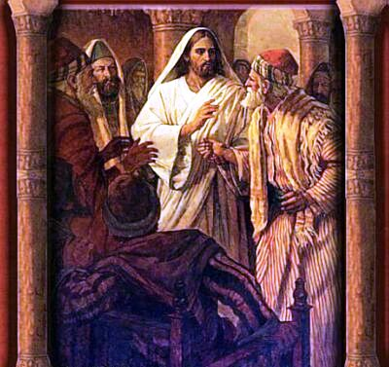
Is Jonah a True Story?
Although this book is clearly about the prophet Jonah, it was written by a later, unknown author
For as Jonas was three days and three nights in the whale’s belly; so shall the Son of man be three days and three nights in the heart of the earth.
The men of Nineveh shall rise in judgment with this generation, and shall condemn it: because they repented at the preaching of Jonas; and, behold, a greater than Jonas is here.
(Matthew 12:40-41, See also Matthew 16:4)
For as Jonas was a sign unto the Ninevites, so shall also the Son of man be to this generation. Luke 11:30
The account contains details that appear to be exaggerations, which has raised questions for some readers about how much of the book is historical. Nevertheless, its literary elements make it a “beautiful poem” containing valuable lessons . (8)
(2,6)

Slide 8
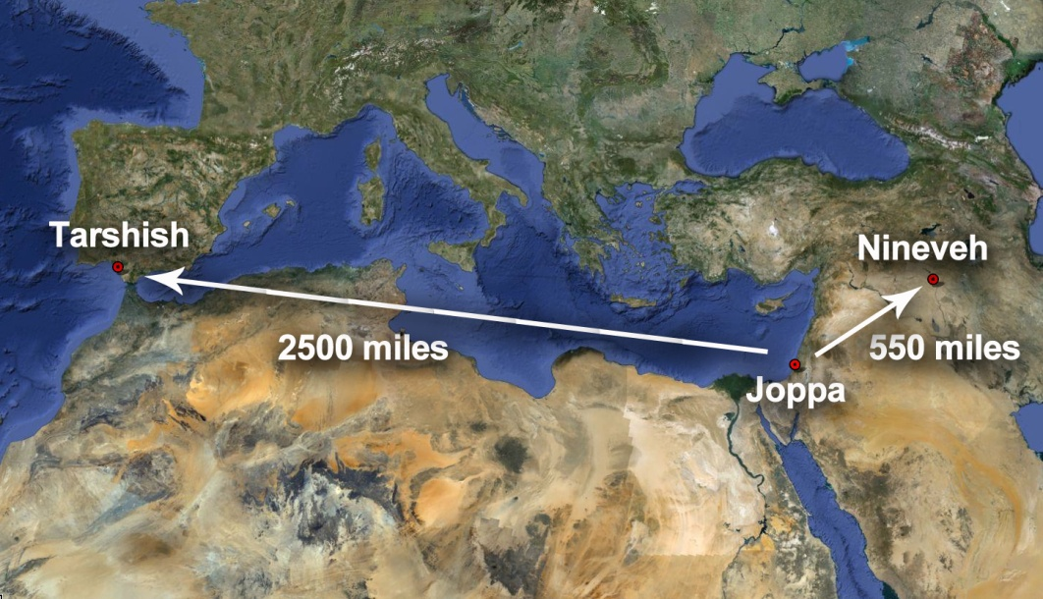
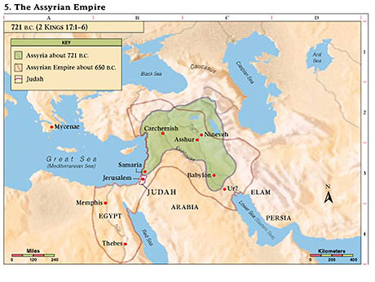
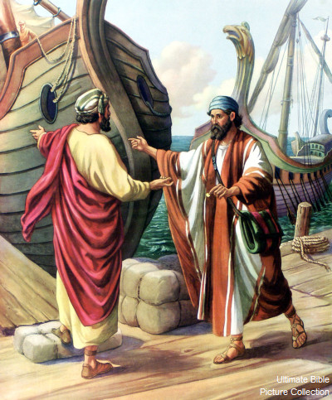
Jonah Flees (Fear of Assyrian Nation)
“The mission of Jonah was a fact of symbolical and typical importance, which was intended not only to enlighten Israel as to the position of the Gentile world in relation to the kingdom of God, but also to typify the future adoption of such of the heathen, as should observe the word of God, into the fellowship of the salvation prepared in Israel for all nations.(9)
Jonah rose up to flee unto Tarshish from the presence of the Lord, and went down to Joppa; and he found a ship going to Tarshish: so he paid the fare thereof, and went down into it, to go with them unto Tarshish from the presence of the Lord.
“He did not intend to lay down his prophetic office; he merely wanted to absent himself without leave for a time until an unpleasant situation adjusted itself.” (10)
Jonah 1:3
(2,6)

Slide 9
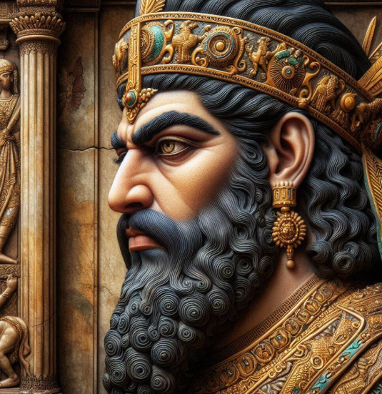
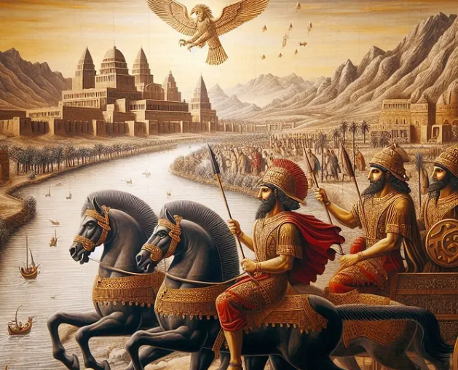
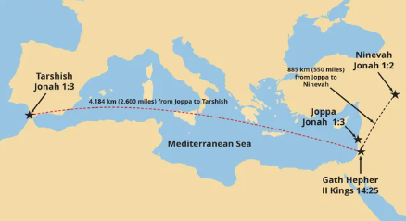
Nineveh
Ninevah was a major city of the Assyrians.
The Assyrian kings and soldiers were known for their brutality, such as torturing and murdering the people they conquered.
Tarshish might be in present-day Spain, indicating that Jonah left Israel and traveled in the opposite direction of Ninevah.
Jonah 1:1-2

Slide 10
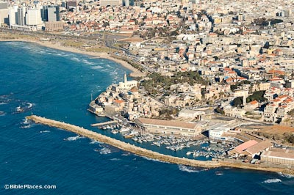
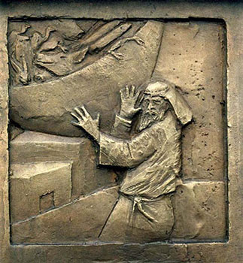
Joppa
Joppa was a significant seaport on Israel’s coast.
From there ships sailed to points throughout the Mediterranean. Joppa is the same as the present-day city of Jaffa, beside which the modern city of Tel Aviv has grown.
Joppa Today
Jonah 1:3
(1)

Slide 11
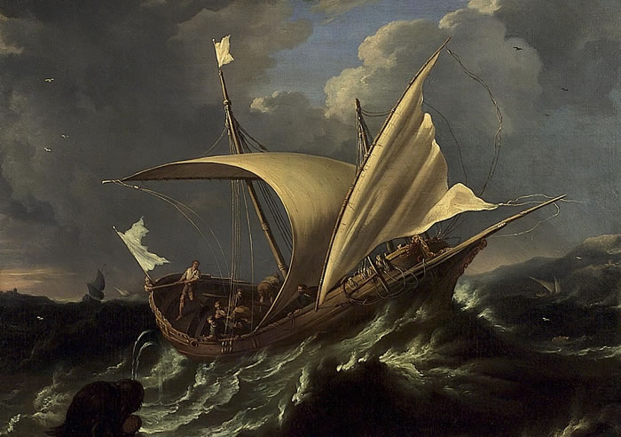
The Storm
The men on the ship feared they might perish in the storm. They believed that Jonah was responsible, and they asked him why the storm had come upon them.
The ship master ordered all his mariners to pray “Every man to his own god
Into the sides of the ship = Jonah had gone down in the hold of the ship asleep.
“Arise, call upon thy god, if so be that God will think upon us, that we perish not!”.
Jonah 1:5-9

Slide 12
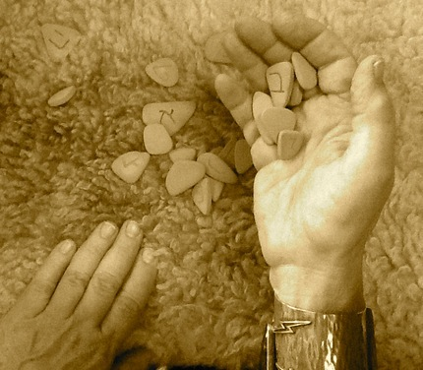
Casting Lots
In ancient times lots were cast when an impartial decision was desired.
The character and shape of the objects used in biblical times are not known, nor is the precise method by which they were cast, although some scholars suggest that smooth stones or sticks distinguished by colors or symbols were used.
The heathens cast lots because, they believed, the gods would guide what happened. In Jonah’s case, the Lord seems to have guided the outcome. (1)
Jonah 1:5-9

Slide 13
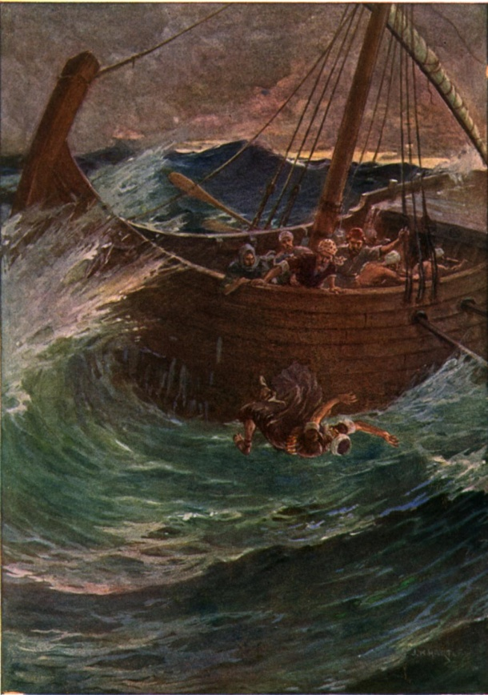
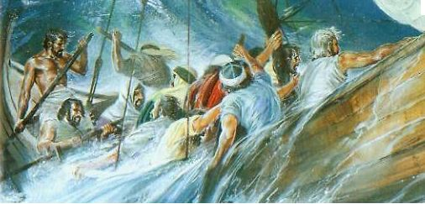
Jonah Witnesses Of Jehovah
Jonah admits that he had fled from God
The men did not accept Jonah’s offer until they had made every effort to save themselves in other ways.
I am an Hebrew; and I fear the Lord, the God of heaven, which hath made the sea and the dry land.
Only reluctantly did the sailors cast Jonah overboard, as he had commanded them to do. In an attempt to absolve themselves from offense against any of the gods, the sailors offered a prayer to the Lord and begged that their deed might not be counted against them. (1)
Jonah 1:11-16

Slide 14

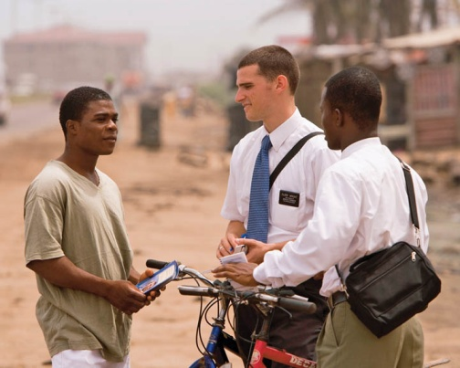


The Lord will hold us accountable for the responsibilities He gives us, even if we try to avoid them
What are some responsibilities the Lord gives people today that they may try to avoid?

Slide 15
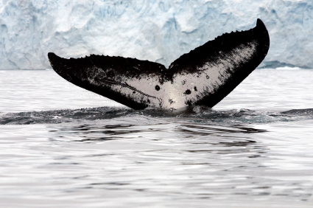
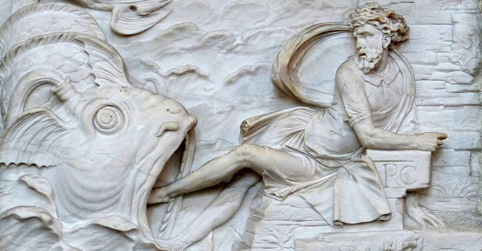
The Great Fish
Jesus taught that Jonah’s being swallowed by the fish served as a foreshadowing of Jesus’ own death and resurrection (11)
The Hebrew word taneen used in Jonah and the Greek word katos used in the New Testament describe any sea creature of immense proportion.
Sharks are common to the Mediterranean and have throats sufficiently large to admit the body of a man.
Of course, the miraculous nature of this event lies in the fact that Jonah could survive in the digestive tract of a large fish for three days as much as in the fact that he could be swallowed whole. (1)
Jonah 1:8-10

Slide 16

Jonah Finally Turns to the Lord
Jonah’s Anguish:
“the floods compassed me about: all thy billows and thy waves passed over me.”
Jonah’s Environment:
“the waters compassed me about, even to the soul: the depth closed me round about, the weeds were wrapped about my head.
Jonah’s Repentance:
“yet I will look again toward thy holy temple..”
“I will sacrifice unto thee with the voice of thanksgiving; I will pay that that I have vowed. Salvation is of the Lord.”
Jonah 2:3-9

Slide 17
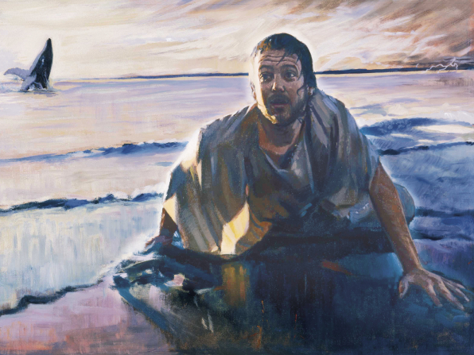
Receiving Mercy
The Lord is merciful, kind, and forgiving.
“the Lord spake unto the fish, and it vomited out Jonah upon the dry land”
To become like the Lord, we must be merciful, kind, and forgiving as He is
Jonah 2:10

Slide 18
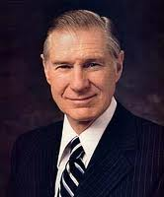
“Many of us backslide, many stumble, and I believe firmly in the gospel of the second chance.
But the gospel of the second chance means that having once been found weak, … thereafter we become steadfast.”
Jonah 2:10
(12)

Slide 19
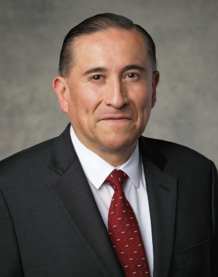
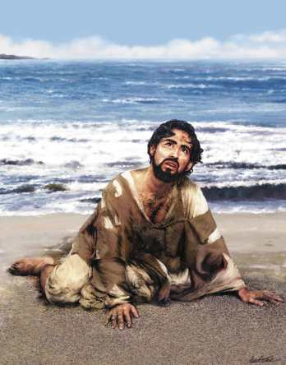
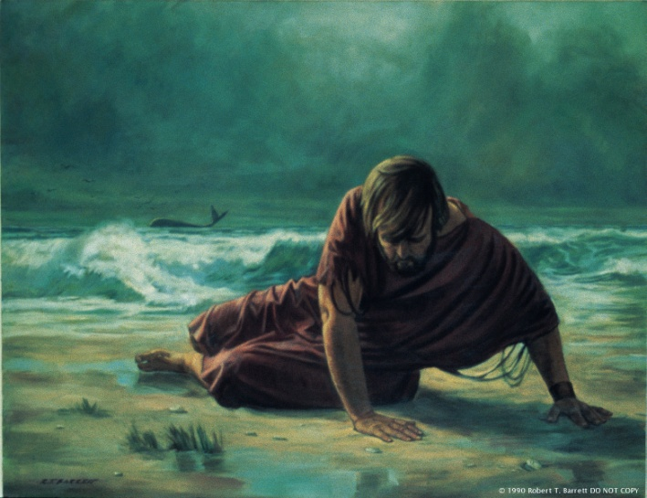


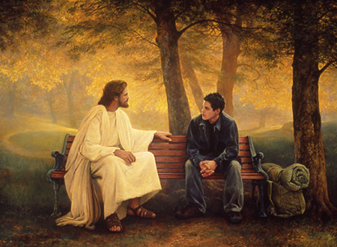
Second Chance’s
“It is comforting to know that we worship a God who is merciful and who allows His children many chances to learn His ways and be obedient to them.
Who among us would be saved without a second chance—more than one opportunity to prove ourselves in the sight of God? “ (13)
Jonah 2:10

Slide 20


Heavenly Father’s love for all His children is unbounded, and there is no need to resent that love when it is manifested in the lives of others. There is plenty of love for us, and we share more fully in that love as we not only celebrate the return of the prodigal but also assist as many as possible to return to the fold “safe and sound”. (16)
Because God’s love is all-embracing, some speak of it as “unconditional,” and in their minds they may project that thought to mean that God’s blessings are “unconditional” and that salvation is “unconditional.” They are not. Some are wont to say, “The Savior loves me just as I am,” and that is certainly true. But He cannot take any of us into His kingdom just as we are, “for no unclean thing can dwell there, or dwell in his presence”. (17)
Luke 15:27; Moses 6:57

Slide 21
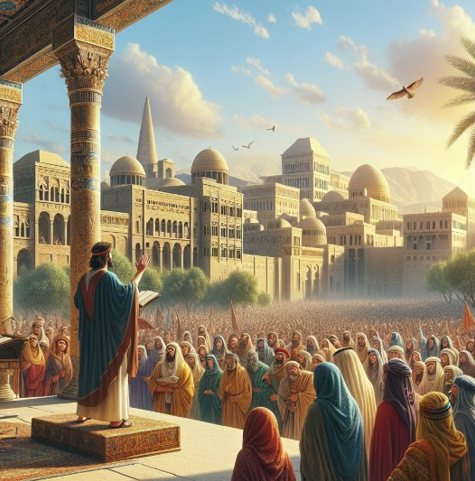
Jonah’s Mission to Nineveh
So the people of Nineveh believed God, and proclaimed a fast, and put on sackcloth, from the greatest of them even to the least of them. Jonah 3:5
The Great City:
Nineveh was a well-known trade center in Jonah’s day. It had terraces, arsenals, barracks, libraries, and temples. (1)
“Sackcloth and ashes (accompanied by the fasting, prayer, and turning to the Lord that attended their use) became a symbol of the most sincere and humble repentance.” (14)
Jonah 3

Slide 22
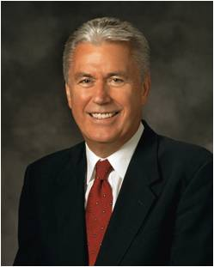
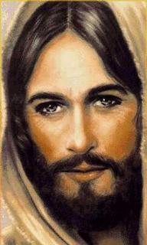
The Merciful Obtains Mercy
“Because we all depend on the mercy of God, how can we deny to others any measure of the grace we so desperately desire for ourselves? …
“The pure love of Christ can remove the scales of resentment and wrath from our eyes, allowing us to see others the way our Heavenly Father sees us: as flawed and imperfect mortals who have potential and worth far beyond our capacity to imagine. Because God loves us so much, we too must love and forgive each other.”
Jonah 4:2
(16)

Slide 23
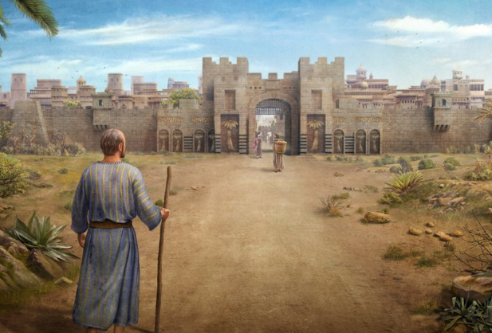
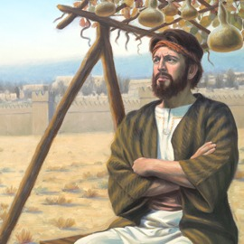


Second Chance For Nineveh
Jonah knew that God could revoke the destruction pronounced upon Nineveh, but he apparently presumed that God would revoke the punishment even if the people did not repent.
Jonah 4:5
To become like the Lord, we must learn to love and forgive others as He does
The Lord taught Jonah about love and forgiveness.
Jonah 4:9-10
Jonah 4:5-11

Slide 24
Sources:
Videos:
“Jonah the Prophet” (2:30).
“President Uchtdorf: Forgiveness” (3:40).
Old Testament Institute Manual Jonah: One Should Not Flee from His Responsibilities Chapter 9
Cleon W. Skousen The Fourth Thousand Years pp. 448-468
Will Durant, Our Oriental Heritage p. 275
Grayson, A.K., 1991. Assyrian Rulers of the Early First Millennium BC: I (1114-859 BC) (Royal Inscriptions of Mesopotamia. Assyrian Periods. Volume 2), Toronto: University of Toronto Press, pp. 217, A.0.101.1:iii 65-68.
Werner Keller, The bible as History pp. 240-241
Wikipedia
2 Kings 14:25 Peloubet’s Bible Dictionary under Gather-hepher
Bible Dictionary
C. F. Keil and F. Delitzsch Commentary on the Old Testament,10:1:383–85.
Sperry, Voice of Israel’s Prophets, pp. 328–331.)
Presentation by ©http://fashionsbylynda.com/blog/
Old Testament Seminary Manual commentary
James E. Faust “Stand Up and Be Counted,” Ensign, Feb. 1982, 71).
Elder Juan Uceda Jonah and the Second Chance September 2002 Ensign
Elder Bruce R. McConkie (Mormon Doctrine, p. 659.)
President Dieter F. Uchtdorf (“The Merciful Obtain Mercy,” Ensign or Liahona, May 2012, 75–76).
Elder LeGrand R. Curtis Jr. (“He Ran, and Fell on His Neck, and Kissed Him,” Ensign or Liahona, Jan. 2015, 47)
Elder D. Todd Christofferson Our sins must first be resolved. (“The Love of God,” Liahona, Nov. 2021, 16)

Slide 25
Jonah 1 | Jonah 2 | Jonah 3 | Jonah 4
God calls Jonah to preach to the people of Nineveh. Jonah flees in a ship. A storm arises and threatens to sink the ship. Jonah confesses he is to blame for the storm, and he is cast overboard and swallowed by a great fish. | Jonah repents. The Lord hears his cries and delivers him from the belly of the great fish. | God again calls Jonah to preach to Nineveh. Jonah goes to Nineveh and prophesies of the people’s destruction. The people respond with fasting and humility, and the Lord revokes their punishment. | Jonah is angered by the Lord’s decision to show mercy to the people. The Lord teaches him about His concern for the salvation of the people of Nineveh.

Slide 26
Jonah:
“There can be little doubt, therefore, that Jonah was a historical person and was engaged in prophetic activities. The prophet’s home, Gath-hepher, according to Joshua 19:10–13, was located in the territory of the tribe of Zebulun. According to monastic tradition it was the same as the present Arab village of El-Meshed, some three miles northeast of Nazareth, where one of the many Moslem tombs of Nebi Yunus, the ProphetJonah, is pointed out. St. Jerome (circa 400 A.D.) also speaks of Gath-hepher as being situated two Roman miles from Sepphoris towards Tiberias. (1)
Sack Cloth and Ashes: Jonah 3:5-9:
“A coarse, dark cloth made of hair of camels and goats and used anciently for making sacks and bags was called sackcloth. It was also used for making the rough garments worn by mourners, and so it became fixed in the prophetic mind as a symbol for sorrow and mourning. It was the custom for mourners, garbed in sackcloth, either to sprinkle ashes upon themselves or to sit in piles of ashes, thereby showing their joy had perished or been destroyed. (Gen. 37:34; Esther 4:1–3;Isa. 61:3; Jer. 6:26.)
“The use of sackcloth and ashes anciently was also a token of humility and penitence. When righteous persons used the covering of sackcloth and the sprinkling of ashes to aid them in attaining the spiritual strength to commune with Deity, their usage was always accompanied by fasting and prayer. Daniel, for instance, prefaced the record of one of his great petitions to the throne of grace with this explanation: ‘I set my face unto the Lord God, to seek by prayer and supplications, with fasting, and sackcloth, and ashes: And I prayed unto the Lord my God, and made my confession.’ (Dan. 9:3–4; Isa. 58:5; 1 Kings 21:17–29.)
“Sackcloth and ashes (accompanied by the fasting, prayer, and turning to the Lord that attended their use) became a symbol of the most sincere and humble repentance.” Elder Bruce R. McConkie (Mormon Doctrine, p. 659.)
Jonah’s mission:
The object of Jonah’s mission to Nineveh was to combat in the most energetic manner, and practically to overthrow, a delusion which had a seeming support in the election of Israel to be the vehicle of salvation, and which stimulated the inclination to pharisaical reliance upon an outward connection with the chosen nation and a lineal descent from Abraham. … The attitude of Israel towards the design of God to show mercy to the Gentiles and grant them salvation, is depicted in the way in which Jonahacts, when he receives the divine command, and when he goes to carry it out. (9)
Preparing the Whale Jonah 1:17:
“Are we to reject it as being an impossibility and say that the Lord could not prepare a fish, or whale, to swallow Jonah? … Surely the Lord sits in the heavens and laughs at the wisdom of the scoffer, and then on a sudden answers his folly by a repetition of the miracle in dispute, or by the presentation of one still greater. …
“I believe, as did Mr. William J. Bryan, the story of Jonah. My chief reason for so believing is not in the fact that it is recorded in the Bible, or that the incident has been duplicated in our day, but in the fact that Jesus Christ, our Lord, believed it. The Jews sought him for a sign of his divinity. He gave them one, but not what they expected. The scoffers of his day, notwithstanding his mighty works, were incapable, because of sin, of believing.
“‘He answered and said unto them, An evil and adulterous generation seeketh after a sign; and there shall no sign be given to it, but the sign of the Prophet Jonas: For as Jonas was three days and three nights in the whale’s belly; so shall the Son of man be three days and three nights in the heart of the earth.’” Joseph Fielding Smith (Doctrines of Salvation, 2:314–15.)
Using Gourd and Worm Jonah 4: 6-10:
The Lord taught Jonah in a way that he could understand that all things are in His hand—the gourd, the worm, even life itself. First, the Lord sent the dreaded east wind, which was very destructive, for it blew off the hot, dry Arabian Desert. Then the Lord caused the sun to beat upon Jonah, making him so uncomfortable that he wished for death.
Once Jonah was in that position, the Lord was able to teach him the worth of souls in Nineveh. Because the thousands who lived in Nineveh were ignorant of the saving gospel principles, they could not fully “discern between their right hand and their left hand” (Jonah 4:11). Surely the Lord felt more pity for them than Jonah felt for the gourd (see Alma 26:27, 37). By means of this simple plant, the Lord taught Jonah about the way in which God loves all of His children.

Slide 27
Adad-nirari II (911–891 BC), the son of Ashur-Dan II
Tukulti-Ninurta II (890–884 BC), the son of Adad-nirari II
Ashurbanipal II (884–859 BC), the first Assyrian king to make extensive use of wall reliefs; see his quote above about cutting off ears, noses, and lips
Shalmeneser III (859–824 BC), son of Ashurbanipal II
Shamsi-Adad V (824–811 BC), conquered Babylon
Adad-nirari III (811–783 BC), Babylon became independent again during his reign
Shalmeneser IV (783–773 BC), son of Adad-nirari III
Ashur-dan III (773–755 BC), son of Adad-nirari III. The prophet Jonah served during the time of King Jeroboam II in Israel (783–743 BC) and likely visited Nineveh during this time.
Ashur-nirari V (755–745 BC), may have been deposed and killed by his successor
Tiglath-Pileser III (745–727 BC), Assyria became the supreme power in the Near East under his reign. He successfully invaded Israel as recorded in 2 Kings 15:29.
In the time of Pekah king of Israel, Tiglath-Pileser king of Assyria came and took Ijon, Abel Beth Maakah, Janoah, Kedesh and Hazor. He took Gilead and Galilee, including all the land of Naphtali, and deported the people to Assyria. Source: 2 Kings 15:29
Shalmeneser V (727–722 BC), he was deposed and killed by Sargon II in a coup. It’s likely Shalmeneser who is ruling when the prophet Isaiah said:
For this is what the Sovereign Lord says:
“At first my people went down to Egypt to live;
lately, Assyria has oppressed them. Source, Isaiah 52:4
Sargon II (722–705 BC), changed the imperial capital from Nimrud to Dur-Sharrukin (“fortress of Sargon”). He also captured Ashdod, one of the cities in Judah.
In the year that the supreme commander, sent by Sargon king of Assyria, came to Ashdod and attacked and captured it — Source, Isaiah 20:1
Something of Interest
List of Assyrian Kings
The Neo-Assyrian age was the pinnacle of power for the ancient Assyrians.
It followed the Old-Assyrian period that stretched back to 2350 and the Middle Assyrian period of 1365–1000 BC. But it was the Neo-Assyrian period that was the time of true empire.
It lasted for over 300 years from the reign of Adad-nirari II in 911 BC until the final destruction by the Babylonians and Medes in 609 BC under the time of Assur-ubalit II. But the time of “empire” really ended a few years before that when the great (then capital) city of Nineveh was destroyed by the same Medes and Babylonians.
Many of the greatest kings, like Tiglath Pileser III (reigned 745–727 BC), Sargon II (722–705 BC), Sennacherib (705–681 BC), Esarhaddon (681–669 BC) are directly named in the Hebrew Bible. Others, like Shalmeneser V (727–722 BC) are likely referenced in the Bible without being named directly.
https://medium.com/@zduncan/list-of-assyrian-kings-f7c373331576

Slide 28
List of Assyrian Kings--continued
Esarhaddon (681–669 BC), the son of Sennacherib assumed the throne after Sennacherib was killed. The Neo-Assyrian empire reached its peak under Esarhaddon.
Ashurbanipal (669–631 BC), the son of Esarhaddon who is commonly regarded as the last of the great Assyrian kings. The empire began to fall from the heights of its imperial dominance following his reign, and that continued through the following kings.
Assur-etil-ilani (631–627 BC), the son of Ashurbanipal.
Sin-sar-iskun (627–612 BC), the son of Ashurbanipal who succeeded Assur-etil-ilani when he died. He put down a brief rebellion by Sin-sumu-lisir who had claimed the throne for himself in 626 BC. Sin-sar-iskun was killed by the Babylonians and Medes during the fall of Nineveh. The collapse of that great city was foretold by the prophet Nahum in the Bible.
Assur-ubalit II (612–609 BC), organized a final resistance by the remaining Assyrians against the Babylonians and Medes at the city of Harran. He was defeated and the Assyrian kings were never restored.
Following the collapse of the Neo-Assyrian empire, Nebuchadnezzar II led the Neo-Babylonian to prominence on the world stage. He came to power in 605 BC, just 4 years after the end of the line of the Assyrian kings.
Just like the Assyrian kings, Nebuchadnezzar and Babylon feature prominently in the Bible. And just like the line of Assyrian kings, Babylon is broken. The book of Daniel tells how Babylon falls under mysterious circumstances.
Sennacherib (705–681 BC), changed the Assyrian imperial capital to Nineveh. He conquered many the walled cities in the southern kingdom of Judah (like Lachish, the second biggest city) but did not conquer the capital at Jerusalem. He is recorded taunting the king of Judah, Hezekiah, who had refused to surrender the Jerusalem to him despite the massive Assyrian army besieging it.
Now Sennacherib received a report that Tirhakah, the king of Cush, was marching out to fight against him. So, he again sent messengers to Hezekiah with this word: “Say to Hezekiah king of Judah: Do not let the god you depend on deceive you when he says, ‘Jerusalem will not be given into the hands of the king of Assyria.’ Surely you have heard what the kings of Assyria have done to all the countries, destroying them completely. And will you be delivered? Source: 2 Kings 19:9–11
Later, Sennacherib’s army is destroyed outside the walls of Jerusalem and he retires to Nineveh. Where he is killed by two of his sons before being succeeded by another of his sons.
That night the angel of the Lord went out and put to death a hundred and eighty-five thousand in the Assyrian camp. When the people got up the next morning — there were all the dead bodies! 36 So Sennacherib king of Assyria broke camp and withdrew. He returned to Nineveh and stayed there.
37 One day, while he was worshiping in the temple of his god Nisrok, his sons Adrammelek and Sharezer killed him with the sword, and they escaped to the land of Ararat. And Esarhaddon his son succeeded him as king. [Source, 2 Kings, 19:35–37]
https://medium.com/@zduncan/list-of-assyrian-kings-f7c373331576

