Slide 1

Judgment, Mercy, and Forgiveness
Micah
And as one generation hath been destroyed among the Jews because of iniquity, even so have they been destroyed from generation to generation according to their iniquities; and never hath any of them been destroyed save it were foretold them by the prophets of the Lord.
2 Nephi 25:9

Slide 2
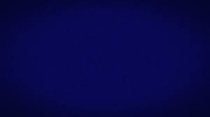
Micah--Micaiah
He was a Moresthite and a prophet of Judah who prophesied during the time of King Jotham , Ahaz, and Hezekiah around 740 to 697 B.C.
He was from Moresheth-gath, a small rural town in the kingdom of Judah
He saw the fall of the Northern Tribes (Israel) and prophesied that some of the people in Jerusalem (Jews) will be taken to Babylon, but later delivered
Micah pleaded with Israel to remember the great blessings they had received from the Lord and invited them to repent and be gathered to Him
He mentions the coming forth of the Messiah to be born at Bethlehem (some 735 years later) and the Lord’s kingdom of glory and salvation will rise in the latter days
He prophesied during the same time as Isaiah, Hosea, Joel (possibly), Jonah, and Amos
He ministered during a time when the people of Israel were thriving economically but suffering spiritually
The Book of Micah comprises of 3 major divisions: prophecies of judgment and destruction; prophecies concerning the Restoration and the Messianic mission; and prophecies concerning the goodness of the Lord and His expectations of the covenant people
(1,3)

Slide 3
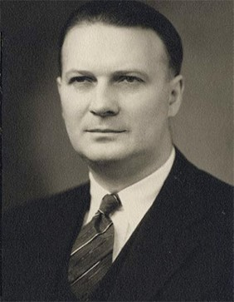
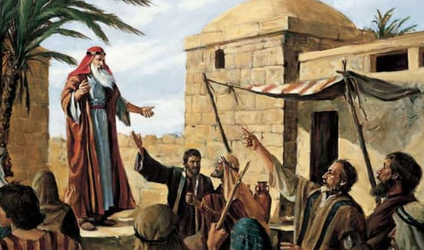
Micah the Prophet
“Since Micah was a contemporary of Isaiah, Hosea, and Amos, the problems he faced were much the same as theirs. … Micah was not a statesman like Isaiah; consequently, he was not so much concerned about his nation’s political sins.
“The prophet was more like Amos in that his grievances were social in character. He was especially concerned with the attempts of the nobles to build up large estates by ejecting small property owners.”
Micah was taught to “do justly, and to love mercy, and to walk humbly”
(4)

Slide 4
The Wickedness of Jerusalem
A Hebrew Translation
“Weep tears at Teartown (Bochim),
grovel in the dust at Dustown (Beth-ophrah)
fare forth stripped, O Fairtown (Saphir)!
Stirtown (Zaanan) dare not stir,
Beth-êsel …
And Maroth hopes in vain;
for doom descends from the Eternal
to the very gates of Jerusalem.
“To horse and drive away, O Horsetown (Lakhish)
O source of Sion’s sin,
where the crimes of Israel centre!
O maiden Sion, you must part with
Morêsheth of Gath;
and Israel’s kings are ever balked
at Balkton (Achzib).”
Saphir
Beth-ophrah (House of Aphrah)
Zaanan
Lakish
Gath
Small towns around Jerusalem
(2)
Micah 1:8-16

Slide 5
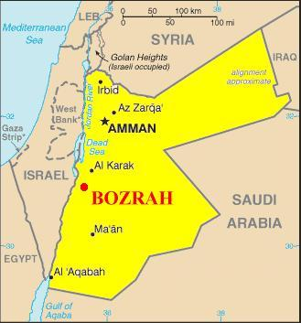
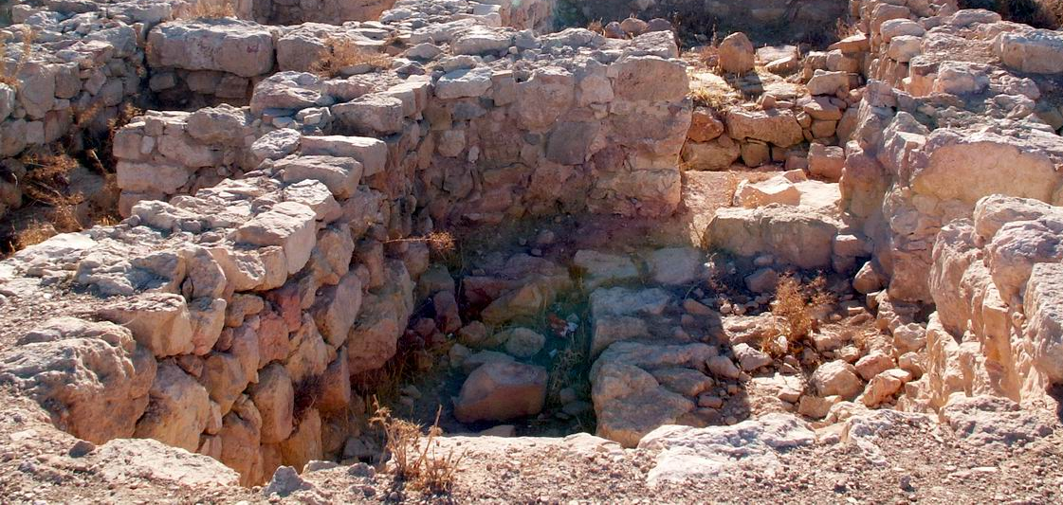
Bozrah
Micah foretold a miraculous growth as the people were gathered. He used the illustration of the sheep-rich area of Bozrah to illustrate how the people will become mighty.
Bozrah was the capital city of Edom. According to the Old Testament, the city was the homeland of Jacob's twin brother, Esau. Bozrah means "sheepfold" and was a pastoral city in Edom southeast of the Dead Sea.
Bozrah ruins
Micah 2:12
(2, 5)

Slide 6
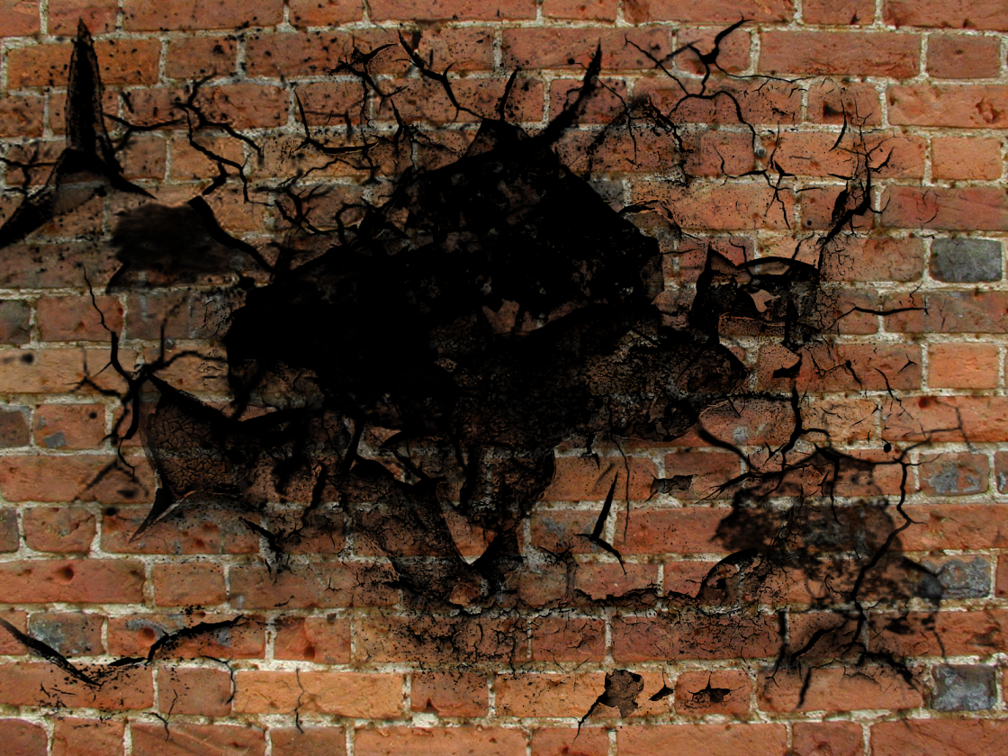
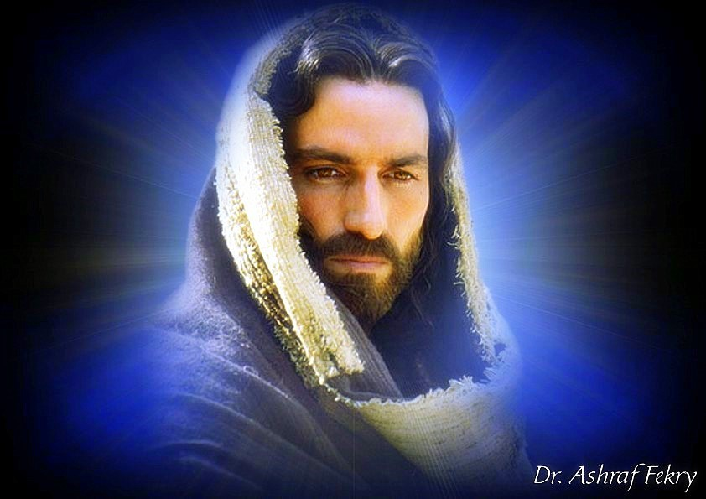
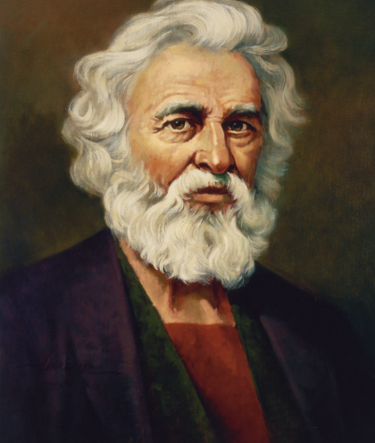
Future Gathering of Israel
After he castigated the false prophets for telling the people all was well, Micah prophesied salvation.
This prophecy concerns a people who had been scourged because of iniquity, and only a remnant remained of the once mighty house of Israel.
Dr. Ashraf Fekry
He compared their scattered condition to a form of imprisonment and foretold a Savior and Redeemer who would break the prison walls and lead the people to the promised land.
Micah 2:13
(2)

Slide 7
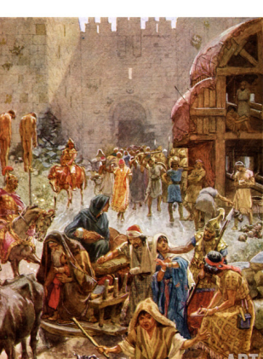
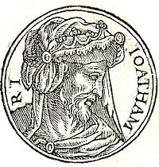
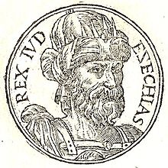
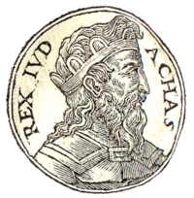
The Heads of Jacob
Micah, referring to the iniquity that lay before him, spoke to the “heads of Jacob”, or the current rulers of the house of Israel.
He accused them of hating good and loving evil, and he likened them and their use of administrative powers to a group of cannibals who eat the flesh and break the bones of their own people vivid imagery that seared in its condemnation of their wickedness.
Micah 3:1-3
(2)

Slide 8
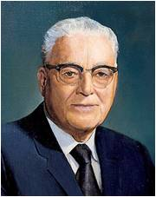
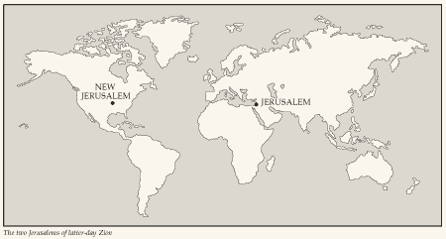
For the Future
“With the coming of the pioneers to establish the Church in the tops of the mountains, our early leaders declared this to be the beginning of the fulfillment of the prophecy that out of Zion should go forth the law and the word of the Lord from Jerusalem.
…all must also be willing to bring forth his work and to bring forth and establish Zion. This meant to work and labor with all one’s might, mind, and strength if he would obtain a place in the celestial world.”
Micah 4
(6)

Slide 9
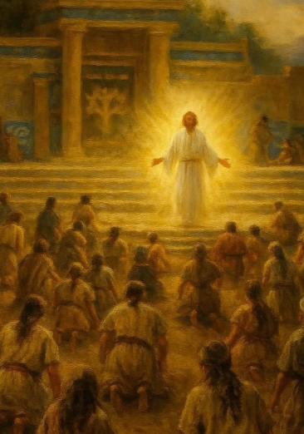
Jesus Quotes Micah
3 Nephi 20:18-20
And I will gather my people together as a man gathereth his sheaves into the floor.
For I will make my people with whom the Father hath covenanted, yea, I will make thy horn iron, and I will make thy hoofs brass. And thou shalt beat in pieces many people; and I will consecrate their gain unto the Lord, and their substance unto the Lord of the whole earth. And behold, I am he who doeth it.
And it shall come to pass, saith the Father, that the sword of my justice shall hang over them at that day; and except they repent it shall fall upon them, saith the Father, yea, even upon all the nations of the Gentiles.
Jesus used Micah’s prophecy to depict the kind of destruction that awaited the Gentiles of that period if they did not repent
Micah 4:11-13

Slide 10
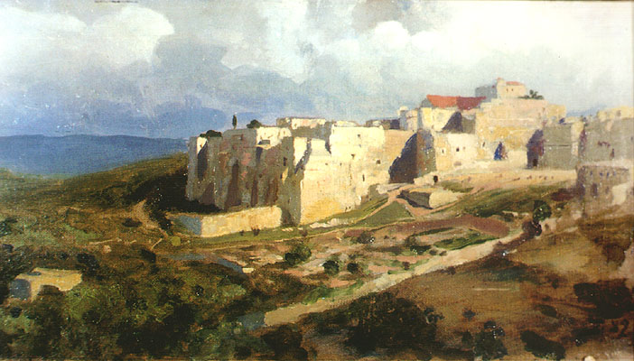
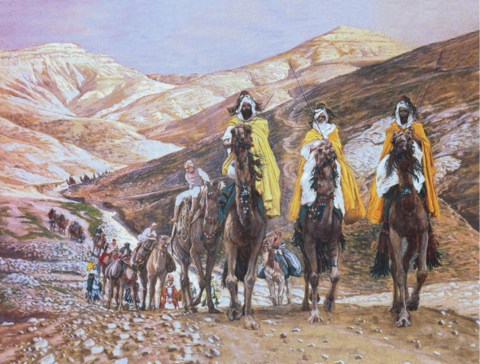
Micah Names Bethlehem
The Birthplace of the Messiah
But thou, Beth-lehem Ephratah, though thou be little among the thousands of Judah, yet out of thee shall he come forth unto me that is to be ruler in Israel; whose goings forth have been from of old, from everlasting.
Now when Jesus was born in Bethlehem of Judæa in the days of Herod the king, behold, there came wise men from the east to Jerusalem,
Saying, Where is he that is born King of the Jews? for we have seen his star in the east, and are come to worship him.
Micah 5:2

Slide 11
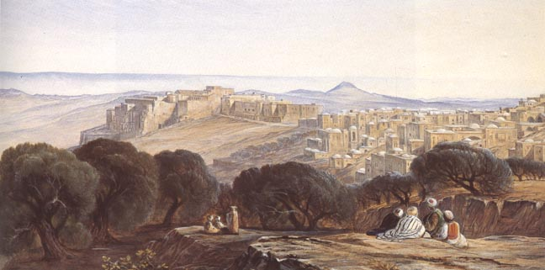
Bethlehem
House of bread
Ephratah is simply an additional name to distinguish the Bethlehem in Judah from another Bethlehem in the land assigned to the tribe of Zebulun .
The prophecy was fulfilled, of course, when Jesus was born in Bethlehem of Judea in the days of Herod the king.
And Kattath, and Nahallal, and Shimron, and Idalah, and Beth-lehem: twelve cities with their villages. Joshua 19:15
Bethlehem is five miles south of Jerusalem
Rehoboam built the city of Bethlehem
Ruth was from Bethlehem and return, then met Boaz
Samuel Anoints David at Bethlehem
David drank from the well at Bethlehem
123 children of Bethlehem were taken to Babylon and returned to Jerusalem (7)
Micah 5:2; Matthew 2:1; Luke 2:1-20
(2)

Slide 12
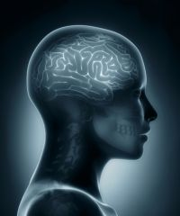
A Division About the Prophecy
Ironically, this prophecy was used by some of the Jews to try to disprove that Jesus was the Messiah. Not knowing that he was born in Bethlehem but thinking he was from Nazareth, these people cited Micah to show that Jesus could not be the Messiah
Many of the people therefore, when they heard this saying, said, Of a truth this is the Prophet.
Others said, This is the Christ. But some said, Shall Christ come out of Galilee?
Hath not the scripture said, That Christ cometh of the seed of David, and out of the town of Bethlehem, where David was?
So there was a division among the people because of him.
John 7:40-43
Micah 5:2
(2)

Slide 13
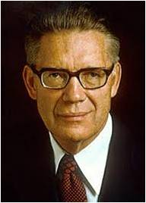
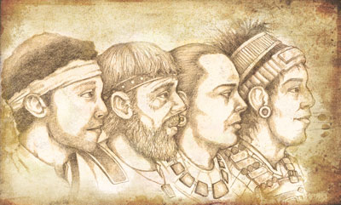
The Remnants of Jacob
Christ quoted Isaiah 52 to emphasize the work His servant will do to bring the covenant to the Gentiles (3 Nephi 21:8, 10). And concluded by commenting on Micah 5:8–15, showing the devastation that would fall on those Gentiles if they reject the covenant (3 Nephi 21:12–22).12
“These words of our Lord to the Nephites are quoted from Micah 5:8–9 and have reference to the desolations and ultimate burning that shall destroy the wicked at the Second Coming. …
The righteous﻿—here called the remnant of Jacob﻿—shall abide the day.
And then, in the prophetic imagery, it will be as though the remnant of Israel overthrew their enemies as a young lion among the flocks of sheep.”
And my people who are a remnant of Jacob shall be among the Gentiles, yea, in the midst of them as a lion among the beasts of the forest, as a young lion among the flocks of sheep, who, if he go through both treadeth down and teareth in pieces, and none can deliver. 3 Nephi 21:12
Micah 5:8-9
(9, 10)

Slide 14
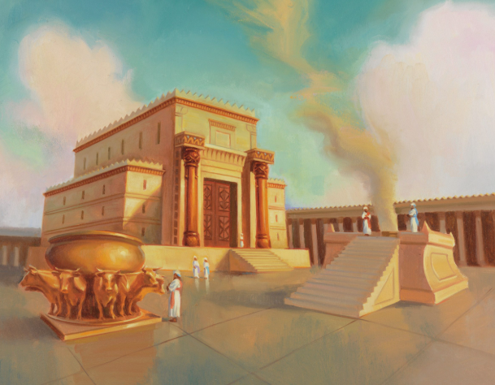
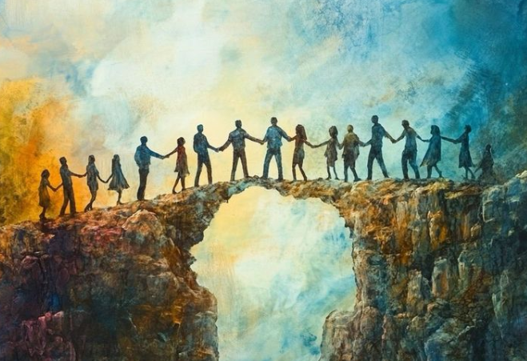
To Please the Lord
Do justly, love mercy, or walk humbly with the Lord.
Wherewith shall I come before the Lord, and bow myself before the high God? shall I come before him with burnt offerings, with calves of a year old?
Will the Lord be pleased with thousands of rams, or with ten thousands of rivers of oil? shall I give my firstborn for my transgression, the fruit of my body for the sin of my soul?
To do justly:
Acting honorably with God and with other people. … To be Christlike, a person does justly, behaving honorably with both God and other people. (10)
Micah 6:6-8

Slide 15
The Lord Reminds The People
Through His prophet Micah, the Lord reminded the people of Judah of His goodness toward them so that they would serve Him and show gratitude and devotion to Him.
Under the Law of Moses, the Lord required sacrifice and other ritualistic practices, but they were all symbolic of principles that were to lead His people to higher and better things.
But Israel’s worship had become formalized, and the wickedness of the people had rendered their ritual unacceptable to God.
Micah conveyed to the people the fundamental requirements of true religion in an answer that is one of the noblest of all time.
Micah 6:6-8
(2)

Slide 16
To Worship the Lord
What does the Lord require of us as we worship and serve Him?
If we desire to come unto the Lord and worship Him, then we must love and serve Him with all our hearts
And now, Israel, what doth the Lord thy God require of thee, but to fear the Lord thy God, to walk in all his ways, and to love him, and to serve the Lord thy God with all thy heart and with all thy soul,
To keep the commandments of the Lord, and his statutes, which I command thee this day for thy good?
Deuteronomy 10:12-13
What do you think it means to serve the Lord with all our hearts?
Micah 6:6-8

Slide 17
No Excuses
The Lord said He could not justly excuse the children of Israel because they continued in their wickedness. He then pronounced consequences that would come to them because of their sins.
Micah 6:9-16

Slide 18
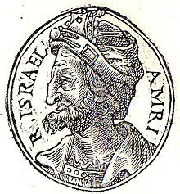
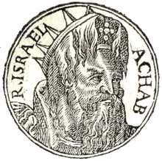
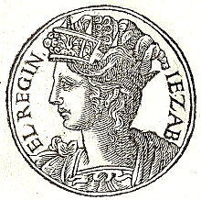
Omri—Father of Ahab
“Omri, king of Israel, the father of Ahab, was one of the worst kings the Israelites ever had; and Ahab followed in his wicked father’s steps.
The statutes of those kings were the very grossest idolatry. Jezebel, wife of the latter, and daughter of Ithobaal, king of Tyre, had no fellow on earth.
Omri, Ahab, and Jezebel, were the models followed by the Israelites in the days of this prophet. …”
Micah 6:16
(8)

Slide 19

Poetry of Micah
Micah 7:1
Micah 7:2
Micah 7:3
Solitary grape upon the vine
A battle between a man with a net and a man without a net
Comparison of a wicked man to a briar or a thorn hedge
Small number of righteous people to be found
Duel between the retiarius and secutor see notes *
They are useless in themselves, and cannot be touched without wounding him that comes in contact with them
Micah 7:1
(2)

Slide 20
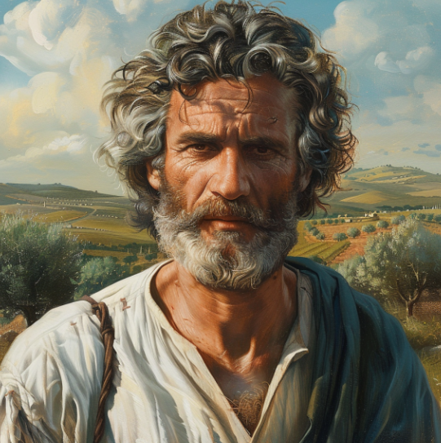
The Mercy of God
Micah continued to lament the wickedness of the Israelites and the destructions that were coming because of their sins.
As we repent of our sins, we will be forgiven because the Lord delights in mercy
However, Micah prophesied that Israel would turn to righteousness and rise again with the Lord’s help and that other nations would be amazed at what the Lord had done for Israel
Micah 7:1-17

Slide 21
Sources:
Videos:
“The Christ Child” from time code 11:30 to 17:15.
Strive (3:06)
Who’s Who in the Old Testament by Ed J. Pinegar and Richard J. Allen pp. 126-127
Old Testament Student Institute Manual Promise of Judgments, Promise of Salvation
W. Cleon Skousen The Fourth Thousand Years pp.503-511
Sidney B. Sperry The Voice of Israel’s Prophets, pp. 334–35 and Message of the Twelve Prophets, pp. 125–26.
Wikipedia
Presentation by ©http://fashionsbylynda.com/blog/
Harold B. Lee Improvement Era, Oct. 1945, p. 504 and Conference Report, Manchester England Area Conference 1971, pp. 138–39
Bible Dictionary
Adam Clarke The Holy Bible … with a Commentary and Critical Notes, 4:725.
Bruce R. McConkie, The Millennial Messiah: The Second Coming of the Son of Man[1982], 248).
https://knowhy.bookofmormoncentral.org/knowhy/why-did-jesus-mix-together-micah-and-isaiah
Elder Dale G. Renlund (“Do Justly, Love Mercy, and Walk Humbly with God,” Ensign or Liahona, Nov. 2020, 110, 111)

Slide 22
Micah 1-3 | Micah 4-5 | Micah 6-7
Micah prophesies of judgment and ruin upon the Israelites, including those living in Samaria and Jerusalem. Micah identifies the sins of idolatry and the oppression of the poor by the upper classes as the reasons for the Israelites’ imminent destruction. He also condemns corrupt religious teachers who teach for money. | Micah prophesies of the restoration of Israel. He also prophesies that the Messiah will be born in Bethlehem. | Micah describes some of the ways in which Jehovah has blessed the Israelites. Micah teaches his people that living justly, loving mercy, and following the Lord are more important than sacrifices and offerings. Micah testifies that Jehovah is compassionate and forgives the sins of those who repent.
Jerusalem around the time of Micah: Corrupt judges assisted their greedy friends in robbing the weak; widows and orphans without means of defense were deprived of their goods by force and oftentimes sold into slavery. The common people were kept in bondage through high taxation, and creditors were unmerciful on their victims. Micah held the nobility to be responsible for the terrible moral and social corruption among his people. He likened the nobles to cannibals, who eat the flesh of the people and chop their bones in pieces for the pot. There was no end to their greed and rapacity, and decisions were given to those who paid the largest bribes.” Sidney B. Sperry (The Voice of Israel’s Prophets, pp. 334–35.)
* The Net Micah 7:2:
“They hunt every man his brother with a net. This appears to be an allusion to the ancient mode of duel between the retiarius and secutor. The former had a casting net, which he endeavored to throw over the head of his antagonist, that he might then despatch him with his short sword. The other parried the cast; and when the retiarius missed, he was obliged to run about the field to get time to set his net in right order for another throw. While he ran, the other followed, that he might dispatch him before he should be able to recover the proper position of his net; and hence the latter was called secutor, the pursuer, as the other was called retiarius, or the net man . …
The Great Last Battles: Micah 5:5-15
Still looking into the far distant future, Micah prophesied of the great last battles through which Israel, under Christ, will at last triumph over all enemies. “In this relation the Messiah is called the Prince of peace in [Isaiah 9:5], as securing peace for Israel in a higher and more perfect sense than Solomon. But in what manner? This is explained more fully in what follows: viz. (1) by defending Israel against the attacks of the imperial power (vers. 5 b, 6); (2) by exalting it into a power able to overcome the nations (vers. 7–9); and (3) by exterminating all the materials of war, and everything of an idolatrous nature, and so preventing the possibility of war (vers. 10–15). Asshur is a type [symbol] of the nations of the world by which the people of the Lord are attacked, because in the time of the prophet this power was the imperial power by which Israel was endangered. Against this enemy Israel will set up seven, yea eight princes, who, under the chief command of the Messiah, i.e. as His subordinates, will drive it back, and press victoriously into its land. … Seven is mentioned as the number of the works proceeding from God, so that seven shepherds, i.e. princes, would be quite sufficient; and this number is surpassed by the eight, to express the thought that there might be even more than were required.” (C. F. Keil and F. Delitzsch, Commentary on the Old Testament,10:1:486–87.)

