Slide 1

Burden, Faith, and Choices
Nahum, Habakkuk, Zephaniah, Haggai

Slide 2
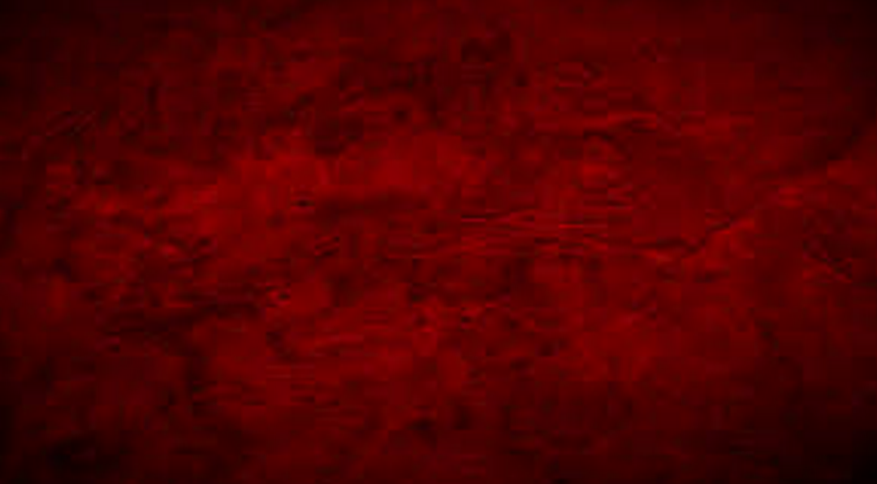
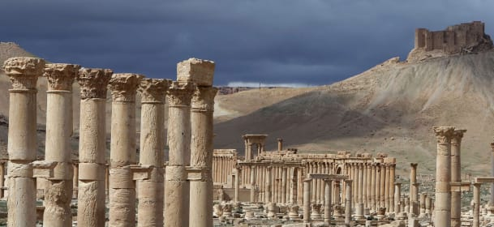
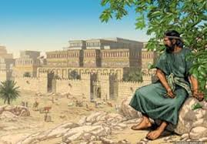
Nahum
The book of Nahum contains a prophecy that Nineveh, the capital of Assyria, would be destroyed because of its people’s wickedness.
The Assyrians had brutally conquered and terrorized large areas of the Near East in the eighth century B.C., destroying the Northern Kingdom of Israel and deporting its inhabitants in approximately 721 B.C. and later laying siege to Jerusalem in 701 B.C.
Nahum addressed a significant portion of his prophecy to the people of Nineveh. These people were not the same as those who had repented of their sins after Jonah had preached in Nineveh more than a century earlier.
The people of Nineveh in Nahum’s time had returned to wickedness, and their actions led to their destruction. The destruction of Assyria can be likened to the destruction of the wicked in the last days.
By studying the Ninevites in both Jonah’s day and Nahum’s time, we can learn that when people turn from sin, the Lord will forgive them, and when they do not, they will be destroyed.

Slide 3
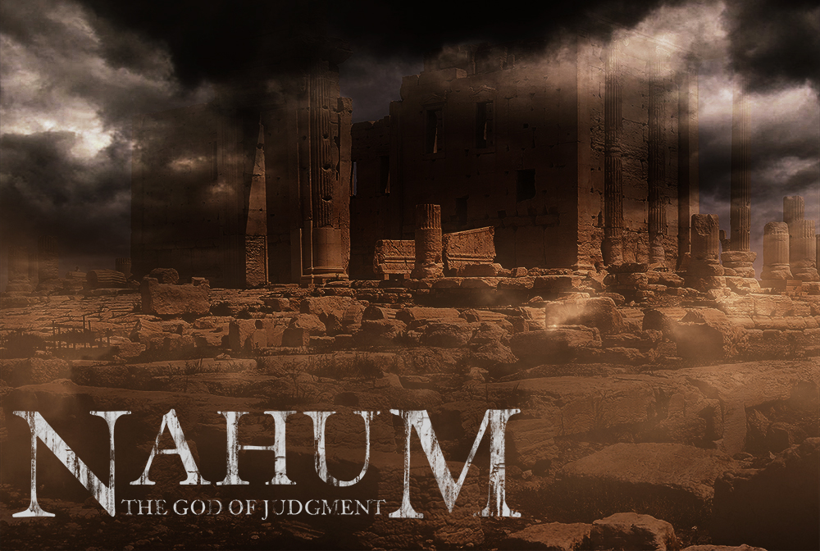
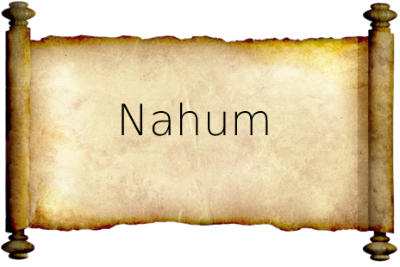
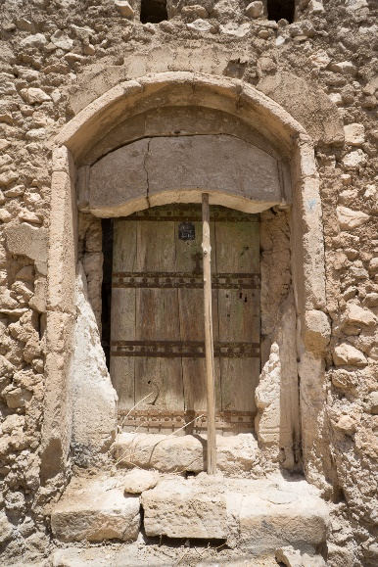
Who Wrote Nahum?
According to Nahum 1:1, this book records “the vision of Nahum the Elkoshite.”
We do not know whether Nahum wrote or dictated the words of this vision or someone else wrote them.
Nahum prophesied in the seventh century B.C., at about the same time as Zephaniah and Jeremiah. Each of these prophets shared insights into the years leading up to the Babylonian conquest of Judah.
When Was Nahum Written?
The prophecy of Nahum was most likely recorded in the kingdom of Judah sometime after 660 B.C. and before the fall of Nineveh, which occurred around 606 B.C.
(18)
Tomb of Prophet Nahum

Slide 4
Nahum
His name means consoler. He calls himself an Elkoshite. Where he is from is unknown
The book of Nahum was written during the reign of King Hezekiah, some time after 660 B.C. and before 606 B.C.
It is unknown who wrote the book of Nahum, but he probably preached in the same time period as Zephaniah and Jeremiah
After Jonah had preached to Nineveh they returned to wickedness and during Nahum’s time he prophesied the details of their destruction and the wicked Assyrians while he was a safe distance in Jerusalem
He reminds the Assyrians what happened to a great Egyptian city when it fell
The Chaldeans from Babylonia would be among the conquerors of Nineveh
He had a deep sense of concern for the suffering of the many people who had been conquered, slain, enslaved, and terrorized by Assyria
(1,4)

Slide 5
The Evils of Our Day
Morality
Peer pressure
Media and Entertainment
Degeneration of Family Values
Porn
Selfishness

Slide 6
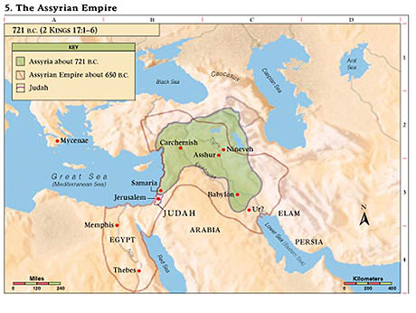
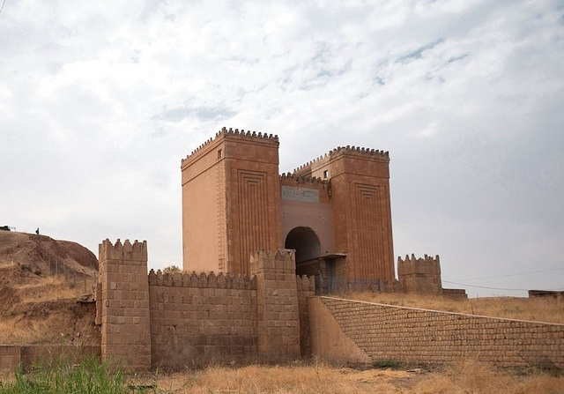
Burden of Nineveh
Nahum prophesied during the time of the Assyrian Empire.
Approximately 100 years after the time of Jonah.
The Assyrian army had already destroyed the Northern Kingdom of Israel and was planning to conquer the Southern Kingdom of Judah.
The people of Nineveh had repented once before when Jonah preached to them. But more than 100 years later, at the time of Nahum, the people of Nineveh had again become wicked.
Nahum 1:1

Slide 7
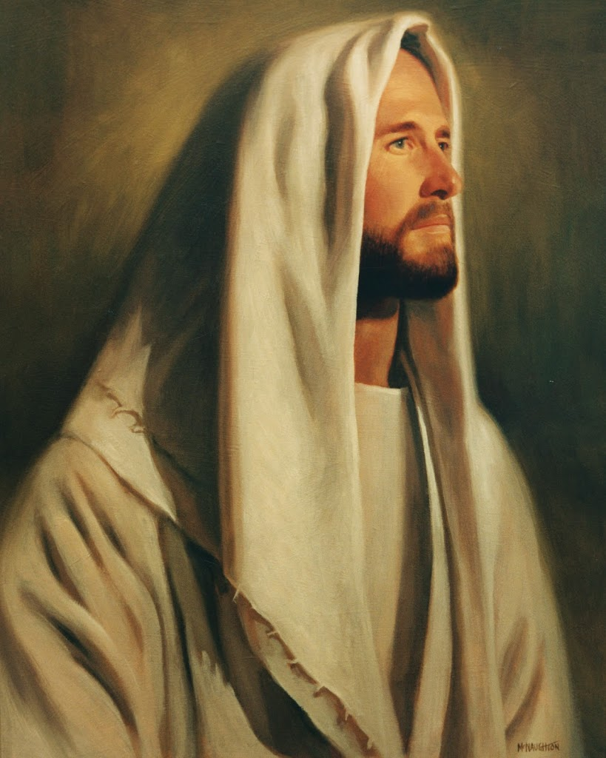
Slow To Anger
The Lord exercises much longsuffering towards his enemies, that this may lead them to repentance. And it is because of this longsuffering that vengeance is not speedily executed on every evil work.
But with Great Power = He is able and ready to save or destroy.
(3)
Nahum 1:3

Slide 8
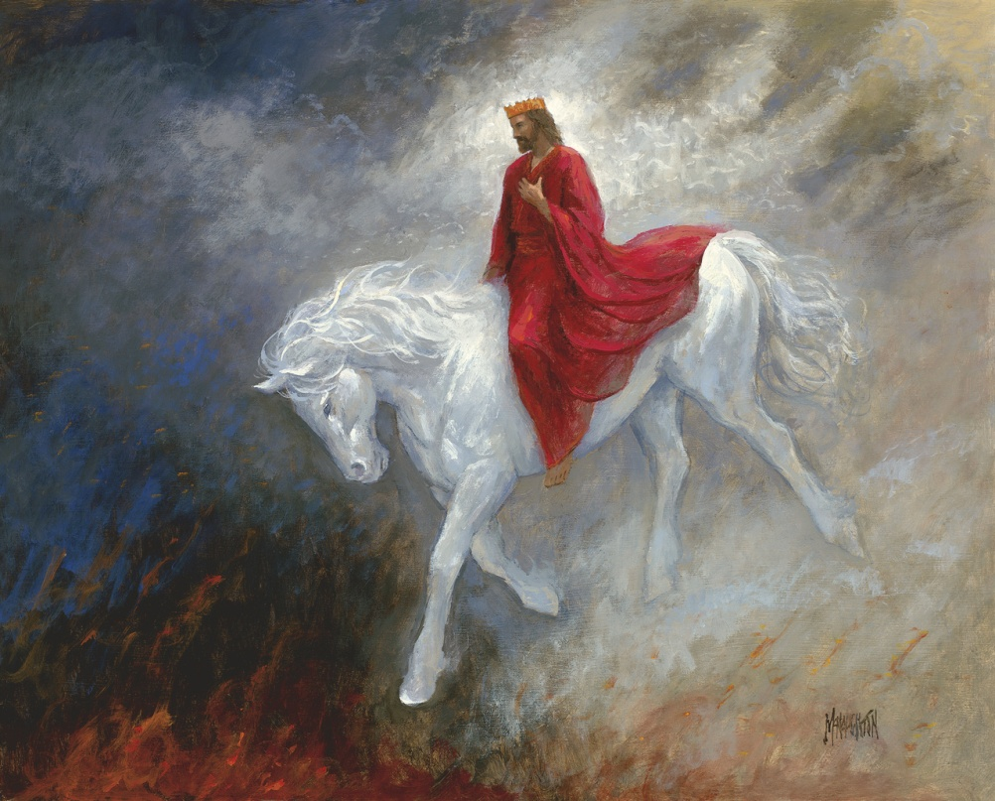
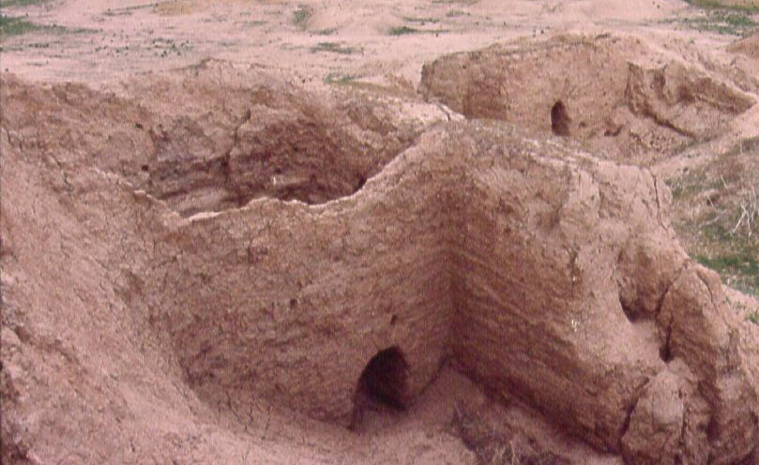
The Second Coming Image
Another example of the prophetic dualism so common in the Old Testament
The mountains quake at him, and the hills melt, and the earth is burned at his presence, yea, the world, and all that dwell therein.
Nahum employed imagery usually associated with the Savior’s Second Coming to depict Assyria’s future devastation.
Assyria would be as easily burned as dry stubble in a field.
(2)
Nahum 1:5-8

Slide 9
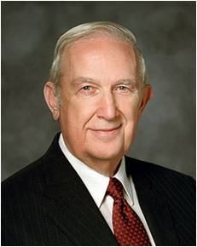
The Lord Is Good
Stronghold = a fortress or position that provides a strong defense against attacking forces.
The Lord is a stronghold in the day of trouble, and He knows those who trust Him
Trust in the Lord with all thine heart; and lean not unto thine own understanding.
In all thy ways acknowledge him, and he shall direct thy paths.
Be not wise in thine own eyes: fear the Lord, and depart from evil.
Proverbs 3:5-7
“To trust means to obey willingly without knowing the end from the beginning.” (5)
Nahum 1:7

Slide 10
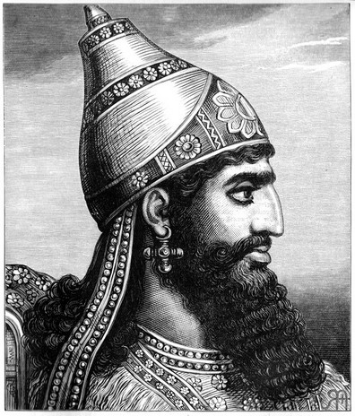
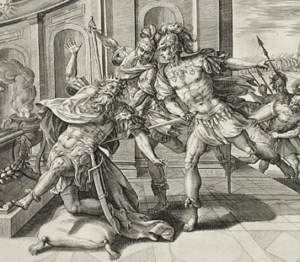
Destruction of Nineveh
“Wicked counsellor”
Sennacherib, king of Assyria, had invaded Judah with a force of nearly two hundred thousand men. The prophecy foretold that Sennacherib would die shortly, and the house of his gods would become his grave.
While he was worshiping in the temple dedicated to the god Nisrock, Sennacherib’s two sons, Adrammelech and Sharazer, murdered their father as Nahum had prophesied.
Nahum 1:9-14; 2 Kings 17:14; 2 Kings 19:37

Slide 11
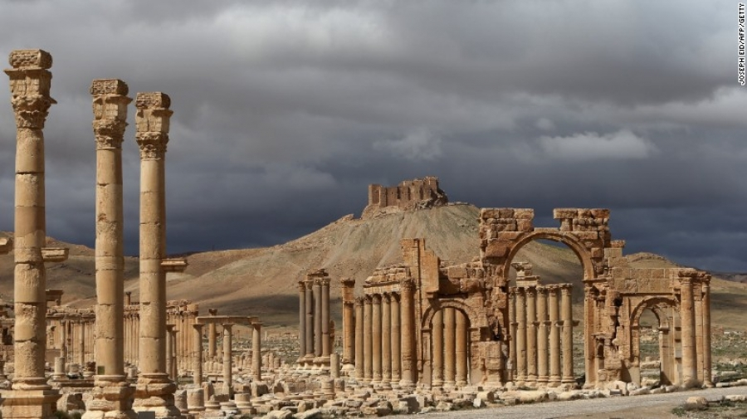
The Final Poem
Thy shepherds slumber, O king of Assyria,
Thy worthies are at rest;
Thy people are scattered upon the mountains,
And there is none to gather them.
There is no assuaging of thy hurt,
Thy wound is grievous;
All that hear the report of thee
Clap the hands over thee;
For upon whom hath not thy wickedness passed continually?
Nahum 3:18-19

Slide 12

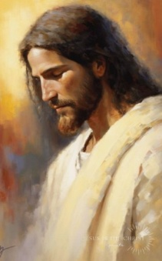
Questions and Faith
?
questions or concerns
Faith in the Lord and His gospel
Is it possible to struggle with difficult questions and have faith in Jesus Christ and His restored Church at the same time?

Slide 13
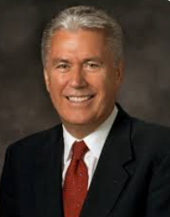
Inquiry is the birthplace of testimony. Some might feel embarrassed or unworthy because they have searching questions regarding the gospel, but they needn’t feel that way.
Asking questions isn’t a sign of weakness; it’s a precursor of growth.
God commands us to seek answers to our questions and asks only that we seek “with a sincere heart, with real intent, having faith in Christ”.
When we do so, the truth of all things can be manifested to us “by the power of the Holy Ghost”.
Fear not; ask questions. Be curious, but doubt not! Always hold fast to faith and to the light you have already received. (21)
Moroni 10:4-5

Slide 14
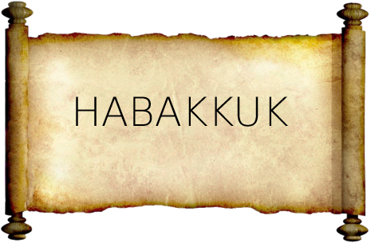
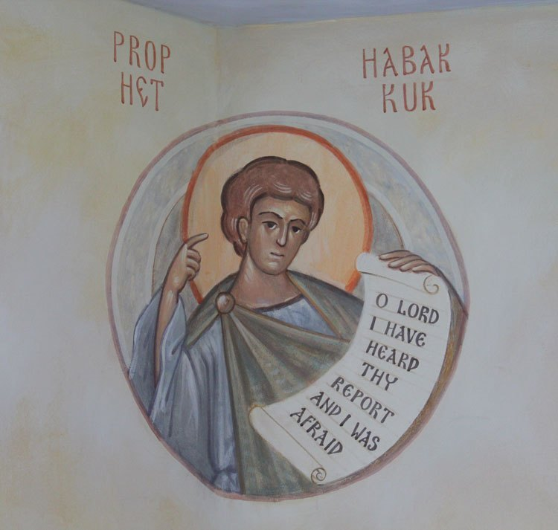
Habakkuk
The book of Habakkuk contains an exchange between Habakkuk and the Lord that is “similar to those in Jeremiah 12 and D&C 121
Like Jeremiah and Joseph Smith, Habakkuk asked God sincere and bold questions that reflected concern for his people and for the Lord’s plans for them.
By studying the book of Habakkuk, we can learn about the value of taking our troubles and questions to Heavenly Father in honest prayer.
This book is attributed to a prophet named Habakkuk.
We do not know exactly when or where this book was written. The date of Habakkuk’s ministry is uncertain, but it likely took place shortly before the Babylonian siege of Jerusalem in 597 B.C.
Habakkuk 1:1; 3:1
(18, 19)

Slide 15
Habakkuk
Little is known about Habakkuk except that he was a prophet who lived in the kingdom of Judah, “possibly in the reign of Josiah or of Jehoiakim (about 600 B.C.)
If the dates are correct the book was written during the times of Jeremiah, Zephaniah, Obadiah, and Ezekiel.
The date of Habakkuk’s ministry is uncertain, but it likely took place shortly before the Babylonian siege of Jerusalem in 597 B.C.
Habakkuk writes in question and answer form
Habakkuk asked God sincere and bold questions that reflected concern for his people and for the Lord’s plans for them
In response to Habakkuk’s prayer, God counseled him to be patient and faithful and reassured him of God’s justice, concern, and plans
The poetic prayer in Habakkuk 3 contains Habakkuk’s praises to the Lord for the miraculous ways He has protected and delivered His people.
(1,4)

Slide 16
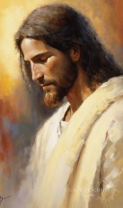
Questions and Faith
What is the danger of setting aside our faith and relationship with the Lord when we have questions?
We don’t have to set aside our faith in Jesus Christ because of questions. We can move forward with trust in the Lord as we look for answers.

Slide 17
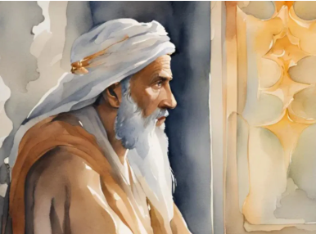
How Long Shall I Cry?
Habakkuk learned that the Lord would use a wicked nation (the Babylonians, also known as Chaldeans) to destroy the kingdom of Judah.
This troubled Habakkuk, and he asked the Lord why He would use a wicked people to destroy His chosen people.
The Lord answered kindly and encouraged patience, assuring Habakkuk that in time the wicked Chaldeans would also be punished.
Habakkuk 2:2-6

Slide 18
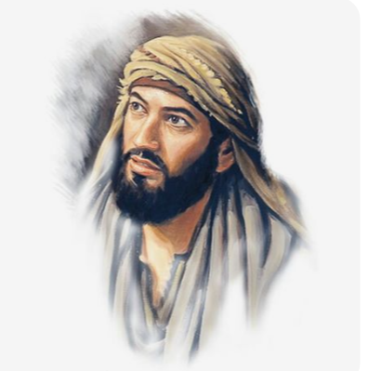


Yet to Be Appointed—Wait Patiently
Watch and Wait
For the vision is yet for an appointed time
We can choose to remain faithful to the Lord while waiting for answers to our sincere questions.
Habakkuk 2:1-3
(2)

Slide 19
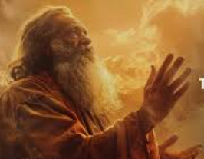
Habakkuk’s Faith Is Tested
The Lord replied that He intended to use the Chaldeans for His righteous purposes in such a way that it would be difficult for Habakkuk to believe it.
The Lord’s response merely increased Habakkuk’s confusion: how could God condone the cruelties of a nation more wicked than Judah?
Were the Chaldeans never to get what was due them for their evil ways?
The Lord told Habakkuk that the Babylonians would eventually be punished for their wickedness.
Habakkuk 2:5-20
(2)

Slide 20
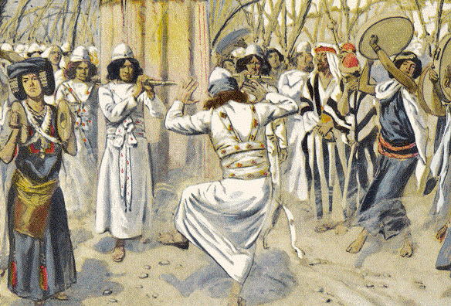
Shigionoth and Selah
Shiggaion of David, which he sang unto the Lord, concerning the words of Cush the Benjamite. Caption beginning in Psalms 7
A shigionoth may have been a stringed instrument, or more likely a musical expression used to accompany singers.
Possibly this prayer of Habakkuk was set to music and intended for use in the temple.
A selah was a cue for the person singing or chanting the words. The use of this word in Psalms is further evidence that Habakkuk’s prayer may have been set to music.
I will praise the Lord according to his righteousness: and will sing praise to the name of the Lord most high. Psalms 7:17
Habakkuk 3:1-3
(2)

Slide 21
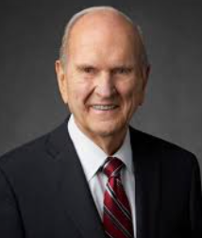
Choose to believe in Jesus Christ. If you have doubts about God the Father and His Beloved Son or the validity of the Restoration or the veracity of Joseph Smith’s divine calling as a prophet, choose to believe and stay faithful.
Allow the Lord to lead you on your journey of spiritual discovery.
Take your questions to the Lord and to other faithful sources.
Study with the desire to believe rather than with the hope that you can find a flaw in the fabric of a prophet’s life or a discrepancy in the scriptures.
Stop increasing your doubts by rehearsing them with other doubters.
(22)

Slide 22
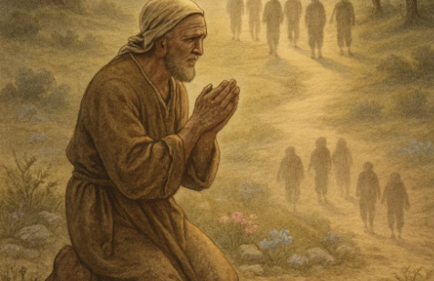
Prayer of Praise
Yet I will rejoice in the Lord,
I will joy in the God of my salvation.
The Lord God is my strength,
and he will make my feet like hinds’ feet,
and he will make me to walk upon mine high places …
Habakkuk 3
(2)

Slide 23


Zephaniah
The book is attributed to a prophet named Zephaniah, who prophesied in Judah during the seventh century B.C.
Zephaniah may have been a contemporary of other Old Testament prophets such as Jeremiah and Nahum and the Book of Mormon prophet Lehi.
By studying the book of Zephaniah, we can learn that we do not need to follow the sinful customs of the societies in which we live and that we can seek the Lord regardless of what others around us choose to do.
Studying the book of Zephaniah can also help us prepare for the Second Coming of Jesus Christ, which is also referred to as “the day of the Lord.”
(18, 20)

Slide 24

Zephaniah
His name means “The Lord Hides”
He was the son of Cushi, the son of Gedaliah, the son of Amariah, the son of Hizkiah, in the days of Josiah the son of Amon, king of Judah.
Zephaniah prophesied of “the day of the Lord” or the pending judgment of Judah and other nations
Zephaniah explained that on this day God would punish the proud and mighty and reward the righteous
He prophesied in Judah during the seventh century B.C. and during a time when a foreign army was threatening to destroy Judah and had words for the Philistines
Zephaniah may have been around during Jeremiah and Nahum, also along the same time period as Book of Mormon prophet Lehi
Zephaniah ministered in Judah during the reign of King Josiah, which lasted from about 639 to 608 B.C. However, we do not know when and where the prophecies were recorded
The words of Zephaniah can apply to both his day and the future.
(1,4)

Slide 25

How Do You Prepare For A…
Date
School test
Performance
Athletic Meet or Game
Audition
Mission
General Conference
Patriarchal Blessing

Slide 26
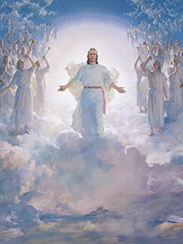
Commissioned by God to Warn Judah
Encourage Judah to Repent
“Turned back from the Lord” = description for the destruction awaiting the people.
“Bid his guests” to come to “a sacrifice” = that which He had prepared.
“Strange apparel” = Those who wore clothing worn for idolatrous purposes.
Day of the Lord = Usually refers in the scriptures to the Second Coming of Jesus Christ. (Verse 14)
This prophecy is in keeping with the dualism so common in the writings of Hebrew prophets. Zephaniah both anticipated Judah’s impending disaster and foresaw the final destruction of all the wicked. (6)
Zephaniah 1:6-14

Slide 27
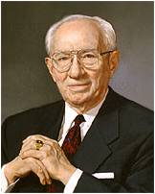
“Meekness implies a spirit of gratitude as opposed to an attitude of self-sufficiency, an acknowledgment of a greater power beyond oneself, a recognition of God, and an acceptance of his commandments.”
As we seek the Lord, seek righteousness, and seek meekness, we can be protected from harm in the day of His judgment
Zephaniah 2:1-3
(7)

Slide 28
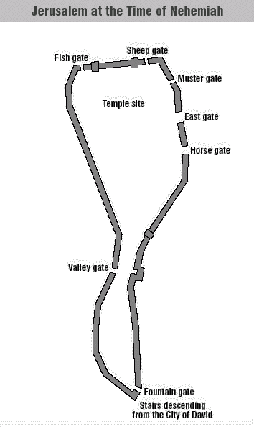
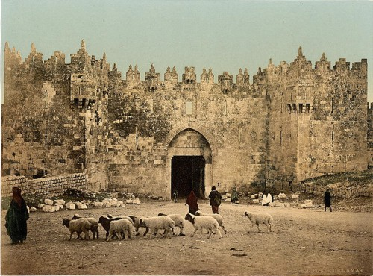
Fish Gate
The “fish gate” was on the north end of the city. People there would be the first to see an enemy invading from the north.
The fish gate opened into the part of the city known as the “second quarter”, probably because it was an expansion of the original city of David. This quarter would be the first reached from the north.
“Maktesh” was the name of the merchant quarter, which lay in the second quarter; thus, the reference to merchants, “they that bear silver.”
Zephaniah 1:10-11
(8)

Slide 29
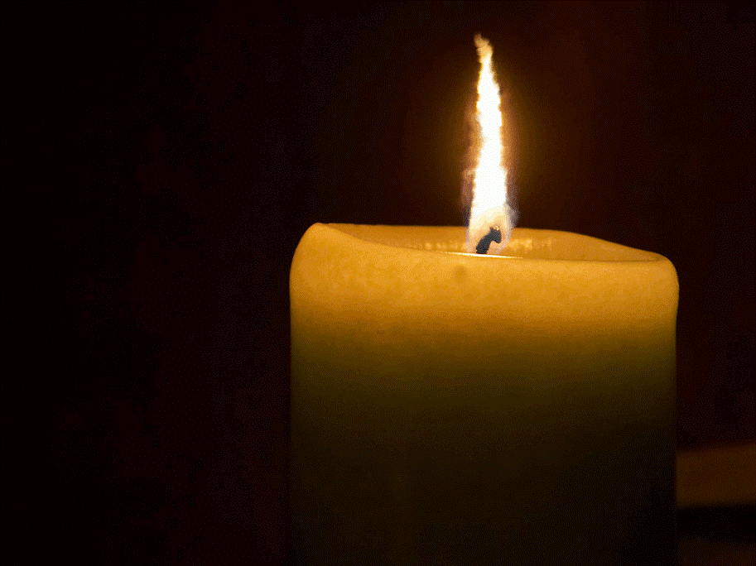
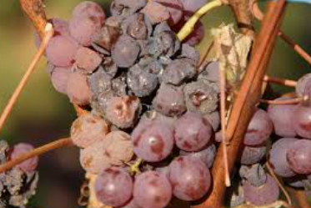
Search and Settled
To “search with candles” suggests an exhaustive search, since in the poorly lighted houses of those times one would have to use a candle to look for a lost object at night.
“Settled upon their lees” is a figure drawn from wine making. The lees are the thick residue of the pulp of the grapes. “Good wine, when it remains for a long time upon its lees, becomes stronger; but bad wine becomes harsher and thicker. (2)
The interpretation of the symbol is that wicked men, like bad wine, remain apathetic about the true religion and become increasingly harsh and bitter.
Zephaniah 1:12
(8)

Slide 30
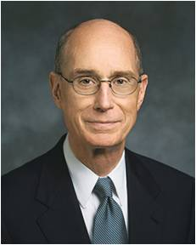
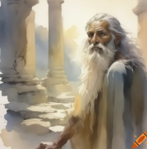
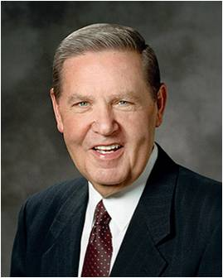
Wait and Hope
“The word wait in scripture language means to hope for or anticipate.”
If we will wait upon the Lord, He will deliver us from our sorrows, afflictions, and captivity
“Those who see the worst in human nature are often the first to see a gleam of hope. Following the gloom, unmitigated and unrelieved in any way, Zephaniah sends one shaft of light into the darkness. A remnant may yet be saved.
“Some blessings come soon, some come late, and some don’t come until heaven; but for those who embrace the gospel of Jesus Christ, they come”
Zephaniah 3:8-20
(9, 10, 11)

Slide 31
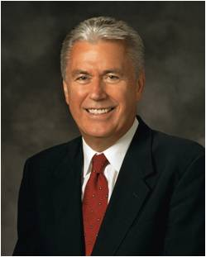
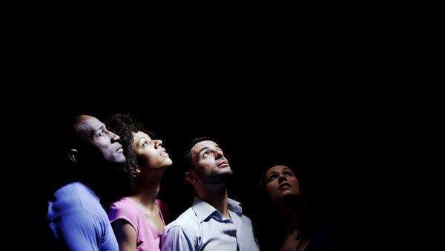
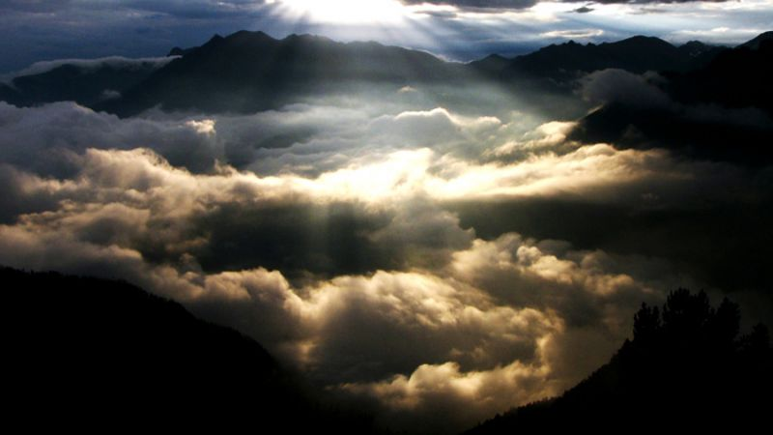
Signs of the Coming of the Son of Man
“We are the Saints of the latter days. Inherent in our name is the commitment to look forward to the Savior’s return and prepare ourselves and the world to receive Him. Therefore, let us serve God and love our fellowmen.
Let us do this with a natural confidence, with humility, never looking down on any other religion or group of people. Brothers and sisters, we are charged with studying the word of God and heeding the voice of the Spirit, that we may ‘know the signs of the times, and the signs of the coming of the Son of Man’.
“… Rather than dwelling on the immensity of our challenges, would it not be better to focus on the infinite greatness, goodness, and absolute power of our God, trusting Him and preparing with a joyful heart for the return of Jesus the Christ?”
Zephaniah 3:13-12; D&C 68:11
(21)

Slide 32


Haggai
The book of Haggai affirms that a temple will again be built in Jerusalem and that peace will finally come to Jerusalem.
Studying the book of Haggai can help us gain a deeper understanding of the urgency and importance of building temples and worshipping in the temple.
(1,12)

Slide 33
Haggai
He was prophet in Jerusalem who prophesied shortly after the return from the Babylonian exile
He was called “the prophet unto Zerubabbel”
The Book of Haggai was written around 520 B.C.
He received 5 dated revelations which are compiled together in 2 chapters in the Book of Haggai
Darius, Daniel, Haggai, and Zechariah together helped to change their current situation
He energized the people into rebuilding the temple in Jerusalem
He warned the Jews about worldly desires had brought them earlier into captivity
He also encouraged the people that they were capable of greater things
(1, 12, 18)

Slide 34
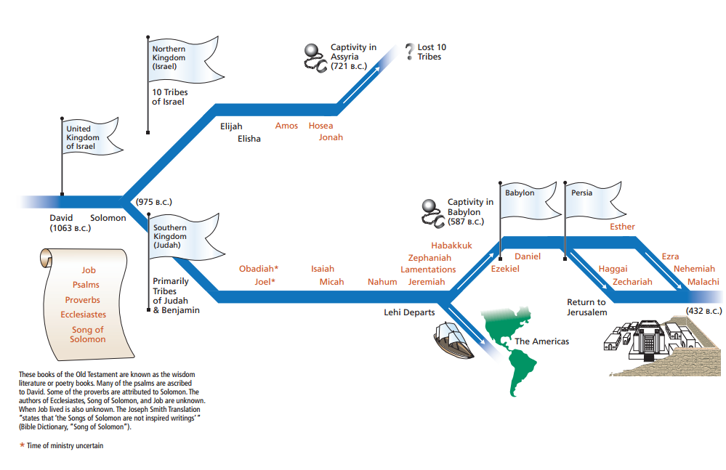
The Kingdoms of Israel and Judah at a Glance
After the Jews arrived in Jerusalem from their captivity in Babylon, they put great effort into rebuilding the temple, the city, their homes, and their lives.
However, because of opposition from the Samaritans and their own apathy, they stopped working on the temple for several years.
Ezra 4:1–5, 24

Slide 35
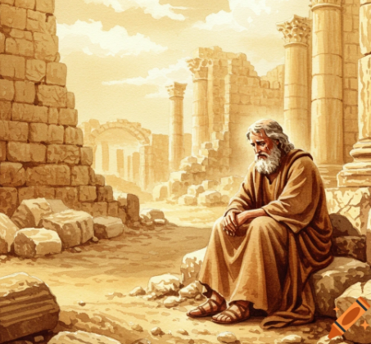

Message to Zerubbabel and Joshua
Zerubbabel was the governor of Jerusalem and Joshua was the High Priest
Rebuild the Temple
“Ceiled houses” = the way many Jews furnished their homes with fine wood
“this house” = the temple
If the time be not come to rebuild the temple, it cannot be come for you to build yourselves comfortable houses: but ye are rebuilding your houses; why then do ye not rebuild the house of the Lord? (4)
Ye have sown much, and bring in little; ye eat, but ye have not enough; ye drink, but ye are not filled with drink; ye clothe you, but there is none warm; and he that earneth wages earneth wages to put it into a bag with holes.
Haggai 1:1-4

Slide 36




Yes, It Will Be Difficult—A Parallel
If ye labor with all your might, I will consecrate that spot that it shall be made holy.
D&C 124:44
The Lord told the Jews that the difficulties they were experiencing, including a drought and a famine, were the result of putting a higher priority on furnishing their own homes than on rebuilding His temple.
The Latter-day Saints also built two temples, one in Kirtland and one in Nauvoo, in times of great poverty and persecution.
THE HOUSE OF THE LORD
Built by
THE CHURCH OF JESUS CHRIST OF LATTER-DAY SAINTS
COMMENCED APRIL 6, 1841
HOLINESS TO THE LORD
The Lord directly tied the poverty of the people of Haggai’s time and the sterility of the land to their failure to heed the commandment to rebuild the Lord’s house .
Haggai 1:7-11; D&C 124:31-55
(13)

Slide 37
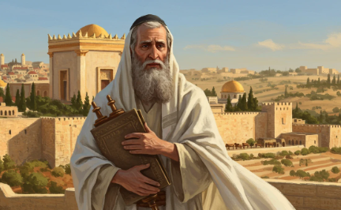
Built In Poverty
When the foundation of the second temple was laid, some who had known the former temple wept with joy at the thought that they could have again the blessings that had been available in Solomon’s temple.
The Lord assured the people, however, that it was not the relative splendor of the two buildings that concerned Him, but their obedience to His command to build a house to Him.
Haggai prophesied of a future temple that would surpass Solomon’s in glory and splendor and would be the place where the Lord would give His people peace.
Haggai 2:1-9
(13)

Slide 38
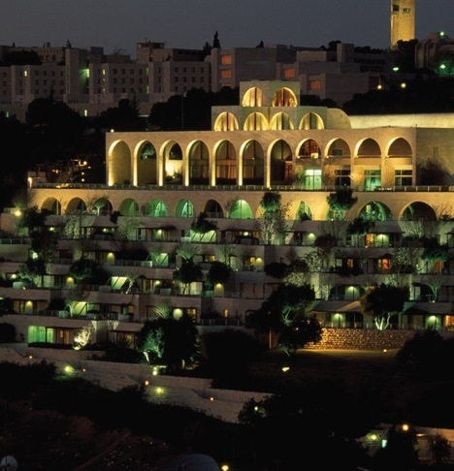
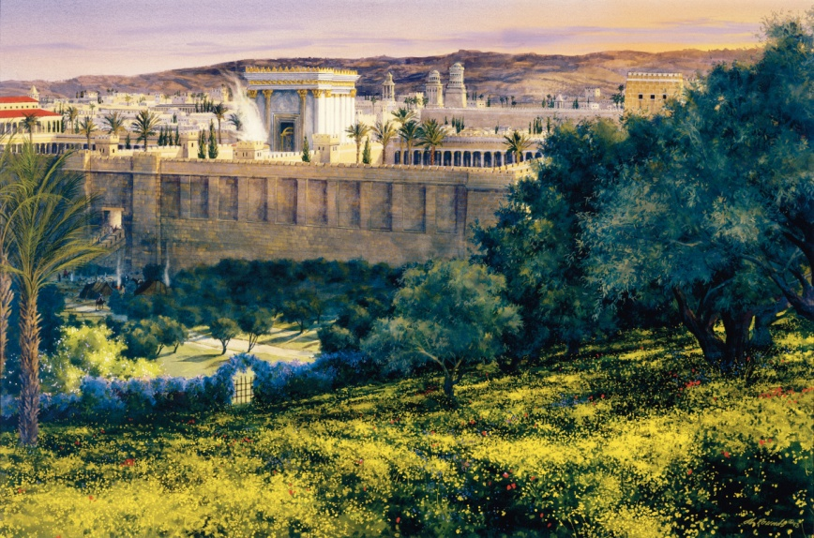
Fulfilled In the Latter-days
This prophecy will be fulfilled in the latter-day temple that will be built on the same site. Haggai’s prophecy that the “desire of all nations shall come” is a prophecy of Christ, who will bring a lasting peace to the world.
Lasting peace, however, will be brought only after the Lord shakes “the heavens, and the earth, and the sea, and the dry land … and … all nations” when He comes in His glory to usher in the Millennium.
The Jerusalem Center located on Mount Scopus, on the northern end of the Mount of Olives
Then His house will indeed be filled with glory, peace will be established, and the desire of all nations will be completely fulfilled.
Haggai 2:1-9
(13)

Slide 39
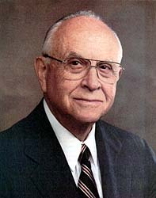
“The moment we step into the house of the Lord, the atmosphere changes from the worldly to the heavenly, where respite from the normal activities of life is found, and where peace of mind and spirit is received.
It is a refuge from the ills of life and a protection from the temptations that are contrary to our spiritual well-being.”
When we are in the house of the Lord, He can give us peace
Haggai 2:9
(15)

Slide 40
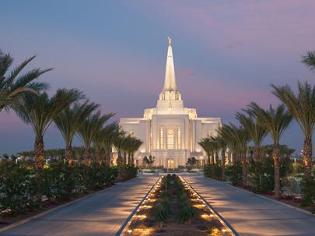
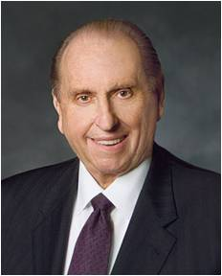
In This Place Will I Give Peace
A future day when peace will come to Jerusalem and the peace we can receive in temples of the Lord
Peace I leave with you, my peace I give unto you: not as the world giveth, give I unto you. Let not your heart betroubled, neither let it be afraid. John 14:27
“The temple provides purpose for our lives. It brings peace to our souls—not the peace provided by men but the peace promised by the Son of God when He said, ‘Peace I leave with you, my peace I give unto you: not as the world giveth, give I unto you. Let not your heart be troubled, neither let it be afraid’”.
“The world can be a challenging and difficult place in which to live. We are often surrounded by that which would drag us down. As you and I go to the holy houses of God, as we remember the covenants we make within, we will be more able to bear every trial and to overcome each temptation. In this sacred sanctuary we will find peace; we will be renewed and fortified”
Haggai 2:9
(16)

Slide 41
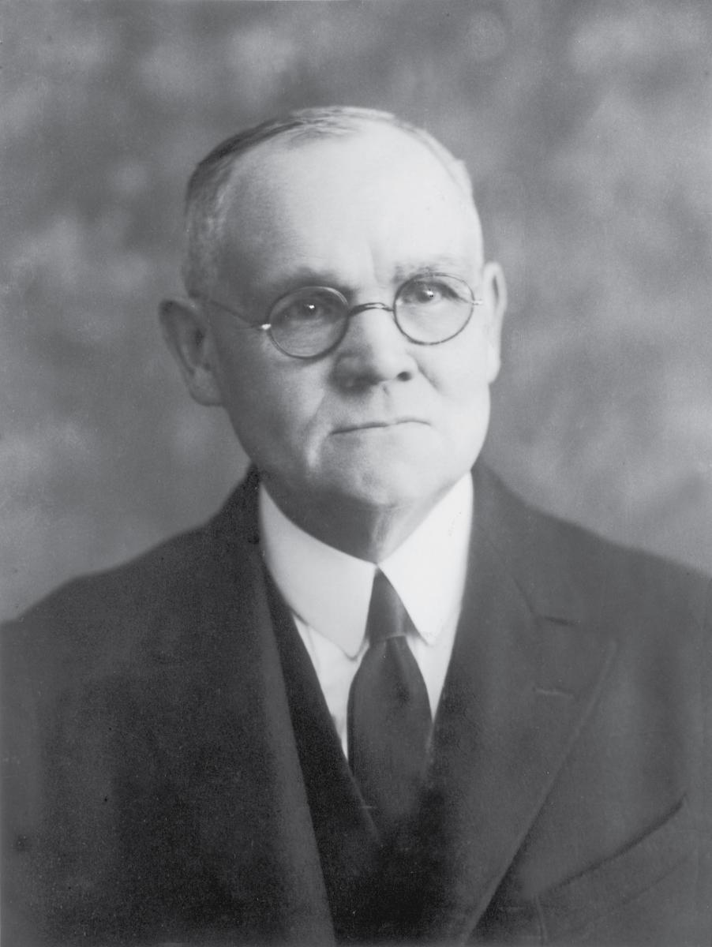
Putting the Lord First
If the people were to fix their temporal problems they could resume building the house of the Lord.
If the people were to fix their spiritual problems the Lord would bless them
If we put God and His will first in our lives, then He will be with us and bless all aspects of our lives
“‘Material belongings, relative wealth or poverty, physical environment—the things on which we are prone to set our hearts and anchor our aspirations, the things for which we sweat and strive, oft times at the sacrifice of happiness and to the forfeiture of real success—these after all are but externals, the worth of which in the reckoning to come shall be counted in terms of the use we have made of them.” (14)
Haggai 2:18-19

Slide 42
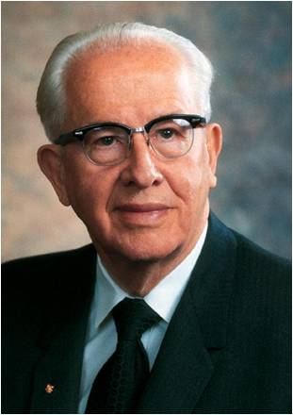
“Men and women who turn their lives over to God will find out that he can make a lot more out of their lives than they can. He will deepen their joys, expand their vision, quicken their minds, strengthen their muscles, lift their spirits, multiply their blessings, increase their opportunities, comfort their souls, raise up friends, and pour out peace.”
(17)

Slide 43
Sources:
Video: After the Storm (5:25)
“His Grace: Choosing to Believe in God” (4:07)
“Wisdom and Order” (3:19).
Who’s Who in the Old Testament by Ed J. Pinegar and Richard J. Allen pp. 139
Old Testament Student Institute Manual The Burden of Ninevah (Nahum) Chapter 20
The Day of the Lord’s Wrath(Zephaniah) Chapter 21
A Question is Asked of the Lord (Habakkuk) Chapter 22
Adam Clarke Commentary
Bible Dictionary
Elder Richard G. Scott (“Trust in the Lord,” Ensign, Nov. 1995, 17).
Ellis T. Rasmussen, An Introduction to the Old Testament and Its Teachings, 2:273).
President Gordon B. Hinckley (“With All Thy Getting Get Understanding,” Ensign, Aug. 1988, 3–4).
Keil and Delitzsch, Commentary, 10:2:134
President Henry B. Eyring (“Waiting Upon the Lord” [Brigham Young University fireside, Sept. 30, 1990], 4;speeches.byu.edu).
Guthrie and Motyer, New Bible Commentary, p. 777.
Elder Jeffrey R. Holland “An High Priest of Good Things to Come,” Ensign, Nov. 1999, 38).
W. Cleon Skousen The Fourth Thousand Years pp. 774-776
Presentation by ©http://fashionsbylynda.com/blog
Old Testament Student Institute Manual Haggai: Prophet of the Second Temple Chapter 30
James E. Talmage, The Vitality of Mormonism, 1919, p. 352.
Elder David B. Haight (“Temples and the Work Therein,” Ensign, Nov. 1990, 61).
President Thomas S. Monson Blessings of the Temple, Ensign, Oct. 2010, 15.
President Ezra Taft Benson The Holy Templeana Beacon to the World, Ensign, May 2011, 93.
President Ezra Taft Benson (“Jesus Christ—Gifts and Expectations,” New Era, May 1975, 20).

Slide 44
Sources continued:
19. Bible Dictionary, “Nahum and Guide to the Scriptures, “Habakkuk”; scriptures.lds.org
20. Bible Chronology
21. Dieter F. Uchtdorf, “Perfect Love Casteth Out Fear,” Ensign or Liahona, May 2017, 106).; (“The Reflection in the Water” [Church Educational System fireside for young adults, Nov. 1, 2009], broadcasts.ChurchofJesusChrist.org)
22. President Russell M. Nelson (“Christ Is Risen; Faith in Him Will Move Mountains,” Liahona, May 2021, 103
Presentation by ©http://fashionsbylynda.com/blog/

Slide 45
Nahum 1 | Nahum 2 | Nahum 3
Nahum explains that the Lord will burn the earth at His Second Coming but will show mercy to the righteous. | Nahum prophesies of Nineveh’s destruction, which foreshadows events that will occur in the latter days. | Nahum continues to foretell Nineveh’s destruction
Habakkuk 1 | Habakkuk 2 | Habakkuk 3
Habakkuk learns that the kingdom of Judah will be conquered by the Chaldeans (Babylonians). In his distress, he asks why the Lord would allow a wicked nation to destroy Judah. | The Lord reminds Habakkuk that His plans are not yet completed but will be fulfilled at a later time. God’s justice will eventually come upon the wicked. | Habakkuk offers a prayer or poetic psalm of praise to God and His majesty.
Zephaniah 1 | Zephaniah 2 | Zephaniah 3
Zephaniah prophesies that God will destroy the people of Judah if they do not repent. | Zephaniah encourages Judah and the meek people of the earth to seek righteousness. He also warns some of Judah’s antagonistic neighbors of God’s judgments that will come upon them. | Zephaniah prophesies of the wickedness of Jerusalem’s leaders and the blessings that the humble inhabitants of Jerusalem will receive after the Lord removes the proud from their city. Zephaniah explains that the Lord will pour out judgment on all nations. Zephaniah reveals that the Lord will give His people a pure language, renew His relationship with them, and reign in the midst of Zion.
Haggai 1 | Haggai 2
Through Haggai, the Lord chastises the people for caring more about the condition of their own homes than that of the Lord’s temple. He explains that their poor crop conditions are a result of their failure to rebuild the temple. He exhorts them to renew their efforts in building the temple. | The Lord commands Haggai to speak to the people and exhort them to be strong as they rebuild the temple. He prophesies that the Messiah (Jesus Christ) will come to His temple and bring peace.

Slide 46
Adam Clarke Commentary on Nahum 1
Nahum 1:3 See also: 2 Kings 19:35 | The Lord hath his way in the whirlwind and in the storm | These are the effects of his power; and when they appear unusual, they may be considered as the immediate effects of his power: and although he be in them to punish and destroy, he is in them to direct their course, to determine their operations, and to defend his followers from being injured by their violence. The pestilential wind which slew one hundred and eighty-five thousand of the Assyrians did not injure one Israelite
Nahum 1:3 | The clouds are the dust of his feet | This is spoken in allusion to a chariot and horses going on with extreme rapidity: they are all enveloped in a cloud of dust. So Jehovah is represented as coming through the circuit of the heavens as rapidly as lightning; the clouds surrounding him as the dust does the chariot and horses.
Nahum 1:4 | He rebuketh the sea - | The Red Sea and the rivers: probably an allusion to the passage of the Red Sea and Jordan. The description of the coming of Jehovah, from the third to the sixth verse, is dreadfully majestic. He is represented as controlling universal nature. The sea and the rivers are dried up, the mountains tremble, the hills melt, and the earth is burnt at his presence. Bashan, Carmel, and Lebanon are withered and languish: streams of fire are poured out, and the rocks are cast down to make him a passage.
Nahum 1:7 | The Lord is good | In the midst of judgment he remembers mercy; and among the most dreadful denunciations of wrath he mingles promises of mercy. None that trust in him need be alarmed at these dreadful threatenings; they shall be discriminated in the day of wrath, for the Lord knoweth them that trust in him.
Nahum 1:8 | Darkness shall pursue | All kinds of calamity shall pursue them till they are destroyed
Nahum 1:9 | Affliction shall not rise up the second time | There shall be no need to repeat the judgment; with one blow God will make a full end of the business.
Nahum 1:10 | While they be folden together | However united their counsels may be, they shall be as drunken men - perplexed and unsteady in all their resolutions; and before God's judgments they shall be as dry thorns before a devouring fire.
Nahum 1:13 See also 2 kings 17:14 | Now will I break his yoke from off thee | This refers to the tribute which the Jews were obliged to pay to the Assyrians.
Nahum 1:14 | No more of thy name be sown - | No more of you shall be carried away into captivity.
Nahum 1:14 See also: 2 kings 19:37 | I will make thy grave; for thou art vile | I think this is an address to the Assyrians, and especially to Sennacherib. The text is no obscure intimation of the fact. The house of his gods is to be his grave: and we know that while he was worshipping in the house of his god Nisroch, his two sons, Adrammelech and Sharezer, smote him there that he died.

Slide 47
The Just Shall Live By His Faith: Habakkuk 2:2:
“This is one of the great passages of the Old Testament. It means essentially this: There is a moral and spiritual distinction between the Chaldeans and the people of Judah. The Chaldeans, puffed up and arrogant, priding themselves in their wealth and power and deceptive in their dealings with other nations, do not possess the moral and spiritual elements which alone can insure permanence and stability. The people of the Lord, on the other hand, [should] possess moral integrity, fidelity, and spiritual insight which insure for them a future. ‘The future belongs to the righteous.’ When the prophet says that ‘the righteous shall live by his faith (more accurately faithfulness)’ he implies permanency.” Sidney B. Sperry (Voice of Israel’s Prophets, pp. 371–72.) OT Institute Manual
Habakkuk 3 The Poetry :
The entire chapter is excellent Hebrew poetry. Habakkuk makes a number of references to events of Moses and Joshua’s time. Anyone familiar with those biblical events will recognize the ones alluded to. The burden of Habakkuk’s prayer is for Jehovah to return and sustain Israel as in days of old. This He will surely do in the latter days. Habakkuk’s trust was fully in God. Rasmussen said of Habakkuk’s song of praise:
“After [his] experience, Habakkuk felt inspired to utter a psalm of praise to God and trust in Him. In awe at the powers and glory of God, he poetically describes the power of Deity over all facets and functions of nature, and speaks of His might to overcome all of His enemies. Then in the spirit expressed also by Job who said, ‘Though He slay me, yet will I trust Him: … ,’ Habakkuk lists in six poetic lines the disasters that could come to him. OT Institute Manual
Zephaniah Genealogy: Zephaniah 1:1:
The brief genealogy in verse one traces Zephaniah back to Hizkiah. It is not known whether this individual was the same as Hezekiah the king, and the other names are not of known individuals. Nothing is known of the life of Zephaniah beyond what can be inferred from his book. OT Institute Manual
“The Last Days Seen Zephaniah 3:8-20
“Zephaniah saw our day and beyond. In it he both suffered and rejoiced. He suffered in spirit because of the desolation and destruction which he saw, but he was able to use this as a warning and threat to his own people. In the redemption and final blessings of Israel he saw a ray of hope to extend to Judah. No prophet has written more clearly or vigorously of the Day of the Lord. Zephaniah must be added to the list of prophets who give us a grave warning of disaster.” (Sidney B. Sperry, The Voice of Israel’s Prophets, p. 388.)

