Slide 1

Rebuilding Jerusalem
Zechariah 1-8

Slide 2

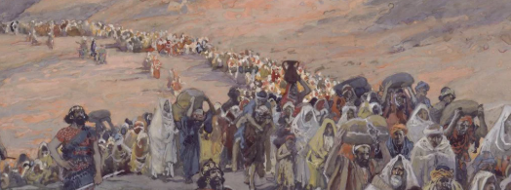
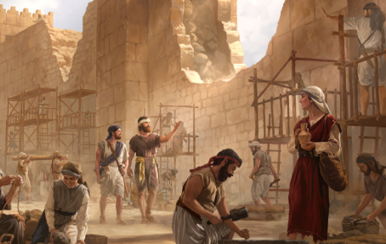
Previously…
After 50 years of captivity in Babylon and Persia, a remnant of the house of Israel had physically returned to their holy land, but spiritually they were still far from the Lord.
They rebuilt the city and started rebuilding the Lord’s temple. But though they had physically returned to Jerusalem, many people were still far from the Lord spiritually.
Ezra 5:1–2; 6:14

Slide 3
Turn Ye Unto Me…
When thou art in tribulation, and all these things are come upon thee, even in the latter days, if thou turn to the Lord thy God, and shalt be obedient unto his voice;
(For the Lord thy God is a merciful God;) he will not forsake thee, neither destroy thee, nor forget the covenant of thy fathers which he sware unto them.
What are some reasons we might turn away from the Lord?
Sometimes we turn away without recognizing that we are drifting.
Zechariah 1:3; Deuteronomy 4:30–31

Slide 4
Which is True for You?
I want to help people I care about who are turning away from the Lord.
I haven’t really thought about how close I am to the Lord.
I am feeling tempted to turn away from the Lord.
I am doing my best to stay close to the Lord and hope I can stay strong.

Slide 5
Zechariah
He was the son of Berechiah, the son of Iddo, the prophet
The book of Zechariah was written shortly after the return of Judah from exile in Babylon under the authority of Cyrus
He and Haggai labored together
He prophesied in the 2nd and 4th years of King Darius
He received the 8 visions of the Lord’s plan of salvation for his people using contemporary events to capture the restoration and sublimation of Israel's faithful at the Second coming
His visions deal with the future of the chosen people and prophesied of the Lord’s plan in defeating the wicked and sustaining and redeeming the righteous in the final days
(1,3)

Slide 6
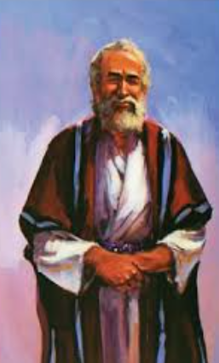
The Lord Sent the Prophet Zechariah
Turn Away From Evil
Be ye not as your fathers, unto whom the former prophets have cried, saying, Thus saith the Lord of hosts; Turn ye now from your evil ways, and from your evil doings: but they did not hear, nor hearken unto me, saith the Lord
Zechariah 1:4

Slide 7
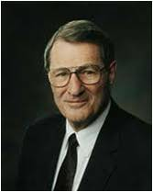
“In the anguishing process of repentance, we may sometimes feel God has deserted us. The reality is that our behavior has isolated us from Him.
Thus, while we are turning away from evil but have not yet turned fully to God, we are especially vulnerable.
Yet we must not give up, but, instead, reach out to God’s awaiting arm of mercy, which is outstretched ‘all the day long.’”
If we turn unto the Lord, then He will turn unto us
Zechariah 1:1-3 ; Jacob 5:5:47; 2 Nephi 28:32; Mormon 5:11
(6)

Slide 8
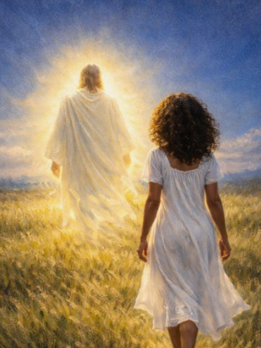
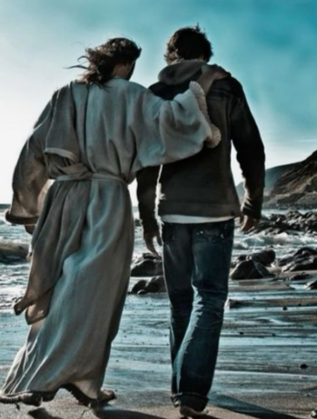
Walking in the Ways of the Lord
Thus saith the Lord of hosts; If thou wilt walk in my ways, and if thou wilt keep my charge, then thou shalt also judge my house, and shalt also keep my courts, and I will give thee places to walk among these that stand by
Zechariah 3:7

Slide 9
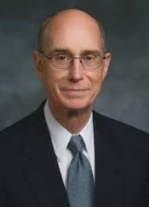
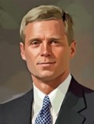
“What does it mean to walk with the Lord? It means to do what He does, to serve the way He serves. He sacrificed His own comforts to bless those in need, so that’s what we try to do.” (11)
“Walking in and with the Savior highlights two vital aspects of discipleship: (1) obeying God’s commandments, and (2) remembering and honoring the sacred covenants that connect us to the Father and the Son.
… Jesus beckons to each of us, ‘Come, follow me’ (Luke 18:22) and ‘walk with me’ (Moses 6:34). I testify that as we press forward in faith and walk in the meekness of the Lord’s Spirit, we are blessed with power, guidance, protection, and peace.” (12)

Slide 10
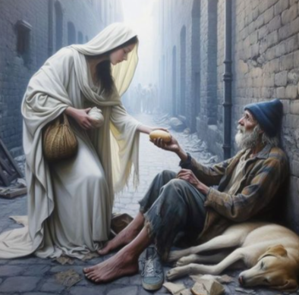
Treating Others With Mercy and Compassion
Thus speaketh the Lord of hosts, saying, Execute true judgment, and shew mercy and compassions every man to his brother:
And oppress not the widow, nor the fatherless, the stranger, nor the poor; and let none of you imagine evil against his brother in your heart.
Zechariah 7:9-10

Slide 11
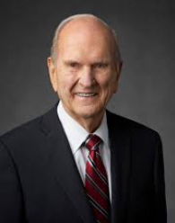
As disciples of Jesus Christ, we are to be examples of how to interact with others—especially when we have differences of opinion. One of the easiest ways to identify a true follower of Jesus Christ is how compassionately that person treats other people. …
My dear brothers and sisters, how we treat each other really matters! How we speak to and about others at home, at church, at work, and online really matters.
Today, I am asking us to interact with others in a higher, holier way. Please listen carefully. “If there is anything virtuous, lovely, or of good report or praiseworthy” [Articles of Faith 1:13] that we can say about another person—whether to his face or behind her back—that should be our standard of communication. (13)

Slide 12
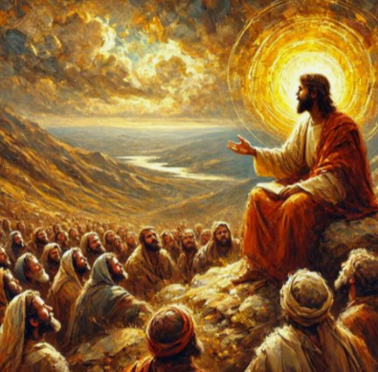
Acting as Peacemakers
These are the things that ye shall do; Speak ye every man the truth to his neighbour; execute the judgment of truth and peace in your gates:
And let none of you imagine evil in your hearts against his neighbour; and love no false oath: for all these are things that I hate, saith the Lord
Zechariah 8:16-17

Slide 13
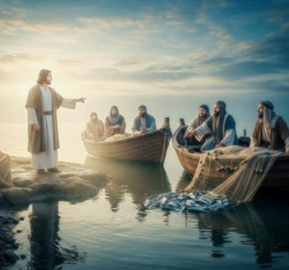
None of us can control nations or the actions of others or even members of our own families. But we can control ourselves. My call today, dear brothers and sisters, is to end conflicts that are raging in your heart, your home, and your life. Bury any and all inclinations to hurt others—whether those inclinations be a temper, a sharp tongue, or a resentment for someone who has hurt you. The Savior commanded us to turn the other cheek, to love our enemies, and to pray for those who despitefully use us. …
We are followers of the Prince of Peace. Now more than ever, we need the peace only He can bring. How can we expect peace to exist in the world when we are not individually seeking peace and harmony? … I plead with you to do all you can to end personal conflicts that are currently raging in your hearts and in your lives. (13)
Zechariah 8:16-17

Slide 14
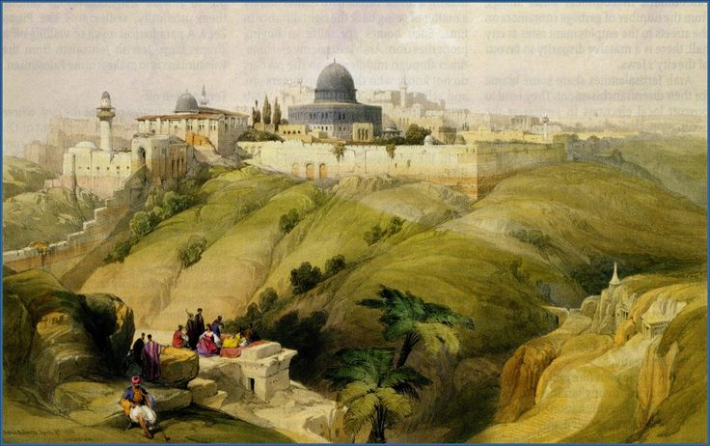
Zechariah’s Visions
First Vision:
He was to assure the Saints of Judah that the Lord was mindful of them and fully intended to restore the land and the people to a stronger position (Zechariah 1:8-17)
Second Vision:
He was to assure them that their enemies would be punished.
(Zechariah 1:18-21)
Third Vision:
Concerned the day of the Lord’s power when He would come and dwell in Jerusalem (Zechariah 2:1-12)
Fourth Vision:
This compared the High Priest, Joshua, of Zechariah’s day, with Prince David who would build and sanctify the temple of Jerusalem in the latter-days.
(Zechariah 3:1-10)
(1,3)

Slide 15
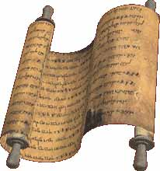
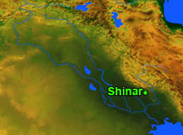
Zechariah’s Visions
Eighth Vision:
Compared with vision 4 with the High Priest of that day and the Priest and king of the last days who would be called the Branch (believed to be Prince David0 and who would build the latter-day temple, rule over Israel, and establish peace among the people
(Zechariah 6:1-15)
Fifth Vision:
He assures Zerubbabel (governor of Jerusalem) that he will yet finish the temples and make reference to the two prophets whom god will raise up to Judah in the last days, just before the Battle of Armageddon
(Zechariah 4:2-14; Revelation 11:4)
Sixth Vision:
He saw a huge scroll whereon the names were written of those who had committed crimes and should be punished
(Zechariah 5:1-4)
Seventh Vision:
This vision is symbolic of the abundance of sin which would be attributed to Shinar or Babylon.
(Zechariah 5:5-11)
(3)

Slide 16
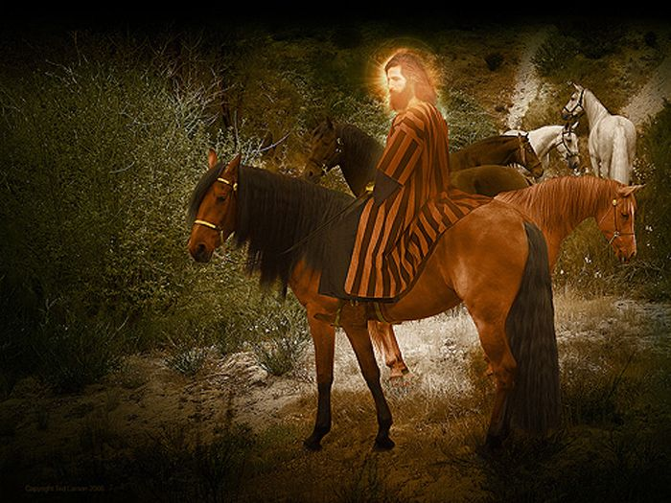
Zechariah’s 1st Vision
A man riding a horse, probably an angel of the Lord and protector of God’s people
A Red horse = battle and bloodshed
White represents victory and peace (Rev. 6:2) = sorrel (speckled in King James Version)
Reddish brown = the aftermath of confusion in the unsettled period after the end of hostilities (Rev. 6:5-8)
Zechariah 1:8-17
(8)

Slide 17
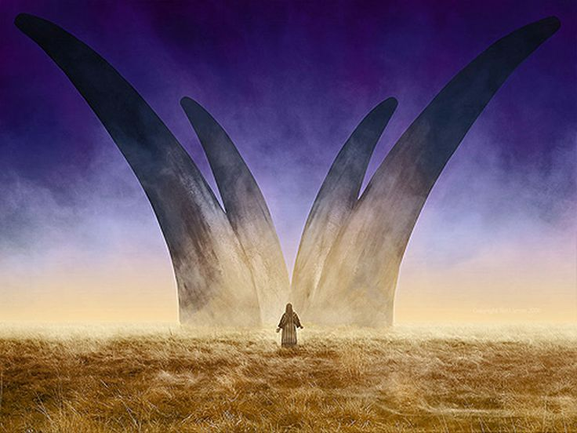
Zechariah’s 2nd Vision
The Horns are a symbol of power. A power of the nation.
The four powers by which the Israelites had been oppressed
By the Assyrians, Persians, Chaldean, and Egyptian…these were their enemies
They came from the North = The Assyrians and Babylonians
They came from the East = The Moabites and Ammonites
They came from the South = The Egyptians
They came from the West = Philistines (4)
For the future, as Daniel had see the four empires would be:
Assyria, Babylonia, Greece, and Rome
Zechariah 1:18-21

Slide 18
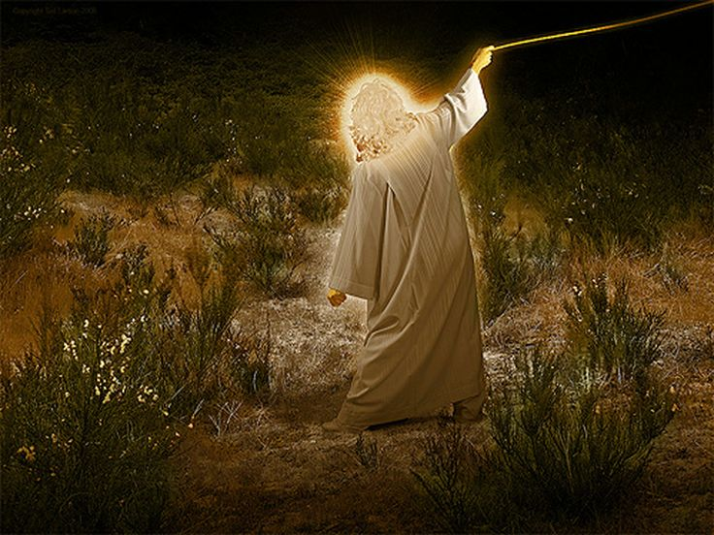
Zechariah’s 3rd Vision
A man with a measuring line in his hand
Jerusalem in the future will resemble an open country, covered with unwalled cities and villages. Jehovah will be the protector with a wall of fire round about, a defense of fire which will consume everyone who ventures to attack it (Isaiah 4:5)
Zechariah 2:1-12; Isaiah 49:19-20; Ezekiel 38:11
(2,9)

Slide 19
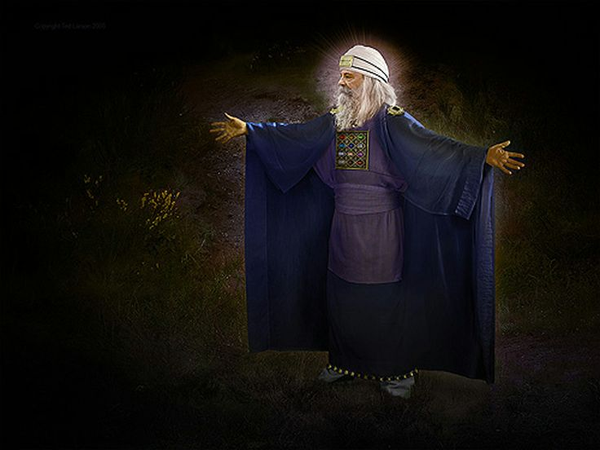
Zechariah’s 4th Vision
Joshua, a High Priest and Satan Standing at his right hand
Typical prophetic fashion:
Joshua = Hebrew -- Yeshua,
Greek--Hee-ay-sous,
English-- Jesus
“From the promises of a glorious future for the city and people of God, Zechariah turns to the means by which they are to be achieved. God will raise up a perfect priestly Mediator, of whom Joshua and his fellow-priests are a foreshadowing.”
Zechariah 3:1-10
(2,9)

Slide 20
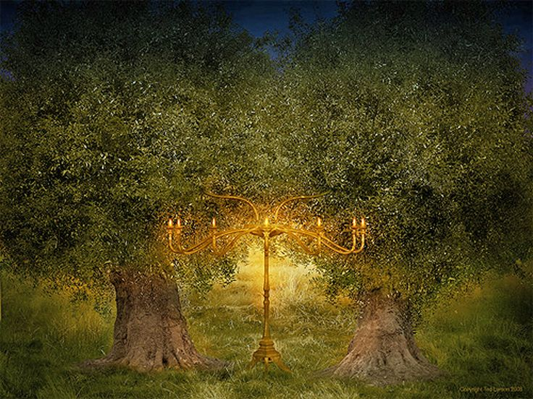
Zechariah’s 5th Vision
These are the two olive trees, and the two candlesticks standing before the God of the earth. Revelation 11:4
The candlestick represents Judah, who had returned from exile in Babylon
Three things must happen before the Messiah comes:
Restoration
Jews must gather to the land of their inheritance
Jews must rebuild Jerusalem
They not only uphold the light (Christ) but the substance of the light, the Holy Ghost, flows through them
The two olive trees represent Joshua and Zerubbabel --They represent Priest and King…both are necessary to rule spiritually and politically.
They are two prophets that are to be raised up to the Jewish nation in the last days, at the time of the restoration, and to prophesy to the Jews after they are gathered and have built the city of Jerusalem in the land of their fathers.
Two prophets--Members of the Quorum of the 12 or the First Presidency
Zechariah 4:2-14; D&C 77:15
(2,7,10)

Slide 21
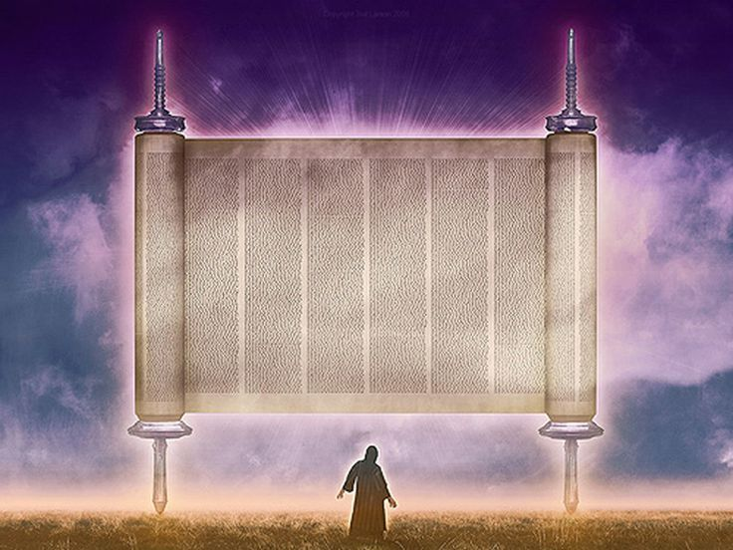
Zechariah’s 6th Vision
A divine standard of holiness.
Its flight in the heavens shows from which quarter judgment comes and also the speed of its execution.
Two particular sins are condemned, one on each side of the scroll, according to the force of the Hebrew. (11)
The roll was a scroll or book flying through the air
This represents the main provision of the law, both moral and religious
Stealing and swearing are supposed to be two general heads of crimes; the former, comprising sins against men; the latter, sins against God. It is supposed that the roll contained the sins and punishments of the Chaldeans. (4)
Zechariah 5:1-4
(2)

Slide 22
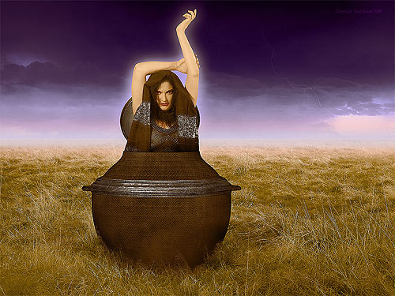
Zechariah’s 7th Vision
Ephah. A round vessel that was one of the largest measures of capacity among the Jews.
Talent of lead. The talent was the largest measure of weight. A talent of lead suggests a very weighty matter.
Woman. A symbol of Israel and her sins.
Shinar. A symbol of Babylon or the world
Zechariah saw in the vision the woman being put in an ephah, covered with a lid made of lead, and carried away into Babylon. Babylon was “regarded as the counterpart of Zion and the proper home of all that is evil, especially of sins such as fraud and false swearing. The vision is remarkable. God not only forgives the sins of His people, but carries them altogether away from their land, that they may deceive them no more.” (8)
Zechariah 5:5-11
(2)

Slide 23
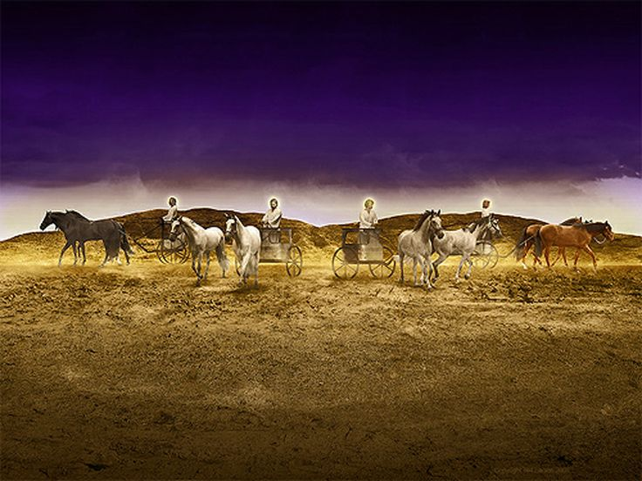
Zechariah’s 8th Vision
And after these things I saw four angels standing on the four corners of the earth, Revelation 7:1
The servants came from between two mountains (two places where the Lord will judge the nations) which were made of brass, a symbol of firmness.
The four servants went throughout the earth in chariots drawn by horses of different colors.
Read D&C 86:4-7
The black horses, the only ones not previously mentioned, seem to represent death or mourning.
Zechariah 6:1-15; Revelation 7:1-3
(2,9)

Slide 24
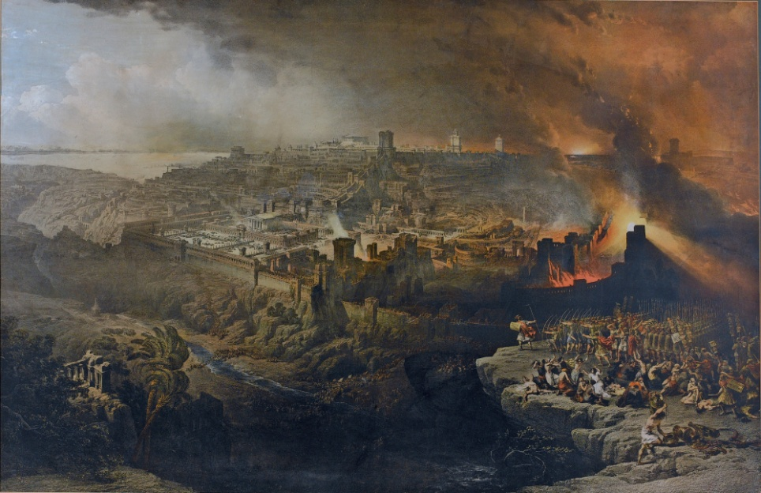
The Feasts
One feast was celebrated in the tenth month, the month in which the Babylonians laid siege to Jerusalem (see Jeremiah 39:1).
A second feast, celebrated in the fourth month, commemorated the destruction of Jerusalem (see Jeremiah 39:2; 52:67).
A fourth feast was celebrated in the seventh month to commemorate the assassination of Gedaliah, the puppet king placed over Judah by the Babylonians after they destroyed Jerusalem (see 2 Kings 25:25).
A third feast, held in the fifth month, marked the destruction of the temple (see Jeremiah 52:12–14).
Zechariah reminded the people that they had set up the feast days to remind them of tragedies, but not once did they remember the Lord through feasts while in captivity.
Zechariah 7
(2)

Slide 25
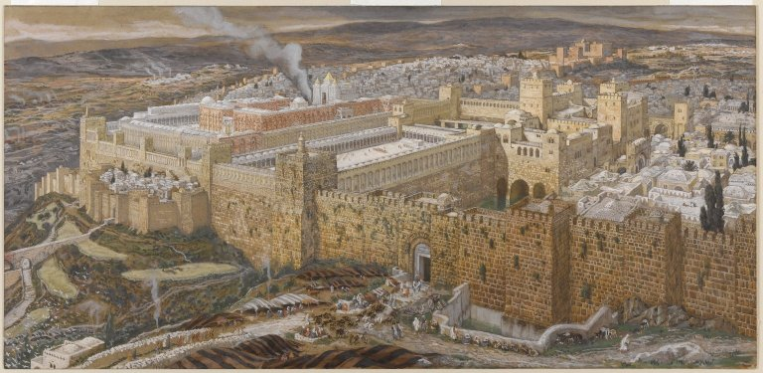
The Promise
The Lord promised to gather Judah and restore the people to the land of Jerusalem.
The heavens would no longer be sealed, and the thirsty land would become productive.
As the promises of punishments were fulfilled to their forefathers, just as surely will the promises of blessings be fulfilled.
The Lord will require then, as always, that His people keep His commandments and walk in continual righteousness.
Zechariah 8:14-17
(2)

Slide 26
Sources:
Videos: Why Mormons Build Temples(3:14)
Repentance (:37)
The Great Commandment—Love The Lord (:38)
Who’s Who in the Old Testament by Ed J. Pinegar and Richard J. Allen pp. 66, 187
Old Testament Student Institute Manual Haggai: Prophet of the Second Temple Chapter 30 Preparations for the Lord’s Return in Glory (Zechariah) Chapter 33
W. Cleon Skousen The Fourth Thousand Years pp. 774-776
Presentation by ©http://fashionsbylynda.com/blog/
Adam Clarke Commentary on the Bible
Elder David B. Haight (“Temples and the Work Therein,” Ensign, Nov. 1990, 61).
Elder Neal A. Maxwell “Repentance,” Ensign, Nov. 1991, 31.
Dummelow, Commentary, p. 603-604
D. Guthrie and J. A. Motyer, eds., The New Bible Commentary: Revised, p. 789-792.)
Keil and Delitzsch, Commentary, 10:2:235, 286-287
Poway Institute California Becky Davies and Lesley Meachamre
President Henry B. Eyring “Walk in the Lord” April 2017 Gen. Conf.
Elder David A. Bednar “Abide in Me, and I in You; Therefore Walk with Me,” April 2023 general conference
President Russel M. Nelson (“Peacemakers Needed,” Liahona, May 2023, 98, 99–100); (“The Power of Spiritual Momentum,” Liahona, May 2022, 97)

Slide 27
Zechariah 1-6 | Zechariah 7-8 | Zechariah 9-11 | Zechariah 12-14
In a series of visions, Zechariah sees the restoration of Jerusalem and the temple; the gathering of Israel; and Joshua, the high priest, crowned in similitude of Christ. | Because of the Israelites’ hypocrisy and oppression of the poor, the Lord scattered them among the nations. In the latter days, He will restore Jerusalem and gather Judah; many Gentiles will gather with them to worship the Lord. | Zechariah prophesies of Christ’s ministry: He will enter Jerusalem riding upon an ass; the spirits in prison will be redeemed by the blood of the covenant. Scattered Israel will be gathered, redeemed, and strengthened. Christ will be betrayed for 30 pieces of silver. | In the final battle before the Second Coming of Jesus Christ, many people will gather to fight against Jerusalem, and the Lord will destroy them. The Jews will recognize their Messiah, whom they crucified, and see the wounds in His hands. Christ will reign as King of the whole earth.

Slide 28
Historical Time Period During Haggai and Zechariah:
“This was a time when the outlying provinces of the Persian Empire, each under their appointed governor (Haggai 1:1), were deprived of direct help from the central government. The enlightened policy of encouraging local autonomy in secular and religious affairs initiated by Cyrus, by whose decree the first return of Jews had begun in 536 B.C., had ceased with his death some 6 years later. His son Cambyses (530–522) showed less sympathy to vassal states and this doubtless contributed to the failure of the Jewish people to press forward with the reconstruction of the Temple at Jerusalem where work had come to a standstill soon after the arrival of the first returnees under Sheshbazzar, the Judean governor nominated by the Persians. This interruption was prolonged by the opposition of the Samaritans and local landowners which led to a prohibition of further work. … Morale was low and men concentrated on the betterment of their own circumstances. To them it was an inappropriate time to spend effort and wealth on God’s house (1:2).” (D. Guthrie and J. A. Motyer, eds., The New Bible Commentary: Revised, p. 781.) found in OT Institute Manual
There's a hole in the bucket, dear Liza, dear Liza,
There's a hole in the bucket, dear Liza,
There's a hole.
Then fix it dear Henry, dear Henry, dear Henry,
Then fix it dear Henry, dear Henry, fix it.
With what should I fix it, dear Liza, dear Liza,
With what should I fix it, dear Liza, with what?
With a straw, dear Henry, dear Henry, dear Henry,
With a straw, dear Henry, dear Henry, with a straw.
But the straw is too long, dear Liza, dear Liza,
The straw is too long, dear Liza, too long.
Then cut it dear Henry, dear Henry, dear Henry,
Then cut it dear Henry, dear Henry, cut it!
With what shall I cut it, dear Liza, dear Liza,
With what shall I cut it, dear Liza, with what?
With an ax, dear Henry, dear Henry, dear Henry,
With an ax, dear Henry, an ax.
But the ax is too dull, dear Liza, dear Liza,
The ax is too dull, dear Liza, too dull.
Then, sharpen it, dear Henry, dear Henry, dear Henry,
Then sharpen it dear Henry, dear Henry, sharpen it!
With what should I sharpen it, dear Liza, dear Liza,
With what should I sharpen, dear Liza, with what?
With a stone, dear Henry, dear Henry, dear Henry,
With a stone, dear Henry, dear Henry, a stone.
But the stone is too dry, dear Liza, dear Liza,
The stone is too dry, dear Liza, too dry.
Then wet it, dear Henry, dear Henry, dear Henry,
Then wet it dear Henry, dear Henry, wet it.
With what should I wet it, dear Liza, dear Liza,
With what should I wet it, dear Liza, with what?
With water, dear Henry, dear Henry, dear Henry,
With water, dear Henry, dear Henry, with water.
But how shall I get it?, dear Liza, dear Liza,
But how shall I get it?, dear Liza, with what?
In the bucket, dear Henry, dear Henry, dear Henry,
In the bucket, dear Henry, dear Henry, in the bucket!
But there's a hole in the bucket, dear Liza, dear Liza,
There's a hole in the bucket, dear Liza, a hole.
There's a hole.
Just For Fun
A traditional Children’s Song…
Aren’t we all like Henry at times?
How many excuses can we give the Lord for not mending our ways?
Reasons for The Fall of Rome:
“A noted historian several years ago summarized the reasons for the fall of Rome as follows:
“1. The breakdown of the family and the rapid increase of divorce.
“2. The spiraling rise of taxes and extravagant spending.
“3. The mounting craze for pleasure and the brutalization of sports.
“4. The decay of religion into myriads of confused forms, leaving the people without a uniform guide. [See Will Durant, The Foundation of Civilization (New York: Simon and Schuster, 1936), pp. 9–10; Will and Ariel Durant, The Lessons of History (New York: Simon and Schuster, 1968), pp. 87–94.]
“Our unconquered appetites and consuming drive for material possessions appear to be leading us on a course so often repeated in history. Greed, lust, and desire historically have only led mankind to waste, destruction, and suffering. Elder Tom L. Perry (In Conference Report, Apr. 1973, p. 14; or Ensign, July 1973, p. 20.)

Slide 29
Different-Colored Horses Zechariah 1:8
“A man riding upon a red horse is probably the angel of the Lord (cf. v. 11; see also Introduction to Exodus, p. 116). In this scene, enacted in the valley bottom, he is the protector of God’s people. Aspects of the divine providence are represented in the colours of the heavenly scouts. Red depicts battle and bloodshed (cf.Rev. 6:4 ; white represents victory and peace (cf. Rev. 6:2); sorrel [speckled in the King James Version], i.e.r eddish brown, is the aftermath of confusion in the unsettled period after the end of hostilities (cf. Rev. 6:5–8).” (D. Guthrie and J. A. Motyer, eds., The New Bible Commentary: Revised, p. 789.)
Horns Zechariah 1: 18-19:
“The horn is a symbol of power [compare Amos 6:13]. The horns therefore symbolize the powers of the world, which rise up in hostility against Judah and hurt it. … The four horns which are seen simultaneously [may] represent nations which succeeded one another. This is shown still more clearly by the visions in [Daniel 2and 7], in which not only the colossal image seen in a dream by Nebuchadnezzar [Daniel 2], but also the four beasts which are seen by Daniel to ascend simultaneously from the sea, symbolize the four empires, which rose up in succession one after the other. It is to these four empires that the four horns of our vision refer. … Zechariah sees these in all the full development of their power, in which they have oppressed and crushed the people of God, … and for which they are to be destroyed themselves.” (Keil and Delitzsch, Commentary, 10:2:238–39.)
It is not clear which four empires are meant in this prophecy. If the prophecy referred to the empires of the past that engaged in the scattering, they would be Assyria, Babylonia, Persia, and Media. But if Zechariah was also looking to the future, as Daniel did, the four empires would be Assyria, Babylonia, Greece, and Rome. Persia and Media would be omitted, since they were responsible for the return of the exiles.
Mission of the Riders: Zechariah 1:9-11
The riders sent out by God now return and report that the earth is by no means shaken and in motion, but the whole world sits quiet and at rest. We must not, indeed, infer from this account that the riders were all sent for the simple and exclusive purpose of obtaining information concerning the state of the earth, and communicating it to the Lord. For it would have been quite superfluous and unmeaning to send out an entire troop, on horses of different colours, for this purpose alone. Their mission was rather to take an active part in the agitation of the nations, if any such existed, and guide it to the divinely appointed end, and that in the manner indicated by the colour of their horses; viz. according to [Revelation 6], those upon the red horses by war and bloodshed; those upon the starling-grey, or speckled horses, by famine, pestilence, and other plagues; and lastly, those upon the white horses, by victory and the conquest of the world.” (Keil and Delitzsch, Commentary, 10:2:234.)
Carpenters Zechariah 1:20-21:
The Lord told Zechariah that the builders would “fray” and “cast out” the four horns. As Keil and Delitzsch noted: “The vision does not show what powers God will use for this purpose. It is simply designed to show to the people of God, that every hostile power of the world which has risen up against it, or shall rise up, is to be judged and destroyed by the Lord.” (Commentary,10:2:241.)
Restoration of Jerusalem Zechariah 1:12-17:
For seventy years Jerusalem lay in ruins after the terrible destruction by the Babylonians at the time of King Zedekiah, king of Judah. Zechariah now prophesied of a time when the land of Judah would again prosper. Cities would cover the land, and Jerusalem would be rebuilt and be adorned with a temple. The Lord will yet accept His people and own Jerusalem. Here again was a dualistic prophecy. Jerusalem was rebuilt under Zerubbabel, Ezra, and Nehemiah and again became the capital of the Jewish nation. But in A.D. 70 Rome destroyed Jerusalem and the Jews as a nation. Not until 1948, when Israel once again became an independent nation, did Jerusalem again become the seat of government for a Jewish nation. On 13 December 1949, the Israeli government announced that “Jerusalem was and would remain Israel’s eternal capital” (Encyclopaedia Judaica, 9:1486).
Apple of His Eye Zechariah 2:8
“The apple of the eye (lit. the gate, the opening in which the eye is placed, or more probably the pupil of the eye, pupilla, as being the object most carefully preserved), is a figure used to denote the dearest possession or good, and in this sense is applied to the nation of Israel as early as [Deuteronomy 32:10].” (Keil and Delitzsch, Commentary, 10:2:248.)
The Olive Trees Zechariah 4;3, 11-14
The two olive trees represent Joshua and Zerubbabel (see Bruce R. McConkie, Doctrinal New Testament Commentary, 3:510).
Joshua and Zerubbabel can be seen as messianic types, “who as Spirit-filled men convey blessing from God to church and state, and are a type of the Messiah as Priest and King” (Guthrie and Motyer, New Bible Commentary, p. 791). The same imagery was used by John in Revelation 11:4.

Slide 30
Vision 8 Zechariah 6:1-8
On 6 December 1832, the Savior told the Prophet Joseph Smith that these angels were crying unto Him day and night for permission to reap down the earth and burn the tares (see D&C 86:4–7).Zechariah 6:7 states that the angels could not go forth upon the earth until given permission by the Lord.
Sixty-one years after the revelation in section 86 of the Doctrine and Covenants was given,
President Wilford Woodruff declared that the Lord had released those destroying angels and they were then upon the earth separating the tares from the wheat in preparation for the burning that would soon take place: “God has held the angels of destruction for many years, lest they should reap down the wheat with the tares. But I want to tell you now, that those angels have left the portals of heaven, and they stand over this people and this nation now, and are hovering over the earth waiting to pour out the judgments. And from this very day they shall be poured out. Calamities and troubles are increasing in the earth, and there is a meaning to these things. Remember this, and reflect upon these matters. If you do your duty, and I do my duty, we’ll have protection, and shall pass through the afflictions in peace and in safety.” (“The Temple Workers’ Excursion,” Young Woman’s Journal, Aug. 1894, pp. 512–13; emphasis added.)
Article of Walking in His Way:
https://www.thechurchnews.com/living-faith/2025/12/29/2026-youth-theme-general-conference-quotes-walk-with-christ/
D&C 86:
President Joseph Fielding Smith said:
“Now I want to make some comments in regard to the statement by President Woodruff and this parable [the parable of the wheat and tares in D&C 86].
“The Lord said that the sending forth of these angels was to be at the end of the harvest, and the harvest is the end of the world. Now, that ought to cause us some very serious reflections. And the angels have been pleading, as I have read it to you, before the Lord to be sent on their mission. Until 1893 the Lord said to them no, and then He set them loose. According to the revelation of President Woodruff, the Lord sent them out on that mission.
“What do we gather out of that? That we are at the time of the end. This is the time of the harvest. This is the time spoken of which is called the end of the world.” (The Signs of the Times, pp. 11–21.)

