Slide 1

Prophesies of Armageddon
Zechariah 9-14

Slide 2

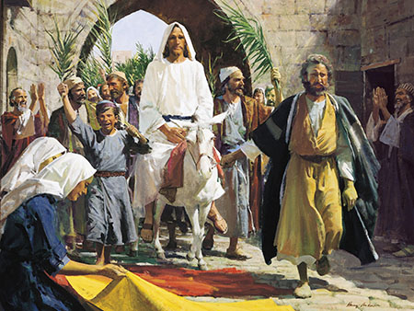
Prophecy Fulfilled
Donkey = symbol of Peace
Horse = symbol of war
Rejoice greatly, O daughter of Zion; shout, O daughter of Jerusalem: behold, thy King cometh unto thee: he is just, and having salvation; lowly, and riding upon an ass, and upon a colt the foal of an ass. Zechariah 9:9
Tell ye the daughter of Sion, Behold, thy King cometh unto thee, meek, and sitting upon an ass, and a colt the foal of an ass. Matthew 21:5
Fear not, daughter of Sion: behold, thy King cometh, sitting on an ass’s colt.
John 12:15
And the multitudes that went before, and that followed, cried, saying, Hosanna to the Son of David: Blessed is he that cometh in the name of the Lord; Hosanna in the highest.
Matthew 21:9
Took branches of palm trees, and went forth to meet him, and cried, Hosanna: Blessed is the King of Israel that cometh in the name of the Lord. John 12:13

Slide 3
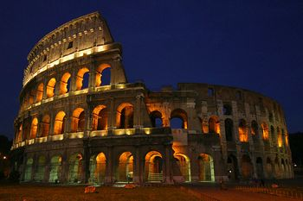
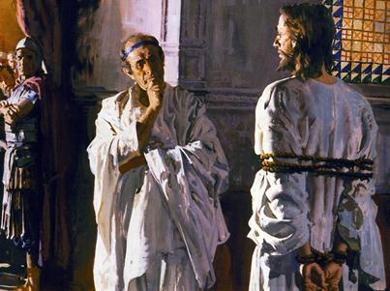
Looking for the Messiah
“Many Jews were looking only for a deliverer from the Roman power and for a greater national prosperity.”
When Jesus Christ rode into Jerusalem, many Jews cheered for Him as a messiah, or a political deliverer, not necessarily the Messiah, who would bring them eternal salvation.
The title Messiah means “the anointed Prophet, Priest, King, and Deliverer whose coming the Jews were eagerly expecting”
Roman Coliseum Dedicated by Titus in 80 AD
Although some people believed that Jesus Christ was the Messiah, many were disappointed that He did not overthrow the Roman rule.
Some of the Jewish leaders envied Him and rejected Him as both a messiah and the Messiah, so they plotted His death.
They persuaded the multitude at Pilate’s court to demand that Barabbas be released instead of Jesus Christ, which resulted in the Savior’s Crucifixion.
Zechariah 9:9
(2)

Slide 4
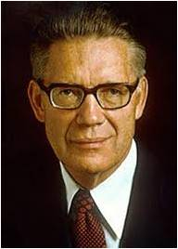
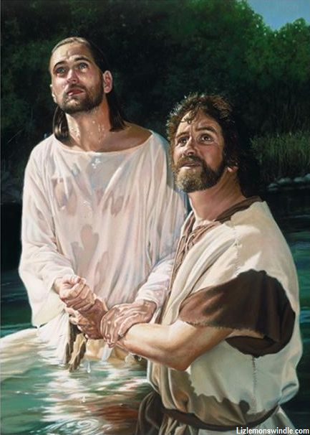
Who Are the Prisoners?
“It was of these that Zechariah prophesied when as part of a longer Messianic utterance, he spoke of ‘prisoners of hope’; it was of these that he gave assurance that ‘the Lord their God shall save them.’
‘By the blood of the covenant’ = symbolic of the blood of Christ
‘I have sent forth thy prisoners out of the pit wherein is no water = Saving water, baptism and earthly ordinance
Baptism cannot be performed by spirit beings while they dwell in the spirit world.
Because of the Atonement of Jesus Christ, salvation is available to all mankind, and those who have died without having been baptized can be freed from spirit prison
Liz Lemon Swindle
What shall they do which are baptized for the dead, if the dead rise not at all? why are they then baptized for the dead?’
1 Cor. 15:29
Zechariah 9:10-16
(3)

Slide 5
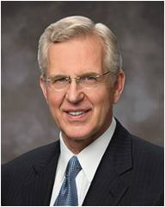
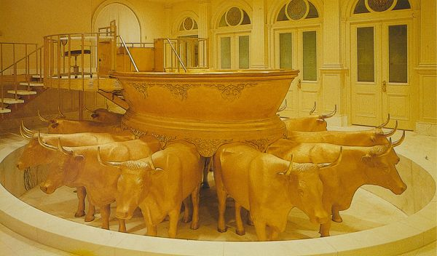
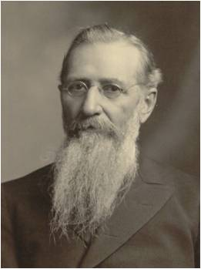
“While yet in life, Jesus prophesied that He would also preach to the dead. Peter tells us this happened in the interval between the Savior’s Crucifixion and Resurrection.
President Joseph F. Smith … witnessed in vision that the Savior visited the spirit world and ‘from among the righteous [spirits], he organized his forces and appointed messengers, clothed with power and authority, and commissioned them to go forth and carry the light of the gospel to them that were in darkness. …
Salt Lake Baptismal Font
“‘These were taught faith in God, repentance from sin, vicarious baptism for the remission of sins, [and] the gift of the Holy Ghost by the laying on of hands’ …
“… Jesus Christ is the divine Redeemer of all mankind. His grace and promises reach even those who in life do not find Him. Because of Him, the prisoners shall indeed go free.”
Zechariah 9:11-16; 1 Peter 3:18-19; D&C 138:30, 33
(4)

Slide 6
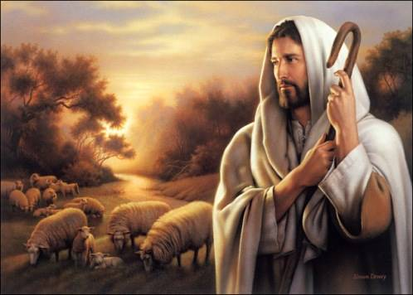
Follow the True Shepherd
Jesus Christ is the true shepherd of our souls
I am the door of the sheep
By me if any enter, he shall be saved and go in and out and find pasture
The good shepherd lives his life for his sheep
The good shepherd knows His sheep
And other sheep I have, which are not of this fold: them also I must bring, and they shall hear my voice; and there shall be one fold, and one shepherd.
John 10:16
Zechariah 10:1-12

Slide 7
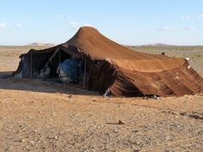
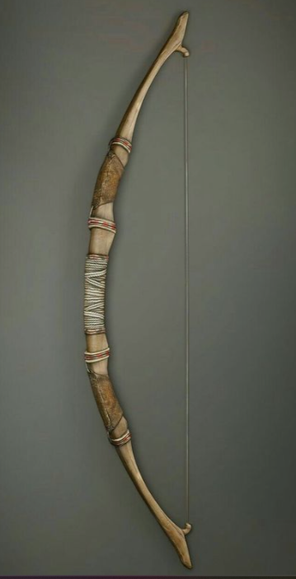
Judah and Ephraim Restored
To Their Rightful Place
“Judah will provide the corner-stone for security.
The nail = The tent peg was the hooked peg built into a wall to hold the implements (weapons) of war as well as the household utensils.
The battle bow = the effective power in leadership
The prince-leader (Jesus Christ) will not oppress by unjust taxation or impose crushing burdens to great for the poor to bear, but will exact tribute from their vanquished enemies (5)
Zechariah 10:4
(1)

Slide 8
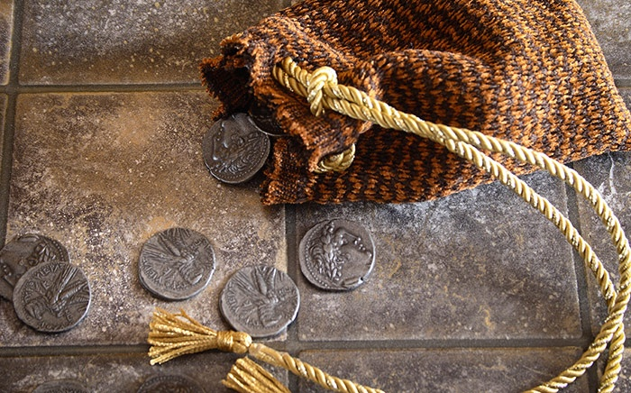
30 Pieces of Silver
The True Shepherd was sold by His own people
To betray = to deceive, beguile, ensnare, trap, sell out, desert, to be a traitor
This shows a low regard that Judas and the chief priests had for Jesus.
Exodus 21:32
Judas took the initiative.
He sought out the chief priest; he chose to betray the Lord:
he asked for money.
30 pieces of silver was the amount recognized as the price of a slave in the law of Moses
Matthew 26:15
Zechariah 11:12: Luke 22:2-6
(1)

Slide 9
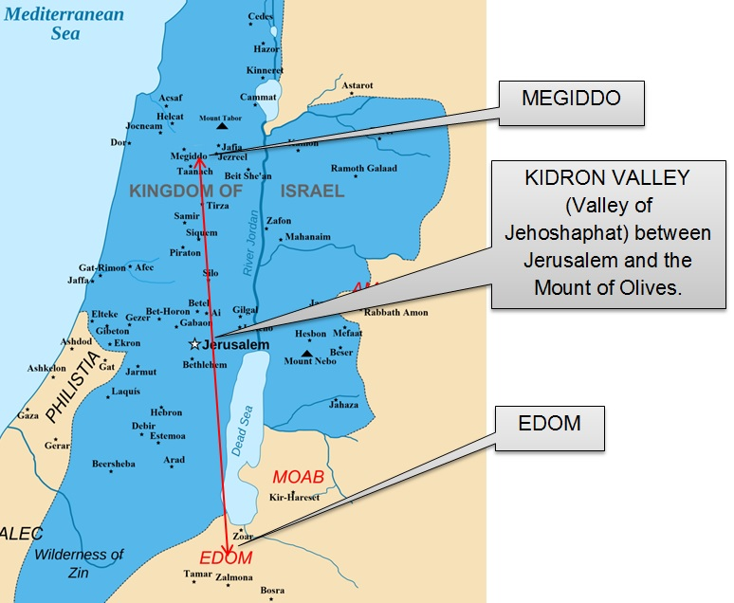
Hadadrimmon
In the Valley of Megiddon
The death of the king was bewailed by the people, especially the righteous members of the nation and Jeremiah compose an elegy on his death.
And Jeremiah lamented for Josiah: and all the singing men and the singing women spake of Josiah in their lamentations to this day, and made them an ordinance in Israel: and, behold, they are written in the lamentations
2 Chronicles 35:25
Hadadremmon is a city near Jerusalem, but is now called Mazimianopolis
It is in the field of Magedoon, where the good king Josiah was wounded by Pharaoh Necho, then soon after “gave up the ghost’
Zechariah compares the lamentation for the putting of the Messiah to death to this great national mourning.
Zechariah 12:11; 2 Chronicles 35:22-24
(1)

Slide 10
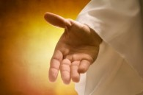
Wounds in His Hand
At the Second Coming, the Jews at Jerusalem will recognize Jesus Christ as the Messiah.
Crucifixion of Jesus Christ
An again another scripture saith, They shall look on him whom they pierced.
John 19:37
Zechariah 13:6; D&C 45:51-51
(3)

Slide 11
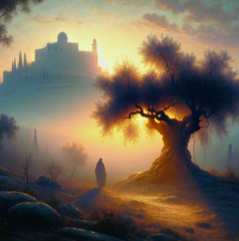
Armageddon
Jesus Christ will return in the last days and gather, save, and protect His people.
Gathering all the nations against Jerusalem to battle
Jesus appears on Mount of Olives– East of Jerusalem
And he gathered them together into a place called in the Hebrew tongue: Armageddon
Revelation 16:16
Trees represent people
Cedars and cypresses of Lebanon
Oaks of Bashan
Figures denoting what is lofty, glorious, and powerful in the world of nature and humanity. The land of Israel will become desolate.
Zechariah 11; 14:3-5
(1)

Slide 12
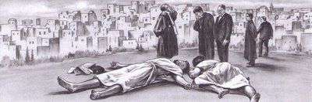
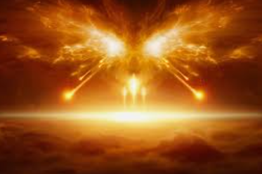
The Final Extremity--Armageddon
Two prophets will be captured and killed by the opposing army and their bodies will be left in the streets of Jerusalem for 3 ½ days
During the “three days and an half” that the prophets lie dead in the streets, the army will ravage the city of Jerusalem and the remaining population of Israel. Revelation 11:9
Zechariah says that only one-third of the nation of Israel will survive this final extremity when the “city [Jerusalem] shall be taken, and the houses rifled [looted], and the women ravished; and half of the city shall go forth into captivity.”
Zechariah 14:2; 13:8-9; 14:1
(1)

Slide 13
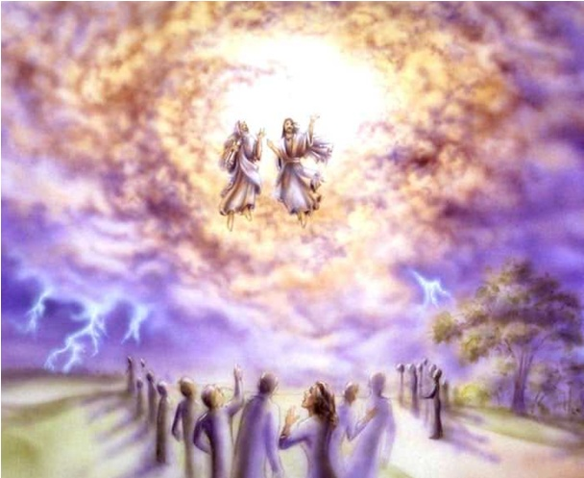
The Blackest Moment in Israel History
Just as it appears that they are about to be annihilated, the Lord’s fury will be unleashed upon the kingdoms of the world, and the Lord will “go forth, and fight against those nations.”
The two prophets, lying dead in the streets of Jerusalem, will be resurrected in the sight of the people.
“After three days and a half, on a sudden, the spirit of life from God will enter them; they will arise and stand upon their feet, and great fear will fall upon them that see them. And then they shall hear a voice from heaven saying, ‘Come up hither,’ and they will ascend up to heaven in a cloud, with their enemies beholding them.”
Revelation 11:11-12
(6)
An earthquake will strike the earth, affecting the whole world—the greatest earthquake the world has ever known
Zechariah 14:3; Ezekiel 38:18-20; Revelation 11:11-13; 16:18; Haggai 2:6- 7
(1)

Slide 14
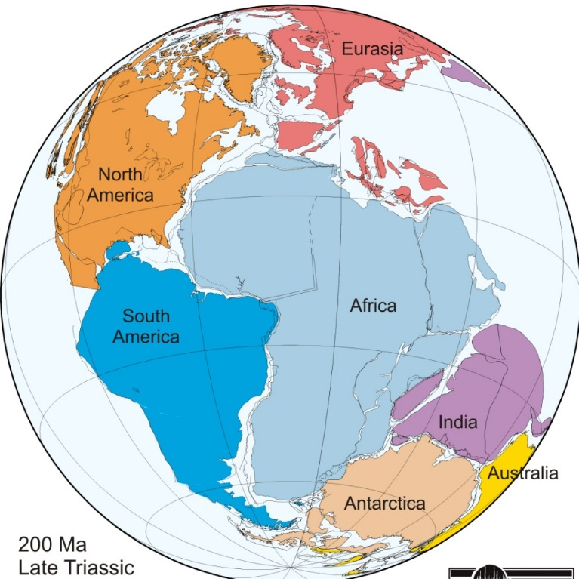
Three Natural Changes
Named in Revelation 16:17-21
1. Earth’s land masses shall unite; islands and continents shall become one land.
2. Every valley shall be exalted and every mountain shall be made low; the rugged terrain of today shall level out into a millennial garden.
3. Such an earthquake as has never been known since man’s foot was planted on this planet shall attend these changes in the earth’s surface and appearance.
“And, fourthly, as recorded elsewhere, the great deep—presumably the Atlantic ocean—shall return to its place in the north, ‘and the earth shall be like as it was in the days before it was divided.”
D&C 133:21-24
(3)

Slide 15
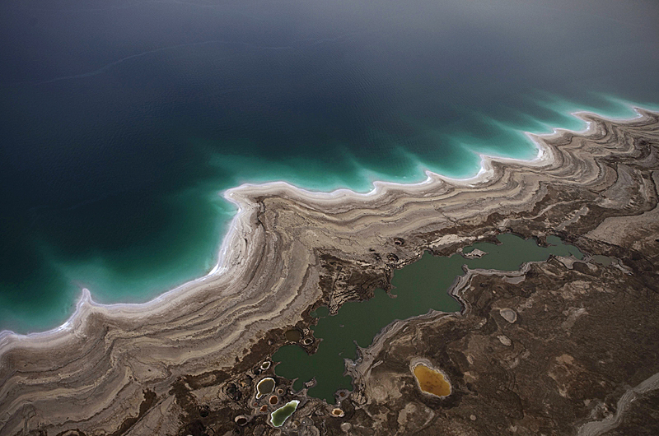
Results of the Quake
This quake will evidently create a huge spring in Jerusalem which will form a new river, flowing westward to the Mediterranean Sea and eastward to the Dead Sea.
Because of this river, the Dead Sea will have its waters healed, that is, it will become a lake with verdant foliage surrounding its shores and fish teeming in its waters.
The area around Jerusalem, which is now very hilly and steep, will be smoothed out and become like “a plain.”
Zechariah 14:8-10; Joel 3:18; Ezekiel 47:1-12
(1)

Slide 16
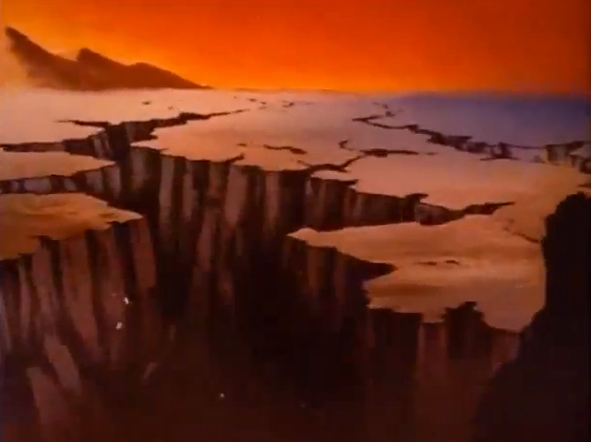
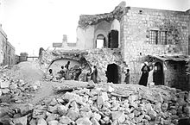
The Mount of Olives—Split in Two
Providing an avenue of escape for the house of Israel
“All [the prophets] speak of [this day]; and when that time comes, the Lord is going to come out of His hiding place. You can see what a terrible condition it is going to be; and the Jews besieged, not only in Jerusalem but, of course, throughout Palestine are in the siege; and when they are about to go under, then the Lord comes. There will be the great earthquake.”
The earthquake will not be only in Palestine. There will not be merely the separation of the Mount of Olives, to form a valley that the Jews may escape, but the whole earth is going to be shaken. There will be some dreadful things take place, and some great changes are going to take place, and that you will find written in the book of Ezekiel.”
Zechariah 14:4-5; Ezekiel 38:17-23
(1)

Slide 17
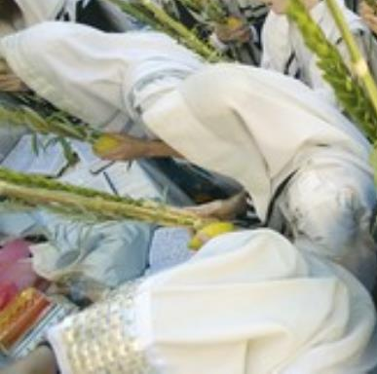
The Jews Will Flee
They will see their Messiah who has come to deliver them.
In gratitude and joy they will throw themselves at the feet of the Deliverer and discover the wounds in His hands and feet.
Suddenly they will realize that their Messiah is the Messiah who came to them before, and the Jewish nation will be converted to their God.
Zechariah 14:4-5; 12:9-10; 13:6; D&C 45:47-53
(1)

Slide 18
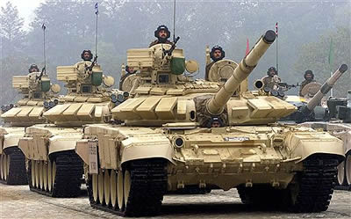
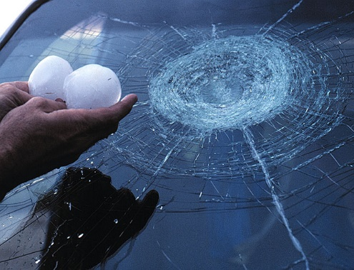
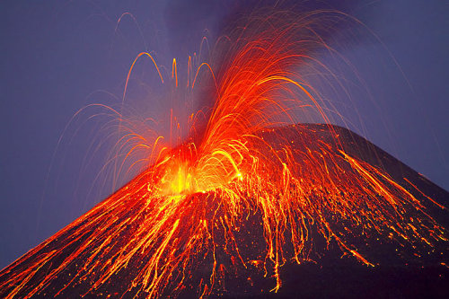
The Lord’s Fury
Upon the army of Gog
The armies of Gog will turn upon each other, perhaps in the panic and confusion of the great earthquake.
A great rain of fire and hail will shower down upon the army .
John said the hailstones will weigh a talent, which is about 75.6 pounds or 34.3 kilograms.
Ezekiel stated that fire will also be sent against the land of Magog. The account by Ezekiel could very easily be a description of atomic warfare.
Isaiah described the fire’s effect on the land itself.
A plague will strike the army, causing terrible disease and calamity
The largest official hailstone ever collected in the U.S., fell in South Dakota on July 23, 2010. 8 inches – 2 lbs
(1,8)
Zechariah 14:12-13; Ezekiel 38:21-22; 39:6; D&C 29:21; Revelation 16:21; Isaiah 34:9-10

Slide 19
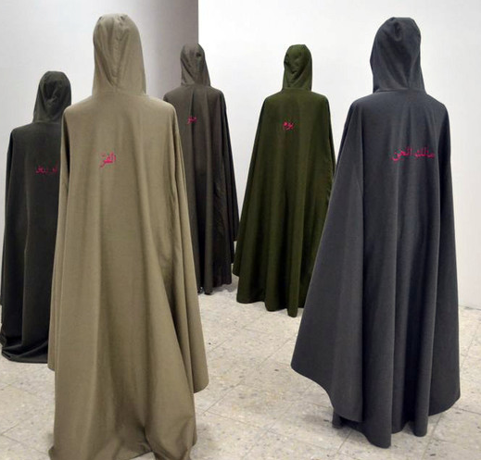
The Results
One sixth of the army will survive the Lord’s judgment
7,000 will be slain, and one-tenth of the city destroyed.
So great will be the devastation that for seven years Israel will be able to live off the spoils of war left behind
It will take seven months to bury the dead, and thereafter burial teams will search out the remaining bodies in an attempt to cleanse the land.
Isaiah said that the Lord “hath delivered them to the slaughter … and the mountains shall be melted with their blood”.
Jeremiah stated that the Lord “will give them that are wicked to the sword, … and the slain of the Lord shall be at that day from one end of the earth even unto the other”
Zechariah 14:12-13; Revelation 11:13; Ezekiel 39:8-16; Isaiah 34:2-3; Jeremiah 25:31,33
(1)

Slide 20
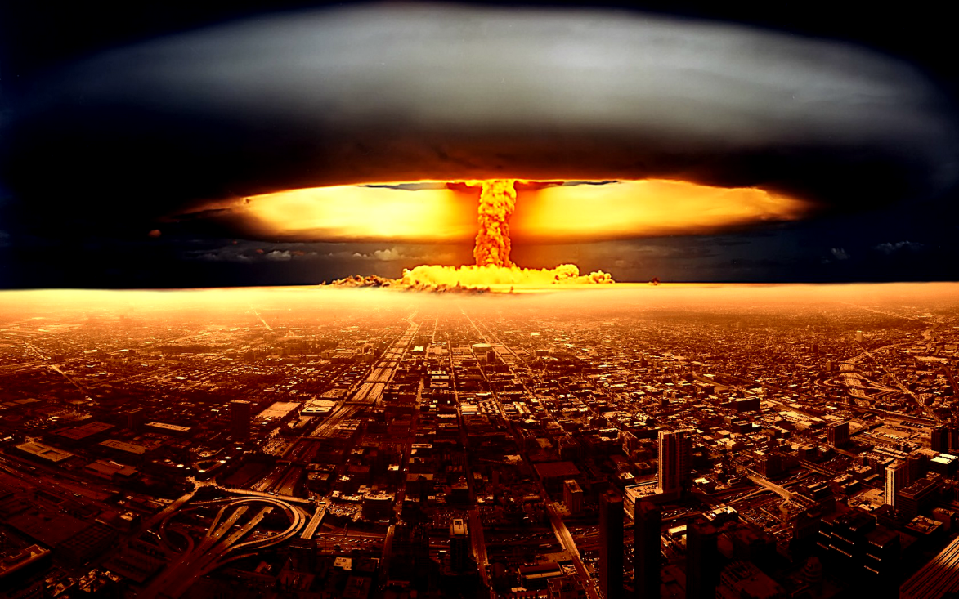
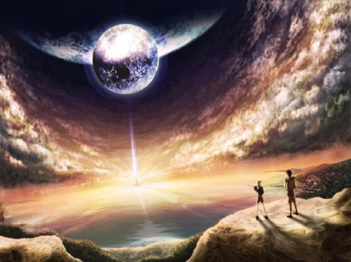
The End and the Beginning
Armageddon signals the end of the world, which is defined as “the destruction of the wicked). But it prepares the way for the ushering in of the millennial reign of Christ and the era of peace that will endure for a thousand years. Mankind will enter a remarkable period of righteousness, health, education, prosperity, and security.
The millennial era could not begin without the widespread destruction of the wicked. Therefore, while the battle of Armageddon is in and of itself a thing horrible to contemplate, it is necessary because of the wickedness of the world, and ultimately it will play an important part in the Lord’s plan for redemption of the world.
Zechariah 14:9
(1)

Slide 21
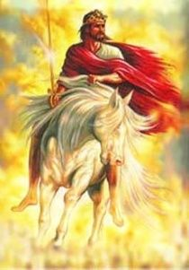
And it shall come to pass, that every one that is left of all the nations which came against Jerusalem shall even go up from year to year to worship the King, the Lord of hosts, and to keep the feast of tabernacles.
Jesus Christ will one day return to the earth and all people will honor Him as their King
Zechariah 14:16

Slide 22
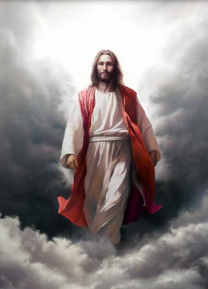
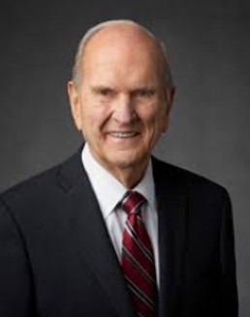
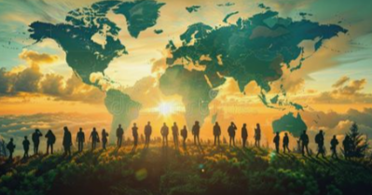
The Lord will return to the land that He made holy by His mission there in mortality. In triumph, He will come again to Jerusalem. In royal robes of red to symbolize His blood, which oozed from every pore, He shall return to the Holy City.
There and elsewhere, “the glory of the Lord shall be revealed, and all flesh shall see it together”.
His “name shall be called Wonderful, Counsellor, The mighty God, The everlasting Father, The Prince of Peace”.
He will govern from two world capitals: one in old Jerusalem and the other in the New Jerusalem “built upon the American continent”.
From these centers He will direct the affairs of His Church and kingdom. Another temple will yet be built in Jerusalem. From that temple He shall reign forever as Lord of Lords. Water will issue from under the temple. Waters of the Dead Sea will be healed.
Zechariah 14: Doctrine and Covenants 101:23; 133:46–48 Isaiah 9:6; 40:5; Articles of Faith 1:10; Ezekiel 47:1-8

Slide 23
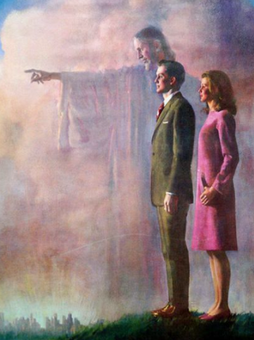
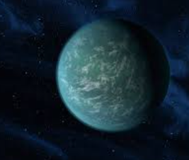
In that day He will bear new titles and be surrounded by special Saints.
He will be known as “Lord of lords, and King of kings: and they that [will be] with him [will be those who] are called, and chosen, and faithful” to their trust here in mortality. Then He “shall reign for ever and ever” .
The earth will be returned to its paradisiacal state and be made new. There will be a new heaven and a new earth.
It is our charge—it is our privilege—to help prepare the world for that day. (9)
Zechariah 14: Revelation 11:15; 17:14; 21:1; Ether 13:9; Doctrine and Covenants 29:23-24

Slide 24
Sources:
Video:
Will I Do My Part? (2:43)
“The Lord’s Triumphal Entry into Jerusalem” (1:22).
Old Testament Student Institute Manual Preparations for the Lord’s Return in Glory (Zechariah) Chapter 33 and Enrichment 1 (Armageddon)
Guide to the scriptures “Messiah”
Elder Bruce R. McConkie The Promised Messiah, p. 241
(Doctrinal New Testament Commentary,3:543.
D. Todd Christofferson (“Why Do We Baptize for the Dead?”New Era, Mar. 2009, 2, 5.
Guthrie and Motyer, New Bible Commentary, p. 769
Presentation by ©http://fashionsbylynda.com/blog/
6. Orson Pratt, Voice of Warning, p. 33.
7. Joseph Smith, Teachings of the Prophet Joseph Smith, p. 286.
Signs of the Times, p. 170.
8. Bible Dictionary
9. President Russell M. Nelson (“The Future of the Church: Preparing the World for the Savior’s Second Coming,” Ensign, Apr. 2020, 16–17)

Slide 25
Zechariah 1-6 | Zechariah 7-8 | Zechariah 9-11 | Zechariah 12-14
In a series of visions, Zechariah sees the restoration of Jerusalem and the temple; the gathering of Israel; and Joshua, the high priest, crowned in similitude of Christ. | Because of the Israelites’ hypocrisy and oppression of the poor, the Lord scattered them among the nations. In the latter days, He will restore Jerusalem and gather Judah; many Gentiles will gather with them to worship the Lord. | Zechariah prophesies of Christ’s ministry: He will enter Jerusalem riding upon an ass; the spirits in prison will be redeemed by the blood of the covenant. Scattered Israel will be gathered, redeemed, and strengthened. Christ will be betrayed for 30 pieces of silver. | In the final battle before the Second Coming of Jesus Christ, many people will gather to fight against Jerusalem, and the Lord will destroy them. The Jews will recognize their Messiah, whom they crucified, and see the wounds in His hands. Christ will reign as King of the whole earth.

Slide 26
Armageddon
The name has inspired books, movies, and an almost endless amount of commentary. The very name conjures up pictures of vast armies, horrible suffering, and widespread devastation. It has created a host of speculations and much embellishment that is not scriptural.
This final war will usher in the Millennium. Isaiah, Jeremiah, Ezekiel, Daniel, Zechariah, John, Joseph Smith, and others have all talked about the battle and events associated wit it.
Joseph Fielding Smith “Now I have read these passages of Scripture from these various prophets. Here you will find Isaiah saying the Lord will pour out war upon all the world
Jeremiah sassing the same thing and speaking of these terrible things;
Daniel say so; Ezekiel say so. We find Joel, Zephaniah, Zechariah, all proclaiming that in this last day, the day when the sun shall be darkened and the moon turned to blood and the stars fall from heaven, that the nations of the earth would gather against Jerusalem. All of them speak of it; and when that time comes, the Lord is going to come out of His hiding place.” (The Signs of the times, p. 170)
Joseph Fielding Smith:
“I know these are unpleasant things. It is not a pleasant thing even for me to stand here and tell you that this is written in the Scriptures. If the Lord has a controversy with the nations, He will put them to the sword. Their bodies shall lie unburied like dung upon the earth. That is not nice, is it, but should we not know it? Is it not our duty to read these things and understand them? Don’t you think the Lord has given us these things that we might know and we might prepare ourselves through humility, through repentance, through faith, that we might escape from these dreadful conditions that are portrayed by these ancient prophets? That is why I am reading them. I feel just as keenly as you do about the condition, and I pray for it to come to an end, but I want it to come to an end right. …
“So I pray every day of my life that the Lord will hasten His work; and while all this has to take place, I hope He will hasten it, that it may soon come to an end, that peace may come; and so I repeat, as I said in one of the talks some time ago, I am praying for the end of the world because I want a better world. I want the coming of Christ. I want the reign of peace. I want the time to come when every man can live in peace and in the spirit of faith, humility and prayer.” (Signs of the Times, pp. 154–55, 175.)
The Name of Armageddon:
In the southern part of Galilee in present-day Israel, about 60 miles north of Jerusalem, is abroad and fertile plain. Today it is one of the richest agricultural areas of the state of Israel and is often called Israel’s breadbasket. It runs from the Bay of Haifa on the northern coast in the southeast direction to the River Jordan 15 miles wide at its great breath, the valley of Esdraelon (its Greek name is still used today) is flanked on the north by the Nazareth ridge and on the south by Mount Carmel, Mount Gilboa, and the hills of Samaria.
One of the most important highways of antiquity passed through the valley. The Via Maris, or “Way of the Sea,” ran up the coast from Egypt, turned inland just south of present-day Haifa and Mount Carmel, followed an important pass through the hills, and then dropped into the Plain of Esdraelon. Because of the strategic importance of the pass, a fortified city lay at the entrance into the valley. The city was Megiddo, which name means in Hebrew “the place of troops”
Because it lay on the flank of a hill, it was also known as Har-Megiddo or the “Mount of Megiddo.” In the English version of the New Testament the name is rendered Armageddon (Rev. 16:16)
From the earliest days, the valley of Armageddon, or the Plain of Esdraelon, has been the site of great battles. Egyptian foot soldiers, shouts of Assyrian battalions, Nebuchadnezzar’s Babylonian troops, Jewish guerillas fought Roman legionnaires, the cries of Crusaders and Moslems locked in battle, Israeli troops maneuvering against Arab forces. Megiddo is called “the place of troops”. OT Institute Manual enrichment I-1

Slide 27
Vision 8 Zechariah 6:1-8
On 6 December 1832, the Savior told the Prophet Joseph Smith that these angels were crying unto Him day and night for permission to reap down the earth and burn the tares (see D&C 86:4–7).Zechariah 6:7 states that the angels could not go forth upon the earth until given permission by the Lord.
Sixty-one years after the revelation in section 86 of the Doctrine and Covenants was given,
President Wilford Woodruff declared that the Lord had released those destroying angels and they were then upon the earth separating the tares from the wheat in preparation for the burning that would soon take place: “God has held the angels of destruction for many years, lest they should reap down the wheat with the tares. But I want to tell you now, that those angels have left the portals of heaven, and they stand over this people and this nation now, and are hovering over the earth waiting to pour out the judgments. And from this very day they shall be poured out. Calamities and troubles are increasing in the earth, and there is a meaning to these things. Remember this, and reflect upon these matters. If you do your duty, and I do my duty, we’ll have protection, and shall pass through the afflictions in peace and in safety.” (“The Temple Workers’ Excursion,” Young Woman’s Journal, Aug. 1894, pp. 512–13; emphasis added.)
Armageddon Struggle:
Elder Pratt explained: “After a struggle of three years and a half, they [Gog’s army] will at length succeed in destroying these two prophets and then overrunning much of the city; they will send gifts to each other because of the death of the two prophets, and in the meantime will not allow their dead bodies to be put in graves, but will suffer them to lie in the streets of Jerusalem three days and a half, during which time the armies of the Gentiles, consisting of many kindreds, tongues, and nations, passing through the city, plundering the Jews, will see their dead bodies lying in the street.” (Voice of Warning, p. 33.)
Foregoing list of events of the Second Coming:
“The bankrupt nations, envying the wealth of the sons of Judah, will seek a pretext to make war upon them, and will invade the ‘holy land’ to ‘take a prey and a spoil.’ …
“His [Christ’s] next appearance [after coming to his temple] will be among the distressed and nearly vanquished sons of Judah. At the crisis of their fate, when the hostile troops of several nations are ravaging the city and all the horrors of war are overwhelming the people of Jerusalem, he will set his feet upon the Mount of Olives, which will cleave and part asunder at his touch. Attended by a host from heaven, he will overthrow and destroy the combined armies of the Gentiles, and appear to the worshipping Jews as the mighty Deliverer and Conqueror so long expected by their race; and while love, gratitude, awe, and admiration swell their bosoms, the Deliverer will show them the tokens of his crucifixion and disclose himself as Jesus of Nazareth, whom they had reviled and whom their fathers put to death. Then will unbelief depart from their souls, and ‘the blindness in part which has happened unto Israel’ be removed.” Elder Charles W. Penrose (“The Second Advent,” Millennial Star, 10 Sept. 1859, pp. 582–83.)
D&C 86:
President Joseph Fielding Smith said:
“Now I want to make some comments in regard to the statement by President Woodruff and this parable [the parable of the wheat and tares in D&C 86].
“The Lord said that the sending forth of these angels was to be at the end of the harvest, and the harvest is the end of the world. Now, that ought to cause us some very serious reflections. And the angels have been pleading, as I have read it to you, before the Lord to be sent on their mission. Until 1893 the Lord said to them no, and then He set them loose. According to the revelation of President Woodruff, the Lord sent them out on that mission.
“What do we gather out of that? That we are at the time of the end. This is the time of the harvest. This is the time spoken of which is called the end of the world.” (The Signs of the Times, pp. 11–21.)

Slide 28
Scripture | Events to take place before the battle begins
Ezekiel 36:24; 37:21 | The house of Israel will be gathered from among the heathen (the Gentiles) and returned to their own land
Ezekiel 36:10-12, 33-36 | The land of Israel will be rebuilt and reinhabited by the covenant people
Ezekiel 36:8, 29-30, 34-35 | The land will become highly productive and fruitful, even like the Garden of Eden
Ezekiel 37:22 | There will be one nation in the land of Israel again
Zechariah 1:16-17, 2:12; 12:6, 3 Nephi 20:46 | Jerusalem will be reestablished as the capital city of the Israelites
Isaiah 19:16-17, Zechariah 10:3, 5-6 | Judah will become powerful in politics and warfare
Revelation 13:1 JST Revelation 13:1; 17:8-14; Revelation 17:1,5 | A great combination of organizations serving Satan will arise in the last days. This combination has several names: The “beast…out of the sea” representing the kingdoms of the earth and the “great and abominable church,” “ the church of the devil,” the great whore,” and “the mother of…abominations

Slide 29
Scripture | Armageddon Participants
Ezekiel 38:1-3 | Ezekiel named God of the land of Magog, the prince of Meshech and Tubal, as the leader of the forces that would come against Israel. Magog, Meshech, and Tubal were ancient peoples in the northern part of Asia Minor. Gog is a symbolic name for the leader or leaders of this great evil power that will arise in the last days.
Ezekiel 38:2-6 | Ezekiel named Persia, Ethiopia, Libya, Gomer, and Togarmah as being in alliance with Gog. (Areas of the ancient world, so a list of modern nations fighting in Armageddon cannot be compiled from these sources
Jeremiah 25:26; Joel 3:1; Zechariah 14:2 Revelation 16:14 | The prophets agreed that all nations should be joined in this alliance in one way or another.
Ezekiel 38:8, 15-16; Joel 2:1; 3:1-2; Zechariah 14:2 | The strategic objective of this great and evil alliance is clearly the nation of Israel
Ezekiel described it as “clothed with all sorts of armour, even a great company with bucklers and shields, all of them handling swords” (Ezekiel 38:4) and as coming like “a storm” and “a cloud to cover the land” (v. 9), having “many people” with him, “all of them riding upon horses [a symbol of power in war], a great company, and a mighty army” (v. 15).
John the Revelator used the imagery of a cloud of locusts (vast numbers that bring great devastation) and described the army as having the “teeth of lions,” “breastplates of iron,” and “wings” that sounded like the “sound of chariots of many horses running to battle” (Revelation 9:8–9). The army was numbered “two hundred thousand thousand” (Revelation 9:16), having “breastplates of fire, and of jacinth, and brimstone” and with “fire and smoke and brimstone” issuing “out of their mouths” (Revelation 9:17). Elder Bruce R. McConkie, referring to the imagery of John and Joel, suggested that “it is not improbable that these ancient prophets were seeing such things as men wearing or protected by strong armor; as troops of cavalry and companies of tanks and flame throwers; as airplanes and airborne missiles which explode, fire shells and drop bombs; and even other weapons yet to be devised in an age when warfare is the desire and love of wicked men” (Doctrinal New Testament Commentary, 3:503).
Daniel described the “king of the north” as coming with a “great army” which others have no “strength to withstand” (Daniel 11:13, 15) and as coming “like a whirlwind, with chariots, and with horsemen, and with many ships; and he shall enter into the countries and shall overflow and pass over” (v. 40). Elder Joseph Fielding Smith specifically identified Daniel 11–12 as referring to the last days (see Signs of the Times, p. 156).
Elder Orson Pratt taught that “so great will be the darkness resting upon Christendom, and so great the bonds of priestcraft with which they will be bound, that they will not understand, and they will be given up to the hardness of their hearts. Then will be fulfilled that saying, That the day shall come when the Lord shall have power over his Saints, and the Devil shall have power over his own dominion. He will give them up to the power of the Devil, and he will have power over them, and he will carry them about as chaff before a whirlwind. He will gather up millions upon millions of people into the valleys around about Jerusalem in order to destroy the Jews after they have gathered. How will the Devil do this? He will perform miracles to do it. The Bible says the kings of the earth and the great ones will be deceived by these false miracles. It says there shall be three unclean spirits that shall go forth working miracles, and they are spirits of devils. Where do they go? To the kings of the earth; and what will they do? Gather them up to battle unto the great day of God Almighty. Where? Into the valley of Armageddon.” (In Journal of Discourses, 7:189.)
Joel stated that the army would be the greatest army in the history of the world up to that point (Joel 2:2). He described it as being like a “fire” that devours the land, leaving what had looked like the “garden of Eden” before their coming as “a desolate wilderness” (Joel 2:3; see also Joel 2:2, 4–5). Joel also said that the army would be highly disciplined in warfare and virtually invincible: “When they fall upon the sword, they shall not be wounded” (Joel 2:8; see also Joel 2:7, 9).

