Slide 1

A Perfect Sacrifice
Malachi 1-2
But with the precious blood of Christ, as of a lamb without blemish and without spot:
1 Peter 1 :19

Slide 2

Malachi
His name means “messenger” and he administered to the Jews in Jerusalem
He was last of the Old Testament prophets shortly after Ezra and Nehemiah disappeared from the scene
The Book of Malachi was written around 430 B.C.
He taught the people of his day and calls them to repentance and reminds them to prepare for the Second Coming and the judgments of the Lord. Also he teaches the Priests and Levites that they were given the Law to teach the people a pattern of obedience
He is remembered for his reference to tithes and offerings
He prophesied regarding Elijah and the last days and is mentioned in the Book of Mormon by Jesus Christ (3 Nephi 24:1) Moroni quoted verses from Malachi (Malachi 4:1,5,6) (Joseph Smith History 1:39)
He was the grand prophet of transition from the Old Testament to the New Testament
He spoke of John the Baptist
He was mentioned by President Joseph F. Smith in his vision of the work of salvation going on in the spiritual world
(1,2)

Slide 3
From the Mouth of Malachi
“Behold, the time has fully come, which was spoken of by the mouth of Malachi—testifying that he [Elijah] should be sent, before the great and dreadful day of the Lord come” (D&C 110:14).
Elijah
And Malachi, the prophet who testified of the coming of Elijah—of whom also Moroni spake to the Prophet Joseph Smith, declaring that he should come before the ushering in of the great and dreadful day of the Lord—were also there.
The Prophet Elijah was to plant in the hearts of the children the promises made to their fathers,
Foreshadowing the great work to be done in the temples of the Lord in the dispensation of the fulness of times, for the redemption of the dead, and the sealing of the children to their parents, lest the whole earth be smitten with a curse and utterly wasted at his coming.
D&C 138:46-48
Doctrines:
of the sealing power, eternal families, and the work we do for the dead in temples

Slide 4
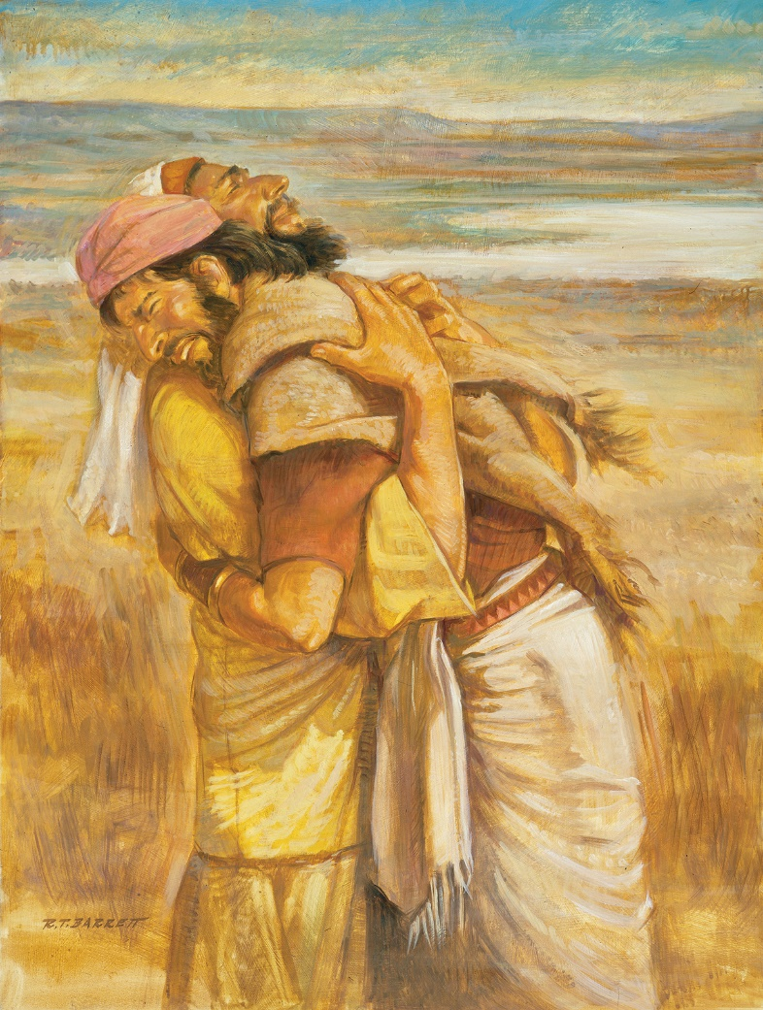
Rebuking the Israelites
Esau’s descendants = wickedness of humanity in general
Before Malachi’s time they were known as Edomites, or Idumeans, and their place of habitation was known as Edom.
hated in Hebrew = to be loved less than someone else, not to be disliked with bitter hostility.
Jacob stood as a symbol for Israel or the chosen people while Esau (Edom) symbolized the world.
The Lord hates the sin rather than the sinner, but when people array themselves against the Lord as Esau and his descendants, the Edomites, had done for centuries, the Lord withdraws His blessings.
Malachi 1:2-5
R.T. Barrett.
(2)

Slide 5
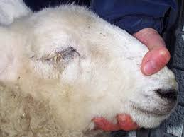
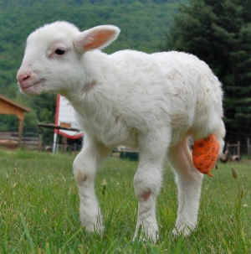
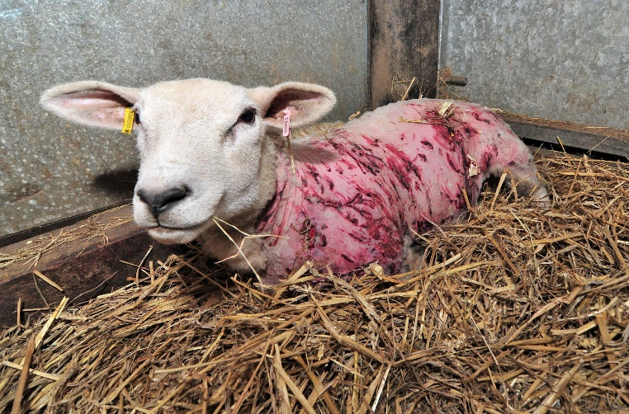
Polluted and Corrupt
The people of Judah, and particularly the Levites living among them, were also polluted and corrupt. As the spiritual sons and servants of the Lord, their offerings to God had become common and worthless. Inasmuch as the sacrifices that they made for the people typified the coming sacrifice and Atonement of the Son of God, the only acceptable sacrifice was that which was spotless.
The priests and Levites of Malachi’s day were mocking God by offering sacrifices to the Lord with sick, blind, and lame animals and calling them acceptable.
Why do you think the Lord only accepted animal sacrifices that were perfect and without blemish?
Malachi 1:8,13
(2)

Slide 6
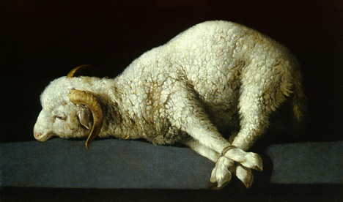
A Perfect Sacrifice
Your lamb shall be without blemish, a male of the first year: ye shall take it out from the sheep, or from the goats.
Exodus 12:5
But with the precious blood of Christ, as of a lamb without blemish and without spot:
1 Peter 1 :19
This thing is a similitude of the sacrifice of the Only Begotten of the Father, which is full of grace and truth.
Moses 5:7
Malachi 1:8,13

Slide 7
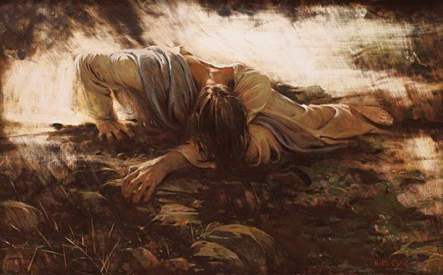
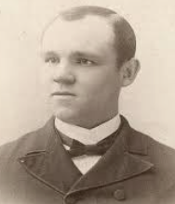
“The atonement was plainly to be a vicarious sacrifice, voluntary and love-inspired on the Savior’s part, universal in its application to mankind so far as men shall accept the means of deliverance thus placed within their reach.
“For such a mission only one who was without sin could be eligible. Even the altar victims of ancient Israel offered as a provisional propitiation for the offenses of the people under the Mosaic law had to be clean and devoid of spot or blemish; otherwise they were unacceptable and the attempt to offer them was sacrilege.”
We honor and please the Lord when we give our best to Him
Malachi 1:8,13
(3)

Slide 8

Corrupt Priest VS Faithful Priest
The faithful priesthood bearer is a sincere worshiper. He acts as if he were in the Lord’s presence when upon the Lord’s errand.
He is honest in all his dealings with others, and his speech is dignified and appropriate.
He walks with the Lord with confidence and assurance and is comfortable in his role of blessing others and leading them into a better way of life.
He is a student of the scriptures and has the capacity to teach the words of life to others.
“He is the messenger [teacher, tool, representative] of the Lord of hosts”
If we do not follow the Lord’s ways, then we may cause others to stumble
Malachi 2:2-17
(2)

Slide 9
Sources:
Videos: With All Your Heart (3:27)
Bullied No More (4:55)
Who’s Who in the Old Testament by Ed J. Pinegar and Richard J. Allen pp. 121-122
Old Testament Student Institute Manual “Behold, I Will Send You Elijah the Prophet” Chapter 34
Presentation by ©http://fashionsbylynda.com/blog/
3. Elder James E. Talmage Jesus the Christ, p. 21

Slide 10
Malachi 1 | Malachi 2 | Malachi 3-4
Through Malachi, the Lord rebukes the Jews for their disobedience in the practices and sacrifices at the temple. The Jewish leaders were offering “polluted bread” (Malachi 1:7) and improper sacrifices using blemished, injured, and diseased animals. | The Lord chastises the priests for not keeping their covenant with the Lord and for being a poor example to the people. He uses the breaching of a marriage covenant to illustrate their failure to keep their covenant with Him. | The Lord will send a forerunner to prepare the way before Him, and He will come suddenly to His temple. He challenges the people to live the law of tithing and promises to send Elijah before the great and dreadful day of the Lord.
The Book of Malachi is a book of chastening:
“I would like to speak of one particular attitude and practice we need to adopt if we are to meet our Heavenly Father’s high expectations. It is this: willingly to accept and even seek correction. Correction is vital if we would conform our lives ‘unto a perfect man, [that is,] unto the measure of the stature of the fulness of Christ’ (Ephesians 4:13). Paul said of divine correction or chastening, ‘For whom the Lord loveth he chasteneth’ (Hebrews 12:6). Though it is often difficult to endure, truly we ought to rejoice that God considers us worth the time and trouble to correct.” Elder D. Todd Christofferson (“As Many as I Love, I Rebuke and Chasten,” Ensign, May 2011, 97–98).
Malachi 2:13-14 One of the gross sins among the ancient people of the Lord was unfaithfulness in marriage vows. Some of the Hebrew men, tiring of their wives and the mothers of their children, were seeking the companionship of younger women. The wives would come to the temple and make an appeal to God at the altar. In this unfaithfulness to marriage vows, the Lord declared, the men had dealt treacherously (see vv. 13–14). The Lord was angry with these men because they did not remain true to their wives, but He also expressed anger toward the priests for knowing the problem and not executing justice. He told the men to scrutinize their innermost feelings toward the women whom they had loved in their youth, who had borne their children, and who had loved and served them, and not to put away their wives (v. 15). For “the Lord … hateth putting away” OT Institute

