Slide 1

Windows of Heaven
Malachi 3
For this is he that was spoken of by the prophet Esaias, saying, The voice of one crying in the wilderness, Prepare ye the way of the Lord, make his paths straight.
Matthew 3:3

Slide 2

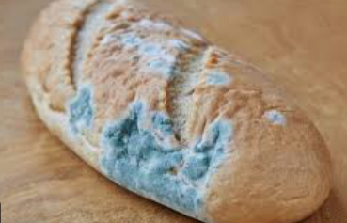
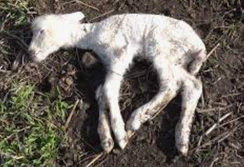
Previously…
Although the people in Malachi’s day continued to offer sacrifices to the Lord, they dishonored Him by offering “polluted bread” and blind, lame, and sick animals as sacrifices that were supposed to symbolize Jesus Christ.
The Lord rebuked the priests, who had “departed out of the [Lord’s] way” and “caused many to stumble” because of their bad examples.
Malachi 1:7-8, 13; 2:8
(1)

Slide 3
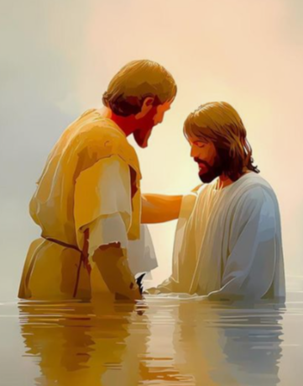
Elias--Forerunner
One of the messengers sent to prepare the way of the Lord at His first coming was John the Baptist. John’s mission was performed in the spirit and power of the priesthood of Elias.
And he shall go before him in the spirit and power of Elias, to turn the hearts of the fathers to the children, and the disobedient to the wisdom of the just; to make ready a people prepared for the Lord. Luke 1:17
Elias is a name for a forerunner, one who goes before or prepares the way for someone or something greater.
In that sense the Aaronic Priesthood is the priesthood of Elias because it prepares and qualifies individuals for greater blessings.
Malachi 3:1
(1)

Slide 4
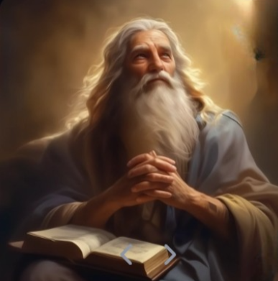
“The spirit of Elias is to prepare the way for a greater revelation of God, which is the Priesthood of Elias, or the Priesthood that Aaron was ordained unto.
And when God sends a man into the world to prepare for a greater work, holding the keys of the power of Elias, it was called the doctrine of Elias, even from the early ages of the world.”
Malachi 3:1
(2)

Slide 5
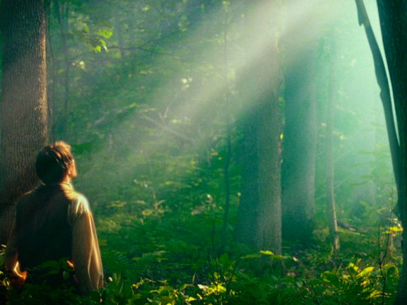
To Prepare The World
The Lord sent Joseph Smith to prepare the world for the Second Coming of Jesus Christ
And immediately there shall appear a great sign in heaven, and all people shall see it together.
D&C 88:93
When He comes to earth a second time, He will make more than one appearance before He comes in the clouds of heaven for all flesh to see Him together.
At least one of those appearances includes a sudden visit to His temple, yet to be built, in Jackson County, Missouri.
Malachi 3:1
(1)

Slide 6
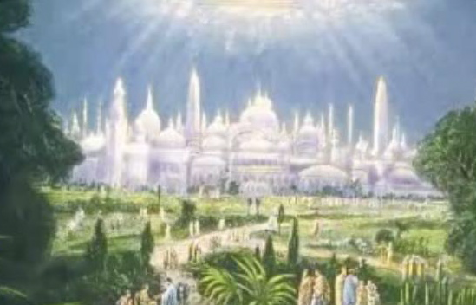
Malachi’s Promise
The Lord, whom ye seek, shall suddenly come to His temple
“… the Almighty is not limited in the number of appearances and returns to earth needed to fulfill the scriptures, usher in the final dispensation, and consummate his great latter-day work..
“This sudden latter-day appearance in the temple does not have reference to his appearance at the great and dreadful day, for that coming will be when he sets his foot upon the Mount of Olivet in the midst of the final great war.
The temple appearance was fulfilled, in part at least, by his return to the Kirtland Temple on April 3, 1836; and it may well be that he will come again, suddenly, to others of his temples, more particularly that which will be erected in Jackson County, Missouri.
Malachi 3:1
(1)

Slide 7
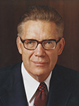

He Will Come Quickly
Fear not, little flock, the kingdom is yours until I come. Behold, I come quickly. Even so. Amen.
D&C 35:27
“…when the appointed hour arrives, he will come with a speed and a suddenness which will leave no further time for preparation for that great day.”
Who will be ready and worthy for the Second Coming?
Malachi 3:2
(3)

Slide 8
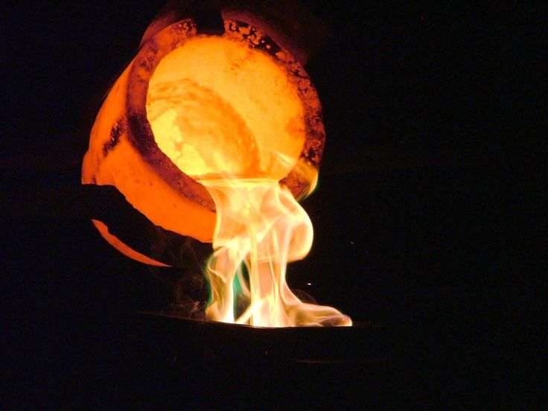
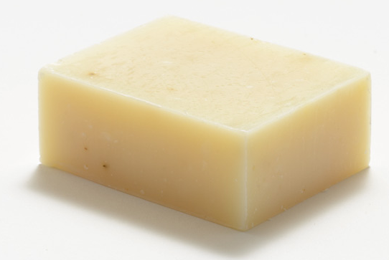
Refiner’s Fire and Fullers Soap
A refiner uses fire to heat a metal like silver or gold until it reaches a liquid state.
The heating process allows dross, or impurities, to rise to the surface of the liquid metal, where the refiner can remove them, thus purging the metal of its impurities.
A fuller is someone who cleans or whitens fabrics using soap.
“The fierce flames, the fervent heat, the burning fires of the Second Coming that destroy the wicked shall also cleanse the righteous. … Evil and sin and dross will be burned out of their souls because they qualify to abide the day”. (3)
Malachi 3:2-3

Slide 9
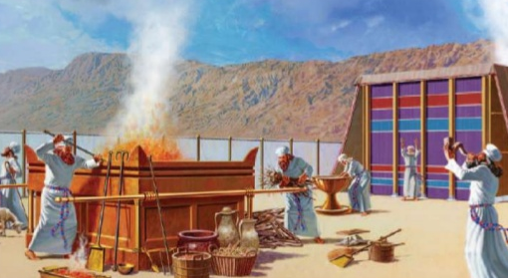
Offering of the Righteous
There is more than one meaning for the “offering in righteousness” to be made by the sons of Levi at or near the Second Coming of the Lord.
Animal Sacrifice
“It is generally supposed that sacrifice was entirely done away when the Great Sacrifice [i.e.,] the sacrifice of the Lord Jesus was offered up, and that there will be no necessity for the ordinance of sacrifice in [the] future; but those who assert this are certainly not acquainted with the duties, privileges and authority of the Priesthood, or with the Prophets. (2)
Malachi 3:4-6
(1)

Slide 10
Doctrinal Mastery
Will a man rob God? Yet ye have robbed me. But ye say, Wherein have we robbed thee? In tithes and offerings.
Ye are cursed with a curse: for ye have robbed me, even this whole nation.
Bring ye all the tithes into the storehouse, that there may be meat in mine house, and prove me now herewith, saith the Lord of hosts, if I will not open you the windows of heaven, and pour you out a blessing, that there shall not be room enough to receive it.
Malachi 3:8-10

Slide 11
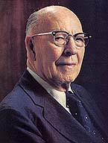
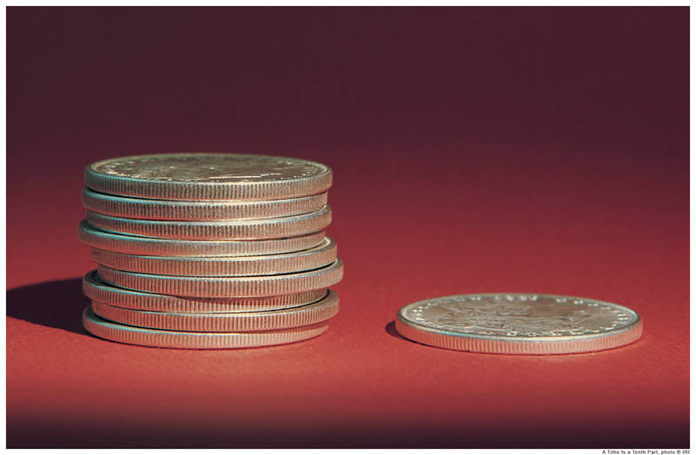
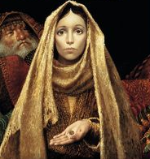
Will A Man Rob God?
Tithing and Offerings
“In addition to giving ourselves, and giving our services, the Lord has asked us to give of our means and our substance.
We have men in the Church who give their time, they will go when they are asked to preach, they will perform a public duty, but it is hard to do the little duty that is seen in secret by them and God alone and their presiding officers. …
And so we are asked to contribute our tithes and offerings, not only because the Church needs money to build itself, for before there was an organization of the Church, God introduced the principle of sacrifice in order that his servants and his children might be tested, that they should bring the best of their lands and of their herds. … They were burned upon the altar of sacrifice; but the giving sanctified the souls of those who gave. …
Malachi 3:7-12
(4)

Slide 12
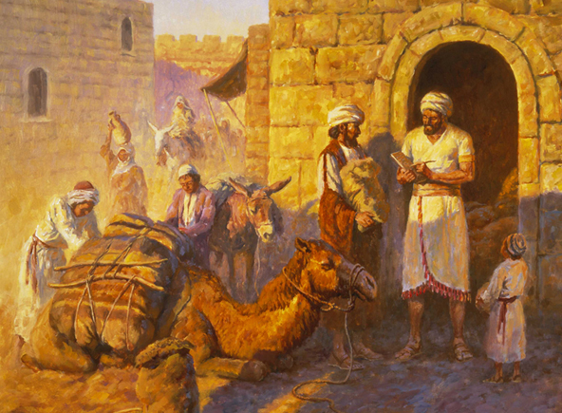
Windows of Heaven
Abraham gave a tenth of all he possessed to the high priest Melchizedek, and his offerings were animals or crops that were given as sacrifices to Jehovah.
Today we pay one-tenth of our income as tithing and contribute the cost of two meals as fast offerings
As we obey the Lord’s law of tithing, He will generously bless us
The Lord invited the Israelites to return to Him by paying tithing.
Malachi 3:10

Slide 13
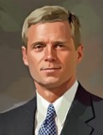
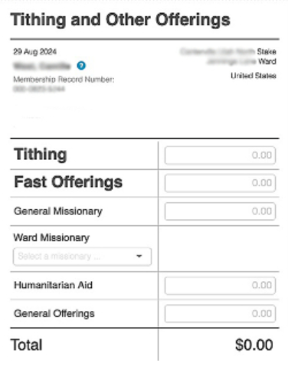
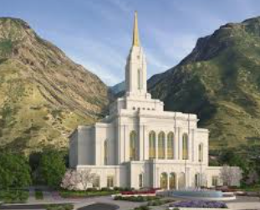
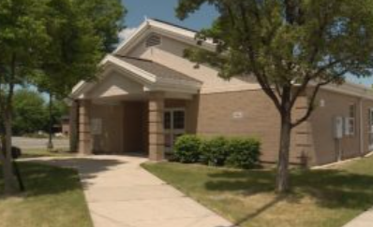
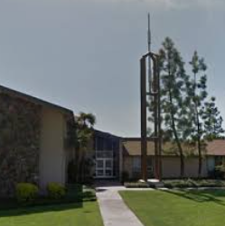
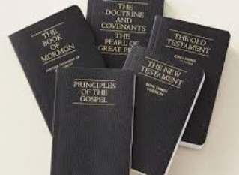
Tithing and Other Offerings
These sacred funds are used in a rapidly growing church to spiritually bless individuals and families by constructing and maintaining temples and houses of worship, supporting missionary work, translating and publishing scriptures, fostering family history research, funding schools and religious education, and accomplishing many other Church purposes as directed by the Lord’s ordained servants. (5)
Malachi 3:10

Slide 14
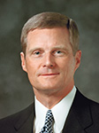
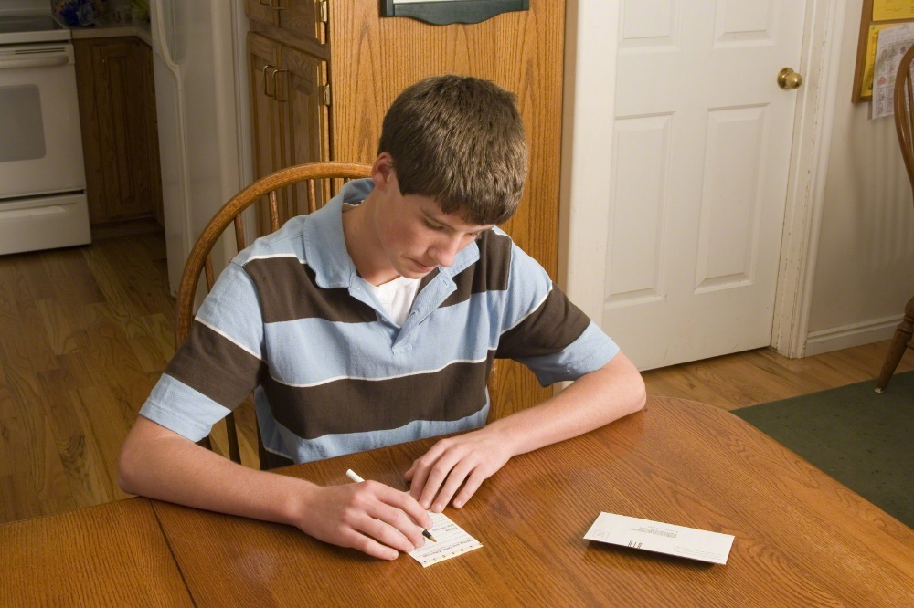
“Often as we teach and testify about the law of tithing, we emphasize the immediate, dramatic, and readily recognizable temporal blessings that we receive. And surely such blessings do occur. Yet some of the diverse blessings we obtain as we are obedient to this commandment are significant but subtle. …
“Sometimes we may ask God for success, and He gives us physical and mental stamina. We might plead for prosperity, and we receive enlarged perspective and increased patience, or we petition for growth and are blessed with the gift of grace. He may bestow upon us conviction and confidence as we strive to achieve worthy goals. And when we plead for relief from physical, mental, and spiritual difficulties, He may increase our resolve and resilience.
“I promise that as you and I observe and keep the law of tithing, indeed the windows of heaven will be opened, and spiritual and temporal blessings will be poured out such that there shall not be room enough to receive them.”
(5)

Slide 15
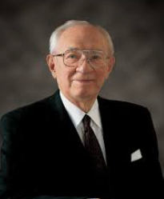
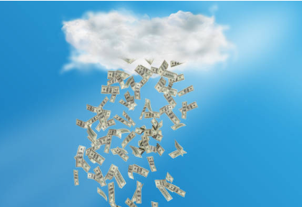
A Matter of Faith
“It is not so much a matter of money as it is a matter of faith.
I have yet to find a faithful tithe payer who cannot testify that in a very literal and wonderful way the windows of heaven have been opened and blessings have been poured out upon him or her” (6)

Slide 16
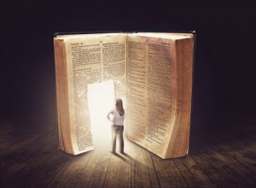

Book of Remembrance
Those who devote themselves to the Lord earn for themselves the privilege of having their names recorded in the Lamb’s book of life. This sacred “book of remembrance” is kept in heaven and contains the names of the faithful children of Father in Heaven, or, in other words, those who are His precious jewels.
They are those who will inherit eternal life, for this book contains “the names of the sanctified, even them of the celestial world” (D&C 88:2).
Those whose names are written there and who afterwards return to sinful ways will have their names blotted from the book
Malachi 3:16-18; D&C 88:2
(1)

Slide 17

The Day of the Lord
A time of final judgment.
On this day, God will reward those who serve Him—often referred to as His "treasured possession" or "jewels"—while the wicked will face consequences.
Malachi 3:18

Slide 18
Sources:
Videos: The Windows of Heaven (1:09)
A Standing Law Unto The Church (5:16)
“The Language of the Gospel,” from time code 6:42 to 7:40.
Old Testament Student Institute Manual “Behold, I Will Send You Elijah the Prophet” Chapter 34
Joseph Smith (Teachings of the Prophet Joseph Smith, pp. 171-172, 335–36.)
Presentation by ©http://fashionsbylynda.com/blog
Elder Bruce R. McConkie Mormon Doctrine, pp. 693–94
The Millennial Messiah: The Second Coming of the Son of Man [1982], 543–44
4. Elder LeGrand Richards In Conference Report, Apr. 1939, pp. 44–45.)
5. Elder David A. Bednar (“The Windows of Heaven,” Ensign or Liahona, Nov. 2013, 17–18).
6. President Gordon B. Hinckley (“The Sacred Law of Tithing,” Ensign, Dec. 1989, 4).

Slide 19
Malachi 1 | Malachi 2 | Malachi 3-4
Through Malachi, the Lord rebukes the Jews for their disobedience in the practices and sacrifices at the temple. The Jewish leaders were offering “polluted bread” (Malachi 1:7) and improper sacrifices using blemished, injured, and diseased animals. | The Lord chastises the priests for not keeping their covenant with the Lord and for being a poor example to the people. He uses the breaching of a marriage covenant to illustrate their failure to keep their covenant with Him. | The Lord will send a forerunner to prepare the way before Him, and He will come suddenly to His temple. He challenges the people to live the law of tithing and promises to send Elijah before the great and dreadful day of the Lord.
Forerunner:
He who was mightier than John and followed after him to baptize with fire and the Holy Ghost was Jesus Christ, the Son of God. He is called the Messenger of the Covenant because He mediates the gospel of salvation unto men.
Elder Bruce R. McConkie explained: “Our Lord is the Messenger of the Covenant. (Mal. 3:1.) He came in his Father’s name (John 5:43), bearing his Father’s message (John 7:16–17), to fulfil the covenant of the Father that a Redeemer and Savior would be provided for men. (Moses 4:1–3; Abra. 3:27–28.) Also, through his ministry the terms of the everlasting covenant of salvation became operative; the message he taught was that salvation comes through the gospel covenant.” (Mormon Doctrine, p. 488.) OT Institute Manual
Offering Sacrifices:
“The offering of sacrifice has ever been connected and forms a part of the duties of the Priesthood. It began with the Priesthood, and will be continued until after the coming of Christ, from generation to generation. We frequently have mention made of the offering of sacrifice by the servants of the Most High in ancient days, prior to the law of Moses; which ordinances will be continued when the priesthood is restored with all its authority, power and blessings. …
“These sacrifices, as well as every ordinance belonging to the Priesthood, will, when the Temple of the Lord shall be built, and the sons of Levi be purified, be fully restored and attended to in all their powers, ramifications, and blessings. This ever did and ever will exist when the powers of the Melchizedek Priesthood are sufficiently manifest; else how can the restitution of all things spoken of by the holy prophets be brought to pass. It is not to be understood that the law of Moses will be established again with all its rites and variety of ceremonies; this has never been spoken of by the prophets; but those things which existed prior to Moses’ day, namely, sacrifice, will be continued.” (Teachings, pp. 172–73.)
Christ to come a second time:
“When Christ comes the second time it will be in the clouds of heaven, and it shall be the day of vengeance against the ungodly, when those who have loved wickedness and have been guilty of transgression and rebellion against the laws of God will be destroyed. All during the ministry of Christ wickedness ruled and seemed to prevail, but when he comes in the clouds of glory as it is declared in this message of Malachi to the world, and which was said by Moroni to be near at hand, then Christ will appear as the refiner and purifier of both man and beast and all that pertains to this earth, for the earth itself shall undergo a change and receive its former paradisiacal glory.” President Joseph Fielding Smith (Doctrines of Salvation, 3:11.)

Slide 20
Book of Remembrance Malachi 3:16:
“Adam kept a written account of his faithful descendants in which he recorded their faith and works, their righteousness and devotion, their revelations and visions, and their adherence to the revealed plan of salvation. To signify the importance of honoring our worthy ancestors and of hearkening to the great truths revealed to them, Adam called his record a book of remembrance. It was prepared ‘according to the pattern given by the finger of God.’ (Moses 6:4–6, 46.)
“Similar records have been kept by the saints in all ages. (Mal. 3:16–17; 3 Ne. 24:15–16.) Many of our present scriptures have come down to us because they were first written by prophets who were following Adam’s pattern of keeping a book of remembrance. The Church keeps similar records today (D. & C. 85) and urges its members to keep their own personal and family books of remembrance.” Elder Bruce R. McConkie (Mormon Doctrine, p. 100.)
Paying Tithing Malachi 3:8-10
President Gordon B. Hinckley taught that paying tithing is a matter of faith:
“It is not so much a matter of money as it is a matter of faith. I have yet to find a faithful tithe payer who cannot testify that in a very literal and wonderful way the windows of heaven have been opened and blessings have been poured out upon him or her” (“The Sacred Law of Tithing,” Ensign, Dec. 1989, 4).

