Slide 1

The Last Prophet of the Old Testament
Malachi 4
To turn the hearts of the fathers to the children, and the children to the fathers…
D&C 110:15

Slide 2

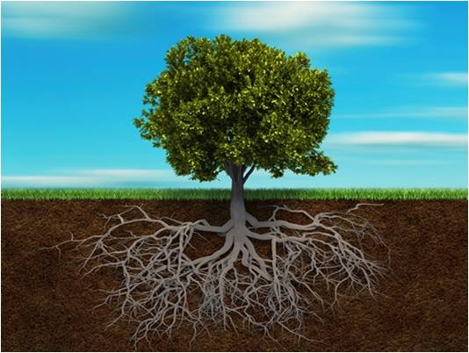

Family
Branches
What would happen to a tree if we eliminated one of its vital parts?
Elijah
Trunk
Roots
If the trunk of the tree represents you, what might the branches and roots represent?

Slide 3
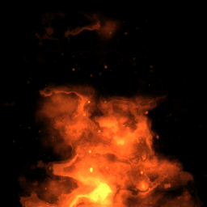

“it shall leave them neither root nor branch”
Stubble = to the short stalks that remain after grain has been harvested from a field. Farmers often burn the stubble in preparation to plow and plant the field again.
Malachi’s reference to the wicked being like stubble in the day of burning means that the wicked will be destroyed as part of the Lord’s cleansing of the earth at His Second Coming.
Malachi 4:1-4

Slide 4
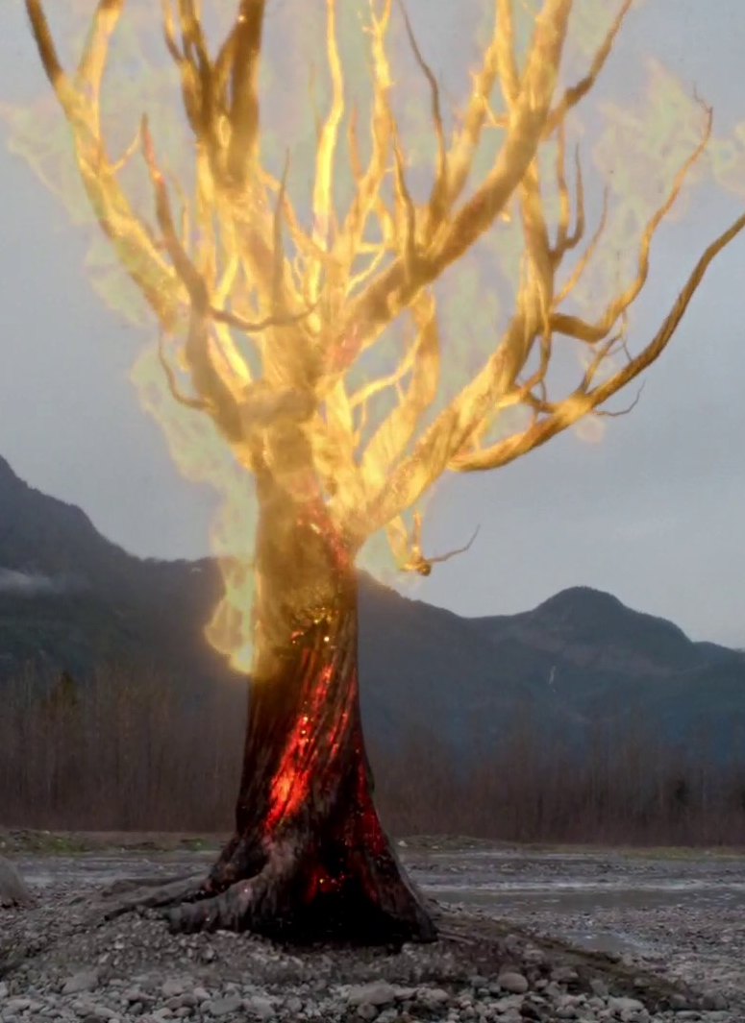
The Proud and the Wicked
“When Malachi prophesied of the second coming of Christ, he spoke of ‘the proud, yea, and all that do wickedly.’ Of whom was he speaking?
First, of those who rejected Christ because of the pride of their hearts, and second, of those who, having accepted Jesus, were not valiant in keeping his commandments.
“Malachi went on to say they ‘shall burn as stubble.’ This means that they shall be destroyed. By whom? Malachi explains, ‘They that come shall burn them, saith the Lord of Hosts.’”
Every corruptible and impure thing, including human and animal, fish and fowl, will be cleansed from the earth
Malachi 4:1; D&C 64:24
(2)

Slide 5

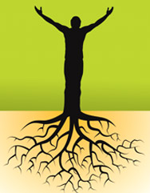
A Family Tree
Each person belongs to a family tree. Our “roots” are the ancestors from whom we descend, and our “branches” are those who descend from us. To be “left with neither root nor branch” is to be cut off from one’s ancestry and posterity eternally.
That is precisely the condition of those for whom the sealing blessings of the Melchizedek Priesthood have not been performed or for those who, having had the ordinances performed, fail to live worthy of claiming their blessings.
Malachi 4:1
(1)

Slide 6
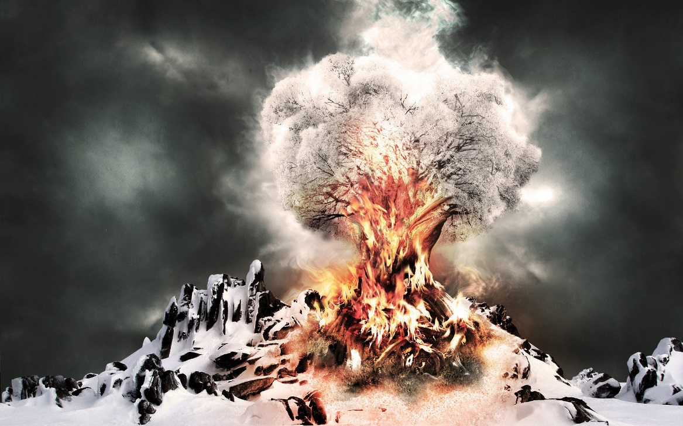
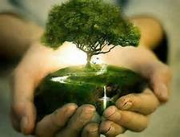
Protect, Care, And Heal
Through the power of the Lord’s Atonement
They will receive healing, “grow up as calves of the stall,” and “tread down the wicked.”.
The phrase “ye shall tread down the wicked” means that the Lord will help the righteous overcome evil by destroying the wicked at His Second Coming.
Malachi 4:2-3

Slide 7

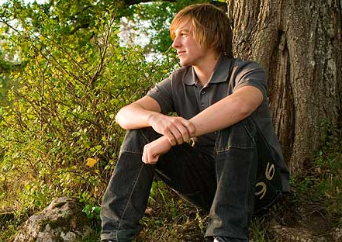
Reverence the Lord
If we reverence and obey the Lord, we will experience the power and protection of the Atonement
What are specific ways we can reverence and obey the Lord?
Why does reverencing and obeying the Lord enable us to experience His power and protection?
When have you experienced the Lord’s power or protection?
Malachi 4:2-3

Slide 8
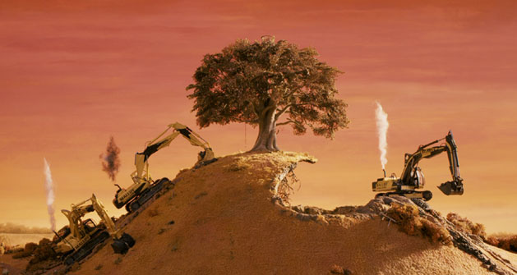
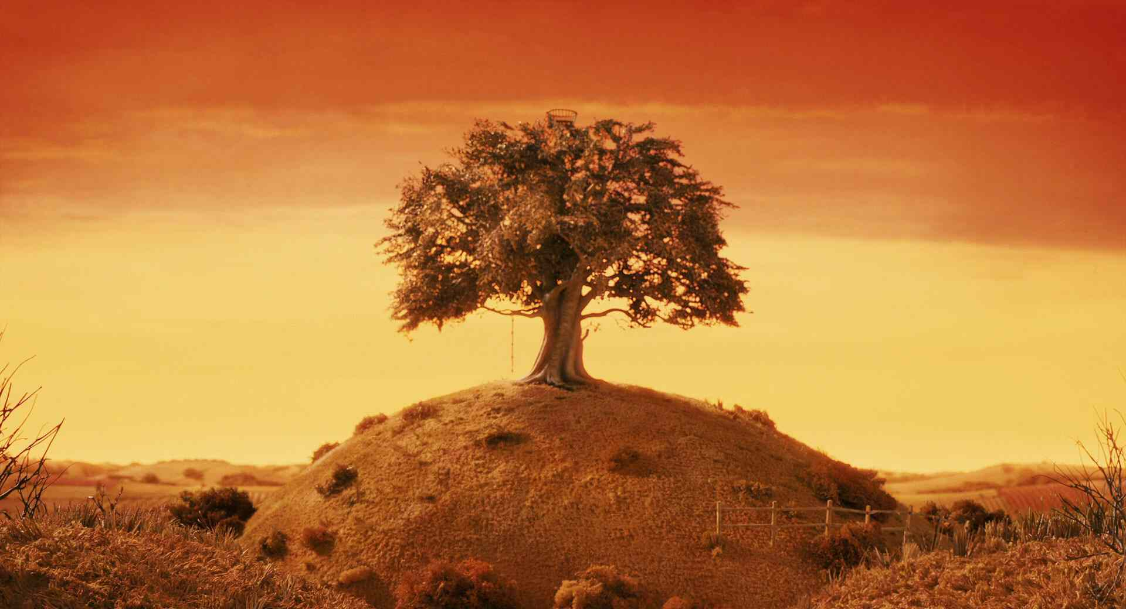
The Sealing Powers
To prevent this great catastrophe…
Elijah was sent to earth in the latter days with the sealing powers
Malachi 4:5-6
(1)

Slide 9
Doctrinal Mastery
Malachi 4:5-6
Behold, I will send you Elijah the prophet before the coming of the great and dreadful day of the Lord:
And he shall turn the heart of the fathers to the children, and the heart of the children to their fathers, lest I come and smite the earth with a curse.

Slide 10
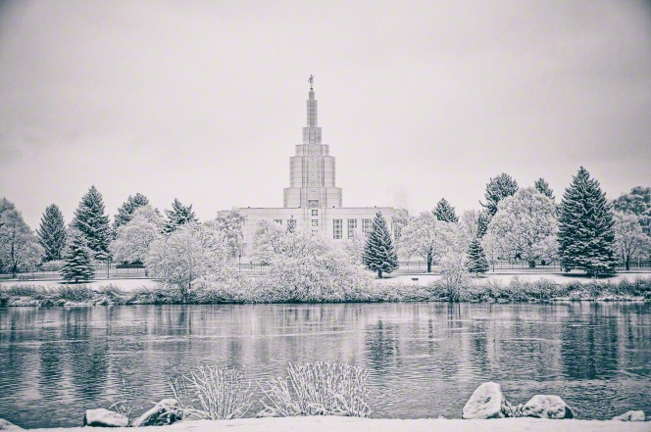
“Many of your ancestors died never having the chance to accept the gospel and to receive the blessings and promises you have received. …
“… There are more temples across the earth than there have ever been.
Idaho Falls Temple
(3)

Slide 11
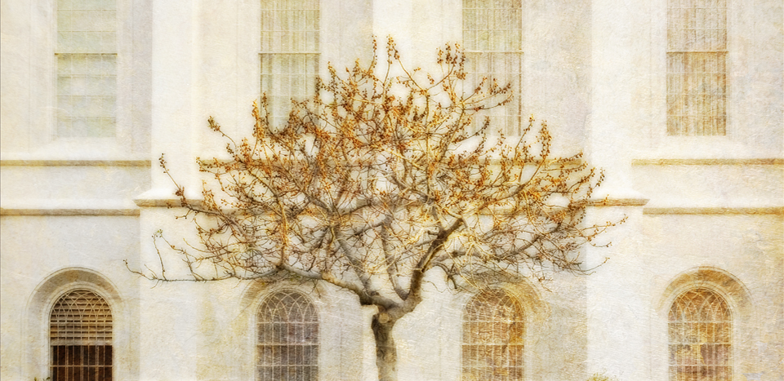
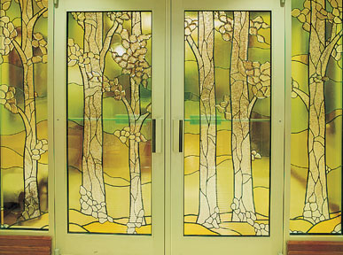
More people in all the world have felt the Spirit of Elijah move them to record the identities and facts of their ancestors’ lives.
There are more resources to search out your ancestors than there have ever been in the history of the world.
The Lord has poured out knowledge about how to make that information available worldwide through technology that a few years ago would have seemed a miracle. …
“… When you were baptized, your ancestors looked down on you with hope. Perhaps after centuries, they rejoiced to see one of their descendants make a covenant to find them and to offer them freedom. In your reunion, you will see in their eyes either gratitude or terrible disappointment. Their hearts are bound to you. Their hope is in your hands. You will have more than your own strength as you choose to labor on to find them.”
(3)

Slide 12

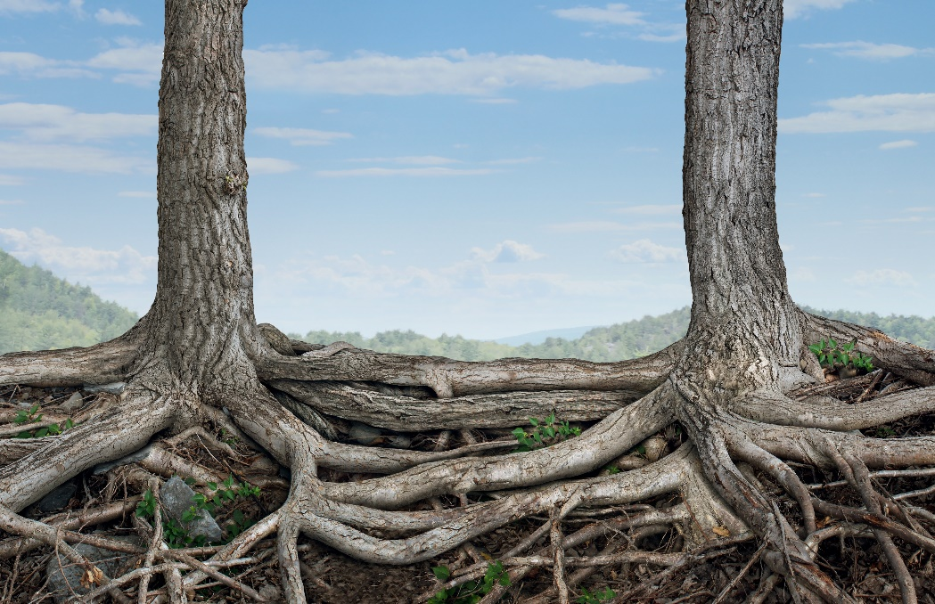
“Elijah restored the sealing powers whereby ordinances that were sealed on earth were also sealed in heaven. That would affect all priesthood ordinances but was particularly important for the sealing of families down through the generations of time, for without that link no family ties would exist in the eternities, and indeed the family of man would have been left in eternity with ‘neither root [ancestors] nor branch [descendants]’
“Inasmuch as such a sealed, united, celestially saved family of God is the ultimate purpose of mortality, any failure here would have been a curse indeed, rendering the entire plan of salvation ‘utterly wasted’ [D&C 2:3]”
(4)

Slide 13
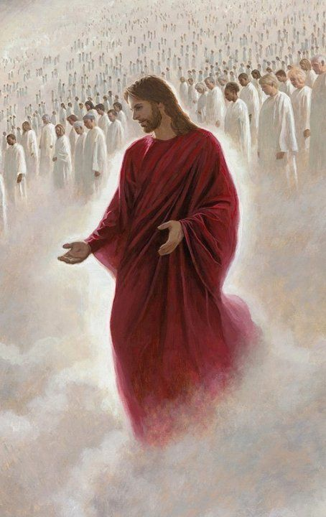
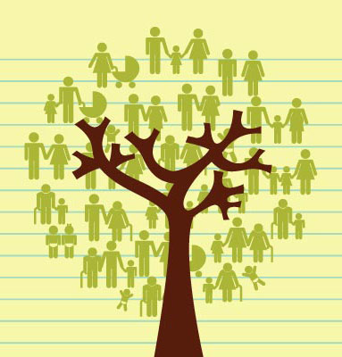
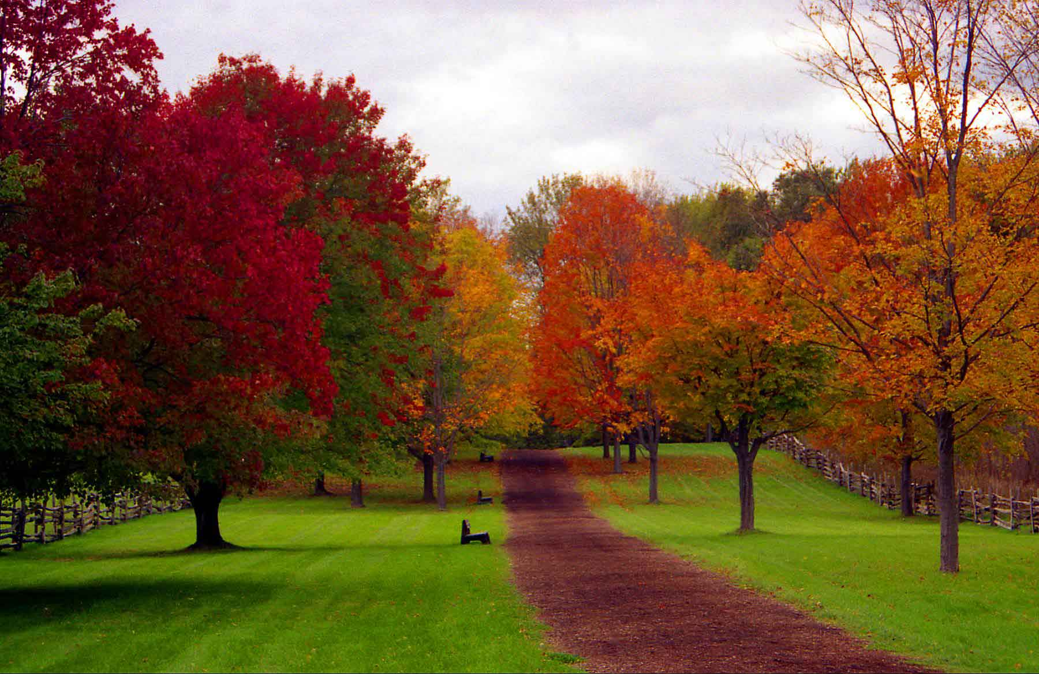
As we do family history and temple work, our hearts will be turned to our ancestors and we will help prepare the earth for the Second Coming of Jesus Christ

Slide 14
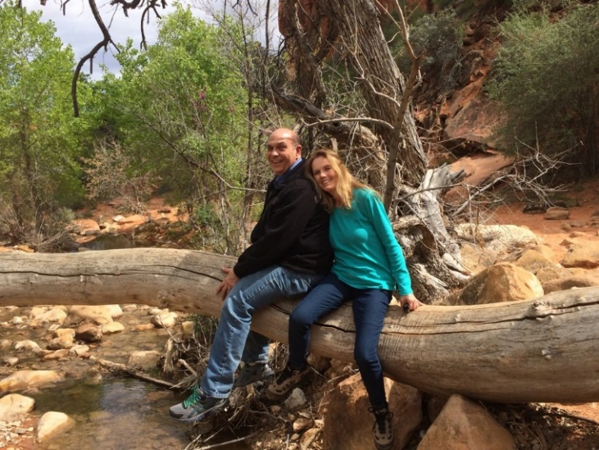
My Testimony
This year has been a whirlwind of emotions that have kept me pondering the importance of the Old Testament in my life. It was very difficult to read and study the harshness of the people and the wars on the earth today. Not only in the world but in our own communities and homes.
I have grown to love my Savior even more and realize that He is very forgiving and compassionate and most of all, loving. Thank you to my husband who encouraged me to dig deep into the Old Testament and continue.
Thank you for the seminary teachers who give so much time and effort into their lessons. They are truly the Lord’s disciples.
I love the Lord with all my heart and know that the gospel is true. The Savior will come again.

Slide 15
Sources:
Suggested Hymn: #152 God Be with You Till We Meet Again (Great Closing Hymn)
Video: By the Hand of Elijah the Prophet (3:32)
Hearts Bound Together (2:18)
Old Testament Student Institute Manual “Behold, I Will Send You Elijah the Prophet” Chapter 34
Elder Theodore M. Burton In Conference Report, Oct. 1967, p. 81
Presentation by ©http://fashionsbylynda.com/blog/
3. Henry B. Eyring (“Hearts Bound Together,” Ensign or Liahona, May 2005, 77, 79–80).
4. Elder Jeffrey R. Holland (Christ and the New Covenant: The Messianic Message of the Book of Mormon [1997], 297–98).

Slide 16
Malachi 1 | Malachi 2 | Malachi 3-4
Through Malachi, the Lord rebukes the Jews for their disobedience in the practices and sacrifices at the temple. The Jewish leaders were offering “polluted bread” (Malachi 1:7) and improper sacrifices using blemished, injured, and diseased animals. | The Lord chastises the priests for not keeping their covenant with the Lord and for being a poor example to the people. He uses the breaching of a marriage covenant to illustrate their failure to keep their covenant with Him. | The Lord will send a forerunner to prepare the way before Him, and He will come suddenly to His temple. He challenges the people to live the law of tithing and promises to send Elijah before the great and dreadful day of the Lord.
Elder David A. Bednar of the Quorum of the Twelve Apostles commented on who Elijah was and what his mission entailed:
“Elijah was an Old Testament prophet through whom mighty miracles were performed. He sealed the heavens, and no rain fell in ancient Israel for 3½ years. He multiplied a widow’s meal and oil. He raised a young boy from the dead, and he called down fire from heaven in a challenge to the prophets of Baal. (See 1 Kings 17–18.) At the conclusion of Elijah’s mortal ministry, he ‘went up by a whirlwind into heaven’ (2 Kings 2:11) and was translated.
“‘We learn from latter-day revelation that Elijah held the sealing power of the Melchizedek Priesthood. …’ (Bible Dictionary, ‘Elijah’). The Prophet Joseph Smith explained, ‘The spirit, power, and calling of Elijah is, that ye have power to hold the key of the … fullness of the Melchizedek Priesthood … ; and to … obtain … all the ordinances belonging to the kingdom of God’ (Teachings of Presidents of the Church: Joseph Smith [2007], 311; emphasis added). This sacred sealing authority is essential for priesthood ordinances to be valid and binding both on earth and in heaven.
“Elijah appeared with Moses on the Mount of Transfiguration (see Matthew 17:3) and conferred this authority upon Peter, James, and John. Elijah appeared again with Moses and others on April 3, 1836, in the Kirtland Temple and conferred the same keys upon Joseph Smith and Oliver Cowdery” (“The Hearts of the Children Shall Turn,” Ensign, Nov. 2011, 24).

