Slide 1
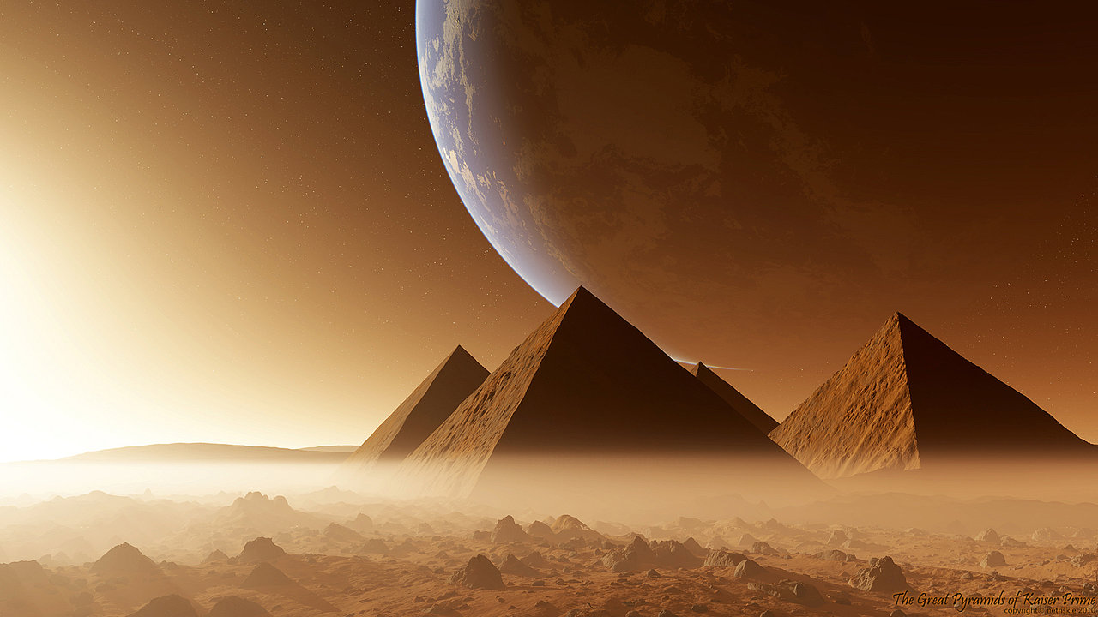
Lesson 30
Warnings and Blessings From the Lord
Genesis 20-22
And Abraham called the name of his son that was born unto him, whom Sarah bare to him, Isaac.
Genesis 21:3
Presentation by ©http://fashionsbylynda.com/blog/

Slide 2
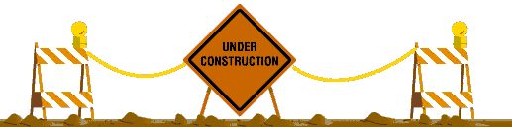






What is the Purpose of These Signs?
Radiation
Poison
To Warn
One Way
Have you or someone you know ever received a warning from God when about to make a mistake?
How was that warning given?
High Voltage

Slide 3
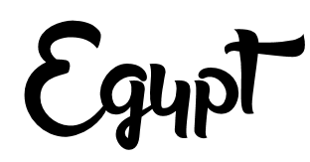

The land of so many of our Father’s children
Biblical Egypt served both as a refuge and as a threat to the Lord’s people in Old Testament and New Testament times.
The emphasis in the Bible consistently falls not on Egyptians as persons but on Egypt as a place.
Thus, when in later Christian scripture Egypt is used as a symbol of spiritual bondage, we note that the writers use the place as a symbol understood by the Jews and not a charge against the people.
In the book of Revelation, for instance, Egypt is equated with Sodom, and both are used as names or symbols for a wicked Jerusalem of the latter days (Rev. 11:8).
While it was often a place of testing or bondage, it was also a frequent haven from their troubles.
For Abraham and Sarah, Egypt constituted a place of refuge from the famine raging at the time of their arrival in Canaan (Gen. 12:10). Interestingly, while Abraham and Sarah enjoyed respite from Canaan’s drought, their visit to Egypt provided Sarah with one of her most difficult trials.
(1)

Slide 4
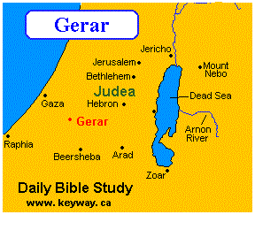
The Land Gerar
Abraham and Sarah journeyed to Gerar.
The King of Gerar took Sarah
Genesis 20:1-2

Slide 5
The Dream
The Curse
Genesis 21:3-7
The Warning
“Closed up all the wombs”
Although Abimelech’s household was immediately cursed because he had taken Sarah, the Lord warned him about his mistake and gave him an opportunity to avoid committing a great sin
Genesis 21: 3-7, 18

Slide 6
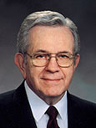


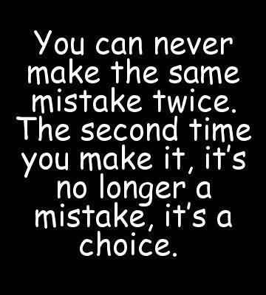
“No member of this Church—and that means each of you—will ever make a serious mistake without first being warned by the promptings of the Holy Ghost.
“Sometimes when you have made a mistake, you may have said afterward, ‘I knew I should not have done that. It did not feel right,’ or perhaps, ‘I knew I should have done that. I just did not have the courage to act!’
Those impressions are the Holy Ghost attempting to direct you toward good or warning you away from harm.”
(2)

Slide 7
The Birth of Isaac
God always keeps His promises to the faithful according to His timetable
Genesis 21:1-8

Slide 8
A House Divided
Sarah saw Hagar’s son Ishmael mocking, or persecuting, Isaac
But as then he that was born after the flesh persecuted him that was born after the Spirit, even so it is now.
Galatians 4:29
Sarah told Abraham to send Hagar and Ishmael away into the wilderness, which grieved Abraham.
While there are details of this story we do not possess, we do know that Sarah was a remarkable woman. However, she also possessed feelings and emotions like any human being and was protective of her covenant son, Isaac.
Genesis 21:9-34

Slide 9
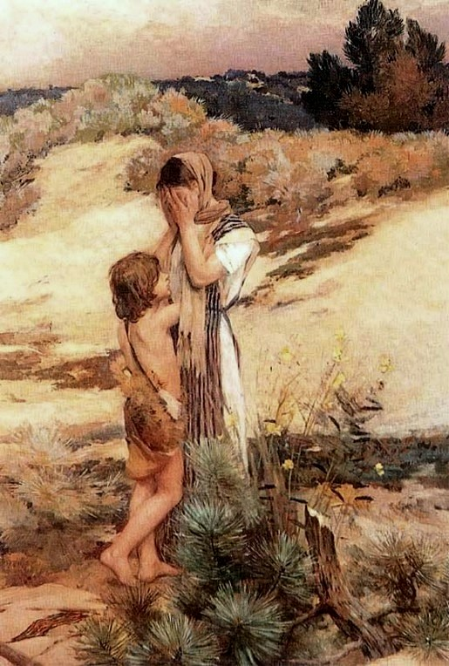
Beer-sheba
Hagar and Ishmael lost their way in the wilderness of Beer Sheba and soon ran out of water.
Hagar could not watch the boy’s suffering and put him in the shade of a bush, while she sat some distance away and cried.
An angel then called to Hagar and assured her that God had seen the suffering of her boy.
He would live and become the father of a mighty nation. And suddenly, Hagar saw a spring nearby.
Jean-Charles Cazin,
Side note
*According to the Koran, Abraham brought Ishmael and his mother to Arabia and settled them near what was to become the great city of Mecca. (7)
Genesis 21:14-20

Slide 10
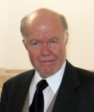
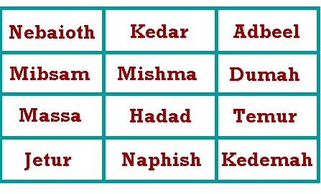
Ishmael’s Descendants
Ishmael eventually became the principal ancestor of much of the Arab world in fulfillment of the promise made to Abraham
Eventually the descendants of Ishmael’s twelve sons began to fill the Arabian peninsula.
The Biblical account, though it differs in specifics, suggests also that Hagar and Ishmael were directed in their wanderings.
Genesis recounts that an angel of the Lord comforted and preserved them, and that “God was with the lad [Ishmael].
Genesis 21:14-20
(3)

Slide 11
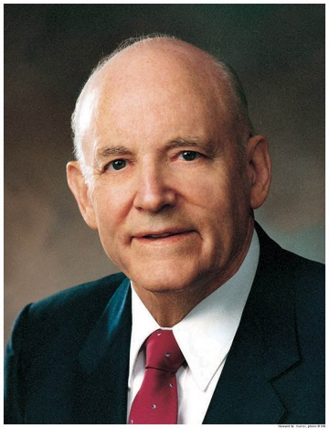
“It should be manifestly evident to members of the Church that our Father loves all of his children.
“He desires all of them to embrace the gospel and come unto him. …
“Both the Jews and the Arabs are children of our Father. They are both children of promise, and as a church we do not take sides. We have love for and an interest in each.”
(4)

Slide 12

A Test of Obedience
Genesis 22
For I know him, that he will command his children and his household after him, and they shall keep the way of the Lord, to do justice and judgment; that the Lord may bring upon Abraham that which he hath spoken of him.
Genesis 18:19

Slide 13
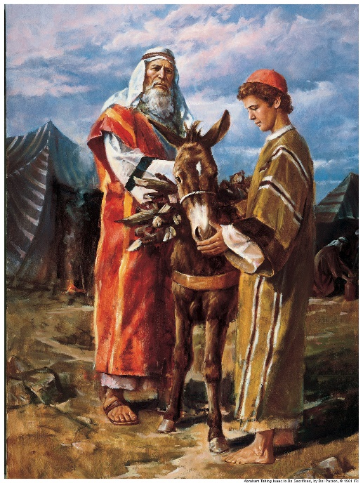
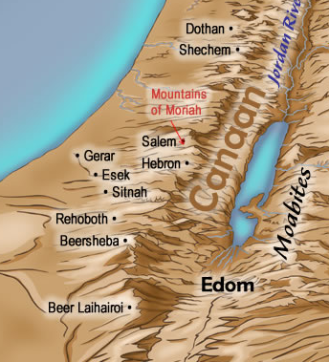
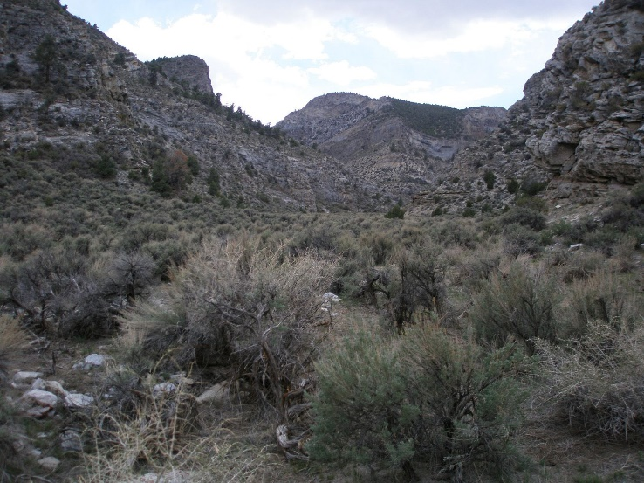
Tempt—To test/to Prove
Today Mount Moriah is a major hill of Jerusalem
The Lord had required Abraham to make his three-day journey with Isaac into the “land of Moriah” to reach the mountain that the Lord would designate
The Lord had required Abraham to sacrifice Isaac as a burnt offering
Genesis 22:1-14

Slide 14
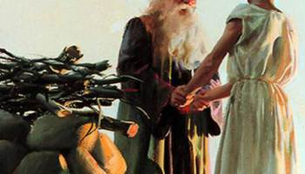
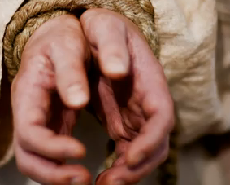
Similitude
A similitude is an object, act, or event in physical reality which corresponds to (is similar to or is a simulation of) some greater spiritual reality.
Behold, they believed in Christ and worshiped the Father in his name, and also we worship the Father in his name. And for this intent we keep the law of Moses, it pointing our souls to him; and for this cause it is sanctified unto us for righteousness, even as it was accounted unto Abraham in the wilderness to be obedient unto the commands of God in offering up his son Isaac, which is a similitude of God and his Only Begotten Son.
Jacob 4:5
Abraham obviously was a type or similitude of the Father. Interestingly enough, his name, Abram, means “exalted father,” and Abraham means “father of a great multitude” Both are names appropriate of Heavenly Father.
Isaac was a type of the Son of God. One of the meanings of his name is “he shall rejoice.”
By faith Abraham, when he was tried, offered up Isaac: and he that had received the promises offered up his only begotten son, Hebrews 11:17
Genesis 22:1-14

Slide 15
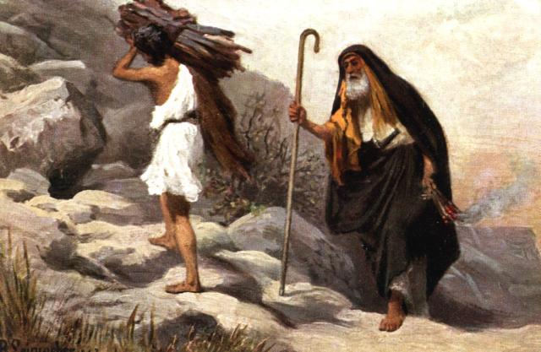
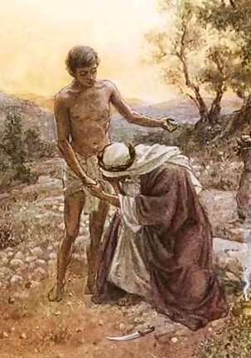
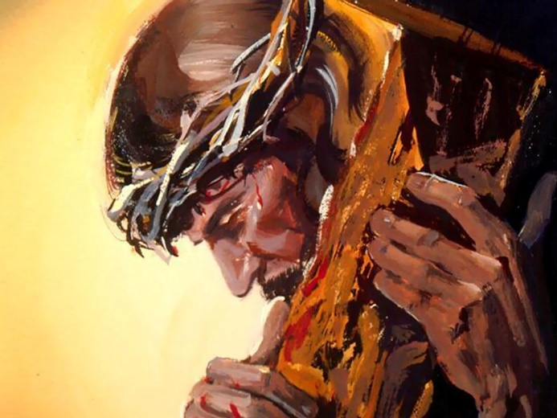
Placing of the Wood
“laid it upon Isaac his son”
Genesis 22:6
“laid it upon his back”
JST Genesis 22:7
Similitude of Christ carrying his own cross
Isaac voluntarily submitted to Abraham
William Brassey Hole
Genesis 22:6-7

Slide 16
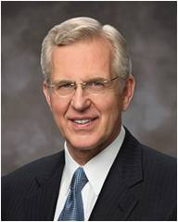
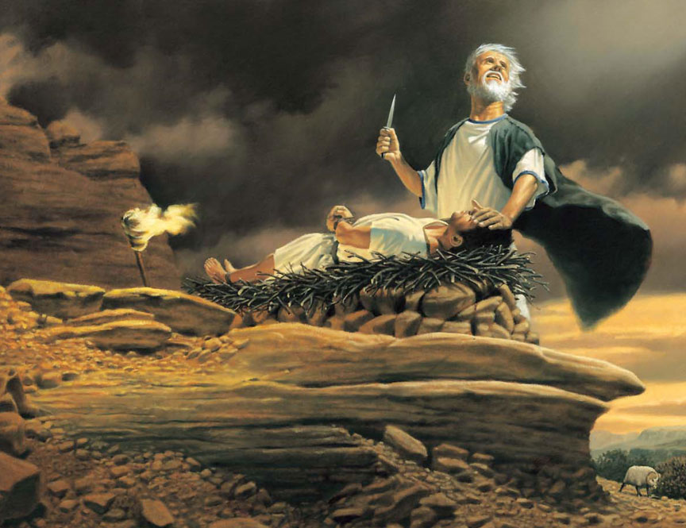
Here Am I
“We generally interpret the word fear as ‘respect’ or ‘reverence’ or ‘love,’” we should also “so love and reverence Him that we fear doing anything wrong in His sight.” (5)
When we are willing do what the Lord commands us, we show our reverence and love for Him
Once the event was over and all ended happily, Abraham named the place Jehovah-jireh, which the King James Version translates as “in the mount of the Lord it shall be seen.” (6)
Genesis 22:9-12

Slide 17
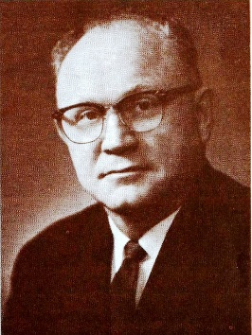
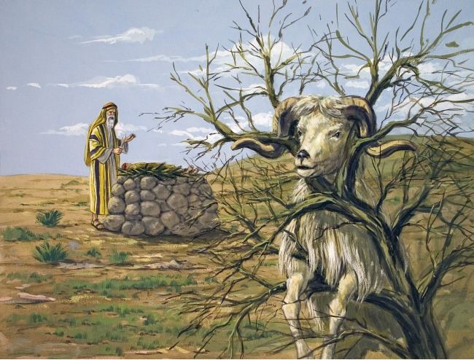
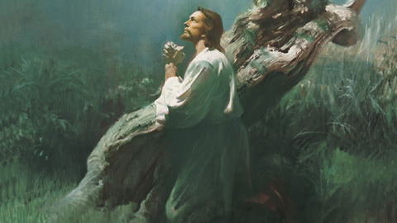
The Lord Provides a Way
Heavenly Father demonstrated His love for us through the sacrifice of His Son, Jesus Christ.
“God has provided one way and only one way for his mortal children to attain godlike perfection.”
“For God so loved the world, that he gave his only begotten Son, that whosoever believeth in him should not perish, but have everlasting life. For God sent not his Son into the world to condemn the world; but that the world through him might be saved.”
John 3:16–17
“God’s greatest gift to his children is for them to be saved in the kingdom of God.”
Genesis 22:13
(7)

Slide 18
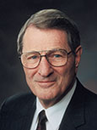
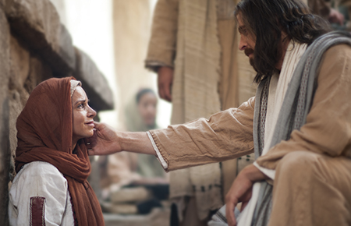
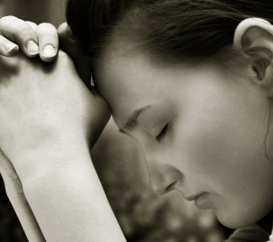
“The submission of one’s will is really the only uniquely personal thing we have to place on God’s altar.
The many other things we ‘give,’ brothers and sisters, are actually the things He has already given or loaned to us.
“However, when you and I finally submit ourselves, by letting our individual wills be swallowed up in God’s will, then we are really giving something to Him!”
(8)

Slide 19
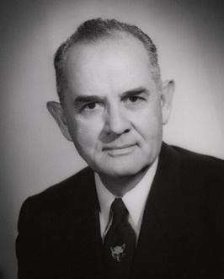
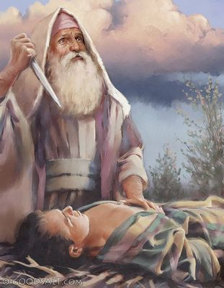
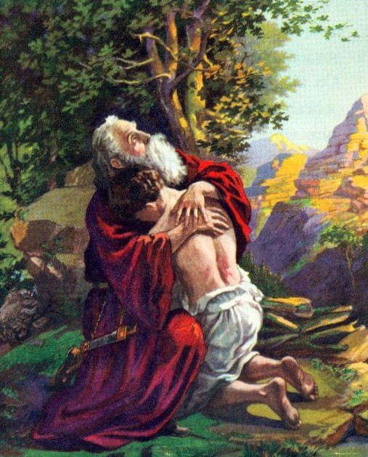
“Exceeding faith was shown by Abraham when the superhuman test was applied to him.
His young ‘child of promise,’ destined to be the father of empires, must now be offered upon the sacrificial altar. It was God’s command, but it seemed so contradictory!
How could his son, Isaac, be the father of an uncountable posterity if in his youth his mortal life was to be terminated?
Why should he, Abraham, be called upon to do this revolting deed?
It was irreconcilable, impossible! And yet he believed God. His undaunted faith carried him with breaking heart toward the land of Moriah with this young son who little suspected the agonies through which his father must have been passing.”
(9)

Slide 20
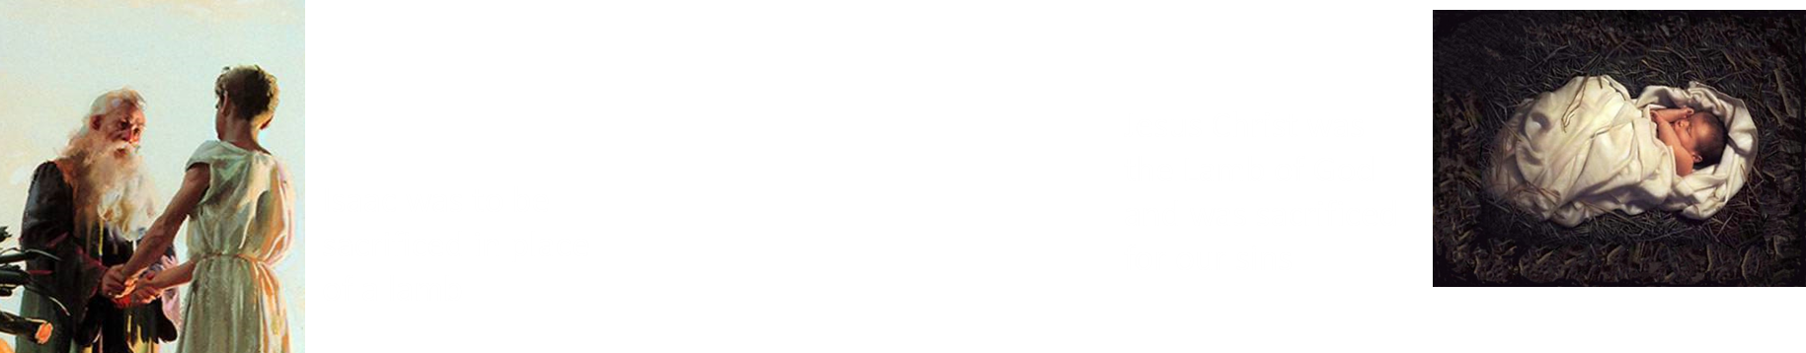
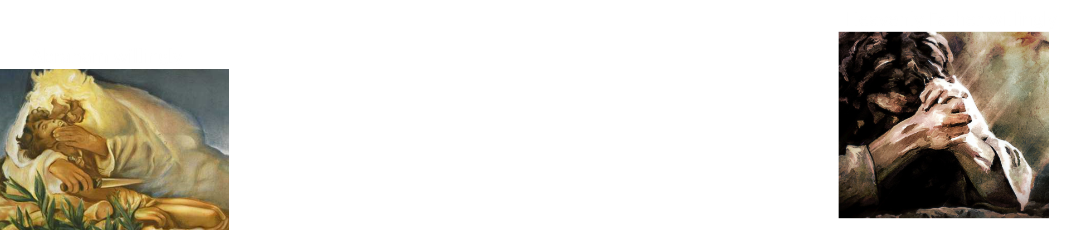
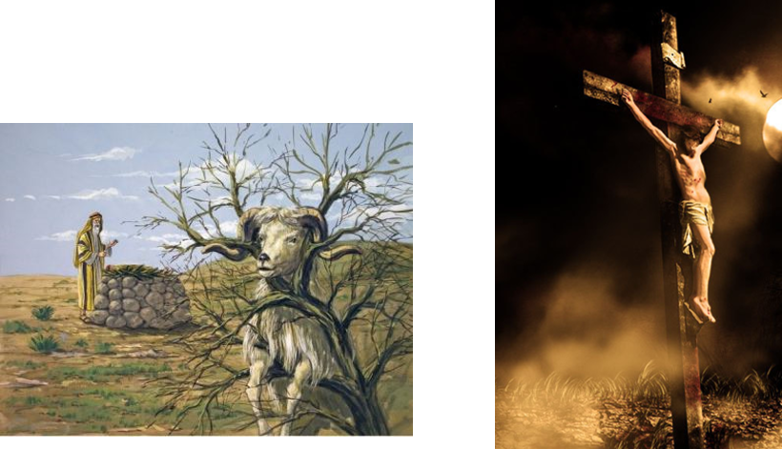
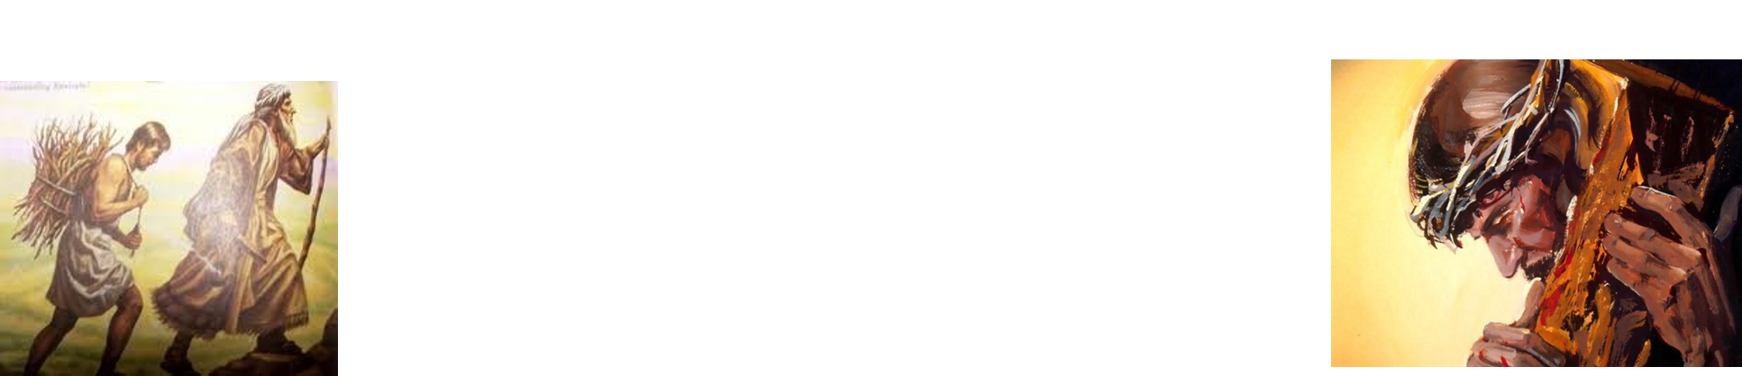
Similarities Between the Two Sacrifices
Abraham’s Sacrifice of Isaac | Heavenly Father’s Sacrifice of Jesus Christ

Slide 21
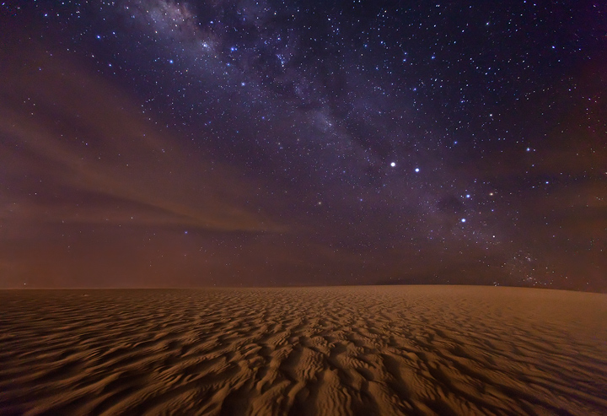

The Promise in Obedience
I will multiply thy seed as the stars of the heaven, and as the sand which is upon the sea shore;
And in thy seed shall all the nations of the earth be blessed; because thou hast obeyed my voice.
Genesis 22:15-19

Slide 22
Scenes For Next Time
Abraham returns home, and learns about children born into the household of his brother Nahor, including a granddaughter named Rebekah, who would play an important role in the fulfillment of God’s promises to Abraham.
Milcah
Nahor
Reumah
Tebah
Huz
Gaham
Buz
Thahas
Kemuel
Aram
Maachah
Chesed
Hazo
Pildash
Jidlaph
(3)
Rebekah
Bethuel
Genesis 22:20-24

Slide 23
Sources:
Suggested Hymn: # 275 Men Are That They Might Have Joy
Video: “Akedah (The Binding)” (12:57)
S. Kent Brown Biblical Egypt: Land of Refuge, Land of Bondage September 1980 Ensign
President Boyd K. Packer (“How to Survive in Enemy Territory,” New Era, Apr. 2012, 3).
3. James B. Mayfield Ishmael, Our Brother June 1979 Ensign
4. President Howard W. Hunter (That We Might Have Joy [1994], 73–74, 75.)
5. Elder D. Todd Christofferson (“A Sense of the Sacred,” [Church Educational System fireside for young adults, Nov. 7, 2004], 6, 7;LDS.org).
6. Old Testament Institute Student Manual Genesis 18-23
7. Bernard P. Brockbank God’s Way to Eternal Life Oct. 1973 Ensign
8. Elder Neal A. Maxwell (“Swallowed Up in the Will of the Father,” Ensign, Nov. 1995, 24).
9. Elder Spencer W. Kimball (In Conference Report, Oct. 1952, p. 48.)
Presentation by ©http://fashionsbylynda.com/blog/

Slide 24
Mt. Moriah:
Solomon constructed the temple on “mount Moriah” over the threshing floor of Ornan the Jebusite (2 Chronicles 3:1; 2 Samuel 24:16-25)
Flavius Josephus, a Jewish leader involved in Judah’s rebellion against Rome in A.D. 66–70, says that it was the same (see his Antiquities of the Jews, bk. 1, ch. 13, sect. 2).
Although Moriah has been called “hill,” “mount,” and “mountain,” it is only a few hundred feet above the floor of the adjacent valleys and is less than a mile and half long from one end to the other. It is dwarfed by some of its neighbors, including the Mount of Olives.
The mountain has been given several names. Abraham himself, after Isaac’s life was spared, called the mount “Jehovah-jireh,” meaning, “in the mount of the Lord it shall be seen” (Gen. 22:14)
Artel Ricks Mount Moriah: Some Personal Reflections September 1980 Ensign
Jesus was sentenced to death within the walls of the Antonia fortress, which was only about a hundred yards from the traditional site of Abraham’s sacrifice. He was put to death at Golgotha, part of the same ridge system as Moriah. Institute Student Manual Old Testament Gen. 22
Similitude: The Importance of Symbols
Thomas Carlyle once wrote: “It is in and through symbolism that man consciously or unconsciously lives, works, and has his being. Those ages, moreover, are accounted the noblest which can best recognize symbolical worth, and prize it the highest.” (In Maurice H. Farbridge, Studies in Biblical and Semitic Symbolism, flyleaf.)
It should not be surprising, then, that symbolic language and imagery should play a central role in religion, which is concerned with man’s eternal destiny. Religious ordinances and rituals are deeply symbolic, and the scriptures, which contain the word of the Lord revealed for His children, abound with similes, metaphors, parables, allegories, types, and symbols. The symbolism is so profound and so extensive that if one does not have an understanding of the meaning of that symbolism, many of the most important and satisfying truths will be missed.
Symbolic language and imagery have the power to convey important truths through many languages and cultures with great power and impact. A figurative image can provide powerful teaching impact. For example, in the midst of lengthy prophecies of judgment upon Israel, Isaiah gave what at first seems to be a difficult and obscure passage: “Give ye ear, and hear my voice; hearken, and hear my speech.
Couching great truths in symbolic language helped preserve them from those who sought to take away the plain and precious parts of the scriptures.
Figurative language can convey truth and meaning to all levels of spiritual maturity.
Symbols deeply affect the emotions and attitudes of an individual.
Spiritual power comes when one is forced to ponder and search out the meaning of symbolic imagery in an attitude of quest.
Two things should be kept in mind. First, these practices (animal sacrifice) were not offensive to the people of the Old Testament. The killing of animals for food, the sight of blood, the cleansing of the meat were all part of everyday life. The typical family in those times kept animals and slaughtered them for food. Even in large cities people purchased meat in open-air markets where often the animal was killed on the spot so that the meat would be fresh. Such a practice is common in the Middle East to this day. Second, it is the denotation of these practices that may be offensive to today’s urbanized reader. But when one looks beyond the symbol itself to what it was meant to connote, then the offense is replaced by appreciation for the spiritual truths being taught.
Excerpts from: Enrichment Section C: Symbolism and Typology in the Old Testament
Old Testament Student Manual Genesis-2 Samuel, (1980), 110–15
How Old was Isaac?
Isaac voluntarily submitted to Abraham. This important parallel is often overlooked. The Old Testament does not give enough detail to indicate exactly how old Isaac was at the time of this event, but it is possible that he was an adult. Immediately following the account of the sacrifice on Mount Moriah is recorded the statement that Sarah died at the age of 127 (see Genesis 23:1). Thus, Isaac would have been 37 at the time of her death. Even if the journey to Moriah had happened several years before Sarah’s death, Isaac could have been in his thirties, as was the Savior at the time of His Crucifixion. Nevertheless, Isaac’s exact age is not really important. What is significant is that Abraham was well over a hundred years old and Isaac was most likely a strong young man who could have put up a fierce resistance had he chosen to do so. In fact, Isaac submitted willingly to what his father intended, just as the Savior would do.

Slide 25
Offerings:
Under the law there were three kinds of sacrifice: (1) sin offerings, (2) burnt offerings, and (3) peace offerings. The Bible Dictionary states that the fundamental idea of the sin offerings “was atonement, expiation. They implied that there was a sin, or some uncleanness akin to a sin, that needed atoning for before fellowship with Jehovah could be obtained. …
“Trespass or guilt offerings were a particular kind of sin offerings.
“The burnt offering got its Hebrew name from the idea of the smoke of the sacrifice ascending to heaven” (“Sacrifices,” 766). It was placed on the altar and completely burned, symbolizing complete surrender and total devotion to God and parallels the process of justification and sanctification, a process of “retaining a remission of [our] sins” (Alma 4:14).
“As the obligation to surrender [to God] was constant on the part of Israel, a burnt offering, called the continual burnt offering, was offered twice daily, morning and evening. …
“Peace offerings, as the name indicates, presupposed that the sacrificer was at peace with God; they were offered for the further realization and enjoyment of that peace. …
“… When the three offerings were offered together, the sin always preceded the burnt, and the burnt [preceded] the peace offerings. Thus the order of the symbolizing sacrifices was the order of the atonement, sanctification, and fellowship with the Lord” (“Sacrifices,” 766–67).
September 2011 Ensign Sacrament Meeting and the Sacrament By Elder Vaughn J. Featherstone Of the Seventy
Tempt:
The word translated as “tempt” in the King James Version comes from the Hebrew word nissah, which means “to test, try, or prove.” The test given to Abraham had two aspects. First, he was asked to give up something very precious to him. To kill one’s child would be horrible enough but to kill the child that had come after decades of fruitless waiting, the child promised by holy men sent from God, the child in whom the covenant was to be fulfilled, must have been a test beyond comprehension. The willingness of Abraham to give up something as dear as Isaac sharply contrasts with the reluctance of the rich young ruler who asked the Savior what he must do to be saved. When told he should sell all of his possessions and follow the Master, “he went away sorrowful: for he had great possessions” (Matthew 19:22).
But an equally difficult, if not greater, test was what could be described as the question of the integrity of God. Abraham himself had nearly lost his life on an idolatrous altar and had been saved by the direct intervention of the Lord (see Abraham 1:12–20). Abraham knew that the law of God forbids human sacrifice or murder of any sort. Surely one would wonder at such a command, asking himself, “Can this be from God? Does God contradict himself?” And then to know that, additionally, it would mean the end of the very covenant line that God had Himself promised to establish would surely be almost overwhelming.
The Ram-- Our Savior:
“This story also shows the goodness of God in protecting Isaac and in providing a substitute so he would not have to die. Because of our sins and our mortality, we, like Isaac, are condemned to death. When all other hope is gone, our Father in Heaven provides the Lamb of God, and we are saved by his sacrifice” Elder Dallin H. Oaks (“Bible Stories and Personal Protection,” Ensign, Nov. 1992, 37).
“Knowing that God would make no capricious nor unnecessary demands, that the lad could be raised even from death if necessary, Abraham obeyed. A ram was provided” (in Conference Report, Oct. 1954, 52). Spencer W. Kimball
Thoughts on Abraham and His Son:
“In that hour I think I can see our dear Father behind the veil looking upon these dying struggles. … His great heart almost breaking for the love that He had for His Son. Oh, in that moment when He might have saved His Son, I thank Him and praise Him that He did not fail us. … I rejoice that He did not interfere, and that His love for us made it possible for Him to endure to look upon the sufferings of His [Only Begotten] and give Him finally to us, our Saviour and our Redeemer. Without Him, without His sacrifice, … we would never have come glorified into His presence. … This is what it cost, in part, for our Father in heaven to give the gift of His Son unto men” Elder Melvin J. Ballard(in Crusader for Righteousness [1966], 137).

Slide 26
Ishmael eventually became the principle ancestor of much of the Arab world in fulfillment of the promise made to Abraham (see Genesis 21:13). President Howard W. Hunter taught:
“It should be manifestly evident to members of the Church that our Father loves all of his children.
“He desires all of them to embrace the gospel and come unto him. …
“Both the Jews and the Arabs are children of our Father. They are both children of promise, and as a church we do not take sides. We have love for and an interest in each” (That We Might Have Joy [1994], 73–74, 75.)
For more information about Ishmael and his modern descendants, see “Ishmael, Our Brother” (James B. Mayfield, Ensign, June 1979, 24–32).
Sarah the Sister of Abraham:
Most are familiar with the story of Sarah posing as Abraham’s sister (see Gen. 12:11–15). Even though Abraham later insisted that Sarah was his sister through his father, but not his mother (see Gen. 20:12), many students have felt confused with this explanation. It was not until the discovery of ancient Hurrian legal texts at the site of Nuzi, a city east of Ashur, the capital of ancient Assyria, that we obtained a clearer background for this incident.
The Hurrians were people who flourished about the time of Abraham, and later. Their kingdom included the land of Haran in which Abraham and Sarah lived for a number of years before moving to Canaan (see Gen. 11:31; Gen. 12:5). Interestingly, only in stories dealing with Sarah and Rebecca do we find the claim made that the wife was also a sister to her husband (see Gen. 12:10–20; Gen. 20:2–6; Gen. 26:1–11). Rebecca, like Sarah, spent her youth growing up in Haran, no doubt in contact with Hurrians.
The contact is important when we learn that under Hurrian law women were frequently adopted as sisters by their husbands either before or during the marriage ceremony. Such a dual status, both wife and sister, had important consequences for a woman. It guaranteed to her special legal and social protections and opportunities which were simply not available to women in any other culture of the Near East. Because Sarah had lived within the Hurrian culture for a number of years, it is not unlikely that she enjoyed this status in her marriage, a status common among Hurrians. Therefore, Abraham’s claim that Sarah was his sister upon their entry into the land of Egypt is not far-fetched in the least. Further, it is possible that Terah, Abraham’s father, had adopted Sarah before her marriage to Abraham and that this is the meaning of the passage in Genesis 20:12 [Gen. 20:12]. This particular practice, on the part of a prospective father-in-law, is documented from the Nuzi tablets. (See E. A. Speiser, “The Wife-Sister Motif in the Patriarchal Narratives,” in Biblical and Other Studies, Cambridge, Mass.: Harvard Univ. Press, 1963, pp. 15–28.)
See S. Kent Brown (1) reference
Some ancient cultures if a king wanted to marry a woman and she was already married, the king might have her husband killed so he could take her as his own wife (see Old Testament Student Manual: Genesis–2 Samuel, 3rd ed. [Church Educational System manual, 2003], 65–66).
It appears that Abraham feared this might happen to him. Abraham may have also been relying on the instructions the Lord had given him when he was in a similar situation in Egypt.
Abraham was technically correct in stating that Sarah was his sister. After the death of Sarah’s father Haran [Abraham’s older brother], it is likely that Abraham’s father Terah took Sarah into his household and cared for her, and so she was, for all intents and purposes, the sister of Abraham.
Terah
Abram--Sarai
Nahor--Malacah
Haran
Sarai
Lot

