Slide 1
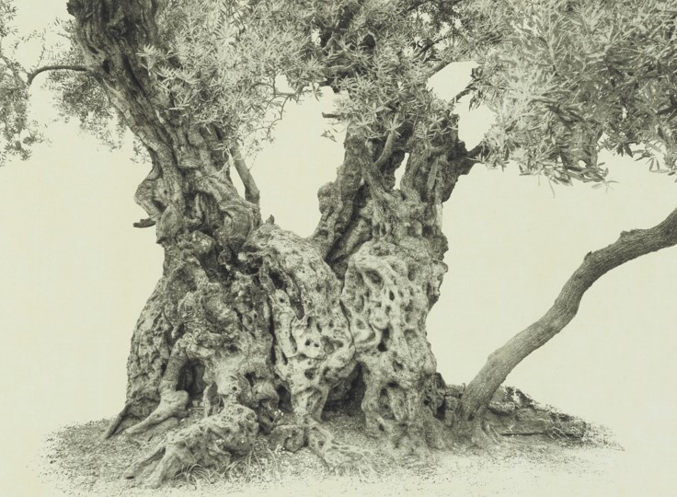
Why Hast Thou Forsaken Me?
Understanding the Mission of Christ
Psalm 22

Slide 2
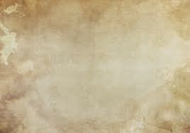
David foretells events in the Messiah’s life
To the chief Musician upon Aijeleth Shahar, the name meaning “land of the morning”
Aijeleth Shahar could be a name of a person or the name of an instrument, or the name of a song.
Psalm 22 was quoted or alluded to at least eleven times by New Testament authors

Slide 3
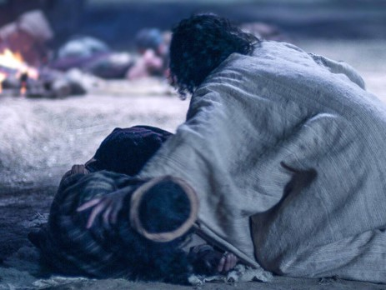
My God, My God
My God, my God, why hast thou forsaken me? why art thou so far from helping me, and from the words of my roaring?
“Quoted from the Psalms by Christ as he hung upon the cross.
And at the ninth hour Jesus cried with a loud voice, saying, Eloi, Eloi, lama sabachthani? which is, being interpreted, My God, my God, why hast thou forsaken me?
Matthew 27:46 and Mark 15:34
Psalm 22:1

Slide 4
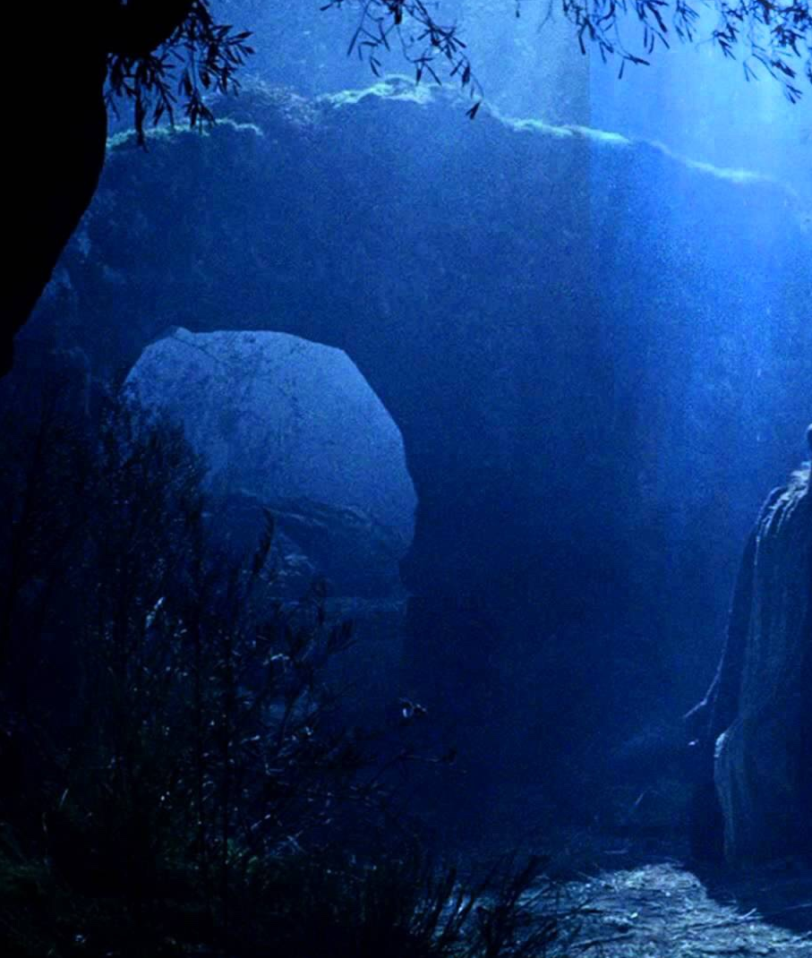
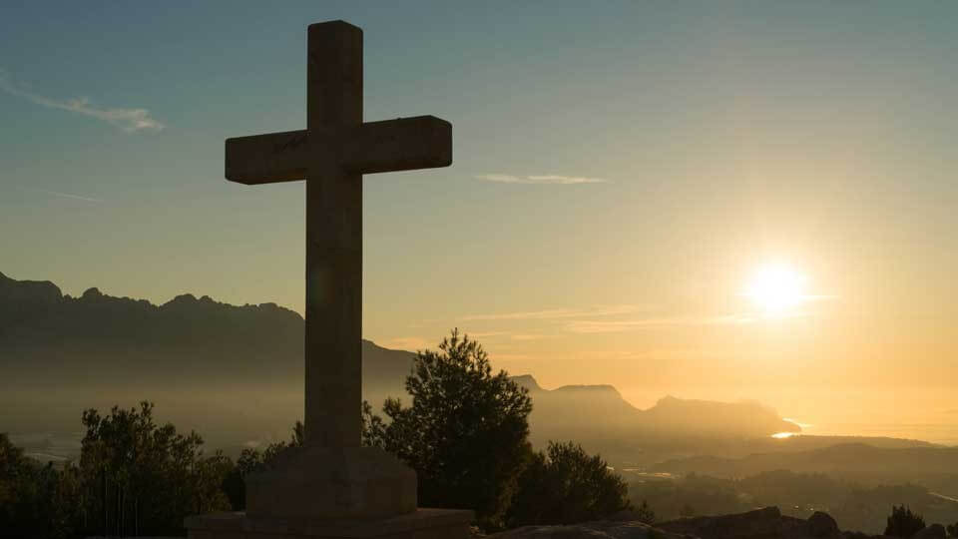
Night and Day
O my God, I cry in the daytime, but thou hearest not; and in the night season, and am not silent.
Christ suffered for our sins in the night and died for our sins in the day.
And he went forward a little, and fell on the ground, and prayed that, if it were possible, the hour might pass from him.
Matthew 26:39 Mark 14:35
And it was the third hour, and they crucified him.
Matthew 27:46 Mark 15:25
Psalm 22:2
Psalm 22:2

Slide 5
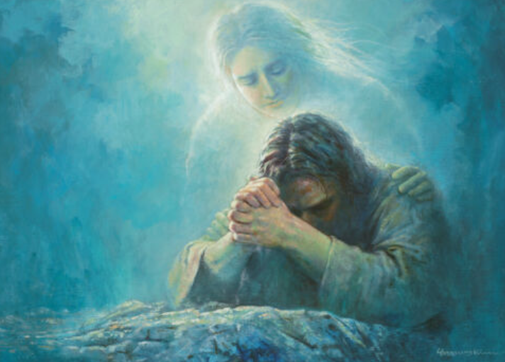
Cry of Abandonment
But thou art holy, O thou that inhabitest the praises of Israel.
Our fathers trusted in thee: they trusted, and thou didst deliver them.
They cried unto thee, and were delivered: they trusted in thee, and were not confounded.
Yongsong Kim
The cry of abandonment expressed by Christ on the cross indicates that He trusted His Father even while feeling the overwhelming burden of His mission.
Psalm 22:3, 4, 5

Slide 6

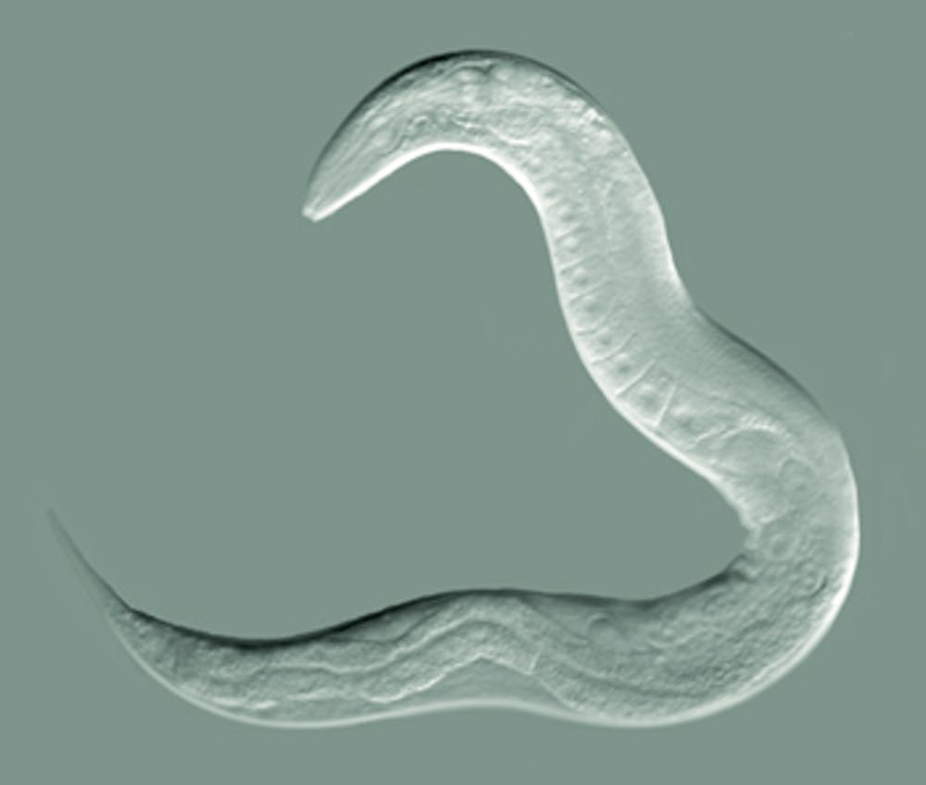
Worm-Meaning 1
But I am a worm, and no man; a reproach of men, and despised of the people.
Christ, who “descended below all things” (D&C 88:6; see also Eph. 4:9–10), was considered as less than any other human being, having become in a manner guilty of the darkest sins of all humankind through his atoning sacrifice (2 Cor. 5:21). He was treated as the “lowest of creatures”
How much less man, that is a worm? and the son of man, which is a worm? Job 25:6
Job’s friend Bildad uses the word “worm” to suggest that Job’s suffering is due to his sins, a state of uncleanness that is common to all of humankind:
Psalm 22:6

Slide 7
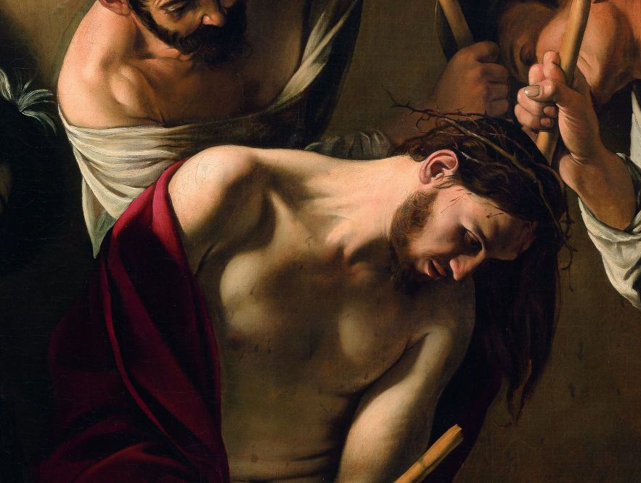
Worm-Meaning 2
“Worm” in Hebrew (tola‘at) is a variant name for the creature (Heb. tole‘ah) used to provide the color scarlet in the ancient world.
Only royalty or the rich could afford the dye from this worm, and scarlet became identified with kingly authority and wealth.
The soldiers at Christ’s crucifixion, placed upon him a robe of scarlet o mock him as “King of the Jews.”
The coloring for this robe would have come from the tola‘at, thus teaching that the Messiah is “a worm, and no man,” because he is more than man; he is of kingly heritage, the Son of God.
Psalm 22:6 (see Matt. 27:28; a purple robe in John 19:2)

Slide 8
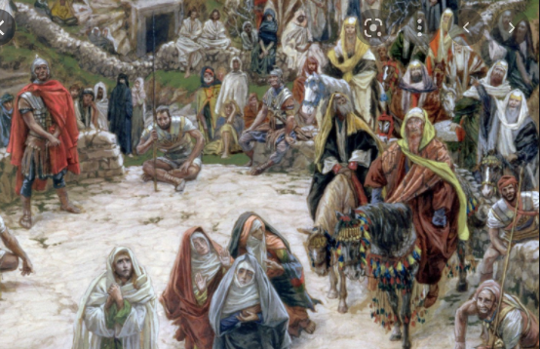
Scorn-Reviled
All they that see me laugh me to scorn: they shoot out the lip, they shake the head, saying,
And they that passed by reviled him, wagging their heads. Matthew 27:39
And they that passed by railed on him, wagging their heads… Mark 15:29
Those deriding Jesus viewed with delight the predicament of the cross that indicated to them that Jesus’s trust had been misplaced and that his belief that the Father “honoure[d him]” (John 8:54) was incorrect.
Psalm 22:7-8

Slide 9
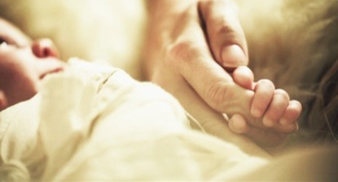
From the Womb
I was cast upon thee from the womb:
Christ’s atoning sacrifice was not carried out only at his death, but instead began at the beginning of his life, when he was called “from the womb.”
God’s role in Jesus’s birth.
God provided a unique protection and support from Jesus’s earliest days in the role typically filled by a father.
Jesus had been called “from the foundation of the world” (Rev. 13:8)
Jesus was called the Messiah before he was born.
Psalm 22:9-10

Slide 10
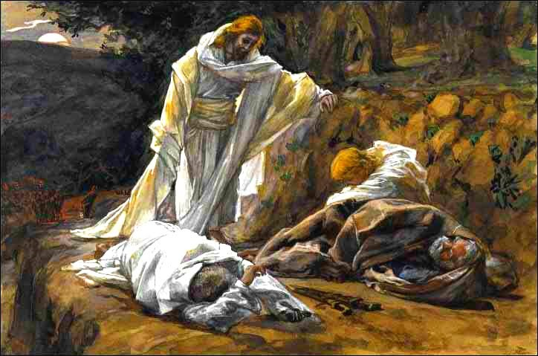
None to Help
Be not far from me; for trouble is near; for there is none to help
Jesus’ Apostles did not always stand by him throughout his greatest hours of need.
When Jesus was betrayed by Judas and taken captive, “all [his] disciples forsook him, and fled
Matthew 26:56;
Mark 14”50
My soul is exceeding sorrowful, even unto death: tarry ye here, and watch with me. (Matthew 26:38)
Psalm 22:11

Slide 11
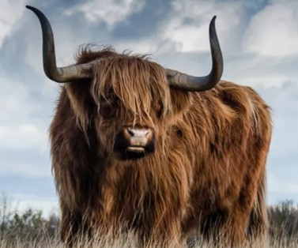
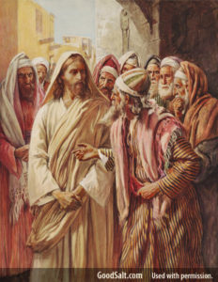
Bulls
Many bulls have compassed me: strong bulls of Bashan have beset me round.
Bulls of Bashan--The phrase is using imagery of living things from a notoriously evil place.
Bashan was used by Israelite prophets as a symbol of haughty pride (Jer. 22:20; 50:19; Ezek. 27:6),
The Pharisees and Sadducees surrounded Christ at his trial, slapping and spitting upon him.
Psalm 22:12

Slide 12
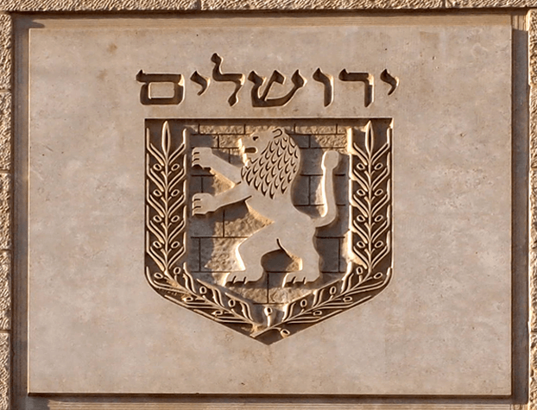
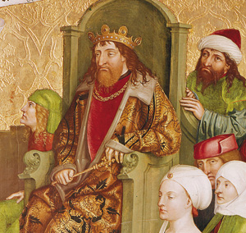
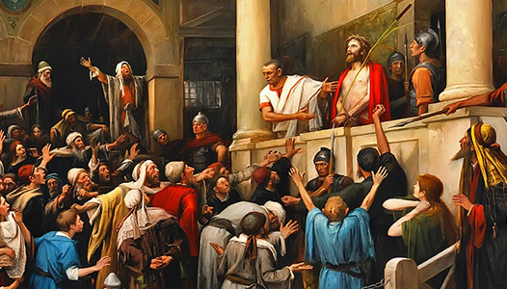
Roaring Lion
They gaped upon me with their mouths, as a ravening and a roaring lion.
The Lion was a symbol of the Tribe of Judah
When the chief priests therefore and officers saw him, they cried out, saying, Crucify him, crucify him. Pilate saith unto them, Take ye him, and crucify him: for I find no fault in him. John 19:6
Possibly King Herod
(3)
Psalm 22:13

Slide 13
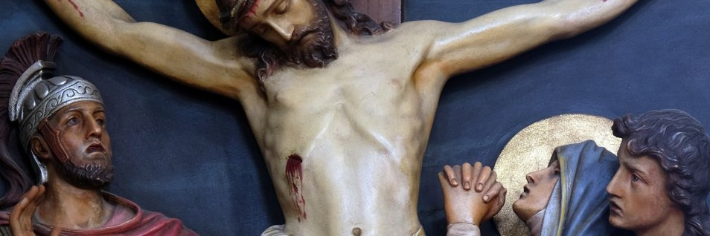
In the Midst of My Bowels
I am poured out like water, and all my bones are out of joint: my heart is like wax; it is melted in the midst of my bowels.
And being in an agony he prayed more earnestly: and his sweat was as it were great drops of blood falling down to the ground. (Luke 22:44)
But one of the soldiers with a spear pierced his side, and forthwith came there out blood and water.
(John 19:34)
“This event signaled that Christ had died of a broken heart.” (4)
Psalm 22:14

Slide 14
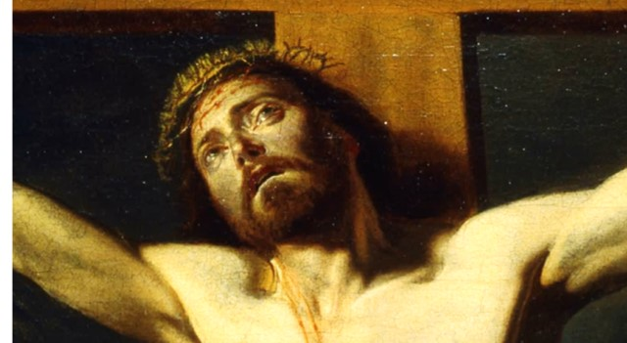
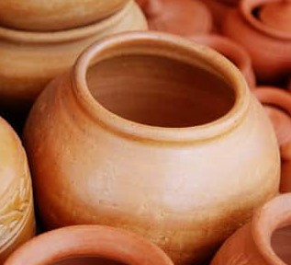
Dried Up-Dust of Death
My strength is dried up like a potsherd; and my tongue cleaveth to my jaws; and thou hast brought me into the dust of death.
“… a broken piece of pottery. In those days, everyday pottery was not glazed. Therefore, if a drop of water was put on a broken piece of unglazed pottery, the drop would be soaked up almost instantly. Severe dehydration also causes the mouth to become dry and the tongue to swell up so that it ‘cleaveth’ to the jaws.” (5)
I thirst” (John 19:28}
Psalm 22:15

Slide 15
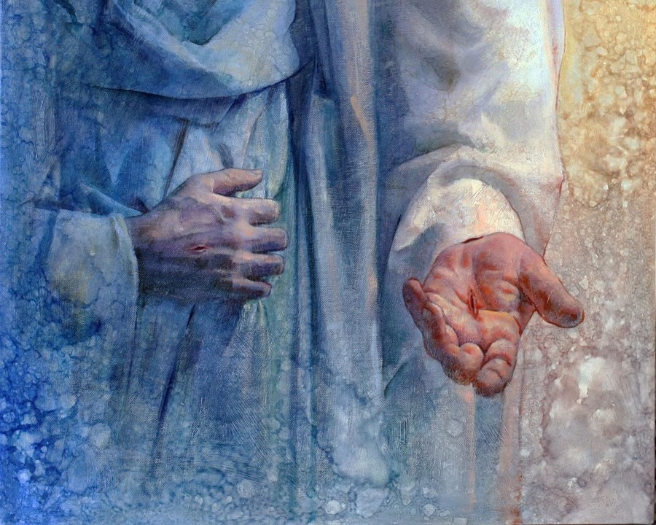
Pierced My Hands and My Feet
For dogs have compassed me: the assembly of the wicked have inclosed me: they pierced my hands and my feet.
“behold [his] hands and [his] feet”
(Luke 24:39).
“feel the prints of the nails in [his] hands and in [his] feet” (3 Ne. 11:14)
I may tell all my bones: they look and stare upon me. (17)
Psalm 22:16-17

Slide 16
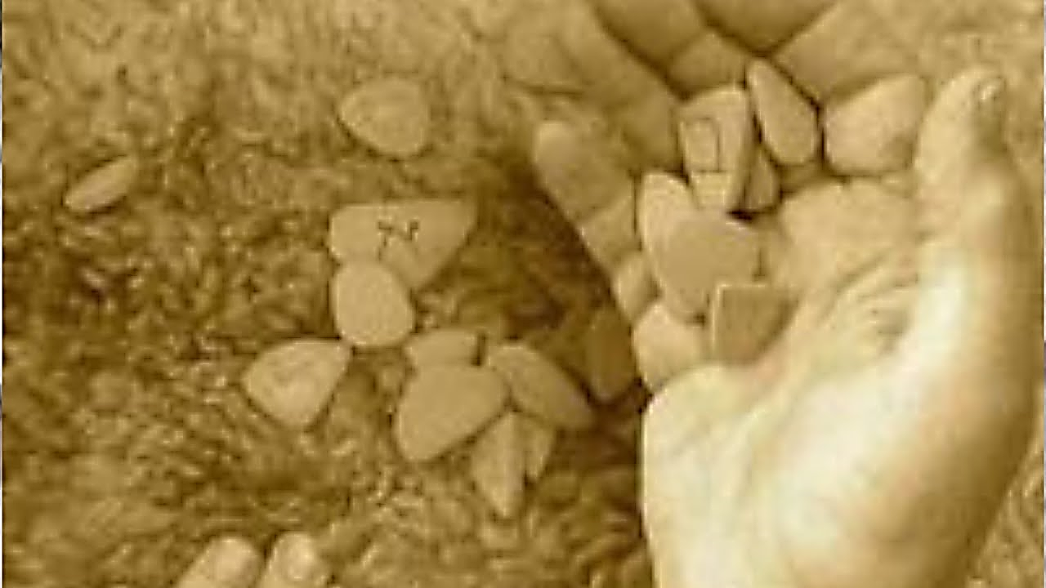
Casting Lots
They part my garments among them, and cast lots upon my vesture
Then said Jesus, Father, forgive them; for they know not what they do. And they parted his raiment, and cast lots. (Luke 23:34)
Not only did the persecutors divide Jesus’s garments, but John also mentions that there was a second “vesture” or “raiment,” a special “coat . . . without seam, woven from the top throughout.
(John 19:23–24)
Psalm 22:18

Slide 17
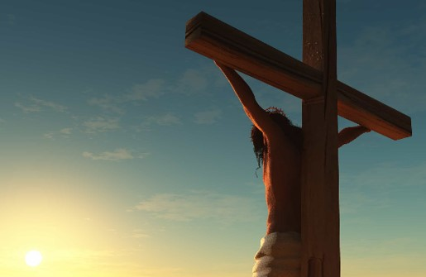
Why Hast Thou Forsaken Me?
But be not thou far from me, O Lord: O my strength, haste thee to help me.
Deliver my soul from the sword
Save me from the lion’s mouth
Jesus had power of life and death and had already given up his life when the wound came, trusting to God that he would be able to “break the bands of death” (Mosiah 15:8).
Psalm 22:19-21

Slide 18
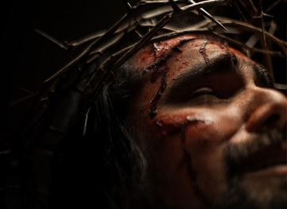
Lament to Praise
I will declare thy name unto my brethren: in the midst of the congregation will I praise thee
Ye that fear the Lord, praise him
God has already “heard” and responded to the cry of the sufferer
but when he cried unto him, he heard
My praise shall be of thee in the great congregation
Psalm 22:22-24

Slide 19
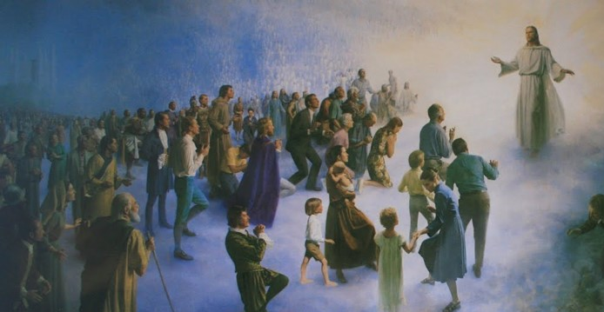
Gathering
My praise shall be of thee in the great congregation
And there were gathered together in one place an innumerable company of the spirits of the just, who had been faithful in the testimony of Jesus while they lived in mortality;
(D&C 138:12)
And who had offered sacrifice in the similitude of the great sacrifice of the Son of God, and had suffered tribulation in their Redeemer’s name. (D&C 138:13)
All these had departed the mortal life, firm in the hope of a glorious resurrection, through the grace of God the Father and his Only Begotten Son, Jesus Christ.
D&C 138:14
Psalm 22:25

Slide 20
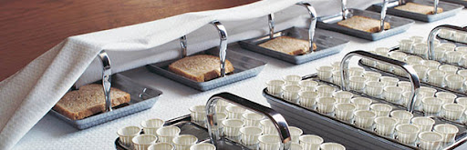
The Meek
The meek shall eat and be satisfied: they shall praise the Lord that seek him: your heart shall live for ever.
“The meek shall eat and be satisfied,” contains the message of two verses in the Beatitudes: “Blessed are the meek: for they shall inherit the earth” (Matthew 5:5)
“Blessed are they which hunger and thirst after righteousness: for they shall be filled” (Matthew 5:6).
Today:
To appropriately “eat” the sacrament under proper priesthood authority and feast upon the words of Christ revealed in the last days.
Psalm 22:26

Slide 21
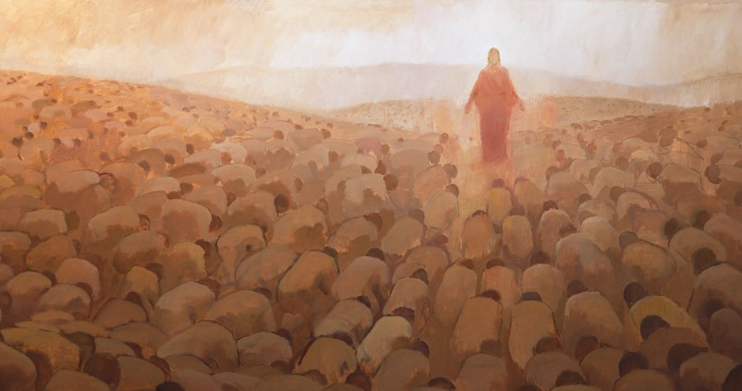
Remember and Turn to the Lord
All the ends of the world shall remember and turn unto the Lord: and all the kindreds of the nations shall worship before thee.
They provide a witness of the judgment day and resurrection, when all those in the spirit world who have suffered and turned unto Christ will see their spirits and bodies “united never again to be divided, that they might receive a fulness of joy”
(D&C 138:17)
Psalm 22:27

Slide 22
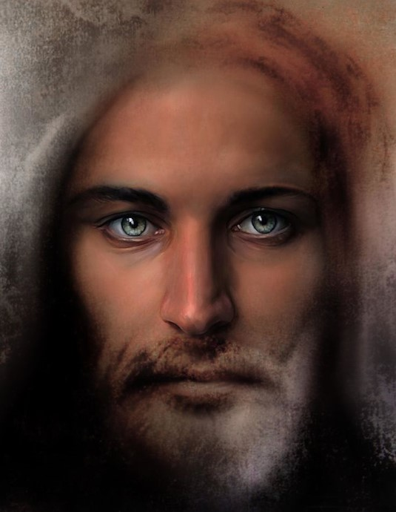
Govern
For the kingdom is the Lord’s: and he is the
governor among the nations.
For unto us a child is born, unto us a son is given: and the government shall be upon his shoulder: and his name shall be called Wonderful, Counsellor, The mighty God, The everlasting Father, The Prince of Peace.
(Isaiah 9:6)
Psalm 22:28

Slide 23
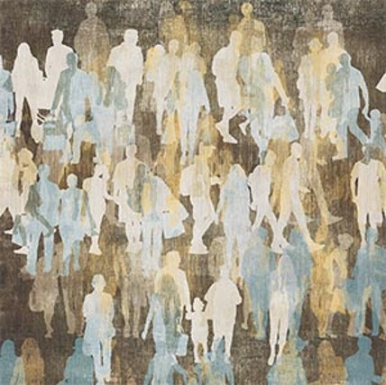
Our Souls
All they that be fat upon earth shall eat and worship: all they that go down to the dust shall bow before him: and none can keep alive his own soul.
Their sleeping dust was to be restored unto its perfect frame, bone to his bone, and the sinews and the flesh upon them, the spirit and the body to be united never again to be divided, that they might receive a fulness of joy.
(D&C 138:17)
None of us—is able to “keep alive his own soul”, but in the end, they will receive a fullness of joy because the suffering Messiah was able to keep alive his soul.
Psalm 22:29

Slide 24
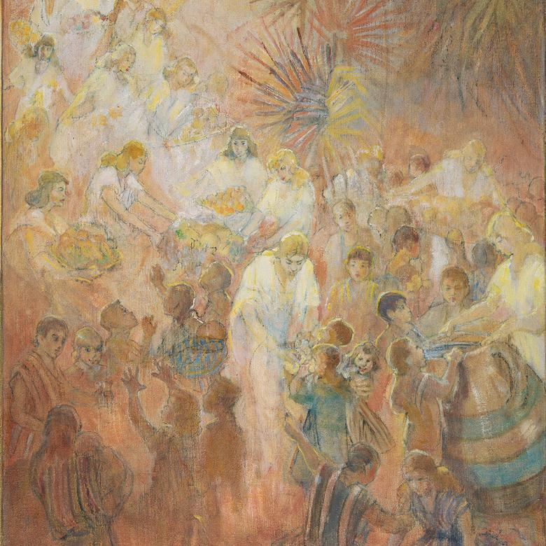
His Seed
A seed shall serve him; it shall be accounted to the Lord for a generation.
And now, because of the covenant which ye have made ye shall be called the children of Christ, his sons, and his daughters; for behold, this day he hath spiritually begotten you; for ye say that your hearts are changed through faith on his name; therefore, ye are born of him and have become his sons and his daughters. (Mosiah 5:7)
The same is occurring in the spirit world, where “from among the righteous, he organized his forces and appointed messengers, clothed with power and authority, and commissioned them to go forth and carry the light of the gospel to them that were in darkness, even to all the spirits of men[,] . . . to declare the acceptable day of the Lord and proclaim liberty to the captives who were bound, even unto all who would repent of their sins and receive the gospel”
Psalm 22:30

Slide 25
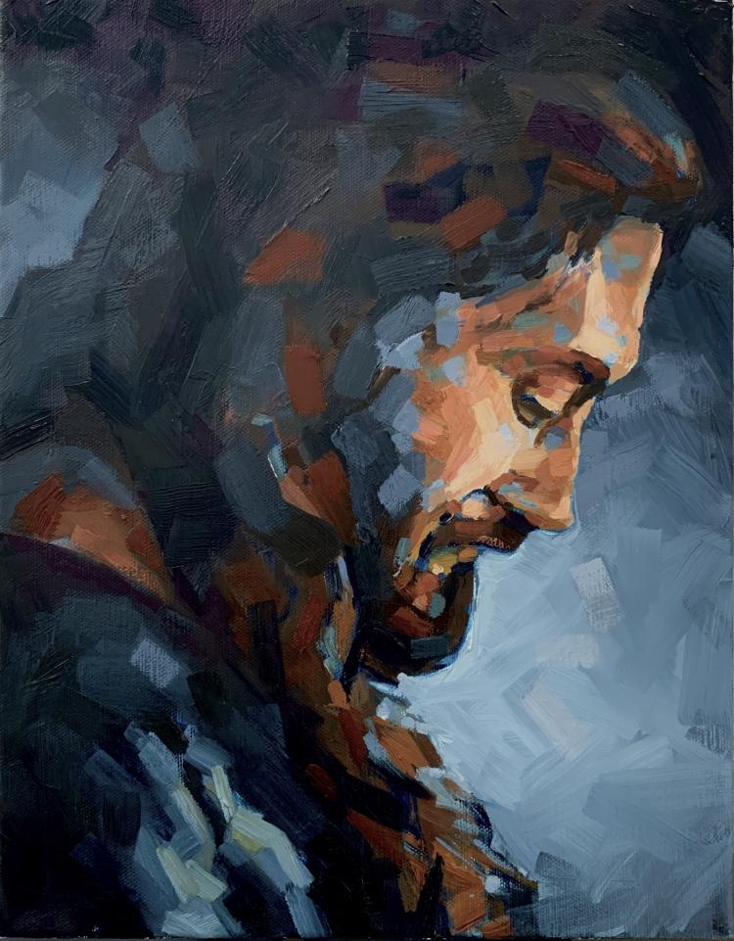
Declare His Righteousness
They shall come, and shall declare his righteousness unto a people that shall be born, that he hath done this.
“The same is occurring in the spirit world, where “from among the righteous, he organized his forces and appointed messengers, clothed with power and authority, and commissioned them to go forth and carry the light of the gospel to them that were in darkness, even to all the spirits of men,
. . . to declare the acceptable day of the Lord and proclaim liberty to the captives who were bound, even unto all who would repent of their sins and receive the gospel” (1)
Psalm 22:31

Slide 26
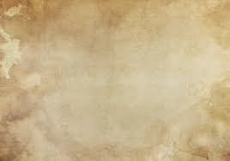
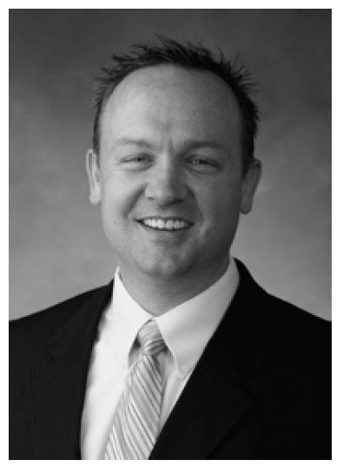
Sources:
1. This section was inspired by BYU Studies
“My God, My God,
Why Hast Thou Forsaken Me?”
Psalm 22 and the Mission of Christ
Shon Hopkin
2. Justin Martyr, Dialogue with Trypho, ch. 98.
3. Augustine, St. Augustine on the Psalms, 1:203.
4. James E. Talmage, Jesus the Christ (Salt Lake City: Deseret Book, 1981), 668–69, n. 8.
5. Hoskisson, “Witness for Christ in Psalm 22,” 295.

