Slide 1

Help Us Forgive
1 Samuel 25-31
I pray thee, forgive the trespass of thine handmaid: for the Lord will certainly make my lord a sure house;
1 Samuel 25:28

Slide 2


Choices
What effect do your choices have on other people?
How might those choices affect you?
What was different between Saul’s choices and Samuel’s choices?

Slide 3
Samuel Dies
…and all the Israelites were gathered together, and lamented him, and buried him in his house at Ramah. And David arose, and went down to the wilderness of Paran.
Mt. Carmel
Ramah
Jerusalem
Samuel the prophet died, and all the Israelites gathered to mourn his loss. After Samuel’s funeral, David and his men went into the wilderness.
Mt. Nebo
Bethlehem
1 Samuel 25:1

Slide 4
Nabal And Abigail
Nabal was a wealthy sheep shearer. He was rude, rough, or hard
Abigail was a ‘good woman’ understanding and beautiful
David was insulted by a man named Nabal.
1 Samuel 25:3-4

Slide 5
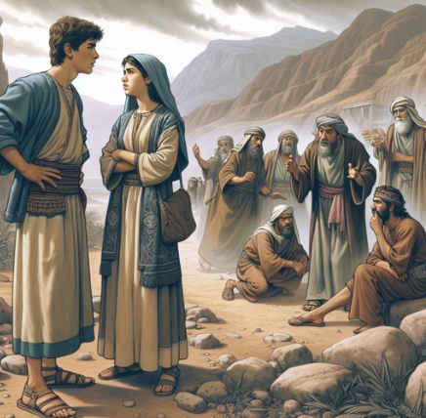
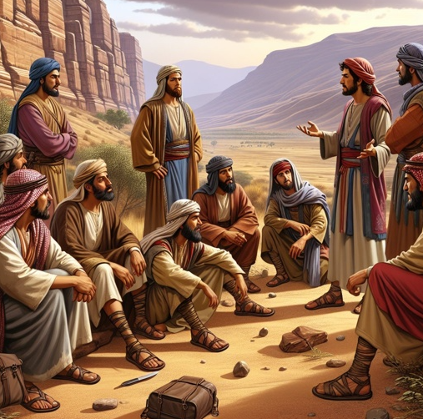
David Requests Supplies
As David and his men traveled in the wilderness, they met servants of a man named Nabal. During times of battle, weary soldiers often broke the law to get what they needed. David and his men needed help and support.
One of Nabal’s servants told Abigail, Nabal’s wife, how her husband had mistreated David’s men.
The servant also told Abigail how David and his men had provided protection to Nabal’s servants and had never tried to take any of Nabal’s animals.
1 Samuel 25:14-17

Slide 6
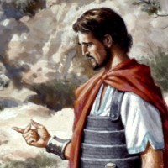
David’s Reaction to the Insult
So and more also do God unto the enemies of David, if I leave of all that pertain to him by the morning light any that pisseth against the wall..
The phrase “any that pisseth against the wall” is a cultural expression used to mean “all males.”(1)
David threatened not only to kill Nabal himself but also to destroy completely all that was his.
1 Samuel 25:21-34

Slide 7
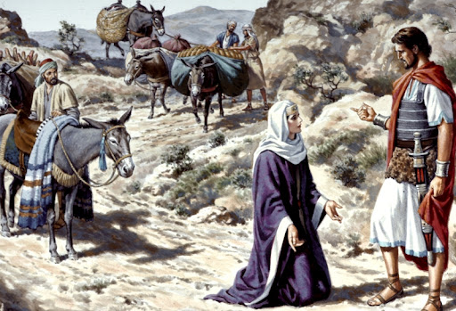
Abigail’s Choice To Make Peace
When Abigail found David in the wilderness, she bowed before him and humbly asked him to spare her household despite the iniquities of her husband.
Our righteous choices can bless not only us but also others around us
1 Samuel 25:32-34

Slide 8

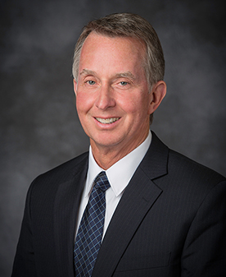
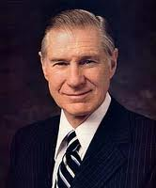
Choices To Be Made
Have you been effected by some else’s good choice?
“On this mortal journey we must never think that our choices affect only us” (1)
Other people’s actions do not dictate what is right or wrong. One person having the courage to make the right choice can influence many others to also choose wisely.(2)

Slide 9

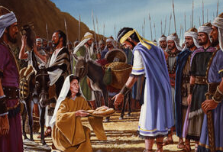
Forgiveness
Abigail interceded and helped David to forgive.
Through [the Savior’s] infinite Atonement, you can forgive those who have hurt you and who may never accept responsibility for their cruelty to you.
It is usually easy to forgive one who sincerely and humbly seeks your forgiveness. But the Savior will grant you the ability to forgive anyone who has mistreated you in any way. Then their hurtful acts can no longer canker your soul. (8)
I, the Lord, will forgive whom I will forgive, but of you it is required to forgive all men.
D&C 64:10
Because of Jesus Christ, I can forgive people who have hurt me.

Slide 10

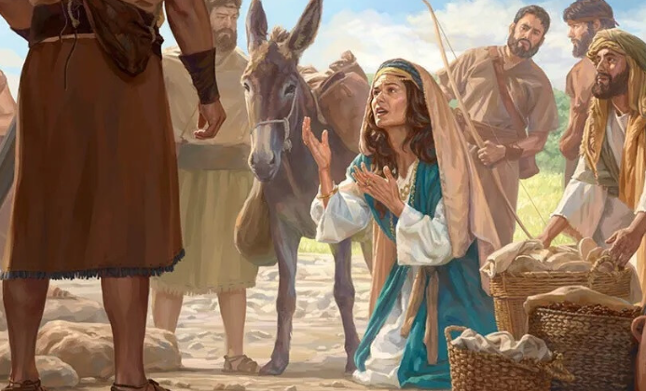
In this account, Abigail can be seen as a powerful type or symbol of Jesus Christ. Through His atoning sacrifice, He can release us from the sin and weight of a warring heart and provide us with the sustenance we need.
Just as Abigail was willing to take Nabal’s sin upon herself, so did the Savior—in an incomprehensible way—take upon Him our sins and the sins of those who have hurt or offended us. …
Abigail’s bringing an abundance of food and supplies can teach us that the Savior offers to those who have been hurt and injured the sustenance and help we need to be healed and made whole. …
Just as Abigail helped David not to have an “offence of heart” and to receive the help he needed, so will the Savior help you. (9)
1 Samuel 25:31

Slide 11
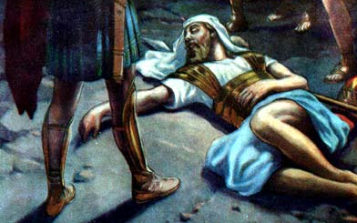
Nabal’s Death
Abigail tells Nabal all that had transpired with the famous and heroic David
After 10 days Nabal died of a heart attack
His statement was a way of saying that Nabal was terrified to think of what he had narrowly escaped only because David heeded his wife’s plea. He may have suffered a stroke or heart attack because of the shock. (3)
1 Samuel 25:36-44

Slide 12
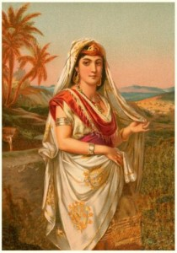
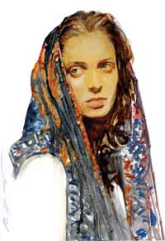
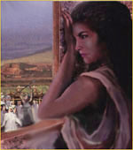
David Takes Abigail As a Wife
After Nabal’s death, David sent for Abigail and the two were married.
David also takes a wife, Ahinoam, of Jezreel
Saul had given Michal to another man, Phalti the son of Laish, which was of Gallim.
1 Samuel 25:36-44

Slide 13
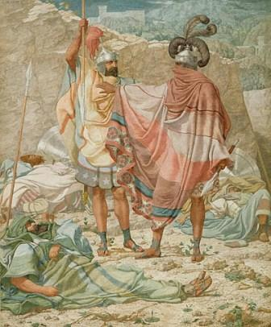
David Spares Saul’s Life Again
King Saul took 3,000 men into the wilderness to find and kill David. When Saul and his men were asleep in their camp one night, David and one of his servants went to where Saul was sleeping.
David’s servant wanted to kill Saul, but David refused.
Later, when King Saul discovered that David had spared his life again, he said he would no longer seek David’s life.
David did not believe Saul, so he moved his family to live among the Philistines.
1 Samuel 26-27

Slide 14
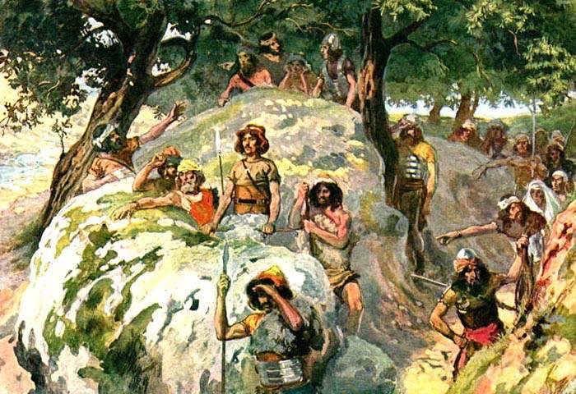
David Goes To Gath
He Dwells with them for 16 months
King Achish (a Philistine) welcomed him and their families and gave his family a village called Ziklag
David was attacking the surrounding communities including the Geshurites, Gezerites, and the Amalekites and King Achish thought David was attacking the Israelites and an ally.
Mt. Carmel
Philistine occupied
Jerusalem
Gath
Mt. Nebo
The king of the Philistines wanted David to go with him to war against Israel.
1 Samuel 28

Slide 15
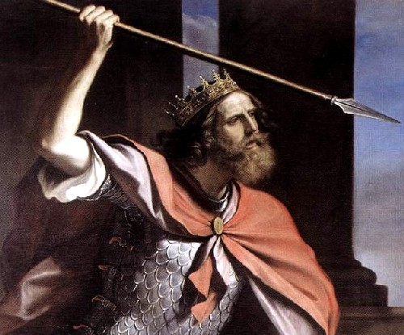
Meanwhile…
Saul, now devoid of spiritual sensitivity because of his wickedness and unable to get an answer from the Lord “neither by dreams, nor by Urim, nor by prophets”, sought out a medium, a witch, one who claimed to be able to communicate with those in the world of spirits. It was the act of a desperate man. (3)
Why do you think the Lord did not answer Saul?
When we willfully disobey God, we separate ourselves from His strength and guidance
Why can our disobedience make it difficult to receive personal revelation and answers to our prayers?
1 Samuel 28

Slide 16
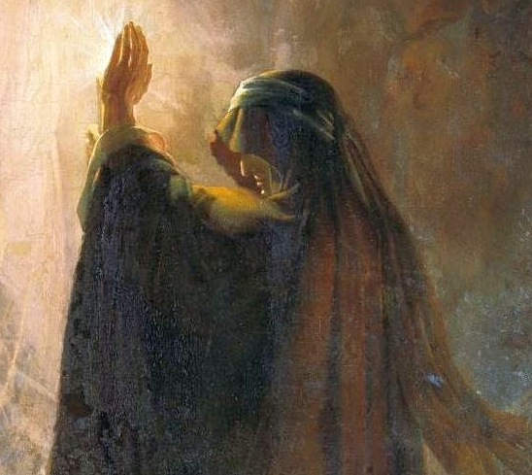
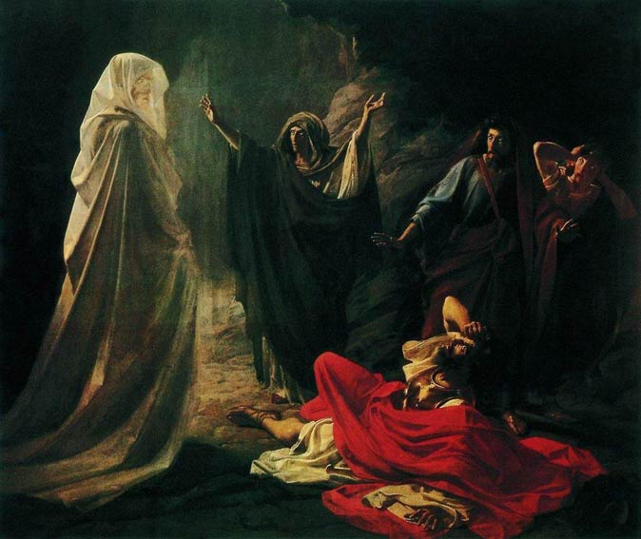
Witch of Endor
Because Samuel had died and there was no revelation given, Saul sought out a woman to reveal the future
“hath got a familiar spirit” in verse 7 refers to a person who claimed to be able to speak with the dead.
Saul did not see Samuel or anybody but the medium or witch.
She declared that she saw an old man coming up and that he was covered with a mantle. (4)
1 Samuel 28

Slide 17
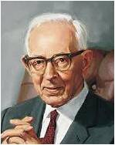
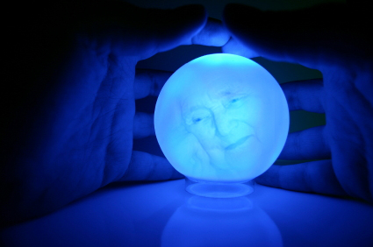
“… No matter how sincerely mediums may be deceived into thinking they are following a divinely approved pattern, they are in fact turning to an evil source ‘for the living to hear from the dead.’ Those who are truly spiritually inclined know this by personal revelation from the true Spirit; further, the information revealed from spirits through mediums is not according to ‘the law and to the testimony.’
“… In ancient Israel, spiritualistic practices were punishable by death.” (5)
A man also or woman that hath a familiar spirit, or that is a wizard, shall surely be put to death: they shall stone them with stones: their blood shall be upon them.
Lev. 20:27
1 Samuel 28

Slide 18

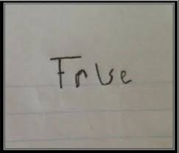
The powers of darkness would never prevail without the use of some light.
A little truth mixed with plausible error is one of the means by which they lead mankind astray.
1 Samuel 28
(5)

Slide 19
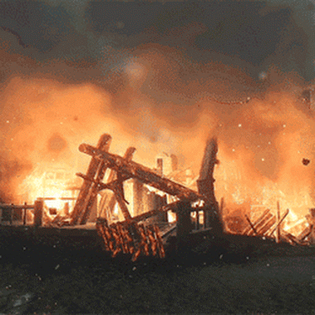
The Princes of the Philistines
The Princes of the Philistines questioned David’s loyalty, so while David and his men were away from Ziklag the Philistines burned the village and taken their possessions, and all the people including and David’s wives
1 Samuel 29

Slide 20
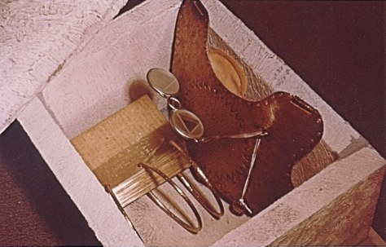
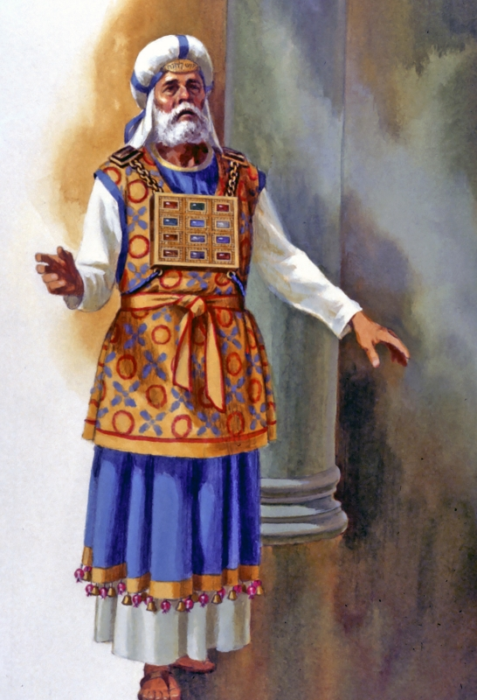
Urim and Thummin
Divinely approved instruments of revelation: Abiathar the high priest, Ahimelech’s son,
And David said to Abiathar the priest, Ahimelech’s son, I pray thee, bring me hither the ephod. And Abiathar brought thither the ephod to David.
And he girded him with the curious girdle of the ephod, and bound it unto him therewith.
And he put the breastplate upon him: also he put in the breastplate the Urim and the Thummim.
Lev. 8:7-8
1 Samuel 30:6-8

Slide 21
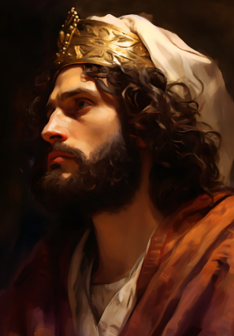
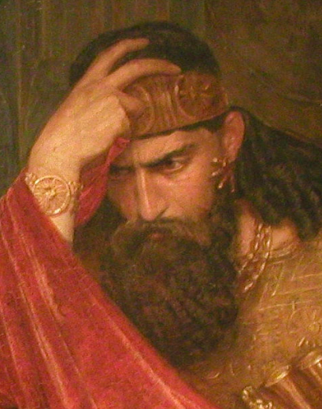
The Lord’s Direction
Why do you think David was blessed with the Lord’s direction, but King Saul was not?
When we are faithful, we invite the Lord to direct our lives
1 Samuel 30

Slide 22
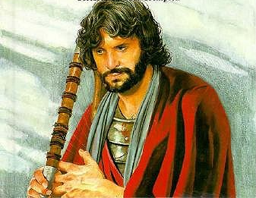
Sharing David’s Spoils
David took 400 men into battle with the Amalekites and 200 stayed behind because of weakness.
When they returned with their families and the spoils of war David shared all the supplies with everyone even the ones who had stayed behind.
And it was so from that day forward, that he made it a statute and an ordinance for Israel unto this day.
1 Samuel 30:9-25

Slide 23
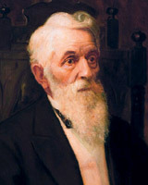
Honoring a Cause
“Now if a man is not the anointed of the Lord we may have a fellow feeling for him, that feeling which human nature teaches, but when a man is the anointed of the Lord, we feel like David did with Saul.
David would not lift his hand against Saul, because, said he, he is the anointed of the Lord, but how could they move hand in hand and be one, when they were of a different spirit?
There was an opposite spirit in Saul, but yet David would not put forth his hand and slay him, although he had him in his power; he had a respect for him because he was the Lord’s anointed.
(7)

Slide 24
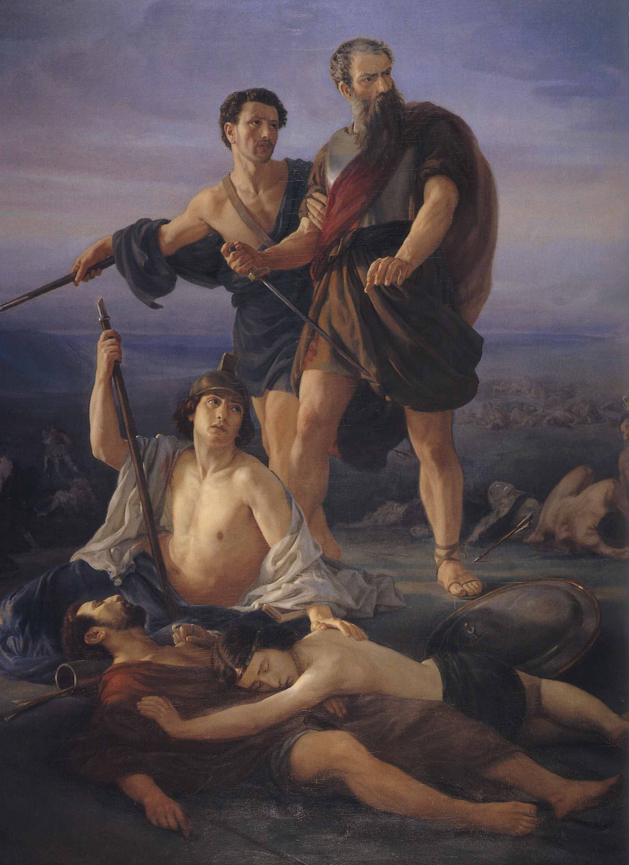
Israel Against Philistines
Mt. Gilboa
Three of Saul’s sons, Jonathan, and Abinadab, and Malchi-shua, Saul’s sons. were killed.
Their defense lines did not hold and they were wildly fleeing in every direction.
Saul was hit by the archers and was wounded.
He didn’t want to be taken alive so he ordered his body guard (armor-bearer) to kill him.
The armor-bearer would not so Saul fell upon his own sword
The armor-bearer also committed suicide
1 Samuel 30

Slide 25

The Remains of Saul
The Philistines cut off Saul’s head as a trophy and stripped his armour for exhibition in their temple.
They hung his remains on the wall of Beth-shan
Mt. Carmel
Beth-shan
Jabesh-Gilead
Jerusalem
Mt. Nebo
News spread and reached an Israelite city of Jabesh-Gilead which Saul had recued from the Ammonites many years before.
These people rescued the body of Saul at night and the bodies of his three sons burned them and their bones and ashes were then gathered together and buried under a tree at Jabesh (6)
1 Samuel 30:7-13

Slide 26
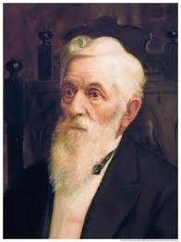
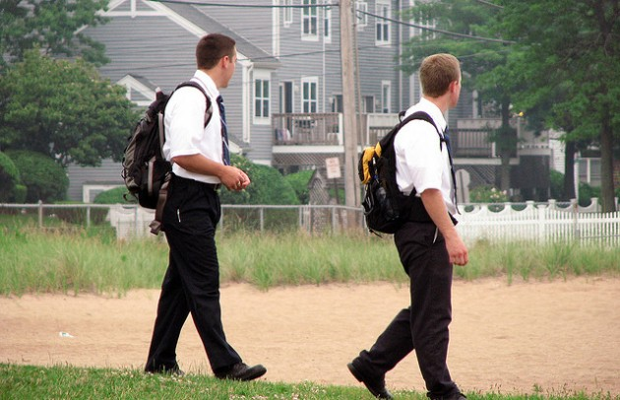
The Lord’s Anointed
A man may move in the same car or in the same kingdom, and yet be of a different spirit from another man, and he may pass quietly along for a time, because he is the Lord’s anointed, but still he will not exert himself for the carrying out of the principles of the kingdom, he lies dormant all the time.
How can he who is filled with the principles of righteousness and with the love of Jesus love that man? He cannot do it as he desires.
We have got to be inspired by the same Spirit and by the same kind of knowledge, in order that we may love one another and be of one heart and one mind.”
(7)

Slide 27
Sources:
Videos:
“Happy and Forever” from time code 2:32 to 4:23.
Lesson’s I Learned About as a Boy (4:04)
Finding Your Purpose in Life: Does Faith Matter? (5:08)
Elder Larry S. Kacher Trifle Not with Sacred Things Oct. 2014 Gen. Conf.
Elder James E. Faust Choices April 2004 Gen. Conf.
Old Testament Institute Manual
Joseph Fielding Smith (Answers to Gospel Questions, comp. Joseph Fielding Smith Jr., 5 vols. [1957–66], 4:107–8).
McConkie, Mormon Doctrine, pp. 759–60
Presentation by ©http://fashionsbylynda.com/blog/
6. W. Cleon Skousen The Fourth Thousand Years pp. 72-73
7. (Lorenzo Snow, in Journal of Discourses, 4:156.)
8. President Russell M. Nelson (“Four Gifts That Jesus Christ Offers to You” [First Presidency Christmas devotional, Dec. 2, 2018], Gospel Library)
9. Sister Kristin M. Yee (“Beauty for Ashes: The Healing Path of Forgiveness,” Liahona, Nov. 2022, 36–37)

Slide 28
Abigail | The Savior
Provided abundant support (1 Samuel 25:18) | Succors us in our need (Alma 7:11–12; Doctrine and Covenants 62:1)
Took the mistakes of Nabal upon herself (1 Samuel 25:24) | Takes the sins of the world upon Himself (Alma 7:13; 3 Nephi 11:11)
Asked David to forgive her for Nabal’s mistakes (1 Samuel 25:28) | Pleads our cause before the Father as our Advocate (Doctrine and Covenants 45:3–5)
Worked to remove grief and offense from David’s heart (1 Samuel 25:31) | Invites His disciples to forgive others (Doctrine and Covenants 64:8–11)
Abigail | The Savior
Provided abundant support (1 Samuel 25:18) | Succors us in our need (Alma 7:11–12; Doctrine and Covenants 62:1)
Took the mistakes of Nabal upon herself (1 Samuel 25:24) | Takes the sins of the world upon Himself (Alma 7:13; 3 Nephi 11:11)
Asked David to forgive her for Nabal’s mistakes (1 Samuel 25:28) | Pleads our cause before the Father as our Advocate (Doctrine and Covenants 45:3–5)
Worked to remove grief and offense from David’s heart (1 Samuel 25:31) | Invites His disciples to forgive others (Doctrine and Covenants 64:8–11)

Slide 29
“The Witch of Endor … instead of being a prophetess of the Lord, was a woman who practiced necromancy; that is, communication or pretended communication with the spirits of the dead; but she was led by a familiar spirit. In other words, she was a spiritual medium, similar to those modern professors of the art, who claim to be under the control of some departed notable, and through him or her to be able to communicate with the dead. It should be observed that in the séance with the king of Israel, Saul did not see Samuel or anybody but the medium or witch. She declared that she saw an old man coming up and that he was covered with a mantle. It was she who told Saul what Samuel was purported to have said. Saul ‘perceived that it was Samuel’ through what the witch stated to him. The conversation that ensued between Samuel and Saul was conducted through the medium. All of this could have taken place entirely without the presence of the prophet Samuel. The woman, under the influence of her familiar spirit, could have given to Saul the message supposed to have come from Samuel, in the same way that messages from the dead are pretended to be given to the living by spiritual mediums of the latter days, who, as in the case under consideration, perform their work at night or under cover of darkness.
“It is beyond rational belief that such persons could at any period in ancient or modern times, invoke the spirits of departed servants or handmaidens of the Lord. They are not at the beck and call of witches, wizards, diviners, or necromancers. Pitiable indeed would be the condition of spirits in paradise if they were under any such control. They would not be at rest, nor be able to enjoy that liberty from the troubles and labors of earthly life which is essential to their happiness, but be in a condition of bondage, subject to the will and whims of persons who know not God and whose lives and aims are of the earth, earthy” (Answers to Gospel Questions, comp. Joseph Fielding Smith Jr., 5 vols. [1957–66], 4:107–8).
Nabal: The phrase used by David when he threatened the destruction of Nabal is shocking to modern readers. Today the word is used only in profanity, but such was not the case when the King James Version was translated. The phrase was a Hebrew idiom used several times in the Bible that meant “every male” (Keil and Delitzsch, Commentary, 2:2:242). Thus, David threatened not only to kill Nabal himself but also to destroy completely all that was his. The same idea occurs in modern revelation but without the offensive expression (see D&C 121:15).
The account in 1 Sam. 28:5–20 of the prophet being brought back from the dead by the witch of Endor, at King Saul’s request, presents a problem. It is certain that a witch or other medium cannot by any means available to her bring up a prophet from the world of spirits. We may confidently be assured that if Samuel was present on that occasion, it was not due to conjuring of the witch. Either Samuel came in spite of and not because of the witch, or some other spirit came impersonating him” (Bible Dictionary, “Samuel”).
The ephod was an article of sacred clothing worn by the high priests of the Levitical Priesthood. The Lord directed that they were not to wear ordinary clothing during their service, but they were to have “holy garments” made by those whom the Lord had “filled with the spirit of wisdom.” (Ex. 28:2–3.) These sacred garments were to be passed from father to son along with the high priestly office itself. (Ex. 29:29.)
The ephod, worn over a blue robe, was made of blue, purple, and scarlet material, with designs of gold thread skillfully woven into the fabric. This garment was fastened at each shoulder and had an intricately woven band with which it could be fastened around the waist. In gold settings on each shoulder were onyx stones engraved with the names of the 12 sons of Israel as a “memorial” as the priest served before the Lord. (See Ex. 28:6–14 and Ex. 39:2–7). Fastened to the ephod was a breastplate into which the Urim and Thummim could be placed. (Ex. 28:15–30.)
The exact function of the ephod is not known. As President Joseph Fielding Smith observed, information concerning these ancient ordinances “was never recorded in any detail, because such ordinances are sacred and not for the world.” (Improvement Era, November 1955, p. 794.)
There are later references to a linen ephod; the boy Samuel, for example, wore such a garment when he served the Lord.
I Have a Question December 1973 Ensign
Spiritual mediums:
If the Lord desired to impart this information to Saul, why did he not respond when Saul enquired of him through the legitimate channels of divine communication? Saul had tried them all and failed to obtain an answer. Why should the Lord ignore the means he himself established, and send Samuel, a prophet, to reveal himself to Saul through a forbidden source? Why should he employ one who had a familiar spirit for this purpose, a medium which he had positively condemned by his own law? Joseph Fielding Smith

