Slide 1

Who Shall Ascend into the Hill of the Lord?
Psalm 24

Slide 2
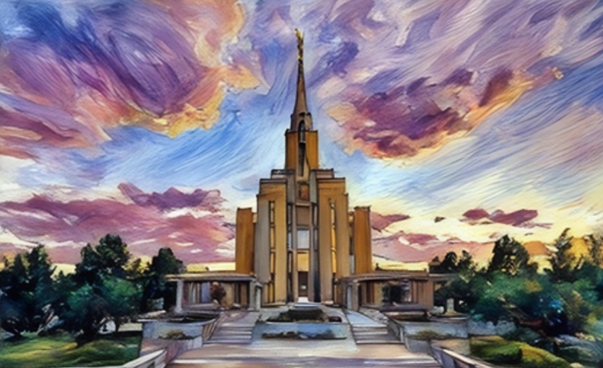
Temples
Temples are holy places that are clean and pure.
King David invites us to strive to be spiritually clean and pure so we can enter the Lord’s temple and His presence someday.

Slide 3
Temple Recommend Questions for Youth
Do you have faith in and a testimony of God, the Eternal Father; His Son, Jesus Christ; and the Holy Ghost?
Do you have a testimony of the Atonement of Jesus Christ and of His role as your Savior and Redeemer?
Do you have a testimony of the Restoration of the gospel of Jesus Christ?
Do you sustain the President of The Church of Jesus Christ of Latter-day Saints as the prophet, seer, and revelator and as the only person on the earth authorized to exercise all priesthood keys? Do you sustain the members of the First Presidency and the Quorum of the Twelve Apostles as prophets, seers, and revelators? Do you sustain the other General Authorities and local leaders of the Church?
The Lord has said that all things are to be “done in cleanliness” before Him (Doctrine and Covenants 42:41). Do you strive for moral cleanliness in your thoughts and behavior? Do you obey the law of chastity?
Do you follow the teachings of the Church of Jesus Christ in your private and public behavior with members of your family and others?
Do you support or promote any teachings, practices, or doctrine contrary to those of The Church of Jesus Christ of Latter-day Saints?
Do you strive to keep the Sabbath day holy, both at home and at church; attend your meetings; prepare for and worthily partake of the sacrament; and live your life in harmony with the laws and commandments of the gospel?

Slide 4


Temple Recommend Questions for the Youth Continued
Do you strive to be honest in all that you do?
Are you a full-tithe payer?
Do you understand and obey the Word of Wisdom?
Are there serious sins in your life that need to be resolved with priesthood authorities as part of your repentance?
Do you consider yourself worthy to enter the Lord’s house and participate in temple ordinances?
For the Strength of Youth: A Guide for Making Choices [2022].

Slide 5
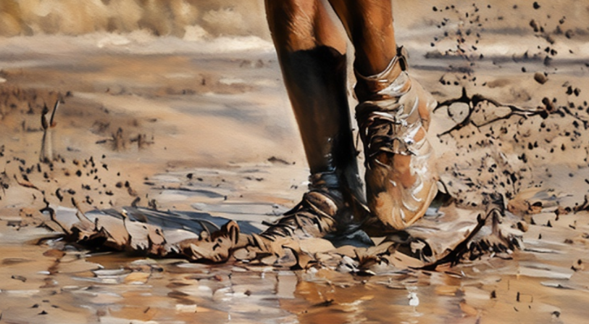
Dirty or Clean
When was the last time you were very muddy or dirty?
How did you feel?

Slide 6

Entering Into the Temple
How do you feel when you enter the temple?
How would you feel if you were very muddy inside the temple?

Slide 7

Worthily Worship
We are not expected to be perfect to enter the temple. Rather, the purpose of the things we learn and the covenants we make in the temple is to help perfect us. We must, however, be worthy to enter.
The Lord has set the standards of worthiness to enter the temple, as expressed by the Psalmist:
“Who shall ascend into the hill of the Lord? or who shall stand in his holy place?
“He that hath clean hands, and a pure heart” (1)
Psalm 24:3–4

Slide 8

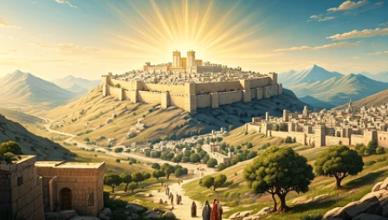
Ascend Into the Hill of the Lord
And it shall come to pass in the last days, that the mountain of the Lord’s house shall be established in the top of the mountains, and shall be exalted above the hills; and all nations shall flow unto it.
Come ye, and let us go up to the mountain of the Lord, to the house of the God of Jacob
Isaiah 2:2-3

Slide 9
Doctrinal Mastery
Psalms
24:3-4
Who shall ascend into the hill of the Lord? or who shall stand in his holy place?
He that hath clean hands, and a pure heart; who hath not lifted up his soul unto vanity, nor sworn deceitfully.

Slide 10
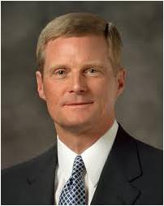


Clean Hands and Pure Hearts
…it is possible for us to have clean hands but not have a pure heart.
Please notice that both clean hands and a pure heart are required to ascend into the hill of the Lord and to stand in His holy place.
…that hands are made clean through the process of putting off the natural man and by overcoming sin and the evil influences in our lives through the Savior’s Atonement. Hearts are purified as we receive His strengthening power to do good and become better.
Psalm 24:4
(3)

Slide 11


Vanity
pride or arrogance.
Isaiah warned us against drawing "iniquity with cords of vanity." (Isa. 5:18.)
Yes, vanity is a sin.
And if we don't carefully watch our steps, we can find ourselves easily slipping into the arena of puffed-up egos, self-righteousness or some other prideful attitude that will turn our otherwise good intentions into boastful and vain behavior.
… vanity is not limited to the wearing of costly apparel or tied into possessions or social status. Vanity has as much to do with our attitude as our appearance or possessions. (2)
Psalm 24:4

Slide 12
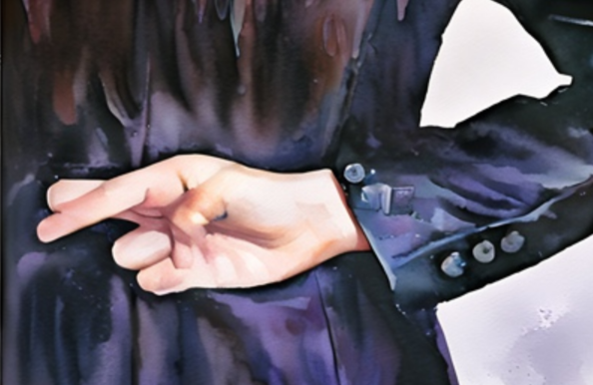
Sworn Deceitfully
to swear an oath falsely, making a promise that is not genuine with the intent to deceive.
The People of Nephi
… for they were perfectly honest and upright in all things; and they were firm in the faith of Christ, even unto the end.
Alma 27:27
A little lying, a little cheating, or taking a little unfair advantage is not acceptable to the Lord.
The scriptures warn that these are Satan’s ways to lead us “carefully down to [destruction]”.
Psalm 24:4; 2 Nephi 28:8-9, 21
(2)

Slide 13

Nor sworn deceitfull
Not lifted up his soul into vanity
Pure Heart
Clean Hands

Slide 14
Hope for the Last Days
Even the king of glory shall come unto you; and shall redeem his people, and shall establish them in righteousness.
Lift up your heads, O ye generations of Jacob; and be ye lifted up; and the Lord strong and mighty
Psalm 24:7-10

Slide 15
Sources:
Video: “Standing in Holy Places” (5:36),
Being Worthy to Enter the Temple Aug. 2010 (Ensign)
Beware of Vanity. Church News Article 25 Feb. 1995
Presentation by http://fashionsbylynda.com/blog/
3. Elder David A. Bednar Clean Hands and Pure Heart Oct. 2007 Ensign

