Slide 1

O Give Thanks unto the Lord
Psalm 136

Slide 2
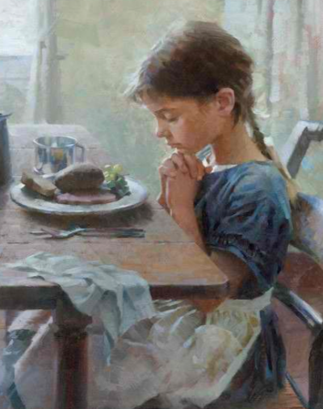
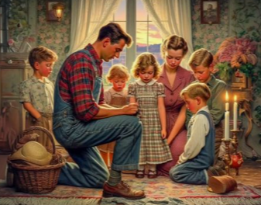
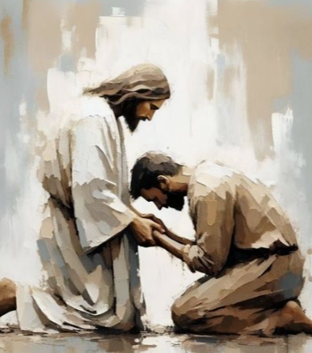
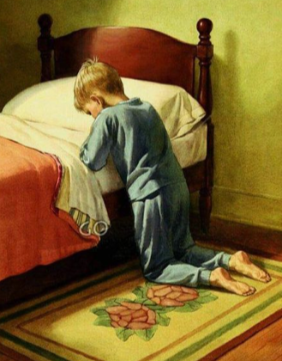
Giving Thanks
Psalm 136:1
Expressing gratitude for our blessings helps us feel God’s love.
O give thanks unto the Lord; for he is good: for his mercy endureth for ever.
Psalm 136:3
O give thanks to the Lord
of lords: for his mercy endureth for ever.
Psalm 136:26
Psalm 136:2
O give thanks unto the God of heaven: for his mercy endureth for ever.
O give thanks unto the God of gods: for his mercy endureth for ever.
Hebrew the word for mercy in these verses is hesed, which is “a special kind of love and mercy that God feels for and extends to those who have made a covenant with Him” (1).

Slide 3
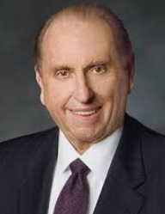
My brothers and sisters, do we remember to give thanks for the blessings we receive? Sincerely giving thanks not only helps us recognize our blessings, but it also unlocks the doors of heaven and helps us feel God’s love. (2)

Slide 4

Recognizing God’s Blessings
Writing blessings down to remember later
Remembering what you have been taught in your homes and at church
Remembering when your prayers have been answered
Only take heed to thyself, and keep thy soul diligently, lest thou forget the things which thine eyes have seen, and lest they depart from thy heart all the days of thy life: but teach them thy sons, and thy sons’ sons; Deuteronomy 4:9
Remembering a special feeling, writing it down, and/or sharing it with others

Slide 5

Listing and Sharing
Express your gratitude for Heavenly Father and Jesus Christ in a social media post or by writing in your journal.
Make a list of things that you are grateful for. Remember to include those things in your next prayer.

Slide 6
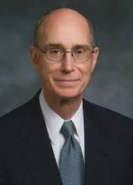
I try to remember the Savior’s sacrifice and His love for me.
Then, when I pray to Heavenly Father to give thanks, I feel love and assurance that my prayers are heard and that I will receive whatever is best for me and those I love.
It strengthens my testimony. (3)

Slide 7
Sources:
Videos:
“Principles of Peace: Gratitude” (2:32)
“President Russell M. Nelson on the Healing Power of Gratitude” (from time code 2:45 to 4:27)
“In the Spirit of Thanksgiving” (4:48)
” (Russell M. Nelson, “The Everlasting Covenant,” Liahona, Oct. 2022, 6).
President Thomas S. Monson (“The Divine Gift of Gratitude,” Ensign or Liahona, Nov. 2010, 87)
President Henry B. Eyring (“Our Constant Companion,” Liahona, Nov. 2023, 94)
https://fashionsbylynda.com/blog/

