Slide 1
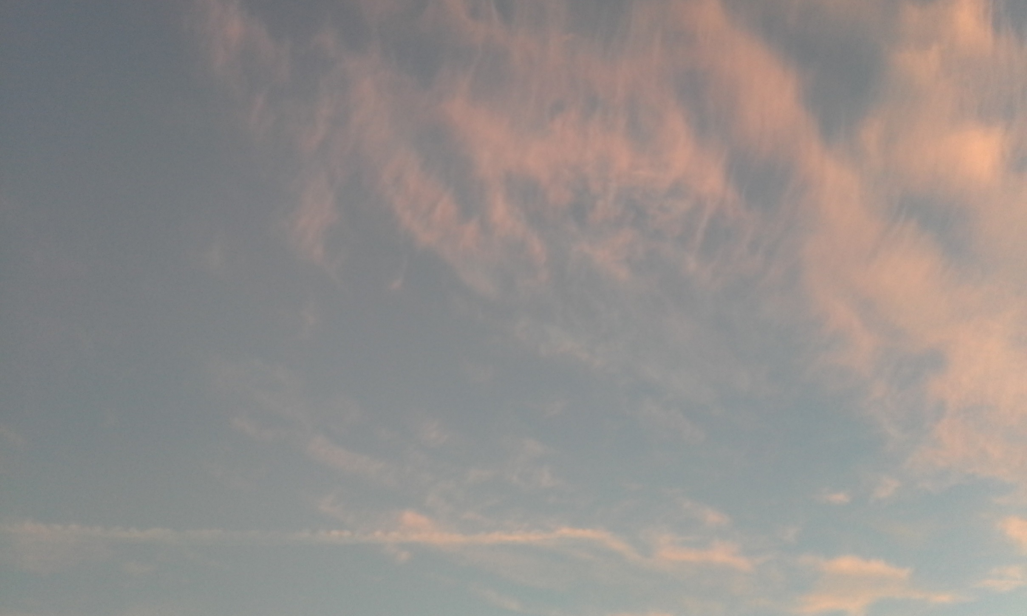
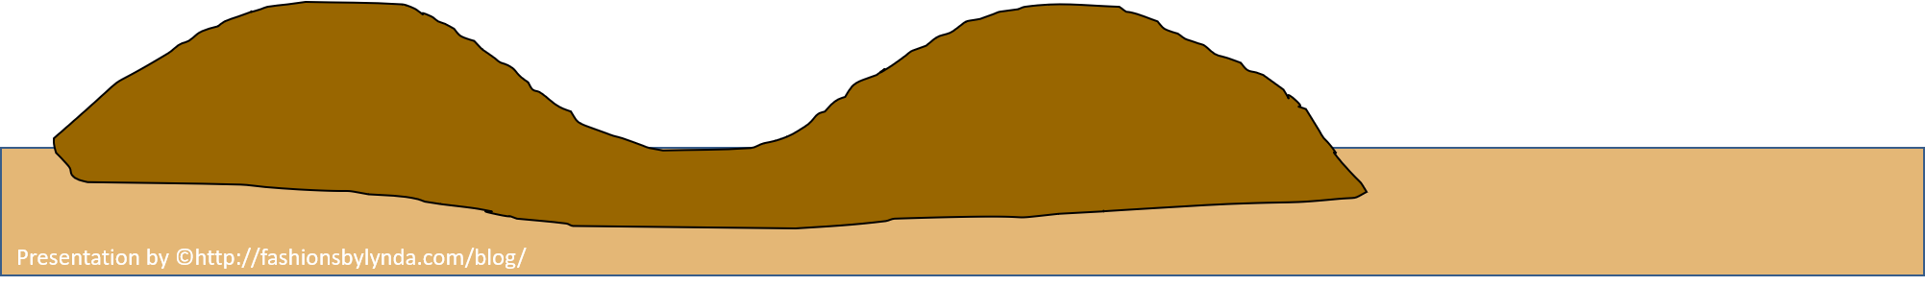
Moses’ Final Sermon
Deuteronomy 27-34
“…they should erect an altar, that should face the rising sun, not far from the city of Shechem, between the two mountains, that of Gerizzim, situate on the right hand, and that of called Ebal, on the left;…”
Josephus

Slide 2


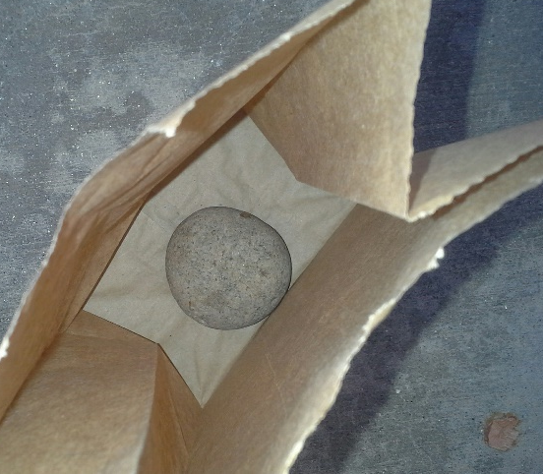
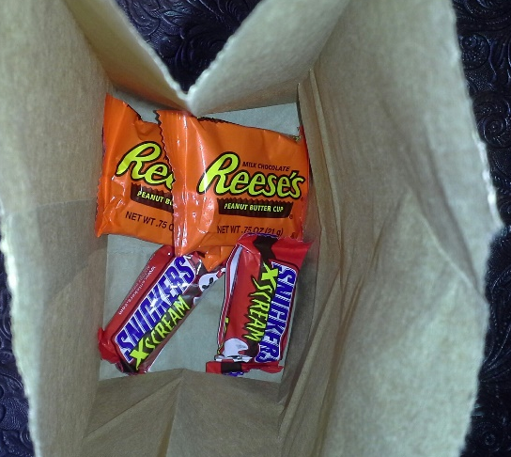
Making a Choice
One Bag Has a Treat—One Bag Has a Rock
Which bag has the treat in it?
What could you do to know which bag had the treat in it?
Lesson 71

Slide 3
West
Mt. Ebal
(Mount of Cursing)
Mt. Gerizim
(Mount of Blessing)
Obey
Shechem
Disobey
Moses was nearing the end of his mortal life, he wanted the Israelites to be able to choose to be blessed instead of cursed
Deuteronomy 27

Slide 4
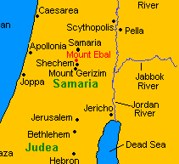
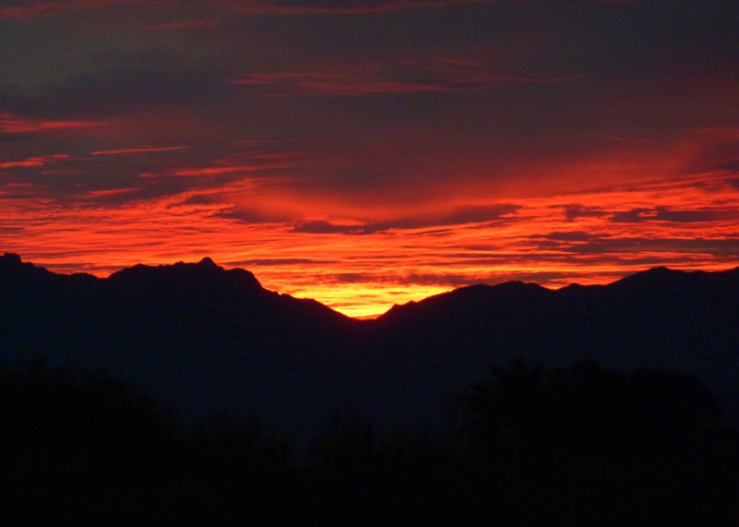
A Learning Experiment
Lord gave instructions about what was to happen once the children of Israel entered the promised land. They were to go to Shechem, which was located in a valley between Mount Ebal and Mount Gerizim.
Moses instructed that half of the tribes of Israel should stand on Mount Gerizim …
…and the other half should stand on Mount Ebal.
6 tribes would pray for blessings:
Simeon, Levi, Judah, Issachar, Joseph, and Benjamin:
6 tribes pronounce curses: Reuben, Gad, and Asher, and Zebulun, Dan, and Naphtali.
The Levites were to stand in the valley between the two mountains and recite the actions that would result in blessings and those that would result in curses as designated by God.
Deuteronomy 27

Slide 5
Blessings on Mt. Gerizim
“For those who observed the law and diligent about the worship of God, and the observation of his laws, and who did not reject what Moses had said to them.”
“While others wished them all manner of happiness also; and when these last put up the like prayers, the former praise the.”
Deuteronomy 27:12
(1)

Slide 6
Blessings From the Lord
Based upon obedience
We can no more disobey God’s commands and reap promised rewards than we can enjoy the benefits of electricity without conforming to the physical laws that govern its effects.
The principle of free agency allows us to make our own choices, to seek our own goals.
Some choices, however, are better than others. Wise children of our Father in Heaven understand the spiritual laws of cause and effect and govern themselves accordingly.
Unwise children do not. The former reap the promised blessings; the latter sometimes reap the sorest cursings.
Deuteronomy 27
(2)

Slide 7

Curses Written Upon the Alter
AMEN
AMEN
AMEN
AMEN
AMEN
AMEN
Those who transgress the laws
Those who do not keep the commandments
Those who commit murder
Those who do not help the sick, the strangers, and the poor
Those who commit sexual sin
Those who harm their neighbor
Those who make graven images
Those who disobey their parents
Those who take other’s property
Deuteronomy 27:15-26

Slide 8

Blessings VS Curses
Blessings
Curses
The City and fields | v. 3
Healthy Bodies | v. 4
Fruitful Trees and fertile ground | v. 4
Increase in livestock | v. 4
Plenty of food and storage | v. 5, 8
Safety in traveling | v. 6
Protection from enemies—victory of wars | v. 7
Plenty of rain during the season | v. 12
Poverty | v. 17-18
Pestilence instead of health | v. 21-22
The land would become desert | v. 24
Defeat during wartime | v. 25
Unhappy in marriage, wives kidnapped and ravished | v. 30
Children sold into slavery | v. 32, 41
Left destitute with no livestock | v. 31
Considered to be the lowest of citizens | v. 44
Religious freedom abolished because of idol worship | v. 36
Hunger, thirst, and nakedness | v. 48
Deuteronomy 28
(2)

Slide 9
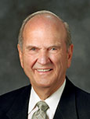
Choices
If we choose not to obey all of God’s commandments, we lose the blessings He desires to give us
If we choose to obey all of God’s commandments, He will bless us in all areas of our lives
“[Have] faith to keep all the commandments of God, knowing that they are given to bless His children and bring them joy. [You] will encounter people who pick which commandments they will keep and ignore others that they choose to break. I call this the cafeteria approach to obedience. This practice of picking and choosing will not work. It will lead to misery. To prepare to meet God, one keeps all of His commandments.”
(3)

Slide 10
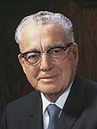
“The most important of all the commandments of God is that one that you are having the most difficulty keeping today.
If it is one of dishonesty, if it is one of unchastity, if it is one of falsifying, not telling the truth, today is the day for you to work on that until you have been able to conquer that weakness. …
Then you start on the next one that is most difficult for you to keep.”
(4)

Slide 11
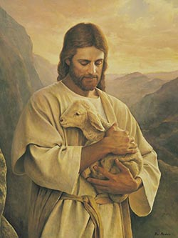
The Lost Lamb
How can the lost lamb in this painting represent each of us?
What qualities or attributes of the Savior come to mind as you contemplate this picture?
Keep therefore the words of this covenant, and do them, that ye may prosper in all that ye do.
Moses promised that if they kept this covenant they would be blessed and prospered
Deuteronomy 29:9-13

Slide 12
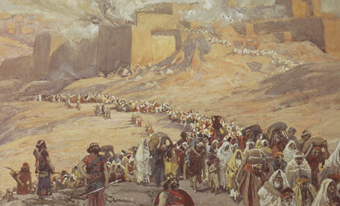
Lost Because of Sin
Moses prophesied that Israel would become lost if the people sinned.
Failure to keep the covenant would curse the people and the land as Sodom and Gomorrah had been cursed. “All the curses that are written in this book” (the book of Deuteronomy) would then be in effect.
Eventually, the people would be scattered among the nations for their rejection of the covenant.
Deuteronomy 29:20
(2)

Slide 13
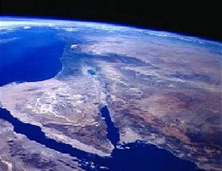
Eventually Return
Moses prophesied that Israel would eventually return
“Two great promises” from God that have not yet been fulfilled.
“One is that scattered Israel will be gathered again in the latter days, and the other is that there will be the great Second Coming of the Lord. We don’t doubt this; we just don’t know when.
“And neither of those will be fulfilled without the Restoration. So I say that song for you with those ‘whys’ interjected; the ‘why’ is so that Israel can be gathered. The ‘why’ is that the world will be prepared for the Second Coming of the Lord.”
Deuteronomy 30
(3)

Slide 14
Blessings to the Tribes
Reuben | “…live, and not die; and let not his men be few.
Judah | “…and bring him unto his people; let his hands be sufficient for him; and be thou an help to him from his enemies.
Levi | Let thy Thummim and thy Urim be with they holy one
Benjamin | “the LORD shall dwell in safety by him; and the LORD shall cover him all the day long, and he shall dwell between his shoulders. (Strength)
Zebulun | “…in thy going out.”
Issachar | “…in thy tents.”
Gad | “…dwelleth as a lion, and teareth the arm with the crown of the head.”
Dan | “…a lion’s whelp: he shall leap from Bashan.”
Naphtali | “…full of blessings of the LORD; possess thou the west and south.”
Asher | “…be blessed with children; let him be acceptable to his brethren, and let him dip his foot in oil…(strength)
Simeon | Simeon’s tribe was surrounded by Judah’s tribe—perhaps that is why there is not his name particularly mentioned for a blessing. (unknown reason)
Deuteronomy 33
What About Joseph?

Slide 15
Responsibility of Tribe of Joseph
And for the precious things of the earth and fulness thereof, and for the good will of him that dwelt in the bush: let the blessing come upon the head of Joseph, and upon the top of the head of him that was separated from his brethren.
His glory is like the firstling of his bullock, and his horns are like the horns of unicorns: with them he shall push the people together to the ends of the earth: and they are the ten thousands of Ephraim, and they are the thousands of Manasseh.
v
Deuteronomy 33:13-17

Slide 16
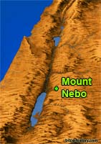
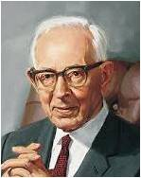
The Final Counsel From Moses
Deuteronomy is the last of the books of Moses. I
Moses gave his final counsel to the Israelites and blessed each tribe. He counseled them to be strong and courageous as they entered the land of Canaan.
The Lord told Moses that Israel would eventually turn away from God and worship other gods
“Moses was likewise taken up [like Elijah], though the scriptures say that the Lord buried him upon the mountain. Of course, the writer of that wrote according to his understanding; but Moses, like Elijah, was taken up without tasting death, because he had a mission to perform.”
Deuteronomy 31-34
(5)

Slide 17
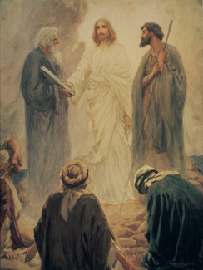
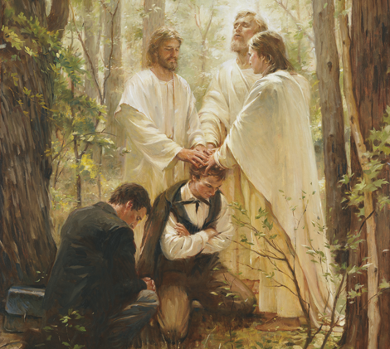
The Keys of the Priesthood
One reason why Moses was translated was so he could bestow priesthood keys upon Peter, James, and John during the Savior’s earthly ministry. In order to do so, he needed a body and was therefore taken up to God without experiencing physical death.
Joseph Smith and Oliver Cowdery received the priesthood from Peter, James and John in. D&C 27:13
Then…
Restoration of the Melchizedek Priesthood, by Walter Rane.
The Transfiguration, by W. H. Margetson
(5)

Slide 18
Sources:
Flavius Josephus Translated by William Whiston. A.M. 4.8.47 p. 147
Old Testament Institute Manual
Elder Russell M. Nelson (“Face the Future with Faith,” Ensign or Liahona, May 2011, 34).
Elder Russell M. Nelson speaks at the final session of 2014 Seminar for New MTC Presidents and Visitors’ Center Directors. R. Scott Lloyd.
Presentation by ©http://fashionsbylynda.com/blog/
President Harold B. Lee (Teachings of Presidents of the Church: Harold B. Lee [2000], 30).
Joseph Fielding Smith (Doctrines of Salvation, comp. Bruce R. McConkie, 3 vols. [1954–56], 2:107).
Moses and Elijah—two ancient prophets who were translated and taken to heaven without tasting death, so they could return with tangible bodies on this very occasion, an occasion preceding the day of resurrection—appeared on the mountain; and they and Jesus gave the keys of the kingdom to Peter, James, and John [Teachings: Joseph Smith, 105].

Slide 19
Deuteronomy
Deuteronomy 1-13 | Deuteronomy 14-19 | Deuteronomy 20-26 | Deuteronomy 27-34
Preparing Israel to enter the Promised Land | The Lord’s Laws and Feasts | War and Punishments | Obedience and Disobedience Moses’ Final Sermon
Deuteronomy 27-29 | Deuteronomy 30 | Deuteronomy 31 | Deuteronomy 32 | Deuteronomy 33-34
The Altar Admonition to Obey the law Curses Warnings of Covenants Blessings for Obedience Promised curses for disobedience | Scattered Israel and restoration | Moses counsels Joshua and Israel The law is to be read to all Israel every 7 years Prophecy: The children of Israel will follow false gods and corrupt themselves. | Song of Moses Moses was gathered to his people | Blessings of the Tribes of Israel and the Promised Land Mt. Nebo: Moses was translated or changed so he would not experience death (Alma 45:19)

Slide 20
GERIZIM, MOUNT (Heb. הַר גְּרִזִּים), mountain in Ereẓ Israel, S. of Shechem. After crossing the Jordan River
The children of Israel were commanded to build a stone altar on Mt. Ebal, to engrave upon it "all the words of this law" (Deut. 27:4–8), and to "set the blessing upon Mt. Gerizim, and the curse upon Mt. Ebal" (ibid. 11:29; 27:12–13).
According to Joshua 8:30, this was Joshua's first act after the conquest of Ai. Har-Gerizzim (as written in the masoretic text; Har Gerizim, according to *Ben-Asher; usually Hargerizim in the traditional Samaritan text of the Pentateuch) is the present-day Jebel al-Ṭūr (shortened from the Samaritan name Tura Brikha).
Mt. Gerizim and Mt. Ebal rise above the city of Shechem (Nablus), in the south and north respectively; Gerizim is approximately 2,600 ft. (881 m.) high and Ebal approximately 2,800 ft. (940 m.). Between them lies the valley of Shechem. Both hills are composed of oolithic limestone, ten springs descending from their slopes to the fertile and well-watered valley.
Mt. Ebal has comparatively little vegetation and no water issuing along its southern side, because the slope of the tilted rock is northward; one exception is at the southeast end of Ebal, where a spring makes it possible for the village of Askar to exist. The slopes of Mt. Gerizim, on the other hand, are covered with trees to the very top of the ridge, and the slope of the rock causes the main springs to issue on the side of the valley facing the city of Shechem. The contrast in the amount of water on the two sides of the valley is very marked. A pilgrim's legend from the Middle Ages, which has often been reprinted, relates that Mt. Gerizim, the blessed mountain (Deut. 11:29), is pleasant and fertile, while Mt. Ebal, cursed by divine decree (ibid.), is desolate and barren.
Later History of Mt. Gerizim:
Later Mt. Gerizim is mentioned when the Samaritans erected their temple there about the time of Nehemiah (in the time of Alexander the Great, according to Jos., Ant., 11:310–11, but this is apparently a mistake; cf. Neh. 13:28, according to which a man of priestly stock was cast out by Nehemiah for intermarriage with the Samaritans). From then on, the Samaritans considered this temple to be their most holy spot, and their tradition ascribes nearly all of the biblical account of the patriarchs' deeds and the places associated with them (the land of Moriah, Beth-El, etc.) to Mt. Gerizim. …The Samaritans gave it the title "mountain of blessing" or "blessed mount" (Tūrbarīk; Samaritan Book of Joshua, ch. 21; Gen. R. 32:10; Song. R. 4:4, no. 5; Tura Brikha; Deut. R. 3:6; Tura Kaddisha) and they claimed that the mountain was not submerged at the time of the Flood (ibid.).
Mt. Gerizim became the main point of divergence between the Samaritans and the Jews. (Cf. the end of Kut.: "At what point can the Samaritans be accepted into Judaism? When they reject their belief in Mt. Gerizim.") In the time of Ptolemy I Soter (323–284 B.C.E.), there was an argument over this point between the Samaritans and the Jews of Alexandria (Jos., Ant., 12:1ff.). When Antiochus IV Epiphanes passed decrees against the Jews, he converted the Samaritan temple on Mt. Gerizim into a pagan shrine in honor of Zeus Xenios or Hellenios (II Macc. 5:23; 6:1; Jos., Ant., 12:257ff.).
This temple was destroyed in 129 B.C.E. by John Hyrcanus (Jos., Ant., 13:255ff.; cf. Meg. Ta'an. 333). However, it remained a holy site for the Samaritans, and all religious acts were performed "in the name of Mt. Gerizim" (TJ, Yev. 8:1, 9a). Due to the Samaritan belief in the ancient sanctity of the mountain, the Roman procurator Pontius Pilate massacred a large gathering of Samaritans who had assembled to look at vessels which Moses allegedly made for the Tabernacle and which one of the Samaritans claimed he would show them (these vessels had supposedly been concealed on Mt. Gerizim; Jos., Ant., 18:85).
For more information on Mt. Gerizim go to:
https://www.jewishvirtuallibrary.org/jsource/judaica/ejud_0002_0007_0_07198.html

Slide 21
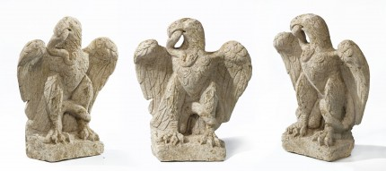
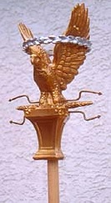
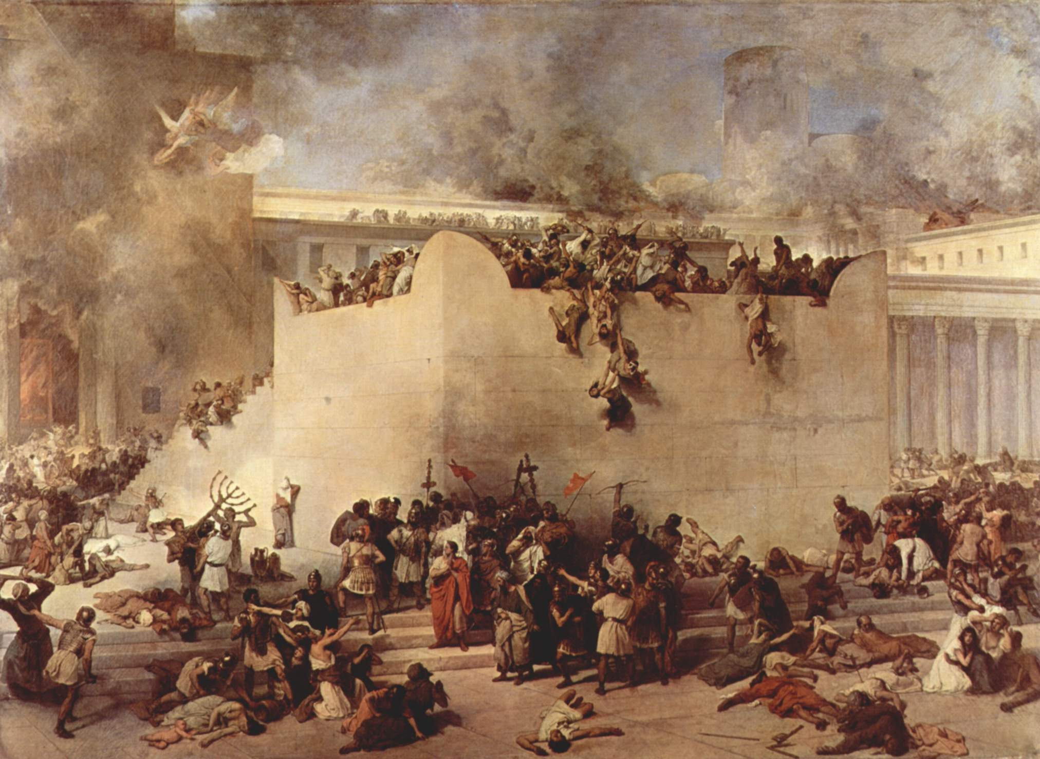
Punishments Chapter 28: Predictions
One particularly gruesome prediction added in this chapter concerned a siege so terrible that cannibalism would result (see vv. 49–57). When Jerusalem fell to Babylonian forces under Nebuchadnezzar, conditions were so terrible that the people did turn to cannibalism to survive (see Lamentations 4:1–10). But in the siege of Jerusalem by the Romans in A.D. 70, the prophecy seems to have been fulfilled with particular preciseness. Note the parallels.
“A nation … from far” (v. 49). Rome lies over a thousand miles from Israel.
“Swift as the eagle flieth” (v. 49). The eagle was the symbol of Rome and was carried on the standards of the legions of Rome.
“Whose tongue thou shalt not understand” (v. 49). While the Aramaic of Babylon was a sister tongue to Hebrew, Latin was completely different in alphabet, structure, and so on.
“A nation of fierce countenance which … shall not shew favor” (v. 50). Roman ferocity in battle and treatment of captives not profitable for slavery was well known.
“He shall besiege thee in all thy gates” (v. 52). Titus built a siege wall completely around Jerusalem so that none could escape (see Josephus, Wars of the Jews, bk. 5, chap. 12).
“Thou shalt eat the fruit of thine own body” (v. 53). Under siege, the people in Jerusalem soon became so desperate for food that all kinds of things were eaten, and finally the people turned to cannibalism (see Josephus, Wars, bk. 5, chap. 10, pars. 1–5; chap. 13, par. 7; bk. 6, chap. 3, par. 2).
“The tender and delicate woman … shall eat them … secretly in the siege” (vv. 56–57). Josephus described a noblewoman from Perea who killed her son and used him for food during the siege (see Josephus, Wars, bk. 6, chap. 3, pars. 4–5).
Several experts have examined the eagle now and all confirm that it is a Romano-British sculpture from the 1st or 2nd century A.D.
Carved out of oolithic limestone—same as stone on Mt. Gerizim---hummm!
Destruction of the Temple of Jerusalem,
Francesco Hayez, oil on canvas, 1867. Depicting the destruction and looting of the Second Temple by the Roman army.

Slide 22
Why was Moses translated?
President Joseph Fielding Smith explained why Moses was translated:
“Moses, like Elijah, was taken up without tasting death, because he had a mission to perform. …
“When Moses and Elijah came to the Savior and to Peter, James, and John upon the Mount, what was their coming for? Was it just some spiritual manifestation to strengthen these three apostles? Or did they come merely to give comfort unto the Son of God in his ministry and to prepare him for his crucifixion? No! That was not the purpose. I will read it to you. The Prophet Joseph Smith has explained it as follows:
“‘The Priesthood is everlasting. The Savior, Moses, and Elias [Elijah], gave the keys to Peter, James, and John, on the mount, when they were transfigured before him. The Priesthood is everlasting—without beginning of days or end of years; without father, mother, etc. If there is no change of ordinances, there is no change of Priesthood. Wherever the ordinances of the Gospel are administered, there is the Priesthood. … Christ is the Great High Priest; Adam next’ [Teachings of Presidents of the Church: Joseph Smith (2007), 105; italics added]. …
“From that we understand why Elijah and Moses were preserved from death: because they had a mission to perform, and it had to be performed before the crucifixion of the Son of God, and it could not be done in the spirit. They had to have tangible bodies. Christ is the first fruits of the resurrection; therefore if any former prophets had a work to perform preparatory to the mission of the Son of God, or to the dispensation of the meridian of times, it was essential that they be preserved to fulfill that mission in the flesh. For that reason Moses disappeared from among the people and was taken up into the mountain, and the people thought he was buried by the Lord. The Lord preserved him, so that he could come at the proper time and restore his keys, on the heads of Peter, James, and John, who stood at the head of the dispensation of the meridian of time [Deuteronomy 34:5–6; Alma 45:18–19]” (Doctrines of Salvation, comp. Bruce R. McConkie, 3 vols. [1954–56], 2:107, 110–11).

