Slide 1

The Downfall of King David
2 Samuel 11-12:9
But every man is tempted, when he is drawn away of his own lust, and enticed.
James 1:14

Slide 2


The Switch
A switch point is a piece of a railroad track that can move, allowing train cars to be diverted onto another track
President Gordon B. Hinckley, when working for a railroad early in his career, received a call from a railroad worker in the state of New Jersey.
He said a passenger train had arrived without its baggage car.
(1)

Slide 3
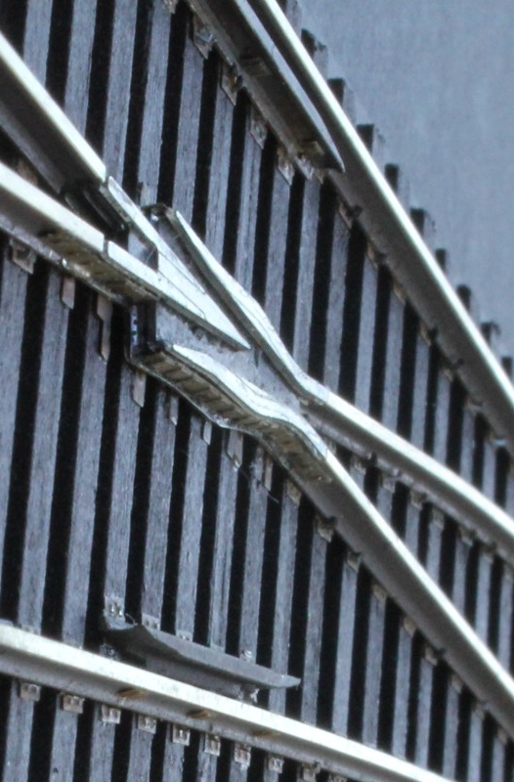

“We discovered that a baggage car that belonged in Newark, New Jersey, was in fact in New Orleans, Louisiana—1,500 miles from its destination.
Just the three-inch movement of the switch in the St. Louis yard by a careless employee had started it on the wrong track, and the distance from its true destination increased dramatically.
That is the way it is with our lives. Instead of following a steady course, we are pulled by some mistaken idea in another direction.
The movement away from our original destination may be ever so small, but, if continued, that very small movement becomes a great gap and we find ourselves far from where we intended to go.”
(1)

Slide 4
Bath-sheba And Uriah
She was the daughter of Captain Eliam, one of David's commanders
She had married Uriah the Hittite, a dedicated soldier in David’s army
She was invited to David’s palace, but the visit became more than a social call and became with child
King David sent Joab to get Uriah at the battle front so Uriah could come home and be with his wife
Uriah returned but not to his home, but felt a loyalty to sleep at the doorsteps of the king’s home with all the servants
King David invited Uriah to his palace to dine with him and give him wine so he would return home, but Uriah did not go home and took his sleep with the servants
King David sent Uriah back to Joab who then sent Uriah to attack the city wall. Not only did the men get killed but Uriah also
When the mourning period was over for Bath-sheba, King David married her, but the child died of an illness as an infant. Her second son was named Solomon

Slide 5
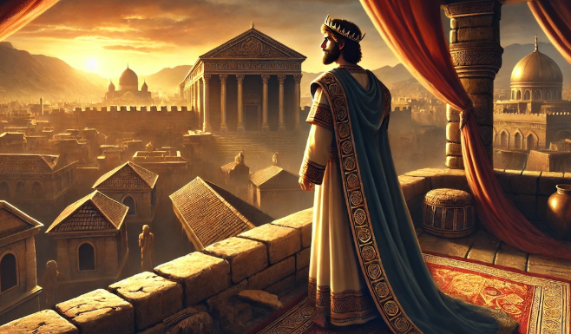
David’s Personal Course
Strolling along the roof of his palace David looked down and saw Bath-sheba bathing in the courtyard of her home.
Bath-sheba’s husband Uriah was a soldier and on the top list of David’s Gibborim Commanders.
(2 Sam. 23:39)
2 Samuel 11:1-5

Slide 6
Decisions
I can repent later
It’s not a big deal
I’m not hurting anyone
No one will know
What are some things the Lord invites us to do to turn to Him?
What lies might Satan use to convince us to turn away from the Lord?

Slide 7
Choices
He committed adultery
Which was David’s first big mistake?
What righteous choice could David have made when he first saw Bathsheba washing herself?
He invited
her to his place
He found out
she was married
He inquired after her
Where should have David been during war time?
At what other points could David have controlled his lustful desires and corrected the direction he was heading?
He looked upon a woman washing herself
He tarried at Jerusalem
instead of going to battle
2 Samuel 11:1-5

Slide 8

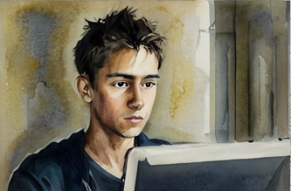
Susceptible
One way some people choose to entertain lustful desires is by using pornography.
The word pornography refers to any pictures, videos, books, or song lyrics intended to stimulate sexual desires.
If we choose to entertain lustful desires, we become susceptible to serious sins
“Pornography in all forms is especially dangerous and addictive. What may begin as an unexpected exposure or a curious exploration can become a destructive habit. Use of pornography is a serious sin and can lead to other sexual transgression.
Avoid pornography at all costs. … It causes you to lose the guidance of the Spirit and can damage your ability to have a normal relationship with others, especially your future spouse. It limits your ability to feel true love. If you encounter pornography, turn away from it immediately” (2)

Slide 9
Second Mistake
Why did Uriah refuse to go home
Instead of repenting what does David do?
He placed Uriah on the front lines of battle
What other way did David persuade Uriah to go home?
He asked Uriah to supper and caused him to drink, so Uriah would go home
Uriah was devoted to the king
Why was David wanting Uriah to go home?
What sin did David commit in order to hide his adultery?
He wanted Uriah to spend the night with Bathsheba
David attempts to hide his sin
2 Samuel 11:6-17

Slide 10
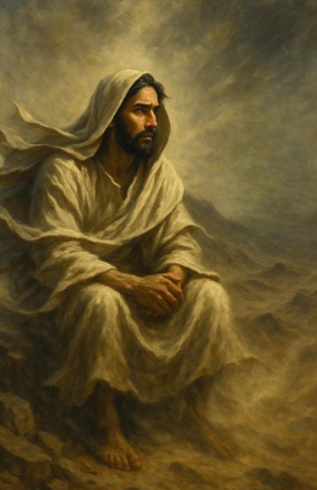
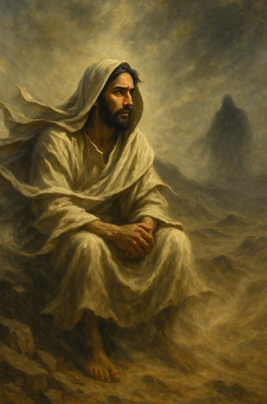
To Resist
There hath no temptation taken you but such as is common to man: but God is faithful, who will not suffer you to be tempted above that ye are able; but will with the temptation also make a way to escape, that ye may be able to bear it.
1 Corinthians 10:13
Even with temptations like those David faced, the Lord has provided teachings that can help us avoid temptation and escape sin.
(3)

Slide 11
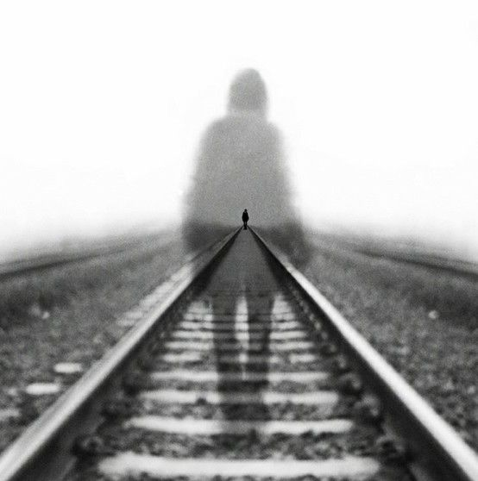
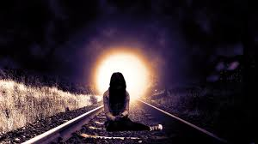
To Hide
“At times, consequences of sin may appear to be very subtle to the sinner. We may even convince ourselves …
that no one will be able to detect our sins and that they are well concealed. But always to our Heavenly Father and often to spiritually sensitive leaders, parents, and friends, our sins are glaringly apparent. …
“‘When we undertake to cover our sins … the heavens withdraw themselves; [and] the Spirit of the Lord is grieved’.
We lose our spiritual gifts. …
(3)

Slide 12

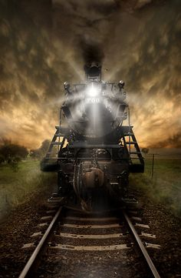
To Remove
“If the Spirit is pricking your heart to correct something in your life, know this: your soul is precious. Heavenly Father wants you to be part of His eternal family.
We cannot hide our sins from God
“I lovingly plead, ‘Do not procrastinate the day of your repentance’.
Start the process now. Remove the stench of sin with the remedy of repentance. Then, through the Atonement, the Savior can wash you clean.”
(3)

Slide 13
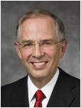
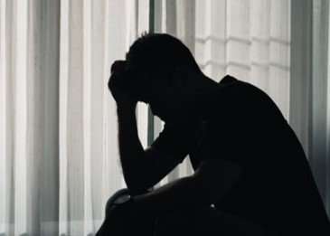

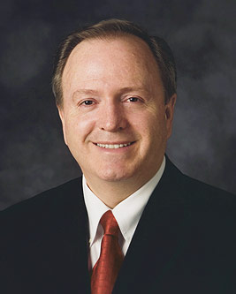
To Repent
When we sin, we turn away from God. When we repent, we turn back toward God.
The invitation to repent is rarely a voice of chastisement but rather a loving appeal to turn around and to “re-turn” toward God. It is the beckoning of a loving Father and His Only Begotten Son to be more than we are, to reach up to a higher way of life, to change, and to feel the happiness of keeping the commandments. (5)
Repentance is God’s ever-accessible gift that allows and enables us to go from failure to failure without any loss of enthusiasm. Repentance isn’t His backup plan in the event we might fail. Repentance is His plan, knowing that we will. This is the gospel of repentance, and as President Russell M. Nelson has observed, it will be “a lifetime curriculum.” (6)

Slide 14
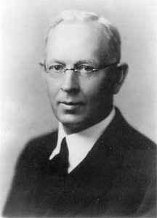
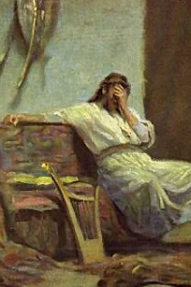
Displeasing the Lord
Can one continue with their sins kept in secret?
“The Lord also hath not put away thy sin” (JST, 2 Samuel 12:13).
“David committed a dreadful crime, and all his life afterwards sought for forgiveness. Some of the Psalms portray the anguish of his soul; yet David is still paying for his sin.
He did not receive the resurrection at the time of the resurrection of Jesus Christ.
Peter declared that his body was still in the tomb, and the Prophet Joseph Smith has said, ‘David sought repentance at the hand of God carefully with tears, for the murder of Uriah; but he could only get it through hell: he got a promise that his soul should not be left in hell.’”
2 Samuel 11:27
(4)

Slide 15
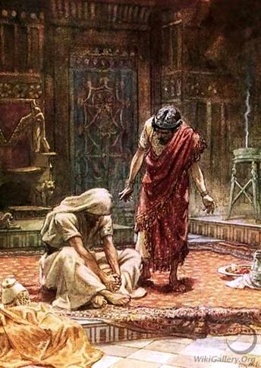
Nathan Knew
The Lord sent the prophet Nathan to David, and Nathan told him a parable
2 Samuel 12:1

Slide 16
Parable of the Lamb
He took the poor man’s lamb and dressed it
-- He killed the lamb and prepared it as a meal for his guest
What punishment did King David propose for the rich man who stole the poor man’s lamb?
Death: "The man who has done this deserves to die!".
Fourfold restitution: "He shall restore fourfold for the lamb". This was based on ancient Israelite law for stolen sheep.
2 Samuel 12:1-6
(4)

Slide 17
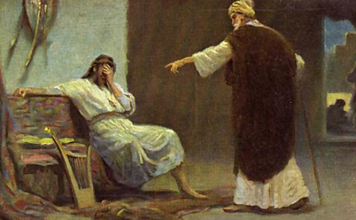
Next Time: Consequences
Now therefore the sword shall never depart from thine house; because thou hast despised me, and hast taken the wife of Uriah the Hittite to be thy wife.
2 Samuel 12:10 See Notes*

Slide 18
Sources:
Videos: To Look Upon (4:15)
“The Savior Wants to Forgive” (5:50)
“I Stand All Amazed” (5:15)
“Let God Guide You: From Weakness to Strength,” time code 2:51 to 5:28.
President Gordon B. Hinckley (“Words of the Prophet: Seek Learning,” New Era, Sept. 2007, 2).
(For the Strength of Youth [booklet, 2011], 12).
Presentation by ©http://fashionsbylynda.com/blog/
3. Elder Spencer V. Jones (“Overcoming the Stench of Sin,” Ensign or Liahona, May 2003, 88, 89).
4. Elder Joseph Fielding Smith(Answers to Gospel Questions, 1:74.)
5. Elder Neil L. Anderson (Repent … That I May Heal You,” Ensign or Liahona, Nov. 2009, 40)
6. Elder Lynn G. Robbins (“Until Seventy Times Seven,” Ensign or Liahona, Apr. 2018, 22)

Slide 19
David’s decision | Teachings of the Savior and His prophets
2 Samuel 11:1—David remained in Jerusalem when kings went to the battlefield with their army. | Alma 7:22; Doctrine and Covenants 42:42
2 Samuel 11:2—David saw Bathsheba washing herself and continued to look upon her. | Mosiah 4:30; 3 Nephi 12:28–29
2 Samuel 11:3—David pursued her. | Doctrine and Covenants 63:16
2 Samuel 11:4—Knowing Bathsheba was married, David had her brought to his palace. | Genesis 39:9
2 Samuel 11:4—David broke the law of chastity. | Doctrine and Covenants 42:23–25
David’s decision | Teachings of the Savior and His prophets
2 Samuel 11:1—David remained in Jerusalem when kings went to the battlefield with their army. | Alma 7:22; Doctrine and Covenants 42:42
2 Samuel 11:2—David saw Bathsheba washing herself and continued to look upon her. | Mosiah 4:30; 3 Nephi 12:28–29
2 Samuel 11:3—David pursued her. | Doctrine and Covenants 63:16
2 Samuel 11:4—Knowing Bathsheba was married, David had her brought to his palace. | Genesis 39:9
2 Samuel 11:4—David broke the law of chastity. | Doctrine and Covenants 42:23–25

Slide 20
David sinned when he became involved with Bathsheba, the wife of Uriah. “In God’s sight, sexual sins are extremely serious. They defile the sacred power God has given us to create life. The prophet Alma taught that sexual sins are more serious than any other sins except murder or denying the Holy Ghost (see Alma 39:5)” (For the Strength of Youth [booklet, 2011], 36).
David further sinned when he orchestrated Uriah’s death to hide his sin of adultery. Because of this sin, David fell from exaltation (see D&C 132:39). However, he pleaded with the Lord for forgiveness (see Psalm 51) and asked the Lord to not “leave [his] soul in hell” (Psalm 16:10).
President Boyd K. Packer of the Quorum of the Twelve Apostles noted:
“Forgiveness will come eventually to all repentant souls who have not committed the unpardonable sin (see Matt. 12:31).Forgiveness does not, however, necessarily assure exaltation, as is the case with David (see D&C 132:38–39)” (“The Brilliant Morning of Forgiveness,” Ensign, Nov. 1995, 21, note 15).
My dear young friends, if the Savior were here right now, what would He say to you?
I believe He would start by expressing His deep love for you. He might say it with words, but it would also flow so strongly—just from His presence—that it would be unmistakable, reaching deep into your heart, filling your whole soul!
And yet, because we’re all weak and imperfect, some concerns might creep into your mind. You might remember mistakes you’ve made, times you gave in to temptation, things you wish you hadn’t done—or wish you had done better.
The Savior would sense that, and I believe He would assure you with words He has spoken in the scriptures:
“Fear not.”
“Doubt not.”
“Be of good cheer.”
“Let not your heart be troubled.”
I don’t think He would make excuses for your mistakes. He wouldn’t minimize them. No, He would ask you to repent—to leave your sins behind, to change, so He can forgive you. He would remind you that 2,000 years ago He took those sins upon Himself so that you could repent. That is part of the plan of happiness gifted to us from our loving Heavenly Father. Elder Dieter F. Uchtdorf (“Jesus Christ Is the Strength of Youth,” Liahona, Nov. 2022, 9)
Unworthy Thoughts:
President Boyd K. Packer of the Quorum of the Twelve Apostles suggested a method to drive away unworthy thoughts:
“If you can control your thoughts, you can overcome habits, even degrading personal habits. If you can learn to master them you will have a happy life.
“This is what I would teach you. Choose from among the sacred music of the Church a favorite hymn, one with words that are uplifting and music that is reverent, one that makes you feel something akin to inspiration. … Go over it in your mind carefully. Memorize it. Even though you have had no musical training, you can think through a hymn.
“Now, use this hymn as the place for your thoughts to go. Make it your emergency channel. Whenever you find these shady actors have slipped from the sidelines of your thinking onto the stage of your mind, put on this record, as it were.
“As the music begins and as the words form in your thoughts, the unworthy ones will slip shamefully away” (“Inspiring Music—Worthy Thoughts,” Ensign, Jan. 1974, 28).

Slide 21
Consequences of David’s Actions for his family:
The death of the first child: The infant son born to David and Bathsheba fell ill and died, despite David's week-long prayer and fasting.
The sword never departing his house: David's own family was torn apart by violence and tragedy, starting with his own children.
Amnon's rape of Tamar: David's firstborn son, Amnon, raped his half-sister Tamar. In a parallel to David's own lustful and coercive behavior, Amnon manipulated Tamar into his chamber and then cruelly cast her out.
Absalom's revenge and murder: Two years after the rape, Tamar's full brother, Absalom, murdered Amnon for his heinous act. David's failure to punish Amnon for the crime fueled Absalom's bitterness and desire for vengeance.
Public humiliation by Absalom: Absalom later led a rebellion against David, forcing the king to flee Jerusalem. To publicly assert his claim to the throne and shame his father, Absalom had sexual relations with ten of David's concubines in view of all Israel, just as Nathan had foretold.
Absalom's death: The rebellion ended when Absalom was killed by David's army commander, Joab, despite David's direct order to deal gently with his son. David was overcome with grief upon hearing the news.
Consequences of David’s Actions for the nation:
Civil war: Absalom's rebellion plunged the kingdom into a bloody civil war that caused widespread death and instability.
Plague and famine: Later in his reign, David's prideful act of ordering a census brought a plague upon the nation that killed 70,000 people. David was given a choice of punishments from God and chose a plague over famine or war.

