Slide 1


To Know Who the Lord Is
1 Kings 18-22
Hear me, O Lord, hear me, that this people may know that thou art the Lord God, and that thou hast turned their heart back again. 1 Kings 18:37

Slide 2

False Gods
The Lord
What would happen if you tried to walk down both lines at the same time?
Eventually you would have to choose which line to follow.

Slide 3
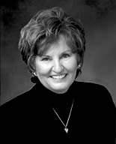
What are some ways we may be tempted to try to follow the Lord and the ways of the world at the same time?
False Gods
The Lord
“Our faith and commitment are tested when the world offers tempting and enticing alternatives that can turn our faces from the Lord’s kingdom.
Some would like to live in that eternal city and still keep a ‘summer home’ in Babylon. If we are not consciously and deliberately choosing the kingdom of God, we will in fact be moving backwards as the kingdom of God moves forward.”

Slide 4
Previously…
1 Kings 17
Elijah wanted the kingdom of Israel to fully commit to the Lord. It had been about three years since Elijah used his sealing power to bring a drought upon the land.
But Israel continued worshiping false gods, including Baal.
1 Kings 18:18

Slide 5
Ahab
Ahab was King of Northern Israel (Samaria) from about 869-850 BC. He was the son of Omri, and 7th king of Israel
He lead Israel into idolatry and moral decline by worshipping Baal and other gods in connection with his wife Jezebel
He focused on preserving his political station by overcoming the forces of Ben-hadad, king of Syria, with whom he then formed an alliance to oppose Assyria.
He had 3 encounters (warnings) with prophets; Elijah; the unknown prophet, who criticized Ben-hadad; and Micaiah. (1 Kings 17,18, 20-22)
He turned to Jehoshaphat, king of Judah, to take joint action against Syria
He reigned for 22 years
He was killed by an random arrow during a battle
(7)

Slide 6
Jezebel
Jezebel was born a Phoenician princess and a daughter of Ethbaal (Ithobaal), king of Tyre or Sidon (Zidon), a city closely connected
She married Ahab, king of Israel and with him worshipped Baal
She aggressively promoted idolatry in Israel and systematically attempted to exterminate the Lord’s priests
She sought to kill the prophet, Elijah, who prophesied a gruesome death for her
Her name became a symbol of idolatry and immorality
Ordered by Jehu, two eunuchs threw her out a window, trampled by horses, then eaten by dogs
(7)

Slide 7
Ahab and Jezebel Choose Wickedness
Jezebel had killed many of the Lord’s prophets, but Elijah had survived.
Ahab wanted to find the prophets to kill them. But Obadiah a steward of Ahab found them (100) first and hid them, fifty in a cave, and fed them with bread and water.
Elijah runs across him on his way to Ahab after his visit with the widow in Zarephath during the drought and sends Obadiah to tell Ahab that “Elijah is here.”
1 Kings 18:1-16

Slide 8
The Contest
Mt. Carmel
Which is the true God?
All the Israelites and 450 false prophets (of Baal) who worshipped Baal was invited to attend
400 of Jezebel’s ‘ false prophets’ stayed behind
1 Kings 18:19-24

Slide 9
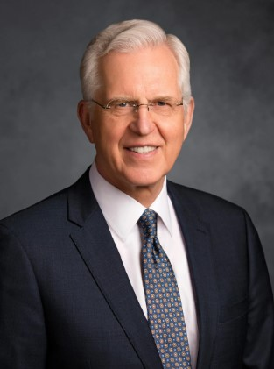
What Might Elijah Say Today?
Either God, our Heavenly Father, exists, or He does not, but if He exists, worship Him.
Either Jesus Christ is the Son of God, the resurrected Redeemer of mankind, or He is not, but if He is, follow Him. (6)

Slide 10
Choices
The Lord allows us to choose whether we will follow Him or the false gods and unrighteous ways of the world
When we know that Heavenly Father exists and Jesus is the Christ, we should commit to follow Them.
“You are responsible for the choices you make. …
“While you are free to choose your course of action, you are not free to choose the consequences. Whether for good or bad, consequences follow as a natural result of the choices you make.” (2)

Slide 11

How strongly do I believe that I have a Father in Heaven and a Savior?
How committed am I to following Them?
What might keep me from committing to follow Them completely?

Slide 12
450 Were Slain
And they took them (the false prophets) and Elijah brought them down to the brook Kishon, and slew them there.
These false prophets were wicked people who deliberately led the Israelites away from worshipping the Lord.
They promoted evil practices such as sexual immorality and the sacrifice of innocent children.
Elijah’s words in verse 27 emphasized that the gods of these false prophets had no power to bless or save the children of Israel.
The Lord’s power is greater than the power of men, and the Lord can help us know that He is the true God.
1 Kings 18:25-40

Slide 13

Then The Rains Came
After the contest, Elijah prophesied that rain would soon come upon the land
1 Kings 18:41-45

Slide 14
Jezebel’s Response to Elijah’s Miracle
Jezebel swore an oath that she would have Elijah killed within 24 hours
Elijah fled from the land of Israel and traveled many days until he came to Mount Horeb (another name for Mount Sinai)
Samaria
Mt. Sinai
1 Kings 19:1-3

Slide 15
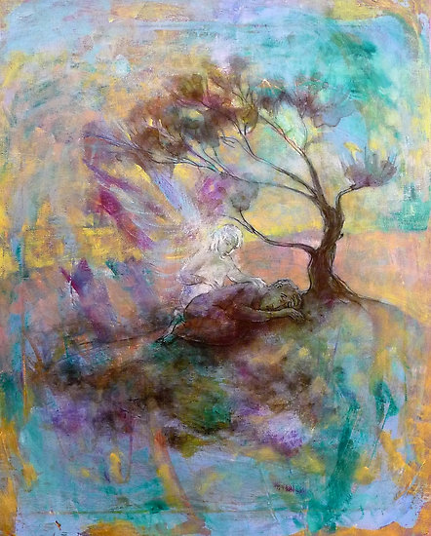
A Request to Die
Those who are heavy-laden with despair should come unto the Lord, for his yoke is easy and his burden is light (3)
Come unto me, all ye that labour and are heavy laden, and I will give you rest.
Take my yoke upon you, and learn of me; for I am meek and lowly in heart: and ye shall find rest unto your souls.
For my yoke is easy, and my burden is light.
Matthew 11:28-30
O Lord, take away my life; for I am not better than my fathers.
1 Kings 19:4

Slide 16
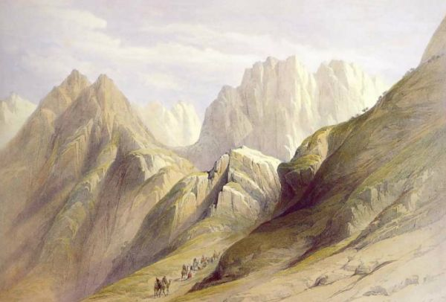
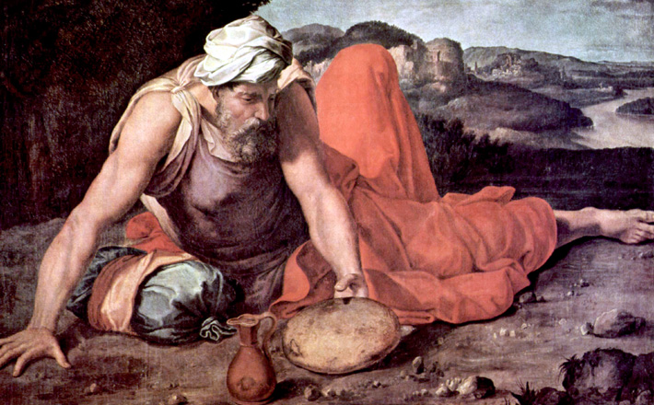
Arise and Eat: 2 Times
An angel touched him, and said unto him, Arise and eat.
…went in the strength of that meat forty days and forty nights unto Horeb the mount of God.
1 Kings 19:5-9

Slide 17
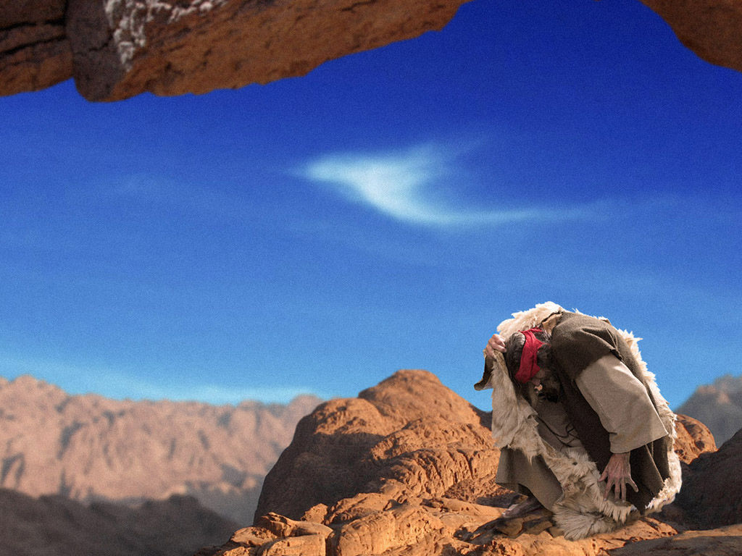
Prepare To Hear the Still Small Voice
As the wind, the earthquake, and the fire, were only the forerunners of the still small voice,
Elijah was now standing on the same place where Moses stood, when God revealed himself to him in the giving of the law
The Lord Was Not in the Wind or the Rains
The Lord often speaks to us through the still, small voice of the Spirit
1 Kings 19:11-12

Slide 18
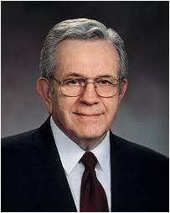
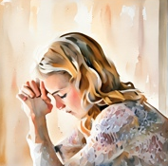
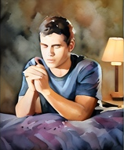
“That sweet, quiet voice of inspiration comes more as a feeling than it does as a sound. Pure intelligence can be spoken into the mind.
The Holy Ghost communicates with our spirits through the mind more than through the physical senses. This guidance comes as thoughts, as feelings through promptings and impressions …
“This process is not reserved for the prophets alone. The gift of the Holy Ghost operates equally with men, women, and even little children. It is within this wondrous gift and power that the spiritual remedy to any problem can be found. …
“You can know the things you need to know. Pray that you will learn to receive that inspiration and remain worthy to receive it.
Keep that channel— your mind—clean and free from the clutter of the world.”
(4)

Slide 19
You Are Not Alone
Yet I have left me seven thousand in Israel, all the knees which have not bowed unto Baal, and every mouth which hath not kissed him.
Seven thousand in Israel - That is, many thousands; for seven is a number of perfection, as we have often seen: so, the barren has borne seven - has had a numerous off-spring; Gold seven times purified - purified till all the dross is perfectly separated from it. The court and multitudes of the people had gone after Baal; but perhaps the majority of the common people still worshipped in secret the God of their fathers. (5)
1 Kings 19:16-19

Slide 20
Elijah Obeys The Lord
Things were about to change in Israel
Anoint Hazel to be king over Syria
Appoint Jehu to be king over Israel
Call Elisha to be a prophet
1 Kings 19

Slide 21
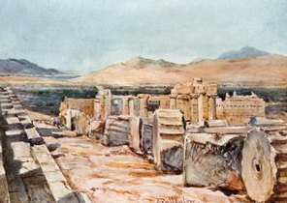
Syrians VS Israelites
The Israelites defended themselves in battle against the Syrians.
Elijah prophesied that Ahab and Jezebel would die.
His words were fulfilled, and eventually they were both killed
1 Kings 20-22

Slide 22
Sources:
Videos:
Individual Choices (1:53)
Feeling the Holy Ghost (3:18)
“Elijah and the Priests of Baal” (2:16)
Sister Sharon G. Larsen (“Agency—A Blessing and a Burden,” Ensign, Nov. 1999, 12). Also found in: Recalling Elder Neal A. Maxwell’s phrase, let us once and for all establish our residence in Zion and give up the summer cottage in Babylon (see Neal A. Maxwell, A Wonderful Flood of Light [1990], 47).
Presentation by ©http://fashionsbylynda.com/blog/
2. For the Strength of Youth[booklet, 2011], 2).
3. Ezra Taft Benson Do Not Despair Oct. 1986 First Presidency Message
4. President Boyd K. Packer (“Prayer and Promptings,” Ensign or Liahona, Nov. 2009, 44, 45).
5. Adam Clarke Bible Commentary 1 Kings 19:18
6. Elder D. Todd Christofferson (“Firm and Steadfast in the Faith of Christ,” Ensign or Liahona, Nov. 2018, 30)
7. Who’s Who in the Old Testament Pinegar and Allen pages 11 and 100

Slide 23
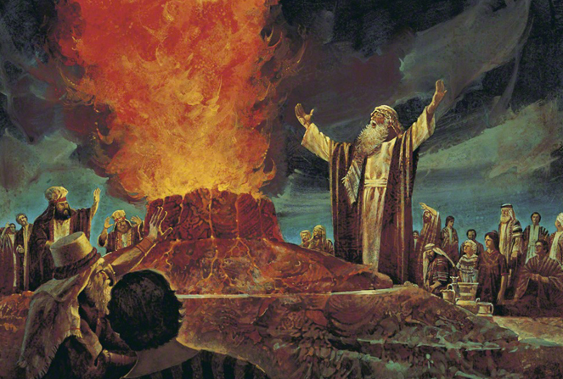
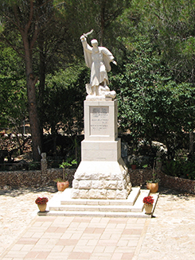
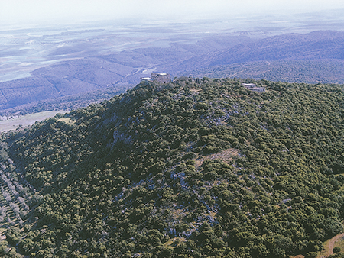
A statue commemorating the victory of Elijah over the wicked priests of Baal, located on top of Mount Carmel in modern-day Israel.
Aerial view of one of the spurs of Mount Carmel in Israel.

Slide 24
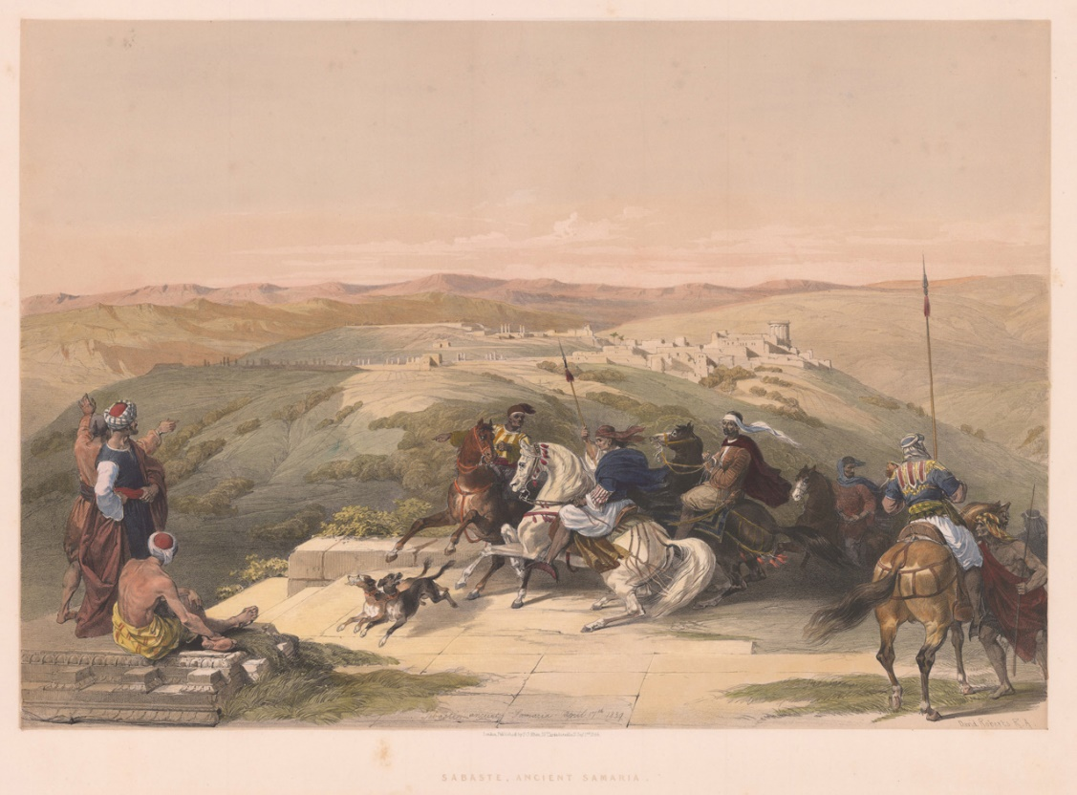
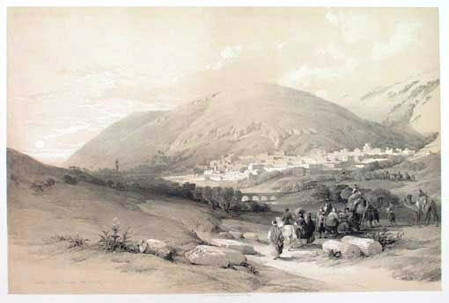
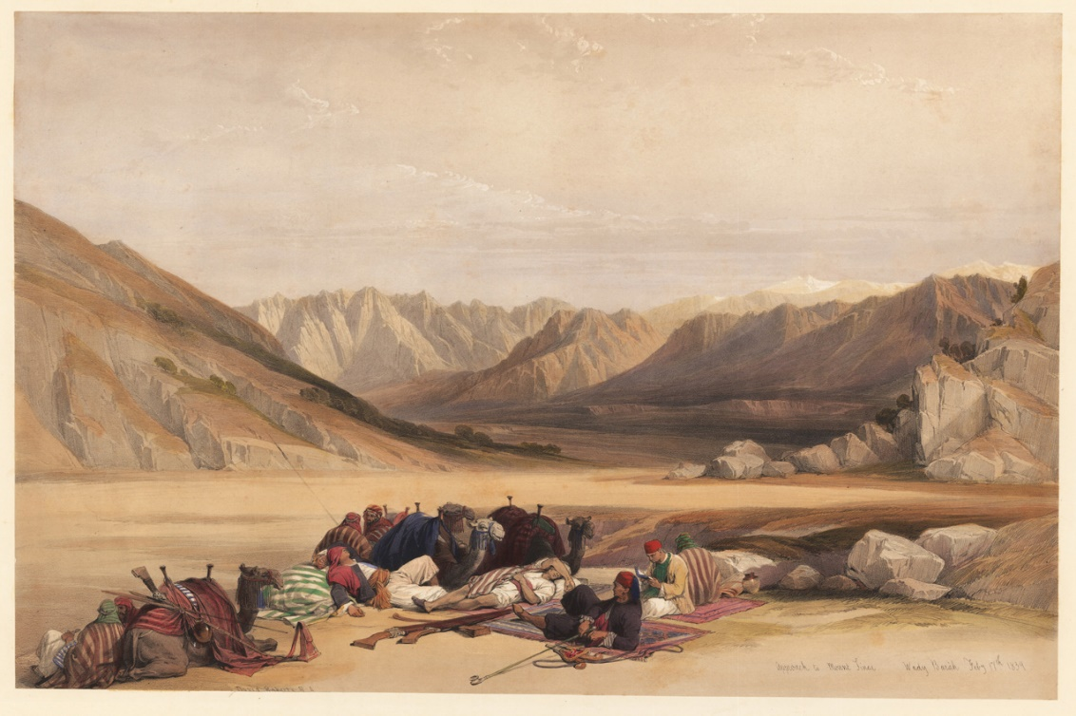
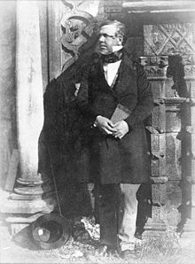
Ancient Samaria
Nablous, ancient Shechem
David Roberts (24 October 1796 – 25 November 1864) was a Scottish painter. He is especially known for a prolific series of detailed lithograph prints of Egypt and the Near East that he produced from sketches he made during long tours of the region (1838–1840). These and his large oil paintings of similar subjects made him a prominent Orientalist painter. He was elected as a Royal Academician in 1841.
David Roberts--lithographs
Approach to Mount Sinai.

Slide 25
Syrians:
The territory northeast of Palestine is known to us as Syria but it used to be called the land of Aram. It started as “Aram between the rivers” or Mesopotamia and then gradually shifted its major axis toward the west, until by Elijah’s day its capital was Damascus.
Original, these people had been led by the immediate relatives of Abraham. Around 2,000 BC., Abraham and his brother, Nahor, had settled a region on the upper Euphrates which they called Haran, but eventually it assumed the name of Nahor’s grandson, Aram. (Gen. 22:21)
When he was 62, Abraham and his nephew, Lot, moved down from Aram and eventually settled among the Canaanites in accordance with the commandments of the Lord, but his father, brother, and other relatives remained in Aram. Therefore, Abraham continued to call the upper Euphrates “my country” and “my kindred.” (Gen. 24:4)
Haran, the father of Abraham, turned again unto his idolatry way…Aram or Syria eventually became a land of rank apostates even though they were relatives of the Israelites. No doubt by they were much like the descendants of Lot, the Ammonites and Moabites, who also refused to be identified with Israel, but made themselves some of Israel’s most persistent enemies. W. Cleon Skousen The Fourth Thousand Years pp. 361-362
Queen Jezebel was killed by her own eunuchs under the orders of King Jehu, then trampled by horses. Her gruesome demise, detailed in the Hebrew Bible in 2 Kings 9.
After eating and drinking, Jehu commanded that she be buried, saying, "Bury that cursed woman, for she was a king's daughter". However, when his men went to bury her, they found only her skull, feet, and the palms of her hands. Stray dogs had devoured the rest of her body, fulfilling the prophecy delivered by Elijah years earlier in the vineyard of Naboth.
Halt Between Two Opions: 1 Kings 18:21
We live in a world with many voices seeking our attention. With all the breaking news, tweets, blogs, podcasts, and compelling advice from Alexa, Siri, and others, we can find it difficult to know which voices to trust. Sometimes we crowdsource guidance in our lives, thinking the majority will provide the best source of truth. Other times we “halt … between two opinions” (1 Kings 18:21), choosing to be “neither cold nor hot” (Revelation 3:15–16). Still other times we follow what is convenient, focus on a single voice or issue to guide us, or rely exclusively upon our own ability to think. …
What is popular is not always what is best. Halting between two opinions brings no direction. Convenience rarely leads to things that matter. Fixation on a single voice or issue can impair our ability to see. And relying solely upon our own thinking can lead us into a hyperintellectual stupor of thought. If we are not careful, the wrong voices can draw us away from the gospel center to places where faith is difficult to sustain, and we find little more than emptiness, bitterness, and dissatisfaction. …
And so, we need to decide which among all the different voices we will obey. Will we follow the unreliable voices advocated by the world, or will we do the work required to allow our Father’s voice to guide us in our decisions and protect us from danger? Elder David P. Homer (“Hearing His Voice,” Ensign or Liahona, May 2019, 41–43)

