Slide 1

Elijah is Translated
2 Kings 1-4
As also through your administration the keys of the school of the prophets, which I have commanded to be organized;
D&C 90:7
Presentation by ©http://fashionsbylynda.com/blog/

Slide 2
2 Kings
2 Kings is commonly called the Fourth Book of the Kings
2 Chronicles
Judges
1 Chronicles
Joshua
Ruth
1 Kings
2 Kings
2 Samuel
1 Samuel
Nehemiah
Ezra
Esther
The kingdom divided in 1 Kings becomes the kingdom dissolved in 2 Kings
2 Kings is a continuation of the two kingdoms—Israel (to the north)and Judah (to the south)
The division leads to decline and ultimately ends in double deportation.
Israel is captured and dispersed by the Assyrian, while Judah is led off to exile in Babylonia.
(1)

Slide 3
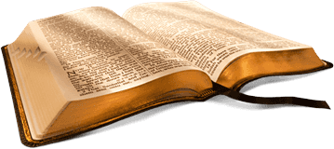
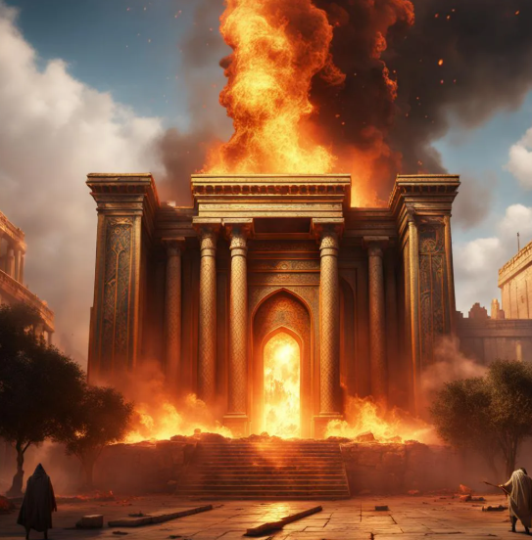
Kings and Prophets
The books of Kings show that judgment come to the kingdoms of Israel and Judah because of their idolatry, immorality, and disunity.
Judah lasts 136 years longer than Israel because of the relative goodness of 8 of its 20 kings.
Israel Kings
Of Israel’s 19 kings, not one is righteous in God’s sight. All but one of its nine dynasties are created by murdering the previous king.
The Righteous Kings—only in Judah
Asa
Jehosephat
Jehoash
Amaziah
Uzziah
Jotham
Hezekiah
Josiah
The last chapter of 2 Kings records the utter destruction of the city of Jerusalem and its glorious temple. Only the poor of Israel are left, and even some of them flee for their lives to Egypt.
(1)

Slide 4

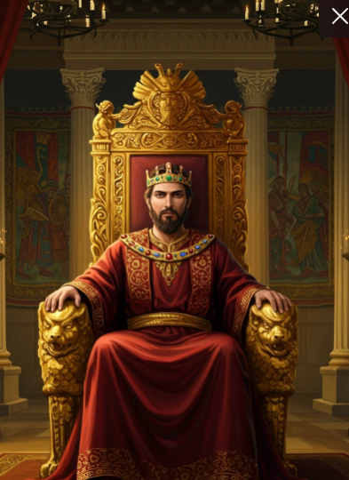
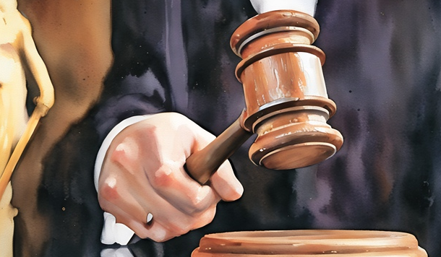
The Source of Power and Authority
Where does someone’s authority come from?
Medical doctors get their authority to practice by obtaining a state-issued license, which is granted after they have met educational and training requirements, passed licensing exams, and passed a background check by a state medical board.
Ancient kings derived authority from a combination of divine justification, hereditary succession, and military or economic power.
A judge's authority comes from the U.S. Constitution.

Slide 5
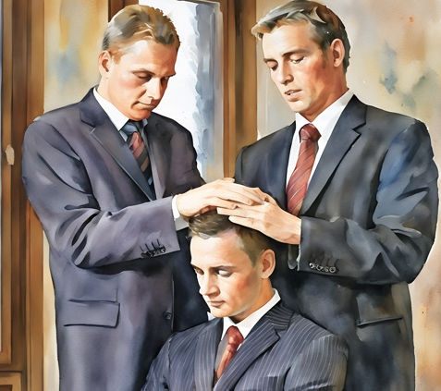
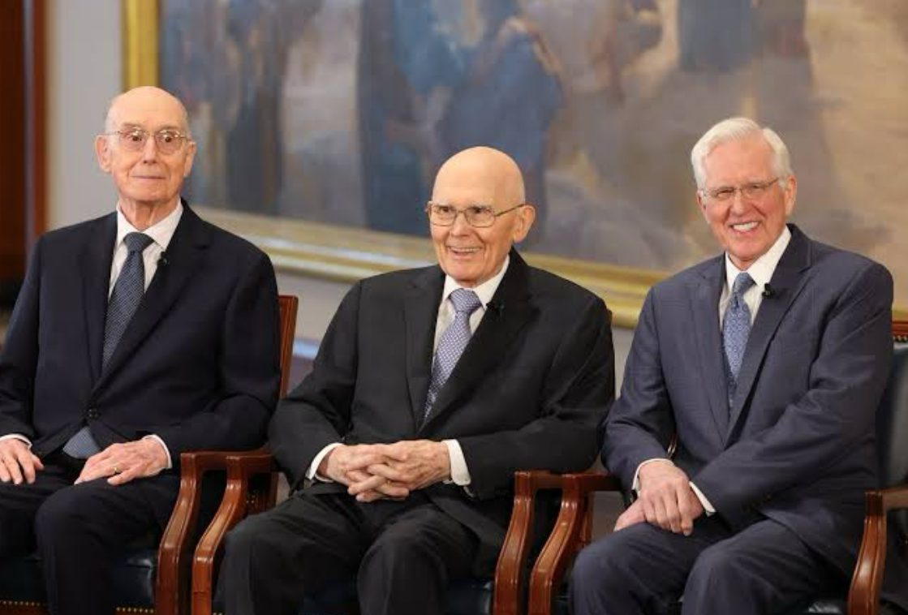
Power and Authority From God
There is a difference between the authority of the priesthood and the power of the priesthood.
Priesthood authority comes through ordination to the priesthood or through Church callings and assignments given by Church leaders who hold priesthood keys.
Power comes from personal righteousness.

Slide 6
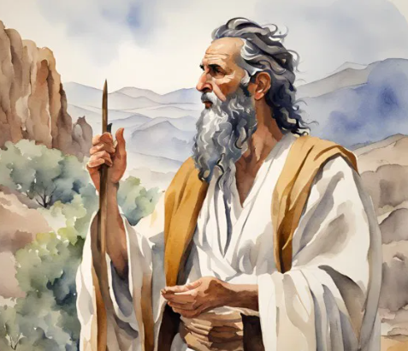
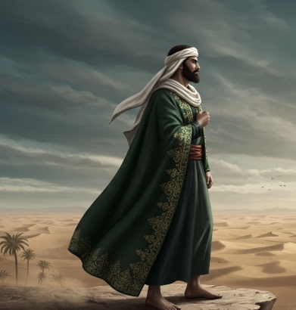
Elisha Receives God’s Power and Authority
The Lord revealed to Elijah that Elisha would become a prophet
And Jehu the son of Nimshi shalt thou anoint to be king over Israel: and Elisha the son of Shaphat of Abel-meholah shalt thou anoint to be prophet in thy room. (1 Kings 19:16)
So he departed thence, and found Elisha the son of Shaphat, who was plowing with twelve yoke of oxen before him, and he with the twelfth: and Elijah passed by him, and cast his mantle upon him. (1 Kings 19:16)
Elisha knew that the Lord would soon take Elijah away. On Elijah’s final day, Elisha followed Elijah from city to city until the two arrived at the Jordan River.
2 Kings 2:1–3

Slide 7
Elisha
He was the son of Shaphat
His name means God of salvation or God shall save
Elisha lived among the people in the cities while Elijah lived apart from the people
He was the student and companion of Elijah for several years
He was a prophet of the Northern kingdom of Israel
His calling came by divine command to Elijah at the same time the prophet was directed to anoint Jehu as king
He divided the waters of the Jordan River, and preformed mighty miracle, including raising the dead
His ministry lasted more than half a century during the righns of Jehoram, Jehu, Jehoahaz, and Joash
(2)

Slide 8
Ahaziah
He was the son of Ahab and Jezebel and successor as the king of Israel
He continued the depraved practices of Ahab and furthered the idolatrous culture of his mother
He fell through the roof of his palace
The Lord sent Elijah to tell Ahaziah that he would not recover from his injury and that he would die. This event occurred near the end of Elijah’s ministry
Ahaziah sent his messengers to go to the oracle or chief priest of Baalzebub to see if he would recover
Elijah intercepted the messengers, told them what an angel had said about Ahaziah dying
The messengers returned to Ahaziah and told them about the man and instantly he knew that it was ‘Elijah, the Tishbite’
He sent 50 men to find the prophet, fire fell upon the captain and his guard and killed them…Ahaziah attempted again and sent 50 men, but the same thing happened. Ahaziah could not touch Elijah
He died as a result of the injury. He reigned only 2 years.
(2)

Slide 9
Jephoshapat
He was the son of Asa and Azubah, who ruled jointly with his father for 3 years before becoming king for Judah
He strengthened the military fortification and promoted further religious reform
He established instructional programs directed by the priesthood
He received tribute from the Philistines and Arabians as a guarantee of peace
He joined alliance with King Ahab of Israel against the Syrian
His son, Jehoram married Athaliah, the daughter of Ahab and Jezebel in which Athaliah promoted idolatrous worship
He established a system of religious and civil courts
He miraculously withstood an attack from the Ammonites and their allies
He continued the alliance with Israel in an attempt to jointly establish ships for trade, but the venture failed
He reigned for 25 years
(3)

Slide 10
Elijah and Elisha
Elijah generally lived apart from the people and stresses law, judgment, and repentance.
Elisha lives among the people and emphasized grace, life, and hope
What did Elijah request of Elisha three times?
What did Elisha say to Elijah three times?
Tarry here, I pray thee
As the Lord liveth, and as thy soul liveth, I will not leave thee.
What can Elisha’s responses teach us about following the prophet?
2 Kings 2:1-6

Slide 11
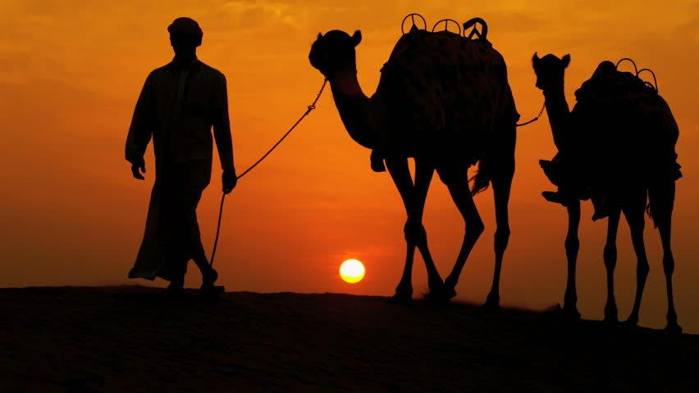
School of the Prophets
The name given to bands of prophets or “sons of prophets” living together for instruction and worship under Samuel, Elijah, and Elisha.
Little is known about these schools, but they seem to have been important religious institutions in Israel and references to them are frequent.
Not all the “sons of the prophets” claimed to have a supernatural gift; they were simply trained religious teachers, while some inspired prophets had received no training in the schools.
2 Kings 2:1-6

Slide 12
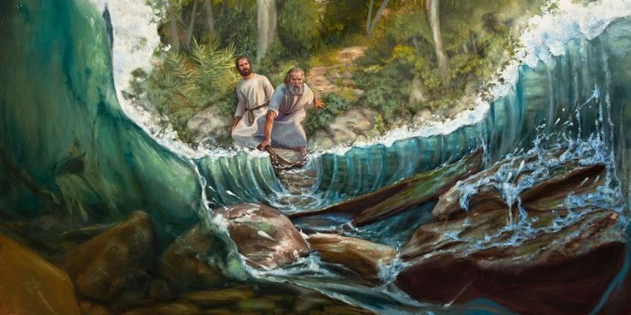
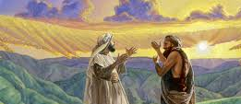
Dividing the Waters
Mantle-- a covering such as a cloak or other article of clothing. In biblical times, a mantle was typically a large, loosely fitting garment made of animal skin, probably sheepskin.
Elisha, Ask what I shall do for thee, before I be taken away from thee.
Elisha requested a double portion of Elijah’s spirit was essentially a request to inherit Elijah’s spiritual gifts, which would help Elisha to carry on the prophetic ministry.
2 Kings 2:7-10

Slide 13
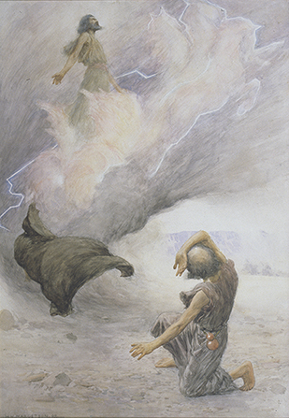
Elisha is Translated
Elijah was taken from the earth as a translated being.
Elisha called upon God to part the waters in the same way that Elijah had done earlier.
2 Kings 2:7-9

Slide 14
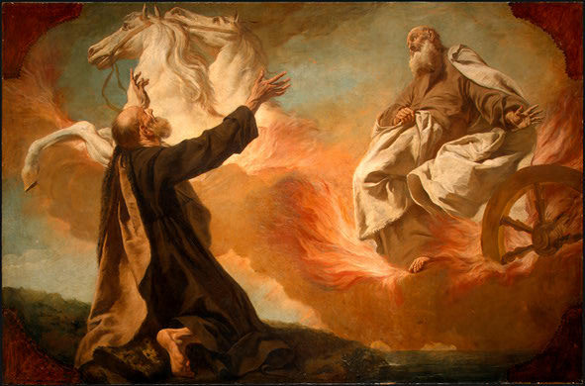
A Chariot of Fire
And it came to pass, as they still went on, and talked, that, behold, there appeared a chariot of fire, and horses of fire, and parted them both asunder; and Elijah went up by a whirlwind into heaven.
2 Kings 2:11-12

Slide 15
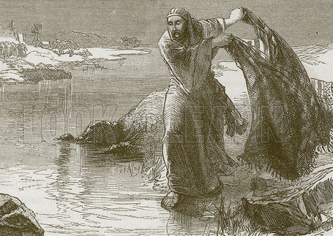
Taking Elijah’s Mantel
Elisha called upon God to part the waters in the same way that Elijah had done earlier.
The Lord gives authority and power to those whom He calls
The authority and power of a leader being transferred to the new leader.
In the Church today we sometimes refer to a leader’s calling, authority, and duties as his or her “mantle.”
2 Kings 2:13-14

Slide 16
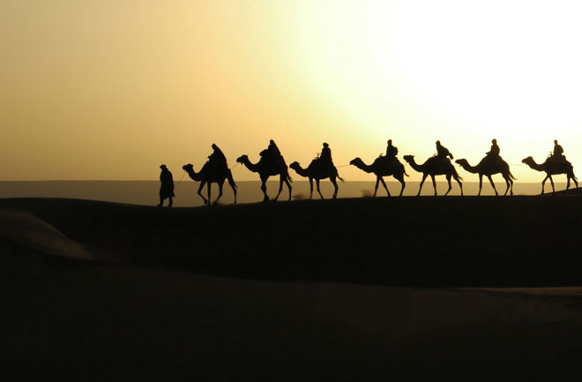
Son’s of the Prophets
These “sons of the prophets” formed a peculiar group. Possibly they assisted the prophets in their duties, and in time succeeded them.
These “sons of the prophets” were trained teachers of religion. Some of them were married and probably lived in houses of their own. Others were unmarried and occupied a building in common, eating at a common table.
The 50 did not know that Elijah had been translated and wanted to go look for him and Elisha encouraged them not to go…they did anyway and returned empty handed…
Did Elisha ever tell the sons of the Prophets where Elijah had gone?
2 Kings 2:15-18

Slide 17
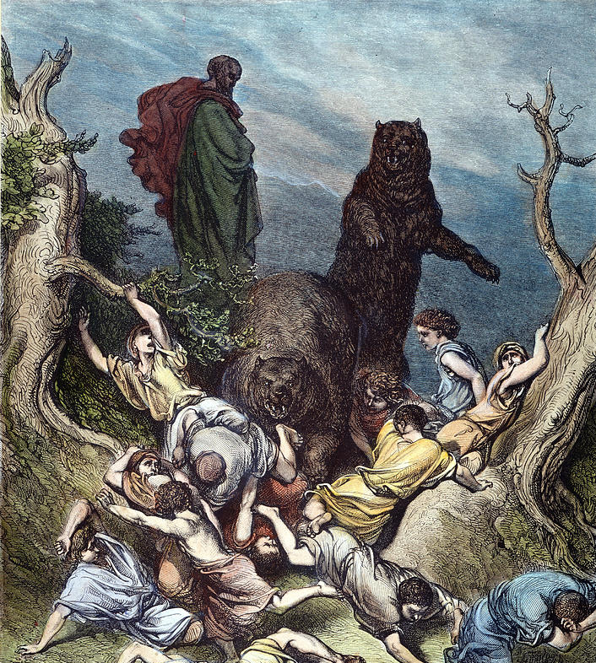
The Water in Jericho
Elisha learned that the water in Jericho was unusable. Elisha healed the waters for the people, saving them from death and famine.
On his way to Bethel from Jericho ‘little children’ (youth) mock him because he was bald.
Elisha cursed them and 2 she-bears came ‘tare’ 42 of them…whether any of them died, it is not known.
Bethel
Jericho
2 Kings 2:19-25

Slide 18
Jehoram
He was the son of Ahab and brother of Ahaziah and reigned 12 years
He forbade the worship of foreign gods but retained the idol worship instituted by Jeroboam
He joined in an alliance with Judah against Moab and wounded in battle
He was successful in holding off Syrian attacks on the people of Israel
Part of his reign was simultaneous with King Jehoram of Judah
He was killed by Jehu in a bloody purge of the Omri dynasty—a fulfilment of Elijah’s prophecy (1 Kings 21:29)
(2,3)

Slide 19
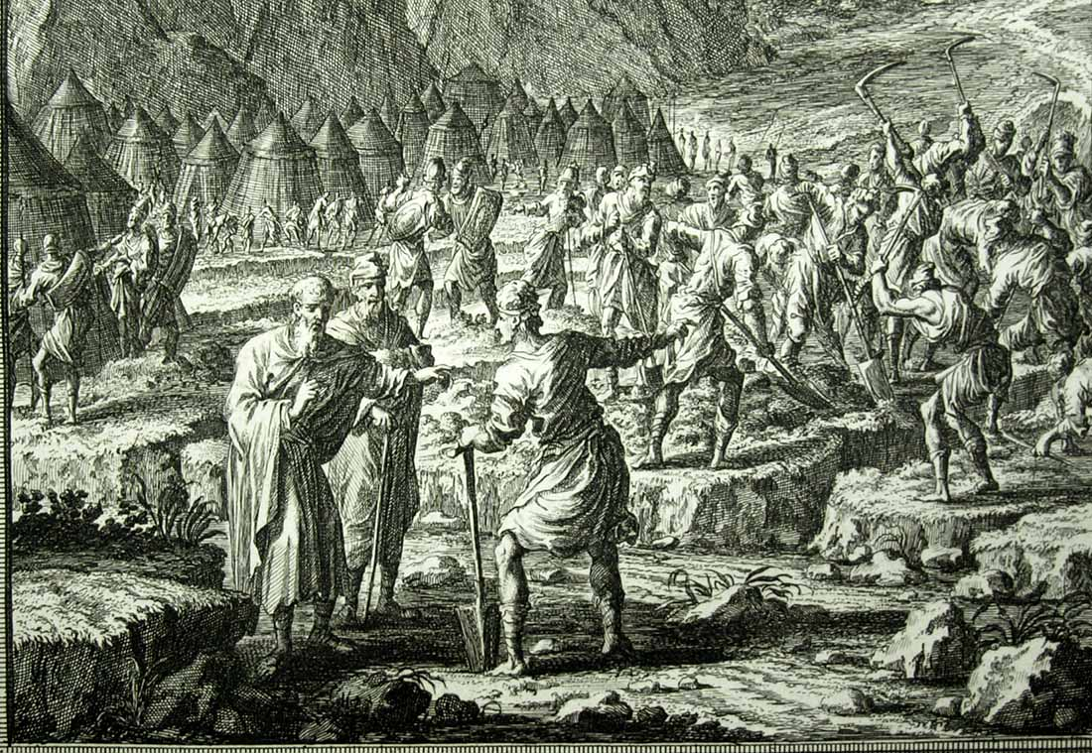
King Turns to Elisha
But Jehoshaphat said, Is there not here a prophet of the Lord, that we may inquire of the Lord by him? And one of the king of Israel’s servants answered and said, Here is Elisha the son of Shaphat, which poured water on the hands of Elijah.
If we seek for guidance from the Lord’s prophets, then we can receive His protection from those influences that would harm us
The armies of the three kings(Israel, Judah and Edom) were put to work digging ditches, canals, and reservoirs to catch the water which was to flow through the Arabah valley
2 Kings 3:21-37

Slide 20
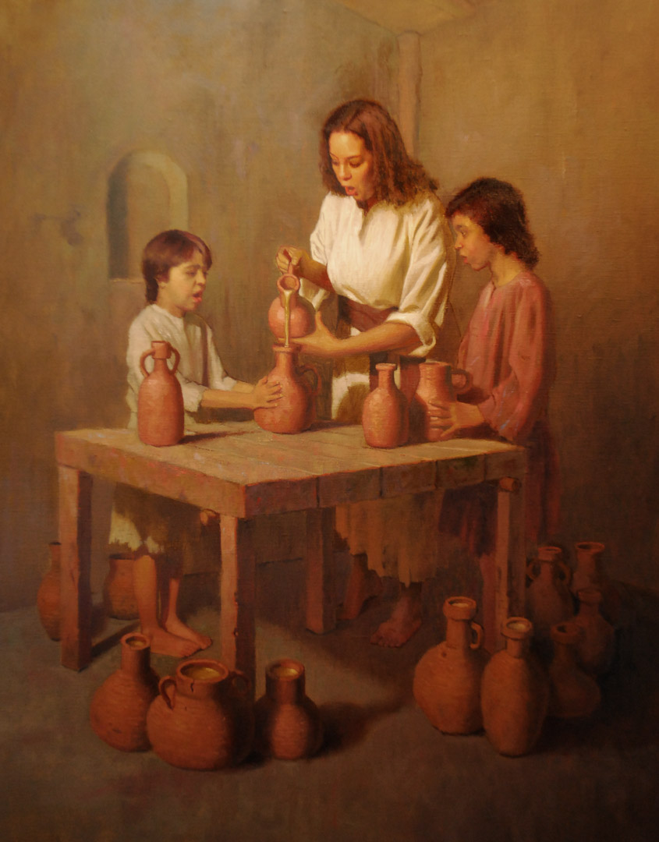
A Widow’s Oil
A widow woman from the community of the faithful was about to have her sons sold into bondage to pay for their dead father’s debts.
When she appealed to Elisha, he asked her what resources she had. It turned out to be nothing more than a small vessel of oil.
Elisha had her obtain every empty jar, pot and vessel from the whole neighborhood and out of the one jar he poured out enough of this substance to fill everything she should set before him.
When all of them were filled, he told her to sell the oil, pay the debt, and live with her children.
2 Kings 4:1-7

Slide 21
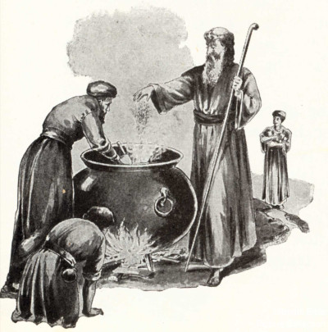
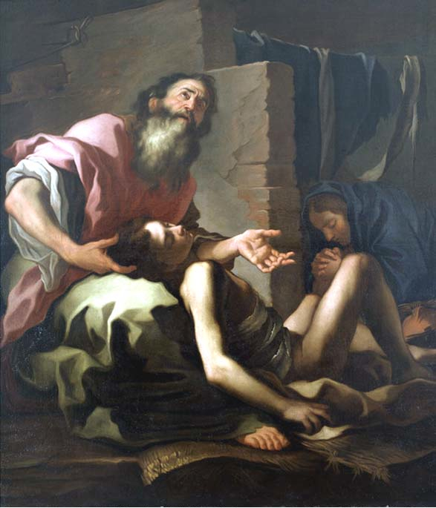
Elisha’s Miracles
Elisha promised a woman that she would bear a child. When that child later died, Elisha raised him from the dead
Elisha also purified a poisonous pot of pottage and multiplied food for the people to eat.
2 Kings 4:8-44

Slide 22
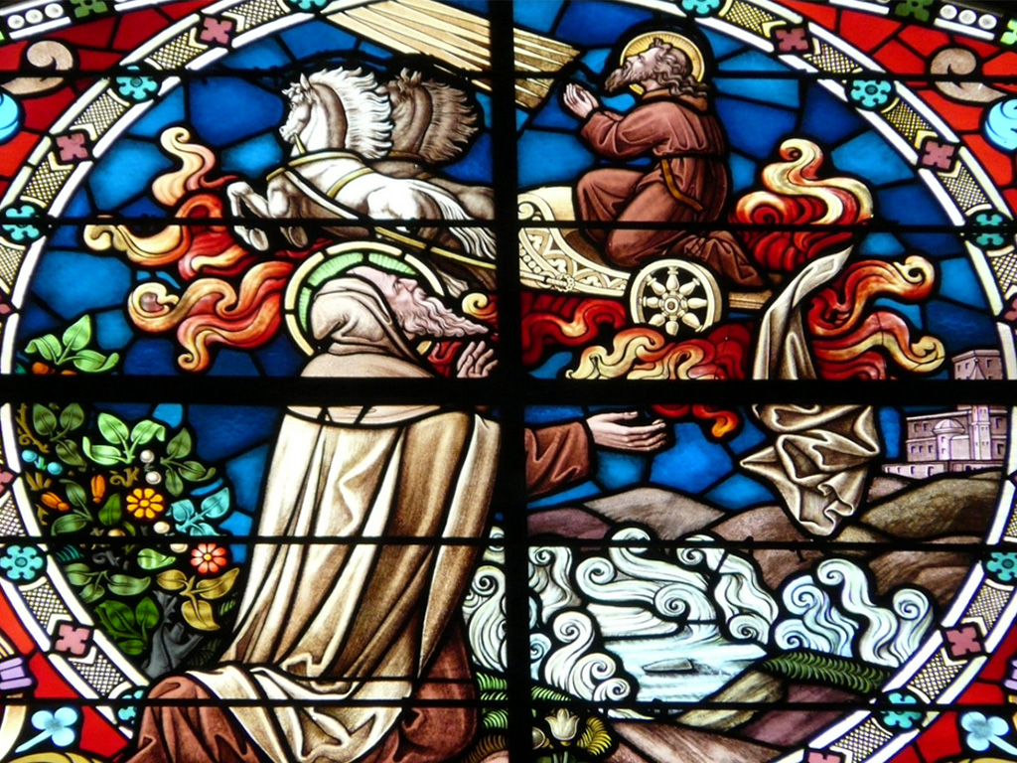
Sources:
Videos:
We Need Living Prophets (2:44)
Pure and Simple Faith (5:22)
“Jesus Calls Twelve Apostles to Preach and Bless Others” (1:38)
Talk thru the Bible by Bruce Wilkinson and Kenneth Boa p. 92-94
Presentation by ©http://fashionsbylynda.com/blog/
3. Who’s Who in the Old Testament by Ed J. Pinegar and Richard J. Allen p. 13, 48-49, 88
4. Old Testament Institute Manual (The Divided Kingdoms)
5. Priesthood Topics and Questions

Slide 23
Prophets:
Elder John A. Widtsoe gave this important insight about prophets as men:
“Men are called to the prophetic office because of their humility and their willingness to be in the hands of the Lord as clay in the hands of the potter. Yet a man called to the prophetic office is almost without exception of high native endowment, often with large experience in life, and possessed of wisdom and sound judgment.
That is, the prophet, though but a man, is an able man, rising in ability above the multitude. An examination of sacred history from Adam to the present will show that able men, in the words of Jethro, men ‘such as fear God, men of truth, hating covetousness’ (Exodus 18:21), have been called to the prophetic office. The unofficial views and expressions of such a man with respect to any vital subject, should command respectful attention. Wise men seek the counsel of those wiser or abler than themselves. …
“How may the rank and file of the Church recognize the prophetic voice, whether official or unofficial, when it speaks? The answer is simple enough. A person who is in harmony in his life, in thought and practice, with the gospel and its requirements, who loves truth so well that he is willing to surrender to it, will recognize a message from the Lord.” (Evidences and Reconciliations, pp. 237–38.)
Prophets and Teachers:
Elder Widtsoe also explained that “the teacher must learn before he can teach. Therefore, in ancient and modern times there have been schools of the prophets, in which the mysteries of the kingdom have been taught to men who would go out to teach the gospel and to fight the battles of the Lord.” (Evidences and Reconciliations, p. 257.)
The disciples of the prophets were called sons, just as teachers were sometimes called fathers (see 2 Kings 2:12; 6:21). These “sons of the prophets” formed a peculiar group. Possibly they assisted the prophets in their duties, and in time succeeded them. These “sons of the prophets” were trained teachers of religion. Some of them were married and probably lived in houses of their own. Others were unmarried and occupied a building in common, eating at a common table.
It is supposed that the schools of the prophets were founded by the prophet Samuel. A description of him instructing them is found in 1 Samuel 19:19–20. But just how long the schools of the prophets lasted in Old Testament times is not known. They seem to have flourished in the times of Samuel, Elijah, and Elisha. Eventually they degenerated into an unscrupulous guild that divined for money and power. (See C. F. Keil and F. Delitzsch, Commentary on the Old Testament, 2:2:199–206.)
A Prophet and a Seer:
Elder John A. Widtsoe summarized the role of prophets in these words:
“A prophet is a teacher of known truth; a seer is a perceiver of hidden truth, a revelator is a bearer of new truth. In the widest sense, the one most commonly used, the title, prophet, includes the other titles and makes of the prophet, a teacher, perceiver, and bearer of truth.
“One who bears the title of prophet, and they who sustain him as such, are first of all believers in God, and in a divine plan of salvation for the human family; and, secondly, they commit themselves to the task of bringing to pass the purposes of the Almighty. They believe that the children of men are capable of receiving and obeying truth. Were it not so, the title ‘prophet, seer, and revelator’ would be empty, hollow words. As it is, they are clarion calls of the Church of Christ to a world walking in the dim shadows of misunderstanding.” (Evidences and Reconciliations, pp. 258–59.)
Little Children and Bears:
In 2 Kings 2:23, footnote a we learn that the people who mocked Elisha were “youths (not little children).” These youths were likely young men who were old enough to go into battle. The phrase “go up, thou bald head” was intentional mocking, scorning, or jeering that showed the youths’ contempt for God’s chosen prophet.
Additionally, the bears likely did not kill the youths: “When [Elisha] ‘cursed them in the name of the Lord’ [2 Kings 2:24], he called upon the Lord to punish them (compare the imprecation in Jude 1:9); it is the opposite of blessing someone in the name of the Lord. The bears did not kill the offenders, as some commentaries assume, but ‘tare,’ or lacerated, them” (Ellis T. Rasmussen, A Latter-day Saint Commentary on the Old Testament[1993], 301).
Old Testament Institute Manual

Slide 24
Judah—931 BC to 586 BC
Israel—931 BC to 722 BC
Approximate dates
Kings | Year | Years Reigned | Prophets | Kings | Year | Years Reigned | Prophets
Jeroboam | 930-909 BC | 22 | Ahijah, man of God Iddo | Rehoboam | 930-913 BC | 17 | Shemaiah, Iddo
Nadab | 909-908 BC | 2 |  | Abijam/Abijah | 913-910 BC | 3 | Iddo
Baasha | 908-886 BC | 24 | Jehu | Asa | 910-869 BC | 41 | Azariah, Hanani
Elah | 886-895 BC | 2 |  | Jehoshaphat | 872-848 BC | 25 | Jehaziel
Zimri, Tibni, Omri | 885 BC | 7 days, 12 |  | Jehoran | 848-841 BC | 8 | Obadiah ?
Ahab | 874-853 BC | 22 | Elijah, Michaiah | Ahazaih | 841 BC | 1
Ahaziah | 853-852 | 2 | Elijah | Athaliah | 841-835 BC | 6
Jehoram/Joram | 852-841 BC | 12 | Elisha | Jehoash/Joash | 835-796 BC | 40 | Joel
Jehu | 841-814 BC | 28 | Elisha | Amaziah | 796-767 BC | 29 | Joel
Jehoahaz | 814-798 BC | 17 | Elisha | Azariah/Uzziah | 792-740 BC | 52 | Joel, Isaiah
Jehoash/Joash | 798-782 BC | 16 | Elisha Jonah | Jotham | 750-735 BC | 16 | Isaiah, Micah
Jeroboam II | 793-753 BC | 41 | Jonah, Amos, Hosea | Ahaz | 735-715 BC | 16 | Isaiah, Micah
Zechariah | 753 BC | 6 mon | Hosea | Hezekiah | 715-686 BC | 29 | Isaiah, Micah
Shallum | 752 BC | 1 mon | Hosea | Manasseh | 697-642 BC | 55 | Nahum
Menahem | 752-742 BC | 10 | Hosea | Amon | 642-640 BC | 2 | Nahum
Pekahiah | 742-740 BC | 2 | Hosea | Josiah | 640-609 BC | 31 | Naham, Zephaniah, Habakkuk, Jeremiah, Huldah
Pekah | 752-732 BC | 20 | Hosea, Micha | Jehoahaz | 609 BC | 3 mon | Habakkuk, Jeremiah
Hoshea | 732-722 BC | 9 | Hosea, Micha | Jehoiakim | 609-598 BC | 11 | Habakkuk, Jeremiah, Daniel
 |  |  |  | Jehoiachin | 598 BC | 3 mon | Jeremiah, Daniel
 |  |  |  | Zedekiah | 597-586 BC | 11 | Jeremiah, Ezekiel, Daniel
http://gen2revarg.com/gentorevkingsandprophets.html
Red indicates Righteous Kings
Mark Barry—the kings of Judah and Israel

