Slide 1

Elisha’s Miracles
2 Kings 5-13
…and they cast the man into the sepulchre of Elisha: and when the man was let down, and touched the bones of Elisha, he revived, and stood up on his feet.
2 Kings 13:21

Slide 2

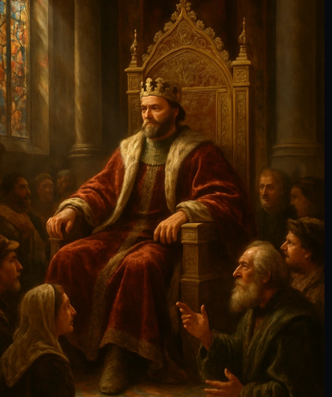
Previously…
Elisha had passed through Shunem and stopped at a home of a “great woman” who fed him bread.
Every time Elisha passed this way he stayed at this house.
The wife told her husband that they would make a little chamber (roof room) for Elisha to stay in because she knew “he was a holy man”.
During a famine this woman and husband left Shunem then returned seven years later and found that the families land and home was seized during their long absence.
The Shunem woman went to the King. While overhearing a servant named Gehazi telling the king all about the miracles of Elisha, she was able to tell her story of her son being restored back to life.
2 Kgs. 4:8-14

Slide 3
Naaman
He was a nobleman in the royal court of Syria
He had leprosy
His wife had a maid who had been captured from among the Israelites by the Syrians and knew of a prophet in Israel who could heal him
He gained permission from the King of Syria (Ben-hadad II) and from the king of Israel
The prophet Elisha said, “Let him come now to me, and he shall know that there is a prophet in Israel”
Naaman and his company went to Elisha seeking a blessing
Elisha had him go to the River Jordan and wash himself 7 times and he was healed
Naaman wanted to pay Elisha for his services, but Elisha refused. Naaman’s servant, Gehazi, accepted for himself the gifts, but later himself became a leper
(2)

Slide 4
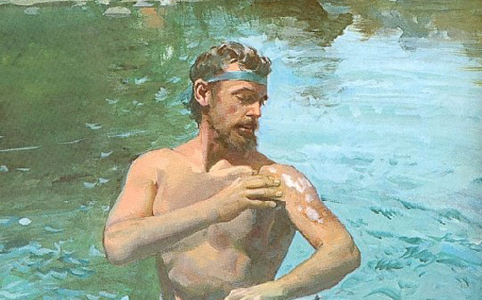
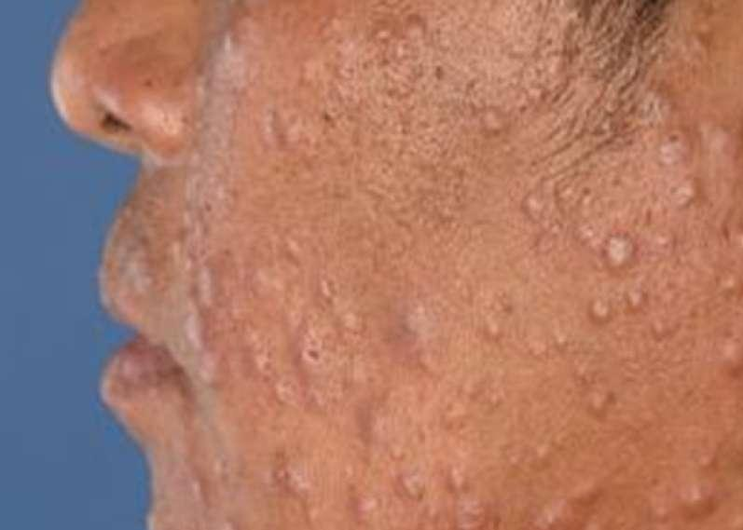
Leprosy
A leper could never rise to such greatness in Israel. Leprosy was considered unclean and became a loathsome disease among the Jews (Lev. 13).
While the Lord was trying to teach the people the difference between clean and unclean, instead, they let their traditions justify prejudice and malice toward the afflicted.
The Syrians, not under the Law of Moses, did not develop the same prejudice.

Slide 5
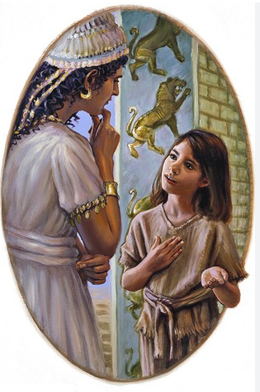
The Little Maid-Small and Simple Invitations
The little maid lived in Naaman’s household, who was the captain of the guard for the Syrian King.
Israel had lost a battle with Syria.
It was customary during the victory of a battle was to carry off any valuables including slaves.
One of the slaves was “the little maid”
Because of the stress of having leprosy, Naaman had tried everything.
His wife’s servant, the little maid suggested to her:
Would God my lord were with the prophet that is in Samaria! for he would recover him of his leprosy.
The king of Syria heard of Naaman’s leprosy and sent a letter to the king of Israel. Israel thought this was to provoke them. However, Elisha heard of the king of Israel’s distress and told him to send Naaman to him, only to be met with a servant of Elisha.
2 Kgs. 5:2-4

Slide 6
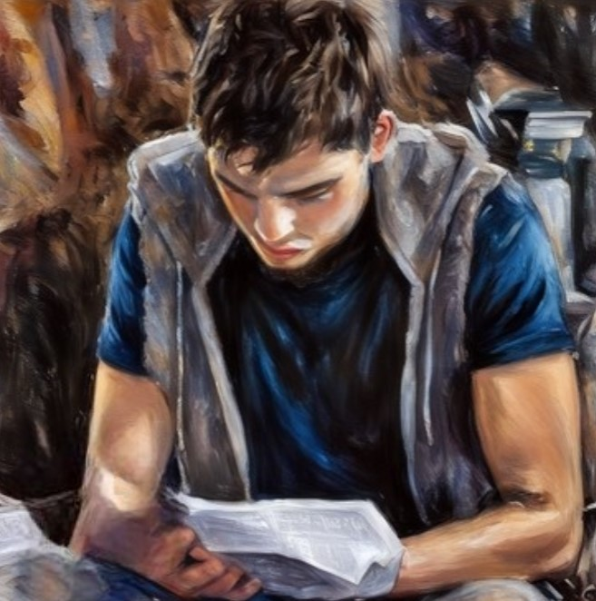
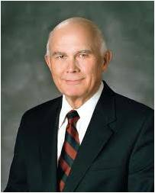
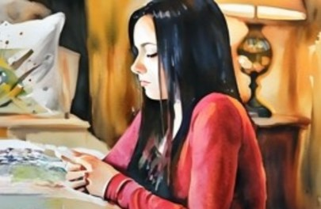
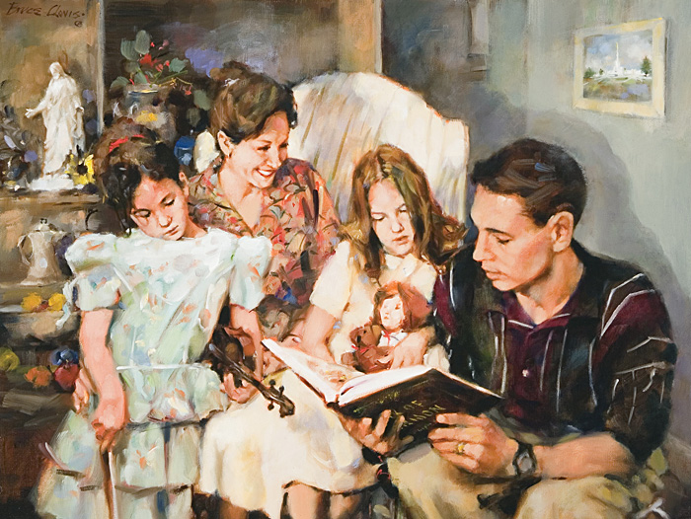
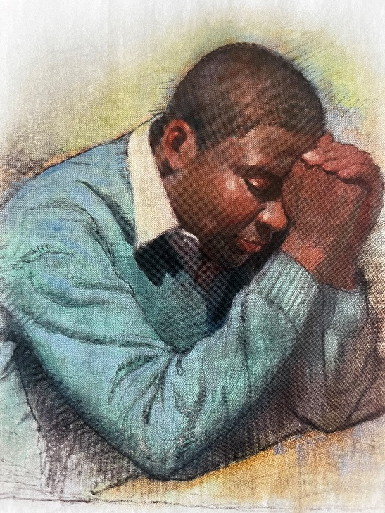
Consider the scripture study we’ve been taught to incorporate into our daily lives.
Or consider the personal prayers and the kneeling family prayers that are regular practices for faithful Latter-day Saints.
Consider attendance at seminary for youth or institute classes for young adults.
Though each of these practices may seem to be small and simple, over time they result in powerful spiritual uplift and growth.
This occurs because each of these small and simple things invites the companionship of the Holy Ghost, the Testifier who enlightens us and guides us into truth. (9)

Slide 7
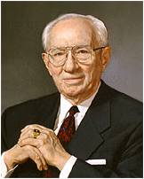
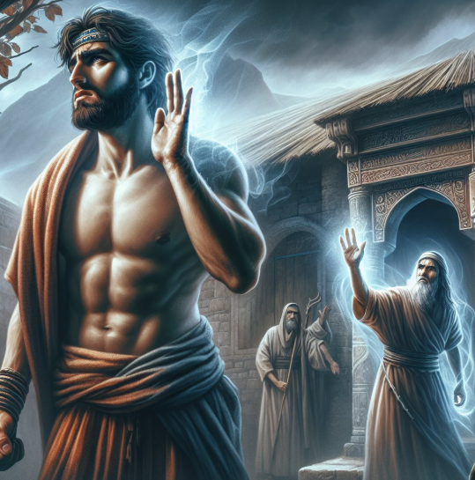
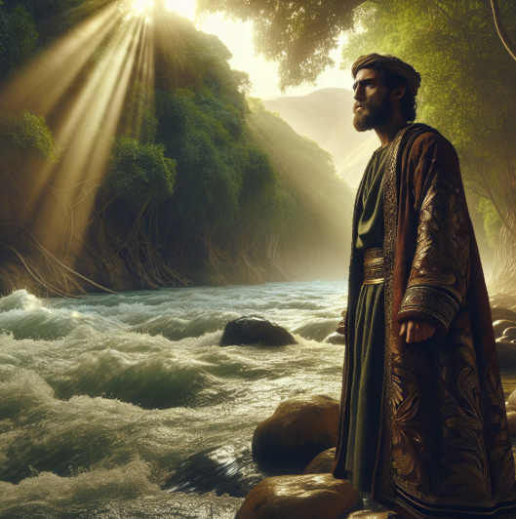
Walk in Obedience
Gehazi was Elisha’s servant
“Naaman was insulted that he should be told to wash in Jordan when there were cleaner streams in his own land, and “he turned and went away in a rage.”
But his servants pleaded with him to do as Elisha had suggested. The proud captain finally relented, and the scripture records, “Then went he down, and dipped himself seven times in Jordan, according to the saying of the man of God: and his flesh came again like unto the flesh of a little child, and he was clean.”
And so, I repeat, do not let pride stand in your way. The way of the gospel is a simple way. Some of the requirements may appear to you as elementary and unnecessary. Do not spurn them. Humble yourselves and walk in obedience. I promise that the results that follow will be marvelous to behold and satisfying to experience.”
2 Kgs. 5:9–14
(2)

Slide 8

Showing Faith
How did Naaman show his faith in the words of God as given through Elisha?
If you were Naaman, what might you have been thinking the first time you dipped yourself in the water? The second time? The seventh time?
What thoughts or feelings might you have had as you saw your leprosy healed?
How might this experience have affected your testimony of the prophet’s calling?
2 Kgs. 5:11–14

Slide 9
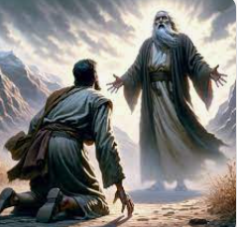
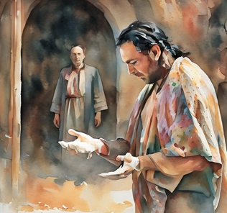
Gehazi
Naaman wanted to thank Elisha by giving him money and gifts.
Elisha declined Naaman’s offer. After Naaman departed, Elisha’s servant Gehazi went after Naaman and lied to him, saying that Elisha requested silver and clothing. Naaman gave Gehazi gifts, which Gehazi kept for himself.
The Lord punished Gehazi by afflicting him with Naaman’s leprosy.
“Ironically, the story involves a pagan who, because of a prophet’s refusal to accept any reward for what God had done, accepts the God of Israel, and an Israelite who, because of unbridled greed, betrays that God. The talent of silver measures Gehazi’s covetousness and lies. His was no mere hankering after a reward for the curing of leprosy—it was a craving to become financially well-established.”
2 Kgs. 5:15-27
(3)

Slide 10
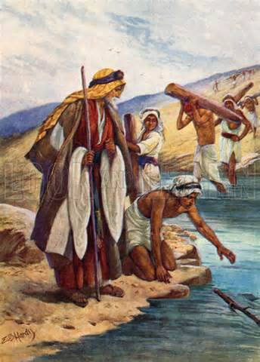
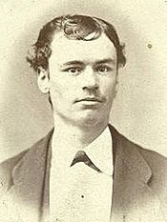
The Iron Did Swim
Elisha gave the sons of the prophet's permission to build a new home because the one they were living in was too small.
As they were cutting down the trees they lost their axe in the water
And the man of God said, Where fell it? And he shewed him the place. And he cut down a stick, and cast it in thither; and the iron did swim.
“Now what was it that caused the axe to rise in the water? The same Being who gave the law of gravitation, which caused the axe to sink, counteracted that law, and caused the axe to swim.”
2 Kings 6:1-7
(4)

Slide 11
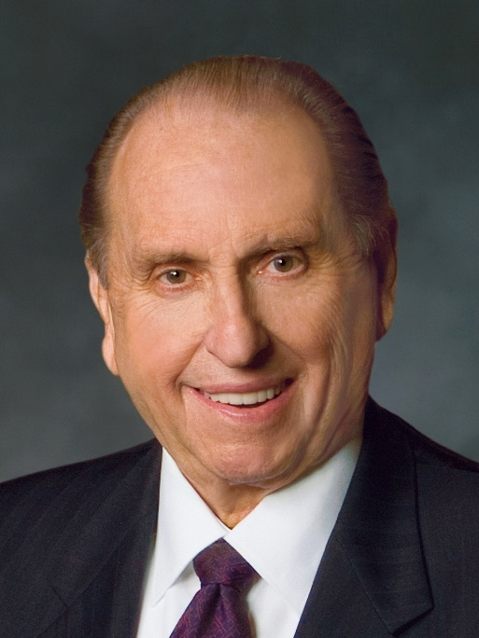
“Our Heavenly Father is aware of our needs and will help us as we call upon Him for assistance. I believe that no concern of ours is too small or insignificant.
The Lord is in the details of our lives.”
(5)

Slide 12
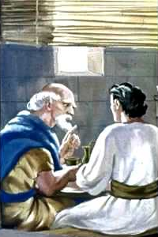
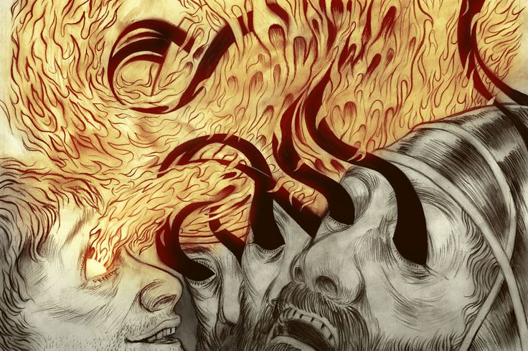
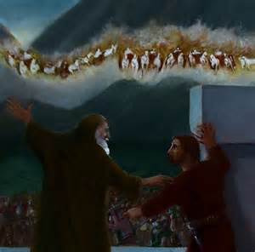
Blinded
Syria and the Northern Kingdom of Israel began to fight each other, and the king of Syria would privately discuss his battle plans with his servants.
Elisha knew of the plans of Syria and told the King of Israel (Jeroham) their plan.
Elisha was at Dothan, a few miles from Samaria and the Syrian army marched in to seize Elisha in the intent of killing him.
The Heavenly Army
The young lad didn’t, initially, see what the prophet saw but that through the help and prayer of the prophet he was able to see; his eyes were opened too. (7)
Elisha prayed that the Syrians would be “blinded” to a realization of where they were or who Elisha was…a confusion of mind.
2 Kings 6:8-23
(6)

Slide 13
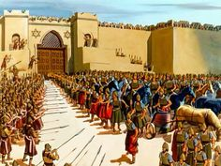
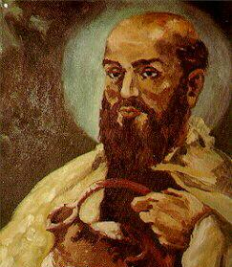
Following “the man”
Elisha said unto the confused Syrian commander to follow him.
Elisha led them right into Samaria and their eyes were open.
When King Jehoram of Israel saw what had happened, he wanted to kill them…
However, Elisha told him to give them something to eat and drink and ‘go to their master’
So, the bands of Syria came no more into the land of Israel.
2 Kings 6:8-23
(6)

Slide 14
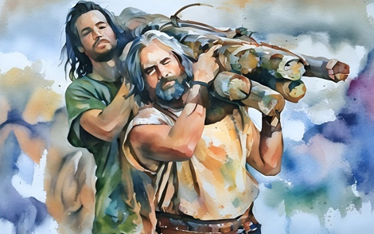
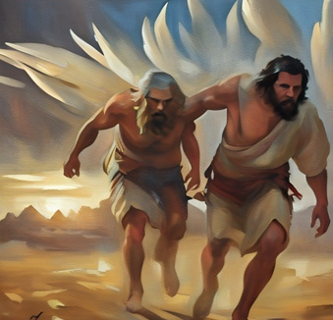
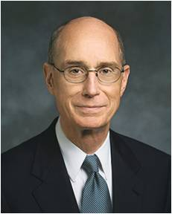
Alma and His People During Afflictions
Mosiah 24:13–15
The voice of the Lord came to them in their afflictions:
Deliver out of bondage
Ease your burdens
Visit in their afflictions
The Follow Up
And now it came to pass that the burdens which were laid upon Alma and his brethren were made light; yea, the Lord did strengthen them that they could bear up their burdens with ease, and they did submit cheerfully and with patience to all the will of the Lord.
Like that servant of Elisha, there are more with you than those you can see opposed to you. Some who are with you will be invisible to your mortal eyes. The Lord will bear you up and will at times do it by calling others to stand with you. (10)
The Lord can help us recognize His blessings and protection in our lives.

Slide 15

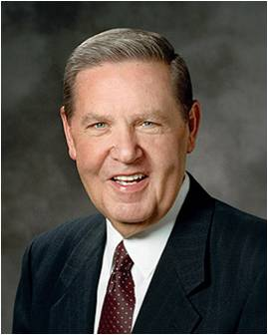
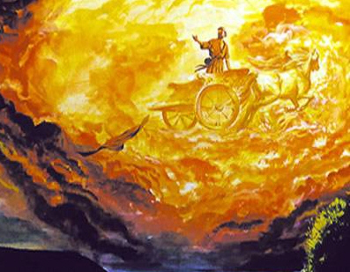
Opening Our Eyes
In the gospel of Jesus Christ you have help from both sides of the veil and you must never forget that.
When disappointment and discouragement strike—and they will—you remember and never forget that if our eyes could be opened, we would see horses and chariots of fire as far as the eye can see riding at reckless speed to come to our protection.
They will always be there, these armies of heaven, in defense of Abraham’s seed. (8)

Slide 16
The Rest of the Story—2 Kings 6:24-13:25
Kings, Rulers and Prophet Elisha |  | 2 Kings
Miracles from Elisha | Second Syrian Attack | 6:24-7:20
Siege of Samaria | Causes famine | 6:24-29
Elisha’s Prophecies |  | 6:30-7:20
Elisha’s Ministry | With Shunammite Woman | 8:1-6
Elisha’s Ministry | With the King of Syria | 8:7-15
The Reign of Judah |  | 8:16-24
The Reign of Ahaziah in Judah—and death | Spiritual evaluation, and political situation under Ahaziah | 8:25-9:29 9:27-29
Battle against Syria |  | 8:28-29
Anointing of Jehu | King over Israel | 9:1-13
Execution of Joram | And Jehu drew a bow with his full strength, and smoteJehoram between his arms, and the arrow went out at his heart, and he sunk down in his chariot | 9:14-26
The Reign of Jehu—and death | Spiritual evaluation, and political situation under Jehu/ and fulfilment of Elisha’s prophecy | 9:30-10:36 9:30-10:28
The Reign of Queen Athaliah in Judah—and death | Salvation of Joash, Overthrow of Athaliah by Jehoiada | 11:1-16
The Reign of Joash in Judah—and death | Revewal of Covenant, Spiritual and poltical situation under Joash | 11:17-12:21
The Reign of Jehoahaz and Jehoash in Israel |  | 13:1-13
Last Prophecies of Elisha—and death | Prophecy of Israel’s Victory, Miracle of Resurrection at Elisha’s Tomb, and Israel’s Victory over Syria | 13:14-25
Elisha led them right into Samaria and their eyes were open
(6)

Slide 17
Sources:
Suggested Hymn: #293 Each Life That Touches Ours for Good
Video: Naaman and Elisha (14:30)
Who’s Who in the Old Testament by Ed J. Pinegar and Richard J. Allen pp. 137-138
President Gordon B. Hinckley (“Everything to Gain—Nothing to Lose,” Ensign, Nov. 1976, 96)
Richard Tice, “Bekahs, Shekels, and Talents: A Look at Biblical References to Money,” Ensign, Aug. 1987, 31
Orson F. Whitney (Journal of Discourses, 26 vols. [London: Latter-day Saints' Book Depot, 1854-1886], 21: 239 - 240)
Thomas S. Monson Consider the Blessings Ensign or Liahona, Nov. 2012
Summary from W. Cleon Skousen’s The Fourth Thousand Years pp. 409-411
Elder Neal A. Maxwell (Ensign, Apr. 1981, 58–59)
Presentation by ©http://fashionsbylynda.com/blog/
8. Elder Jeffrey R. Holland (“For Times of Trouble,” New Era, Oct. 1980, 15)
9. President Dallin H. Oaks (“Small and Simple Things,” Ensign or Liahona, May 2018, 90)
10. President Henry B. Eyring (“O Ye That Embark,” Ensign or Liahona, Nov. 2008, 58)

Slide 18
On doing menial things:
Human nature hasn’t changed over the years. Even today some of us expect to be bidden to do some “great things” in order to receive the blessings of the Lord. When we receive ordinary counsel on ordinary things, there is disappointment, and, like Naaman, we turn away.
Let me give you a modern-day example. President Kimball has been President of the Church for eight years. In virtually every conference sermon he has included at least a sentence telling us to clean up, paint up, and fix up our property. Many of us have paid little attention to the counsel.
Question: Why would a prophet tell us to do that? Has he no great prophecies to utter?
But, is that not a form of prophecy? For has he not said to us over and over again, “Take good care of your material possessions, for the day will come when they will be difficult, if not impossible, to replace.”
Already there is a fulfillment. Families who might have afforded a home when first he spoke now despair of getting one.
For some reason, we expect to hear, particularly in welfare sessions, some ominous great predictions of calamities to come. Instead, we hear quiet counsel on ordinary things which, if followed, will protect us in times of great calamity. Elder Boyd K. Packer (“The Gospel—The Foundation for Our Career,” Ensign, May 1982, 85)
Horses and Chariots:
We are not alone in our mortal struggles. As the prophet Elisha teaches, unseen hosts watch over us. In his day, Syria was at war against Israel, and the prophet Elisha counseled the king of Israel against entrapment. The king of Israel followed that counsel and saved himself again and again. This stirred up the king of Syria, who sent by night “horses, and chariots, and a great host,” and surrounded the city. “And when the servant of the man of God was risen early, and gone forth, behold, an host compassed the city both with horses and chariots. And his servant said unto him, Alas, my master! how shall we do?”
Then the prophet answered, saying, “Fear not: for they that be with us are more than they that be with them.
“And Elisha prayed, and said, Lord, I pray thee, open his eyes, that he may see. And the Lord opened the eyes of the young man; and he saw: and, behold, the mountain was full of horses and chariots of fire round about Elisha.” With the help of the Lord, the prophet Elisha was able to save Israel. President James E. Faust (“Pioneers of the Future: ‘Be Not Afraid, Only Believe,’ ” Ensign, Nov. 1997, 44)
The iron did swim:
When Elisha the Prophet raised the sunken ax from the bottom of the Jordan River, he might have done it in a commonplace way—might have laid aside his robes, taken off his sandals, and plunged in like a diver and brought the ax to the surface. But he knew a better way. Plucking a sprig of green from a bush growing on the bank of the river, he cast it upon the water and commanded the ax to float. "And the iron did swim," says the sacred record. I believe it. The prophet's act was not contrary to law, but in accordance with law, a higher law than the law of gravitation which, had not its operation on that piece of iron been suspended, would have kept the ax at the bottom of the stream until raised by some other process. Orson F. Whitney (Conference Report, October 1928, Second Day—Morning Meeting 64 - 65)

