Slide 1

The Last of the Kings in Judah
2 Kings 21-25
“It shall come to pass, if thou shalt hearken diligently unto the voice of the Lord thy God, to observe and to do all his commandments which I command thee this day, that the Lord thy God will set thee on high above all nations of the earth.”
Deuteronomy 28:1

Slide 2

Previously…
King Hezekiah dies
Manassah’s son, Amon, reigned, at age 22
His mother’s name was Meshullemeth, the daughter of Haruz of Jotbah
He reigned in wickedness for 2 years
His servants conspired against him and slew Amon and made Josiah (Amon’s son) king
He was buried in his sepulchre in the garden of Uzza
Manassah was the only son of Hezekiah and Hepzibah
He reigned in wickedness for 55 years
He was buried in the garden of his own house, in the garden of Uzza
2 Kings 20:21, 2 Kings 21

Slide 3
Josiah
He was the son of Amon and Jedida (the daughter of Adaiah of Boscath) and reigned at 8 years old in Judah for 31 years (640 to 609 BC)
He commissioned Hilkiah, the high priest, to repair and purify the temple
Hilkiah discovered, “the book of law in the house of the Lord”
Josiah was struck with anxiety over the contrast between the wayward conduct of his people and the high standard engendered by the word of God
He consulted a prophetess, Huldah, who confirmed the word of the Lord concerning the judgements of God that will soon fall on the people
The Lord promised Josiah that he would die before the destruction that would befall his kingdom
He had the “book of covenant” read to all the people, then purged the nation of all idolatry, and directed them to turn to the Lord
He died in a military conflict with Egypt leaving his son Jehoahaz to reign
He was the last righteous king of Judah before the Babylonians captured Jerusalem (586 BC)
(1)

Slide 4
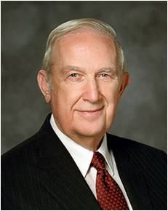



Influences
If we make wicked choices, then our actions can lead others to sin
“Individuals who do wrong want you to join them because they feel more comfortable in what they are doing when others do it also…
“It is natural to want to be accepted by peers, to be part of a group—some even join gangs because of that desire to belong, but they lose their freedom, and some lose their lives….
“You don’t need to compromise your standards to be accepted by good friends….
“You can also help others because they will feel your strength. Let them know about your standards by consistently living them.”
(2)

Slide 5
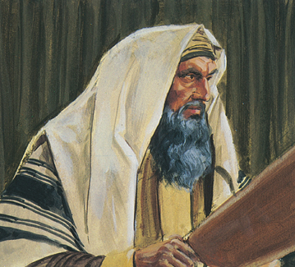
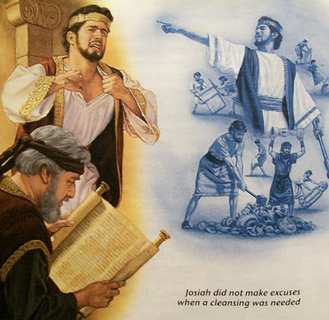
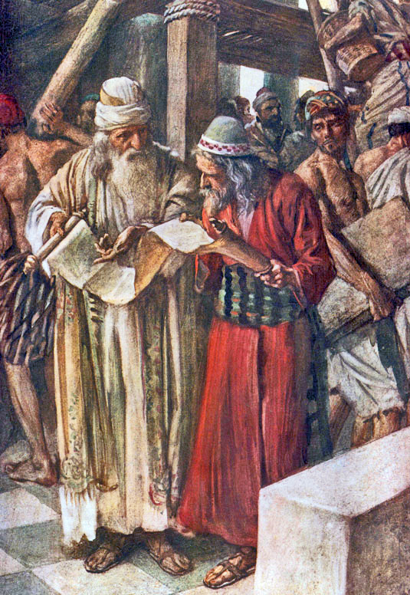
Records Found
Josiah arranged payment for workers to repair the house of the Lord in Jerusalem.
During this repair Hilkiah, the high priest, found a book that had been lost and gave it to Shaphan the scribe and he read it before King Josiah
King Josiah had Hilkiah, Ahikam, the son of Shaphan, Achbor, the son of Michaiah, Shaphan, and Ashahiah, a servant go to the prophetess, Huldah
2 Kings 22:3-15

Slide 6
Huldah
She was a prophetess who consulted King Josiah concerning the discovery of the ‘the book of the law’
She confirmed the impending judgments about to befall the people of Jerusalem because of the idolatry and wickedness
She also prophesied that Josiah would not see the destruction done by Babylon
Besides Hulda, Miriam, and Deborah are also designated in the Old Testament with the title “prophetess”
Huldah was a prophetess in the sense that she had the gift of prophecy. This gift is available to all members of the Lord’s Church.
v
(1)

Slide 7
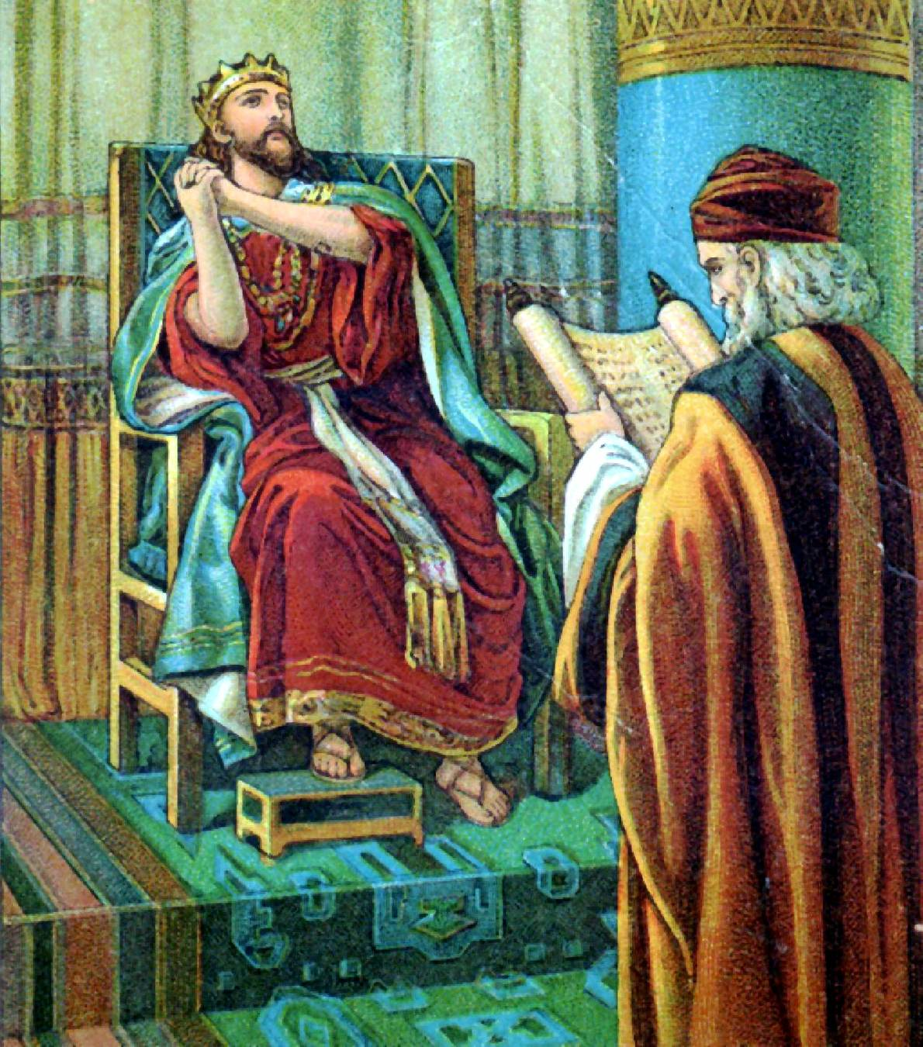
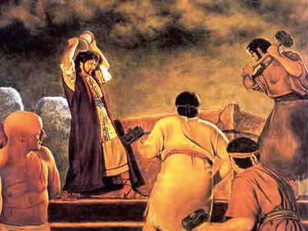
Josiah in Action
All the people promised to live according to the covenant recorded in the book of the law.
And the king stood by a pillar, and made a covenantbefore the Lord, to walk after the Lord, and to keep his commandments and his testimonies and his statutes with all their heart and all their soul, to perform the words of this covenant that were written in this book. And all the people stood to the covenant.
Josiah had the idols brought out of the temple, and from the groves and burnt them in the fields of Kidron and took the ashes to Beth-el.
He ‘defiled Topheth’—the place where they worshiped the fire of Molech.
2 Kings 23:3-14

Slide 8
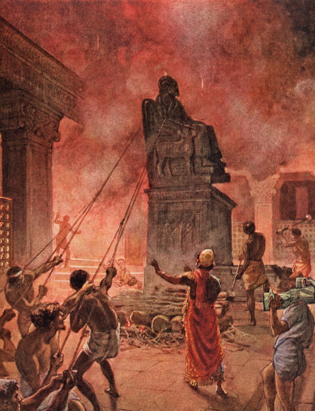
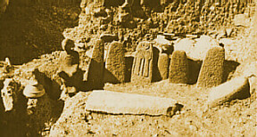
Destruction of Idols in Samaria
Josiah also went to Samaria to the high place which Jeroboam the son of Nebat and destroyed the idols there.
Israel had now no king; and Josiah, of the blood royal of Judah, had certainly a direct right to the kingdom; he had, at this time, an especial commission from God, to reform every abuse through the whole land –
All that ground that was given by the Lord as an inheritance to the twelve sons of Jacob. Therefore he had every right to carry his plans of reformation into the Samaritan states. (3)
2 Kings 23:19

Slide 9


Josiah Put Away Evil Influences
And like unto him was there no king before him, that turned to the Lord with all his heart, and with all his soul, and with all his might, according to all the law of Moses; neither after him arose there any like him.
Studying the scriptures can help us turn to the Lord with all our heart and put away evil influences
2 Kings 23:25

Slide 10
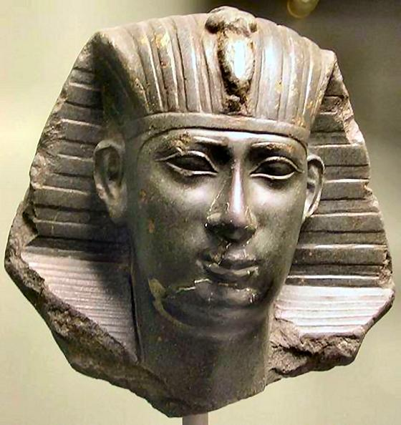
Josiah Dies in Battle
Pharaoh-nechoh king of Egypt went up against the king of Assyria to the river Euphrates: and king Josiah went against him; and he slew him at Megiddo, when he had seen him.
2 Kings 23:29Pharaoh-nechoh king of Egypt went up against the king of Assyria to the river Euphrates: and king Josiah went against him; and he slew him at Megiddo, when he had seen him.

Slide 11
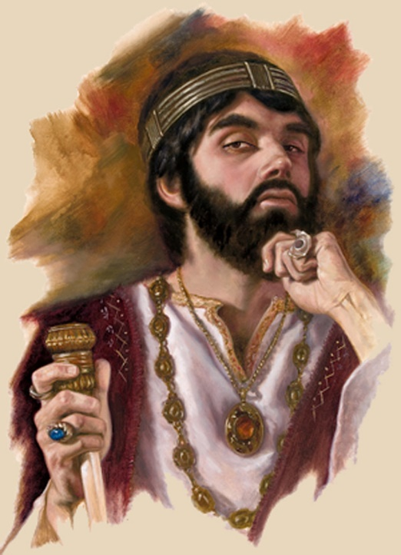
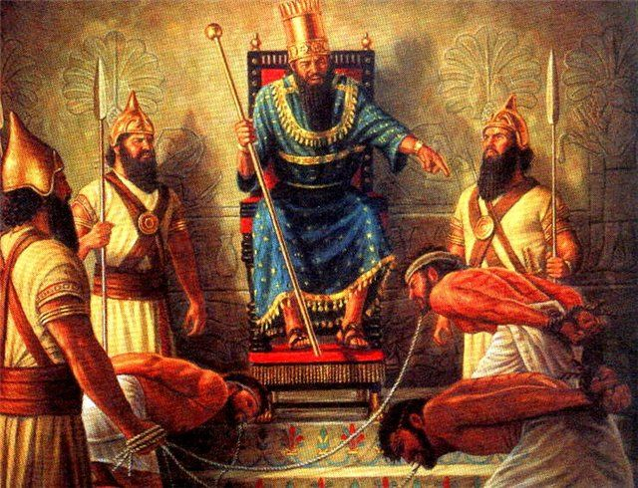
Jehoahaz and Jehoiakim
Leaving a sizable force behind, Necho returned to Egypt. On his return march, he found that the Judeans had selected Jehoahaz to succeed his father Josiah, whom Necho deposed and replaced with Jehoiakim (at age 25).
Necho brought Jehoahaz back to Egypt as his prisoner, where Jehoahaz ended his days (2 Kings 23:31; 2 Chronicles 36:1-4). (4)
Jehoiakim paid tribute to Egypt and placed heavy taxes on the people. He reigned 11 years in wickedness and eventually was carried away as prisoner. (1)
2 Kings 23:29; 24:15

Slide 12
Jehoachin
He was the son of Eliakim/Jehoiakim
He was 8 years old and reigned for 3 months in 598 BC
He was taken away to Babylon by Nebuchadnezzra dn replace by his brother Zedekiah
He was released by the future king, Evil-merodach, of Babylon who treated him in a kindly fashion (Jeremiah 52:31-34)
2 Kings 24:15, 25:27-29
(1)

Slide 13
Zedekiah
He was the son of Josiah, brother of Jehoahaz, half brother of Jehoiakim, making him the uncle to Jehoichin
He was appointed by King Nebuchadnezzar and ‘did that which was evil’
He was the last King of Judah
He was 21 years old when he began to reign and he reigned 11 years in Jerusalem
Nephi informs us that it was during the 1st year of Zedekiah’s rule that Lehi was called to warn the people of Jerusalem about the impending judgments of God about to befall them (2 Nephi 1:4)
He rebelled against Babylon and his reign ended with the Babylonian conquest around 587 BC (Jeremiah 52:10-11)
Gedaliah remained in Jerusalem to govern the remnant… some people were killed and some people fled to Egypt
Zedekiah’s sons perished, but the Book of Mormon makes it clear that his youngest son, Mulek, survived the ordeal and was guided by the Lord to the promised land where he established a colony (Helaman 8:21)
2 Kings 25
(1)

Slide 14
Nebuchadnezzar
He was king of Babylon during 604-561 BC
He besieged Jerusalem and took away many captive to his country, including Zedekiah, King of Judah, and most of his subjects
He burned down all the great houses of the city, including the palace and the temple
In the second year of Nebuchadnezzar’s reign, he dreamed of a stone hewn from the mountain without hands that destroyed a might image in human form
His wise men were powerless to discover the secret of the dream, but Daniel was able to unfold its mystery
2 Kings 23:29; 24
(1)

Slide 15
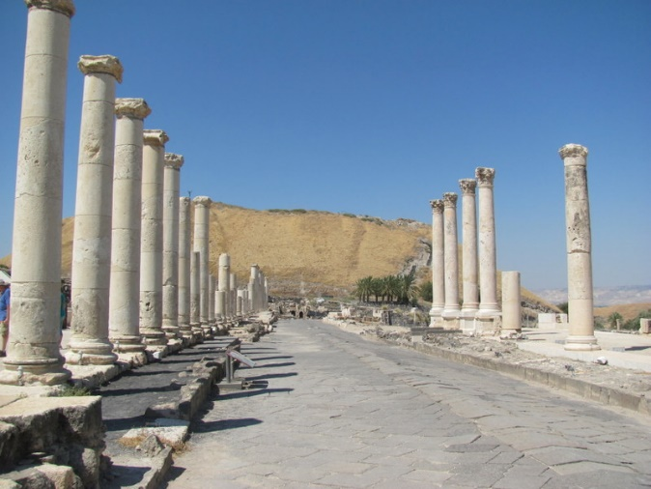
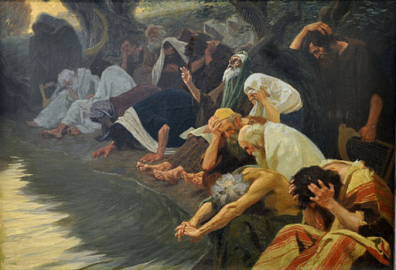
The Lord Withdraws
The Lord said that His purpose for ancient Israel was “to make thee high above all nations … that thou mayest be an holy people unto the Lord.”( Deut. 26:9)
He promised them liberty and prosperity and immunity from the diseases that plagued other nations. He promised them peace and pledged that the sword would not go through their land, and furthermore that their enemies would be afraid to attack them.
On the other hand, the Lord declared that if Israel should refuse to obey Him, He would withdraw His blessings and would send punishments upon them so that they would become the least of the nations; they would be the tail and not the head; they would lose their prosperity and eventually be scattered over the world.
(5)

Slide 16
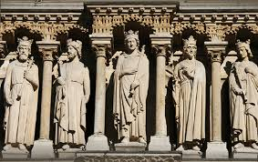
Sources:
Video: Josiah and the Book of Law (12:25)
Eyewitness News At Six; 600 BC (5:13)
Who’s Who in the Old Testament by Ed J. Pinegar and Richard J. Allen pp. 75-76, 86-87, 111-112, 188
2. Elder Richard G. Scott Making the Right Choices October 1994 Gen. Conf.
3. Adam Clark Bible Commentary 2 Kings 23:19
Presentation by ©http://fashionsbylynda.com/blog/
4. Wikipedia
5. Mark E. Petersen The Savor of Men Oct. 1976 Gen. Conf.

Slide 17
Judah—931 BC to 586 BC
Israel—931 BC to 722 BC
Approximate dates
Kings | Year | Years Reigned | Prophets | Kings | Year | Years Reigned | Prophets
Jeroboam | 930-909 BC | 22 | Ahijah, man of God Iddo | Rehoboam | 930-913 BC | 17 | Shemaiah, Iddo
Nadab | 909-908 BC | 2 |  | Abijam/Abijah | 913-910 BC | 3 | Iddo
Baasha | 908-886 BC | 24 | Jehu | Asa | 910-869 BC | 41 | Azariah, Hanani
Elah | 886-895 BC | 2 |  | Jehoshaphat | 872-848 BC | 25 | Jehaziel
Zimri, Tibni, Omri | 885 BC | 7 days, 12 |  | Jehoran | 848-841 BC | 8 | Obadiah ?
Ahab | 874-853 BC | 22 | Elijah, Michaiah | Ahazaih | 841 BC | 1
Ahaziah | 853-852 | 2 | Elijah | Athaliah | 841-835 BC | 6
Jehoram/Joram | 852-841 BC | 12 | Elisha | Jehoash/Joash | 835-796 BC | 40 | Joel
Jehu | 841-814 BC | 28 | Elisha | Amaziah | 796-767 BC | 29 | Joel
Jehoahaz | 814-798 BC | 17 | Elisha | Azariah/Uzziah | 792-740 BC | 52 | Joel, Isaiah
Jehoash/Joash | 798-782 BC | 16 | Elisha Jonah | Jotham | 750-735 BC | 16 | Isaiah, Micah
Jeroboam II | 793-753 BC | 41 | Jonah, Amos, Hosea | Ahaz | 735-715 BC | 16 | Isaiah, Micah
Zechariah | 753 BC | 6 mon | Hosea | Hezekiah | 715-686 BC | 29 | Isaiah, Micah
Shallum | 752 BC | 1 mon | Hosea | Manasseh | 697-642 BC | 55 | Nahum
Menahem | 752-742 BC | 10 | Hosea | Amon | 642-640 BC | 2 | Nahum
Pekahiah | 742-740 BC | 2 | Hosea | Josiah | 640-609 BC | 31 | Naham, Zephaniah, Habakkuk, Jeremiah, Huldah
Pekah | 752-732 BC | 20 | Hosea, Micha | Jehoahaz | 609 BC | 3 mon | Habakkuk, Jeremiah
Hoshea | 732-722 BC | 9 | Hosea, Micha | Jehoiakim | 609-598 BC | 11 | Habakkuk, Jeremiah, Daniel
 |  |  |  | Jehoiachin | 598 BC | 3 mon | Jeremiah, Daniel
 |  |  |  | Zedekiah | 597-586 BC | 11 | Jeremiah, Ezekiel, Daniel
http://gen2revarg.com/gentorevkingsandprophets.html
Red indicates Righteous Kings
Mark Barry—the kings of Judah and Israel

Slide 18
Manasseh (686–642 B.C.). see 2 Kings 21:1–18;2 Chronicles 33:1–20.
Son of Hezekiah. Ruled jointly with his father for eleven years because of his father’s illness and to prepare himself to govern the people. Continued Judah’s tributary status with Assyria. Rebuilt all the idolatrous places his father had destroyed. Placed idols in the temple in Jerusalem and offered his children in human sacrifice. Was responsible for the shedding of much innocent blood.
Numerous prophets labored with this wicked king to no avail, and he killed several of them. Tradition says he martyred Isaiah. The Assyrians took Manasseh hostage for a time. Upon his return he restored the temple and repaired the city walls.
Old Testament Institute Manual
The Divided Kingdoms
Nebuchadnezzar II, sometimes alternately spelled Nebuchadrezzar, was king of Babylonia from approximately 605 BC until approximately 562 BC. He is considered the greatest king of the Babylonian Empire and is credited with the construction of the Hanging Gardens of Babylon. Nebuchadnezzar is mentioned by name around 90 times in the Bible, in both the historical and prophetic literature of the Hebrew Scriptures. Nebuchadnezzar receives the most attention in the book of Daniel, appearing as the main character, beside Daniel, in chapters 1–4.
In biblical history, Nebuchadnezzar is most famous for the conquering of Judah and the destruction of Judah and Jerusalem in 586 BC. Judah had become a tribute state to Babylon in 605 BC but rebelled in 597 BC during the reign of Jehoiachin and then again in 588 BC during the reign of Zedekiah. Tired of the rebellions, and seeing that Judah had not learned its lesson when he invaded, conquered, and deported Judah in 597, Nebuchadnezzar and his general, Nebuzaradan, proceeded to completely destroy the temple and most of Jerusalem, deporting most of the remaining residents to Babylon. In this, Nebuchadnezzar served as God’s instrument of judgment on Judah for its idolatry, unfaithfulness, and disobedience (Jeremiah 25:9).
Amon (642–640 B.C.). see 2 Kings 21:19–26; 2 Chronicles 33:21–24.
Son of Manasseh. Turned to all the wicked practices of his father and was assassinated by his own servants.
It was probably during this time that Nahum prophesied.
Old Testament Institute Manual
The Divided Kingdoms
The Lost Books:
Most scholars agree that the book of the law discovered in the temple was some form of the book of Deuteronomy. The book of Deuteronomy, particularly chapter 13, strongly condemns idolatry and most likely led to Josiah’s efforts to end the practice within Judah and restore worship of the true God. “Some scholars also believe that an early version of the books of Joshua–Kings … was compiled in conjunction with this reform to reinforce Josiah’s measures” (Oxford Companion to the Bible[1993], 388).

Slide 19
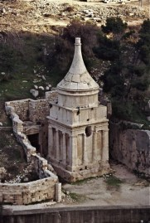
Zedekiah/Mattaniah (597–587 B.C.). see 2 Kings 24:18 through 25:26; 2 Chronicles 36:11–21.
Brother of Jehoahaz and half brother of Eliakim/Jehoiakim. Established as king by the Babylonians, who changed his name to Zedekiah. Showed loyalty at first to Babylonia, but later rebelled at the encouragement of those who preferred an alliance with Egypt. Nebuchadnezzar finally sent his forces against Judah, destroying the temples, palaces, and city proper of Jerusalem. Most of the people were then exiled to Babylon, and the kingdom of Judah became only a memory. During the first year of Zedekiah’s reign Lehi prophesied and was then told to flee from Jerusalem (see 1 Nephi 1:4, 2:2). During the terrible times at the end of his reign, Zedekiah imprisoned Jeremiah for prophesying of the impending destruction of Judah.
The fall of Judah and the exile in Babylon began another era in the history of the Lord’s people.
The Old Testament Institute Manual The Divided Kingdoms
The central point of reference for the Kidron Valley is its confluence of Jerusalem’s richest concentration of rock-hewn tombs
The traditional association with Absalom — who died centuries before it was built — is because this rebellious son of King David erected for himself a memorial pillar in the King’s Valley (2 Samuel 18:18).
This valley was one of the main burial grounds of Jerusalem in the Second Temple Period. Several of these tombs were also used later in time, either as burial or as shelters for hermits and monks of the large monastic communities, which inhabited the Kidron Valley
The Pillar of Absalom in the Kidron Valley
In the time of Jesus, these monuments would have been whitewashed. Perhaps they inspired his outburst: “Woe to you, scribes and Pharisees, hypocrites! For you are like whitewashed tombs, which on the outside look beautiful, but inside they are full of the bones of the dead and of all kinds of filth.” (Matthew 23:27)
St. Jerome says that Topheth was a fine and pleasant place, well watered with fountains, and adorned with gardens. The valley of the son of Hinnom, or Gehenna, was in one part; here it appears the sacred rites of Molech were performed, and to this all the filth of the city was carried, and perpetual fires were kept up in order to consume it…It is here said that Josiah defiled this place that no man might make his son or his daughter to pass through the fire (Adam Clarke Bible Commentary)
Molech (Moloch) worship:
From the fact that I Kings 11: 7 calls Molech the "abomination of the children of Ammon“
Moloch had associations with a particular kind of propitiatory child sacrifice by parents. Moloch figures in the Book of Deuteronomy and in the Book of Leviticus as a forbidden form of idolatry (Leviticus 18:21: "And thou shalt not let any of thy seeds (children) pass through the fire to Moloch"). In the Old Testament, Gehenna was a valley by Jerusalem, where followers of various Baalim and Canaanite gods, including Moloch, sacrificed their children by fire (2 Chr. 28:3, 33:6; Jer. 7:31, 19:2–6). Jewish Bible and Wikipedia
The Hebrew Bible calls the Valley "Valley of Jehoshaphat - Emek Yehoshafat" (Hebrew: עמק יהושפט‎), meaning "The valley where Yahweh shall judge." In the times of the Old Testament kings, the Kidron Valley was identified with, at least in part, the King’s Garden; the kings owned land in the area
Kidron Valley—a famous sight
After the prayer, Jesus and his disciples left the upper room and walked across the Kidron Valley to the Garden of Gethsemane on the Mount of Olives.
Fields of Kidron:
And the whole valley of the dead bodies, and of the ashes, and all the fields unto the brook of Kidron, unto the corner of the horse gate toward the east, shall be holy unto the LORD; it shall not be plucked up, nor thrown down any more for ever. Jeremiah 31:40
A hill east of the Kidron valley, east of Jerusalem. On its western slopes, near the bottom, is the garden of Gethsemane. Bethphage and Bethany are located on the top and east slope. This mount was the place of many biblical events (Matt. 24:3) and will also be an important place in events of the latter days

Slide 20
Josiah:
Josiah had four sons: Johanan, and Eliakim (born c. 634 BCE) by Zebudah the daughter of Pedaiah of Rumah; (Eliakim had his name changed by Pharaoh Necho of Egypt to Jehoiakim 2 Kings 23:34) and Mattanyahu (c. 618 BCE) and Shallum (633/632 BCE) both by Hamutl, the daughter of Jeremiah of Libnah.
Shallum succeeded Josiah as king of Judah, under the name Jehoahaz.
Shallum was succeeded by Eliakim, under the name Jehoiakim, who was succeeded by his own son Jeconiah;
then Jeconiah was succeeded to the throne by Mattanyahu, under the name Zedekiah.
Zedekiah was the last king of Judah before the kingdom was conquered by Babylon and the people exiled.
Pedaiah of Rumah
Jeremiah of Libnah
There are two accounts of Josiah's death in the Bible. The Books of Kings merely state that Necho II met Josiah at Megiddo and killed him (2 Kings 23:29). The Book of Chronicles (2 Chronicles 35:20–27) gives a lengthier account and states that Josiah was fatally wounded by Egyptian archers and was brought back to Jerusalem to die. His death was a result of "not listen[ing] to what Necho had said at God's command..." when Necho stated: "What quarrel is there between you and me, O king of Judah? It is not you I am attacking at this time, but the house with which I am at war. God has told me to hurry; so stop opposing God, who is with me, or he will destroy you." (NIV)
Josiah did not heed this warning and by both accounts his death was caused by meeting Necho at Megiddo. All Judah and Jerusalem mourned for Josiah. According to 2 Chronicles 35:25, Jeremiah wrote a lament for Josiah's passing.
Wikipedia
Zebudah
Josiah
Hamutl
Johanan
Mattaniah/ Zedekiah
?
Eliakim/
Jehoiakim
Shallum/ Jehoahaz
Jeconiah/
Jehoiachin

Slide 21
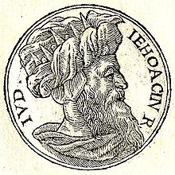
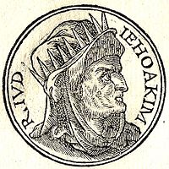
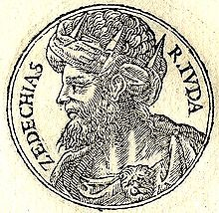
Jehoahaz (609 B.C.). see 2 Kings 23:31–33; 2 Chronicles 36:1–4.
Son of Josiah. Reigned only three months. Removed from office and exiled to Egypt where he later died. His half brother was made the new ruler.
Jehoiachin (597 B.C.). see 2 Kings 24:8–17; 2 Chronicles 36:9–10.
Son of Eliakim/Jehoiakim. Continued to resist the Babylonians but surrendered within months of his ascension. Went to Babylon as a hostage together with political and religious leaders, skilled craftsmen, and educated people, as well as the treasure of the temple. Among those exiled were many of the Levites. Ezekiel was a part of this group. This was the first major deportation of Judah into Babylon.
Eliakim/Jehoiakim (609–597 B.C.). see 2 Kings 23:34–24:7; 2 Chronicles 36:5–8.
Son of Josiah. Chosen by the Egyptians to replace his half brother as king. Was forced to change his name to Jehoiakim and pay tribute to Egypt. Taxed the people very heavily to fulfill this obligation. Was attacked by the Syrians, Moabites, and Ammonites. Was as wicked as Manasseh, his great-grandfather, and was responsible for the shedding of much innocent blood. Became a vassal of Nebuchadnezzar in 605 B.C. when the Babylonians defeated the Egyptians. Gave the vessels from the temple as tribute to the conquering Babylonians, and sent a group of royal and noble families as exiles to the master nation. (Daniel was among that group.) Rebelled against Babylonia after three years of vassalage, and was taken captive by the Babylonians. Apparently killed while on his way to Babylon
Zedekiah/Mattaniah (597–587 B.C.). see 2 Kings 24:18 through 25:26; 2 Chronicles 36:11–21.
Brother of Jehoahaz and half brother of Eliakim/Jehoiakim. Established as king by the Babylonians, who changed his name to Zedekiah. Showed loyalty at first to Babylonia, but later rebelled at the encouragement of those who preferred an alliance with Egypt. Nebuchadnezzar finally sent his forces against Judah, destroying the temples, palaces, and city proper of Jerusalem. Most of the people were then exiled to Babylon, and the kingdom of Judah became only a memory. During the first year of Zedekiah’s reign Lehi prophesied and was then told to flee from Jerusalem (see 1 Nephi 1:4, 2:2). During the terrible times at the end of his reign, Zedekiah imprisoned Jeremiah for prophesying of the impending destruction of Judah.
Old Testament Institute Manual
The Divided Kingdom

