Slide 1
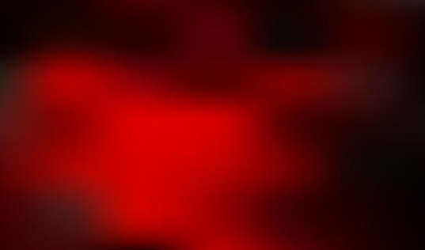
“Thy Word Is a Lamp unto My Feet, and a Light unto My Path”
Psalm 119

Slide 2

Hebrew Letters in Psalm 119
Psalm 119 is divided into eight-verse sections.
This psalm is “an acrostic poem with eight verses for each of the twenty-two letters of the Hebrew alphabet. …
One Hebrew letter and its name appears above each eight-verse segment.
Each eight-verse segment of the psalm begins with its corresponding letter of the Hebrew alphabet.
(2)

Slide 3
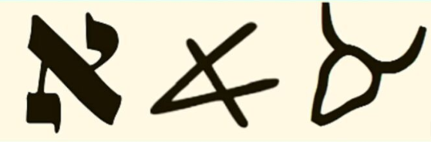
Blessed Are They Who Keep the Commandments.
Psalm 1-8
The first letter of the Hebrew alphabet, a silent letter in modern Hebrew that can also represent a glottal stop.
Its ancient origins lie in an ox-head pictograph representing strength and leadership, and it is a foundational concept in Hebrew, with symbolic and spiritual meanings including "master," "God," and a numerical value of 1. It is the ancestor of the Greek letter alpha (A) and the Latin A used in English.
א Aleph
Strength
Power
Authority
Leader of Humbleness
Being Yoked to Headship

Slide 4

Ponder the precepts and ways of the Lord.
Psalm 9-16
the second letter of the Hebrew alphabet, representing the sound "B" or "V". It also signifies the number two, has the meaning of "house" or "tent," and is a common prefix meaning "in" or "at". The letter is found in many Hebrew names like Bethlehem (house of bread) and Bethel (house of God).
ב Beth
House/Tent: The most common meaning is "house" or "tent," derived from its ancient pictograph.

Slide 5
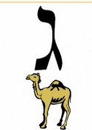
O Lord, open our eyes, that we may behold wondrous things out of Thy law. Psalm 17-24
ג Gimel
The third letter of the Hebrew alphabet, which represents the sound of a hard "g" and has a numerical value of three
"camel" (gamal) and symbolically represents a benefactor or someone who gives, similar to how a camel sustains life in the desert.
It can also be interpreted as a "foot," symbolizing "to walk," "to gather," or "to move".
And again I say unto you, It is easier for a camel to go through the eye of a needle, than for a rich man to enter into the kingdom of God. Matthew 19:24
The phrase "eye of a needle" in Hebrew and related Aramaic/Jewish contexts is primarily used as a metaphor for an impossibility or extreme difficulty

Slide 6
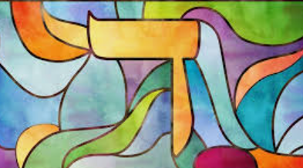
O Lord, grant us Thy law, and make us to understand Thy precepts.
Psalm 25-32
fourth letter of the Hebrew alphabet.
It has a numerical value of four and its name is derived from the Hebrew word for "door" (deleth). Symbolically, it can represent concepts like pathways, transitions, and opportunities.
ד Daleth
The door represents entry and exit points, symbolizing transitions, choices, and opportunities in both physical and spiritual life
The Daleth section of Psalm 119 (verses 25-32) focuses on themes of spiritual renewal, clinging to God's word, and the transition from despair ("my soul cleaves to the dust") to a determined choice to follow God's truth

Slide 7
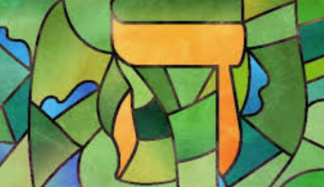
O Lord, teach us Thy statutes, Thy law, and Thy commandments. Psalm 33-40
ה He
The fifth letter of the Hebrew alphabet, with a numerical value of 5.
When used as a suffix at the end of a word (the directional he), it indicates movement towards that person or thing (e.g., towards home, towards the sea).
The ancient pictograph for the letter was a man with his arms raised, and the word "hey" is often translated as "behold", "look", or "breath", symbolizing revelation or a sigh of wonder. The letter ה also holds significant spiritual meaning in Jewish tradition, appearing twice in the Tetragrammaton, the four-letter Hebrew name of God (YHWH)

Slide 8
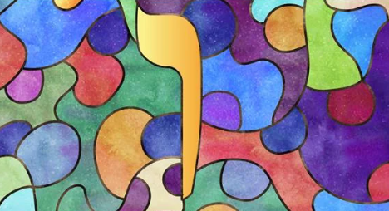
O Lord, give us mercy, truth, and salvation.
Psalm 41-48
The sixth letter of the Hebrew alphabet.
The original meaning of the word "vav" in Hebrew is a "hook" or "tent peg".
ו Vau
A link between the spiritual and earthly realms.
A connector between the first and second halves of the Torah.
Representing the power to add or secure something.
In Kabbalistic traditions, it is seen as the link between the active and passive principles of the divine name (Yod-He-Vau-He)

Slide 9
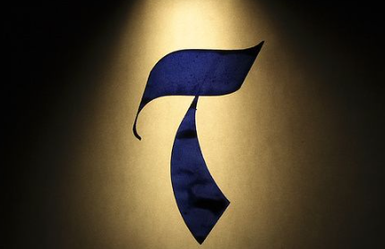
The Lord’s statutes and judgments comfort us during our pilgrimage..Psalm 49-56
The seventh letter of the Hebrew alphabet.
ז Zain
Scepter/Crown: The shape can also be seen as a scepter, symbolizing royal authority and majesty.
Sustain/Nourish: The verb yazan, meaning to feed, is derived from the same root as Zayin, associating it with food and sustenance.
Perfection/Completion: The number 7 holds significant spiritual meaning in the Bible, often representing spiritual perfection and the completion of a covenant (such as the Sabbath, the seventh day)

Slide 10
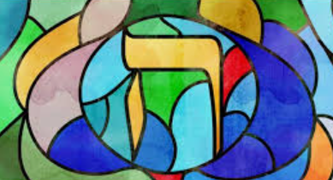
Make faithful people our companions.
Psalm 57-64
The eighth letter of the Hebrew alphabet.
The ancient form of Cheth was a picture of a tent wall or fence, symbolizing protection, separation, or a partition
ח Cheth
symbolic meanings related to life, new beginnings, grace, and connection.
The number eight is often associated with a new cycle, going beyond the natural order of seven (the days of the week). Examples include the eight people saved in Noah's Ark and the brit milah (circumcision) on the eighth day

Slide 11
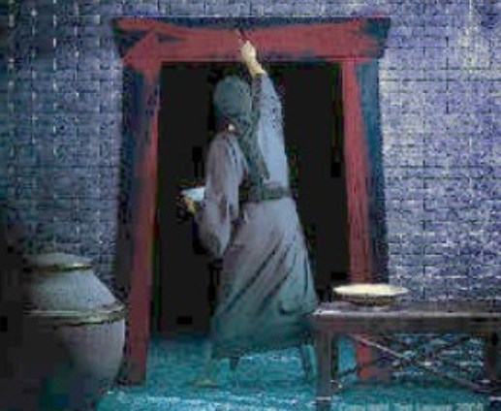
Symbol Over the Door
ח Cheth
In Exodus 12 we see the instructions that were given to the Israelites:
“Then Moses called all the elders of Israel and said to them, “Go and select lambs for yourselves according to your clans, and kill the Passover lamb. Take a bunch of hyssop and dip it in the blood that is in the basin, and touch the lintel and the two doorposts with the blood that is in the basin. None of you shall go out of the door of his house until the morning. For the Lord will pass through to strike the Egyptians, and when he sees the blood on the lintel and on the two doorposts, the Lord will pass over the door and will not allow the destroyer to enter your houses to strike you.”
There are three letters in the Hebrew alphabet that resemble this blood-splattered, the hey, the chet, and the tav.
See Notes

Slide 12

Oh Lord, Teach us Thy statutes Psalm 65-72
The ninth letter of the Hebrew alphabet.
It is used to represent the number nine and the word for "good" (tov)
ט Teth
The letter also has symbolic meanings, such as truth, eternity, and representing a staff or the concept of good works in the Bible
Truth and eternity: Some interpretations link the letter to the concepts of truth and eternity.
Staff: It is the central consonant in the Hebrew word for "staff" (mateh), a symbol of the tribes of Israel.
Purity: The words for "pure" (tahir) and "impure" (tamah) both begin with the letter Teth.

Slide 13
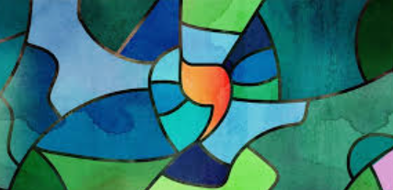
O Lord, let Thy tender mercies come upon us.
Psalm 73-80
The tenth letter in the Hebrew alphabet.
It is the smallest letter in the Hebrew alphabet and is often described as a mere dot or a divine point of energy in mystical traditions.
י Jod
Its name, Yodh, is related to the Hebrew word yad, meaning "hand" or "arm.
In Jewish mysticism, the Yod is the "atom" from which all other letters and, by extension, all of creation, begin. It is the first letter of the divine name (the Tetragrammaton) and appears twice within it.
Humility and Wisdom: Its small size is often interpreted as a symbol of humility and wisdom, reflecting the idea that true wisdom is a rare and modest quality.
Biblical Reference: Jesus is thought to have referred to this letter in Matthew 5:18 when he said that not one "jot" (jod) or "tittle" would pass from the Law until all is fulfilled, emphasizing the eternal nature and precision of God's commandments.

Slide 14

All the Lord’s commandments are faithful.
Psalm 81-88
The eleventh letter of the Hebrew alphabet. Transliterated as Kaph (or Kaf, Caph)
The word "kaph" literally means "palm of the hand" or "sole of the foot".
The ancient form of the letter was a pictograph of an open, three-fingered hand. kaf or spoon symbolizes the Torah that was given from the hand of God.
כ Caph
Bending/Bowing: The bent shape of the hand or a bent cylinder suggests humility, submission, or bowing down.
Containing/Carrying: As the palm of a hand can hold things, the letter represents a vessel or a container, implying the ability to carry or receive.
Likeness/As: When used as a prefix (כְּ◌), it often means "like something" or "as something"

Slide 15
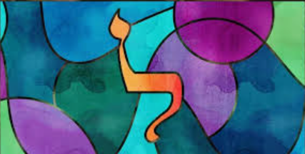
O Lord, save us, for we have sought Thy precepts. Psalm 89-96
The twelfth letter of the Hebrew alphabet. Numerical value of 30.
ל Lamed
Lamed is unique as the only letter in the Hebrew alphabet that rises above the top line, which is often interpreted spiritually to represent soaring aspirations, royalty, or the "King of Kings“
Meaning: To Learn/Teach: The name lamed comes from the Hebrew words limudim (studies) or melamed (teacher), signifying learning and teaching.
Pictograph Origin: The ancient pictograph for Lamed was a shepherd's staff or cattle goad (malmad habakar), a tool used to direct or "teach" animals which way to go. This symbol represents authority, direction, and guidance.
Central Position: Situated in the exact center of the 22-letter Hebrew alphabet, it is associated with the lev (heart), as learning is a matter of the heart.

Slide 16
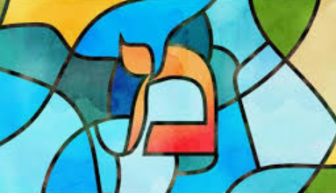
The Lord’s law and His testimonies should be our meditation all the day. Psalm 97-104
מ Mem
The thirteenth letter of the Hebrew alphabet. Numerical value of 40.
Its ancient form resembled waves, and the name is thought to derive from the Hebrew word for water, mayim
There are two forms of the mem: the open mem and the closed mem. As the Talmud explains,¹ the open mem represents the revealed Torah and the closed mem represents the Torah’s secrets.
Resembles waves of waters: Its strong assoctiation with water connects to themes of life, purification and the divine.
Symbolizes foundation events: 40 days and years, such as the flood, Moses’ time on Mount Sinai, and the Israelites wandering the the desert. Jesus’ time of praying.
Symbol of transformation

Slide 17
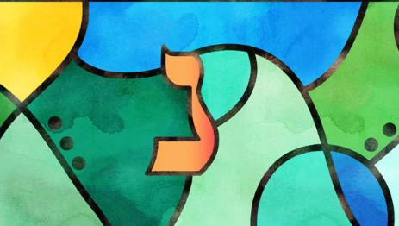
The Lord’s word is a lamp unto our feet.
Psalm 105-112
נ Nun
The fourteenth letter of the Hebrew alphabet. Numerical value of 50.
The name nun means “fish” in Arabic.
Its ancient pictograph was a picture of a sprouting seed,
Continuity and Offspring: The seed continues the plant for the next generation.
Faithfulness and Humility: The bent shape of the letter in its classical form is sometimes seen as representing a bent, humble stature.
Giving: In the Hebrew word natan (נָתַן), meaning "gave", the letter Nun appears at the beginning and end, symbolizing the reciprocal nature of giving.
sAsociated with the name is Joshua, the son of Nun, who led the Israelites into the Promised Land after Moses

Slide 18
Scriptures are like ______ because __________
The Word of God is like ______ because __________

Slide 19
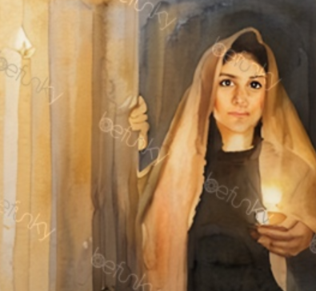
The Word of God
Thy word is a lamp unto my feet, and a light unto my path.
As we study the word of God, He blesses us with guidance.

Slide 20

Walking in the Light VS
Every child of Heavenly Father born in the world is given at birth, as a free gift, the Light of Christ.
You have felt that. It is the sense of what is right and what is wrong and what is true and what is false.
That has been with you since your journey in life began.
The fact that you were baptized and received the Holy Ghost is evidence that you chose to walk in the Light of Christ. (1)
Wherefore, I beseech of you, brethren, that ye should search diligently in the light of Christ that ye may know good from evil; and if ye will lay hold upon every good thing, and condemn it not, ye certainly will be a child of Christ. Moroni 7:19

Slide 21
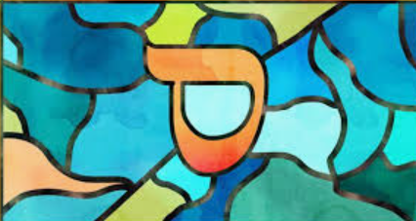
Depart from evildoers and keep the commandments of God. Psalm 113-120
ס Samech
The fifteenth letter of the Hebrew alphabet. Numerical value 60.
Modern Hebrew meaning “around”.
The root of the word "Samekh" means "to uphold, support, or lean on".
Its circular shape can symbolize encompassing protection and completeness.
It is often associated with divine support, protection, and God's presence.
Original pictograph is thought to have been a thorn bush.
Notes:
3-120

Slide 22
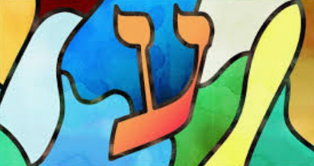
O Lord, we are Thy servants; give us understanding.
Psalm 121-128
ע Ain
The sixteenth letter of the Hebrew alphabet with a numerical value of 60
Physical Eye: Literally, "Ayin" means the organ of sight. In broader contexts, the word is used metaphorically to describe perception, knowledge, providence, and deeper aspects of a person's character, such as an "ayin tov" (a good eye, meaning generosity) or "ayin ra" (an evil eye, meaning jealousy).
Water Spring: The word "Ayin" is also used to describe a natural water spring or source. In the Bible, many places are named after springs, such as Ein Gedi.
The letter represents both physical and spiritual sight, symbolizing the ability to see beyond mere outward appearances.

Slide 23
The Lord’s Law is the Truth
Psalm 137-144
The eighteenth letter of the Hebrew alphabet with a numerical value of 90.
צ Tzaddi
The Hebrew word for a "righteous person" or "just individual" (צדיק) begins with this letter, so it is strongly associated with concepts of justice and righteousness.
Humility: The traditional form of the letter (composed of a bent Nun and a Yud at its top) is sometimes interpreted as a symbol of a righteous person humbly bent before the divine.
Hunting/Fishing: The literal meaning of the letter's name, Tzadi, is "fish hook" or "hunting," representing the pursuit of holiness or the ability to "hunt" and elevate sparks of divinity within the world.

Slide 24
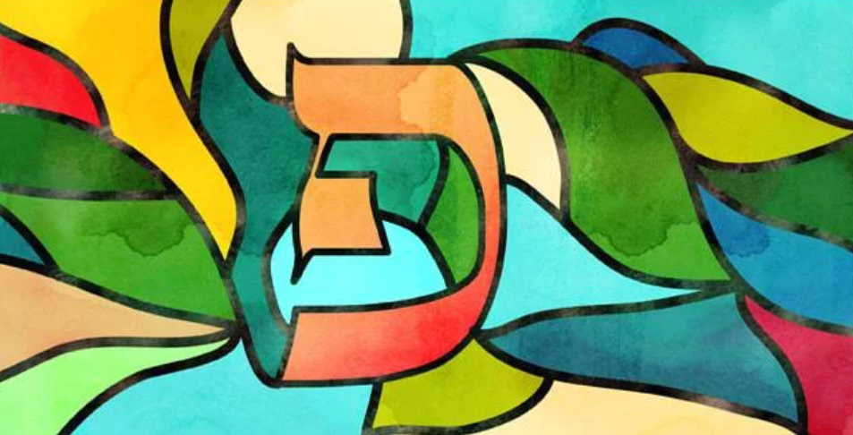
The Lord’s testimonies are wonderful
Psalm 129-136
פ Pe
The seventeenth letter of the Hebrew alphabet with a numerical value of 80.
The letter is associated with the mouth and speech, representing the power of words, both to build and to destroy.

Slide 25
Sources:
Video:
“The Blessings of Scripture” from time code 0:00 to 1:55.
Henry B. Erying “Walk in the Light” April 2008 Gen. Conf.
Ellis T. Rasmussen, A Latter-day Saint Commentary on the Old Testament [1993], 455.
Presentation by http://fashionsbylynda.com/blog/

Slide 26
Helpful articles on the Hebrew alphabet
https://www.chabad.org/library/article_cdo/aid/137085/jewish/Mem.htm
https://tanyaremkiv.com/2021/03/26/psalm-11981-88-kaph/

Slide 27
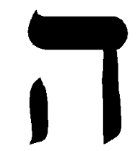
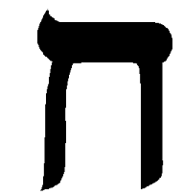
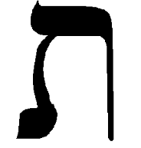
The hey, symbolizes breath and revelation, it is also associated with the indwelling of the Holy Spirit. Interestingly, it comes after the letter dalet, which symbolizes a door or entrance, but is also a symbol of an impoverished, sinful man. The symbol for hey is basically a dalet with an added stroke. This stroke is said to represent the breath of God. When we open the door of our heart and accept Christ’s blood sacrifice for our sin, the breath of God, the Ruach HaKodesh, indwells in us and marks us as His own. The curse of death passes over all those who are marked by His Spirit! The numeric value of the hey is 5. Five is the number that symbolizes grace – by grace we have been saved!
The next letter is the chet. The chet is a symbol of a wall or fence and signifies separation. It is also associated with a Jewish wedding canopy, a chupa, as well as life, chayim. When we accept the free gift of salvation, we are entering into a blood covenant with Christ. We are His Bride and He is our Bridegroom. He calls us out, desires for us to be devoted to Him and separate ourselves from the world. He promises us life – not only new life in Christ, but also eternal life! The numeric value of chet is 8. Eight is the number that represents eternity, new life and new beginnings. Christ’s blood frees us from the bondage of our sin and delivers us into new life and the promise of eternity with Him!
The third letter, and final letter of the alephbet is the tav. The original pictograph for the tav was a cross – it’s origin is thousands of years before the Romans began using crucifixion as a form of death penalty! The tav means mark, covenant, or sign. Jesus’ blood shed on the cross was the ultimate and final atonement for sin. The painting of the doorposts was a foreshadowing, a dress rehearsal for the all-consuming sacrifice of our Passover Lamb. As He gave up His spirit, Christ declared “It is finished.” It’s fascinating that the final letter of the Hebrew alphabet is the tav, as it signifies Christ’s completed, finished work through the covenant of His blood! The numeric value of tav is 400. This number symbolizes a divinely appointed period of time. Interestingly, we read in Exodus that exactly 400 years had passed from the time the Hebrews were enslaved in Egypt to the day of their deliverance which came because of Passover. In addition, 400 years passed between the last recorded word of the Old Testament and Christ’s death on the cross on Passover. WOW!
The Hebrew word for Passover is Pesach. Theses 3 letters together (pey, samech, chet) create the message “the source of protection and separation.” God protected His people from the plague of death and surrounded them with His divine protection, and separated and drew them out to be His chosen people. Jesus, our Passover Lamb, is the source of our victory, thus protection from the curse of death, and He has called us to separate ourselves from the world and to be holy as He is holy!

