Slide 1

David and Goliath
1 Samuel 17
And his name through faith in his name hath made this man strong, whom ye see and know: yea, the faith which is by him hath given him this perfect soundness in the presence of you all.
Acts 3:16

Slide 2

Valley of Elah
The Philistines gathered on one side of a mountain while the Israelites gathered on the other side
Mt. Carmel
Mt. Tabor
Mt. Gilboa
Jerusalem
Mt. Nebo
Bethlehem
Azekah
David’s battle with Goliath occurred near Azekah in the Shephelah or low-lying hills.
1 Samuel 17:1-3

Slide 3
Champion
“Our word champion comes from campus, the field; … ‘Champion is he, properly, who fights in the field; i.e., in camps.’
A man well skilled in arms, strong, brave, and patriotic.
“But is this the meaning of the original … ish habbenayim, a middleman, the man between two;
that is, as here,
the man who undertakes to settle the disputes between two armies or nations.
So, our ancient champions settled disputes between contending parties by what was termed camp fight; hence the campio or champion.”
1 Samuel 17:4
(2)

Slide 4
Goliath
He was from Gath and a Philistine giant
He was about 9.9 feet (3 Meters) tall and struck fear into the hearts of Saul’s warriors
He was armed with a brass helmet, a coat of mail, greaves of brass upon his legs, a shield, brass between his shoulders and his spear was “like a weaver’s beam”
He challenged the Israelites for 40 days
He entered into a one-on-one battle with David while the two armies watched from opposing mountain slopes
He was hit by stones slung by David and died. David took the head of Goliath and presented it to Saul
Goliath’s sword became a legendary icon of the victory of good over evil
The sword was preserved as a religious trophy at the city of Nob and David later retrieved it when, during his flight before Saul
1 Samuel 17:4-11
(1)

Slide 5
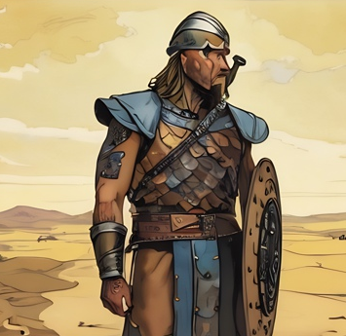
Goliath’s Challenge
The Israelites could hear him for 40 days:
Why are ye come out to set your battle in array? am not I a Philistine, and ye servants to Saul? choose you a man for you and let him come down to me.
If he be able to fight with me, and to kill me, then will we be your servants: but if I prevail against him, and kill him, then shall ye be our servants, and serve us.
And the Philistine said, I defy the armies of Israel this day; give me a man, that we may fight together.
1 Samuel: 17:8-10
(3)

Slide 6
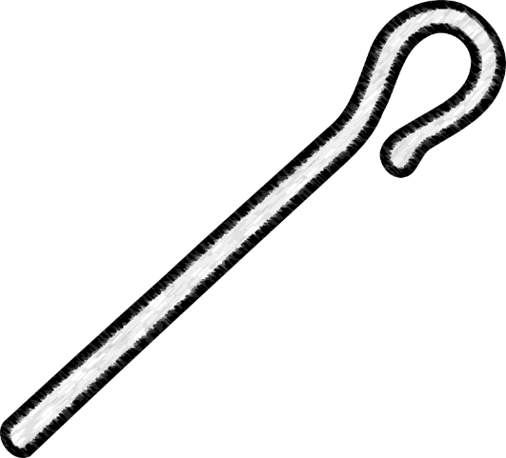
David’s Brothers
Obedience
Eliab the firstborn, and next unto him Abinadab, and the third Shammah were with Saul on the battlefield.
David was at home tending his father’s sheep.
David’s father gave him food to take to his brothers, who were soldiers in the army of Israel, with instructions to see how they were doing at the battlefront.
1 Samuel 17:12-18

Slide 7
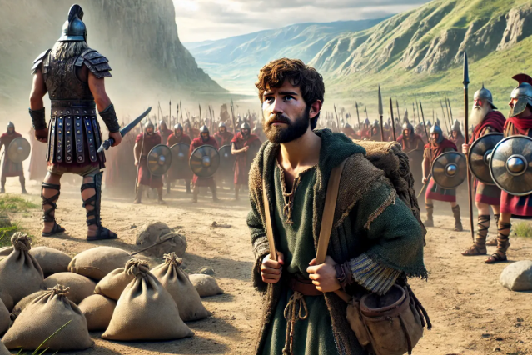
David Volunteers
Perseverance
David’s oldest brother, Eliab, was angry and questioned David’s intentions when he heard how David reacted to Goliath’s challenge.
Despite his brother’s anger, David continued to tell the Israelites that they should not be afraid of Goliath.
Some of the soldiers told King Saul what David said, and the king asked to see him.
1 Samuel 17:27-31

Slide 8
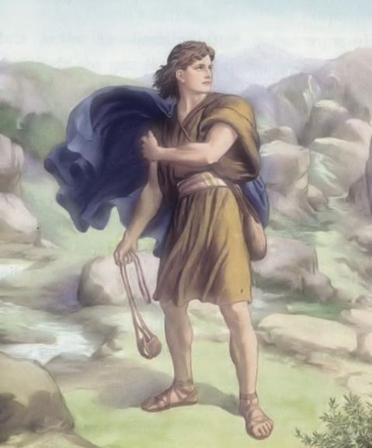
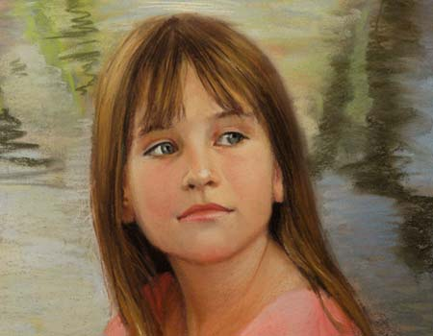
Exercising Faith In God
Faith
Faith brings us the power of the Lord, which—among other things
Faith is both a principle of action and of power.
It “is not to have a perfect knowledge of things; therefore if we have faith we hope for things which are not seen, which are true.”
We too can exercise such faith in the Lord, believing and trusting that our kind and constant God will bless us with His miraculous power suited to our circumstance, according to His timing. As we do so, we too will see the hand of God manifest in our lives.
Barbara Burk
(6)

Slide 9
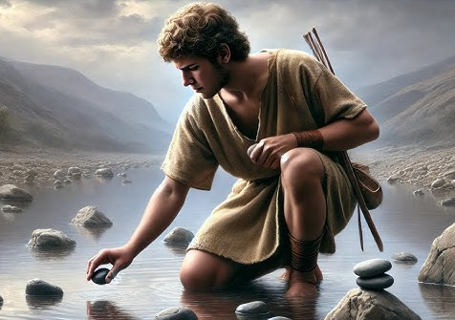
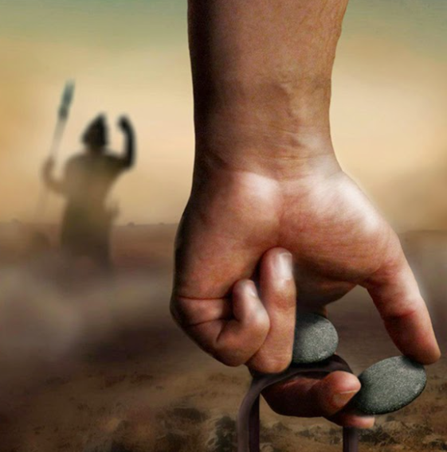
The Armor of God
Identity
David chose not to wear Saul’s armor
“he had not proved it” -- David was not used to wearing armor
“David fell back on his years of experience with his sling… On the way he took from a brook five smooth stones” (5)
1 Samuel 17:39-40

Slide 10
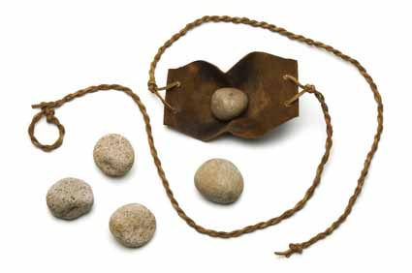
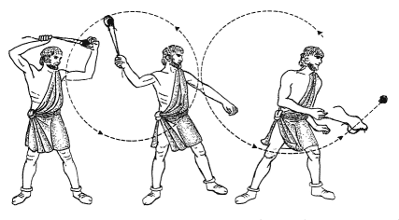
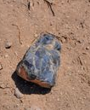
The Sling
As a young shepherd, he had much practice at slinging stones. It was an effective way both to keep wolves and other vicious animals away from the sheep and to attract the attention of straying sheep and drive them back to pasture.
As a result of his experience, David had confidence in his skills, but the true source of his courage was faith in the power of the living God.
Scrip = Shepherds of David’s time carried a sling and a small leather or woolen wallet or bag in which food or stones could be carried to the place where the sheep grazed.
(3)

Slide 11
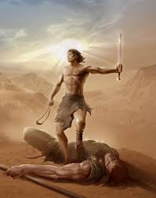
David’s Conquest For the Lord
Grace
… but I come to thee in the name of the Lord of hosts (verse 45)
…This day will the Lord deliver thee into mine hand (verse 46)
…for the battle is the Lord’s (verse 47)
After David defeated Goliath, the Philistine army fled, and the army of the Israelites chased after them. David took Goliath’s head to Jerusalem, and King Saul marveled at David’s bravery.
1 Samuel 17:40-51

Slide 12
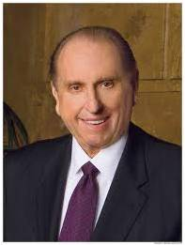
“Is there a Goliath in your life? Is there one in mine? Does he stand squarely between you and your desired happiness?
Your Goliath may not carry a sword or hurl a verbal challenge of insult that all may hear and force you to decision.
He may not be ten feet tall, but he likely will appear equally as formidable, and his silent challenge may shame and embarrass. …
“The giant you face will not diminish in size nor in power or strength by your vain hoping, wishing, or waiting for him to do so.
Rather, he increases in power as his hold upon you tightens.”
(4)

Slide 13
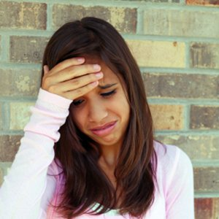
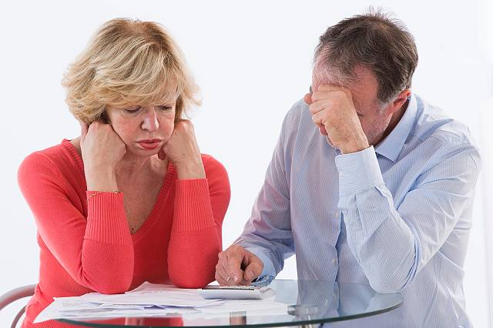


Exercising Faith in Challenges
A young man’s parents decide to get a divorce.
A young woman is struggling to overcome some addictions.
A young woman knows she needs to forgive someone who caused her harm.
A young man has health problems that limit the activities he can participate in.

Slide 14
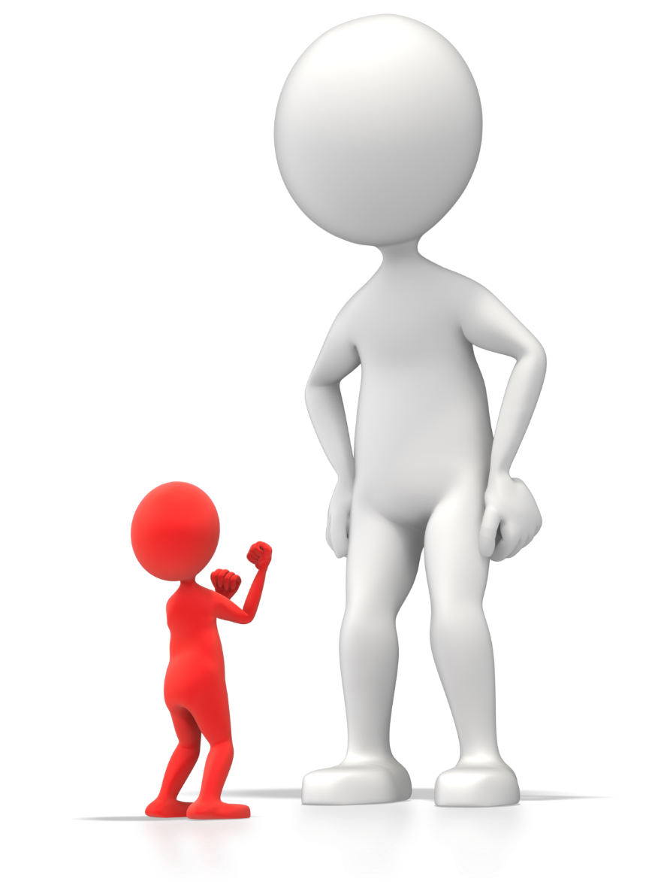
Challenges
What will you do to better exercise your faith as you face your challenges?

Slide 15


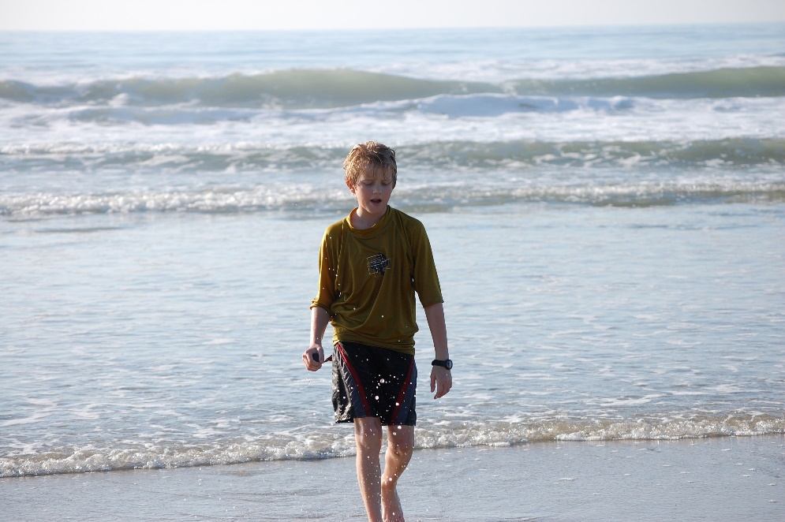
Just Keep (Going)
Regardless of the size, scope, and seriousness of the challenges we face in life, we all have times when we feel like stopping, leaving, escaping, or possibly giving up.
But exercising faith in our Savior, Jesus Christ, helps us overcome discouragement no matter what obstacles we encounter.

Slide 16
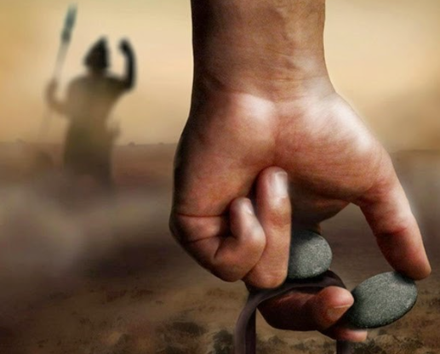
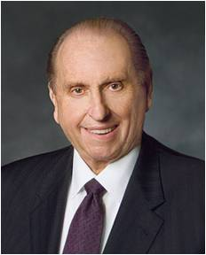
Those Who Qualify
God doesn’t call those who qualify,
He calls those who try.
When we are on the Lord’s errand, He will qualify us to help fulfill His purposes. (8)

Slide 17
Sources:
Videos: Goliaths All Around You (2:02)
Good Things to Come (4:55)
“Working through Emotional Trauma” (3:58).
https://www.youtube.com/watch?v=hwz_P36hkxs David’s 5 Stones Explained (8:24) (not LDS but very powerful)
Who’s Who in the Old Testament by Ed. J. Pinegar and Richard J. Allen p. 64
Clarke, Bible Commentary, 2:261.) Found in Old Testament Institute Manual
Old Testament Institute Manual
Presentation by ©http://fashionsbylynda.com/blog/
4. President Thomas S. Monson (“Meeting Your Goliath,” New Era, June 2008, 5).
5. W. Cleon Skousen The Fourth Thousand Years p. 21
Elder Marcus B. Nash By Faith All Things Are Fulfilled October 2012 Gen. Conf.
Elder Carl B. Cook (“Just Keep Going—with Faith,” Liahona, May 2023, 15)
Chapter 14 Teachings of the Presidents (President Monson)

Slide 18
THE GIANTS
Time of Enoch | Moses 7:15 | And the giants of the land, also, stood afar off; and there went forth a curse upon all people that fought against God;
Days of Noah | Moses 8:18 Genesis 6:4 | And in those days there were giants on the earth, and they sought Noah to take away his life; but the Lord was with Noah, and the power of the Lord was upon him. There were giants in the earth in those days; and also after that, when the sons of God came in unto the daughters of men, and they bare children to them, the same became mighty men which were of old, men of renown.
Time of the Israelites | Numbers 13:33 Deuteronomy 2:10-11 Joshua 15:8 | And there we saw the giants, the sons of Anak, which come of the giants: and we were in our own sight as grasshoppers, and so we were in their sight. The Emims dwelt therein in times past, a people great, and many, and tall, as the Anakims; Which also were accounted giants, as the Anakims; but the Moabites call them Emims. …valley of Hinnom westward, which is at the end of the valley of the giants northward:
Anakim (long-necked or tall in Hebrew) Virtually destroyed in the conquest of Canaan under Joshua | Joshua 11:21 | And at that time came Joshua, and cut off the Anakims from the mountains, from Hebron, from Debir, from Anab, and from all the mountains of Judah, and from all the mountains of Israel: Joshua destroyed them utterly with their cities.
It is recorded that none of the Anakim were left except in Gaze, Ashdod, and Gath | Joshua 11:22 | There was none of the Anakims left in the land of the children of Israel: only in Gaza, in Gath, and in Ashdod, there remained.
(3)

Slide 19
Goliath’s Armor:
Goliath’s coat of mail (the armor over his upper body) weighed approximately 150 pounds (68 kilograms), and the iron tip of his spear weighed between 12 and 26 pounds (5 and 12 kilograms). Explain that greaves are pieces of armor protecting the shins, and a target is armor protecting the neck.
David as a type of Jesus Christ
Slings were commonly used as weapons in David’s day. To become accurate with the sling, a person had to spend a considerable amount of time using it. David had used a sling to protect his father’s sheep. If you constructed a sling, illustrate the difficulty of using a sling effectively by inviting a few students to attempt to hit a target while using a sling and a marshmallow or another small, round, and soft object.
The loop goes over the index or third finger while the knot is held between the thumb and index finger; the object is slung by swinging the sling over the head and releasing the knotted string as the pouch begins its arc toward the target. Timing is critical.
Slings were made from various materials, the most common being leather. Hair, wool, animal sinews, or rushes were used to make the pouch that held the stones. The pouch had strings attached on each side and was whirled until a certain speed was reached. When one string was released, the stone was hurled from the pouch toward its mark. Any variation from perfect roundness affected the accuracy of a stone. Uniform weight and size of the stones were also important. Anciently, slingers, particularly shepherds with time on their hands, developed great accuracy and skill in slinging stones. When not in use, the slings were carried by shepherds around their foreheads or waists.
Slings were used fairly commonly in the ancient Near East. The Israelites, who did not often use chariots in war, employed many trained slingers. The same was true of peoples from surrounding areas.
David | Jesus Christ
1 Samuel 17:12 (David was born in Bethlehem.) | Luke 2:4–7
1 Samuel 16:11; 17:15 (David was a shepherd.) | John 10:14
1 Samuel 16:13 (David was anointed to be king of Israel.) | Luke 4:18; John 1:49
1 Samuel 17:50–51 (David delivered Israel by overcoming a giant.) | 2 Nephi 9:10–12 (Jesus delivers us by overcoming sin and death.)

