Slide 1


Watchmen and Shepherds
Ezekiel 33-36
…Jesus saith unto him, Feed my sheep.
John 21:17
Presentation by ©http://fashionsbylynda.com/blog/

Slide 2
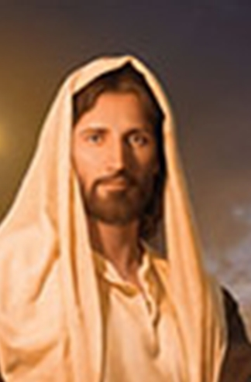
Who is Jehovah?
Heavenly Father appointed Jesus Christ, or Jehovah, to speak for Him to the prophets. Jehovah, “usually identified in the Old Testament as LORD (in small capitals), is the Son, known as Jesus Christ, and … is also a God.
Jesus works under the direction of the Father and is in complete harmony with Him. (3)

Slide 3
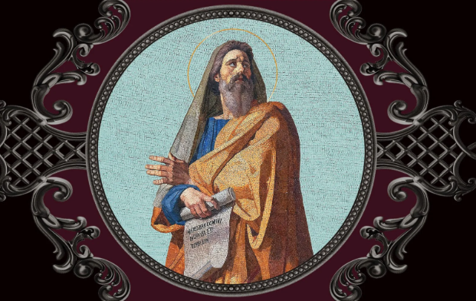
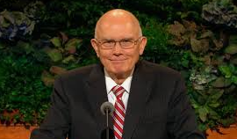
The Role of a Prophet
The work of a Hebrew prophet was to act as God’s messenger and make known God’s will.
The message was usually prefaced with the words “Thus saith Jehovah.”
He was to teach about God’s character and the full meaning of His dealings with Israel in the past.
It is a prophetic office to preserve and edit the records of the nation’s history.
It was also the prophet’s duty to denounce sin and foretell its punishment and to redress, so far as he could, both public and private wrongs.
He was to be, above all, a preacher of righteousness.
When the people had fallen away from a true faith in Jehovah, the prophets had to try to restore that faith and remove false views about the character of God and the nature of the divine requirement.
In certain cases prophets predicted future events, such as the very important prophecies announcing the coming of Messiah’s kingdom; but as a rule a prophet was a forth teller rather than a foreteller.
In a general sense a prophet is anyone who has a testimony of Jesus Christ by the Holy Ghost. (3)
Ezekiel 33:1-9; Numbers 11:25-29; Revelation 19:10

Slide 4
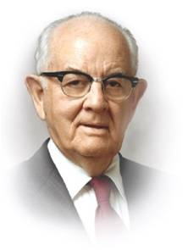
Responsibility to Warn The People
“I am sure that Peter and James and Paul found it unpleasant business to constantly be calling people to repentance and warning them of dangers, but they continued unflinchingly.
So we, your leaders, must be everlastingly at it; if young people do not understand, then the fault may be partly ours. But, if we make the true way clear to you, then we are blameless.
“So, I wish today to help define meanings of words and acts for you young people, to fortify you against error, anguish, pain and sorrow.” (2)
Having a prophet is a great blessing—but only if we obey his counsel
Ezekiel 33:1-9

Slide 5




Righteousness VS Wickedness
“pine away” in their sins = wasting away in their sins.
Those who turn from righteousness to wickedness or from wickedness to righteousness will receive the consequences of their changed condition, not those of their former condition. (4)
…if he turn from his sin, and do that which is lawful and right;
Ezekiel 33:12-19

Slide 6
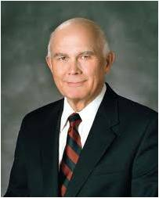
The Sum of It All
“The Final Judgment is not just an evaluation of a sum total of good and evil acts—what we have done.
It is an acknowledgment of the final effect of our acts and thoughts—what we have become.
It is not enough for anyone just to go through the motions.
SINS
RIGHTEOUS ACTS
Jesus Christ will judge us by the person we have become as the result of our thoughts and actions
The commandments, ordinances, and covenants of the gospel are not a list of deposits required to be made in some heavenly account. The gospel of Jesus Christ is a plan that shows us how to become what our Heavenly Father desires us to become.”
Ezekiel 33:12-19
(5)

Slide 7
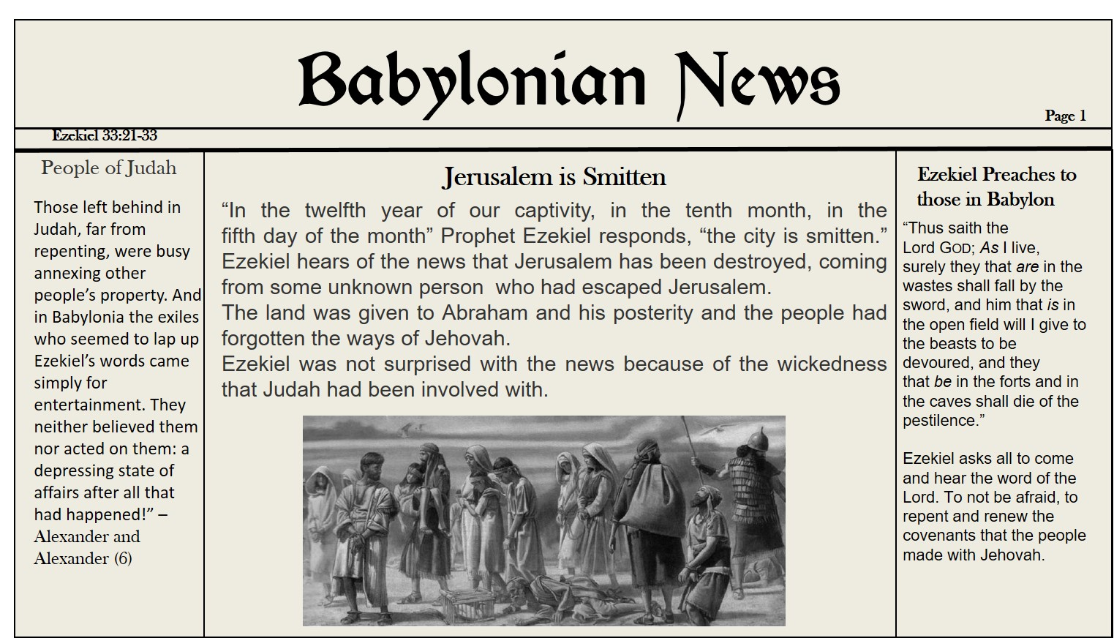

Slide 8
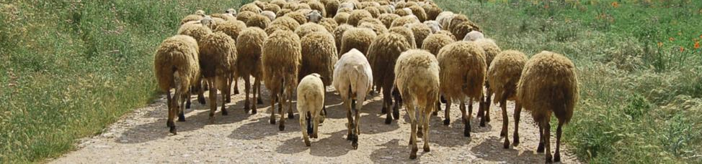
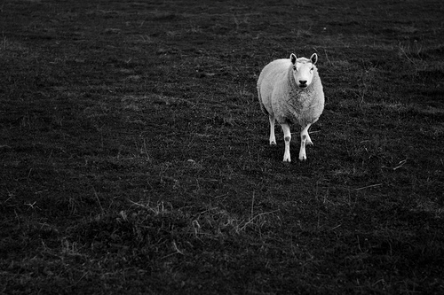
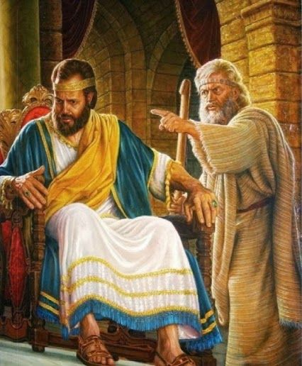
Woe to the Shepherds
Woe be to the shepherds of Israel that do feed themselves! should not the shepherds feed the flocks?
Ezekiel condemned the pastors, or shepherds, of the Lord’s spiritual flock, the religious leaders of Ezekiel’s day.
Leaders who did not “feed the flock” would be held responsible for Israel’s scattering. (4)
Ezekiel 34:1-10

Slide 9
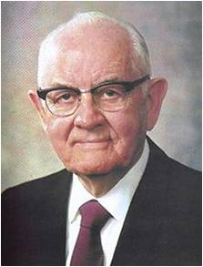
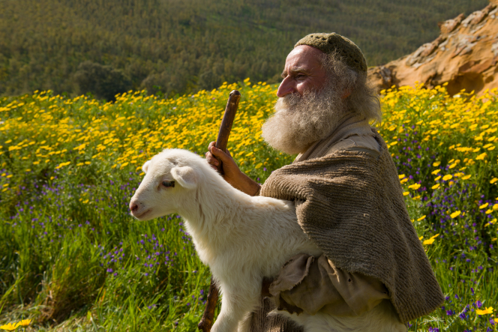


Woe to the Shepherds
“Bishops and branch presidents, please be ever alert to the needs of the precious individuals and families who make up the membership of your wards and branches. You are the nurturing shepherds of our people.”
“An hour with a troubled boy or girl now may save him or her, and is infinitely better than the hundreds of hours spent in their later lives in the reclamation of a boy or girl if they become inactive.”
(7)

Slide 10
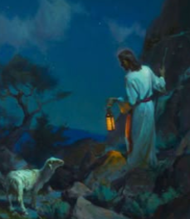
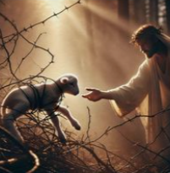
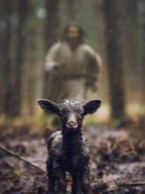
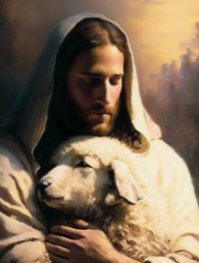
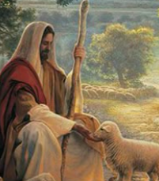
As the Good Shepherd, the Savior …
I will seek that which was lost, and bring again that which was driven away, and will bind up that which was broken, and will strengthen that which was sick: but I will destroy the fat and the strong; I will feed them with judgment.
Seeks out those that are lost
(verses 11–12, 16)
Nourishes them and provides for their needs
(verses 13–15)
Strengthens the sick
(verse 16)
Delivers them from darkness
(verse 12)
Binds up the broken
(verse 16)
Ezekiel 34:11-16

Slide 11

What are some ways you feel you are like the Savior?
Are there ways where you might be more like the shepherds in Israel?
What are possible obstacles you face in caring for others like the Savior?

Slide 12




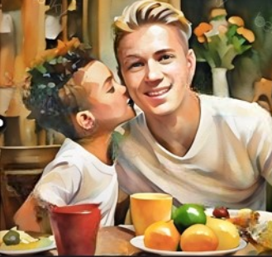
What Can I Do?
I will seek that which was lost, and bring again that which was driven away, and will bind up that which was broken, and will strengthen that which was sick: but I will destroy the fat and the strong; I will feed them with judgment.
Seeks out those that are lost
(verses 11–12, 16)
Nourishes them and provides for their needs
(verses 13–15)
Strengthens the sick
(verse 16)
Delivers them from darkness
(verse 12)
Binds up the broken
(verse 16)
Ezekiel 34:11-16

Slide 13
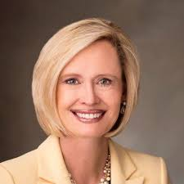
Our sheep may be hurting, lost, or even willfully astray; as their shepherd, we can be among the first to see their need.
We can listen and love without judgment and offer hope and help with the discerning guidance of the Holy Ghost.
Sisters and brothers, the world is more hope-filled and joyful because of the inspired acts of kindness you perform.
As you seek the Lord’s direction on how to convey His love and see the needs of those to whom you minister, your eyes will be opened. others? (10)

Slide 14
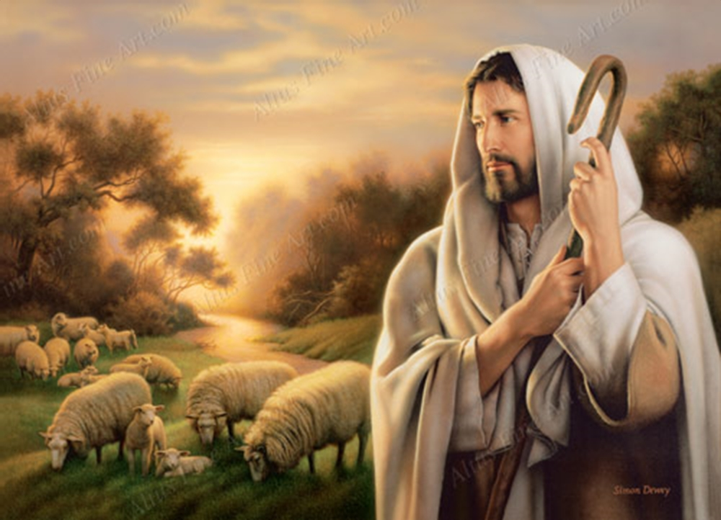
Jesus is the Shepherd
As a shepherd seeketh out his flock in the day that he is among his sheep that are scattered; so will I seek out my sheep, and will deliver them out of all places where they have been scattered in the cloudy and dark day.
The Shepherd of Israel would gather His sheep and reign in their midst
If we follow Jesus Christ, then He will bless us temporally and spiritually
Ezekiel prophesied that the Lord would deliver His people from their oppressors. This prophecy also refers to the time when the Lord will come to the earth in the latter days and gather the lost sheep of Israel through covenants. They will live with Him in safety, never to be scattered again.
Ezekiel 34:11-31

Slide 15
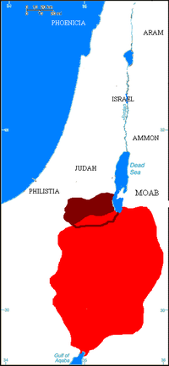
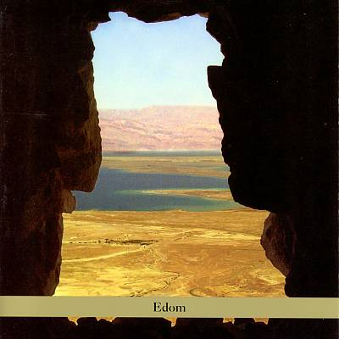
Edom—Left Desolate
After Jerusalem was destroyed and many of the Jews were taken captive to Babylon, the people of Edom, a neighboring nation of Israel and Judah, planned to take over the land that was now left desolate. Jehovah promised that because the people of Edom rejoiced in the destruction of Israel, they would also be destroyed and their land would be left desolate.
Although the nation is no more, Edom, or Idumea, has become a symbol for the wicked world that exists today. (1)
Ezekiel 35

Slide 16

The Recovery of Israel
None of the following events have fully transpired, though today is the day when these prophecies are being fulfilled:
Those men who will multiply upon the land are from all the house of Israel, not just the kingdom of Judah (v. 10).
Israel is to walk upon the land which shall “no more henceforth bereave them of men” (vv. 12-14).
Those who return will be gathered from the heathen and from all countries (v. 24).
They are to be cleansed from their filthiness (v. 25).
They are to be converted to the Lord and receive His Spirit (vv. 26–27).
The recovery of Israel will be quite remarkable and will be done for the Lord’s reasons, not because Israel has earned it (v. 32).
The Israel of the future must be spiritually worthy and must submit themselves to the Lord’s will.
Ezekiel 36
(1)

Slide 17

A Change of Heart
Stoney Heart = hard, impenetrable, and cold; unaffected by heavenly things
If we follow Jesus Christ, He can change our hearts
“To have our hearts changed by the Holy Spirit such that ‘we have no more disposition to do evil, but to do good continually’ (Mosiah 5:2), as did King Benjamin’s people, is the covenant responsibility we have accepted.
This mighty change is not simply the result of working harder or developing greater individual discipline.
Rather, it is the consequence of a fundamental change in our desires, our motives, and our natures made possible through the Atonement of Christ the Lord.
Our spiritual purpose is to overcome both sin and the desire to sin, both the taint and the tyranny of sin.” (8)
Ezekiel 36:24-28
(1)

Slide 18
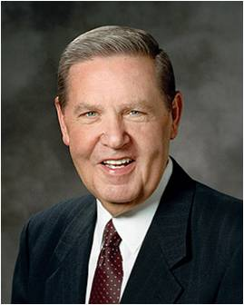
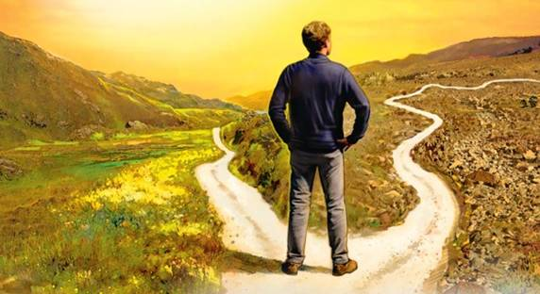
“However late you think you are, however, many chances you think you have missed, however many mistakes you feel you have made or talents you think you don’t have, or however far from home and family and God you feel you have traveled, I testify that you have not traveled beyond the reach of divine love. It is not possible for you to sink lower than the infinite light of Christ’s Atonement shines.
“… There is no problem which you cannot overcome. There is no dream that in the unfolding of time and eternity cannot yet be realized. …
“… To those of you … who may still be hanging back, to each of you, one and all, I testify of the renewing power of God’s love and the miracle of His grace. His concern is for the faith at which you finally arrive, not the hour of the day in which you got there.
“So, if you have made covenants, keep them. If you haven’t made them, make them. If you have made them and broken them, repent and repair them”
(9)

Slide 19
Sources:
Video:
The Challenge to Become (1:26)
A Change of Heart (4:40)
Old Testament Institute Manual Prophecies of the Restoration Chapter 27
Elder Spencer W. Kimball (Love versus Lust, Brigham Young University Speeches of the Year [5 Jan. 1965], pp. 6–7.)
Bible Dictionary: Prophet, God
Old Testament Instructor's Guide, Religion 301-2
Elder Dallin H. Oaks (“The Challenge to Become,” Ensign, Nov. 2000, 32).
(Alexander and Alexander, Eerdmans’ Handbook, p. 426.)
Presentation by ©http://fashionsbylynda.com/blog/
7. Excerpts from Pres. Spencer W. Kimball (In Conference Report, Oct. 1980, p. 67; see also Ensign, Nov. 1980, pp. 45–46.)
8. Elder David A. Bednar (“Clean Hands and a Pure Heart,” Ensign or Liahona, Nov. 2007, 82).
9. Elder Jeffrey R. Holland (“The Laborers in the Vineyard,” Ensign or Liahona, May 2012, 33).
10. Sister Bonnie H. Cordon, “Becoming a Shepherd,” Ensign or Liahona, Nov. 2018, 76.

Slide 20
Ezekiel 1-3 | Ezekiel 4-24 | Ezekiel 25-32 | Ezekiel 33-48
Ezekiel sees the Lord and His glory. He is called as a watchman to the house of Israel to warn, reprove, and call them to repentance. | The Lord instructs Ezekiel to use symbols to represent the wickedness of Israel and the destruction of Jerusalem. Ezekiel prophesies of the Lord’s judgments on Jerusalem and explains why famine, desolation, war, and pestilence will sweep the land of Israel. | The Lord commands Ezekiel to declare the wickedness of the nations surrounding Israel and prophesy of their destruction. | The Lord reproves the leaders of Israel for being poor shepherds over their people. The Lord will be a true shepherd to Israel. Ezekiel records his vision of Israel’s restoration after the exile and in the latter days. The Lord promises to gather the Israelites from captivity, return them to their promised lands, renew His covenant with them, and reunite the kingdoms of Israel and Judah.

Slide 21
Ezekiel 33: 12-19
“Repentance is not to be procrastinated (see Alma 34:32–34), nor is it to be “trifled with every day,” said Joseph Smith. “Daily transgression and daily repentance [incomplete or insincere] is not that which is pleasing in the sight of God.” (Teachings of the Prophet Joseph Smith, p. 148.) But the Prophet also said, “There is never a time when the spirit is too old to approach God. All are within the reach of pardoning mercy, who have not committed the unpardonable sin.” (Teachings, p. 191.)
Warning to Those Who are To Nurture Your Flock Ezekiel 34:1-10
“As we read and study the scriptures, we are made conscious of the fact that the Savior has always been concerned about the welfare of the members of his flock, both individually and collectively. It is about that principle of caring for and ministering to the needs of the Church membership in these troubled days that I desire to speak to you brethren tonight.
“Bishops and branch presidents, please be ever alert to the needs of the precious individuals and families who make up the membership of your wards and branches. You are the nurturing shepherds of our people. To the greatest extent possible, let your counselors and others who serve and work under your direction be the managers of programs. If you will pursue this emphasis, you will often be able to detect very early some of those members who have serious difficulties, while their challenges and problems are still small and manageable. Be conscious of the little tensions and problems you may see in families so that you can give the required attention, counsel, and love when it is most needed. An hour with a troubled boy or girl now may save him or her, and is infinitely better than the hundreds of hours spent in their later lives in the reclamation of a boy or girl if they become inactive.
“As we have said so many times, delegate those tasks which others can do so that you are free to do those things which you, and you alone, can do. Home teachers are to help watch over the flock. Even though they don’t counsel as bishops and branch presidents do, home teachers can render much appropriate and preventive help under the direction of the quorum leaders and bishoprics.
“Stake presidents, bishops, and branch presidents, please take a particular interest in improving the quality of teaching in the Church. The Savior has told us to feed his sheep (see John 21:15–17). I fear that all too often many of our members come to church, sit through a class or meeting, and they then return home having been largely uninformed. It is especially unfortunate when this happens at a time when they may be entering a period of stress, temptation, or crisis. We all need to be touched and nurtured by the Spirit, and effective teaching is one of the most important ways this can happen.
We often do vigorous enlistment work to get members to come to church but then do not adequately watch over what they receive when they do come.” Pres. Spencer W. Kimball (In Conference Report, Oct. 1980, p. 67; see also Ensign, Nov. 1980, pp. 45–46.)
Ezekiel 33:15
“When one is humble in sorrow, has unconditionally abandoned the evil, confessed to those assigned by the Lord, he should next restore insofar as possible that which was damaged. If he burglarized, he should return to the rightful owner that which was stolen. Perhaps one reason murder is unforgivable is that having taken a life, the murderer cannot restore it. Restitution in full is not possible. …
“However, the truly repentant soul will usually find things which can be done to restore to some extent. The true spirit of repentance demands this.
“A pleading sinner must also forgive all people of all offenses committed against himself. The Lord is under no obligation to forgive us unless our hearts are fully purged of all hate, bitterness and accusations against all others.” Spencer W. Kimball (Be Ye Clean, Brigham Young University Speeches of the Year, 4 May 1954, p. 11.)
Negligent Shepherds Ezekiel 34”1-10
The negligent shepherds did not strengthen the sick, bind up the broken, bring back again those who were driven away, or seek for the lost sheep—all of which any real shepherd would do for his own sheep. Instead, they ruled the sheep with force and cruelty and let them wander to become a prey to beasts.(1)

