Slide 1
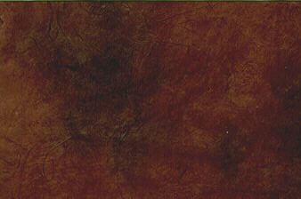
Introduction to the
Old Testament
Old Testament
Presentation by ©http://fashionsbylynda.com/blog/

Slide 2
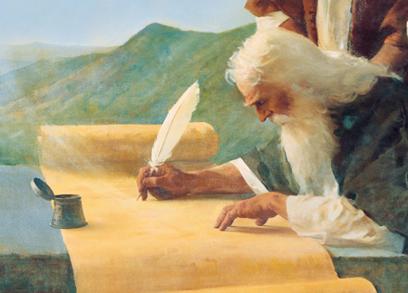
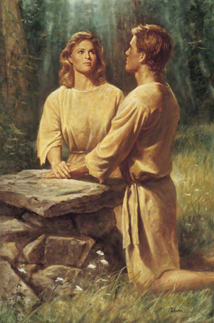
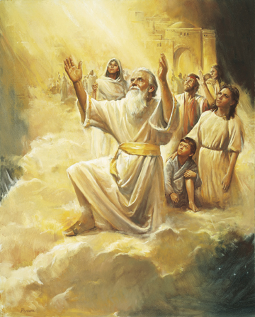
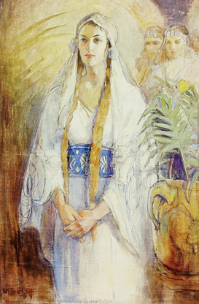
The Message of the Bible
“Scriptures contain the word of God to man.”
“Latter-day Saints accept as scriptures, in addition to the Bible (held by most Christians to be the only scripture), the Book of Mormon, the Doctrine and Covenants, and the Pearl of Great Price.”
“The word search means to inquire into, study, and examine for the purpose of discovering the meaning of. Searching implies more than just reading or even memorizing.”
“In all dispensations holy men have been taught and instructed from heaven with respect to the gospel of Jesus Christ.”
Marion G. Romney

Slide 3
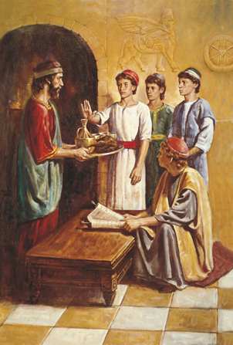
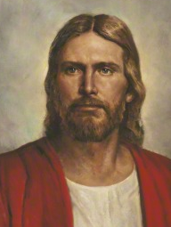
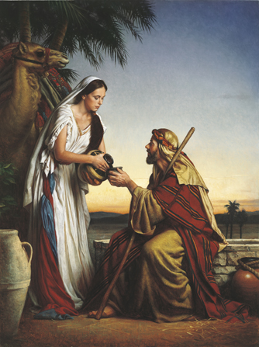
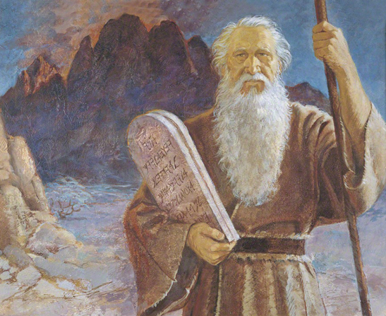
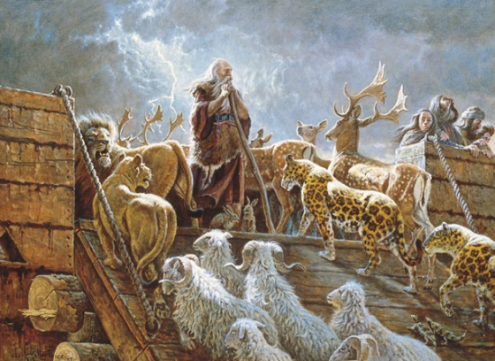
The Bible Testifies of Christ
Marion G. Romney

Slide 4
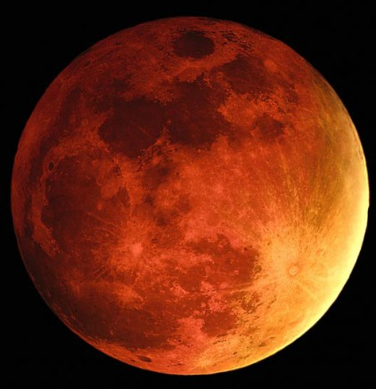

Learn of Jesus Christ
We are the focus of Heavenly Father’s plan and the reason for the Savior’s mission.
And many signs, and wonders, and types, and shadows showed he unto them, concerning his coming; and also holy prophets spake unto them concerning his coming; and yet they hardened their hearts, and understood not that the law of Moses availeth nothing except it were through the atonement of his blood.
Mosiah 3:5
And behold, all things have their likeness, and all things are created and made to bear record of me, both things which are temporal, and things which are spiritual; things which are in the heavens above, and things which are on the earth, and things which are in the earth, and things which are under the earth, both above and beneath: all things bear record of me.
Moses 6:63

Slide 5
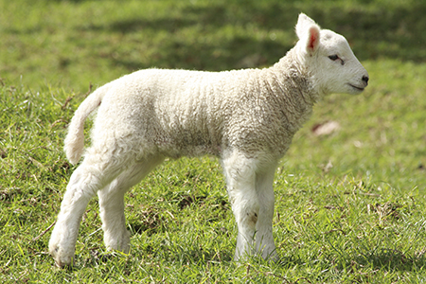
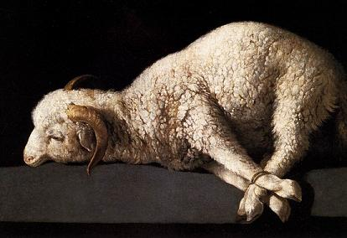
Symbols
Your lamb shall be without blemish, a male of the first year: ye shall take it out from the sheep, or from the goats:
Exodus 12:5
One of the early commandments given to Adam and Eve was to sacrifice the firstborn males of their flocks of sheep as an offering to the Lord.
“without blemish”
Free of flaws or imperfections
This symbol is meant to teach about Jesus Christ and the Atonement.
…let him offer a male without blemish…And he shall put his hand upon the head of the burnt offering; and it shall be accepted for him to make atonement for him.
Leviticus 1:3-4

Slide 6
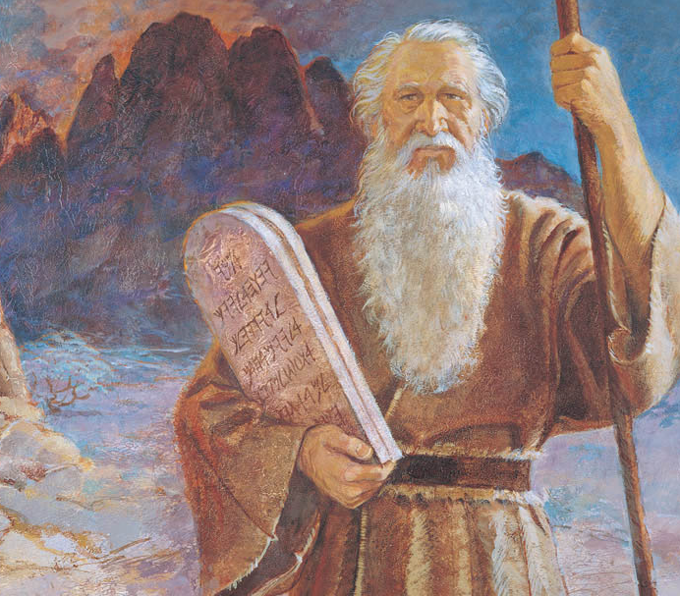
The Law of Moses
Behold, my soul delighteth in proving unto my people the truth of the coming of Christ; for, for this end hath the law of Moses been given; and all things which have been given of God from the beginning of the world, unto man, are the typifying of him.
2 Nephi 11:4
The offerings and sacrifices explained in the book of Leviticus are part of what was known as the law of Moses
“typifying”
to symbolize or represent

Slide 7
Jehovah
For I know that my redeemer liveth, and that he shall stand at the latter day upon the earth:
Job 19:25
Redeemer
For thou wilt not leave my soul in hell; neither wilt thou suffer thine Holy One to see corruption.
Psalms 16:10
Holy One
Therefore the Lord himself shall give you a sign; Behold, a virgin shall conceive, and bear a son, and shall call his name Immanuel.
Isaiah 7:14
Immanuel
Wonderful, Counsellor, The mighty God, The everlasting Father, The Prince of Peace. Saviour and thy Redeemer, the mighty One of Jacob.
Isaiah 9:6; Isaiah 49:26

Slide 8
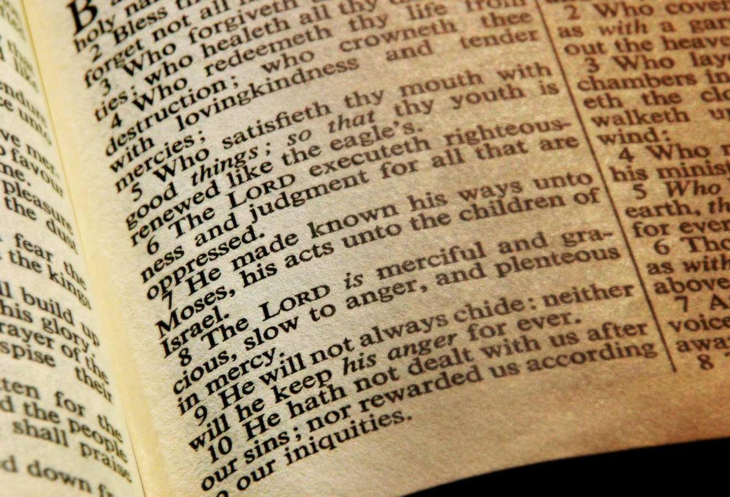
LORD God
This title implies supreme authority and that “when the word [LORD] appears in the Old Testament, it [usually] means Jehovah”

Slide 9
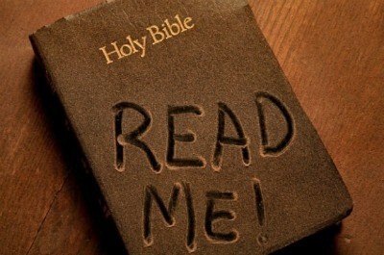

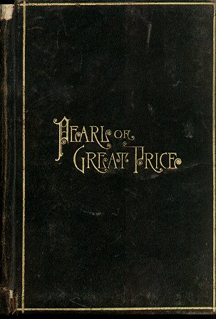
Reading the Bible
Set a time every day to read the Bible
Start by reading Moses 1 which is part of Joseph Smith’s translation of the book of Genesis

Slide 10
Other Themes in the Old Testament
Adam and Eve were cast out from the Garden of Eden
Moses rescues the Israelites from Egypt
Noah and the Flood

Slide 11
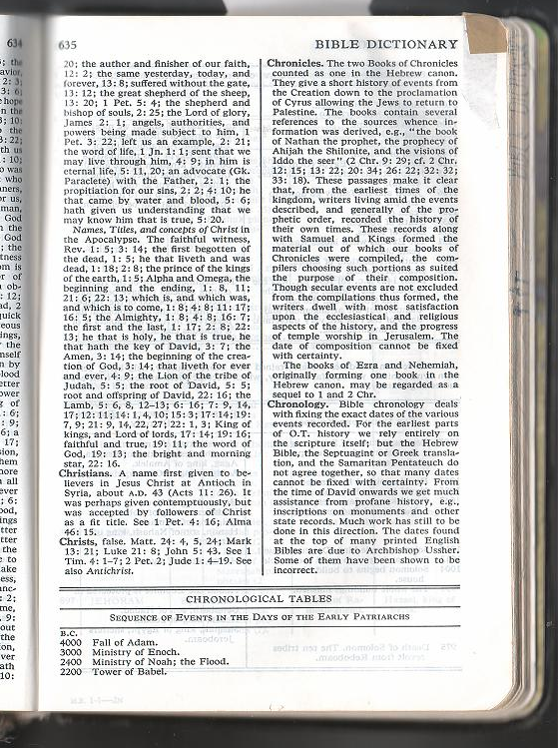
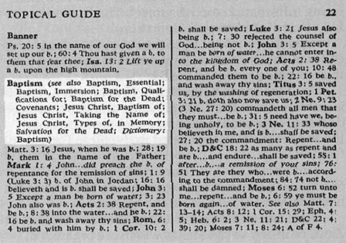
Prophets
In the lessons you will receive information about Basic Doctrines
God calls prophets to preach the gospel and administer His covenants and ordinances.
To help better understand the scripture the Bible offers a Bible Dictionary and a Bible Guide to the scriptures

Slide 12
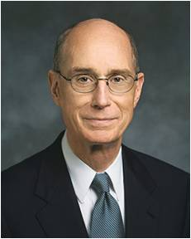
“Heavenly Father has always helped his children by offering them covenants and empowering his servants to offer ordinances. …”
“… Every covenant with God is an opportunity to draw closer to him.”
President Henry B. Eyring
Heavenly Father and Jesus Christ are intimately involved in our lives.

Slide 13
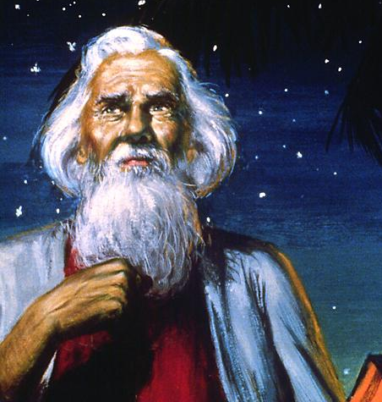
Entering Into A Covenant
The prophet Abraham entered into a covenant with God that would help him “walk before [God]” and become perfect.
And when Abram was ninety years old and nine, the Lord appeared to Abram, and said unto him, I am the Almighty God; walk before me, and be thou perfect.
And I will make my covenant between me and thee, and will multiply thee exceedingly.
Genesis 17:1-2
When people in Old Testament times kept their covenants with God they were blessed and preserved.
God’s covenant people were scattered because they broke their covenants with Him

Slide 14
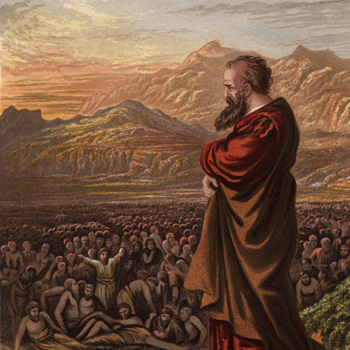
Blessings of Repentance
The prophet Abraham entered into a covenant with God that would help him “walk before [God]” and become perfect.
”gather” not only to a physical but also to the spiritual condition of being gathered to the Lord
God has promised to gather His covenant people.

Slide 15
Sources:
Suggested Hymn: #277 As I Search the Holy Scriptures
Video:
A Marking System that Works (1:57)
https://www.churchofjesuschrist.org/media/video/2013-02-1520-231-a-marking-system-that-works-for-you?lang=eng
The Blessings of Scripture (3:03)
https://www.churchofjesuschrist.org/media/video/2011-08-0015-the-blessings-of-scripture
Marion G. Romney The Message of the Old Testament August 1979
President Henry B. Eyring (“Making Covenants with God” [Brigham Young University fireside, Sept. 8, 1996], 2, 3; speeches.byu.edu).
https://www.lds.org/media-library/video/2013-02-1520-231-a-marking-system-that-works-for-you?lang=eng
Presentation by ©http://fashionsbylynda.com/blog/

Slide 16
Prophets and Revelation
A prophet is a person who has been called by God to speak for Him. Prophets testify of Jesus Christ and teach His gospel. They make known God’s will and true character. They denounce sin and warn of its consequences. At times, they prophesy of future event. Many teachings of prophets are found in the scriptures. As we study the words of prophets, we can learn truth and receive guidance.
We sustain the President of the Church as a prophet, seer, and revelator and the only person on the earth who receives revelation to guide the entire Church. We also sustain the counselors in the First Presidency and the members of the Quorum of the Twelve Apostles as prophets, seers, and revelators.
Revelation is communication from God to His children. When the Lord reveals His will to the Church, He speaks through His prophet. The scriptures—the Bible, Book of Mormon, Doctrine and Covenants, and Pearl of Great Price—contain revelations given through ancient and latter-day prophets. The President of The Church of Jesus Christ of Latter-day Saints is God’s prophet on the earth today.
Individuals can receive revelation to help them with their specific needs, responsibilities, and questions and to help strengthen their testimonies. Most revelations to leaders and members of the Church come through impressions and thoughts from the Holy Ghost. The Holy Ghost speaks to our minds and hearts in a still, small voice. Revelation can also come through visions, dreams, and visitations by angels.
Basic Doctrines
Basic Doctrines, (2012), 1–3
Lds.org
What is the Old Testament?
“In the Old Testament the word testament represents a Hebrew word meaning ‘covenant’” (Guide to the Scriptures, “Bible”; scriptures.lds.org).
The Old Testament contains “writings of ancient prophets who acted under the influence of the Holy Spirit and who over many centuries testified of Christ and his future ministry. It also contains a record of the history of Abraham and his descendants, beginning with Abraham, and the covenant, or testament, the Lord made with Abraham and his posterity” (Guide to the Scriptures, “Old Testament”; scriptures.lds.org).
Daily Scripture Study:
President Ezra Taft Benson emphasized the importance of daily scripture study:
“Let us not treat lightly the great things we have received from the hand of the Lord! His word is one of the most valuable gifts he has given us. I urge you to recommit yourselves to a study of the scriptures. Immerse yourselves in them daily so you will have the power of the Spirit to attend you” (“The Power of the Word,” Ensign, May 1986, 82).
The name Jehovah is “the covenant or proper name of the God of Israel. It denotes ‘the eternal I AM’ (Ex. 3:14; John 8:58). Jehovah is the premortal Jesus Christ and came to earth as a son of Mary (Mosiah 3:8; 15:1; 3 Ne. 15:1–5). Usually, when the word Lord appears in the Old Testament, it means ‘Jehovah.’ Elder Bruce R. McConkie of the Quorum of the Twelve Apostles explained, “In general, in the King James version of the Bible, the name Jehovah has been translated Lord” (Mormon Doctrine, 2nd ed. [1966], 392).
“Jehovah is Christ: Jehovah was known to the ancient prophets (Ex. 6:3; Abr. 1:16). The Apostle Paul taught that Christ was the Jehovah of the Old Testament (Ex. 17:6; 1 Cor. 10:1–4). The brother of Jared in the Book of Mormon saw the premortal Christ and worshiped Him (Ether 3:13–15). Moroni also called Christ ‘Jehovah’ (Moro. 10:34). At the Kirtland Temple, Joseph Smith and Oliver Cowdery saw the resurrected Jehovah (D&C 110:3–4)” (Guide to the Scriptures, “Jehovah”).
In the King James Version of the Bible, the word LORD in small capital letters was used in place of the Hebrew letters that represented the name of Jehovah in the Hebrew Bible. Those letters are called the tetragrammaton and are represented in English by the letters YHWH, pronounced “Yahweh” by some and “Jehovah” by most members of The Church of Jesus Christ of Latter-day Saints.
Elder Russell M. Nelson taught:
“The Old Testament has many references to atonement, which called for animal sacrifice. Not any animal would do. Special considerations included:
“• the selection of a firstling of the flock, without blemish [see Leviticus 5:18; 27:26],
“• the sacrifice of the animal’s life by the shedding of its blood [see Leviticus 9:18],
“• death of the animal without breaking a bone [see Exodus 12:46; Numbers 9:12], and
“• one animal could be sacrificed as a vicarious act for another [see Leviticus 16:10].
“The Atonement of Christ fulfilled these prototypes of the Old Testament. He was the firstborn Lamb of God, without blemish. His sacrifice occurred by the shedding of blood. No bones of His body were broken—noteworthy in that both malefactors crucified with the Lord had their legs broken [see John 19:31–33]. And His was a vicarious sacrifice for others” (“The Atonement,” Ensign, Nov. 1996, 35).

Slide 17
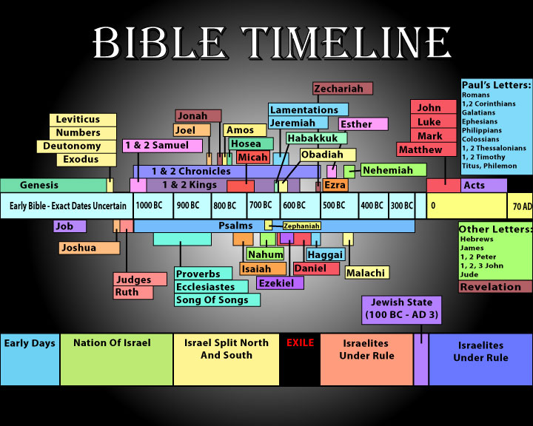
Other names for Jesus Christ:
Anointed One
Creator
Deliverer
Bread of Life
Cornerstone
God Creator
God the Father
Jehovah
Advocate
Divine Redeemer
Firstborn
Good Shepherd
Descendant of David
Exemplar
King
Judge
Light of the World
Lord
Mediator
Messenger of the Covenant
Messiah
Only Begotten Son
Rock
Comforter
God of Abraham, Isaac, and Joseph

Slide 18
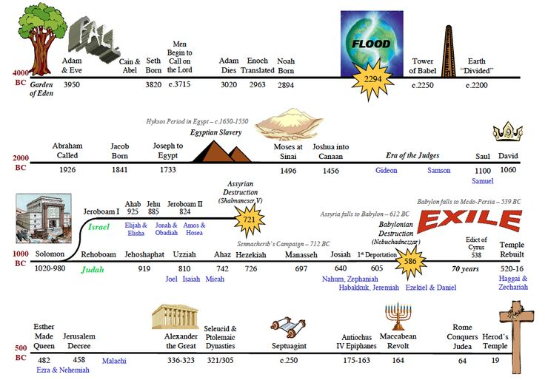

Slide 19
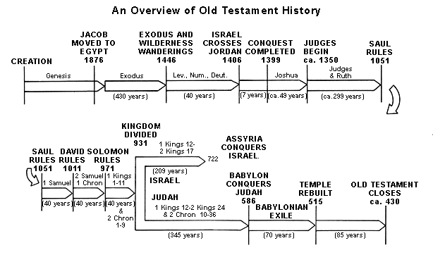

Slide 20
